Slide 1
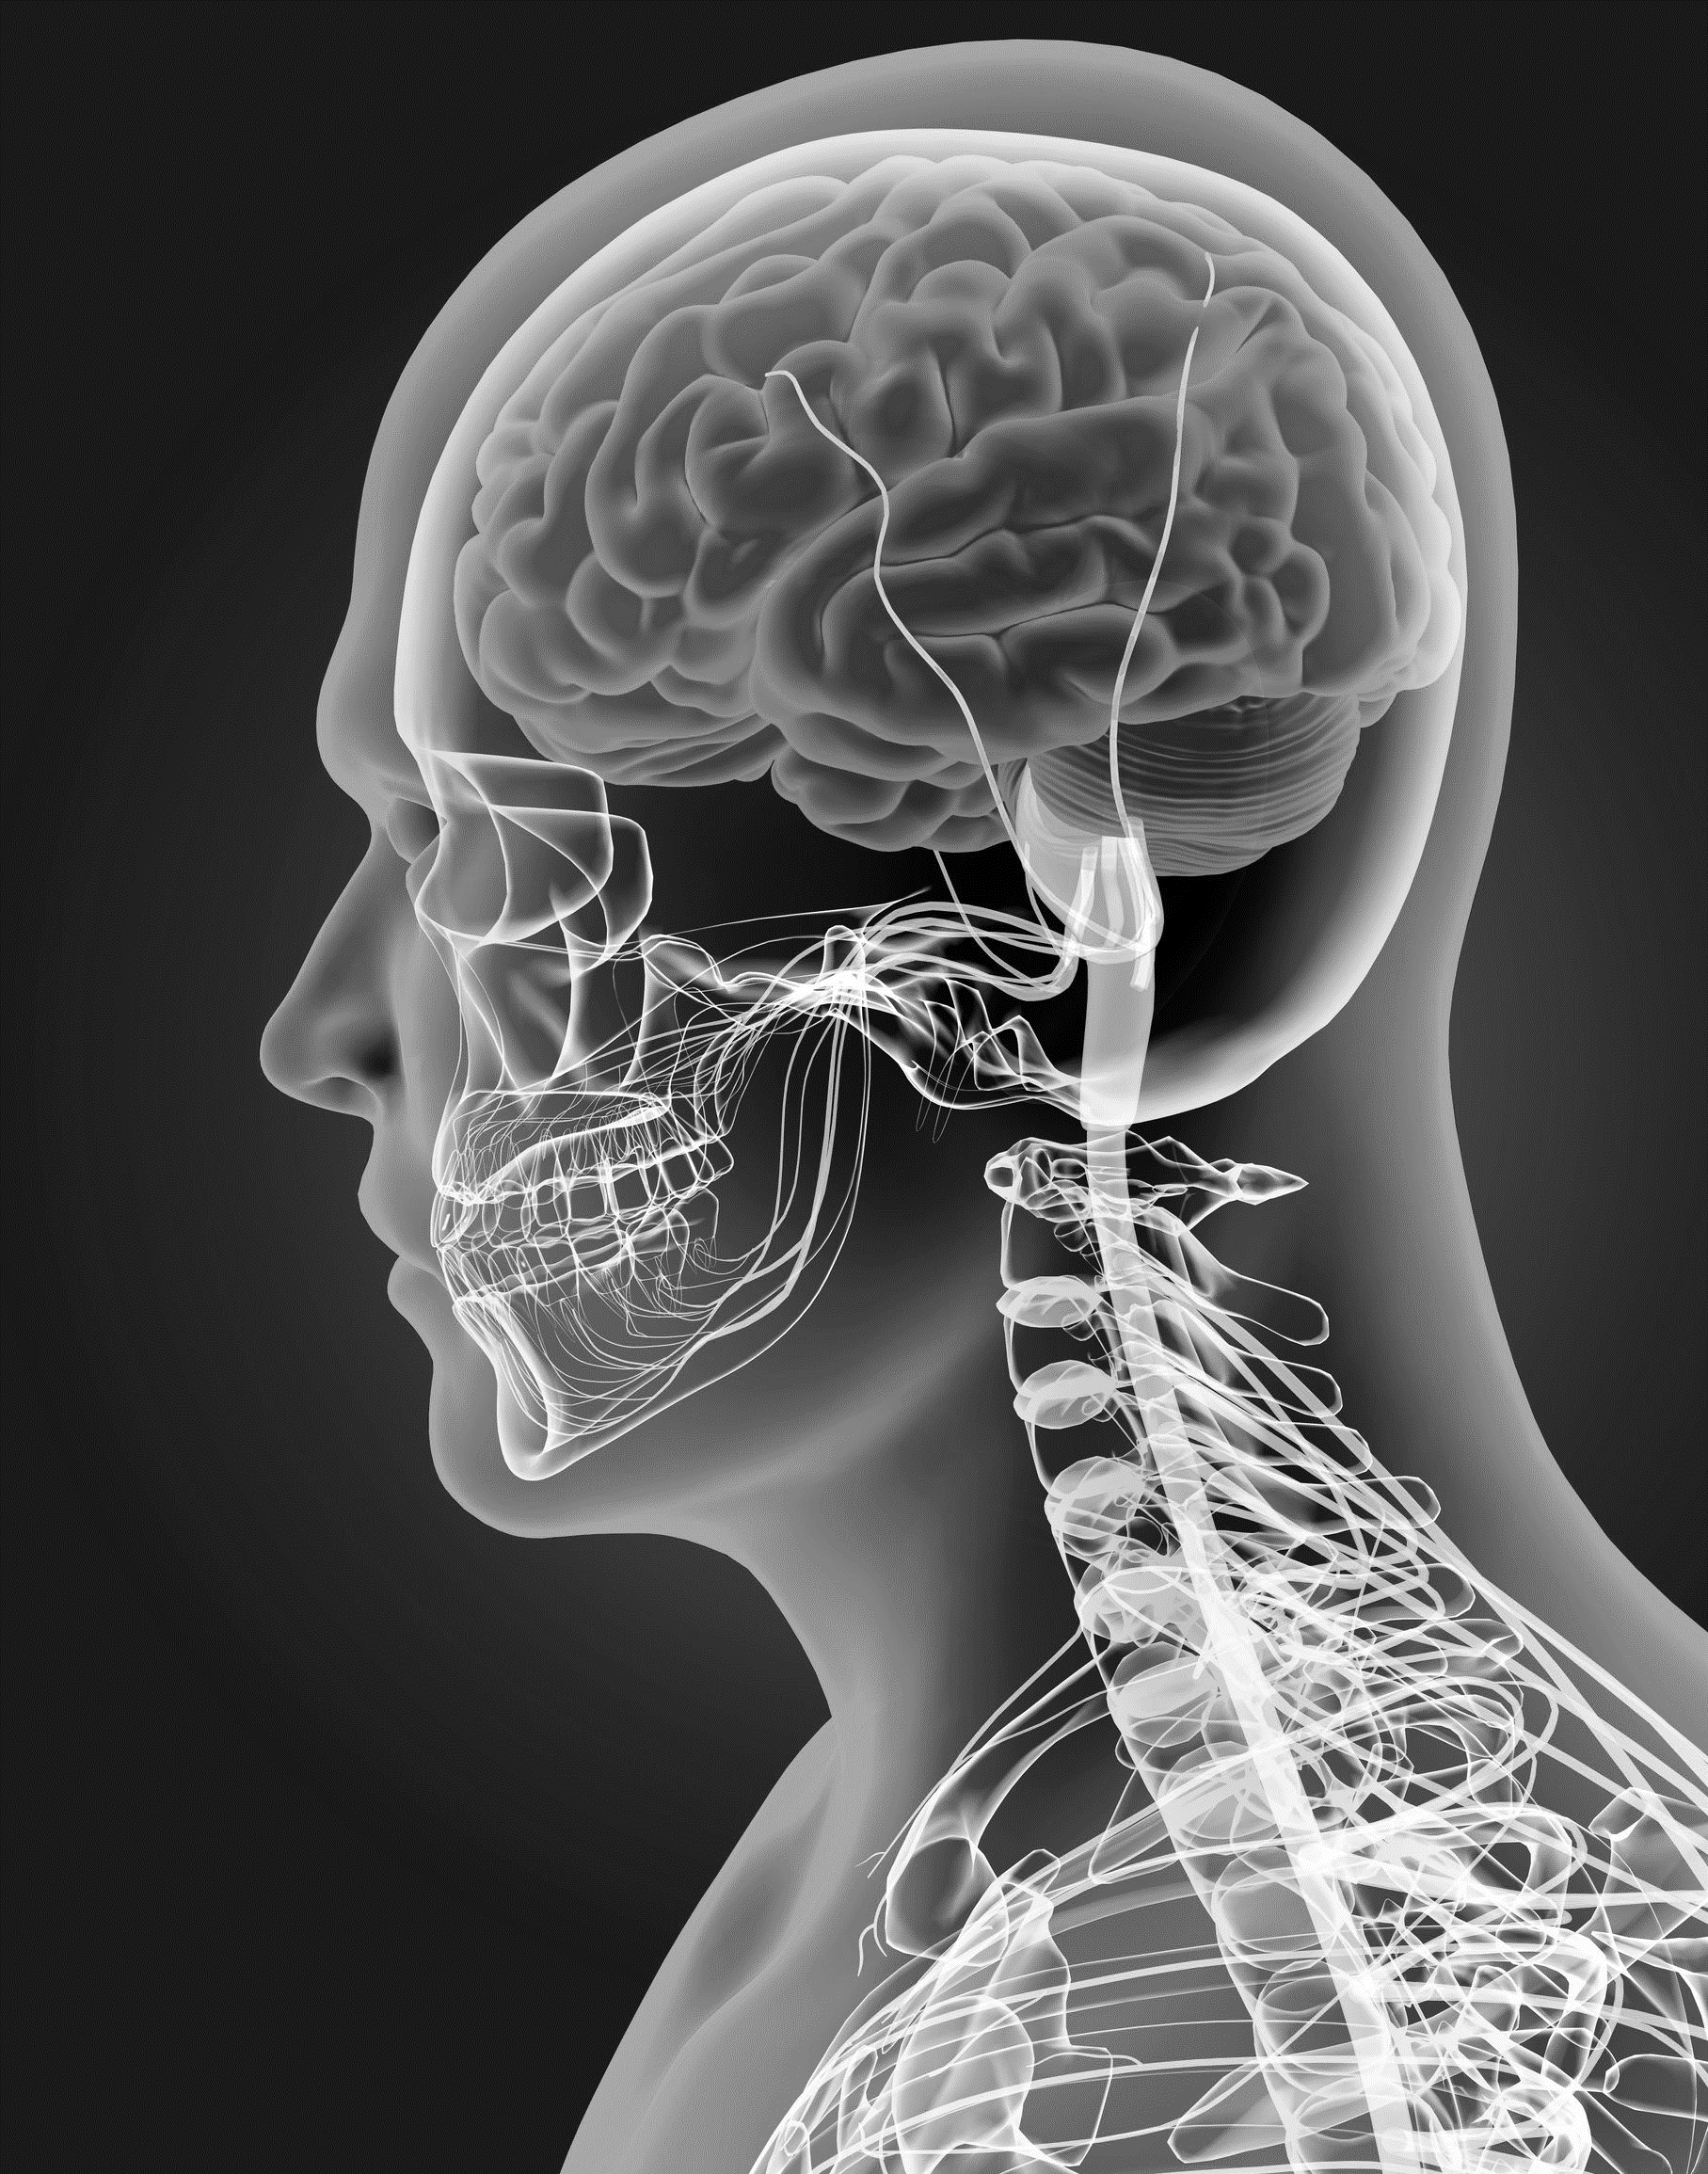
KS4 Homeostasis & Response (TRIPLE student booklet B)
Name
Class
Tutor Group
KS4 Science YEAR 11 Homeostasis & Response
KEYSTONE WORDS
Homeostasis | Homeostasis is the regulation of internal conditions to maintain optimal conditions for enzyme action and cell function.
Nervous system | The nervous system enables humans to react to their surroundings and to coordinate their behaviour.
Endocrine system | The endocrine system is composed of glands which secrete chemicals called hormones directly into the bloodstream.
Reproduction | The process by which offspring are produced by parents.
Hormone | Chemical messengers produced by glands.

Slide 2
BIG PICTURE
How will my prior knowledge develop my understanding of this topic?
Y7 | The Cells and Organisation topic introduced the body structures required.
Y8
Y9 | The GCSE Cell Biology topic added depth to prior learning from KS3. This is a threshold topic for this topic.
Learning Journey
Subtopic 1 | 4.5.1 & 4.5.2.1 – Homeostasis and the human nervous system | Subtopic 5 | 4.5.3.4 Hormones in human reproduction
Subtopic 2 | RP – practical & analysis | Subtopic 6 | 4.5.3.5 Contraception 4.5.3.6 HT only Infertility
Subtopic 3 | 4.5.3.1 Human endocrine system | Subtopic 7 | 4.5.4.2 HT only Use of plant hormones
Subtopic 4 | 4.5.3.2 Control of blood glucose concentration
Key knowledge
By the end of this topic you should know… | How the body responds to changes in the environment using the nervous system and the endocrine system.
By the end of this topic should be able to do… | Explain how to determine the effect of distractions on reaction times.
How will this knowledge develop my understanding of future topics?
This topic is one of the final topics in the course. It is not linked to future topics; however, it will deepen understanding of previous topics. For example, Organisation and Cell Biology.

Slide 3
KEY VOCABULARY LIST
Homeostasis | Homeostasis is the regulation of internal conditions to maintain optimal conditions for enzyme action and cell function.
Nervous system | The nervous system enables humans to react to their surroundings and to coordinate their behaviour.
Endocrine system | The endocrine system is composed of glands which secrete chemicals called hormones directly into the bloodstream.
Reproduction | The process by which offspring are produced by parents.
Hormone | Chemical messengers produced by glands.
EXPECTATIONS
Always write in black or blue pen. Always use a ruler for straight lines. If you make a mistake, cross it out with a single line. Always draw diagrams, tables and graphs in pencil with a ruler if necessary Always mark and correct your work in green pen. Respond to any feedback your teacher gives you in green pen. Take pride in your work, make it neat! All tasks should be completed in silence and by yourself unless your teacher tells you otherwise.
PROUD
Punctuation and grammar
Ruler and pencil for diagrams
Outstanding effort every lesson
Underline date and title
Dates and titles every lesson
PROUD FRIDAY
Any piece of work you complete, which meets our PROUD expectations can be taken to the PROUD station during Friday lunchtime. Show your work to a member of SLT and receive a sweet treat!

Slide 4
Lesson 4: 4.5.3.3 Biology only: Maintaining water and nitrogen balance in the body (2 lessons)
Learning Objective
We are learning to explain how the body balances its water and nitrogen content.
Why are we learning about this?
This lessons helps us understand how different systems within the body interact to keep us alive.

Slide 5
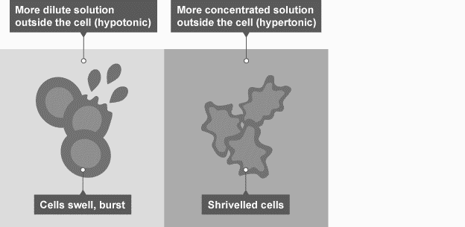
1 2 3 4 5 6 7 8 9 10 11 12 13 14 15 16 17 18 19 20 21 22 23 24 25 26 27 28 29 30 | Importance of water balance in the body Water content Osmoregulation is the control of water levels and mineral salts in the blood. Water levels and mineral salts in the blood are controlled to protect cells by stopping too much water from entering or leaving them, as the concentrations of water and salts is the same inside and outside the cells. If body cells lose or gain too much water by osmosis, they do not function efficiently. If the concentration of water is the same inside and out the cells, they remain in their normal state. If the water concentration is too high outside, water enters the cell by osmosis and they may burst. On the other hand, if the water concentration is too low outside compared to the inside of the cells, water will leave by osmosis and the cells may shrivel. If body cells lose or gain too much water by osmosis they do not function efficiently. Plants also undergo the process of osmosis, in the same way that animals cells do. Cell walls are turgid or firm, when they are full of water. If cell walls lose water, they become flaccid and the cytoplasm shrinks away from the cell wall.

Slide 6
1 2 3 4 5 6 7 8 9 10 11 12 13 14 15 16 17 18 19 20 21 22 23 24 25 26 27 28 29 30 | Human excretory organs The organs of excretion in humans include the skin, lungs and kidneys. Water is lost from the body as: urine from the kidneys sweat from the skin water vapour, from the lungs when we exhale Skin Sweat glands in the skin produce sweat. Water, ions and urea are lost from the skin as they are contained in sweat. Lungs Water leaves the body via the lungs when we exhale as well as excess carbon dioxide. We cannot control the level of water, ion or urea loss by the lungs or skin. For example, in a hot climate, your body sweats to help keep you cool. In the same way, when we breathe out we lose water vapour, and we cannot alter the amount we lose. Kidneys The kidneys are organs of the urinary system - which removes excess water, salts and urea.

Slide 7
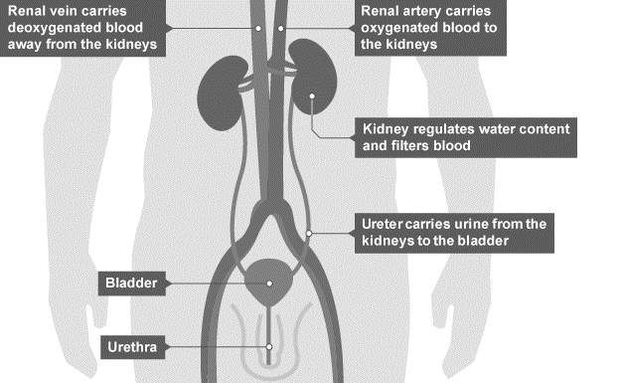
1 2 3 4 5 6 7 8 9 10 11 12 13 14 15 16 17 18 19 20 21 22 23 24 25 26 27 28 29 30 | Maintaining water balance in the body Kidneys The kidneys are organs of the urinary system - which remove excess water, salts and urea. The urinary system Blood is transported to the kidney through the renal artery. The blood is filtered at a high pressure and the kidney selectively reabsorbs any useful materials such as glucose, salt ions and water. After it has been purified, the blood returns to the circulatory system through the renal vein. The kidneys produce urine and this helps maintain water balance. The urine is taken from the kidneys to the bladder by the ureters. The bladder stores the urine until it is convenient to expel it from the body. Note that 'ureter' differs from the word 'urethra'. The ureters are tubes that carry urine from the kidneys to the bladder, whereas the urethra is the tube that carries urine out of the body. Urine Urine contains water, urea and salts. Urea is produced in the liver when excess amino acids are broken down. Urea is the main waste product removed in the urine, as it is not reabsorbed in the kidney.

Slide 8
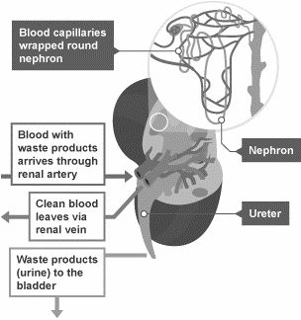
1 2 3 4 5 6 7 8 9 10 11 12 13 14 15 16 17 18 19 20 21 22 23 24 25 26 27 28 29 30 | The kidney works in a number of different stages: Stage 1 - Filtration Blood passes through the nephron inside the kidneys, there are many capillaries inside the kidney, and the blood is under high pressure at the start of the nephron, which aids the ultrafiltration of the blood. Small molecules are filtered out and pass into the nephron tubule. These small molecules include ureas, water, ions, and glucose. However, large molecules, such as blood proteins, are too big to fit through the capillary wall and remain in the blood. Stage 2 - Selective reabsorption Having filtered out small essential molecules from the blood - the kidneys must reabsorb the molecules which are needed, while allowing those molecules which are not needed to pass out in the urine. Therefore, the kidneys selectively reabsorb only those molecules which the body needs back in the bloodstream.

Slide 9
1 2 3 4 5 6 7 8 9 10 11 12 13 14 15 16 17 18 19 20 21 22 23 24 25 26 27 28 29 30 | The reabsorbed molecules include: all of the glucose which was originally filtered out as much water as the body needs to maintain a constant water level in the blood plasma as many ions as the body needs to maintain a constant balance of mineral ions in the blood plasma Stage 3 - The formation of urine The molecules which are not selectively reabsorbed (the urea, excess water and ions) continue along the nephron tubule as urine. This eventually passes down to the bladder. In carrying out these processes, the kidney is able to fulfil its functions of regulating the water and ion balance of the blood plasma, as well as keeping the level of urea low. The effect of ADH on tubule permeability and in water balance – Higher Tier Two important areas inside the brain are the Hypothalamus which detects changes in the blood plasma, and the pituitary gland which regulates the release of the anti-diuretic hormone, known as ADH. Different amounts of ADH are released into the bloodstream according to the concentration of water in the blood plasma. ADH is released by the pituitary gland when the blood is too concentrated and it causes the kidney tubules to become more permeable. This allows more water to be reabsorbed back into the blood during selective reabsorption. If a person has consumed a large volume of water and has not lost much as sweat, too much water might be detected in the blood plasma. If this occurs, less ADH will be released, which results in less water being reabsorbed and a dilute and larger volume of urine will be produced.

Slide 10
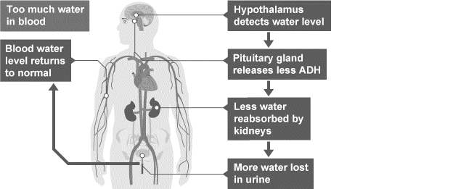
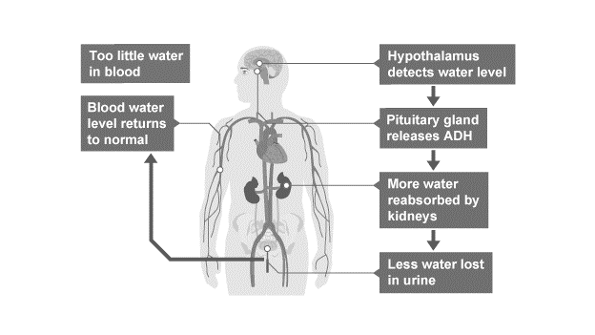
1 2 3 4 5 6 7 8 9 10 11 12 13 14 15 16 17 18 19 20 21 22 23 24 25 26 27 28 29 30 | If a person becomes too hot and sweats a lot, but doesn't drink enough water to replace what was lost, too little water might be detected in the blood plasma. More ADH will be released, which results in water being reabsorbed and a more concentrated but smaller volume of urine will be produced.

Slide 11
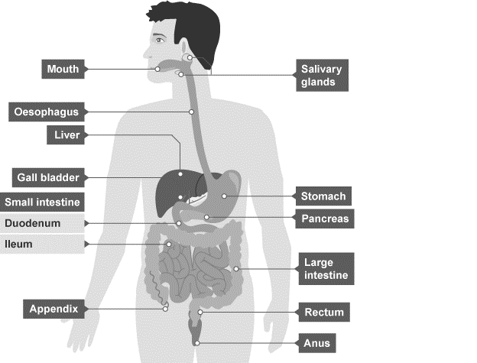
1 2 3 4 5 6 7 8 9 10 11 12 13 14 15 16 17 18 19 20 21 22 23 24 25 26 27 28 29 30 | Maintaining nitrogen balance in the body - Higher The digestion of proteins from the diet results in excess amino acids, which need to be excreted safely. In the liver these amino acids are deaminated to form ammonia. Ammonia is toxic and so it is immediately converted to urea for safe excretion. Once we have eaten our food, it is then digested by the body. The digestion of proteins is broken down by protease enzymes into amino acids in the stomach and small intestine. When excessive amounts of protein are eaten, the excess amino acids produced from digesting proteins are transported to the liver from the small intestine. The liver controls the amino acid concentration in the body, as excess amino acids which need to be Excreted safely. The body is unable to store proteins or amino acids. In the liver ammonia is formed by the deamination of amino acids. It is highly toxic and cannot be allowed to accumulate in the body. Excess ammonia is converted to urea. Urea and water are released from the liver cells in to the bloodstream and transported to the kidneys where the blood is filtered and the urea is passed out of the body in the urine.

Slide 12
Extra Space
……………………………………………………………………………………………………………………………………………………………………………………………………………………………………………………………………………………………………………………………………………………………………………………………………………………………………………………………………………………………………………………………………………………………………………………………………………………………………………………………………………………………………………………………………………………………………………………………………………………………………………………………………………………………………………………………………………………………………………………………………………………………………………………………………………………………………………………………………………………………………………………………………………………………………………………………………………………………………………………………………………………………………………………………………………………………………………………………………………………………………………………………………………………………………………………………………………………………………………………………………………………………………………………………………………………………………………………………………………………………………………………………………………………………………………………………..
…………………………………………………………………………………………………………………………………………………………………………………………………………………………………………………………………………………………………………………………………………………………………………………………………………………………………………………………………………………………………………………………………………………………………………………………………………………………………………………………………………………………………………………………………………………………………………………………………………………………………………………………………………………………………………………………………………………………………………………………………………………………………………………………………………………………………………………………………………………………………………………………………………………………………………………………………………………………………………………………………………………………………………………………………………………………………………………………………………………………………………………………………………………………………………………………………………………………………………………………………………………………………………………………………………………………………..
…………………………………………………………………………………………………………………………………………………………………………………………………………………………………………………………………………………………………………………………………………………………………………………………………………………………………………………………………………………………………………………………………………………………………………………………………………………………………………………………………………………………………………………………………………………………………………………………………

Slide 13
Extra Space
……………………………………………………………………………………………………………………………………………………………………………………………………………………………………………………………………………………………………………………………………………………………………………………………………………………………………………………………………………………………………………………………………………………………………………………………………………………………………………………………………………………………………………………………………………………………………………………………………………………………………………………………………………………………………………………………………………………………………………………………………………………………………………………………………………………………………………………………………………………………………………………………………………………………………………………………………………………………………………………………………………………………………………………………………………………………………………………………………………………………………………………………………………………………………………………………………………………………………………………………………………………………………………………………………………………………………………………………………………………………………………………………………………………………………………………………..
…………………………………………………………………………………………………………………………………………………………………………………………………………………………………………………………………………………………………………………………………………………………………………………………………………………………………………………………………………………………………………………………………………………………………………………………………………………………………………………………………………………………………………………………………………………………………………………………………………………………………………………………………………………………………………………………………………………………………………………………………………………………………………………………………………………………………………………………………………………………………………………………………………………………………………………………………………………………………………………………………………………………………………………………………………………………………………………………………………………………………………………………………………………………………………………………………………………………………………………………………………………………………………………………………………………………………..
…………………………………………………………………………………………………………………………………………………………………………………………………………………………………………………………………………………………………………………………………………………………………………………………………………………………………………………………………………………………………………………………………………………………………………………………………………………………………………………………………………………………………………………………………………………………………………………………………

Slide 14
Extra Space
……………………………………………………………………………………………………………………………………………………………………………………………………………………………………………………………………………………………………………………………………………………………………………………………………………………………………………………………………………………………………………………………………………………………………………………………………………………………………………………………………………………………………………………………………………………………………………………………………………………………………………………………………………………………………………………………………………………………………………………………………………………………………………………………………………………………………………………………………………………………………………………………………………………………………………………………………………………………………………………………………………………………………………………………………………………………………………………………………………………………………………………………………………………………………………………………………………………………………………………………………………………………………………………………………………………………………………………………………………………………………………………………………………………………………………………………..
…………………………………………………………………………………………………………………………………………………………………………………………………………………………………………………………………………………………………………………………………………………………………………………………………………………………………………………………………………………………………………………………………………………………………………………………………………………………………………………………………………………………………………………………………………………………………………………………………………………………………………………………………………………………………………………………………………………………………………………………………………………………………………………………………………………………………………………………………………………………………………………………………………………………………………………………………………………………………………………………………………………………………………………………………………………………………………………………………………………………………………………………………………………………………………………………………………………………………………………………………………………………………………………………………………………………………..
…………………………………………………………………………………………………………………………………………………………………………………………………………………………………………………………………………………………………………………………………………………………………………………………………………………………………………………………………………………………………………………………………………………………………………………………………………………………………………………………………………………………………………………………………………………………………………………………………

Slide 15
Extra Space
……………………………………………………………………………………………………………………………………………………………………………………………………………………………………………………………………………………………………………………………………………………………………………………………………………………………………………………………………………………………………………………………………………………………………………………………………………………………………………………………………………………………………………………………………………………………………………………………………………………………………………………………………………………………………………………………………………………………………………………………………………………………………………………………………………………………………………………………………………………………………………………………………………………………………………………………………………………………………………………………………………………………………………………………………………………………………………………………………………………………………………………………………………………………………………………………………………………………………………………………………………………………………………………………………………………………………………………………………………………………………………………………………………………………………………………………..
…………………………………………………………………………………………………………………………………………………………………………………………………………………………………………………………………………………………………………………………………………………………………………………………………………………………………………………………………………………………………………………………………………………………………………………………………………………………………………………………………………………………………………………………………………………………………………………………………………………………………………………………………………………………………………………………………………………………………………………………………………………………………………………………………………………………………………………………………………………………………………………………………………………………………………………………………………………………………………………………………………………………………………………………………………………………………………………………………………………………………………………………………………………………………………………………………………………………………………………………………………………………………………………………………………………………………..
…………………………………………………………………………………………………………………………………………………………………………………………………………………………………………………………………………………………………………………………………………………………………………………………………………………………………………………………………………………………………………………………………………………………………………………………………………………………………………………………………………………………………………………………………………………………………………………………………

Slide 16
Lesson 5: 4.5.4.1 Biology only: Plant control and coordination (1 lesson)
Learning Objective
To be able to describe the effects of the function of plat hormones
Why are we learning about this?
This lessons helps us understand why plants also need hormones as chemical messengers around the organism and their role in plant growth . It helps us understand why roots always grow downwards and shoots always grow upwards, despite the way they are planted in the soil.

Slide 17
Subtopic 12: Connect
Key explanations
Hormones are chemical messengers. They can also travel to different parts of the plant to bring about an effect in the plant.
Plants detect and respond to stimuli, just like animals. Plants use hormones to coordinate and control growth and responses to light and gravity. When seeds and bulbs are planted, they grow the right way round. This is caused by hormones.
In order to survive, plants require light and water for photosynthesis. They have developed responses called tropisms to help ensure they grow towards adequate sources of light and water.
Tropisms – the response of a plant growing towards or away from a stimulus
Phototropism – plant growth towards the light. The shoots of most plants respond to light by growing towards it. They are said to be positively phototrophic
Gravitropism – growth of a plant towards gravity.
Roots grow downwards towards force of gravity so are positively gravitropic
Shoots grow upwards away from force of gravity and so are negatively gravitropic
Task – using the keywords above, draw the lines between the boxes to correctly describe which tropism is being displayed in each scenario
A bulb planted on its side and the roots change direction and grow downwards
gravitropism
Positive
Negative
A seed produces shoots growing upwards through the soil
phototropism

Slide 18
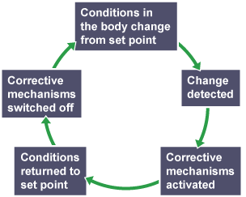
I wasn’t there but I still care!
In mammals, conditions such as water concentration, temperature and glucose concentration must be kept as constant as possible. These are examples of homeostasis.
A negative feedback mechanism is an important type of control that is used in homeostasis. A negative feedback control system responds when conditions change from the ideal or set point and returns conditions to this set point. There is a continuous cycle of events in negative feedback.
General stages in negative feedback
In general:
if the level of something rises, control systems reduce it again
if the level of something falls, control systems raise it again
Task
In your own words describe what is meant by negative feedback?
………………………………………………………………………………………………………………………………………………………………………………………………………………………………………………………………………………………………………………………………………………………………………………………………………………………………………………………………………………
Using the negative feedback system, describe how glucose levels in the blood are controlled by the negative feedback system. (Look back at glucose control)
…………………………………………………………………………………………………………………………………………………………………………………………………………………………………………………………………………………………………………………………………………………………………………………………………………………………………………………………………………………………………………………………………………………………………………………………………………………..………………………

Slide 19
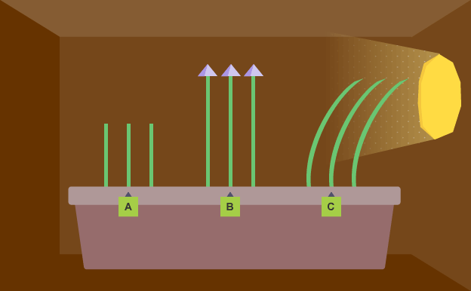
1 2 3 4 5 6 7 8 9 10 11 12 13 14 15 16 17 18 19 20 21 22 23 24 25 26 27 28 29 | In order to survive, plants require light and water for photosynthesis. They have developed responses called tropisms to help ensure they grow towards adequate sources of light and water. There are two main types of tropisms: positive tropisms – the plant grows towards the stimulus negative tropisms – the plant grows away from the stimulus Phototropism is a response to the stimulus of light. Responses to stimuli of different parts of the plant In the plant stem, responses to light are known as a positive phototropism, which means the stem grows towards the light. In the plant root, responses to light are known as a negative phototropism, which means the root grows away from the light Auxins Auxins are a family of plant hormones. They are mostly made in the tips of the growing stems and roots, which are known as apical meristems, and can diffuse to other parts of the stems or roots. Auxins control the growth of plants by promoting cell division and causing elongation in plant cells (the cells get longer). Stems and roots respond differently to high concentrations of auxins: cells in stems grow more cells in roots grow less Phototropism This is caused by an unequal distribution of auxin. In a stem, the shaded side contains more auxin and grows longer, which causes the stem t In a stem, the shaded side contains more auxin and grows longer, which causes the stem to grow towards the light. It is vital to note that the plant does NOT bend towards the light.

Slide 20
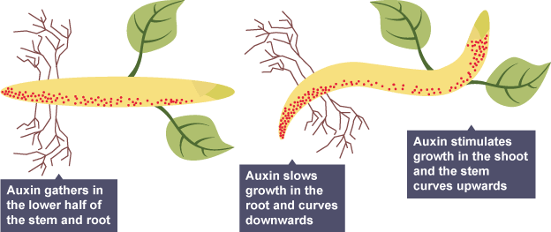
1 2 3 4 5 6 7 8 9 10 11 12 13 14 15 16 17 18 19 20 21 22 23 24 25 26 27 28 29 | Auxins have the opposite effect on root cells. In a root, the shaded side contains more auxin and grows less - causing the root to bend away from the light Auxin and geotropism Geotropisms Phototropism is a response to the stimulus of light, whereas geotropism (also called gravitropism) is a response to the stimulus of gravity. Plants responses to gravity: when the stem grows against the force of gravity, this is known as a negative geotropism when a root grows in the direction of the force of gravity, this is known as a positive geotropism Just like phototropism, geotropism is also caused by an unequal distribution of auxin. In a root placed horizontally, the bottom side contains more auxin and grows less - causing the root to grow in the direction of the force of gravity. The opposite happens in a stem. When a stem placed horizontally, the bottom side contains more auxin and grows more - causing the stem to grow upwards against the force of gravity.

Slide 21
Rehearsal questions
What is a hormone?
……………………………………………………………………………………………………………………………………………………..
Where are auxins made inside a plant?
…………………………………………………………………………………………………………………………………………………….
What word describes the response of a plant growing towards or away from a stimulus?
……………………………………………………..………………………………………………………………………………………………
What is the job of auxins in a plant?
………………………………………………………………………………………………………………………………………………………
5. What word describes plants growing towards the light?
………………………………………………………………………………………………………………………………………………………
6. What word is used to describe growing tips and shoots?
............................................................................................................................................................
What is an auxin?
……………………………………………………………………………………………………………………………………………………..
What is the word used to describe plants growing towards gravity?
………………………………………………………………………………………………………………………………………………………
Where are auxins produced?
……………………………………………………………………………………………………………………………………………………..
10. In a stem, the shaded side contains more auxin . What does this cause the stem to do?
………………………………………………………………………………………………………………………………………………………
What is positive phototropism?
……………………………………………………………………………………………………………………………………………………..
What is the function of auxins in the plant?
………………………………………………………………………………………………………………………………………………………
Which part of the root do auxins gather at?
………………………………………………………………………………………………………………………………………………………
What part of the stem do auxins diffuse to?
............................................................................................................................................................

Slide 22
1 Do:
What does the word tropism mean?
……………………………………………………………………………………………………………………………………………………………………………………………………………………………………………………………………………………………………………..
We do:
What is the definition of phototropism?
………………………………………………………………………………………………………………………………………………………………………………………………………………………………………………………………………………………………………………………………………………………………………………………………………………………………………………………………………
What is the definition of geotropism?
……………………………………………………..………………………………………………………………………………………………………………………………………………………………………………………………………………………………………………………………………………………………………………………………………………………………………………………………………………
You do:
If plant shoots are growing towards the light is this a positive or negative phototropism?
………………………………………………………………………………………………………………………………………………………
What side of the shoot do auxins move to?..........................................................................................
What effect does it have on the shoot if the auxins move to this side?
………………………………………………………………………………………………………………………………………………………………………………………………………………………………………………………………………………………………………………
How do auxins cause the stems of shoots to bend towards the light?
..............................…………...................................................................................................................................................................................................................................................................................................................................................................................................................................................................................................................................................................................................................................................................................................................................................................
6. In the roots at what side do auxins move to?
………………………………………………………………………………………………………………………………………………………
When auxins move to that side in the roots, how does this cause them to bend towards the ground?
………………………………………………………………………………………………………………………………………………………………………………………………………………………………………………………………………………………………………………………………………………………………………...................................................................................................

Slide 23
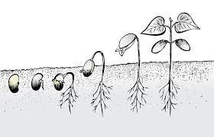
1 2 3 4 5 6 7 8 9 10 11 12 13 14 15 16 17 18 19 20 21 22 23 24 25 26 27 28 | Other plant hormones – Higher Gibberellins, which are a group of plant hormones responsible for growth and development, are important for initiating seed germination. Low concentrations can be used to increase the speed of germination, and they stimulate cell elongation and cause plants to grow taller. They are naturally produced by seeds. Gibberellins can be used to: end seed dormancy promote flowering increase fruit size Seed dormancy must be broken for seeds to germinate, and this can be done by using gibberellins. Controlling fruit ripening Ethene is a hydrocarbon gas which speeds up ripening in bananas and other fruit. It also controls cell division during plant growth. In the food industry fruit is often picked unripe and then transported. This prevents fruit from over-ripening on the journey. It is ripened during storage by adding ethene and then taken to the shops. The effect of ethene released from bananas is clearly visible if you keep them in a bowl with other fruit, as it causes other fruits to ripen very quickly.

Slide 24
Compare…
I DO What are the main differences between auxin and gibberellin hormones?
……………………………………………………………………………………………………………………………………………………………………………………………………………………………………………………………………………………………………………………………………………………………………………………………………………………………………………………………………………………………………………………….…………………………………………………………………………………………………………………………………….
WE DO What are the differences between auxins and ethene?
………………………………………………………………………………………………………………………………………………………………………………………………………………………………………………………………………………………………………………………………………………………………………………………………………………………………………………………………………………………………………………….……...........................................................................................................................................
3. YOU DO What are the similarities between auxins and gibberellins?
………………………………………………………………………………………………………………………………………………………………………………………………………………………………………………………………………………………………………………………………………………………………………………………………………………………………………………………………………………………………………………….……...........................................................................................................................................
4. YOU DO What are the similarities between auxins and ethene?
………………………………………………………………………………………………………………………………………………………………………………………………………………………………………………………………………………………………………………………………………………………………………………………………………………………………………………………………………………………………………………….……...........................................................................................................................................
YOU DO Compare the effects of gibberellins and ethene on plants.
………………………………………………………………………………………………………………………………………………………………………………………………………………………………………………………………………………………………………………………………………………………………………………………………………………………………………………………………………………………………………………….……...........................................................................................................................................

Slide 25
If it didn’t…
1. If plants did not have auxins, how would this affect the rate of photosynthesis reaction that plants carry out?
.......................................................................................................................................................................................................................................................................................................................................................................................................................................................................................................................................................................................................................................................................
2. If plants did not have auxins how would this affect daffodil bulbs planted sidewards?
………………………………………………………………………………………………………………………………………………………………………………………………………………………………………………………………………………………………………………………………………………………………………………………………………………………………………………………………………………………
3. If a fruit bowl contained bananas, apples and oranges, how would the apples and oranges be affected by the bananas?
…............................................................................................................................................................................................................................................................................................................................................................................................................................................................................................................................................................................................................................................................................................................................................................................................................................................................................................................................................................................................................................................................................................................................................................................
4. In an experiment a scientist covered the tips of half a batch of cress shoots with foil caps. First, both the covered and uncovered shoots are exposed to light shining from above. Then they are given several days in a box with light only shining from the side. How would you expect the covered and uncovered shoots to respond?
………………………………………………………………………………………………………………………………………………………………………………………………………………………………………………………………………………………………………………………………………………………………………………………………………………………………………………………………………………………………………………………………………………………………………………………………………………………………………………………………………………………………………………………………………………………………………………………………………………………………………………………………………………………………………………………………………………………………………………

Slide 26
Subtopic 6: Required Practical: Plant Responses
Learning Objective
We are learning how to determine the effect of light on seedlings.
Why are we learning about this?
This lessons helps us understand how plants respond to stimuli. This information is vital to those who work in agriculture as it helps them determine how their crops will respond to stimuli.

Slide 27
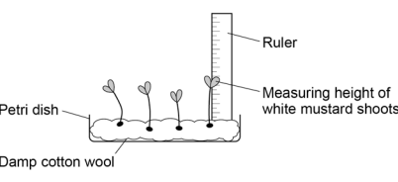
1 2 3 4 5 6 7 8 9 10 11 12 13 14 15 16 17 18 19 20 21 22 23 24 25 26 27 28 29 30 | Investigate the effect of light or gravity on the growth of newly germinated seedlings. • set up three petri dishes with mustard seeds and allow them to germinate • put each dish of seedlings in a different light intensity for the same period of time • monitor the height of each seedling at each light intensity. Apparatus • some white mustard seeds • three Petri dishes • cotton wool • a ruler • water. Method 1. Set up three petri dishes containing cotton wool soaked in equal amounts of water. 2. Put ten mustard seeds in each dish. 3. Put the dishes in a warm place. They must not be disturbed or moved. 4. Allow the mustard seeds to germinate. Water daily with equal amounts of water to each dish. 5. Each dish should have the same number of seedlings after the seeds have geminated. Remove excess seedlings from any dish that has too many. 6. Measure the height of each seedling in mm.

Slide 28
1 2 3 4 5 6 7 8 9 10 11 12 13 14 15 16 17 18 19 20 21 22 23 24 25 26 27 28 29 30 | 7. Move the petri dishes into position. • Put one on a windowsill in full sunlight. • Put the second one in partial light. • Put the third one in darkness. 8. Measure the height of each seedling every day, for at least five consecutive days. 9. Record the heights in a table like this one:

Slide 29
Results tables
Full Sunlight
Partial sunlight
Darkness
Height of seedlings in full sunlight in mm
Height of seedlings in partial sunlight in mm
Height of seedlings in darkness in mm

Slide 30
Analysis
a. Calculate the mean height of the seedlings each day.
…………………………………………………………………………………………………………………………………………………………………………………………………………………………………………………………………………………………………………………………………………………………………………………………………………………………………………………………………………………………………………………………………………………………………………………………………………………………………………………………………………
b. Plot a graph with:
• ‘Mean height in mm’ on the y-axis.
• ‘Day’ on the x-axis.
Your graph should include the data for full sunlight, partial light and darkness.
c. Write a conclusion to state and explain your results, you should include reference to hormones and their distribution in your written answer.
…………………………………………………………………………………………………………………………………………………………………………………………………………………………………………………………………………………………………………………………………………………………………………………………………………………………………………………………………………………………………………………………………………………………………………………………………………………………………………………………………………
…………………………………………………………………………………………………………………………………………………………………………………………………………………………………………………………………………………………………………………………………………………………………………………………………………………………………………………………………………………………………………………………………………………………………………………………………………………………………………………………………………
…………………………………………………………………………………………………………………………………………………………………………………………………………………………………………………………………………………………………………………………………………………………………………………………………………………………………………………………………………………………………………………………………………………………………………………………………………………………………………………………………………

Slide 31
DO NOW
Date: ……………………………………….
 | ANSWER
Q1.
Q2.
Q3.
Q4.
Q5.
Date: ……………………………………….
 | ANSWER
Q1.
Q2.
Q3.
Q4.
Q5.

Slide 32
DO NOW
Date: ……………………………………….
 | ANSWER
Q1.
Q2.
Q3.
Q4.
Q5.
Date: ……………………………………….
 | ANSWER
Q1.
Q2.
Q3.
Q4.
Q5.

Slide 33
Knowledge Retrieval Quiz 2
Date: ……………………………………….
Score: …………...
 |  | Answer
Q1. | Insert question in bold
Q2.
Q3.
Q4.
Q5.
Q6.
Q7.
Q8.
Q9.
Q10.

Slide 34
Extra Space
……………………………………………………………………………………………………………………………………………………………………………………………………………………………………………………………………………………………………………………………………………………………………………………………………………………………………………………………………………………………………………………………………………………………………………………………………………………………………………………………………………………………………………………………………………………………………………………………………………………………………………………………………………………………………………………………………………………………………………………………………………………………………………………………………………………………………………………………………………………………………………………………………………………………………………………………………………………………………………………………………………………………………………………………………………………………………………………………………………………………………………………………………………………………………………………………………………………………………………………………………………………………………………………………………………………………………………………………………………………………………………………………………………………………………………………………..
…………………………………………………………………………………………………………………………………………………………………………………………………………………………………………………………………………………………………………………………………………………………………………………………………………………………………………………………………………………………………………………………………………………………………………………………………………………………………………………………………………………………………………………………………………………………………………………………………………………………………………………………………………………………………………………………………………………………………………………………………………………………………………………………………………………………………………………………………………………………………………………………………………………………………………………………………………………………………………………………………………………………………………………………………………………………………………………………………………………………………………………………………………………………………………………………………………………………………………………………………………………………………………………………………………………………………..
…………………………………………………………………………………………………………………………………………………………………………………………………………………………………………………………………………………………………………………………………………………………………………………………………………………………………………………………………………………………………………………………………………………………………………………………………………………………………………………………………………………………………………………………………………………………………………………………………

Slide 35
Extra Space
……………………………………………………………………………………………………………………………………………………………………………………………………………………………………………………………………………………………………………………………………………………………………………………………………………………………………………………………………………………………………………………………………………………………………………………………………………………………………………………………………………………………………………………………………………………………………………………………………………………………………………………………………………………………………………………………………………………………………………………………………………………………………………………………………………………………………………………………………………………………………………………………………………………………………………………………………………………………………………………………………………………………………………………………………………………………………………………………………………………………………………………………………………………………………………………………………………………………………………………………………………………………………………………………………………………………………………………………………………………………………………………………………………………………………………………………..
…………………………………………………………………………………………………………………………………………………………………………………………………………………………………………………………………………………………………………………………………………………………………………………………………………………………………………………………………………………………………………………………………………………………………………………………………………………………………………………………………………………………………………………………………………………………………………………………………………………………………………………………………………………………………………………………………………………………………………………………………………………………………………………………………………………………………………………………………………………………………………………………………………………………………………………………………………………………………………………………………………………………………………………………………………………………………………………………………………………………………………………………………………………………………………………………………………………………………………………………………………………………………………………………………………………………………..
…………………………………………………………………………………………………………………………………………………………………………………………………………………………………………………………………………………………………………………………………………………………………………………………………………………………………………………………………………………………………………………………………………………………………………………………………………………………………………………………………………………………………………………………………………………………………………………………………

Slide 36
Extra Space
……………………………………………………………………………………………………………………………………………………………………………………………………………………………………………………………………………………………………………………………………………………………………………………………………………………………………………………………………………………………………………………………………………………………………………………………………………………………………………………………………………………………………………………………………………………………………………………………………………………………………………………………………………………………………………………………………………………………………………………………………………………………………………………………………………………………………………………………………………………………………………………………………………………………………………………………………………………………………………………………………………………………………………………………………………………………………………………………………………………………………………………………………………………………………………………………………………………………………………………………………………………………………………………………………………………………………………………………………………………………………………………………………………………………………………………………..
…………………………………………………………………………………………………………………………………………………………………………………………………………………………………………………………………………………………………………………………………………………………………………………………………………………………………………………………………………………………………………………………………………………………………………………………………………………………………………………………………………………………………………………………………………………………………………………………………………………………………………………………………………………………………………………………………………………………………………………………………………………………………………………………………………………………………………………………………………………………………………………………………………………………………………………………………………………………………………………………………………………………………………………………………………………………………………………………………………………………………………………………………………………………………………………………………………………………………………………………………………………………………………………………………………………………………..
…………………………………………………………………………………………………………………………………………………………………………………………………………………………………………………………………………………………………………………………………………………………………………………………………………………………………………………………………………………………………………………………………………………………………………………………………………………………………………………………………………………………………………………………………………………………………………………………………

Slide 37
Extra Space
……………………………………………………………………………………………………………………………………………………………………………………………………………………………………………………………………………………………………………………………………………………………………………………………………………………………………………………………………………………………………………………………………………………………………………………………………………………………………………………………………………………………………………………………………………………………………………………………………………………………………………………………………………………………………………………………………………………………………………………………………………………………………………………………………………………………………………………………………………………………………………………………………………………………………………………………………………………………………………………………………………………………………………………………………………………………………………………………………………………………………………………………………………………………………………………………………………………………………………………………………………………………………………………………………………………………………………………………………………………………………………………………………………………………………………………………..
…………………………………………………………………………………………………………………………………………………………………………………………………………………………………………………………………………………………………………………………………………………………………………………………………………………………………………………………………………………………………………………………………………………………………………………………………………………………………………………………………………………………………………………………………………………………………………………………………………………………………………………………………………………………………………………………………………………………………………………………………………………………………………………………………………………………………………………………………………………………………………………………………………………………………………………………………………………………………………………………………………………………………………………………………………………………………………………………………………………………………………………………………………………………………………………………………………………………………………………………………………………………………………………………………………………………………..
…………………………………………………………………………………………………………………………………………………………………………………………………………………………………………………………………………………………………………………………………………………………………………………………………………………………………………………………………………………………………………………………………………………………………………………………………………………………………………………………………………………………………………………………………………………………………………………………………

Slide 38
Extra Space
……………………………………………………………………………………………………………………………………………………………………………………………………………………………………………………………………………………………………………………………………………………………………………………………………………………………………………………………………………………………………………………………………………………………………………………………………………………………………………………………………………………………………………………………………………………………………………………………………………………………………………………………………………………………………………………………………………………………………………………………………………………………………………………………………………………………………………………………………………………………………………………………………………………………………………………………………………………………………………………………………………………………………………………………………………………………………………………………………………………………………………………………………………………………………………………………………………………………………………………………………………………………………………………………………………………………………………………………………………………………………………………………………………………………………………………………..
…………………………………………………………………………………………………………………………………………………………………………………………………………………………………………………………………………………………………………………………………………………………………………………………………………………………………………………………………………………………………………………………………………………………………………………………………………………………………………………………………………………………………………………………………………………………………………………………………………………………………………………………………………………………………………………………………………………………………………………………………………………………………………………………………………………………………………………………………………………………………………………………………………………………………………………………………………………………………………………………………………………………………………………………………………………………………………………………………………………………………………………………………………………………………………………………………………………………………………………………………………………………………………………………………………………………………..
…………………………………………………………………………………………………………………………………………………………………………………………………………………………………………………………………………………………………………………………………………………………………………………………………………………………………………………………………………………………………………………………………………………………………………………………………………………………………………………………………………………………………………………………………………………………………………………………………

Slide 39
Extra Space
……………………………………………………………………………………………………………………………………………………………………………………………………………………………………………………………………………………………………………………………………………………………………………………………………………………………………………………………………………………………………………………………………………………………………………………………………………………………………………………………………………………………………………………………………………………………………………………………………………………………………………………………………………………………………………………………………………………………………………………………………………………………………………………………………………………………………………………………………………………………………………………………………………………………………………………………………………………………………………………………………………………………………………………………………………………………………………………………………………………………………………………………………………………………………………………………………………………………………………………………………………………………………………………………………………………………………………………………………………………………………………………………………………………………………………………………..
…………………………………………………………………………………………………………………………………………………………………………………………………………………………………………………………………………………………………………………………………………………………………………………………………………………………………………………………………………………………………………………………………………………………………………………………………………………………………………………………………………………………………………………………………………………………………………………………………………………………………………………………………………………………………………………………………………………………………………………………………………………………………………………………………………………………………………………………………………………………………………………………………………………………………………………………………………………………………………………………………………………………………………………………………………………………………………………………………………………………………………………………………………………………………………………………………………………………………………………………………………………………………………………………………………………………………..
…………………………………………………………………………………………………………………………………………………………………………………………………………………………………………………………………………………………………………………………………………………………………………………………………………………………………………………………………………………………………………………………………………………………………………………………………………………………………………………………………………………………………………………………………………………………………………………………………

Slide 40
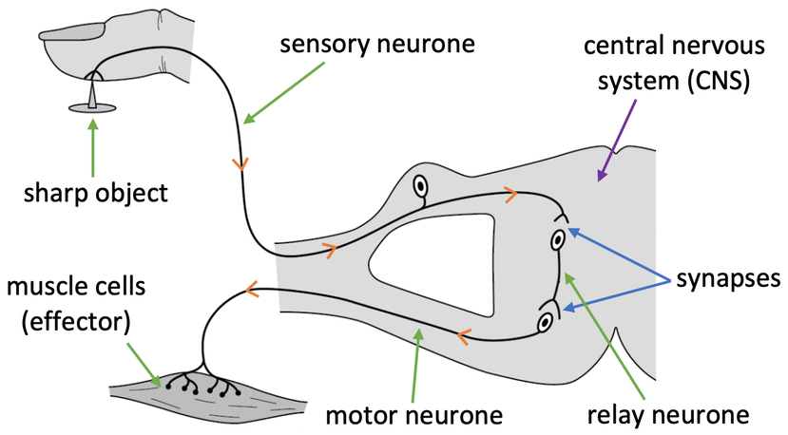
KNOWLEDGE ORGANISER
Subject: Science | Topic: Homeostasis & response | Term: Autumn
KEY WORDS | Key words
1 | Homeostasis | Homeostasis is the regulation of internal conditions to maintain optimal conditions for enzyme action and cell function.
2 | Nervous system | The nervous system enables humans to react to their surroundings and to coordinate their behaviour.
3 | Endocrine system | The endocrine system is composed of glands which secrete chemicals called hormones directly into the bloodstream.
4 | Reproduction | The process by which offspring are produced by parents.
5 | Hormone | Chemical messengers produced by glands.
KEY EXAMPLES
6 | Reflex actions | Automatic and rapid responses to stimuli.
7 | Puberty | Physical changes caused by hormones resulting in sexual maturity.
8 | Menstrual cycle | Recurring series of events in the human female reproductive system.
9 | Phototropism | A plants response to light.
10 | Gravitropism | A plants response to gravity.
KEY DIAGRAMS

