Slide 1
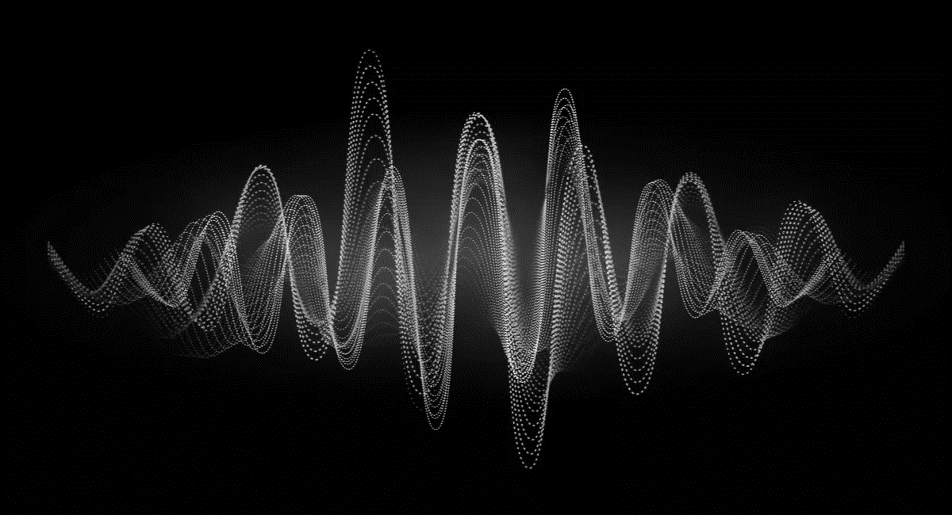
KS4 – Waves (TRILOGY STUDENT BOOKLET B)
Name
Class
Tutor Group
KS4 Science YEAR 11 WAVES
KEYSTONE WORDS
Longitudinal wave | In a longitudinal wave the oscillations are parallel to the direction of energy transfer.
Transverse wave | In a transverse wave the oscillations are perpendicular to the direction of energy transfer.
Refraction | Waves change speed and direction when entering a material with a different density.
Reflection | Reflection of Light occurs when a ray of light approaches a smooth surface and bounces back.

Slide 2
BIG PICTURE
How will my prior knowledge develop my understanding of this topic?
Y7 | You learnt to calculate speed; this will be expanded to include wave speed in this topic. Your knowledge of from the Energy topic will be invaluable waves because waves transfer energy.
Y8 | You studied waves and light. This topic builds on the foundations that you built. You also studied sound waves. How we use sound waves to investigate hidden objects will be studied in this topic.
Learning Journey - Trilogy: Maximum 7 lessons. Triple: Maximum 14 lessons.
Subtopic 1 | 6.6.1.1 Transverse and longitudinal waves 6.6.1.2 Properties of waves | Subtopic 5 | Required practical: Nature of the surface
Subtopic 2 | Required Practical: Waves (ripple tank and wave on a string)
Subtopic 3 | 4.6.2.1 Types of electromagnetic waves 4.6.2.4 Uses and applications of electromagnetic waves
Subtopic 4 | 4.6.2.2 Properties of electromagnetic waves 1 4.6.2.3 Properties of electromagnetic waves 2
Key knowledge
By the end of this topic you should know… | How waves behave in different circumstances and be able to describe how humans use waves to make their lives easier.
By the end of this topic should be able to… | Demonstrate properties of waves such as reflection and refraction.

Slide 3
KEY VOCABULARY LIST
Amplitude | The distance from a peak to the zero position of a wave.
Frequency | The number of complete waves that pass a point in a given time.
Time period | Time taken for one complete wave to pass.
Ray diagram | A ray diagram is a representation of the possible paths light can take to get from one place to another.
Normal line | A line drawn perpendicular to a surface.
Incident ray. | A ray of light that falls on any surface.
Reflected ray. | A ray of light that is reflected from a surface.
EXPECTATIONS
Always write in black or blue pen. Always use a ruler for straight lines. If you make a mistake, cross it out with a single line. Always draw diagrams, tables and graphs in pencil with a ruler if necessary Always mark and correct your work in green pen. Respond to any feedback your teacher gives you in green pen. Take pride in your work, make it neat! All tasks should be completed in silence and by yourself unless your teacher tells you otherwise.
PROUD
Punctuation and grammar
Ruler and pencil for diagrams
Outstanding effort every lesson
Underline date and title
Dates and titles every lesson
PROUD FRIDAY
Any piece of work you complete, which meets our PROUD expectations can be taken to the PROUD station during Friday lunchtime. Show your work to a member of SLT and receive a sweet treat!

Slide 4
Subtopic 4: Properties of electromagnetic waves
Learning Objective
To understand the different effects a material may have on a wave.
To understand the effects that electromagnetic waves can have on the human body.
Why are we learning about this?
This lessons helps us understand why certain electromagnetic waves are used for specific purposes. It also helps us to understand why different things can occur when a wave meets a material.

Slide 5
1 2 3 4 5 6 7 8 9 10 11 12 13 14 15 16 17 18 19 20 21 22 23 24 25 26 27 28 29 30 | Transmission and absorption Waves arriving at the interface (boundary) between two materials can be reflected, refracted, transmitted or absorbed. Absorption occurs when most of the energy being transferred by a wave is transferred to the material the wave is hitting. Transmission occurs when most of the energy being transferred by a wave is retained as the wave passes through the material it hits. The type of wave, its properties such as wavelength, and the difference between the two media will determine what happens to most of the wave energy. Common examples of absorption of wave energy: waves hitting the beach usually give most of their energy to the sand sunlight landing on a face is mostly absorbed, warming the skin sound waves hitting thick curtains give up their energy and the sound is muffled Common examples of transmission of wave energy: sea waves passing a shallow area continue with their energy mostly unchanged light passing through a glass window continues with over 95% of its energy ultrasound waves scanning a baby pass from flesh into bone and continue with enough energy for the machine to detect the echo Effect of wavelength on absorption Wavelength has a big effect on how much of a wave's energy is reflected, absorbed or transmitted at an interface. For example, a greenhouse uses these differences to raise the temperature inside. Ultraviolet light has a very short wavelength, and this is mostly transmitted by the glass. The plants, soil and floor in the greenhouse mostly absorb ultraviolet, and their temperature rises. The plants, soil and floor emit infrared light which has a longer wavelength that is mostly reflected by glass. The infrared cannot escape the greenhouse and reflects until it is re-absorbed by objects inside the greenhouse. The amount of energy in the greenhouse rises so its temperature increases.

Slide 6
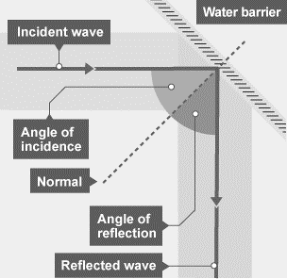
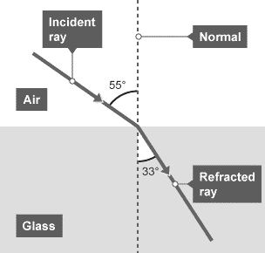
1 2 3 4 5 6 7 8 9 10 11 12 13 14 15 16 17 18 19 20 21 22 23 24 25 26 27 28 29 30 | Reflection of waves Waves - including sound and light waves - can be reflected at the boundary between two different materials. The reflection of sound causes echoes. The law of reflection states that: angle of incidence = angle of reflection For example, if a light ray hits a surface at 32°, it will be reflected at 32°. Refraction of waves Waves transmitted at the interface (boundary) between two materials may change direction. Refraction is the change in direction of a wave at such a boundary. All wave types can be refracted. It is important to be able to draw ray diagrams to show the refraction of a wave at a boundary.

Slide 7
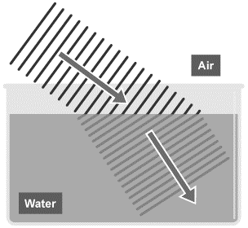
1 2 3 4 5 6 7 8 9 10 11 12 13 14 15 16 17 18 19 20 21 22 23 24 25 26 27 28 29 30 | Explaining refraction - HT The density of a material is one of the factors that affects the speed that a wave will be transmitted through it. Key fact A useful way of remembering the speed and direction changes of waves during refraction is 'FAST': Faster - Away / Slower - Towards Wave speed, frequency and wavelength in refraction For a given frequency of light, the wavelength is proportional to the wave speed: wave speed = frequency × wavelength So if a wave slows down, its wavelength will decrease. The effect of this can be shown using wave front diagrams, like the one below. The diagram shows that as a wave travels across a depth boundary it slows down and the wavelength decreases. Although the wave slows down, its frequency remains the same, due to the fact that its wavelength is shorter.

Slide 8
Rehearsal questions
What is the law of reflection? ................................................................................................................. .................................................................................................................................................................
When a wave crosses a boundary between two different mediums, it is refracted. What happens to the wave when it is refracted? ................................................................................................................ .................................................................................................................................................................
What happens to the energy of a wave when it is absorbed by a material? ......................................... .................................................................................................................................................................
What happens to the energy of a wave when it is transmitted? ........................................................... .................................................................................................................................................................
When a wave is refracted, what happens to its speed and direction? ................................................... .................................................................................................................................................................
Waves hitting a beach is an example of absorption. What does this tell you about the energy of the wave? ...................................................................................................................................................... .................................................................................................................................................................
How is the angle of incidence related to the angle of reflection? ......................................................... .................................................................................................................................................................
Light is transmitted through transparent materials, such as glass. What does this mean? ................... .................................................................................................................................................................
When a wave arrives at the interface between two different materials, most of its energy is transferred to the material it hits. What is this an example of? .............................................................
If light hits a mirror at an angle of 42º, what angle will it reflect at? How do you know? ..................... .................................................................................................................................................................
When light passes through material with a different density than the air, it changes speed and direction. What is this an example of? ...................................................................................................
If most of the energy transferred by a wave is retained as it crosses a boundary between two different materials, what do we say has happened to it? ......................................................................

Slide 9
Contrasting concepts
I DO: Compare the angle of incidence to the angle of reflection, when a wave is reflected.
.....................................................................................................................................................................................................................................................................................................................................................................................................................................................................................................................
WE DO: Compare what happens to the energy of a wave during absorption and transmission.
.....................................................................................................................................................................................................................................................................................................................................................................................................................................................................................................................
YOU DO: Compare what happens to a wave during reflection and refraction.
.....................................................................................................................................................................................................................................................................................................................................................................................................................................................................................................................
YOU DO: Compare the direction change during refraction when a wave speeds up to when a wave slows down.
.....................................................................................................................................................................................................................................................................................................................................................................................................................................................................................................................
YOU DO: Compare the frequency, wavelength, and speed of a wave in air to when it passes through a more dense medium.
.....................................................................................................................................................................................................................................................................................................................................................................................................................................................................................................................
YOU DO: Compare what happens to waves with short wavelengths to those with long wavelengths when they hit the glass walls of a greenhouse.
.....................................................................................................................................................................................................................................................................................................................................................................................................................................................................................................................

Slide 10
Wrong answers
I DO: “When a wave is refracted, it always slows down”. Explain why this statement is incorrect.
.....................................................................................................................................................................................................................................................................................................................................................................................................................................................................................................................
WE DO: “When a wave is reflected, it reflects at the same angle, meaning it only reflects in one direction”. Explain why this statement is incorrect.
.....................................................................................................................................................................................................................................................................................................................................................................................................................................................................................................................
YOU DO: “When a wave is absorbed, all of the energy is transferred to the material”. Explain why this statement is incorrect.
.....................................................................................................................................................................................................................................................................................................................................................................................................................................................................................................................
YOU DO: “When a wave is transmitted, all of the energy passes through and is retained by the wave”. Explain why this statement is incorrect.
.....................................................................................................................................................................................................................................................................................................................................................................................................................................................................................................................
YOU DO: “When a wave is refracted through a more dense medium, its frequency changes, as the waves are closer together”. Explain why this statement is incorrect.
.....................................................................................................................................................................................................................................................................................................................................................................................................................................................................................................................
YOU DO: “Because a greenhouse is made of glass, all waves can pass through easily”. Explain why this statement is incorrect. .....................................................................................................................................................................................................................................................................................................................................................................................................................................................................................................................

Slide 11
1 2 3 4 5 6 7 8 9 10 11 12 13 14 15 16 17 18 19 20 21 22 23 24 25 26 27 28 29 30 | Changes in atoms, and the nuclei of atoms, can result in electromagnetic waves being generated or absorbed over a wide range of frequencies. Gamma rays, for example, originate from changes in the nuclei of atoms. Radio waves Radio waves are used for communication such as broadcasting television and radio, communications and satellite transmissions. Radio waves can be produced by oscillations (back and forth movement) in electrical circuits. When radio waves are absorbed by a conductor, they create an alternating current. This electrical current has the same frequency as the radio waves. Information is coded into the wave before transmission, which can then be decoded when the wave is received. Television and radio systems use this principle to broadcast information. Hazardous radiation Electromagnetic waves increase in energy as the frequency increases (and wavelength decreases). This increases their potential for having hazardous effects on human body tissues. These effects vary depending on the type of electromagnetic wave, as well as the size of the dose. Radiation dose (in sieverts) is a measure of the risk of harm resulting from an exposure of the body to the radiation. ultraviolet waves can damage skin cells and lead to skin cancer and damage the eyes, it can cause skin to age prematurely; X-rays damage cells inside the body. They cause dangerous ionisation and when this happens with molecules in living cells, the genetic material of a cell, the DNA is damaged. This can lead to cancer. This is why doctors and dentists stand behind protective screens when taking lots of X-rays; gamma rays also damage cells inside the body causing dangerous ionisation in living cells which damages DNA. This can lead to cell death and cancer.

Slide 12
Rehearsal questions
Changes within the nuclei of atoms release which type of electromagnetic wave? .............................
How can radio waves be produced? ....................................................................................................... .................................................................................................................................................................
What effects can ultraviolet (UV) radiation have on the body? ............................................................. .................................................................................................................................................................
X-rays and gamma rays both cause dangerous ionisation within cells. What does this mean? ............ .................................................................................................................................................................
Oscillations within an electrical current produce which type of waves? ...............................................
Which type of electromagnetic radiation causes the skin to age prematurely? ....................................
How can gamma rays be produced? ....................................................................................................... .................................................................................................................................................................
DNA within the nuclei of cells can be damaged by radiation. What is this process called? .................................................................................................................................................................
Which types of radiation can cause ionisation within body cells, and what happens as a result of this? ......................................................................................................................................................... .................................................................................................................................................................
Radio waves can be produced by the oscillations in electrical current. How can these radio waves then effect the electrical current of a conductor? .................................................................................. .................................................................................................................................................................
Which type of electromagnetic radiation is likely to lead to skin cancer? .............................................
Gamma rays are produced by changes within which part of an atom? .................................................

Slide 13
Wrong answers
I DO: “Changes to the electrons of an atom release gamma rays” Explain why this statement is incorrect. .....................................................................................................................................................................................................................................................................................................................................................................................................................................................................................................................
WE DO: “Waves with longer wavelengths also have more energy”. Explain why this statement is incorrect. .....................................................................................................................................................................................................................................................................................................................................................................................................................................................................................................................
YOU DO: “Radio waves produce a direct current when absorbed by a conductor”. Explain why this statement is incorrect. .....................................................................................................................................................................................................................................................................................................................................................................................................................................................................................................................
YOU DO: “X-rays and gamma rays damage the mitochondria in cells, preventing respiration and causing cell death”. Explain why this statement is incorrect. .....................................................................................................................................................................................................................................................................................................................................................................................................................................................................................................................
YOU DO: “Ultraviolet waves always cause skin cancer”. Explain why this statement is incorrect. .....................................................................................................................................................................................................................................................................................................................................................................................................................................................................................................................
YOU DO: “Ionisation leads to cancer because the DNA is destroyed”. Explain why this statement is incorrect. .....................................................................................................................................................................................................................................................................................................................................................................................................................................................................................................................

Slide 14
Interleaving questions – YOU DO
We are currently learning about how materials affect waves, and how electromagnetic waves can affect the human body. This links in to the following key topics: Energy, cells and organisation, particles, forces.
The following questions will link our current topic with these previous topics:
Refraction occurs when a wave passes into a medium that is more/less dense than air. Define density, and state its units. ..................................................................................................................................................................................................................................................................................................................................
Solids and liquids are more dense mediums than gases. Draw particle diagrams for a solid and a liquid to show this.
We use the equation “wave speed = frequency x wavelength” to calculate the speed of a wave. What equation would we use to calculate the speed of other objects? ..................................................................................................................................................................................................................................................................................................................................
Using the equation in question 4, calculate the speed of a car that travels 5 km in 10 minutes. Give your answer to 1 d.p. ...................................................................................................................................................................................................................................................................................................................................................................................................................................................................................................
In a greenhouse, ultraviolet waves from the Sun are absorbed by the soil, plants, and floor, increasing their temperature. Which energy store is being filled when this happens? .................................................................................................................................................................
Solid
Liquid

Slide 15
Interleaving questions continued – YOU DO
Electromagnetic radiation can affect cells in the human body. What is a cell? ..................................................................................................................................................................................................................................................................................................................................
The DNA, which can be damaged by radiation, is found in the nucleus (an organelle). Other organelles include the mitochondria and the cell membrane. What are the functions of these organelles?
Mitochondria: ............................................................................................................................. .....................................................................................................................................................
Cell membrane: ........................................................................................................................... .....................................................................................................................................................
Damage to the DNA within the nucleus of a cell can lead to cancer. What is cancer? ..................................................................................................................................................................................................................................................................................................................................
A tumour can be one of two types: Malignant and Benign. Compare these two types of tumour. ...................................................................................................................................................................................................................................................................................................................................................................................................................................................................................................
Cancer is an example of a non-communicable disease. Define non-communicable disease. ..................................................................................................................................................................................................................................................................................................................................
Why do we NOT say that risk factors cause diseases? ........................................................................... ..................................................................................................................................................................................................................................................................................................................................

Slide 16
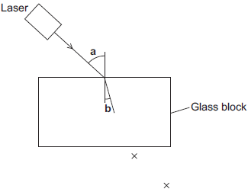
Exam questions – YOU DO – Tier 1
Q1. A student used a laser to investigate the change of direction of light as it entered a glass block.
The apparatus is shown in Figure 1.
The path of a ray of light as it enters the glass block is shown.
Figure 1
(a) The student marked crosses to show the path of the ray of light that left the glass block.
Use a ruler to help you to draw the path of the ray of light through and out of the glass block.
(2)
(b) Light from lasers can damage your eyes.
Suggest one safety precaution that the student should have taken during his investigation.
......................................................................................................................................................................................................................................................................................................................
(1)

Slide 17
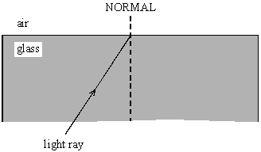
Q2. The diagram shows a ray of light travelling through a glass block.
(a) Complete the diagram to show what happens to the ray of light when it comes out of the glass.
(2)
(b) Explain why this happens to the ray of light. ......................................................................................................................................................................................................................................................................................................................
(2)

Slide 18
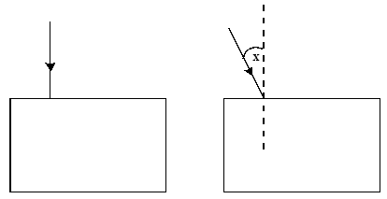
Exam questions – YOU DO – Tier 2
Q1. Explain fully why pregnant women should not normally have X-rays of the lower body.
.......................................................................................................................................................................................................................................................................................................................................................................................................................................................................................................................................................................................................................................................................................................................................................................................................
(Total 4 marks)
Q2.
The diagrams show rays of light. Each ray strikes a surface of a glass block.
On the diagram draw the path of each ray through the glass block and out into the air again.
Label another angle on the diagram which is equal to the angle marked X. Label this angle Y.
(4)

Slide 19
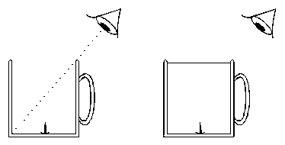
(b) The diagrams show two beakers. Both beakers have a drawing pin inside as shown.
The first beaker is empty. The eye cannot see the drawing pin. The second beaker is full of water and the eye can see the drawing pin.
Explain how the eye is able to see the drawing pin in the second beaker. You may add to the diagram if it helps your answer.
............................................................................................................................................................................................................................................................................................................................................................................................................................................................................................................................................................................................................................................................................................
(3)

Slide 20
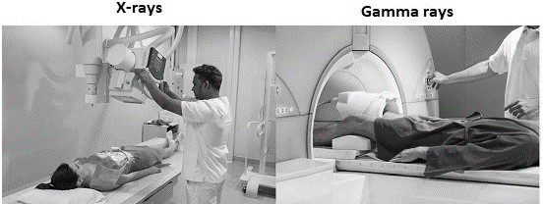
Exam questions – YOU DO – Tier 3
Q1. Figure 2 shows X-rays and gamma rays being used for medical imaging.
To use X-rays for medical imaging, a machine produces a very brief burst of X-rays. To use gamma rays for medical imaging, a radioactive isotope is injected into the patient’s blood. The isotope is circulated around the body in the blood. The isotope emits gamma rays.
Compare the potential risks to a patient of using X-rays and gamma rays for medical imaging.
.............................................................................................................................................................................................................................................................................................................................................................................................................................................................................................................................................................................................................................................................................................................................................................................................................................................................................................................................................................................................................................................................................................................................................................................................................................................................................................................................................................................................................................................................................................................................................................................................................................................................................................................................................................................................................................................................................................................
(4)
Figure 2

Slide 21
Exam questions – YOU DO – Tier 3
Q2. X-rays form part of the electromagnetic spectrum. Radiographers use X-rays to produce images of bones inside the body.
Explain why X-rays can be used to produce images of the bones inside the body.
.....................................................................................................................................................................................................................................................................................................................................................................................................................................................................................................................
(2)
The table below shows the effect of exposure to different doses of radiation.
During an X-ray a person receives a dose of 0.5 mSv. The radiographer takes many X-ray images each day.
Explain why the radiographer stands behind a protective screen when taking an X-ray image.
..........................................................................................................................................................................................................................................................................................................................................................................................................................................................................................................................................................................................................................................................................................................................................................................................................................................................................................................................................................................................................................................
(3)
Dose in mSv | Effect on the human body
100 | slightly increased risk of cancer
1000 | 5% increased risk of cancer
5000 | high risk of death

Slide 22
Exam questions – YOU DO – Tier 3
Radio waves form part of the electromagnetic spectrum. The diagram below shows one use of radio waves.
Explain how electrical signals in the transmitter produce a signal in the receiver.
..........................................................................................................................................................................................................................................................................................................................................................................................................................................................................................................................................................................................................................................................................................................................................................................................................................................................................................................................................................................................................................................
(3)
(Total 8 marks)

Slide 23
Subtopic 5: Required Practical – Radiation and absorption
Learning Objective
Carry out an investigation to compare the amount of infrared radiation radiated from different surfaces
Why are we learning about this?
Investigations are at the heart of science. Without experiments and investigations many scientific phenomena would not have been discovered or accepted. Current theories would also go unchallenged even if they contain errors.
In this investigation you will investigate the radiation of infrared radiation from different surface types.

Slide 24
AQA Content

Slide 25
I wasn’t there but I still care!
Use pages 190 – 191 & 196 – 197 0f the GCSE Physics textbook.
Name the 7 electromagnetic waves
………………………………………………………………………………………………………………………………………………………………………………………………………………………………………………………………………………………………………………………………………………………………………………………………………………………………………………………………………………
What 3 things can electromagnetic waves do?
………………………………………………………………………………………………………………………………………………………………………………………………………………………………………………………………………………………………………………………………………………………………………………………………………………………………………………………………………………
Name the 3 types of ionising radiation
………………………………………………………………………………………………………………………………………………………………………………………………………………………………………………………………………………………………………………………………………………………………………………………………………………………………………………………………………………
What is the unit for radiation dose?
………………………………………………………………………………………………………………………………………………………………………………………………………………………………………………………………………………………………………………………………………………………………………………………………………………………………………………………………………………

Slide 26
1 2 3 4 5 6 7 8 9 10 11 12 13 14 15 16 17 18 19 20 21 22 23 24 25 26 27 28 29 30 | In this investigation you will compare the amount of infrared radiation that is radiated by different surfaces. You will then evaluate the data that you obtain. The method for the basic experiment is given below. You will use an infrared detector to measure the infrared radiation radiated from each surface. Basic method: 1. Put the Leslie cube onto the heat-proof mat. 2. Fill the cube with very hot water and put the lid on the cube. Your apparatus should look like this: 3. Use the detector to measure the amount of infrared radiated from each surface. Make sure that the detector is the same distance from each surface.

Slide 27
Results table:
Plot an appropriate chart of your data

Slide 28
Analysis:
Questions to consider:
Why is it important that the detector is held the same distance from each side of the cube?
……………………………………………………………………………………………………………………………………………………………………………………………………………………………………………………………………………………………………………………………………………………………………………………………………………………………………………………………………………………………………………………………………………………
Why is it appropriate to use the readings to draw a bar chart and not a line graph?
……………………………………………………………………………………………………………………………………………………………………………………………………………………………………………………………………………………………………………………………………………………………………………………………………………………………………………………………………………………………………………………………………………………
Rank the surfaces from highest to lowest radiation by type of surface
1. …………………………………………...........
2. …………………………………………...........
3. …………………………………………...........
4. …………………………………………...........

Slide 29
The nature of the surface:
Your results should indicate that dark, matt surfaces are good absorbers and emitters of infrared radiation, making them warm up quickly when exposed to heat. On the other hand, light, shiny surfaces are poor absorbers and good reflectors of infrared radiation, so they heat up more slowly.
Exam questions:

Slide 36
DO NOW
Date: ……………………………………….
 | ANSWER
Q1.
Q2.
Q3.
Q4.
Q5.
Date: ……………………………………….
 | ANSWER
Q1.
Q2.
Q3.
Q4.
Q5.

Slide 37
DO NOW
Date: ……………………………………….
 | ANSWER
Q1.
Q2.
Q3.
Q4.
Q5.
Date: ……………………………………….
 | ANSWER
Q1.
Q2.
Q3.
Q4.
Q5.

Slide 38
Knowledge Retrieval Quiz 2
Date: ……………………………………….
Score: …………...
 |  | Answer
Q1. | Insert question in bold
Q2.
Q3.
Q4.
Q5.
Q6.
Q7.
Q8.
Q9.
Q10.

Slide 39
Knowledge Retrieval Quiz 3
Date: ……………………………………….
Score: …………...
 |  | Answer
Q1. | Insert question in bold
Q2.
Q3.
Q4.
Q5.
Q6.
Q7.
Q8.
Q9.
Q10.

Slide 40
Extra Space
……………………………………………………………………………………………………………………………………………………………………………………………………………………………………………………………………………………………………………………………………………………………………………………………………………………………………………………………………………………………………………………………………………………………………………………………………………………………………………………………………………………………………………………………………………………………………………………………………………………………………………………………………………………………………………………………………………………………………………………………………………………………………………………………………………………………………………………………………………………………………………………………………………………………………………………………………………………………………………………………………………………………………………………………………………………………………………………………………………………………………………………………………………………………………………………………………………………………………………………………………………………………………………………………………………………………………………………………………………………………………………………………………………………………………………………………..
…………………………………………………………………………………………………………………………………………………………………………………………………………………………………………………………………………………………………………………………………………………………………………………………………………………………………………………………………………………………………………………………………………………………………………………………………………………………………………………………………………………………………………………………………………………………………………………………………………………………………………………………………………………………………………………………………………………………………………………………………………………………………………………………………………………………………………………………………………………………………………………………………………………………………………………………………………………………………………………………………………………………………………………………………………………………………………………………………………………………………………………………………………………………………………………………………………………………………………………………………………………………………………………………………………………………………..
…………………………………………………………………………………………………………………………………………………………………………………………………………………………………………………………………………………………………………………………………………………………………………………………………………………………………………………………………………………………………………………………………………………………………………………………………………………………………………………………………………………………………………………………………………………………………………………………………

Slide 41
Extra Space
……………………………………………………………………………………………………………………………………………………………………………………………………………………………………………………………………………………………………………………………………………………………………………………………………………………………………………………………………………………………………………………………………………………………………………………………………………………………………………………………………………………………………………………………………………………………………………………………………………………………………………………………………………………………………………………………………………………………………………………………………………………………………………………………………………………………………………………………………………………………………………………………………………………………………………………………………………………………………………………………………………………………………………………………………………………………………………………………………………………………………………………………………………………………………………………………………………………………………………………………………………………………………………………………………………………………………………………………………………………………………………………………………………………………………………………………..
…………………………………………………………………………………………………………………………………………………………………………………………………………………………………………………………………………………………………………………………………………………………………………………………………………………………………………………………………………………………………………………………………………………………………………………………………………………………………………………………………………………………………………………………………………………………………………………………………………………………………………………………………………………………………………………………………………………………………………………………………………………………………………………………………………………………………………………………………………………………………………………………………………………………………………………………………………………………………………………………………………………………………………………………………………………………………………………………………………………………………………………………………………………………………………………………………………………………………………………………………………………………………………………………………………………………………..
…………………………………………………………………………………………………………………………………………………………………………………………………………………………………………………………………………………………………………………………………………………………………………………………………………………………………………………………………………………………………………………………………………………………………………………………………………………………………………………………………………………………………………………………………………………………………………………………………

Slide 42
Extra Space
……………………………………………………………………………………………………………………………………………………………………………………………………………………………………………………………………………………………………………………………………………………………………………………………………………………………………………………………………………………………………………………………………………………………………………………………………………………………………………………………………………………………………………………………………………………………………………………………………………………………………………………………………………………………………………………………………………………………………………………………………………………………………………………………………………………………………………………………………………………………………………………………………………………………………………………………………………………………………………………………………………………………………………………………………………………………………………………………………………………………………………………………………………………………………………………………………………………………………………………………………………………………………………………………………………………………………………………………………………………………………………………………………………………………………………………………..
…………………………………………………………………………………………………………………………………………………………………………………………………………………………………………………………………………………………………………………………………………………………………………………………………………………………………………………………………………………………………………………………………………………………………………………………………………………………………………………………………………………………………………………………………………………………………………………………………………………………………………………………………………………………………………………………………………………………………………………………………………………………………………………………………………………………………………………………………………………………………………………………………………………………………………………………………………………………………………………………………………………………………………………………………………………………………………………………………………………………………………………………………………………………………………………………………………………………………………………………………………………………………………………………………………………………………..
…………………………………………………………………………………………………………………………………………………………………………………………………………………………………………………………………………………………………………………………………………………………………………………………………………………………………………………………………………………………………………………………………………………………………………………………………………………………………………………………………………………………………………………………………………………………………………………………………

Slide 43
Extra Space
……………………………………………………………………………………………………………………………………………………………………………………………………………………………………………………………………………………………………………………………………………………………………………………………………………………………………………………………………………………………………………………………………………………………………………………………………………………………………………………………………………………………………………………………………………………………………………………………………………………………………………………………………………………………………………………………………………………………………………………………………………………………………………………………………………………………………………………………………………………………………………………………………………………………………………………………………………………………………………………………………………………………………………………………………………………………………………………………………………………………………………………………………………………………………………………………………………………………………………………………………………………………………………………………………………………………………………………………………………………………………………………………………………………………………………………………..
…………………………………………………………………………………………………………………………………………………………………………………………………………………………………………………………………………………………………………………………………………………………………………………………………………………………………………………………………………………………………………………………………………………………………………………………………………………………………………………………………………………………………………………………………………………………………………………………………………………………………………………………………………………………………………………………………………………………………………………………………………………………………………………………………………………………………………………………………………………………………………………………………………………………………………………………………………………………………………………………………………………………………………………………………………………………………………………………………………………………………………………………………………………………………………………………………………………………………………………………………………………………………………………………………………………………………..
…………………………………………………………………………………………………………………………………………………………………………………………………………………………………………………………………………………………………………………………………………………………………………………………………………………………………………………………………………………………………………………………………………………………………………………………………………………………………………………………………………………………………………………………………………………………………………………………………

Slide 44
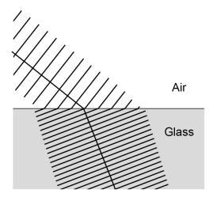
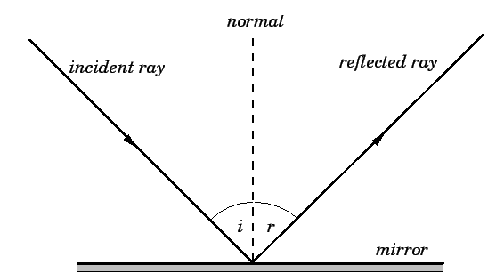
KNOWLEDGE ORGANISER
Subject: Science | Topic: Waves | Term: Autumn
KEY WORDS | Key words
1 | Amplitude | The distance from a peak to the zero position of a wave.
2 | Frequency | The number of complete waves that pass a point in a given time.
3 | Time period | Time taken for one complete wave to pass.
4 | Ray diagram | A ray diagram is a representation of the possible paths light can take to get from one place to another.
5 | Normal line | A line drawn perpendicular to a surface.
6 | Incident ray. | A ray of light that falls on any surface.
7 | Reflected ray. | A ray of light that is reflected from a surface.
KEY EXAMPLES
8 | Reflection from mirrors.
9 | Refraction of light and sound by water.
10 | Uses of waves to investigate the structure of the Earth.
11 | Th wide range of uses for electromagnetic waves.
KEY DIAGRAMS
Wave front diagram showing refraction The Law of Reflection

