Slide 1
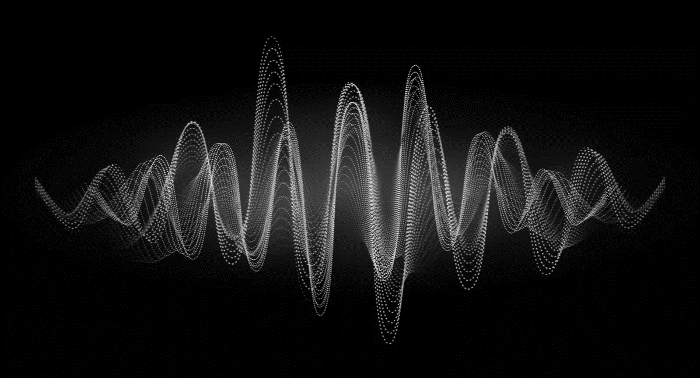
KS4 – Waves (TRIPLE STUDENT BOOKLET A)
Name
Class
Tutor Group
KS4 Science YEAR 11 WAVES
KEYSTONE WORDS
Longitudinal wave | In a longitudinal wave the oscillations are parallel to the direction of energy transfer.
Transverse wave | In a transverse wave the oscillations are perpendicular to the direction of energy transfer.
Refraction | Waves change speed and direction when entering a material with a different density.
Reflection | Reflection of Light occurs when a ray of light approaches a smooth surface and bounces back.

Slide 2
BIG PICTURE
How will my prior knowledge develop my understanding of this topic?
Y7 | You learnt to calculate speed; this will be expanded to include wave speed in this topic. Your knowledge of from the Energy topic will be invaluable waves because waves transfer energy.
Y8 | You studied waves and light. This topic builds on the foundations that you built. You also studied sound waves. How we use sound waves to investigate hidden objects will be studied in this topic.
Learning Journey - Trilogy: Maximum 7 lessons. Triple: Maximum 14 lessons.
Subtopic 1 | Physics only: Required practical – reflection and refraction. | Subtopic 5 | Physics only: 4.6.2.6 Visible light.
Subtopic 2 | Physics only: 4.6.2.5 Lenses.
Subtopic 3 | Physics only (HT only): 4.6.1.5 Waves for detection and exploration.
Subtopic 4 | Physics only: 4.6.3.1 Emission and absorption of infrared radiation 4.6.3.2 Perfect black bodies and radiation.
Key knowledge
By the end of this topic you should know… | How waves behave in different circumstances and be able to describe how humans use waves to make their lives easier.
By the end of this topic should be able to… | Demonstrate properties of waves such as reflection and refraction.

Slide 3
KEY VOCABULARY LIST
Amplitude | The distance from a peak to the zero position of a wave.
Frequency | The number of complete waves that pass a point in a given time.
Time period | Time taken for one complete wave to pass.
Ray diagram | A ray diagram is a representation of the possible paths light can take to get from one place to another.
Normal line | A line drawn perpendicular to a surface.
Incident ray. | A ray of light that falls on any surface.
Reflected ray. | A ray of light that is reflected from a surface.
EXPECTATIONS
Always write in black or blue pen. Always use a ruler for straight lines. If you make a mistake, cross it out with a single line. Always draw diagrams, tables and graphs in pencil with a ruler if necessary Always mark and correct your work in green pen. Respond to any feedback your teacher gives you in green pen. Take pride in your work, make it neat! All tasks should be completed in silence and by yourself unless your teacher tells you otherwise.
PROUD
Punctuation and grammar
Ruler and pencil for diagrams
Outstanding effort every lesson
Underline date and title
Dates and titles every lesson
PROUD FRIDAY
Any piece of work you complete, which meets our PROUD expectations can be taken to the PROUD station during Friday lunchtime. Show your work to a member of SLT and receive a sweet treat!

Slide 4
Subtopic 1: Reflection and refraction.
Learning Objective
We are learning to draw ray diagrams that show reflection and refraction of light from different surfaces.
Why are we learning about this?
Being able to detect and respond to light is key to the survival of most eukaryotic species.
For example, animals have specialized organs that contain receptors that detect light. For example, humans have eyes. The eyes increase the probability of survival because they enable animals to, for example, detect predators and to find food.
The human eye has evolved into a complex organ that focuses (as known as accommodation) light onto light receptors. The light rays are focused by the cornea and the lens using refraction. The lens can even change shape; this changes the extent to which the light rays are refracted and so enables us to focus on objects that are different distances away from us.
Reflection and refraction is also used extensively in technology. For example, the Hubble telescope used a giant mirror to focus light using reflection. More traditional telescopes contain lenses that refract light. Similarly, light microscopes contain lenses that can focus on minute objects by refracting light.
Reflection and refraction are therefore essential to our survival whilst also enabling us to explore microscopic and massive objects.

Slide 5
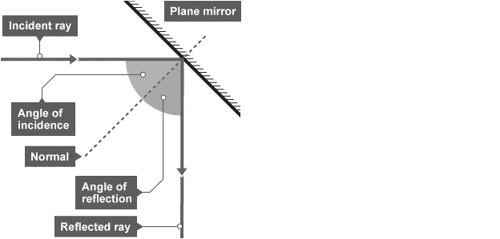
1 2 3 4 5 6 7 8 9 10 11 12 13 14 15 16 17 18 19 20 21 22 23 24 25 26 | Reflection of waves Waves including sound and light - can be reflected at the boundary between two different materials. The reflection of sound causes echoes. The law of reflection states that: angle of incidence = angle of reflection For example, if a light ray hits a surface at 32°, it will be reflected at 32°. The angles of incidence and reflection are measured between the light ray and the normal (an imaginary line at 90° to the surface). The diagrams show a water wave being reflected at a barrier, and a light ray being reflected at a plane mirror. Specular reflection Reflection from a smooth, flat surface is called specular reflection. This is the type of reflection that happens with a flat mirror. The image in a mirror is: upright virtual In a virtual image, the rays appear to diverge from behind the mirror, so the image appears to come from behind the mirror.

Slide 6
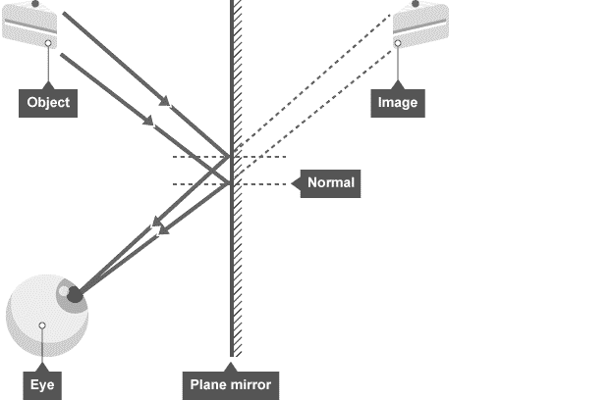
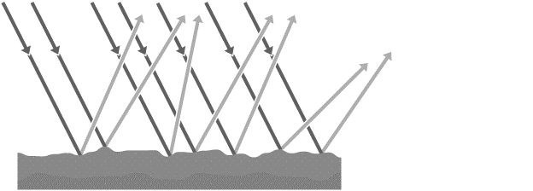
1 2 3 4 5 6 7 8 9 10 11 12 13 14 15 16 17 18 19 20 21 22 23 24 25 26 27 28 | A ray diagram showing how an image forms in a plane mirror. Diffuse reflection If a surface is rough, diffuse reflection happens. Instead of forming an image, the reflected light is scattered in all directions. This may cause a distorted image of the object, as occurs with rippling water, or no image at all. Each individual reflection still obeys the law of reflection, but the different parts of the rough surface are at different angles. Diffuse reflection or scattering from a rough surface.

Slide 7
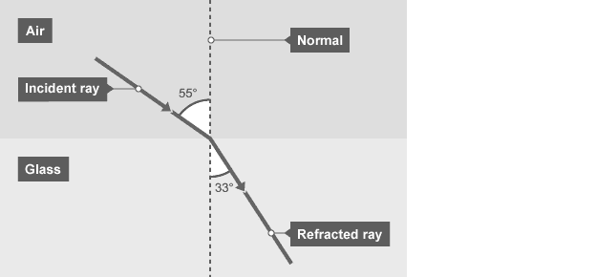
1 2 3 4 5 6 7 8 9 10 11 12 13 14 15 16 17 | Refraction of waves Different materials have different densities. Light waves may change direction at the boundary between two transparent materials. Refraction is the change in direction of a wave at such a boundary. It is important to be able to draw ray diagrams to show the refraction of a wave at a boundary. A ray diagram showing refraction at the boundary between air and glass.

Slide 8
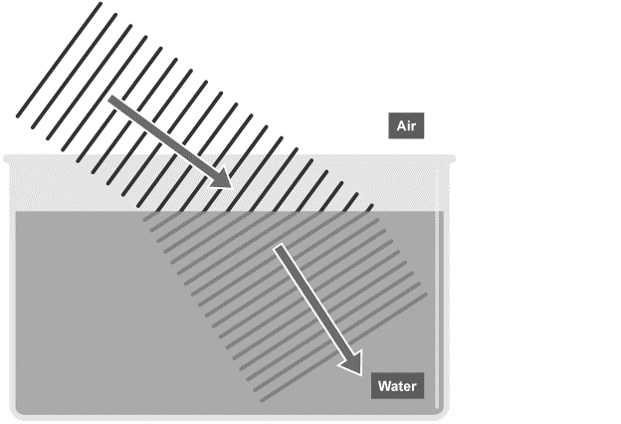
1 2 3 4 5 6 7 8 9 10 11 12 13 14 15 16 17 18 19 20 21 22 23 24 25 26 27 28 29 30 | Explaining refraction – Higher The density of a material affects the speed that a wave will be transmitted through it. In general, the denser the transparent material, the more slowly light travels through it. Glass is denser than air, so a light ray passing from air into glass slows down. If the ray meets the boundary at an angle to the normal, it bends towards the normal. The reverse is also true. A light ray speeds up as it passes from glass into air, and bends away from the normal by the same angle. Wave speed, frequency and wavelength in refraction For a given frequency of light, the wavelength is proportional to the wave speed: wave speed = frequency × wavelength So if a wave slows down, its wavelength will decrease. The effect of this can be shown using wave front diagrams like the one below. The diagram shows that as a wave travels into a denser medium, such as water, it slows down and the wavelength decreases. Although the wave slows down, its frequency remains the same, due to the fact that its wavelength is shorter. In this diagram, the right hand side of the incoming wave slows down before the left hand side does. This causes the wave to change direction.

Slide 9
Rehearsal questions
Light rays can ‘bounce’ off some surfaces. Is this refraction, reflection or diffraction?
………………………………………………………………………………………………………………………………………………………….
2. Which law states that angle of incidence equals the angle of reflection?
………………………………………………………………………………………………………………………………………………………….3. Light rays can change direction when they enter a medium with a different density. Is this refraction, reflection or diffraction?
………………………………………………………………………………………………………………………………………………………….4. Name the line that is at a right angle to the surface. ………………………………………………………………………………………………………………………………………………………….
5. Which type of reflection occurs at a smooth and flat surface?
………………………………………………………………………………………………………………………………………………………….
6. Which type of reflection occurs at a rough surface?
………………………………………………………………………………………………………………………………………………………….
7. If the angle of incidence is 65 degrees, what will be the angle of reflection? ………………………………………………………………………………………………………………………………………………………….
8. Light rays change direction when they enter a more dense material. What is the name of this phenomena? ……………………………………………………………………….…………………………………………………………
9. When studying reflection and refraction, we always draw a line at a right angle to the surface. What do we call this line? ………………………………………………………………………………………………………………
Mirrors have a smooth and flat surface. What type of reflection do they use?
………………………………………………………………………………………………………………………………………………………….
Reflection light rays also happens on rough surfaces. Which type of reflection would occur?
………………………………………………………………………………………………………………………………………………………….
Do light rays move towards or away from the Normal when they enter a more dense material?
………………………………………………………………………………………………………………………………………………………….

Slide 10
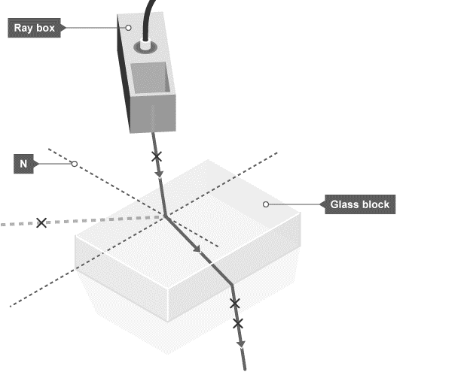
1 2 3 4 5 6 7 8 9 10 11 12 13 14 15 16 17 18 19 20 21 22 23 24 25 26 27 28 | Required Practical – Light Aim of the experiment To investigate the reflection of light by different types of surface, and the refraction of light by different substances. Method Set up a ray box, slit and lens so that a narrow ray of light is produced. Place a 30 centimetre (cm) ruler near the middle of a piece of plain A3 paper. Draw a straight line parallel to its longer sides. Use a protractor to draw a second line at right angles to this line. Label this line with an ‘N’ for ‘normal’. Place the longest side of a rectangular acrylic polymer block against the first line. With the normal near the middle of the block, carefully draw around the block without moving it. Use the ray box to shine a ray of light at the point where the normal meets the block. This is the incident ray.

Slide 11
1 2 3 4 5 6 7 8 9 10 11 12 13 | 5. The angle between the normal and the incident ray is called the angle of incidence. Move the ray box or paper to change the angle of incidence. The aim is to see a clear ray reflected from the surface of the block and another clear ray leaving the opposite face of the block. 6. Using a pencil on the paper, mark the path of the incident ray with a cross the reflected ray with a cross the ray that leaves the block with two crosses - one near the block and the other further away 7. Remove the block. Join the crosses to show the paths of the light rays. 8. Repeat steps 2 to 7 for a rectangular glass block. 9. Measure the angle of incidence, angle of refraction and angle of reflection for each block.

Slide 12
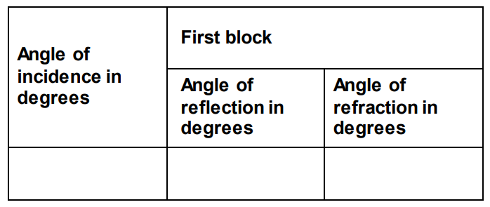
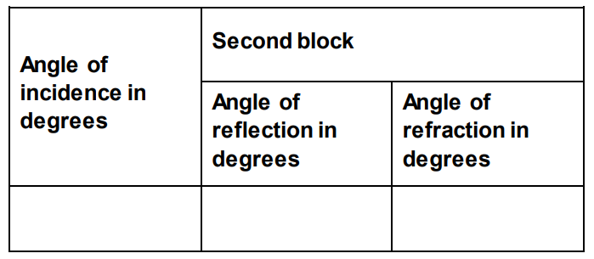
Results.

Slide 13
Conclusion
Physics theory suggests that the angles of incidence and reflection should be the same for a
material, but the angles of refraction for that material should be different.
How well do your results support this theory for the two different materials that you have tested?
…………………………………………………………………………………………………………………………………………………………………………………………………………………………………………………………………………………………………………………………………………………………………………………………………………………………………………………………………………………………………………………………………………………………………………………………………………………………………………………………………………………………………………………………………………………………………………………………………………………………………………………………………………………………………………………………………………………………………………………………………………………………………………………………………………………………………………………………………………………………………………………………………………………………………………………………………………………………………………………………………………………………………………………………………………………………………………………………………………………………………………………………………………………………………………………………………………
Evaluation
Consider the apparatus and method that you used. Are there any improvements that you could
make to improve the accuracy of the angles you measured if you were to repeat this experiment?
……………………………………………………………………………………………………………………………………………………………………………………………………………………………………………………………………………………………………………………………………………………………………………………………………………………………………………………………………………………………………………………………………………………………………………………………………………………………………………………………………………………………………………………………………………………………………………………………………
……………………………………………………………………………………………………………………………………………………………………………………………………………………………………………………………………………………………………………………………………………………………………………………………………………………………………………………………………………………………………………………………………………………………………………………………………………………………………………………………………………………………………………………………………………………………………………………………………

Slide 14
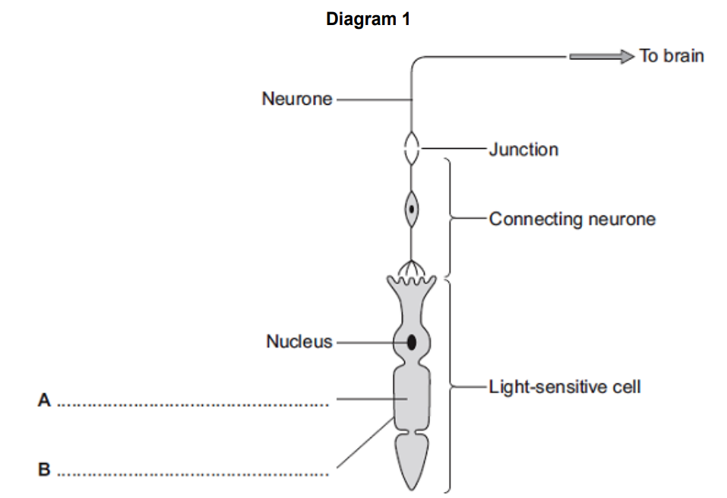
Spaced Retrieval
Most animals can detect changes in light intensity. A large number of them have eyes that enable them to detect changes in the environment and to respond to them. Eyes refract light so the animal can focus on an object. Often the reactions are rapid and automatic; they are reflex actions.
Reflex arcs contain the following parts:
Effector; stimulus; response; coordinator; receptor; sensory neurone; motor neurone; relay neurone; synapse.
Which part is a change in the environment? …………………………………….....................................
Which part includes the brain, spinal cord and pancreas? …………………………………………………….
Which part is made up of cells that detect stimuli?...................................................................
Which part could be a muscle or gland which responds to restore optimum levels?
…………………………………………………………………………………………………………………………………………….
5. Which neurone carries an impulse or message from the receptor to the coordinator?
…………………………………………………………………………………………………………………………………………….
6. Which neurone carries a message from the coordinator to the effector?
…………………………………………………………………………………………………………………………………………….
7. Diagram A shows a light receptor. Receptors are a type of cell.
Label parts A and B.

Slide 15
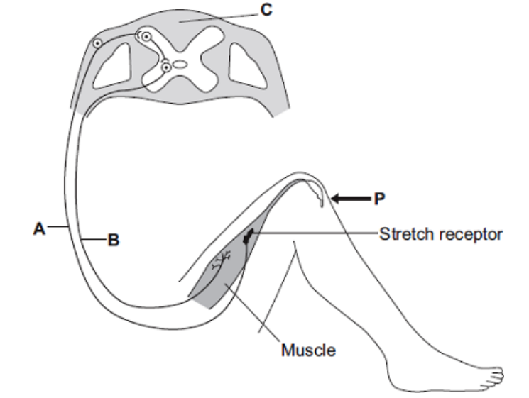
Spaced Retrieval
8. The diagram shows the structures involved in the knee-jerk reflex. When the person is hit at point P, the lower leg is suddenly raised.
Name the structures labelled A, B and C.
A ....................................................................................................................
B ....................................................................................................................
C ....................................................................................................................
Sensory neurone
Spinal cord / coordination centre / coordinator
Motor neurone

Slide 16
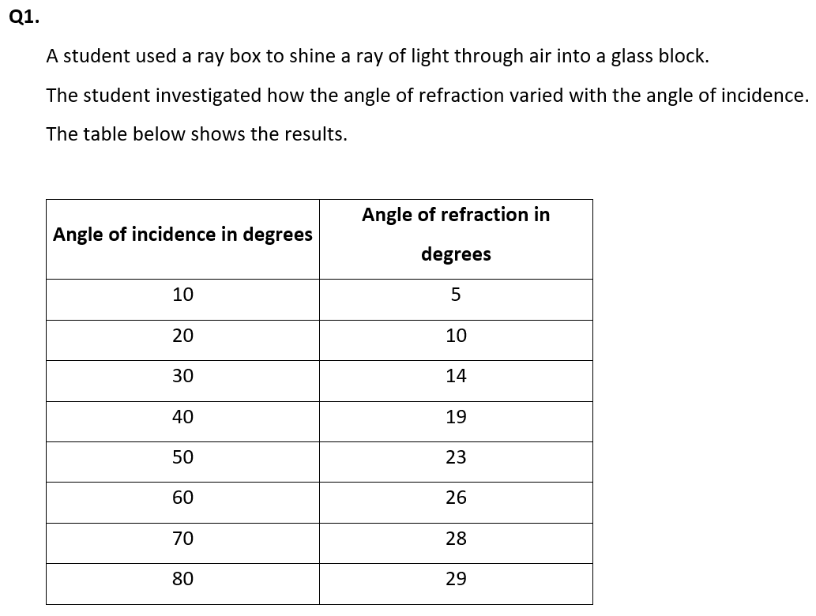
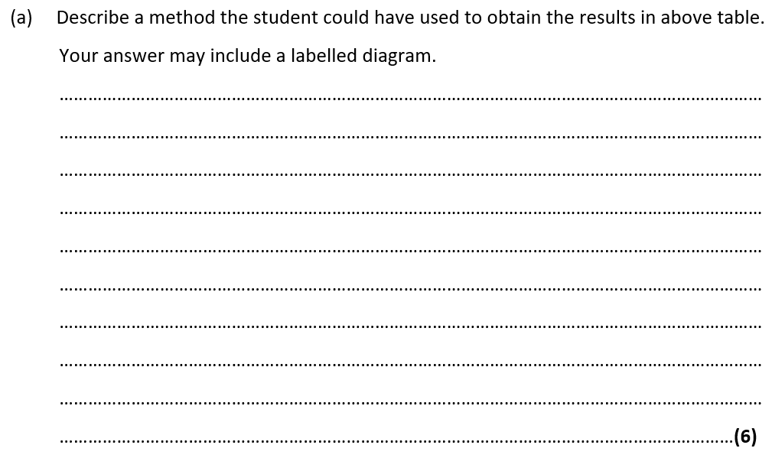
Exam questions

Slide 17
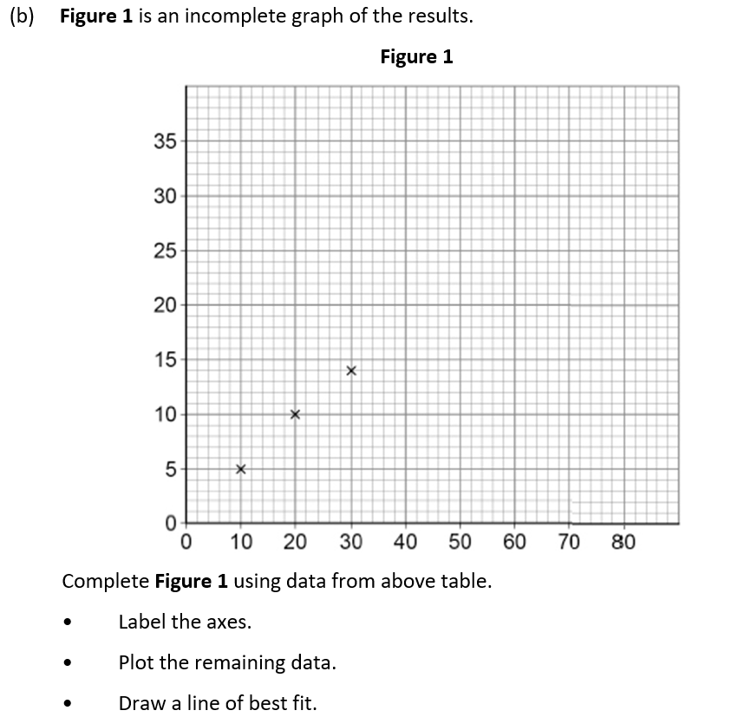

Slide 18
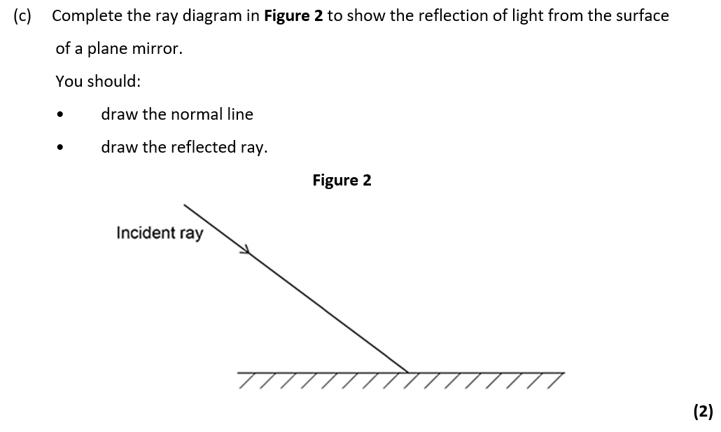
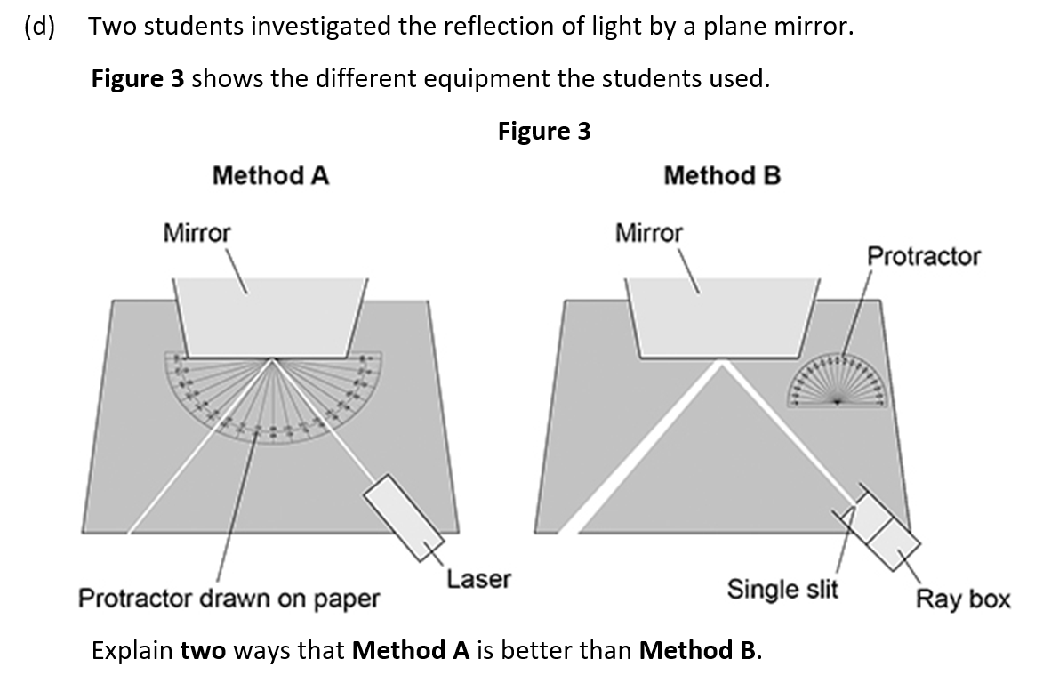

Slide 19
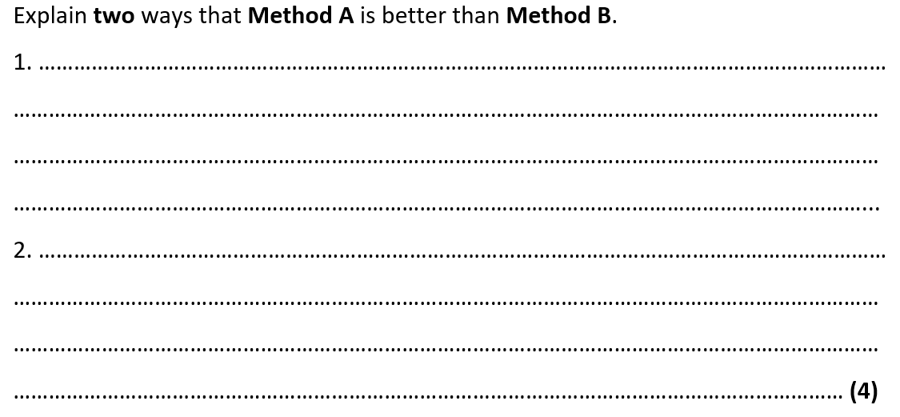

Slide 20
Subtopic 2: Lenses.
Learning Objective
We are learning to draw ray diagrams that show reflection and refraction of light from different surfaces.
Why are we learning about this?
Being able to detect and respond to light is key to the survival of most eukaryotic species.
For example, animals have specialized organs that contain receptors that detect light. For example, humans have eyes. The eyes increase the probability of survival because they enable animals to, for example, detect predators and to find food.
The human eye has evolved into a complex organ that focuses (as known as accommodation) light onto light receptors. The light rays are focused by the cornea and the lens using refraction. The lens can even change shape; this changes the extent to which the light rays are refracted and so enables us to focus on objects that are different distances away from us.
Reflection and refraction is also used extensively in technology. For example, the Hubble telescope used a giant mirror to focus light using reflection. More traditional telescopes contain lenses that refract light. Similarly, light microscopes contain lenses that can focus on minute objects by refracting light.
Reflection and refraction are therefore essential to our survival whilst also enabling us to explore microscopic and massive objects.

Slide 21
1 2 3 4 5 6 7 8 9 10 11 12 13 14 15 16 17 18 19 20 21 22 23 24 25 26 | Reflection of waves Waves including sound and light - can be reflected at the boundary between two different materials. The reflection of sound causes echoes. The law of reflection states that: angle of incidence = angle of reflection For example, if a light ray hits a surface at 32°, it will be reflected at 32°. The angles of incidence and reflection are measured between the light ray and the normal (an imaginary line at 90° to the surface). The diagrams show a water wave being reflected at a barrier, and a light ray being reflected at a plane mirror. Specular reflection Reflection from a smooth, flat surface is called specular reflection. This is the type of reflection that happens with a flat mirror. The image in a mirror is: upright virtual In a virtual image, the rays appear to diverge from behind the mirror, so the image appears to come from behind the mirror.

Slide 22
1 2 3 4 5 6 7 8 9 10 11 12 13 14 15 16 17 18 19 20 21 22 23 24 25 26 27 28 | A ray diagram showing how an image forms in a plane mirror. Diffuse reflection If a surface is rough, diffuse reflection happens. Instead of forming an image, the reflected light is scattered in all directions. This may cause a distorted image of the object, as occurs with rippling water, or no image at all. Each individual reflection still obeys the law of reflection, but the different parts of the rough surface are at different angles. Diffuse reflection or scattering from a rough surface.

Slide 23
1 2 3 4 5 6 7 8 9 10 11 12 13 14 15 16 17 | Refraction of waves Different materials have different densities. Light waves may change direction at the boundary between two transparent materials. Refraction is the change in direction of a wave at such a boundary. It is important to be able to draw ray diagrams to show the refraction of a wave at a boundary. A ray diagram showing refraction at the boundary between air and glass.

Slide 24
1 2 3 4 5 6 7 8 9 10 11 12 13 14 15 16 17 18 19 20 21 22 23 24 25 26 27 28 29 30 | Explaining refraction – Higher The density of a material affects the speed that a wave will be transmitted through it. In general, the denser the transparent material, the more slowly light travels through it. Glass is denser than air, so a light ray passing from air into glass slows down. If the ray meets the boundary at an angle to the normal, it bends towards the normal. The reverse is also true. A light ray speeds up as it passes from glass into air, and bends away from the normal by the same angle. Wave speed, frequency and wavelength in refraction For a given frequency of light, the wavelength is proportional to the wave speed: wave speed = frequency × wavelength So if a wave slows down, its wavelength will decrease. The effect of this can be shown using wave front diagrams like the one below. The diagram shows that as a wave travels into a denser medium, such as water, it slows down and the wavelength decreases. Although the wave slows down, its frequency remains the same, due to the fact that its wavelength is shorter. In this diagram, the right hand side of the incoming wave slows down before the left hand side does. This causes the wave to change direction.

Slide 25
Rehearsal questions
Light rays can ‘bounce’ off some surfaces. Is this refraction, reflection or diffraction?
………………………………………………………………………………………………………………………………………………………….
2. Which law states that angle of incidence equals the angle of reflection?
………………………………………………………………………………………………………………………………………………………….3. Light rays can change direction when they enter a medium with a different density. Is this refraction, reflection or diffraction?
………………………………………………………………………………………………………………………………………………………….4. Name the line that is at a right angle to the surface. ………………………………………………………………………………………………………………………………………………………….
5. Which type of reflection occurs at a smooth and flat surface?
………………………………………………………………………………………………………………………………………………………….
6. Which type of reflection occurs at a rough surface?
………………………………………………………………………………………………………………………………………………………….
7. If the angle of incidence is 65 degrees, what will be the angle of reflection? ………………………………………………………………………………………………………………………………………………………….
8. Light rays change direction when they enter a more dense material. What is the name of this phenomena? ……………………………………………………………………….…………………………………………………………
9. When studying reflection and refraction, we always draw a line at a right angle to the surface. What do we call this line? ………………………………………………………………………………………………………………
Mirrors have a smooth and flat surface. What type of reflection do they use?
………………………………………………………………………………………………………………………………………………………….
Reflection light rays also happens on rough surfaces. Which type of reflection would occur?
………………………………………………………………………………………………………………………………………………………….
Do light rays move towards or away from the Normal when they enter a more dense material?
………………………………………………………………………………………………………………………………………………………….

Slide 26
1 2 3 4 5 6 7 8 9 10 11 12 13 14 15 16 17 18 19 20 21 22 23 24 25 26 27 28 | Required Practical – Light Aim of the experiment To investigate the reflection of light by different types of surface, and the refraction of light by different substances. Method Set up a ray box, slit and lens so that a narrow ray of light is produced. Place a 30 centimetre (cm) ruler near the middle of a piece of plain A3 paper. Draw a straight line parallel to its longer sides. Use a protractor to draw a second line at right angles to this line. Label this line with an ‘N’ for ‘normal’. Place the longest side of a rectangular acrylic polymer block against the first line. With the normal near the middle of the block, carefully draw around the block without moving it. Use the ray box to shine a ray of light at the point where the normal meets the block. This is the incident ray.

Slide 27
1 2 3 4 5 6 7 8 9 10 11 12 13 | 5. The angle between the normal and the incident ray is called the angle of incidence. Move the ray box or paper to change the angle of incidence. The aim is to see a clear ray reflected from the surface of the block and another clear ray leaving the opposite face of the block. 6. Using a pencil on the paper, mark the path of the incident ray with a cross the reflected ray with a cross the ray that leaves the block with two crosses - one near the block and the other further away 7. Remove the block. Join the crosses to show the paths of the light rays. 8. Repeat steps 2 to 7 for a rectangular glass block. 9. Measure the angle of incidence, angle of refraction and angle of reflection for each block.

Slide 28
Results.

Slide 29
Conclusion
Physics theory suggests that the angles of incidence and reflection should be the same for a
material, but the angles of refraction for that material should be different.
How well do your results support this theory for the two different materials that you have tested?
…………………………………………………………………………………………………………………………………………………………………………………………………………………………………………………………………………………………………………………………………………………………………………………………………………………………………………………………………………………………………………………………………………………………………………………………………………………………………………………………………………………………………………………………………………………………………………………………………………………………………………………………………………………………………………………………………………………………………………………………………………………………………………………………………………………………………………………………………………………………………………………………………………………………………………………………………………………………………………………………………………………………………………………………………………………………………………………………………………………………………………………………………………………………………………………………………………
Evaluation
Consider the apparatus and method that you used. Are there any improvements that you could
make to improve the accuracy of the angles you measured if you were to repeat this experiment?
……………………………………………………………………………………………………………………………………………………………………………………………………………………………………………………………………………………………………………………………………………………………………………………………………………………………………………………………………………………………………………………………………………………………………………………………………………………………………………………………………………………………………………………………………………………………………………………………………
……………………………………………………………………………………………………………………………………………………………………………………………………………………………………………………………………………………………………………………………………………………………………………………………………………………………………………………………………………………………………………………………………………………………………………………………………………………………………………………………………………………………………………………………………………………………………………………………………

Slide 30
Spaced Retrieval
Most animals can detect changes in light intensity. A large number of them have eyes that enable them to detect changes in the environment and to respond to them. Eyes refract light so the animal can focus on an object. Often the reactions are rapid and automatic; they are reflex actions.
Reflex arcs contain the following parts:
Effector; stimulus; response; coordinator; receptor; sensory neurone; motor neurone; relay neurone; synapse.
Which part is a change in the environment? …………………………………….....................................
Which part includes the brain, spinal cord and pancreas? …………………………………………………….
Which part is made up of cells that detect stimuli?...................................................................
Which part could be a muscle or gland which responds to restore optimum levels?
…………………………………………………………………………………………………………………………………………….
5. Which neurone carries an impulse or message from the receptor to the coordinator?
…………………………………………………………………………………………………………………………………………….
6. Which neurone carries a message from the coordinator to the effector?
…………………………………………………………………………………………………………………………………………….
7. Diagram A shows a light receptor. Receptors are a type of cell.
Label parts A and B.

Slide 31
Spaced Retrieval
8. The diagram shows the structures involved in the knee-jerk reflex. When the person is hit at point P, the lower leg is suddenly raised.
Name the structures labelled A, B and C.
A ....................................................................................................................
B ....................................................................................................................
C ....................................................................................................................

Slide 32
Exam questions

Slide 35
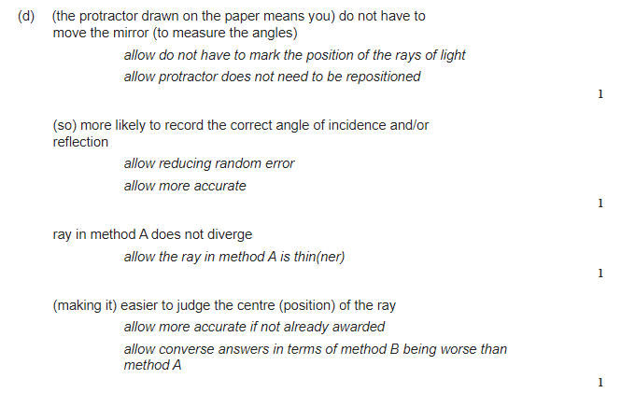

Slide 36
Subtopic 3: Waves for Exploration & Detection
Learning Objective
We are learning how waves can be used to detect and explore structures that are hidden from direct observation
We are learning how the above statement applies to sound waves, ultrasound and seismic waves
Why are we learning about this?
This lessons helps us understand how it is we are able to know about the structure of the Earth and how we can monitor the developing foetus.
3

Slide 37
I wasn’t there but I still care!
Use pages 182 – 183 of the GCSE Physics textbook.
How do sound waves interact with solids?
……………………………………………………………………………………………………………………………………………………………………………………………………………………………………………………………………………………………………………………………………………………………………………………………………………………………………………………………………………..
How does the human ear perceive sound?
……………………………………………………………………………………………………………………………………………………………………………………………………………………………………………………………………………………………………………………………………………………………………………………………………………………………………………………………………………..
What is the range of normal human hearing?
………………………………………………………………………………………………………………………………………………………………………………………………………………………………………………………………………………………………………………………………………………………………………………………………………………………………………………………………………………

Slide 38
1 2 3 4 5 6 7 8 9 10 11 12 13 14 15 16 17 18 19 20 21 22 23 24 25 26 27 28 29 30 | Waves, specifically ultrasound, seismic waves, and echo sounding, play a pivotal role in exploration and detection. They provide us with invaluable insights into our bodies, the Earth, and the oceans, demonstrating the power and versatility of wave-based technologies. Ultrasound: Ultrasound technology uses high-frequency sound waves beyond the range of human hearing. In medical applications, an ultrasound machine emits these waves into the body. When they encounter different types of tissues or structures, they bounce back or echo. The machine captures these echoes and uses them to construct an image known as a sonogram. This is particularly useful in prenatal care for monitoring foetal development, but it also aids in diagnosing conditions within the body by visualizing organs, blood vessels, and tissues. Seismic Waves: Seismic waves are primarily used in geology and geophysics for the exploration of the Earth’s interior. These waves can be naturally occurring, as in earthquakes, or artificially induced for scientific study. When seismic waves travel through the Earth, they are refracted and reflected by different layers, creating distinct patterns. By analysing these patterns with seismographs, scientists can infer the structure and composition of the Earth’s interior. This is crucial in understanding geological phenomena like earthquakes and volcanic activity. Furthermore, in the oil and gas industry, seismic surveys are used to locate potential reserves beneath the Earth’s surface. Echo Sounding: Echo sounding is a type of sonar technology used to measure the depth of water bodies. It works by emitting a sound pulse into the water and then measuring the time it takes for the echo to return after bouncing off the sea floor. Given the speed of sound in water, the depth can be calculated from this time delay. Echo sounding is vital in maritime navigation to avoid submerged obstacles and is also used in oceanography for mapping the topography of the ocean floor.

Slide 39
Rehearsal Questions
What is a transverse wave?
……………………………………………………………………………………………………………………………………………………………………………………………………………………………………………………………………………………………………………………
2. What is a longitudinal wave?
................................................................................................................................................................................................................................................................................................................................
3. Can you provide an example of a transverse wave?
……………………………………………………………………………………………………………………………………………………………………………………………………………………………………………………………………………………………………………………
4. Can you provide an example of a longitudinal wave?
……………………………………………………………………………………………………………………………………………………………………………………………………………………………………………………………………………………………………………………
5. What is the difference between a crest and a trough in a transverse wave?
……………………………………………………………………………………………………………………………………………………………………………………………………………………………………………………………………………………………………………………6. What is the difference between compression and rarefaction in a longitudinal wave?
……………………………………………………………………………………………………………………………………………………………………………………………………………………………………………………………………………………………………………………7. What is meant by the amplitude of a wave?
……………………………………………………………………………………………………………………………………………………………………………………………………………………………………………………………………………………………………………………8. What is meant by the wavelength of a wave?
……………………………………………………………………………………………………………………………………………………………………………………………………………………………………………………………………………………………………………………
………………………………………………………………………………………………………………………………………………………..

Slide 40
Detecting sound:
Sound waves are longitudinal waves. This means that they causes particles to vibrate parallel to the direction of the wave travel. Sound wave vibrations can travel through the 3 states of matter, however will travel at different velocities based on the particle arrangement of the particular matter.
The human ear is designed to detect sound waves. When sound waves enter the ear, they cause the ear drum to vibrate. Three small bones transmit these vibrations to the cochlea. This produces electrical signals which pass through the auditory nerve to the brain, where they are interpreted as sound. Humans can detect sound waves that fall into the range of ~20 – 20,000Hz, although this can vary between individuals, and age can play a factor. Different animals have different ranges of frequencies that they can detect which explains why a dog can hear a dog whistle, but a human cannot.
The pitch of a sound is related to the frequency of the wave. High frequency waves have a high pitch, with low frequency waves having the converse. Volume is related to the amplitude of the sound wave. A high amplitude means a loud sound, whereas a low amplitude is quiet.
If the oscilloscope trace for number 1 is described as a quiet, low pitched sound, how would the oscilloscope traces for numbers 2 and 3 be described?
2 = ………………………………………………………………………………………………………………………………………………
3 = ……………………………………………………………………………………………………………………………………………..

Slide 41
You will be familiar with echoes. An echo is caused by a surface reflecting a sound wave. How far away the surface reflecting the sound wave is will determine the time taken for the echo to be detected. Sound waves typically travel at ~330m/s in air. This means echoes can be used to work how far away the reflective surface is.
For example,
I do:
A sound wave takes 2 seconds to return to its source and the speed of sound is 330m/s, how far has the echo travelled?
……………………………………………………………………………………………………………………………………………………………………………………………………………………………………………………………………………………………………………………………………………………………………………………………………………………………………………………………………………………………………………………………………………………………………………………………………………………………………………………………………………………………………………………………………………………………………………………………………
We do:
An echo is heard 5 seconds after the original sound was made. If the speed of sound is 330m/s, what is the distance between the source of the sound and the reflecting surface?
……………………………………………………………………………………………………………………………………………………………………………………………………………………………………………………………………………………………………………………………………………………………………………………………………………………………………………………………………………………………………………………………………………………………………………………………………………………………………………………………………………………………………………………………………………………………………………………………………
You do:
A sonar pulse returns to a submarine 1.5 seconds after being emitted. The speed of sound in seawater is 1500m/s. How far away is the detected object?
……………………………………………………………………………………………………………………………………………………………………………………………………………………………………………………………………………………………………………………………………………………………………………………………………………………………………………………………………………………………………………………………………………………………………………………………………………………………………………………………………………………………………………………………………………………………………………………………………

Slide 42
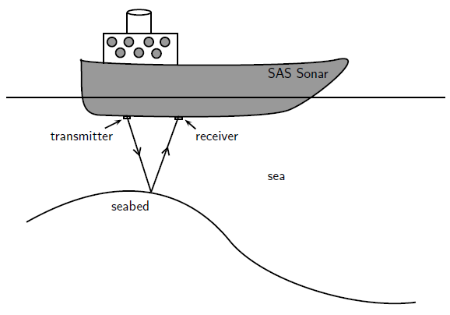
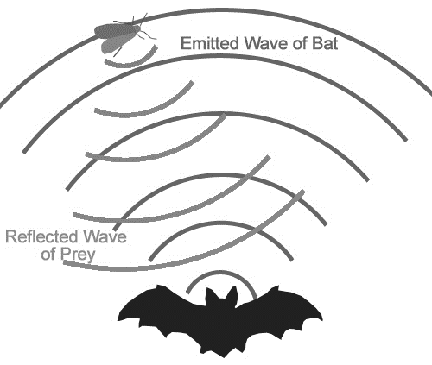
You do:
A bat emits a sound and receives its echo after 0.1 seconds. If the speed of sound is 330m/s, how far way is the object that reflected the sound?
……………………………………………………………………………………………………………………………………………………………………………………………………………………………………………………………………………………………………………………………………………………………………………………………………………………………………………………………………………………………………………………………………………………………………………………………………………………………………………………………………………………………………………………………………………………………………………………………………
This reflection of sound waves is also useful in a process known as echo sounding
In this process, sound waves are sent down into water from a sonar system. This system uses the time for the reflected wave to return, and the speed of sound in water to determine the distance of objects. These objects include the seabed, shipwrecks and shoals of fish.
Speed = distance ÷ time
330 = distance ÷ 0.1
Distance = 330 x 0.1
Distance = 33m
The echo has travelled half of this, 33/2 = 16.5m
Bats (and dolphins) use a similar process called echolocation to find food.

Slide 43
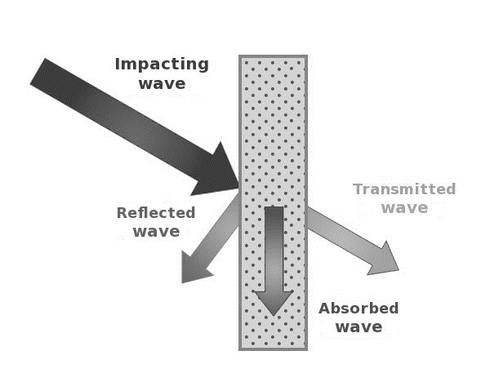
As we have discussed, sound waves can be reflected by surfaces to produce echoes, however, reflection is not the only thing that happens when a sound wave encounters a surface.
This is particularly true for ultrasound waves. Ultrasound is described as a sound wave with a frequency above 20000Hz (20kHz) and are beyond the human audible range. This means that ultrasound waves have a very high pitch and cannot be detected by humans. Having such a high frequency means that ultrasound waves have a number of uses. One such use is cleaning jewellery. The high frequency ultrasound waves causes cleaning fluid to vibrate, causing a process called ‘cavitation’ (the formation and collapse of tiny bubbles in the fluid) which breaks up dirt on the surface of the jewellery. A medical use of ultrasound is the treatment of kidney stones. Again, the high frequency is used to ‘shake’ apart the kidney stones to make them smaller so they can pass out of the kidney.
Three things can occur when a sound wave encounters a surface. These are reflection, absorption ad transmission. This explains why sounds can be heard through walls, and why adding sound proofing to a surface significantly reduces the transmission of sound.

Slide 44
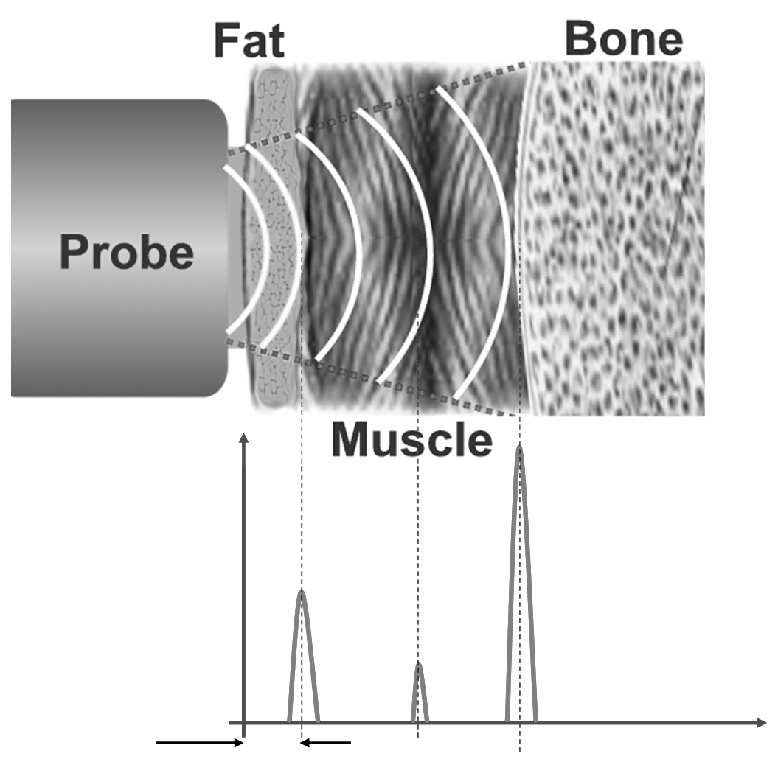
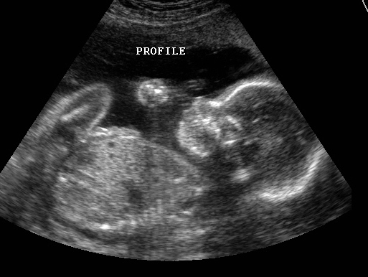
A more common medical use of ultrasound is for body scans and baby scans. The ultrasound waves are sent into the body by a probe attached to a machine. When the ultrasound waves encounter a boundary between different tissue types (fluid and soft tissue, bone and soft tissue) some of the waves get reflected. The rest carry on until they hit another boundary, and again some get reflected.
The reflected waves get detected by the probe and are relayed to the machine. The machine then calculates the distance of the tissue or organ (boundaries) using the speed of sound in tissue (~1540m/s) and the time of each echo’s return. The machine then displays the distances and the intensities of the echoes on a screen, creating a 2 dimensional image.

Slide 45
Rehearsal questions – Ultrasound
What is ultrasound?
………………………………………………………………………………………………………………………………………………………………………………………………………………………………………………………………………………………………………………2. Why can a dog hear the ultrasound produced by a dog whistle but humans cannot?
……………………………………………………………………………………………………………………………………………………………………………………………………………………………………………………………………………………………………………….
3. What are some uses of ultrasound?
………………………………………………………………………………………………………………………………………………………………………………………………………………………………………………………………………………………………………………
4. What happens when ultrasound waves meet the boundary between two different materials?
……………………………………………………………………………………………………………………………………………………………………………………………………………………………………………………………………………………………………………………………………………………………………………………………………………………………………………………………………..
5. How is high frequency sound used in echo sounding?
……………………………………………………………………………………………………………………………………………………………………………………………………………………………………………………………………………………………………………………………………………………………………………………………………………………………………………………………………..
6. Where are the mistakes in this calculation?
A submarine is 1500m away from the bottom of the ocean. The speed of sound in water is 1530m/s. How long will it take for the submarine to detect the ultrasound?
Speed = distance ÷ time
Time = distance ÷ speed
Time = 1500/1530= 0.98s
0.98 ÷2= 0.49s to go there and back

Slide 46
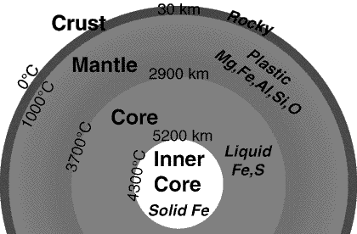
Knowledge of the structure of the Earth
How do we know this about the Earth?
Seismic waves provide us with evidence for the structure of the Earth. Seismic waves are energy waves that travel through the Earth’s layers, and are a result of earthquakes, volcanic eruptions, magma movement, large landslides and manmade explosions that give out low-frequency acoustic energy. They are studied by seismologists to understand the interior structure of the Earth. There are two types: body waves (travel through the Earth’s inner layers) and surface waves (only move along the surface)

Slide 47
Seismic waves:
There are 2 types of seismic wave that can provide us with evidence about the structure of the Earth
P-waves (Primary) which are longitudinal waves
S-waves (Secondary) which are transverse waves
P-waves, or primary waves, are the fastest seismic waves and the first to be detected by seismographs. They can travel through solids, liquids, and gases.
S-waves, or secondary waves, are slower than P-waves and are the second to be detected. They can only travel through solids, not through liquids or gases. This is why S-waves are not detected in the Earth’s outer core, which is liquid.
P-waves can be detected on the opposite side of the Earth. As they move through the different materials of the Earth they get refracted. These refractions cause shadow zones where no P-waves are detected. This provides evidence that the Earth has a solid inner core.
S-waves cannot be detected on the opposite side of the Earth. This suggests that the mantle has solid properties and there is a liquid outer core.

Slide 48
You do – Wrong answers
Read the paragraph below. Underline incorrect phrases and correct them.
P-waves are transverse seismic waves. They can travel through both solids and liquids, and they move at different speeds depending on the medium. They are also slower than S-waves.
On the other hand, S-waves are longitudinal seismic waves. They can only travel through solids and are faster than P-waves.
It’s important to note that only S-waves are detected on the opposite side of the Earth to an earthquake, suggesting the inner core of the Earth is liquid – hence no P-waves can penetrate it. This provides evidence for the structure and size of the Earth’s core.

Slide 49
Exam questions

Slide 50
Exam questions

Slide 51
Exam questions

Slide 52
Exam questions

Slide 53
DO NOW
Date: ……………………………………….
 | ANSWER
Q1.
Q2.
Q3.
Q4.
Q5.
Date: ……………………………………….
 | ANSWER
Q1.
Q2.
Q3.
Q4.
Q5.

Slide 54
DO NOW
Date: ……………………………………….
 | ANSWER
Q1.
Q2.
Q3.
Q4.
Q5.
Date: ……………………………………….
 | ANSWER
Q1.
Q2.
Q3.
Q4.
Q5.

Slide 55
Knowledge Retrieval Quiz 3
Date: ……………………………………….
Score: …………...
 |  | Answer
Q1. | Insert question in bold
Q2.
Q3.
Q4.
Q5.
Q6.
Q7.
Q8.
Q9.
Q10.

Slide 56
Extra Space
……………………………………………………………………………………………………………………………………………………………………………………………………………………………………………………………………………………………………………………………………………………………………………………………………………………………………………………………………………………………………………………………………………………………………………………………………………………………………………………………………………………………………………………………………………………………………………………………………………………………………………………………………………………………………………………………………………………………………………………………………………………………………………………………………………………………………………………………………………………………………………………………………………………………………………………………………………………………………………………………………………………………………………………………………………………………………………………………………………………………………………………………………………………………………………………………………………………………………………………………………………………………………………………………………………………………………………………………………………………………………………………………………………………………………………………………..
…………………………………………………………………………………………………………………………………………………………………………………………………………………………………………………………………………………………………………………………………………………………………………………………………………………………………………………………………………………………………………………………………………………………………………………………………………………………………………………………………………………………………………………………………………………………………………………………………………………………………………………………………………………………………………………………………………………………………………………………………………………………………………………………………………………………………………………………………………………………………………………………………………………………………………………………………………………………………………………………………………………………………………………………………………………………………………………………………………………………………………………………………………………………………………………………………………………………………………………………………………………………………………………………………………………………………..
…………………………………………………………………………………………………………………………………………………………………………………………………………………………………………………………………………………………………………………………………………………………………………………………………………………………………………………………………………………………………………………………………………………………………………………………………………………………………………………………………………………………………………………………………………………………………………………………………

Slide 57
Extra Space
……………………………………………………………………………………………………………………………………………………………………………………………………………………………………………………………………………………………………………………………………………………………………………………………………………………………………………………………………………………………………………………………………………………………………………………………………………………………………………………………………………………………………………………………………………………………………………………………………………………………………………………………………………………………………………………………………………………………………………………………………………………………………………………………………………………………………………………………………………………………………………………………………………………………………………………………………………………………………………………………………………………………………………………………………………………………………………………………………………………………………………………………………………………………………………………………………………………………………………………………………………………………………………………………………………………………………………………………………………………………………………………………………………………………………………………………..
…………………………………………………………………………………………………………………………………………………………………………………………………………………………………………………………………………………………………………………………………………………………………………………………………………………………………………………………………………………………………………………………………………………………………………………………………………………………………………………………………………………………………………………………………………………………………………………………………………………………………………………………………………………………………………………………………………………………………………………………………………………………………………………………………………………………………………………………………………………………………………………………………………………………………………………………………………………………………………………………………………………………………………………………………………………………………………………………………………………………………………………………………………………………………………………………………………………………………………………………………………………………………………………………………………………………………..
…………………………………………………………………………………………………………………………………………………………………………………………………………………………………………………………………………………………………………………………………………………………………………………………………………………………………………………………………………………………………………………………………………………………………………………………………………………………………………………………………………………………………………………………………………………………………………………………………

Slide 58
Extra Space
……………………………………………………………………………………………………………………………………………………………………………………………………………………………………………………………………………………………………………………………………………………………………………………………………………………………………………………………………………………………………………………………………………………………………………………………………………………………………………………………………………………………………………………………………………………………………………………………………………………………………………………………………………………………………………………………………………………………………………………………………………………………………………………………………………………………………………………………………………………………………………………………………………………………………………………………………………………………………………………………………………………………………………………………………………………………………………………………………………………………………………………………………………………………………………………………………………………………………………………………………………………………………………………………………………………………………………………………………………………………………………………………………………………………………………………………..
…………………………………………………………………………………………………………………………………………………………………………………………………………………………………………………………………………………………………………………………………………………………………………………………………………………………………………………………………………………………………………………………………………………………………………………………………………………………………………………………………………………………………………………………………………………………………………………………………………………………………………………………………………………………………………………………………………………………………………………………………………………………………………………………………………………………………………………………………………………………………………………………………………………………………………………………………………………………………………………………………………………………………………………………………………………………………………………………………………………………………………………………………………………………………………………………………………………………………………………………………………………………………………………………………………………………………..
…………………………………………………………………………………………………………………………………………………………………………………………………………………………………………………………………………………………………………………………………………………………………………………………………………………………………………………………………………………………………………………………………………………………………………………………………………………………………………………………………………………………………………………………………………………………………………………………………

Slide 59
Extra Space
……………………………………………………………………………………………………………………………………………………………………………………………………………………………………………………………………………………………………………………………………………………………………………………………………………………………………………………………………………………………………………………………………………………………………………………………………………………………………………………………………………………………………………………………………………………………………………………………………………………………………………………………………………………………………………………………………………………………………………………………………………………………………………………………………………………………………………………………………………………………………………………………………………………………………………………………………………………………………………………………………………………………………………………………………………………………………………………………………………………………………………………………………………………………………………………………………………………………………………………………………………………………………………………………………………………………………………………………………………………………………………………………………………………………………………………………..
…………………………………………………………………………………………………………………………………………………………………………………………………………………………………………………………………………………………………………………………………………………………………………………………………………………………………………………………………………………………………………………………………………………………………………………………………………………………………………………………………………………………………………………………………………………………………………………………………………………………………………………………………………………………………………………………………………………………………………………………………………………………………………………………………………………………………………………………………………………………………………………………………………………………………………………………………………………………………………………………………………………………………………………………………………………………………………………………………………………………………………………………………………………………………………………………………………………………………………………………………………………………………………………………………………………………………..
…………………………………………………………………………………………………………………………………………………………………………………………………………………………………………………………………………………………………………………………………………………………………………………………………………………………………………………………………………………………………………………………………………………………………………………………………………………………………………………………………………………………………………………………………………………………………………………………………

Slide 60
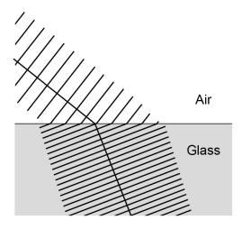
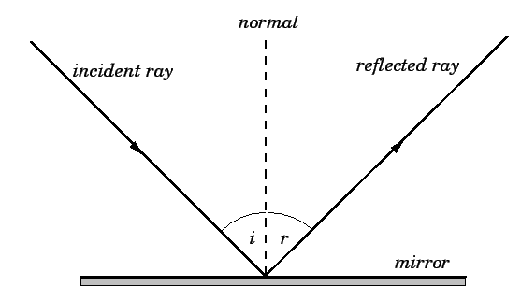
KNOWLEDGE ORGANISER
Subject: Science | Topic: Waves | Term: Autumn
KEY WORDS | Key words
1 | Amplitude | The distance from a peak to the zero position of a wave.
2 | Frequency | The number of complete waves that pass a point in a given time.
3 | Time period | Time taken for one complete wave to pass.
4 | Ray diagram | A ray diagram is a representation of the possible paths light can take to get from one place to another.
5 | Normal line | A line drawn perpendicular to a surface.
6 | Incident ray. | A ray of light that falls on any surface.
7 | Reflected ray. | A ray of light that is reflected from a surface.
KEY EXAMPLES
8 | Reflection from mirrors.
9 | Refraction of light and sound by water.
10 | Uses of waves to investigate the structure of the Earth.
11 | Th wide range of uses for electromagnetic waves.
KEY DIAGRAMS
Wave front diagram showing refraction The Law of Reflection

