Slide 1

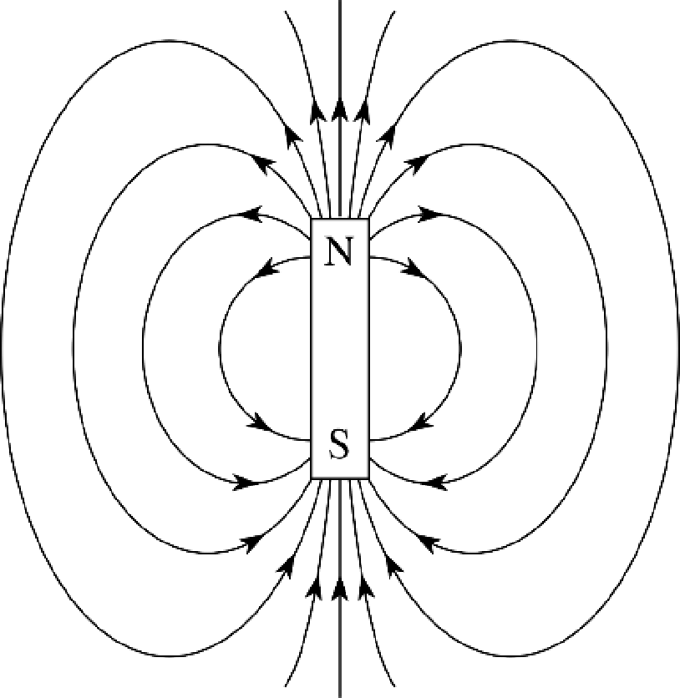
KS4 – Magnetism (TEACHER / TRILOGY)
Name
Class
Tutor Group
KS4 Science YEAR 11 MAGNETISM
KEYSTONE WORDS
Magnetic field | The region around a magnet where a force acts on another magnet or on a magnetic material
Electromagnetism | An interaction that occurs between particles with electric charge via electromagnetic fields.
Motor effect | A wire carrying a current creates a magnetic field. This can interact with another magnetic field, causing a force that pushes the wire at right angles.

Slide 2
BIG PICTURE
How will my prior knowledge develop my understanding of this topic?
Y7 | Magnetism is related to the key ideas of forces and energy in year 7.
Y8 | Fields are covered in year 8.
Learning Journey -
Subtopic 1 | Magnets and magnetic fields | Subtopic 3 | Fleming’s left hand rule (HT)
Subtopic 2 | Electromagnetism | Subtopic 4 | Electric motors (HT)
Key knowledge
By the end of this topic you should know… | How magnets interact with other objects using magnetic fields, and how humans use this phenomena in a range of applications.
By the end of this topic should be able to… | Describe how magnets are used in range of everyday devices and explain how different devices work using the principles of magnetism.

Slide 3
KEY VOCABULARY LIST
Magnetic field | The region around a magnet where a force acts on another magnet or on a magnetic material
Electromagnetism | An interaction that occurs between particles with electric charge via electromagnetic fields.
Motor effect | A wire carrying a current creates a magnetic field. This can interact with another magnetic field, causing a force that pushes the wire at right angles.
EXPECTATIONS
Always write in black or blue pen. Always use a ruler for straight lines. If you make a mistake, cross it out with a single line. Always draw diagrams, tables and graphs in pencil with a ruler if necessary Always mark and correct your work in green pen. Respond to any feedback your teacher gives you in green pen. Take pride in your work, make it neat! All tasks should be completed in silence and by yourself unless your teacher tells you otherwise.
PROUD
Punctuation and grammar
Ruler and pencil for diagrams
Outstanding effort every lesson
Underline date and title
Dates and titles every lesson
PROUD FRIDAY
Any piece of work you complete, which meets our PROUD expectations can be taken to the PROUD station during Friday lunchtime. Show your work to a member of SLT and receive a sweet treat!

Slide 4
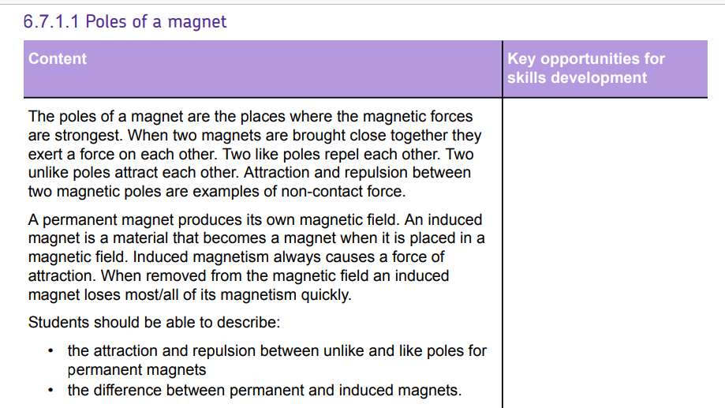
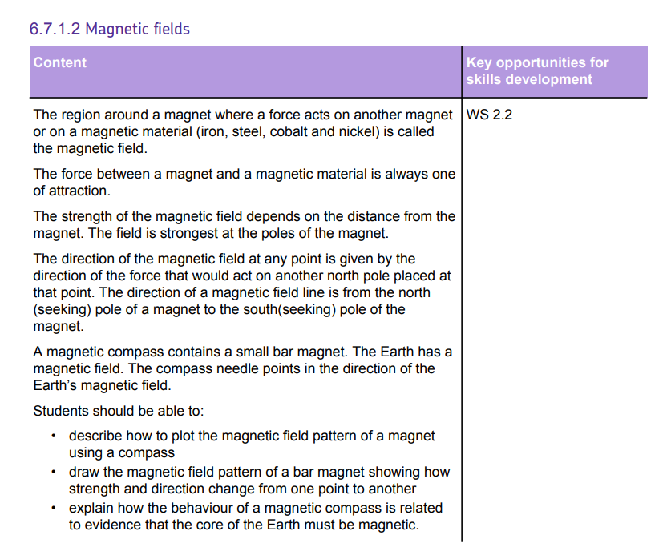
AQA Content – This is combined science and triple content

Slide 5
Subtopic 1: Magnets and magnetic fields
Learning Objective
Students need to be able to:
Describe the difference in properties of permanent and induced magnets in terms of forces of attraction or repulsion between like and unlike poles
Describe and draw magnetic field lines around a bar magnet and explain how the distribution of magnetic field lines can be used to determine the magnetic field strength and also how the use of a compass indicates the presences of Earth’s magnetic core.
Why are we learning about this?
Before GPS systems navigation was done using compasses that tracked the Earth’s magnetic field. This topic builds on previous knowledge of the electromagnetic spectrum. And KS3 knowledge about how a magnet works. Magnets are used in everyday applications such as to help keep doors and lids closed, used in scrap yards to pick up and move magnetic materials.

Slide 6
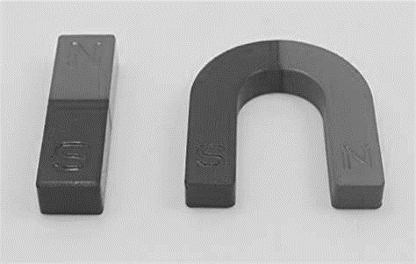
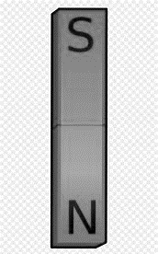
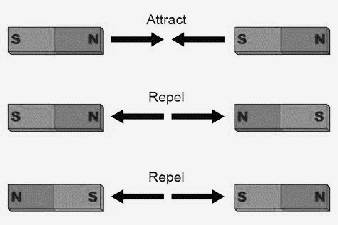
1 2 3 4 5 6 7 8 9 10 11 12 13 14 15 16 17 18 19 20 21 22 23 24 25 26 27 28 29 30 | Properties of Magnets and Magnetic Fields What is a magnet? A magnet is any material capable of producing a magnetic field. Since any moving electric charge generates a magnetic field, electrons are tiny magnets. This electric current is one source of magnetism. However, the electrons in most materials are randomly oriented, so there is little or no overall magnetic field. To put it simply, the electrons in a magnet tend to be oriented the same way. This happens naturally in many ions, atoms, and materials when they are cooled, but isn't as common at room temperature. Some elements (e.g., iron, cobalt, and nickel) are ferromagnetic (can be induced to become magnetized in a magnetic field) at room temperature. This is why iron, cobalt, nickel and the alloy steel are (for the sake of GCSE science) the only magnetic materials. Magnets are made from one of these magnetic materials, but the main material used is iron. Magnets can be shaped in different ways, but the main shape is a bar magnet or a horseshoe magnet. Poles of a magnet A magnet can exert a force on another nearby magnet. Magnets have two poles: a north pole a south pole The magnetic force is strongest near the magnet's poles. The rules of magnetism Two magnets will either attract or repel each other in the following way: like poles (N-N or S-S) repel unlike poles (N-S or S-N) attract Magnetic forces are non-contact forces - this means that magnets affect each other without touching.

Slide 7
1 2 3 4 5 6 7 8 9 10 11 12 13 14 15 16 17 18 19 20 21 22 23 24 25 26 27 28 29 30 | Induced and Permanent magnetism Iron, steel, nickel and cobalt are magnetic materials. They are affected by magnets and are attracted to either pole of a magnet. Permanent magnets A permanent magnet is often made from a magnetic material such as iron. A permanent magnet always causes a force on other magnets, or on magnetic materials. Key features of a permanent magnet: it produces its own magnetic field the magnetic field cannot be turned on and off - it is there all the time Bar magnets and horseshoe magnets are examples of permanent magnets. Can attract and repel other magnets Induced magnets Unlike a permanent magnet, an induced magnet only becomes a magnet when it is placed in a magnetic field. The induced magnetism is quickly lost when the magnet is removed from the magnetic field. Like all induced magnets: they are only attracted by other magnets, they are not repelled they lose most or all of their magnetism when they are removed from the magnetic field Testing for magnetism A permanent magnet can attract or repel another permanent magnet, but induced magnets can only repel A permanent magnet can produce their own magnetic field, but an induced magnet can only be magnetic whilst in a magnetic field. This means that you can only show that an object is a permanent magnet by checking if it repels another magnet.

Slide 8
Rehearsal Questions
1. What are the 4 magnetic materials?
………………………………………………………………………………………………………………………………………………………
2. When two north poles are placed close towards each other, what would happen to the magnets?
………………………………………………………………………………………………………………………………………………………
3.When opposite poles are placed near each other what would happen?
…………………………………………………………………………………………………………………………………………………………
What is a permanent magnet
……………………………………………………………………………………………………………………………………………………..
Wat is an induced magnet?
………………………………………………………………………………………………………………………………………………….
6. What are the properties of a permanent magnet? …………………………………………………………………………………………………………………………………..…………………….
…………………………………………………………………………………………………………………………………………………….…....
When do magnets repel each other?
………………………………………………………………………………………………………………………………………………………..
When do magnets attract each other?
..………………………………………………………………………………………………………………………………………………………
9. What materials can produce a magnetic field?
………………………………………………………………………………………………………………………………………………………….
10. What type of force do magnets exert on magnetic materials?
…………………………………………………………………………………………………………………………………..……………
11. What combination of poles on a magnet will cause them to be attracted?
…………………………………………………………………………………………………………………………………..…………………….
12. What combination of poles on a magnet will cause them to repel each other? ………………………………………………………………………………………………………………………………..…………………….
How can a piece of iron become an induced magnet?
…………………………………………………………………………………………………………………………………..……………………
12. How can you determine if a magnet is a permanent or induced magnet? ………………………………………………………………………………………………………………………………..…………………….
………………………………………………………………………………………………………………………………..…………………….

Slide 9
1 2 3 4 5 6 7 8 9 10 11 12 13 14 15 16 17 18 19 20 21 22 23 24 25 26 27 28 29 30 | Detecting and drawing magnetic fields A magnetic field is the region around a magnet where a force acts on another magnet or on a magnetic material. Detecting magnetic fields A magnetic field is invisible, but it can be detected using a magnetic compass. A compass contains a small bar magnet on a pivot so that it can rotate. The compass needle points in the direction of the Earth's magnetic field, or the magnetic field of a magnet. Task: Magnetic fields can be mapped out using small plotting compasses: 1. place the plotting compass near the magnet on a piece of paper 2. mark the direction the compass needle points move the plotting compass to many different positions in the magnetic field, marking the needle direction each time join the points to show the field lines Put an arow to show the direction of the field lines from the plotting compass The needle of a plotting compass points to the south pole of the magnet. The behaviour of a compass shows that the Earth has a magnetic field. The Earth's core, which is made from iron and nickel, produces this magnetic field.

Slide 10
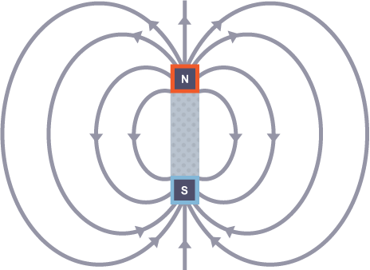
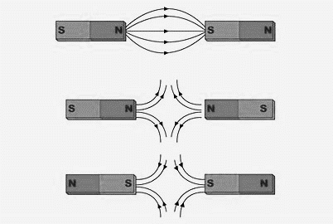
1 2 3 4 5 6 7 8 9 10 11 12 13 14 15 16 17 18 19 20 21 22 23 24 25 26 27 28 29 30 | Detecting and drawing magnetic fields The diagram shows these key features: The magnetic field lines never cross each other the closer the lines, the stronger the magnetic field the lines have arrowheads to show the direction of the force exerted by a magnetic north pole the arrowheads point from the north pole of the magnet to its south pole The diagram shows the magnetic field lines and how they interact with poles of other attracting and repelling magnets

Slide 11
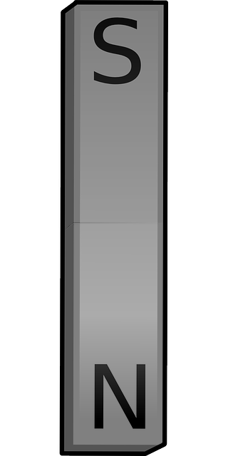
Rehearsal Questions
1. What is a magnetic field?
……………………………………………………………………………………………………………………………………………………….
2. In what direction do magnetic fields run?
………………………………………………………………………………………………………………………………………………………
3. Where around a magnet are the magnetic fields the strongest? …………………………………………………………………………………………………………………………………………………………
How does a magnetic compass work to help with direction?
……………………………………………………………………………………………………………………………………………………..
Draw the magnetic field lines around this bar magnet
What are the 4 magnetic materials?
…………………………………………………………………………………………………………………………………….………………….
7. How can an induced magnet be identified? …………………………………………………………………………………………………………………………………..……………
What word describes when two like poles push away from each other?
…………………………………………………………………………………………………………………………………..…………………….
9. What word is used to describe the phenomena of 2 different poles connect together?
…………………………………………………………………………………………………………………………………..…………………….
Describe the direction that magnetic field lines run in?
..............................................................................................................................................................
Where are magnetic field lines the strongest?
……………………………………………………………………………………………………………………………………………………….

Slide 12
Interleaving
I DO: In the northern hemisphere when a compass is not near a magnet it always points north. Explain why?
……………………………………………………………………………………………………………………………………………………………………………………………………………………………………………………………………………………………………………………………………………………………………………………………………………………………………………………………………………………………………………………………………………………………………………………………………………………………………………………………………….
We Do: Explain what a magnetic field is and how it affects magnetic materials?
…………………………………………………………………………………………………………………………………………………………………………………………………………………………………………………………………………………………………………………………………………………………………………………………………………………………………………………………………………………………………………………………………………………………………………………………………………………………………………………….………………….
You do:
Magnetic force is non contact force. What are the differences between a contact and a non-contact force? Give example of a contact force?
………………………………………………………………………………………………………………………………………………………………………………………………………………………………………………………………………………………………………………………………………………………………………………………………………………………………………………………………………………………………………………………………………………………………………………………………………………………………………………………………………
4. I have 3 different metals: Aluminium, copper and iron. Describe what would happen to each metal if I put it inside the magnetic field of a magnet?
………………………………………………………………………………………………………………………………………………………………………………………………………………………………………………………………………………………………………………………………………………………………………………………………………………………………………………………………………………………………………
5. In magnetic metals the electrons are all oriented the same way. In terms of electrons explain why metals are good conductors of heat and electricity?
………………………………………………………………………………………………………………………………………………………………………………………………………………………………………………………………………………………………………………………………………………………………………………………………………………………………………………………………………………………………………

Slide 13
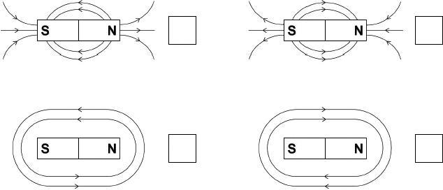

1. A magnet produces a magnetic field.
(a) Which diagram shows the magnetic field pattern around a bar magnet? Tick one box.
(b) Figure 1 shows three metal blocks. The blocks are not labelled.
One block is a permanent magnet, one is iron and one is aluminium.
Figure 1
Describe how another permanent magnet can be used to identify the blocks.
………………………………………………………………………………………………………………………………………………………………………………………………………………………………………………………………………………………………………………………………………………………………………………………………………………………………………………………………………………………………………………………………………………………………………………………………………………………………………………………………………………………………………………………………………………………………………………………………………………………………………………………………………………………………………………………………………………………………………………………………

Slide 14

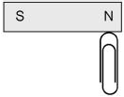
Figure 1 shows an iron bar near a permanent magnet.
Figure 1
The iron bar becomes an induced magnet.
(b) Label the poles on the iron bar. (1)
(c) The magnet is turned around so that the north pole is closest to the iron bar.
Which statement about the iron bar is true? Tick (✓) one box.
d) Figure 2 shows a paper clip being attracted to a permanent magnet.
(b) The paper clip is not a permanent magnet.
Explain what would happen if the paper clip was removed and brought close to the south pole of the permanent magnet.
…………………………………………………………………………………………………………………………………………………………………………………………………………………………………………………………………………………………………………………………………………………………………………………………………………………………………………………………………………………..(2)
The iron bar does not experience a magnetic force.
The iron bar experiences a magnetic force of attraction.
The iron bar experiences a magnetic force of repulsion.
(1)

Slide 15
Answers to exam questions
1. (a) 1st box ticked 1
(b) (permanent magnet) has no effect on the aluminium 1
iron is attracted (to the permanent magnet) 1
(only) the (permanent) magnet can be repelled (by the permanent magnet) 1
(c) the iron bar experiences a magnetic force of attraction 1
(d) (b) the paperclip would still be attracted to the magnet 1
because of induced magnetism
allow the paper clip becomes an induced magnet
allow because the paper clip is a temporary magnet
allow there is a magnetic field at the south pole

Slide 16
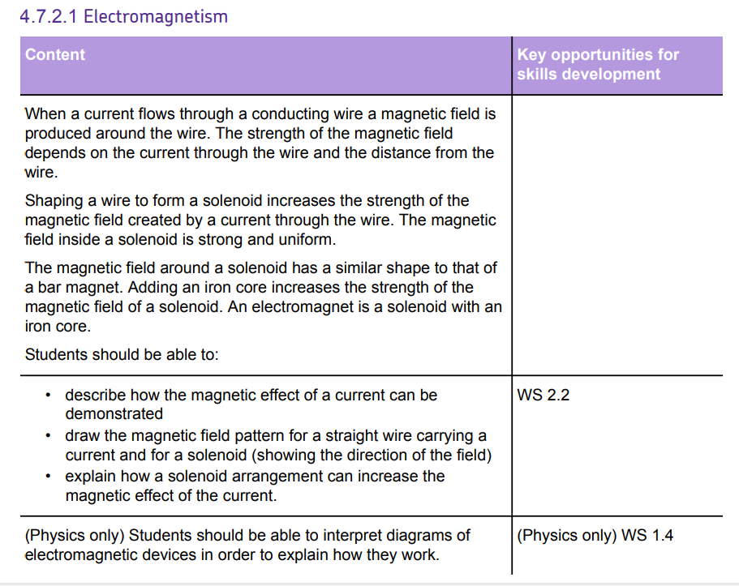
AQA Content – This is combined science and triple content

Slide 17
Subtopic 2: Electromagnetism
Learning Objective
Describe how the magnetic effect of the current can be demonstrated
Draw a magnetic field pattern for a straight wire carrying a current and for a solenoid
Explain how a solenoid arrangement can increase the magnetic effect of a current
Why are we learning about this?
This topic builds on the knowledge about the effects of electrons all orienteering in the same direction causing a permanent magnet. This will also explain why when a wire carrying a current creates a magnetic field around the wire. It builds links between knowledge about electrical current and magnetic fields..
3

Slide 18
Wasn’t there but still care!
What is a magnet?
A magnet is any material capable of producing a magnetic field. iron, cobalt, nickel and the alloy steel are (for the sake of GCSE science) the only magnetic materials.
Poles of a magnet
A magnet can exert a force on another nearby magnet. Magnets have two poles:
a north pole
a south pole
The magnetic force is strongest near the magnet's poles.
The rules of magnetism
Two magnets will either attract or repel each other in the following way:
like poles (N-N or S-S) repel unlike poles (N-S or S-N) attract
Permanent magnets and Induced Magnets
A permanent magnet is often made from a magnetic material such as iron. A permanent magnet always causes a force on other magnets, or on magnetic materials. it produces its own magnetic field, and the magnetic field cannot be turned on and off - it is there all the time. They can attract and repel other magnets. Unlike a permanent magnet, an induced magnet only becomes a magnet when it is placed in a magnetic field. The induced magnetism is quickly lost when the magnet is removed from the magnetic field.
A magnetic field is the region around a magnet where a force acts on another magnet or on a magnetic material.
Q1. What are the 4 magnetic materials?
…………………………………………………………………………………………………………………………………………………………
Q2. When do magnets attract each other? When do magnets repel each other?
……………………………………………………………………………………………………………………………………………………….
3. What is a magnetic field? What direction do magnetic fields run? …………………………………………………………………………………………………………………………………………………..
………………………………………………………………………………………………………………………………………………………

Slide 19
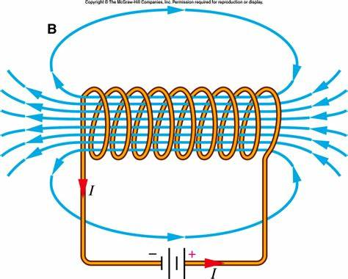
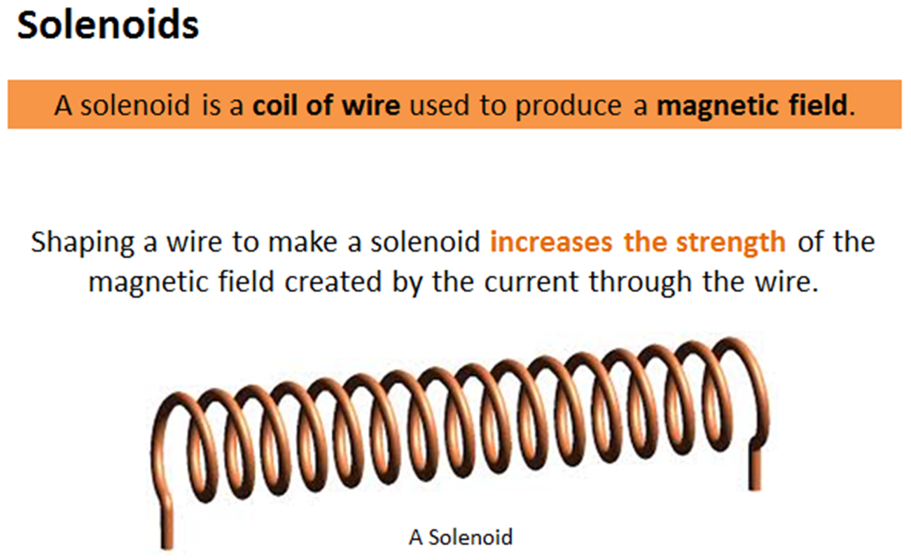
1 2 3 4 5 6 7 8 9 10 11 12 13 14 15 16 17 18 19 20 21 22 23 24 25 26 27 28 29 30 | I wasn’t there but still care! When a current flows in a wire, it creates a circular magnetic field around the wire. The strength of the magnetic field is greater: closer to the wire; if the current is increased. Solenoids A solenoid consists of a wire coiled up into a spiral shape. When an electric current flows, the shape of the magnetic field is very similar to the field of a bar magnet. The field inside a solenoid is strong and uniform. The small magnetic fields caused by the current in each coil add together to make a stronger overall magnetic field. A solenoid carrying a current creates a magnetic field and this can be increased by increasing the number of coils, increasing the current running through the wires and putting an iron core through the center of the solenoid. Electromagnets Electromagnets are created when an iron core is place through the center of a solenoid that is carrying a current. These can make the electromagnets stronger. However, when the current in the wire is switched off the solenoid loses the magnetic field. This creates a type of magnet that can be switched on and off. Q1. What is a solenoid? …………………………………………………………………………………………………………………………………………… Q2. How can a magnetic field be produced by a solenoid? ………………………………………………………………………………………………………………………………………… Q3. What is the difference between a solenoid and an electromagnet? …………………………………………………………………………………………………………………………………………… Q4. How is the permanent magnet different to an electromagnet? ……………………………..

Slide 20
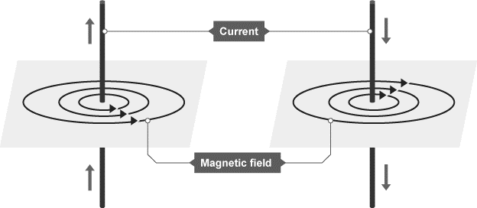
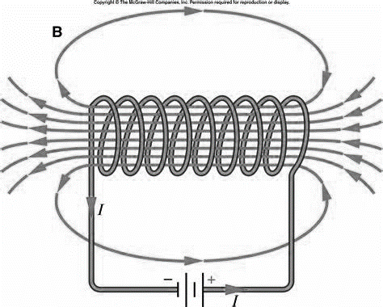
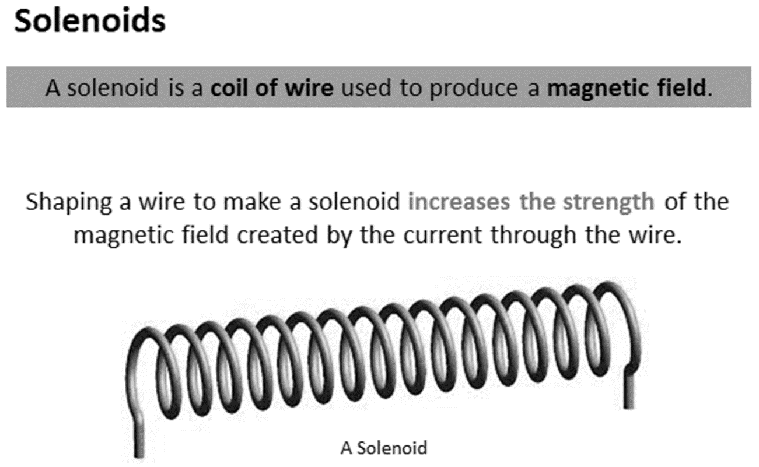
Subtopic 2: Electromagnetism
1 2 3 4 5 6 7 8 9 10 11 12 13 14 15 16 17 18 19 20 21 22 23 24 25 26 27 28 29 30 | When a current flows in a wire, it creates a circular magnetic field around the wire. This magnetic field can deflect the needle of a magnetic compass. The strength of the magnetic field is greater: closer to the wire if the current is increased The direction of the field lines depends on the direction of the current. Use the right hand rule to help determine this. Solenoids A solenoid consists of a wire coiled up into a spiral shape. When an electric current flows, the shape of the magnetic field is very similar to the field of a bar magnet. The field inside a solenoid is strong and uniform. The small magnetic fields caused by the current in each coil add together to make a stronger overall magnetic field. A solenoid carrying a current creates a magnetic field and this can be increased by increasing the number of coils, increasing the current running through the wires and putting an iron core through the center of the solenoid. Electromagnets Electromagnets are created when an iron core is place through the center of a solenoid that is carrying a current. These can make the electromagnets stronger. However, when the current in the wire is switched off the solenoid loses the magnetic field. This creates a type of magnet that can be switched on and off.

Slide 21
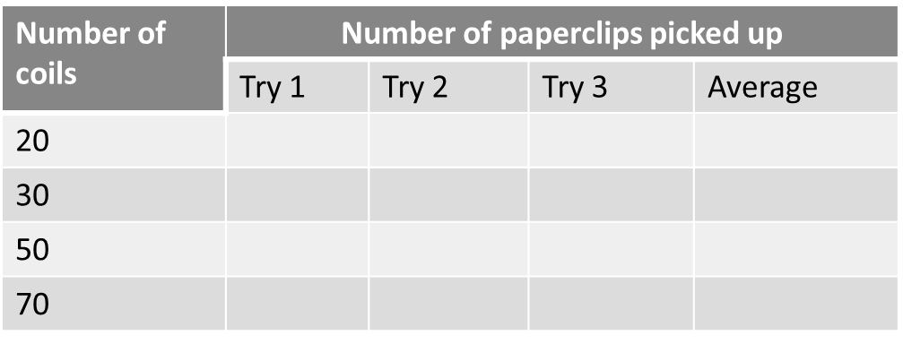
1 2 3 4 5 6 7 8 9 10 11 12 13 14 15 16 17 18 19 20 21 22 23 24 25 26 27 28 29 30 | Electromagnets Investigating how the number of coils on a solenoid affects the strength of an electromagnet. 1. Wind the insulated wire tightly around the nail to make an electromagnet. Add 20 coils. 2. Adjust the power pack so that a current of 0.1 A flows. Record the current 3. Attach as many paper clips to the electromagnet as it will hold. Count the number of paper clips and record in the table. Switch off the electromagnet. 4. Switch on again. Check that the current is still 0.1 A and repeat the paper clip reading. 5. Record in the table and calculate the average number of paper clips held. 6. Repeat this process increasing the current by 0.1 A up to 0.6 A. Uses of Electromagnets Electromagnets are useful because the magnetic field can be switch off. This is done when there is no current flowing through the wire. This means a magnet can be turned on and off. This is useful when trying to move magnetic objects or make something move. Such as: lifting and moving scrap metal or cars with cranes Operating switches, relays, and valves Producing sound in electric bells, buzzers, headphones, and loudspeakers Generating images in MRI machines Separating magnetic materials from non-magnetic materials

Slide 22
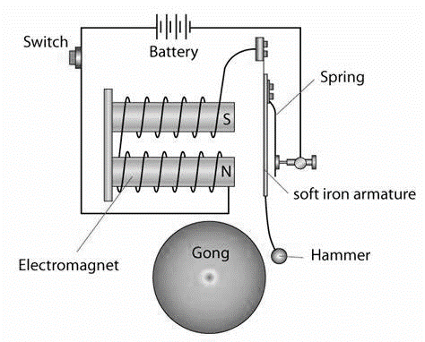
1 2 3 4 5 6 7 8 9 10 11 12 13 14 15 16 17 18 19 20 21 22 23 24 25 26 27 28 29 30 | Triple physics only -Electromagnets and how they work This picture shows how the electric bell can continuously ring. When the switch is on there is a current in the wire. The wire is wrapped round an iron core. This creates the electromagnet. When the current is switched on, the electromagnet becomes magnetic. The soft iron armature is magnetic and is attracted to the electromagnet. This causes the hammer to hit the gong. As the hammer hits the gong, the spring becomes disconnected from the wire carrying the current. This stops the bell being hit by the hammer. The hammer returns to its original position and as it does the armature becomes re connected to the wire carrying a current. The process is repeated really fast.

Slide 23
Rehearsal Questions
What is a solenoid
……………………………………………………………………………………………………………………………………………………….
2. What is magnetic field shape of a solenoid similar to?
………………………………………………………………………………………………………………………………………………………
3. What turns a solenoid into an electromagnet?
…………………………………………………………………………………………………………………………………………………………
How can the strength of the electromagnet be increased?
……………………………………………………………………………………………………………………………………………………..
5. What has to run through the wire to cause a magnetic field to be induced round the wire? ………………………………………………………………………………………………………………………………………………….
6. What is another name for a coiled piece of wire? ………………………………………………………………………………………………………………………………………………………….
7. What effect will increasing the current have on the magnetic field strength of an electromagnet? …………………………………………………………………………………………………………………………………..……………
8.How is an electromagnetic different to a permanent magnet?
…………………………………………………………………………………………………………………………………..…………………….
10. Where can electromagnets be used? …………………………………………………………………………………………………………………………………..…………………….
Triple only:
…………………………………………………………………………………………………………………………………..……………………
11. What causes the hammer to hit the bell continuously when the switch is on?
…………………………………………………………………………………………………………………………………..…………………….
How is the electromagnet switched on to cause the bell to be hit?
…………………………………………………………………………………………………………………………………..…………………….
13. How could the bell be made to ring louder?
…………………………………………………………………………………………………………………………………………………………

Slide 24
Interleaving
I DO: How is a permanent magnet different to an induced magnet?
…………………………………………………………………………………………………………………………………………………………………………………………………………………………………..…………………..………………………………………………………….
2. We DO: How is a solenoid different to an electromagnet?
………………………………………………………………………………………………………………………………………………………….
………………………………………………………………………………………………………………………………………………………….
You do: 3. How is a permanent magnet different to an electromagnet?
………………………………………………………………………………………………………………………………………………………….
………………………………………………………………………………………………………………………………………………………….
4. Why can metals conduct electricity through them? ………………………………………………………………………………………………………………………………………………………….
………………………………………………………………………………………………………………………………………………………….
5. Explain how an electromagnet can be switched on and off? ………………………………………………………………………………………………………………………………………………………….
………………………………………………………………………………………………………………………………………………………….
6.How would the strength of an electromagnet be increased? ………………………………………………………………………………………………………………………………………………………….
………………………………………………………………………………………………………………………………………………………….
7. Describe how current should be measured in a circuit? Where would this component be placed in a circuit?
………………………………………………………………………………………………………………………………………………………….
………………………………………………………………………………………………………………………………………………………….
8. A student was investigating how the number of coils affects the strength of an electromagnet. Describe the dependent variable, independent variable and 2 control variables? ………………………………………………………………………………………………………………………………………………………….
……………................................................................................................................................................... …………………………………………………………………………………………………………………………………………………………………………………………………………………………………………………………………………………………………………………..
…………………………………………………………………………………………………………………………………………………………

Slide 25
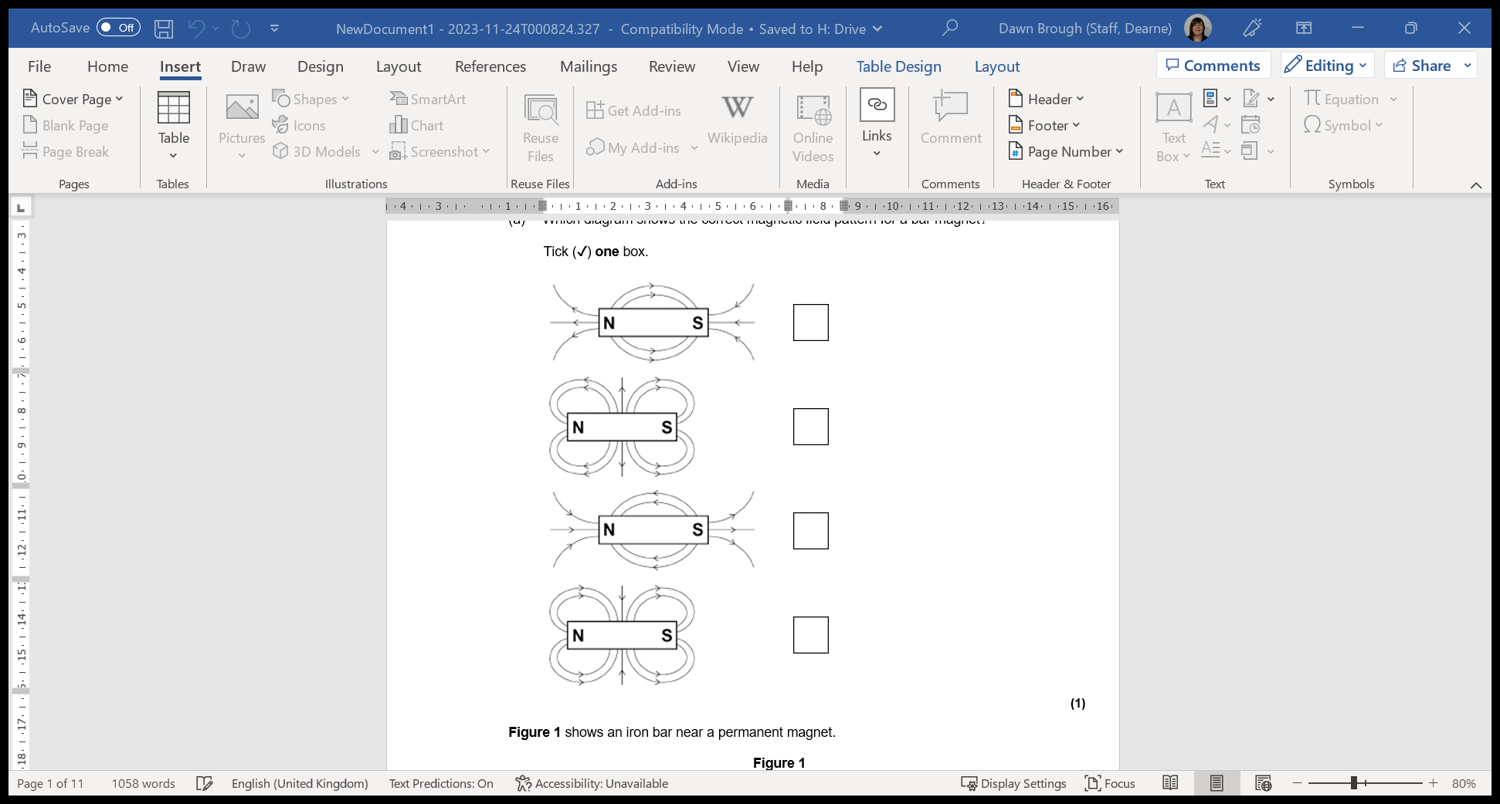
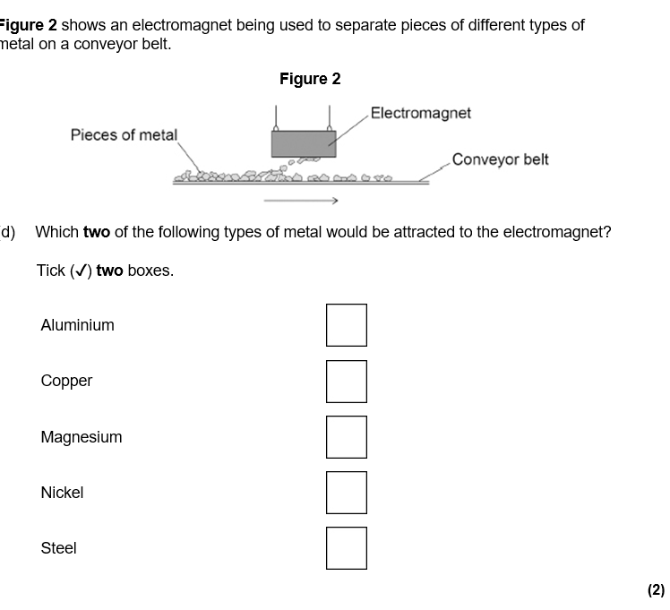
Q1. Magnets attract some metals.
Which diagram shows the correct magnetic field pattern for a bar magnet? Tick (✓) one box.

Slide 26
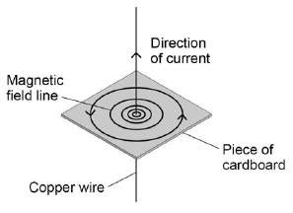
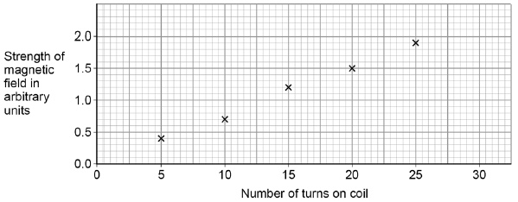
Figure 1 shows the magnetic field around a copper wire carrying a current
a) What do the arrows on the magnetic field line represent?
…………………………………………………………………………………………………………………………………………………………..
(b) Complete the sentence. Choose the answer from the box.
As the distance from the copper wire increases, the magnetic field strength ____________________ .c) Suggest how the field lines on Figure 1 show the variation in field strength. ………………………………………………………………………………………………………………………………………………………………………………………………………………………………………………………………………………………………………………………………………………………………………………………………………………………………………………………………………………………………………………………………………………………………………………………………………………………………………………………...............(3A student coiled the copper wire a different number of times to form a solenoid. Each time the student measured the strength of the magnetic field inside the solenoid. Figure 2 shows the results.
Figure 2
decreases | increases | stays the same

Slide 27

(d) Draw a line of best fit on Figure 2. (1)
(e) Determine the increase in strength of magnetic field when the number of turns on the coil is changed from 12 to 18. …………………………………………………………………………………………………………………………………………………………………………………………………………………………………………………………………………………………………………………………………………………………………………………………………………………………………………………………………………
Increase in strength of magnetic field = ____________________ arbitrary units
(2)
(f) How could the strength of the magnetic field be increased? Tick two boxes.
Increase the current through the solenoid.
Increase the potential difference across the solenoid.
Increase the temperature of the solenoid.
Spread the turns of wire on the solenoid further apart.
Use wire with a higher resistance to make the solenoid.
(2)
Figure 3 shows the north and south poles of a solenoid. Figure 3
.
Draw field lines to show the magnetic field around the solenoid. (2)

Slide 28
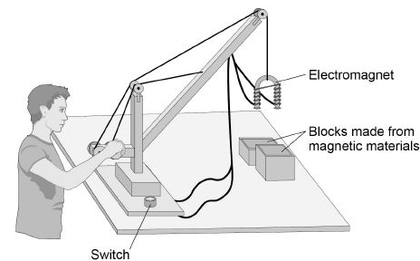
(h) How can the solenoid be made into an electromagnet?
……………………………………………………………………………………………………………………………………………………………………………………………………………………………………………………………………………………………………………………………………………………………………………………………………………………………………………………………………………(1)
(c) Figure 2 shows a toy crane.
            Figure 2
The toy crane uses an electromagnet to pick up and move the blocks.
Explain how this electromagnet is able to pick up and move the blocks. (6)
………………………………………………………………………………………………………………………………………………………………………………………………………………………………………………………………………………………………………………………………………………………………………………………………………………………………………………………………………….....
………………………………………………………………………………………………………………………………………………………………………………………………………………………………………………………………………………………………………………………………………………………………………………………………………………………………………………………………………….....
………………………………………………………………………………………………………………………………………………………………………………………………………………………………………………………………………………………………………………………………………………………………………………………………………………………………………………………………………….....
…………………………………………………………………………………………………………………………………………………………

Slide 29
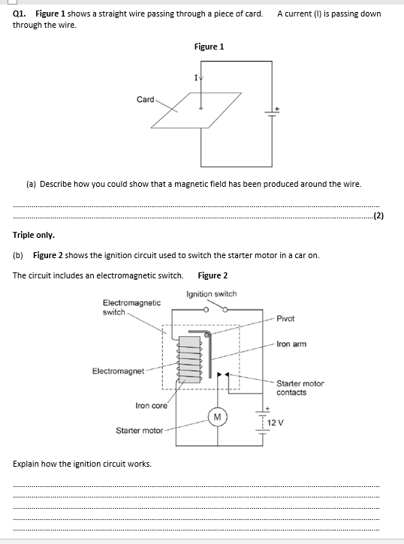

Slide 30
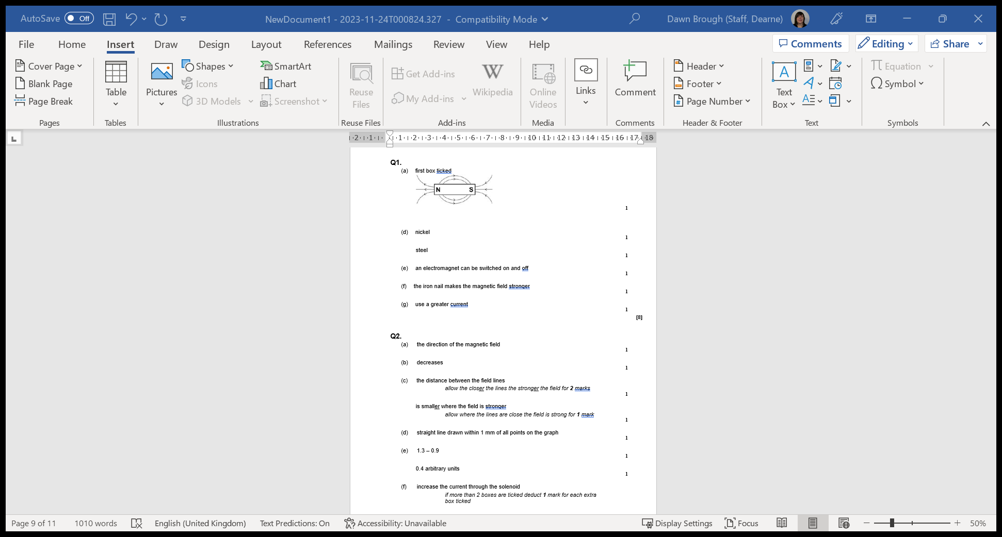

Slide 31
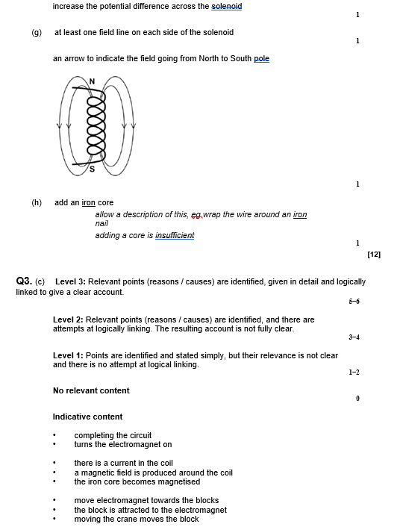

Slide 32
Mark schemes
Q1.
(a) move a (magnetic / plotting) compass around the wire
1
the changing direction of the compass needle shows a magnetic field has been produced
OR
sprinkle iron filings onto the card (1)
tapping the card will move the filings to show the magnetic field (pattern) (1)
(b) Level 2 (3–4 marks):
A detailed and coherent explanation is provided. The response makes logical links between clearly identified, relevant points that explain how the ignition circuit works.
Level 1 (1–2 marks):
Simple statements are made. The response may fail to make logical links between the points raised.
0 marks:
No relevant content.
Indicative content
• closing the (ignition) switch causes a current to pass through the electromagnet
• the iron core (of the electromagnet) becomes magnetised
• the electromagnet / iron core attracts the (short side of the ) iron arm
• the iron arm pushes the (starter motor) contacts (inside the electromagnetic switch) together
• the starter motor circuit is complete
• a current flows through the starter motor (which then turns)
4
12

Slide 33
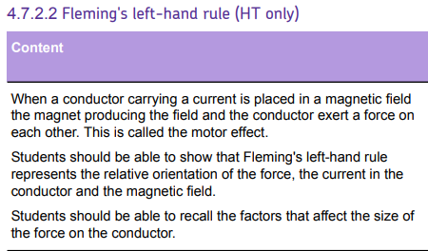
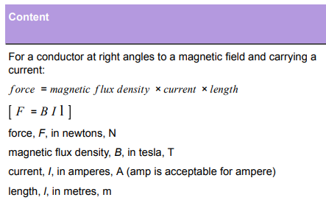
AQA Content

Slide 34
Subtopic 3: Fleming’s left-hand rule
Learning Objective: to be able to decide the direction of the force on a current carrying conductor using Flemings left hand rule
Why are we learning about this? We use appliances everyday that have electric motors in them. When electricians need to decide which way a current is flowing through a motor and how magnetic field, current and movement are related they use Flemings Left hand rule
3

Slide 35
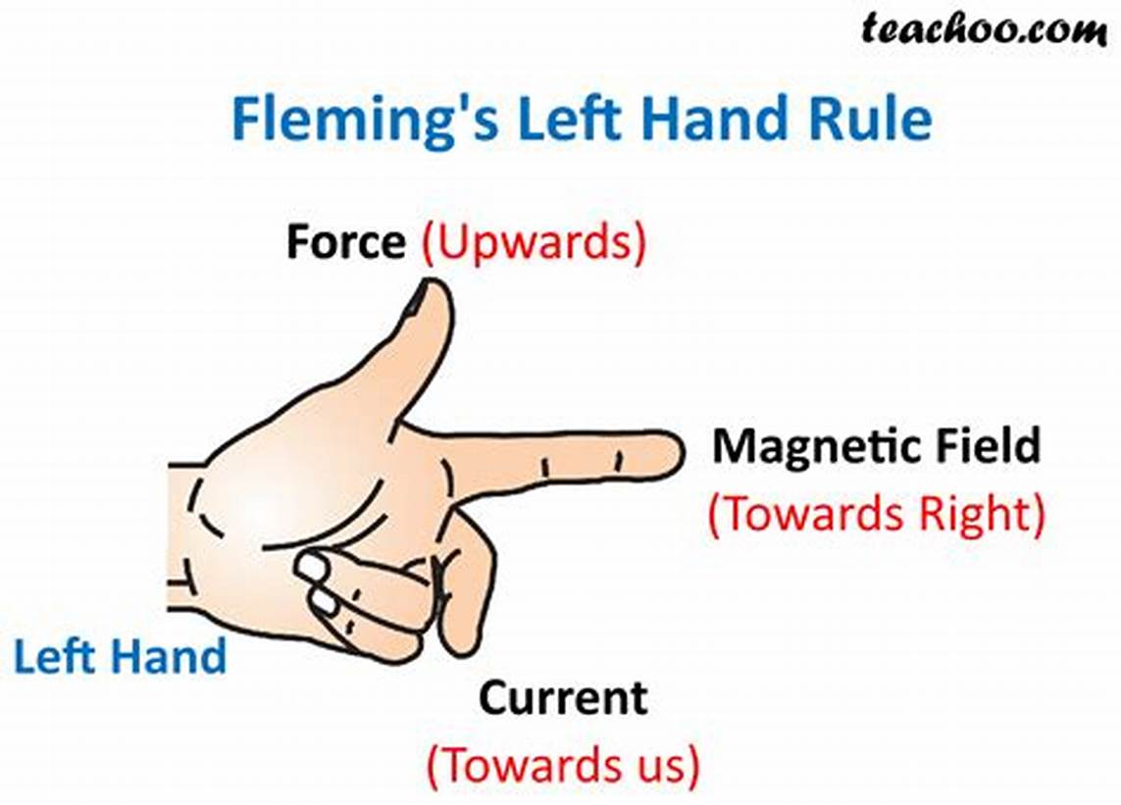
1 2 3 4 5 6 7 8 9 10 11 12 13 14 15 16 17 18 19 20 21 22 23 24 25 26 27 28 29 30 | Flemings left and Rule Flemings's Left Hand Rule allows us to work out the relative directions of the current, magnetic field and motion of the wire. You will use this in your exam. Don’t worry about it looking daft . It will help Your thumb and first two fingers of your left hand should be at right angles to each other. Point your first finger in the direction of the magnetic field from North to South. Point your second finger in the direction of the current. This is known as CONVENTIONAL CURRENT flowing from POSITIVE TO NEGATIVE. (this is the opposite direction to the direction of electron flow).Your thumb then shows the direction of the motion of the wire. ThuMb = Motion First finger = Field SeCond finger = Current

Slide 36
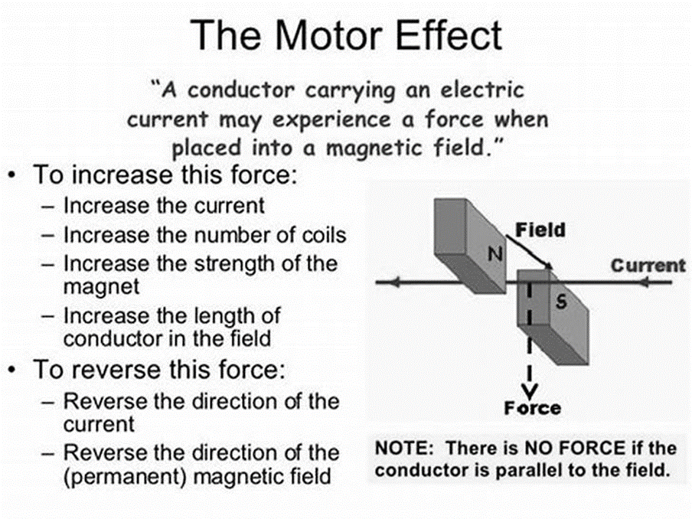
1 2 3 4 5 6 7 8 9 10 11 12 13 14 15 16 17 18 19 20 21 22 23 24 25 26 27 28 29 30 | We use appliances everyday that have electric motors in them e.g. hairdryers, shavers, fridges, computers are just a few. All of these contain an electric motor. The motor works because a force can act on a wire (or any other conductor) in a magnetic field when a current is passed through the wire. This is called THE MOTOR EFFECT. The direction of the force is always at right angles to the wire and the magnetic field. The direction of the Motion/ force is reversed if either the direction of the current or the magnetic field is reversed. We can use FLEMINGS LEFT HAND RULE to show how the directions are related to each other. The size of the force can be increased by: Increasing the current Increasing the size of the magnet The length of the wire that is in the magnetic field. When a straight wire with a current flowing through it is put between the poles of a magnet, the two magnetic fields combine making the resultant field stronger in one area and weaker in another. This produces a force on the wire which makes it move. This is called THE MOTOR EFFECT. The direction of the force and the motion of the wire is perpendicular to both the magnetic field and the current. Flemings rule allows us to work out these directions

Slide 37
1 2 3 4 5 6 7 8 9 10 11 12 13 14 15 16 17 18 19 20 21 22 23 24 25 26 27 28 29 30 | The size of the resultant force also depends on the angle between the wire and the magnetic field lines. The force is greatest when the wire is perpendicular/ 90 degrees to the magnetic field and zero when parallel to the magnetic field lines. The size of the force in the wire or conductor depends on : The current I in the wire or conductor The length of the wire or conductor L The size of the magnetic flux density of the magnetic field B They are linked by this formula: Force (F) = magnetic flux density (B) x current (I) x length (L) UNITS: Force in newtons (N) Magnetic flux Density in tesla (T) Current in amperes (A) Length in metres (m) Remember length is in meters so you must convert it if the measurement is in centimetres

Slide 38
Rehearsal Questions
What does Flemings left hand rule show?
………………………………………………………………………………………………………………………………………………………
2 What does your first finger show the direction of?
………………………………………………………………………………………………………………………………………………………
3. What does your second finger show the direction of?
………………………………………………………………………………………………………………………………………………………
4. What does your thumb show the direction of?
……………………………………………………………………………………………………………………………………………………
5. What is the current represented by on you left hand?
………………………………………………………………………………………………………………………………………………………
6. What is the motion represented by on your left hand?
………………………………………………………………………………………………………………………………………………………
7. What is the magnetic field represented by on your left hand? ………………………………………………………………………………………………………………………………………………………
8. Conventional current is represented by which finger?
………………………………………………………………………………………………………………………………………………………
9.Magnetic field is represented by your first finger. What shows motion? ……………………………………………………………………………………
10. The motor effect is when a wire moves in a magnetic field. What rule shows us the direction of all three parts?…………………………………………………… ……………………………………………………………………………
.
Directions of current field and motion
field
current
Motion
2nd finger
thumb
1st finger
2nd finger
thumb
Fleming left hand rule

Slide 39
Contrasting concepts
I DO
Compare what the first finger shows to the thumb
…………………………………………………………………………………………………………………………………………………………
……………………………………………………………………………………………………………………………………………………….
.WE DO
Compare what the thumb shows to the second finger …………………………………………………………………………………………………………………………………………………………………………………………………………………………………………………………………………………………………………………
.YOU DO
Compare what the second finger shows to the first finger
………………………………………………………………………………………………………………………………………………………………. ………………………………………………………………………………………………………………………………………………….
Compare the units of flux to the units of length
………………………………………………………………………………………………………………………………………………………………. ………………………………………………………………………………………………………………………………………………….
Compare the units of current to the units of force
……………………………………………………………………………………………………………………………………………………………………………………………………………………………………………………………………………………………………………………
.Compare the units of force to the units of flux
………………………………………………………………………………………………………………………………………………………….
……………………………………………………………………………………………………………………………………………………….
Field to Motion or force direction
Motion or force to current
Current to field
Flux is tesla length is metres
Current is Amps force is newtons
Force is newtons flux is teslas

Slide 40
Wrong answers
I DO
Flux is measured in Amps ………………………………………………………………………………………………………………………………………………………………………………………………………………………………..……………………………………………………………………………………
WE DO
Force is measured in Tesla's
………………………………………………………………………………………………………………………………………………………………………………………………………………………………………………….…………………………………………………………………..…
YOU DO
Length is measured in centimetres
………………………………………………………………………………………………………………………………………………………………………………………………………………………………………………….……………………………………………………………………
You used the right hand rule to work out the direction of the size of the current
………………………………………………………………………………………………………………………………………………………………………………………………………………………………………………….………………………………………………………………………….
The smaller the current the greater the motion ………………………………………………………………………………………………………………………………………………………………………………………………………………………………………………….…………………………………………………………………
The bigger the magnetic field the smaller the resultant motion or force
………………………………………………………………………………………………………………………………………………………………………………………………………………………………………………….…………………………………………………………………………….
No Tesla's
No newtons
No metres
Left hand for direction of field force or current
No larger
No bigger field bigger current

Slide 41
Interleaving questions - YOU DO
What force exist between two like poles of a magnet?
………………………………………………………………………………………………………………………………………………………………………………………………………………………………………………….………………………………………………
2. Why might a current carrying wire move when place between ,magnetic poles?
………………………………………………………………………………………………………………………………………………………………………………………………………………………………………………….………………………………………………………
………………………………………………………………………………………………………………………………………………………………………………………………………………………………………………….………………………………………………………
………………………………………………………………………………………………………………………………………………………
3. What does the directions of the thumb indicate in Flemings left hand rule?
………………………………………………………………………………………………………………………………………………………………………………………………………………………………………………….…………………………………………………………
4. What does the first finger indicate in Flemings left hand rule?
………………………………………………………………………………………………………………………………………………………
5. What angle must exist between ad magnetic field and a conductor?
………………………………………………………………………………………………………………………………………………………
6. What is an example a good conductor?
………………………………………………………………………………………………………………………………………………………
7. What is a good example of a good insulator? ………………………………………………………………………………………………………………………………………………………
8. Heat loss through solids occurs by which process
………………………………………………………………………………………………………………………………………………………………………………………………………………………………………………….………………………………………………………
9. Convection currents occur in which two media?
………………………………………………………………………………………………………………………………………………………………………………………………………………………………………………….………………………………………………………
………………………………………………………………………………………………………………………………………………………………………………………………………………………………………………….………………………………………………………
repulsion
Magnetic field around wire interacts with field between poles, causing magnet and wire to exert a force on each other. Force cause wire to move
motion
field
90 degrees
metals
air
conduction
Liquids and gases

Slide 42
1 2 3 4 5 6 7 8 9 10 11 12 13 14 15 16 17 18 19 20 21 22 23 24 25 26 27 28 29 30 | Exam Questions A teacher used the equipment shown in the figure below to demonstrate the motor effect. Describe how Fleming’s left-hand rule can be used to determine the direction in which the rod will move when the switch is closed and state the direction. ……………………………………………………………………………………………………………………. ……………………………………………………………………………………………………………………. ………………………………………………………………………………………………………… b) Increasing the current can increase the force acting on the copper rod. Give one other way in which the size of the force acting on the copper rod could be increased. ……………………………………………………………………………………………………………………. (1) (c) The copper rod in the figure above has a length of 7 cm and a mass of 4 ×10^{–4} kg. When there is a current of 1.12 A the resultant force on the copper rod is 0 N. Calculate the magnetic flux density. Gravitational field strength = 9.8 N / kg Magnetic flux density = __________________ T A teacher used the equipment shown in the figure below to demonstrate the motor effect. Describe how Fleming’s left-hand rule can be used to determine the direction in which the rod will move when the switch is closed and state the direction. ……………………………………………………………………………………………………………………. ……………………………………………………………………………………………………………………. ………………………………………………………………………………………………………… b) Increasing the current can increase the force acting on the copper rod. Give one other way in which the size of the force acting on the copper rod could be increased. ……………………………………………………………………………………………………………………. (1) (c) The copper rod in the figure above has a length of 7 cm and a mass of 4 ×10^{–4} kg. When there is a current of 1.12 A the resultant force on the copper rod is 0 N. Calculate the magnetic flux density. Gravitational field strength = 9.8 N / kg Magnetic flux density = __________________ T Explain one way that the motor could be changed to increase the rate at which the coil rotates. ……………………………………………………………………………………………… ……………………………………………………………………………………………… (2) (Total 7 marks) .
Thumb shows motion or force, first finger shows current. 2nd finger shows current. copper rod moves upwards
Increase magnet
Increase MFD
Increase rod length
W = 9.8 x4 x 10⁻⁴ = 3.92 x 10⁻³
7 cm = .07 m
3.92 x 10⁻³ = B x 1.12 x .07
B = 3.92 x 10⁻³
.0784
B = .05T

Slide 43
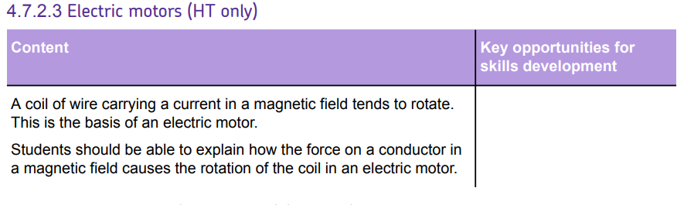
Subtopic 4: Electric Motors (HT only)
AQA Content

Slide 44
Subtopic 4: Electric Motors (HT only)
Learning Objective
to explain how the force on a conductor in a magnetic field causes the rotation of the coil in an electric motor
Why are we learning about this?
This lessons helps us understand that electric motors are inherent in a lot of appliances that we use on a day-to-day basis
3

Slide 45
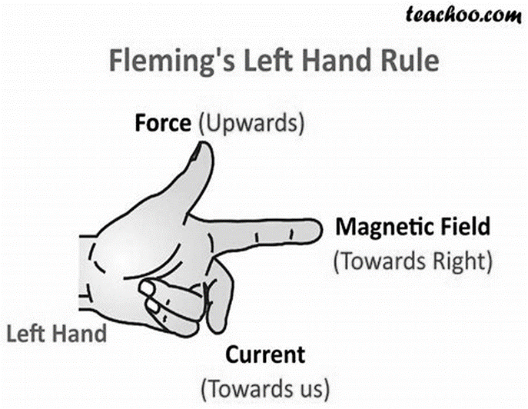
1 2 3 4 5 6 7 8 9 10 11 12 13 14 15 16 17 18 19 20 21 22 23 24 25 26 27 28 29 30 | I wasn’t there but I still care – using the physics text book page220: What is Flemings left hand rule …………………………………………………………………………………………………………………………………. ……………………………………………………………………………………………………………………………………… ……………………………………………………………………………………………………………………………………….. What does the size of the force depend on …………………………………………………………………………………………………………………………………….. ……………………………………………………………………………………………………………… ………………………………………………………………………………………………………………………………………. …. What does the thumb represent? …………………………………………………………………………………………………………………………………….. ………………………………………………………………………………………………………………………………………… What does the first finger represent? ……………………………………………………………………………………………………………………………………….. ……………………………………………………………………………………………………………………………………….. What does the second finger represent? ……………………………………………………………………………………………………………………………………… ………………………………………………………………………………………………………………………………………. .
Show the relative positions of the field, current and motion
The angle between the wire and the magnetic field
Motion or force
field
current

Slide 46
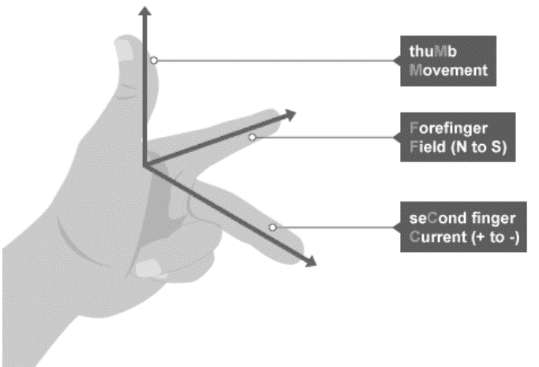
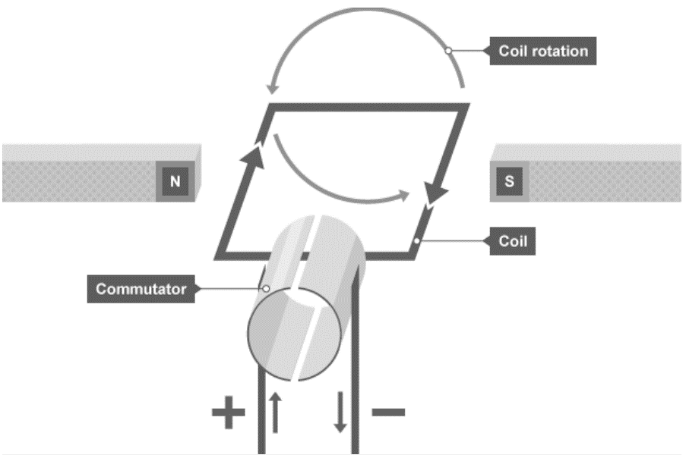
1 2 3 4 5 6 7 8 9 10 11 12 13 14 15 16 17 18 19 20 21 22 23 24 25 26 27 28 29 30 | The phenomenon of a coil of wire carrying a current in a magnetic field tending to rotate forms the fundamental principle of an electric motor. This is a key concept and is crucial to understanding how many of our everyday appliances function. When a current-carrying coil is placed in a magnetic field, it experiences a force. This force is due to the interaction between the magnetic field and the magnetic field created by the current flowing through the coil. The direction of this force can be determined using Fleming’s left-hand rule, which states that if the thumb, forefinger, and middle finger of the left hand are extended such that they are mutually perpendicular, and if the forefinger points in the direction of the magnetic field, the middle finger in the direction of the current, then the thumb will point in the direction of the force or motion. In an electric motor, the coil is arranged to rotate freely about an axis. When the coil rotates, the direction of the current in the coil changes. This, in turn, changes the direction of the force on each side of the coil. As a result, the coil continues to rotate. This rotation is what drives the motor and, in turn, the appliance in which the motor is housed.

Slide 47
1 2 3 4 5 6 7 8 9 10 11 12 13 14 15 16 17 18 19 20 21 22 23 24 25 26 27 28 29 30 | The force experienced by the coil, and therefore the speed of rotation of the motor, can be increased by increasing the current flowing through the coil, increasing the strength of the magnetic field in which the coil is placed, or increasing the number of turns of wire in the coil. Conversely, the force and speed of rotation can be decreased by reducing any of these factors. The rotation of a current-carrying coil in a magnetic field is a fundamental concept in physics. It underpins the operation of the electric motor, a device that has revolutionised technology and our daily lives.

Slide 48
Rehearsal Questions
What is the fundamental principle of an electric motor?
……………………………………………………………………………………………………………………………………………………………………………………………………………………………………………………………………………………………………………………
2. What happens when a current-carrying coil is placed in a magnetic field?
……………………………………………………………………………………………………………………………………………………………………………………………………………………………………………………………………………………………………………………………………………………………………………………………………………………………………………………………………………… 3. How can the direction of the force on a current-carrying coil in a magnetic field be determined?
……………………………………………………………………………………………………………………………………………………….
4. What happens in an electric motor when the coil rotates?
………………………………………………………………………………………………………………………………………………………………………………………………………………………………………………………………………………………………………………………………………………………………………………………………………………………………………………………………………………
5. What drives the rotation of the motor in an electric motor?
…………………………………………………………………………………………………………………………………………………………………………………………………………………………………………………………………………………………………………………… 6. How can the force experienced by the coil, and therefore the speed of rotation of the motor, be increased?
………………………………………………………………………………………………………………………………………………………………………………………………………………………………………………………………………………………………………………………………………………………………………………………………………………………………………………………………………………
7. How can the force and speed of rotation be decreased?
………………………………………………………………………………………………………………………………………………………………………………………………………………………………………………………………………………………………………………………………………………………………………………………………………………………………………………………………………………
8. What principle of physics is at work in devices like computer fans and electric car motors?
……………………………………………………………………………………………………………………………………………………….
The fundamental principle of an electric motor is the phenomenon of a coil of wire carrying a current in a magnetic field tending to rotate.
When a current-carrying coil is placed in a magnetic field, it experiences a force due to the interaction between the magnetic field and the magnetic field created by the current flowing through the coil.
The direction of the force can be determined using Fleming’s left-hand rule.
When the coil rotates, the direction of the current in the coil changes. This, in turn, changes the direction of the force on each side of the coil, causing the coil to continue rotating.
The rotation of the coil, driven by the force experienced by the coil in the magnetic field, drives the motor.
The force and speed of rotation can be increased by increasing the current flowing through the coil, increasing the strength of the magnetic field in which the coil is placed, or increasing the number of turns of wire in the coil.
The force and speed of rotation can be decreased by reducing the current flowing through the coil, reducing the strength of the magnetic field in which the coil is placed, or reducing the number of turns of wire in the coil.
The principle of the rotation of a current-carrying coil in a magnetic field is at work in these devices.

Slide 49
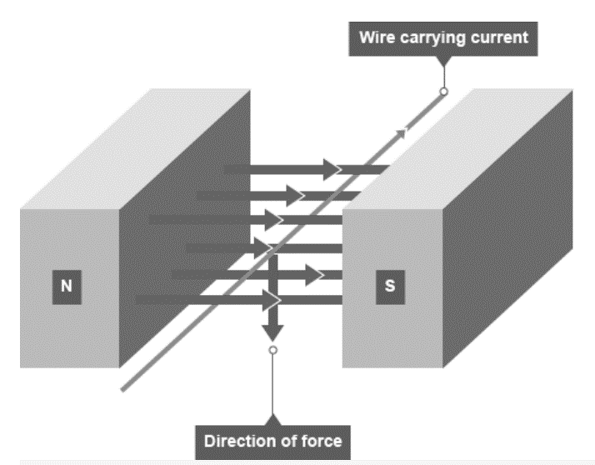
How an electric motor works
The motor effect can be used to explain how
an electric motor rotates. When a wire
Carrying a current passes through a magnetic
Field, it experiences a force. The direction
of the current determines the direction of
the force. This can be determined using
Fleming’s left hand rule.
If you place a coil of wire into a magnetic field, with current moving in both directions, one part of the wire will experience a force in the opposite direction of the other part of the wire. This makes the coil rotate. This effect can be described as follows:
Based on the diagram above:
1. Current in the left-hand part of the coil causes a downward force, and current in the right-hand part of the coil causes an upward force. This causes the coil to rotate anti-clockwise.
2. When the coil is vertical, it moves parallel to the magnetic field, producing no force, the coil should stop, but two features allow the coil to continue rotating:
a. the momentum of the motor carries it round a little
b. a spilt ring commutator changes the current direction every half turn
3. Once the conducting brushes reconnect with the commutator after a half turn:
a. current flows in the opposite direction through the wire in the coil
b. each side of the coil is now near the opposite magnetic pole
This means that the motor effect forces continue to cause anti-clockwise rotation of the coil.

Slide 50
Rehearsal Questions
What causes the coil in a motor to rotate anti-clockwise?
……………………………………………………………………………………………………………………………………………………………………………………………………………………………………………………………………………………………………………………
Why doesn’t the coil stop when it moves parallel to the magnetic field?
……………………………………………………………………………………………………………………………………………………………………………………………………………………………………………………………………………………………………………………
What is the role of the split ring commutator in a motor?
……………………………………………………………………………………………………………………………………………………………………………………………………………………………………………………………………………………………………………………
What happens after the conducting brushes reconnect with the commutator after a half turn?
……………………………………………………………………………………………………………………………………………………………………………………………………………………………………………………………………………………………………………………
How does the change in current direction affect the rotation of the coil in a motor?
……………………………………………………………………………………………………………………………………………………………………………………………………………………………………………………………………………………………………………………
The coil rotates anti-clockwise due to the forces caused by the current in the coil.
The coil doesn’t stop due to its momentum and the action of the split ring commutator.
The split ring commutator changes the current direction, allowing the coil to keep rotating.
After reconnection, the current direction changes and the coil continues its anti-clockwise rotation.
The change in current direction keeps the coil rotating anti-clockwise

Slide 51
How could you…:
I DO: Make the motor spin in the opposite direction?
……………………………………………………………………………………………………………………………………………………………………………………………………………………………………………………………………………………………………………………
WE DO: Make the motor spin faster?
……………………………………………………………………………………………………………………………………………………………………………………………………………………………………………………………………………………………………………………
YOU DO: Make the motor spin in the opposite direction?
……………………………………………………………………………………………………………………………………………………………………………………………………………………………………………………………………………………………………………………
YOU DO: Make the motor spin faster? (HINT: think back to electromagnets)
…………………………………………………………………………………………………………………………………………………………………………………………………………………………………………………………………………………………………………………… 5. YOU DO: Make the motor spin faster? (HINT: think tesla…)
……………………………………………………………………………………………………………………………………………………………………………………………………………………………………………………………………………………………………………………
Reverse the direction of the magnetic field
Increase the size of the current
Reverse the direction of the current
Increase the number of coils
Increase magnetic flux density

Slide 52
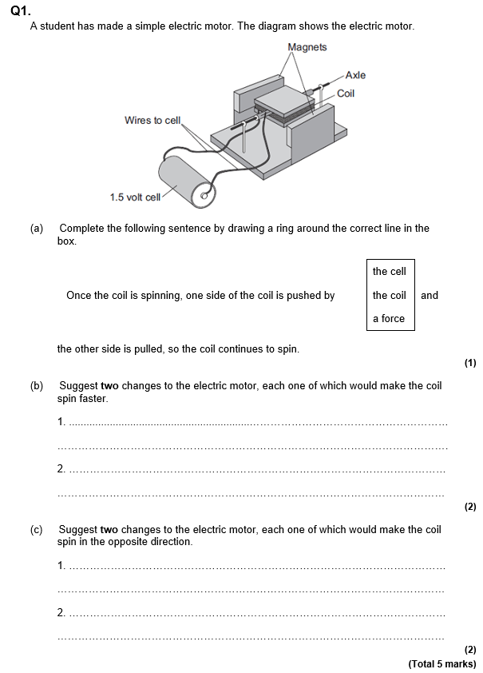
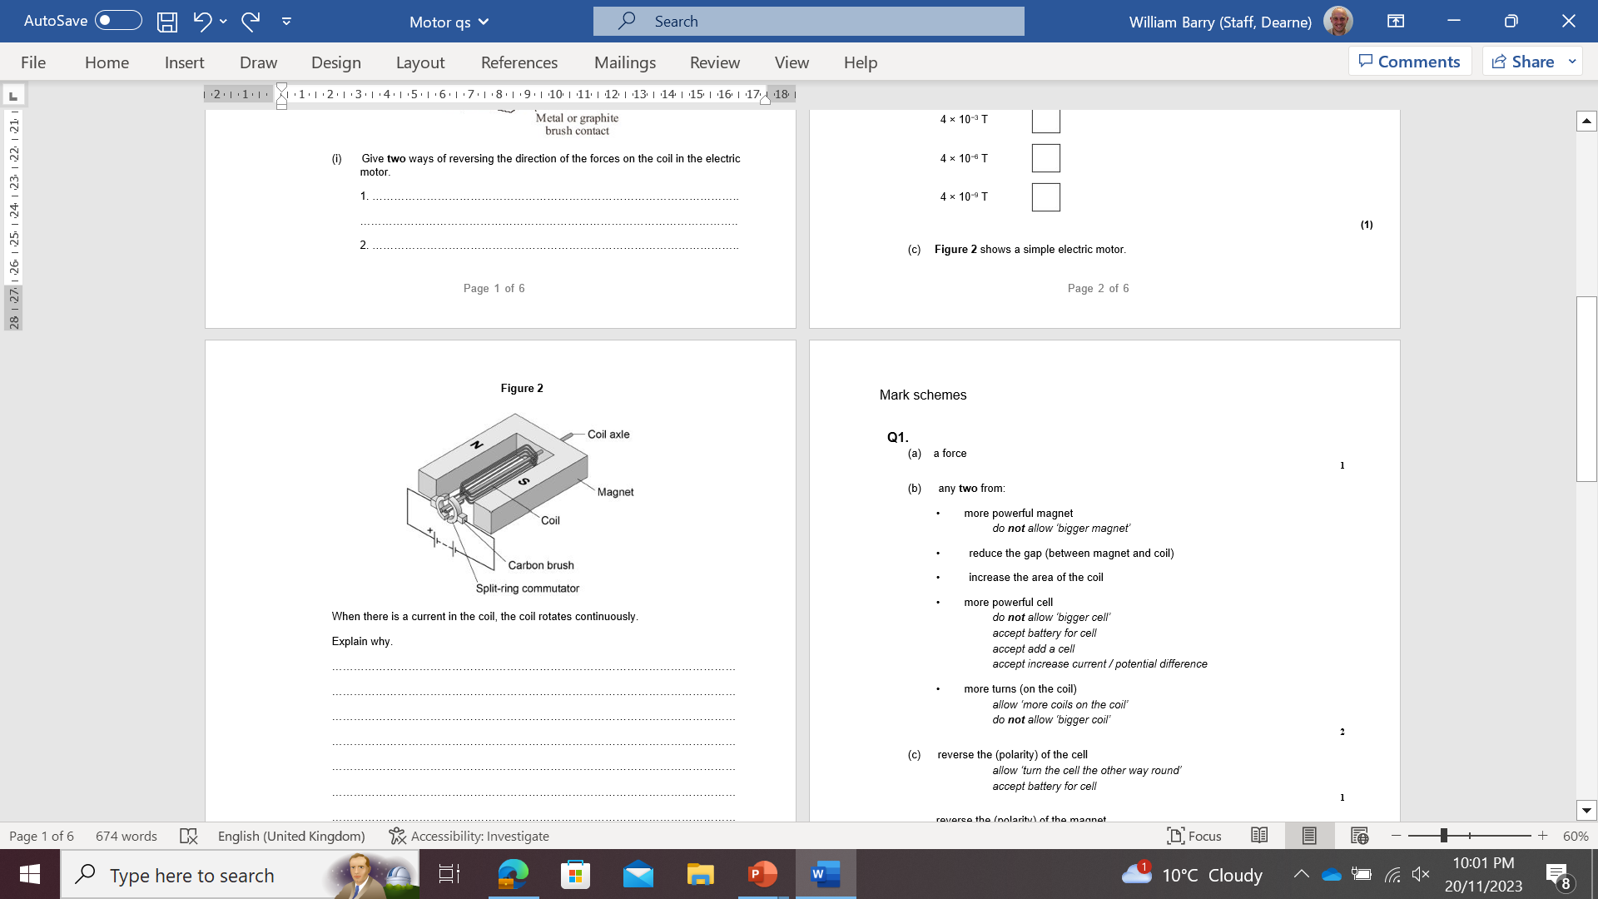
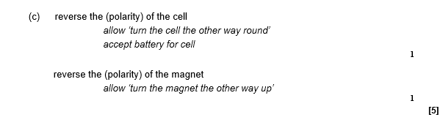
Exam questions

Slide 53
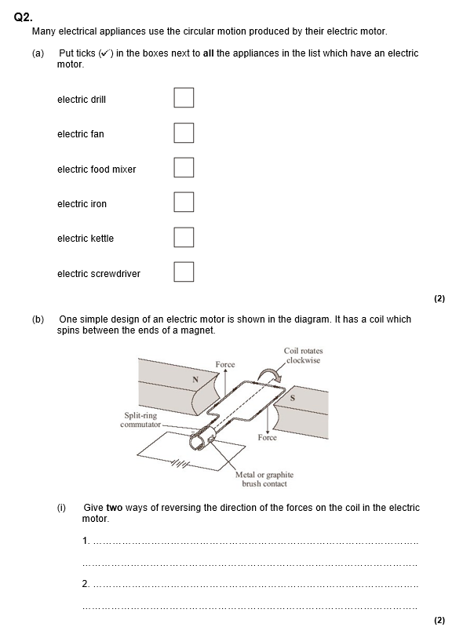
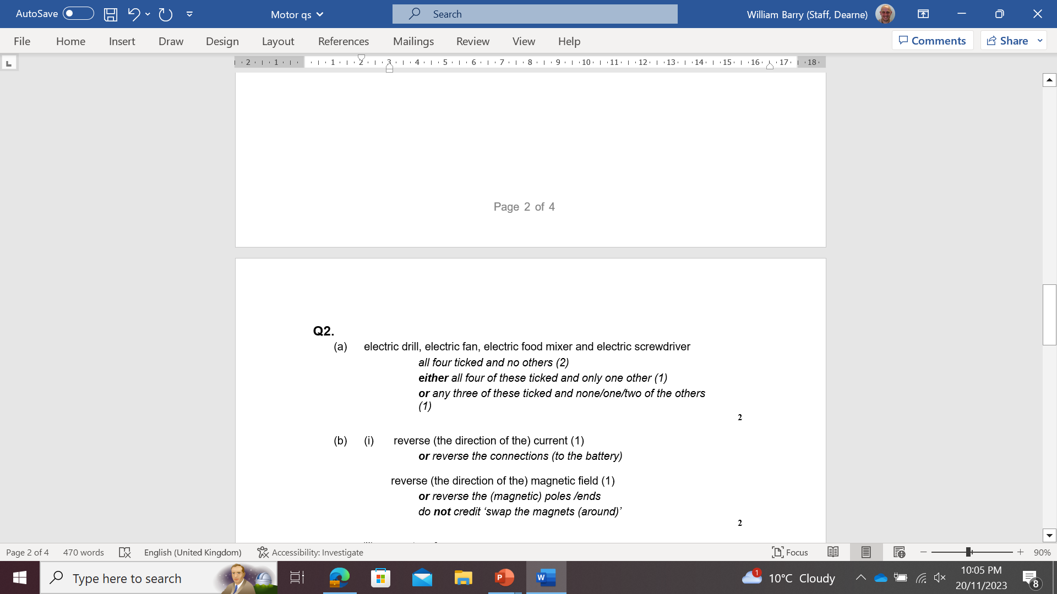
Exam questions

Slide 54
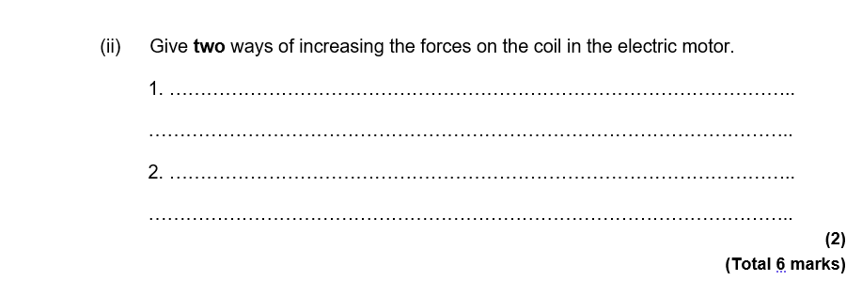
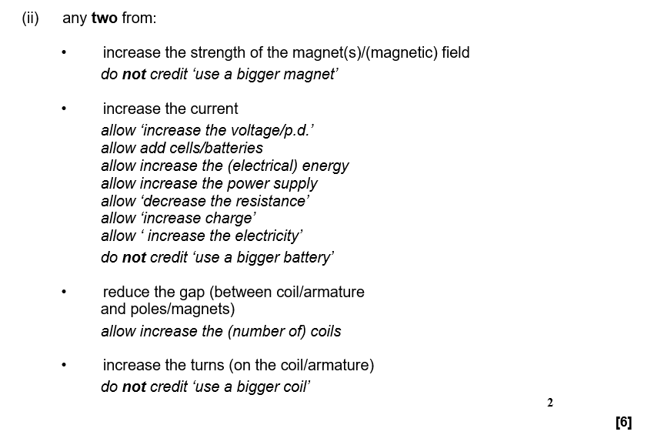
Exam questions

Slide 55
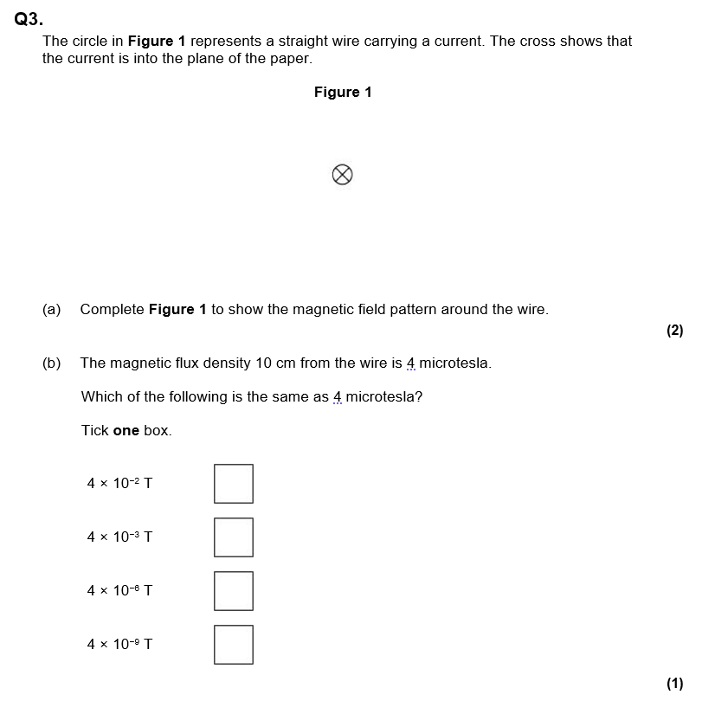
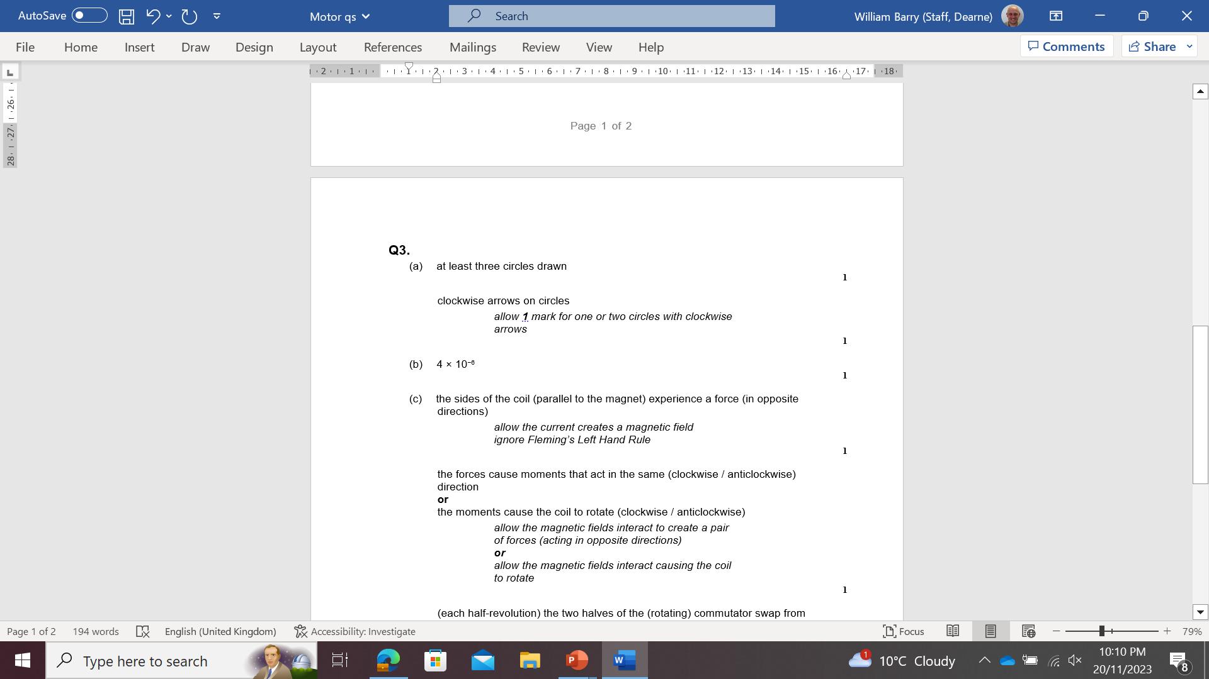
Exam questions

Slide 56
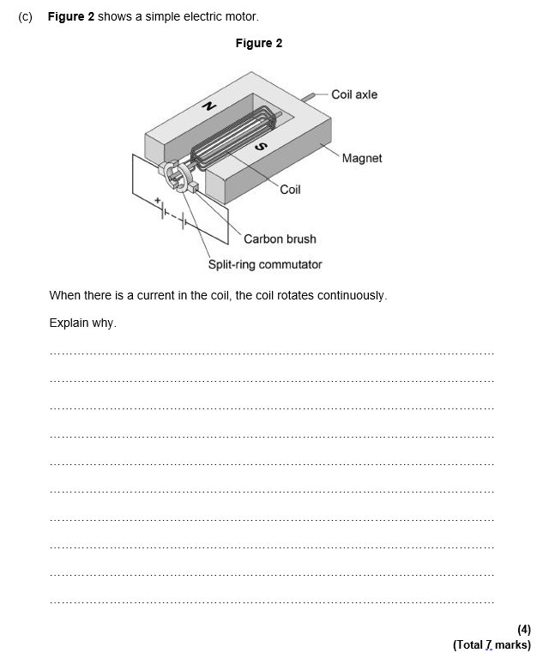
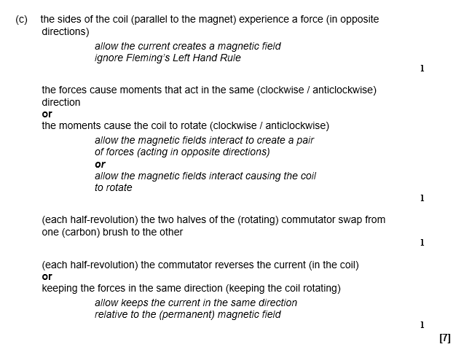
Exam questions

Slide 57
DO NOW
Date: ……………………………………….
 | ANSWER
Q1.
Q2.
Q3.
Q4.
Q5.
Date: ……………………………………….
 | ANSWER
Q1.
Q2.
Q3.
Q4.
Q5.

Slide 58
DO NOW
Date: ……………………………………….
 | ANSWER
Q1.
Q2.
Q3.
Q4.
Q5.
Date: ……………………………………….
 | ANSWER
Q1.
Q2.
Q3.
Q4.
Q5.

Slide 59
Knowledge Retrieval Quiz 1
Date: ……………………………………….
Score: …………...
 |  | Answer
Q1. | Insert question in bold
Q2.
Q3.
Q4.
Q5.
Q6.
Q7.
Q8.
Q9.
Q10.

Slide 60
Knowledge Retrieval Quiz 2
Date: ……………………………………….
Score: …………...
 |  | Answer
Q1. | Insert question in bold
Q2.
Q3.
Q4.
Q5.
Q6.
Q7.
Q8.
Q9.
Q10.

Slide 61
Extra Space
……………………………………………………………………………………………………………………………………………………………………………………………………………………………………………………………………………………………………………………………………………………………………………………………………………………………………………………………………………………………………………………………………………………………………………………………………………………………………………………………………………………………………………………………………………………………………………………………………………………………………………………………………………………………………………………………………………………………………………………………………………………………………………………………………………………………………………………………………………………………………………………………………………………………………………………………………………………………………………………………………………………………………………………………………………………………………………………………………………………………………………………………………………………………………………………………………………………………………………………………………………………………………………………………………………………………………………………………………………………………………………………………………………………………………………………………..
…………………………………………………………………………………………………………………………………………………………………………………………………………………………………………………………………………………………………………………………………………………………………………………………………………………………………………………………………………………………………………………………………………………………………………………………………………………………………………………………………………………………………………………………………………………………………………………………………………………………………………………………………………………………………………………………………………………………………………………………………………………………………………………………………………………………………………………………………………………………………………………………………………………………………………………………………………………………………………………………………………………………………………………………………………………………………………………………………………………………………………………………………………………………………………………………………………………………………………………………………………………………………………………………………………………………………..
…………………………………………………………………………………………………………………………………………………………………………………………………………………………………………………………………………………………………………………………………………………………………………………………………………………………………………………………………………………………………………………………………………………………………………………………………………………………………………………………………………………………………………………………………………………………………………………………………

Slide 62
Extra Space
……………………………………………………………………………………………………………………………………………………………………………………………………………………………………………………………………………………………………………………………………………………………………………………………………………………………………………………………………………………………………………………………………………………………………………………………………………………………………………………………………………………………………………………………………………………………………………………………………………………………………………………………………………………………………………………………………………………………………………………………………………………………………………………………………………………………………………………………………………………………………………………………………………………………………………………………………………………………………………………………………………………………………………………………………………………………………………………………………………………………………………………………………………………………………………………………………………………………………………………………………………………………………………………………………………………………………………………………………………………………………………………………………………………………………………………………..
…………………………………………………………………………………………………………………………………………………………………………………………………………………………………………………………………………………………………………………………………………………………………………………………………………………………………………………………………………………………………………………………………………………………………………………………………………………………………………………………………………………………………………………………………………………………………………………………………………………………………………………………………………………………………………………………………………………………………………………………………………………………………………………………………………………………………………………………………………………………………………………………………………………………………………………………………………………………………………………………………………………………………………………………………………………………………………………………………………………………………………………………………………………………………………………………………………………………………………………………………………………………………………………………………………………………………..
…………………………………………………………………………………………………………………………………………………………………………………………………………………………………………………………………………………………………………………………………………………………………………………………………………………………………………………………………………………………………………………………………………………………………………………………………………………………………………………………………………………………………………………………………………………………………………………………………

Slide 63
Extra Space
……………………………………………………………………………………………………………………………………………………………………………………………………………………………………………………………………………………………………………………………………………………………………………………………………………………………………………………………………………………………………………………………………………………………………………………………………………………………………………………………………………………………………………………………………………………………………………………………………………………………………………………………………………………………………………………………………………………………………………………………………………………………………………………………………………………………………………………………………………………………………………………………………………………………………………………………………………………………………………………………………………………………………………………………………………………………………………………………………………………………………………………………………………………………………………………………………………………………………………………………………………………………………………………………………………………………………………………………………………………………………………………………………………………………………………………………..
…………………………………………………………………………………………………………………………………………………………………………………………………………………………………………………………………………………………………………………………………………………………………………………………………………………………………………………………………………………………………………………………………………………………………………………………………………………………………………………………………………………………………………………………………………………………………………………………………………………………………………………………………………………………………………………………………………………………………………………………………………………………………………………………………………………………………………………………………………………………………………………………………………………………………………………………………………………………………………………………………………………………………………………………………………………………………………………………………………………………………………………………………………………………………………………………………………………………………………………………………………………………………………………………………………………………………..
…………………………………………………………………………………………………………………………………………………………………………………………………………………………………………………………………………………………………………………………………………………………………………………………………………………………………………………………………………………………………………………………………………………………………………………………………………………………………………………………………………………………………………………………………………………………………………………………………

Slide 64
Extra Space
……………………………………………………………………………………………………………………………………………………………………………………………………………………………………………………………………………………………………………………………………………………………………………………………………………………………………………………………………………………………………………………………………………………………………………………………………………………………………………………………………………………………………………………………………………………………………………………………………………………………………………………………………………………………………………………………………………………………………………………………………………………………………………………………………………………………………………………………………………………………………………………………………………………………………………………………………………………………………………………………………………………………………………………………………………………………………………………………………………………………………………………………………………………………………………………………………………………………………………………………………………………………………………………………………………………………………………………………………………………………………………………………………………………………………………………………..
…………………………………………………………………………………………………………………………………………………………………………………………………………………………………………………………………………………………………………………………………………………………………………………………………………………………………………………………………………………………………………………………………………………………………………………………………………………………………………………………………………………………………………………………………………………………………………………………………………………………………………………………………………………………………………………………………………………………………………………………………………………………………………………………………………………………………………………………………………………………………………………………………………………………………………………………………………………………………………………………………………………………………………………………………………………………………………………………………………………………………………………………………………………………………………………………………………………………………………………………………………………………………………………………………………………………………..
…………………………………………………………………………………………………………………………………………………………………………………………………………………………………………………………………………………………………………………………………………………………………………………………………………………………………………………………………………………………………………………………………………………………………………………………………………………………………………………………………………………………………………………………………………………………………………………………………

Slide 65
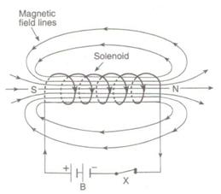
KNOWLEDGE ORGANISER
Subject: Science | Topic: Magnetism | Term: Spring
KEY WORDS | Key words
1 | Magnetic field | The region around a magnet where a force acts on another magnet or on a magnetic material
2 | Electromagnetism | An interaction that occurs between particles with electric charge via electromagnetic fields.
3 | Motor effect | A wire carrying a current creates a magnetic field. This can interact with another magnetic field, causing a force that pushes the wire at right angles.
KEY DIAGRAMS
16

