Slide 1
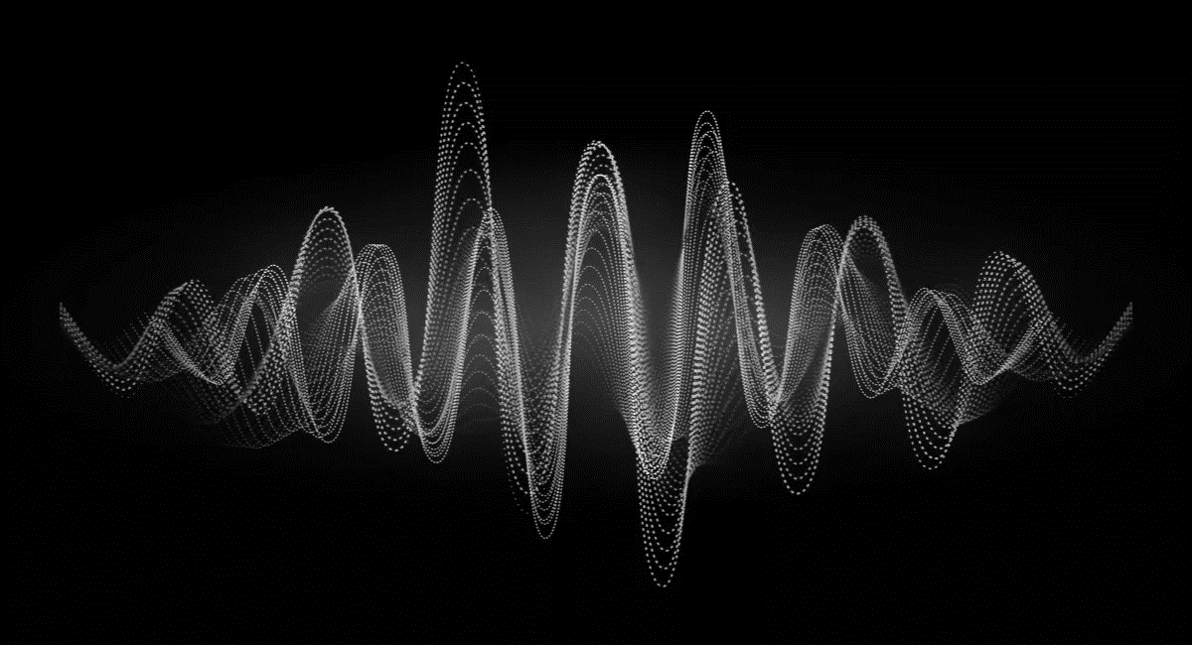
KS4 – Waves (TRIPLE STUDENT BOOKLET B)
Name
Class
Tutor Group
KS4 Science YEAR 11 WAVES
KEYSTONE WORDS
Longitudinal wave | In a longitudinal wave the oscillations are parallel to the direction of energy transfer.
Transverse wave | In a transverse wave the oscillations are perpendicular to the direction of energy transfer.
Refraction | Waves change speed and direction when entering a material with a different density.
Reflection | Reflection of Light occurs when a ray of light approaches a smooth surface and bounces back.

Slide 2
BIG PICTURE
How will my prior knowledge develop my understanding of this topic?
Y7 | You learnt to calculate speed; this will be expanded to include wave speed in this topic. Your knowledge of from the Energy topic will be invaluable waves because waves transfer energy.
Y8 | You studied waves and light. This topic builds on the foundations that you built. You also studied sound waves. How we use sound waves to investigate hidden objects will be studied in this topic.
Learning Journey - Trilogy: Maximum 7 lessons. Triple: Maximum 14 lessons.
Subtopic 1 | Physics only: Required practical – reflection and refraction. | Subtopic 5 | Physics only: 4.6.2.6 Visible light.
Subtopic 2 | Physics only: 4.6.2.5 Lenses.
Subtopic 3 | Physics only (HT only): 4.6.1.5 Waves for detection and exploration.
Subtopic 4 | Physics only: 4.6.3.1 Emission and absorption of infrared radiation 4.6.3.2 Perfect black bodies and radiation.
Key knowledge
By the end of this topic you should know… | How waves behave in different circumstances and be able to describe how humans use waves to make their lives easier.
By the end of this topic should be able to… | Demonstrate properties of waves such as reflection and refraction.

Slide 3
KEY VOCABULARY LIST
Amplitude | The distance from a peak to the zero position of a wave.
Frequency | The number of complete waves that pass a point in a given time.
Time period | Time taken for one complete wave to pass.
Ray diagram | A ray diagram is a representation of the possible paths light can take to get from one place to another.
Normal line | A line drawn perpendicular to a surface.
Incident ray. | A ray of light that falls on any surface.
Reflected ray. | A ray of light that is reflected from a surface.
EXPECTATIONS
Always write in black or blue pen. Always use a ruler for straight lines. If you make a mistake, cross it out with a single line. Always draw diagrams, tables and graphs in pencil with a ruler if necessary Always mark and correct your work in green pen. Respond to any feedback your teacher gives you in green pen. Take pride in your work, make it neat! All tasks should be completed in silence and by yourself unless your teacher tells you otherwise.
PROUD
Punctuation and grammar
Ruler and pencil for diagrams
Outstanding effort every lesson
Underline date and title
Dates and titles every lesson
PROUD FRIDAY
Any piece of work you complete, which meets our PROUD expectations can be taken to the PROUD station during Friday lunchtime. Show your work to a member of SLT and receive a sweet treat!

Slide 4
Subtopic 4: Emission & Absorption of infrared radiation
Learning Objective
We are learning that all bodies, no matter what temperature emit and absorb infra red radiation
Why are we learning about this?
This lessons helps us understand how temperature is related to the amount of infra red radiation given out or taken in by an object

Slide 5
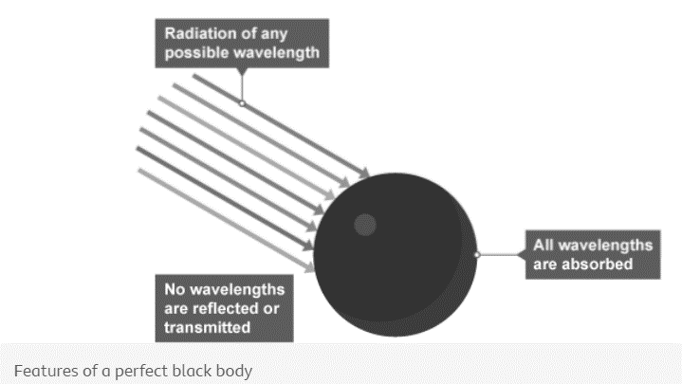
1 2 3 4 5 6 7 8 9 10 11 12 13 14 15 16 17 18 19 20 21 22 23 24 25 26 27 28 29 30 | Emission and absorption of infrared radiation All bodies (objects) emit and absorb infrared radiation. They do this whatever their temperature. The hotter the body: the more infrared radiation it gives out in a given time the greater the proportion of emitted radiation is visible light Black bodies There are no known objects that are perfect at absorbing or emitting all the radiation, of every possible frequency, that may be directed at it. Some objects do, however, come close to this and these are referred to as "black bodies". A perfect black body is a theoretical object. It would have these properties: it would absorb all the radiation that falls on it it would not reflect or transmit any radiation An object that is good at absorbing radiation is also a good emitter, so a perfect black body would be the best possible emitter of radiation. Stars are considered to be black bodies because they are very good emitters of most wavelengths in the electromagnetic spectrum . This suggests that stars also absorb most wavelengths. Whilst there are a few wavelengths that stars do not absorb or emit, this figure is very low, so they can be treated as black bodies. Planets and black holes are also treated as nearly perfect black bodies.

Slide 6
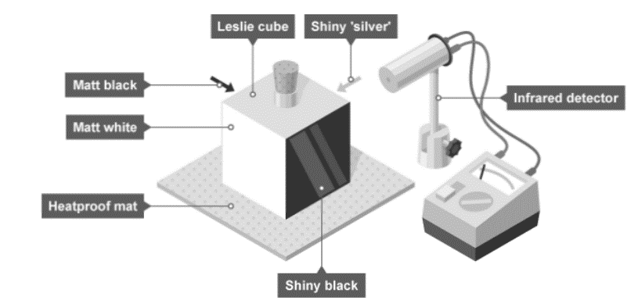
1 2 3 4 5 6 7 8 9 10 11 12 13 14 15 16 17 18 19 20 21 22 23 24 25 26 27 28 29 30 | Poor absorbers and emitters White and shiny silvery surfaces are the worst absorbers, as they reflect all visible light wavelengths. Poor absorbers are also poor emitters, and do not emit radiation as quickly as darker colours. Radiators in homes are usually painted white so that the infrared radiation is emitted gradually. Investigate how the amount of infrared radiation absorbed or radiated by a surface depends on the nature of that surface There are different ways to investigate the amount of infrared radiation absorbed or radiated by a surface. It is important to: use appropriate apparatus to measure and record temperature accurately. make observations regarding the effects of electromagnetic waves on different substances. The method described here uses a Leslie cube. This is a metal cube with four different types of surface. It is filled with hot water to increase its temperature. Aim of the experiment Method Place a Leslie cube on a heat-resistant mat. Fill it, almost to the top, with boiling water and replace the lid. Leave for one minute. This is to enable the surfaces to heat up to the temperature of the

Slide 7
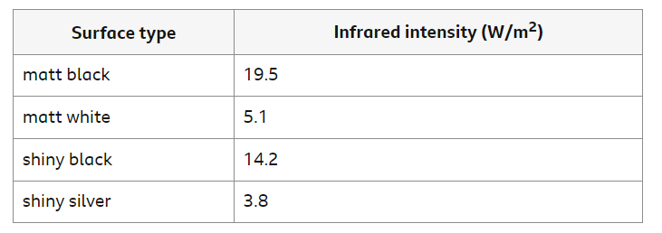
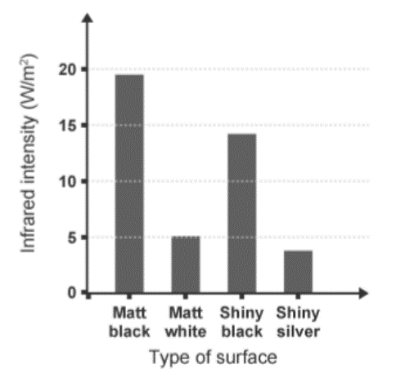
1 2 3 4 5 6 7 8 9 10 11 12 13 14 15 16 17 18 19 20 21 22 23 24 25 26 27 28 29 30 | water. Use the infrared detector to measure the intensity of infrared radiation emitted from each surface, or the temperature of the surface. Make sure that the detector is the same distance from each surface for each reading. Results Record results in a suitable table. The Table below shows some example results: Analysis Plot a bar chart to show the results. Make sure each bar is the same width and labelled clearly to show which surface it represents. Evaluation Explain why the detector must be placed the same distance from each surface before taking a reading.

Slide 8
1 2 3 4 5 6 7 8 9 10 11 12 13 14 15 16 17 18 19 20 21 22 23 24 25 26 27 28 29 30 | Hazards and control measures The Earth's temperature - Higher The temperature of a body is linked to the balance between the amount of radiation absorbed and emitted. Factors affecting the Earth’s temperature The temperature of the Earth depends on many factors including the concentration of greenhouse gases such as water vapour, methane and carbon dioxide. The Earth’s temperature also depends on the rates at which light radiation and infrared radiation are: absorbed by the Earth’s surface and atmosphere emitted by the Earth’s surface and atmosphere When visible light and high frequency infrared radiation are absorbed by the surface of the Earth, the planet’s internal energy increases and the surface gets hotter. Some of this energy is transferred to the atmosphere by conduction and convection. The Earth also radiates lower frequency infrared radiation. Some of this infrared radiation is transmitted through the atmosphere back out into space, and some is absorbed by greenhouse gases in the atmosphere. The greenhouse gases emit infrared radiation in all directions - some out into space and some back towards Earth, which is then re-absorbed.

Slide 9
1 2 3 4 5 6 7 8 9 10 11 12 13 14 15 16 17 18 19 20 21 22 23 24 25 26 27 28 29 30 | The greenhouse effect The ‘greenhouse effect’ caused by naturally occurring greenhouse gases, such as water vapour, stabilises the surface temperature of Earth. This allows the planet to support life. However, human activities such as deforestation and the burning of fossil fuels are releasing additional carbon dioxide. This causes more infrared radiation to be ‘trapped’ and reabsorbed by the Earth’s surface. This enhanced greenhouse effect is causing global temperatures to increase, leading to climate change.

Slide 10
Rehearsal questions - Emission & Absorption of infra red radiation
1. What is meant by infra red radiation?
……………………………………………………………………………………………………………………………………………………………
………………………………………………………………………………………………………………………………………………………….…
2. What is meant by the terms emission & absorption?
………………………………………………………………………………………………………………………………………………………………
………………………………………………………………………………………………………………………………………………………….…
3. Which surfaces are better at emitting infra red radiation?
…………………………………………………………………………………………………………………………………………………………………
4. Which surfaces are better at reflecting infra red radiation?
.……………………………………………………………………………………………………………………………………………………………....
5. Suggest why solar heating panels are dull black colour
…………………………………………………………………………………………………………………………………………………………………
…………………………………………………………………………………………………………………………………………………………………
6. The sun releases what parts of the electromagnetic spectrum?
…………………………………………………………………………………………………………………………………………………………………
…………………………………………………………………………………………………………………………………………………………………
7. What is meant by the term ‘ a perfect black body’?
………………………………………………………………………………………………………………………………………………………...........
…………………………………………………………………………………………………………………………………………………………………
8. When radiation is given out or taken in we can say it is
………………………………………… or ……………………………………
9. Which surfaces are better at absorbing infra red radiation?
……………………………………………………………………………………………………………………………………………………………….
10. Which surfaces give out the least amount of infra red radiation?
.......................................................................................................................................................................
11. What is the name of an object that does not reflect or transmit any radiation?
…………………………………………………………………………………………………………………………………………………………………

Slide 11
YOU DO Wrong answers – Perfect black bodies and radiation
Read the passage below. There are 20 scientific detail mistakes. Underline incorrect words/phrases, and correct them.
All objects emit electromagnetic radiation over a range of wavelengths. The cooler object, the more infrared radiation it radiates in a given time whilst a hotter object radiates less. At thermodynamic equilibrium, the rate at which an object absorbs radiation is more than the rate at which it emits it. A perfect absorber emits all electromagnetic radiation incident on it; such an object is called a whitebody. An object that absorbs all of the radiation incident on it and does not reflect or transmit any radiation is called a faulty black body. Since a good absorber is also a good emitter, a perfect black body would be the worst possible emitter too. As a result, an object which perfectly absorbs all radiation will be white. This is because the colour black is what is seen when all colours from the visible light spectrum are reflected. The colour of a body is linked to the balance between the amounts of radiation absorbed and emitted. If the rate of absorption is lower than the rate of emission, then the objects temperature is constant. If absorption & emission rates are equal ,then the temperature will be fall but if absorption is less than the rate of emission, then temperature is increasing.
The temperature of the Earth depends on many factors including the concentration of greenhouse gases such as oxygen, nitrogen and carbon dioxide. The Earth’s temperature also depends on the rates at which light radiation and infrared radiation are absorbed and emitted by the Earth’s core and atmosphere. When visible light and infrared radiation are emitted by the surface of the Earth, the surface gets hotter. The Earth also radiates lower frequency infrared radiation. Some of this infrared radiation is transmitted through the atmosphere back out into space, and some is absorbed by water vapour in the atmosphere. The greenhouse gases take in infrared radiation in all directions – some out into space and some back towards Earth, which is then reabsorbed.

Slide 12
If It didn’t – Black bodies and infra red radiation
I DO: How would the temperature of an object be affected if it didn’t absorb or emit infrared radiation?
……………………………………………………………………………………………………………………………………………………………………………………………………………………………………………………………………………………………………………………………………
WE DO: How would the temperature of an object be affected if it didn’t have a light colour?
…………………………………………………………………………………………………………………………………………………………………
YOU DO: How would the temperature of an object be affected if it didn’t emit radiation?
………………………………………………………………………………………………………………………………………………………………
YOU DO: How would the temperature of an object be affected if it didn’t absorb radiation?
……………………………………………………………………………………………………………………………………………………………..
YOU DO: How would the temperature of a black body be affected if it wasn’t black?
……………………………………………………………………………………………………………………………………………………………..
YOU DO: How would the infra red radiation detected from Leslie’s Cube be affected if you didn’t maintain a constant gap between detector and cube?
……………………………………………………………………………………………………………………………………………………………..
YOU DO: How would the temperature of the earth be affected if greenhouse gases didn’t exist in the atmosphere?
……………………………………………………………………………………………………………………………………………………………..

Slide 13
Spaced Retrieval – radiation and the Earths atmosphere
The earth’s temperature depends on the absorption of infrared radiation from the sun and the emission of radiation from the Earth’s surface and atmosphere. What can you remember about the greenhouse effect and global warming?
1. What is meant by the term ‘global warming?
………………………………………………………………………………………………………………………………………………….…..……......…………………………………………………………………………………………………………………………………………….……..………….
2. Name 3 greenhouse gases? ………………………………………………………………………………………………………………………………………………….…..……......…………………………………………………………………………………………………………………………………………….……..………….
3. Suggest 3 ways that carbon dioxide levels are increasing in the Earth’s atmosphere? ………………………………………………………………………………………………………………………………………………….…..……......…………………………………………………………………………………………………………………………………………….……..………….
4.Explain why deforestation increases carbon dioxide levels ………………………………………………………………………………………………………………………………………………….…..……….. …………………………………………………………………………………………………………………………………………….……..………….
5. Explain why burning fossil fuels increases carbon dioxide levels ………………………………………………………………………………………………………………………………………………….…..…….....
………………………………………………………………………………………………………………………………………………….…..……….. 6.Explain what is meant by the term ‘greenhouse effect’?
………………………………………………………………………………………………………………………………………………….…..……….. ………………………………………………………………………………………………………………………………………………….…..……......…………………………………………………………………………………………………………………………………………….……..………….
7. Suggest 2 consequences of global warming ………………………………………………………………………………………………………………………………………………….…..……......…………………………………………………………………………………………………………………………………………….……..………….
8.What is meant by the term ‘carbon footprint’?
.…………………………………………………………………………………………………………………………………………….……..………….
………………………………………………………………………………………………………………………………………………….…..…….....
9. Suggest 2 ways to reduce the carbon footprint of a company
………………………………………………………………………………………………………………………………………………….…..…….....

Slide 14
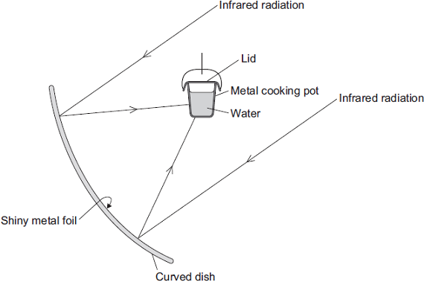
Exam questions
Q1. The diagram shows the design of a solar cooker. The cooker heats water using infrared radiation from the Sun.
(a). Why is the inside of the large curved dish covered with shiny metal foil?
…………………………………………………………………………………………………………………………………………………………………………………………………………………………………………………………………………………………………………(1)
(b) Which would be the best colour to paint the outside of the metal cooking pot?
Draw a ring around the correct answer. black silver white
Give a reason for your answer.
…………………………………………………………………………………………………………………………………………………………………………………………………………………………………………………………………………………………………………(2)

Slide 15
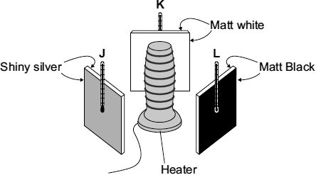
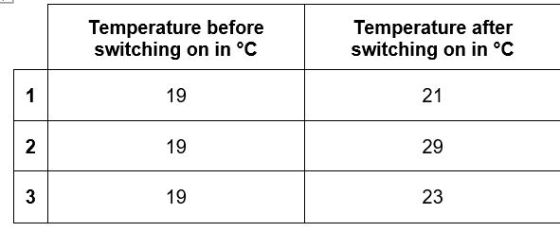
Exam questions
Q2. (b) A student set up the following equipment. The 3 metal plates are the same distance from the heater. The surfaces of each of the 3 metal plates are different colours.
The student switched the heater on for 10 minutes. The thermometers were read before the heater was switched on. The thermometers were read again just after the heaters were switched off. The readings are shown in the table.
Which set of readings, 1, 2 or 3, is most likely to have been taken from the thermometer labelled L? …………………………….. Give a reason for your answer.
…………………………………………………………………………………………………………………………………………………………………………………………………………………………………………………………………………………………………………(2)

Slide 16
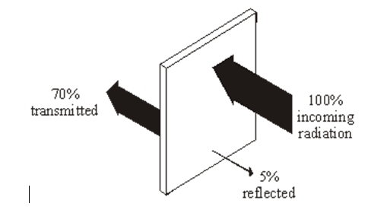
Exam questions
(ii) Which one of the following was not a control variable in this experiment? Put a tick next to your answer. (1)
the distance between the heater and the metal plates
the power of the heater
the temperature before the heater was switched on
the colour of the metal plates
Suggest one advantage of using a temperature sensor, data logger and computer, rather than a thermometer to carry out this experiment. …………………………………………………………………………………………………………………………………………………………………………………………………………………………………………………………………………………………(1)
Q3.(a) Infra red radiation can be reflected, absorbed and transmitted by glass.
(i) What percentage of infra red is absorbed by the glass? ………………………………………………(1)

Slide 17
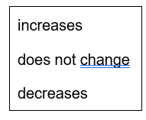
Exam questions
(ii) Complete the following sentence by drawing a ring around the correct word or phrase.
The absorbed infra red the temperature of the glass. (1)
Two of the following statements are true. One of the statements is false. Tick the boxes next to the two true statements. (2)
The following statement is false. Black surfaces are good reflectors of infra red radiation.
Change one word in this statement to make it true. Write down your new statement. …………………………………………………………………………………………………………………………………………………………………………………………………………………………………………………………………………………………………………(1)
(d) All objects emit and absorb infrared radiation. Use the correct answer from the box to complete each sentence.
The best emitters of infrared radiation have …………………………………… surfaces.
The worst emitters of infrared radiation have ………………………………… surfaces. (2)

Slide 18
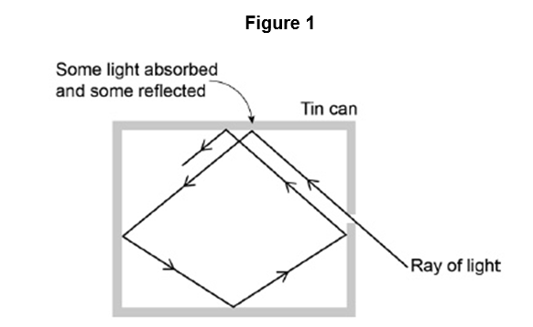
Exam questions
Q5. Figure 1 shows what happens when a ray of light enters a tin can through a small hole.
(a). Explain why the small hole looks black ……………………………………………………………………………………………………………………………………………………………………………………………………………………………………………………………………………………………………………………………………………………………………………………………………………………………………………………………….....(2)
(b) All objects absorb and emit radiation. What is meant when an object is described as a perfect black body? …………………………………………………………………………………………………………………………………………………………………………………………………………………………………………………………………………………………………………(1)
Figure 2 shows how the intensity of different wavelengths of radiation from a hot object varies with temperature.
What can be concluded from Figure 2 about how the distribution of the intensity of radiation from an object changes as the temperature of the object increases?
……………………………………………………………………………………………………………………………………………………………………………………………………………………………………………………………………………………………………………………………………………………………………………………………………………………………………………………………………………………………………………………………………………………………………………………………………………………….....(3)

Slide 19
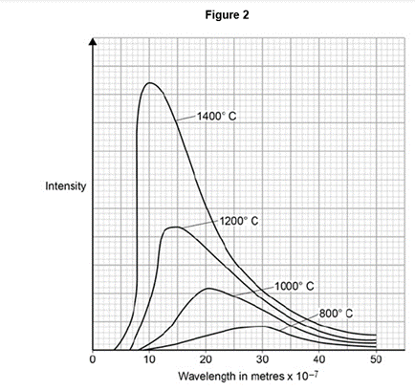
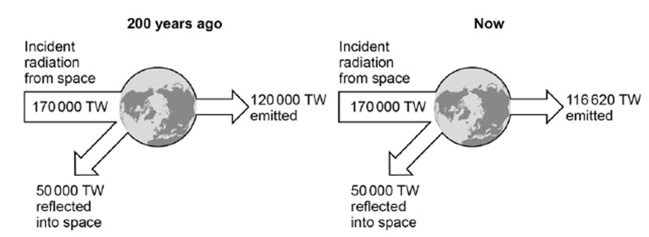
Exam questions
(d) The wavelength at which the Sun emits the maximum intensity of radiation is approximately 5 × 10–7 m. Estimate the surface temperature of the Sun. Use Figure 2.
…………………………………………………………………………………………………………………………………………………………………………………………………………………………………………………………………………………………………………(1) (e) Figure 3 shows how the balance between the incident radiation from space and the radiation emitted by the Earth into space has changed over the last 200 years.
Figure 3
……………………………………………………………………………………………………………………………………………………………………………………………………………………………………………………………………………………………………………………………………………………………………………………………………………………………………………………………………………………………………………………………………………………………………………………………………………………………………………………………………………………………………………………………………………………………………………………………………………………………………………………………………………………………………………………………………….....(3)

Slide 20
Subtopic 5: Visible Light
Learning Objective
We are learning that all colours within the visible spectrum behaves differently due to their wavelength and frequency
Why are we learning about this?
This lessons helps us understand how parts of the visible spectrum are observed as different colours

Slide 21
Subtopic 11 Visible Light
I wasn’t there but I still care!
Using the Physics AQA Text book from pages 26-29 and the glossary on pages 284-287 to help you answer the following;
Define the term infra red radiation ……………………………………………………………………………………………………………………………………………………………………………………………………………………………………………………………………………………………………………………
Define the term black body radiation ……………………………………………………………………………………………………………………………………………………………………………………………………………………………………………………………………………………………………………………
Explain how objects emit and absorb different amounts of infra red radiation depending upon their temperature and colour ………………………………………………………………………………………………………………………………………………………………………………………………………………………………………………………………………………………………………………………………………………………………………………………………………………………………………………………………………………
Describe how wavelength affects the intensity of radiation
……………………………………………………………………………………………………………………………………………………………………………………………………………………………………………………………………………………………………………………
…………………………………………………………………………………………………………………………………………………………
State the factors that affect the temperature of the Earth
……………………………………………………………………………………………………………………………………………………………………………………………………………………………………………………………………………………………………………………
Explain how the temperature of the Earth is dependant upon the greenhouse gases in the atmosphere
……………………………………………………………………………………………………………………………………………………………………………………………………………………………………………………………………………………………………………………
……………………………………………………………………………………………………………………………………………………………………………………………………………………………………………………………………………………………………………………
………………………………………………………………………………………………………………………………………………..………

Slide 22
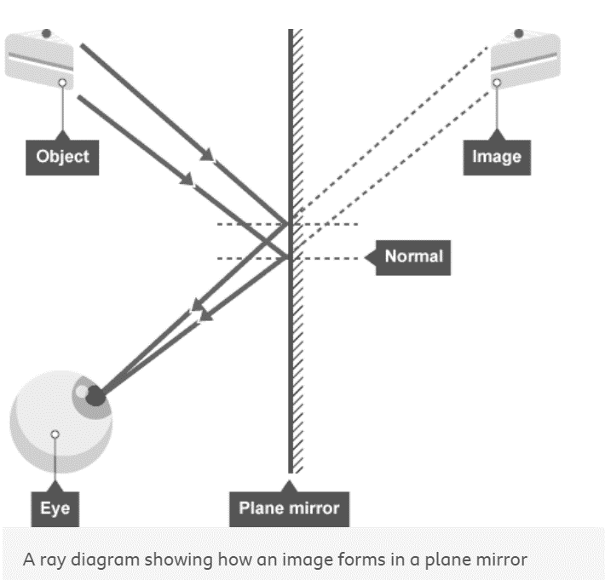
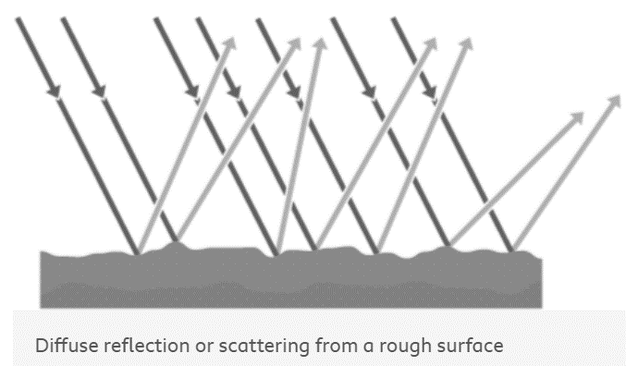
1 2 3 4 5 6 7 8 9 10 11 12 13 14 15 16 17 18 19 20 21 22 23 24 25 26 27 28 29 30 | Specular reflection . This is the type of reflection that happens with a flat mirror. The image in a mirror is: upright virtual In a virtual image , the rays appear to diverge from behind the mirror, so the image appears to come from behind the mirror. Diffuse reflection If a surface is rough, diffuse reflection happens. Instead of forming an image, the reflected light is scattered in all directions. This may cause a distorted image of the object, as occurs with rippling water, or no image at all. Each individual reflection still obeys the law of reflection, but the different parts of the rough surface are at different angles.

Slide 23
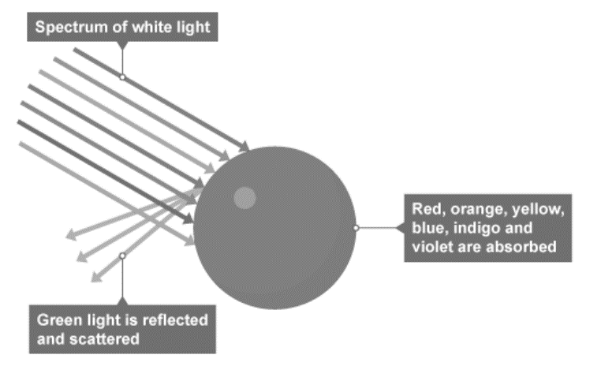
1 2 3 4 5 6 7 8 9 10 11 12 13 14 15 16 17 18 19 20 21 22 23 24 25 26 27 28 29 30 | Colour Within the visible light range of the electromagnetic spectrum there is a spectrum of colour. This is a continuous range of colours. In order of increasing frequency and decreasing wavelength these are given as: red orange yellow green blue indigo violet Each colour within the visible light spectrum has its own narrow band of wavelength and frequency. Absorption of light Waves can be absorbed at the boundary between two different materials. When waves are absorbed by a surface, the energy of the wave is transferred to the particles in the surface. This will usually increase the internal energy of the particles. When white light shines on an opaque object, some wavelengths or colours of light are absorbed. These wavelengths are not detected by our eyes. The other wavelengths are reflected, and these are detected by our eyes. For example, grass appears green in white light, red, orange, yellow, blue, indigo and violet are absorbed by the grass but green light is reflected by the grass and detected by our eyes.

Slide 24
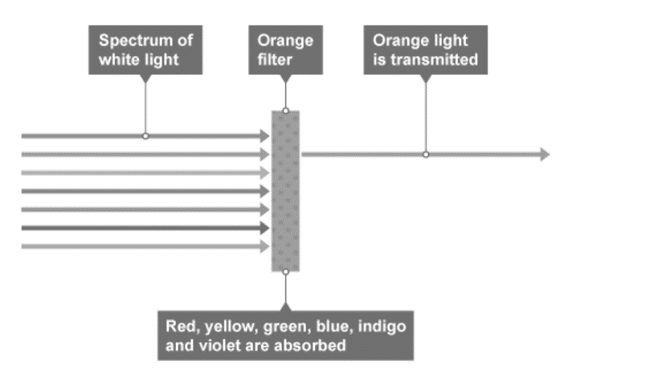
1 2 3 4 5 6 7 8 9 10 11 12 13 14 15 16 17 18 19 20 21 22 23 24 25 26 27 28 29 30 | Transmission of light Waves can also be transmitted at the boundary between two different materials. When waves are transmitted, the wave continues through the material. Air, glass and water are common materials that are very good at transmitting light. They are transparent because light is transmitted with very little absorption. Translucent materials transmit some light but are not completely clear. Lamp shades, shower curtains and window blinds are often translucent objects. Colour filters When white light passes through a coloured filter, all colours are absorbed except for the colour of the filter. For example, an orange filter transmits orange light but absorbs all the other colours. If white light is shone on an orange filter, only the orange wavelengths will be observed by the human eye. Coloured objects in coloured light An object appears to be black if it absorbs all the wavelengths of visible light. For example, an object that appears blue in white light will appear black in red light. This is because the red light contains no blue light for the object to reflect.

Slide 25
Rehearsal questions - visible light
1. Where is visible light positioned on the electromagnetic spectrum?
……………………………………………………………………………………………………………………………………………………………..
………………………………………………………………………………………………………………………………………………………….….
2. Explain what is meant by the term visible light.
………………………………………………………………………………………………………………………………………………………………
………………………………………………………………………………………………………………………………………………………….…..
3. What is meant by the spectrum of visible light?
…………………………………………………………………………………………………………………………………………………………………
………………………………………………………………………………………………………………………………………………………….…….
4. Describe how the wavelengths change across the spectrum of visible light.
.……………………………………………………………………………………………………………………………………………………………... ………………………………………………………………………………………………………………………………………………………….…….
5. Describe what is meant by a translucent object
…………………………………………………………………………………………………………………………………………………………………
…………………………………………………………………………………………………………………………………………………………………
6. Describe what is meant by a transparent object
…………………………………………………………………………………………………………………………………………………………………
…………………………………………………………………………………………………………………………………………………………………
7. Compare the wavelength of visible light to that of ultraviolet and infra red’?
………………………………………………………………………………………………………………………………………………………...........
…………………………………………………………………………………………………………………………………………………………………
8. All the colours of the rainbow make up what?
…………………………………………………………………………………………………………………………………………………………………
9. A material that allow only some light through is called what?
……………………………………………………………………………………………………………………………………………………………….
10. An object allowing all light that enters it pass through is known as ?
.......................................................................................................................................................................
11. Name the primary colours of light?
…………………………………………………………………………………………………………………………………………………………………

Slide 26
Contrasting concepts - visible light
I DO: Compare the effect of light on transparent and opaque materials
.……………………………………………………………………............................................................................................... …………………………………………………………………………………………………………………………………………………………........
WE DO: Compare the effect of white light on a red ball to that of a green ball
.……………………………………………………………………............................................................................................... …………………………………………………………………………………………………………………………………………………………........…………………………………………………………………………………………………………………………………………………………........
YOU DO: Compare the wavelengths of visible light.
.……………………………………………………………………............................................................................................... …………………………………………………………………………………………………………………………………………………………........
.……………………………………………………………………............................................................................................... YOU DO: In terms of visible light, compare white objects to black
.……………………………………………………………………............................................................................................... …………………………………………………………………………………………………………………………………………………………........
.……………………………………………………………………............................................................................................... …………………………………………………………………………………………………………………………………………………………........
YOU DO: Compare specular and diffuse reflection & the images they produce.
.……………………………………………………………………............................................................................................... …………………………………………………………………………………………………………………………………………………………........
.……………………………………………………………………............................................................................................... …………………………………………………………………………………………………………………………………………………………........
.……………………………………………………………………............................................................................................... …………………………………………………………………………………………………………………………………………………………........
YOU DO: Compare the colour of a blue object in daylight to that seen in red light
.……………………………………………………………………............................................................................................... …………………………………………………………………………………………………………………………………………………………........
.……………………………………………………………………...............................................................................................

Slide 27
If It didn’t – visible light
Explain how you would view a red object if it didn’t
I DO: have white light shining on it?
……………………………………………………………………………………………………………………………………………………………………………………………………………………………………………………………………………………………………………………………………
WE DO: have a smooth surface?
…………………………………………………………………………………………………………………………………………………………………
…………………………………………………………………………………………………………………………………………………………………
YOU DO: have the red component of visible light shining on it?
………………………………………………………………………………………………………………………………………………………………
YOU DO: absorb any light?
…………………………………………………………………………………………………………………………………………………………………
………………………………………………………………………………………………………………………………………………………………..
YOU DO: have the component of visible light that has the longest wavelength shining on it?
…………………………………………………………………………………………………………………………………………………………………
………………………………………………………………………………………………………………………………………………………………..
YOU DO: have the blue and green components of the visible spectrum shining on it?
…………………………………………………………………………………………………………………………………………………………….. ……………………………………………………………………………………………………………………………………………………………..
YOU DO: have the red and blue components of white light shining on it?
……………………………………………………………………………………………………………………………………………………………..
……………………………………………………………………………………………………………………………………………………………..

Slide 28
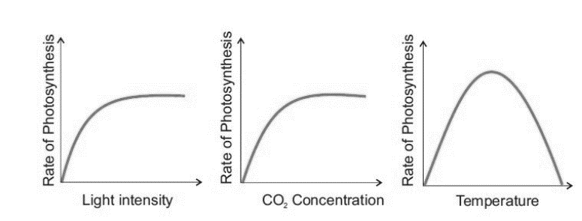
Spaced Retrieval – visible light
Visible Light is also needed by plants for process of photosynthesis .
1. Recall the photosynthesis word equation
………………………………………………………………………………………………………………………………………………….…..……......…………………………………………………………………………………………………………………………………………….……..………….
2. Recall the photosynthesis balanced symbol equation ………………………………………………………………………………………………………………………………………………….…..……......…………………………………………………………………………………………………………………………………………….……..………….
3. Why is light needed for photosynthesis to occur?
………………………………………………………………………………………………………………………………………………….…..……….. …………………………………………………………………………………………………………………………………………….……..………….
4. Name the component that absorbs the light energy for photosynthesis? ………………………………………………………………………………………………………………………………………………….…..……..... 5. Describe where these components are situated ………………………………………………………………………………………………………………………………………………….…..……….. …………………………………………………………………………………………………………………………………………….……..………….
6. Explain how leaves are adapted to photosynthesise efficiently ………………………………………………………………………………………………………………………………………………….…..…….....
………………………………………………………………………………………………………………………………………………….…..……….. ………………………………………………………………………………………………………………………………………………….…..…….....
………………………………………………………………………………………………………………………………………………….…..……….. 7.Name the factors that limit the rate of photosynthesis in plants
………………………………………………………………………………………………………………………………………………….…..……….. ………………………………………………………………………………………………………………………………………………….…..…….....
8. Sketch 3 graphs to show how each limiting factor affects the rate of photosynthesis

Slide 29
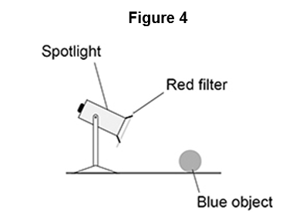
Exam questions
Q1. (a) An object was blue in colour. A student looked at the blue object through a green filter. Complete the sentences.
Choose answers from the box.
Looking at the blue object through a green filter makes the object appear …………………………. This is because the green filter only transmits the light that is …………………………. (2)
(b) Figure 4 shows a spotlight containing a convex lens. A red filter is placed in front of the spotlight. The spotlight is directed at a blue object.
Explain why the blue object appears black. (3) ………………………………………………………………………………………………………………………………………………….…..………………………………………………………………………………………………………………………………………………….…. ………………………………………………………………………………………………………………………………………………….…..………………………………………………………………………………………………………………………………………………….…..
(

Slide 30
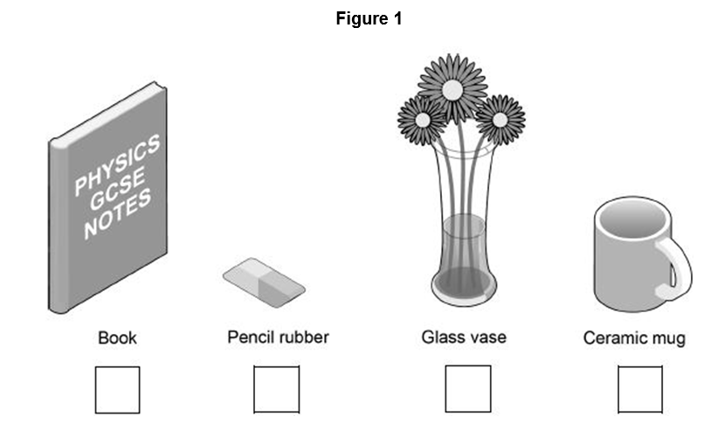
Exam questions
Q2. Some objects are transparent and some objects are opaque.
(a) Which one of the objects in Figure 1 is transparent?
Tick one box. (1)
(b) Complete the sentence. Choose an answer from the box.
An opaque object does not ………………………………….. light. (1)
A student wears a white T-shirt and a red baseball cap to a party.
(c) Why does the T-shirt look white in white light? (1)
………………………………………………………………………………………………………………………………………………….…..………………………………………………………………………………………………………………………………………………….…..
(d) Explain how the colour of the baseball cap appears to change when the room lights at the party change from white to blue. (2)
………………………………………………………………………………………………………………………………………………….…..………………………………………………………………………………………………………………………………………………….….

Slide 31
Exam questions
Q3. (a) The appearance of visible light can change when it interacts with different objects.
Complete the sentences choosing the answers from the box. Each answer may be used once, more than once or not at all.
When white light is incident on a green filter, only green light passes through the filter. This is because green light is ………………………… by the filter. All other colours of light are ………………………… by the filter. When red light shines on a blue object the red light is ………………………… . (3)
(b) Explain why violet light is refracted more than red light when it passes through a prism (2)
……………………………………………………………………………………………………………………………………………..…….…..…………………………………………………………………………………………………………………………………………….….…..………………………………………………………………………………………………………………………………………………….

Slide 32
Extra Space
……………………………………………………………………………………………………………………………………………………………………………………………………………………………………………………………………………………………………………………………………………………………………………………………………………………………………………………………………………………………………………………………………………………………………………………………………………………………………………………………………………………………………………………………………………………………………………………………………………………………………………………………………………………………………………………………………………………………………………………………………………………………………………………………………………………………………………………………………………………………………………………………………………………………………………………………………………………………………………………………………………………………………………………………………………………………………………………………………………………………………………………………………………………………………………………………………………………………………………………………………………………………………………………………………………………………………………………………………………………………………………………………………………………………………………………………..
…………………………………………………………………………………………………………………………………………………………………………………………………………………………………………………………………………………………………………………………………………………………………………………………………………………………………………………………………………………………………………………………………………………………………………………………………………………………………………………………………………………………………………………………………………………………………………………………………………………………………………………………………………………………………………………………………………………………………………………………………………………………………………………………………………………………………………………………………………………………………………………………………………………………………………………………………………………………………………………………………………………………………………………………………………………………………………………………………………………………………………………………………………………………………………………………………………………………………………………………………………………………………………………………………………………………………..
…………………………………………………………………………………………………………………………………………………………………………………………………………………………………………………………………………………………………………………………………………………………………………………………………………………………………………………………………………………………………………………………………………………………………………………………………………………………………………………………………………………………………………………………………………………………………………………………………

Slide 33
DO NOW
Date: ……………………………………….
 | ANSWER
Q1.
Q2.
Q3.
Q4.
Q5.
Date: ……………………………………….
 | ANSWER
Q1.
Q2.
Q3.
Q4.
Q5.

Slide 34
DO NOW
Date: ……………………………………….
 | ANSWER
Q1.
Q2.
Q3.
Q4.
Q5.
Date: ……………………………………….
 | ANSWER
Q1.
Q2.
Q3.
Q4.
Q5.

Slide 35
Knowledge Retrieval Quiz 3
Date: ……………………………………….
Score: …………...
 |  | Answer
Q1. | Insert question in bold
Q2.
Q3.
Q4.
Q5.
Q6.
Q7.
Q8.
Q9.
Q10.

Slide 36
Extra Space
……………………………………………………………………………………………………………………………………………………………………………………………………………………………………………………………………………………………………………………………………………………………………………………………………………………………………………………………………………………………………………………………………………………………………………………………………………………………………………………………………………………………………………………………………………………………………………………………………………………………………………………………………………………………………………………………………………………………………………………………………………………………………………………………………………………………………………………………………………………………………………………………………………………………………………………………………………………………………………………………………………………………………………………………………………………………………………………………………………………………………………………………………………………………………………………………………………………………………………………………………………………………………………………………………………………………………………………………………………………………………………………………………………………………………………………………..
…………………………………………………………………………………………………………………………………………………………………………………………………………………………………………………………………………………………………………………………………………………………………………………………………………………………………………………………………………………………………………………………………………………………………………………………………………………………………………………………………………………………………………………………………………………………………………………………………………………………………………………………………………………………………………………………………………………………………………………………………………………………………………………………………………………………………………………………………………………………………………………………………………………………………………………………………………………………………………………………………………………………………………………………………………………………………………………………………………………………………………………………………………………………………………………………………………………………………………………………………………………………………………………………………………………………………..
…………………………………………………………………………………………………………………………………………………………………………………………………………………………………………………………………………………………………………………………………………………………………………………………………………………………………………………………………………………………………………………………………………………………………………………………………………………………………………………………………………………………………………………………………………………………………………………………………

Slide 37
Extra Space
……………………………………………………………………………………………………………………………………………………………………………………………………………………………………………………………………………………………………………………………………………………………………………………………………………………………………………………………………………………………………………………………………………………………………………………………………………………………………………………………………………………………………………………………………………………………………………………………………………………………………………………………………………………………………………………………………………………………………………………………………………………………………………………………………………………………………………………………………………………………………………………………………………………………………………………………………………………………………………………………………………………………………………………………………………………………………………………………………………………………………………………………………………………………………………………………………………………………………………………………………………………………………………………………………………………………………………………………………………………………………………………………………………………………………………………………..
…………………………………………………………………………………………………………………………………………………………………………………………………………………………………………………………………………………………………………………………………………………………………………………………………………………………………………………………………………………………………………………………………………………………………………………………………………………………………………………………………………………………………………………………………………………………………………………………………………………………………………………………………………………………………………………………………………………………………………………………………………………………………………………………………………………………………………………………………………………………………………………………………………………………………………………………………………………………………………………………………………………………………………………………………………………………………………………………………………………………………………………………………………………………………………………………………………………………………………………………………………………………………………………………………………………………………..
…………………………………………………………………………………………………………………………………………………………………………………………………………………………………………………………………………………………………………………………………………………………………………………………………………………………………………………………………………………………………………………………………………………………………………………………………………………………………………………………………………………………………………………………………………………………………………………………………

Slide 38
Extra Space
……………………………………………………………………………………………………………………………………………………………………………………………………………………………………………………………………………………………………………………………………………………………………………………………………………………………………………………………………………………………………………………………………………………………………………………………………………………………………………………………………………………………………………………………………………………………………………………………………………………………………………………………………………………………………………………………………………………………………………………………………………………………………………………………………………………………………………………………………………………………………………………………………………………………………………………………………………………………………………………………………………………………………………………………………………………………………………………………………………………………………………………………………………………………………………………………………………………………………………………………………………………………………………………………………………………………………………………………………………………………………………………………………………………………………………………………..
…………………………………………………………………………………………………………………………………………………………………………………………………………………………………………………………………………………………………………………………………………………………………………………………………………………………………………………………………………………………………………………………………………………………………………………………………………………………………………………………………………………………………………………………………………………………………………………………………………………………………………………………………………………………………………………………………………………………………………………………………………………………………………………………………………………………………………………………………………………………………………………………………………………………………………………………………………………………………………………………………………………………………………………………………………………………………………………………………………………………………………………………………………………………………………………………………………………………………………………………………………………………………………………………………………………………………..
…………………………………………………………………………………………………………………………………………………………………………………………………………………………………………………………………………………………………………………………………………………………………………………………………………………………………………………………………………………………………………………………………………………………………………………………………………………………………………………………………………………………………………………………………………………………………………………………………

Slide 39
Extra Space
……………………………………………………………………………………………………………………………………………………………………………………………………………………………………………………………………………………………………………………………………………………………………………………………………………………………………………………………………………………………………………………………………………………………………………………………………………………………………………………………………………………………………………………………………………………………………………………………………………………………………………………………………………………………………………………………………………………………………………………………………………………………………………………………………………………………………………………………………………………………………………………………………………………………………………………………………………………………………………………………………………………………………………………………………………………………………………………………………………………………………………………………………………………………………………………………………………………………………………………………………………………………………………………………………………………………………………………………………………………………………………………………………………………………………………………………..
…………………………………………………………………………………………………………………………………………………………………………………………………………………………………………………………………………………………………………………………………………………………………………………………………………………………………………………………………………………………………………………………………………………………………………………………………………………………………………………………………………………………………………………………………………………………………………………………………………………………………………………………………………………………………………………………………………………………………………………………………………………………………………………………………………………………………………………………………………………………………………………………………………………………………………………………………………………………………………………………………………………………………………………………………………………………………………………………………………………………………………………………………………………………………………………………………………………………………………………………………………………………………………………………………………………………………..
…………………………………………………………………………………………………………………………………………………………………………………………………………………………………………………………………………………………………………………………………………………………………………………………………………………………………………………………………………………………………………………………………………………………………………………………………………………………………………………………………………………………………………………………………………………………………………………………………

Slide 40
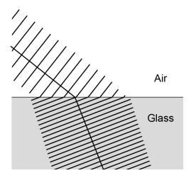
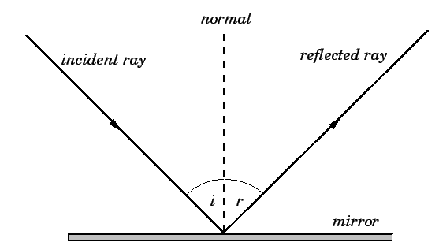
KNOWLEDGE ORGANISER
Subject: Science | Topic: Waves | Term: Autumn
KEY WORDS | Key words
1 | Amplitude | The distance from a peak to the zero position of a wave.
2 | Frequency | The number of complete waves that pass a point in a given time.
3 | Time period | Time taken for one complete wave to pass.
4 | Ray diagram | A ray diagram is a representation of the possible paths light can take to get from one place to another.
5 | Normal line | A line drawn perpendicular to a surface.
6 | Incident ray. | A ray of light that falls on any surface.
7 | Reflected ray. | A ray of light that is reflected from a surface.
KEY EXAMPLES
8 | Reflection from mirrors.
9 | Refraction of light and sound by water.
10 | Uses of waves to investigate the structure of the Earth.
11 | Th wide range of uses for electromagnetic waves.
KEY DIAGRAMS
Wave front diagram showing refraction The Law of Reflection

