Slide 1

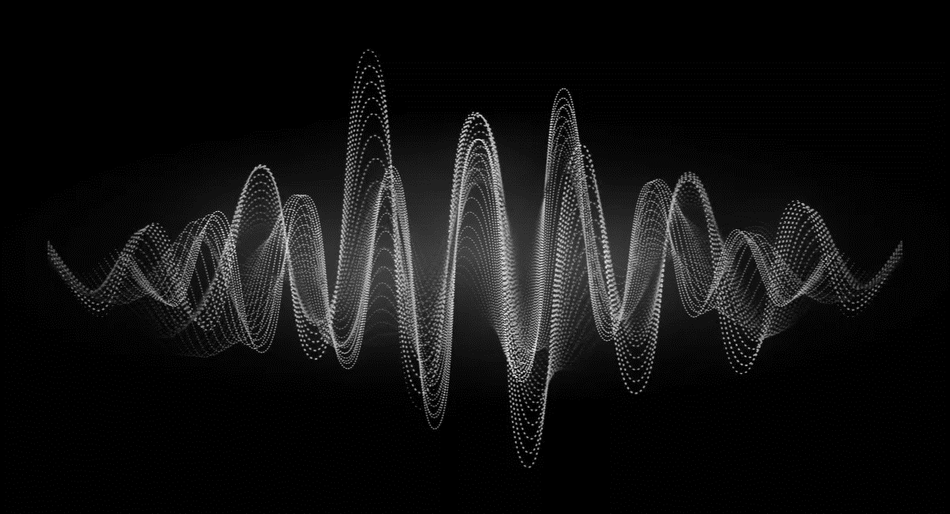
KS4 – Waves (TRILOGY TEACHER BOOKLET)
Name
Class
Tutor Group
KS4 Science YEAR 11 WAVES
KEYSTONE WORDS
Longitudinal wave | In a longitudinal wave the oscillations are parallel to the direction of energy transfer.
Transverse wave | In a transverse wave the oscillations are perpendicular to the direction of energy transfer.
Refraction | Waves change speed and direction when entering a material with a different density.
Reflection | Reflection of Light occurs when a ray of light approaches a smooth surface and bounces back.

Slide 2
BIG PICTURE
How will my prior knowledge develop my understanding of this topic?
Y7 | You learnt to calculate speed; this will be expanded to include wave speed in this topic. Your knowledge of from the Energy topic will be invaluable waves because waves transfer energy.
Y8 | You studied waves and light. This topic builds on the foundations that you built. You also studied sound waves. How we use sound waves to investigate hidden objects will be studied in this topic.
Learning Journey - Trilogy: Maximum 7 lessons. Triple: Maximum 14 lessons.
Subtopic 1 | 6.6.1.1 Transverse and longitudinal waves 6.6.1.2 Properties of waves | Subtopic 5 | Required practical: Nature of the surface
Subtopic 2 | Required Practical: Waves (ripple tank and wave on a string)
Subtopic 3 | 4.6.2.1 Types of electromagnetic waves 4.6.2.4 Uses and applications of electromagnetic waves
Subtopic 4 | 4.6.2.2 Properties of electromagnetic waves 1 4.6.2.3 Properties of electromagnetic waves 2
Key knowledge
By the end of this topic you should know… | How waves behave in different circumstances and be able to describe how humans use waves to make their lives easier.
By the end of this topic should be able to… | Demonstrate properties of waves such as reflection and refraction.

Slide 3
KEY VOCABULARY LIST
Amplitude | The distance from a peak to the zero position of a wave.
Frequency | The number of complete waves that pass a point in a given time.
Time period | Time taken for one complete wave to pass.
Ray diagram | A ray diagram is a representation of the possible paths light can take to get from one place to another.
Normal line | A line drawn perpendicular to a surface.
Incident ray. | A ray of light that falls on any surface.
Reflected ray. | A ray of light that is reflected from a surface.
EXPECTATIONS
Always write in black or blue pen. Always use a ruler for straight lines. If you make a mistake, cross it out with a single line. Always draw diagrams, tables and graphs in pencil with a ruler if necessary Always mark and correct your work in green pen. Respond to any feedback your teacher gives you in green pen. Take pride in your work, make it neat! All tasks should be completed in silence and by yourself unless your teacher tells you otherwise.
PROUD
Punctuation and grammar
Ruler and pencil for diagrams
Outstanding effort every lesson
Underline date and title
Dates and titles every lesson
PROUD FRIDAY
Any piece of work you complete, which meets our PROUD expectations can be taken to the PROUD station during Friday lunchtime. Show your work to a member of SLT and receive a sweet treat!

Slide 4
Subtopic 1: Transverse & Longitudinal Waves and their properties
Learning Objective
We are learning the different types of wave and how to identify amplitude and wavelength from given diagrams.
We are learning how to label waves to show their features and link this to the differences in their behaviour.
We are learning to use the wave speed equation in calculations
Why are we learning about this?
This lessons helps us understand how waves carry energy and how the features of different waves differ. It also relates the properties of waves to their features. Th relationship between structure / features and properties is an important one in science; understanding the relationship is at the heart of truly understanding science.

Slide 5
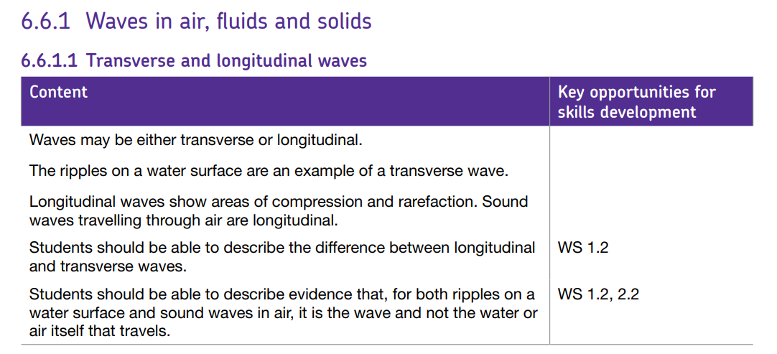
AQA Content

Slide 6
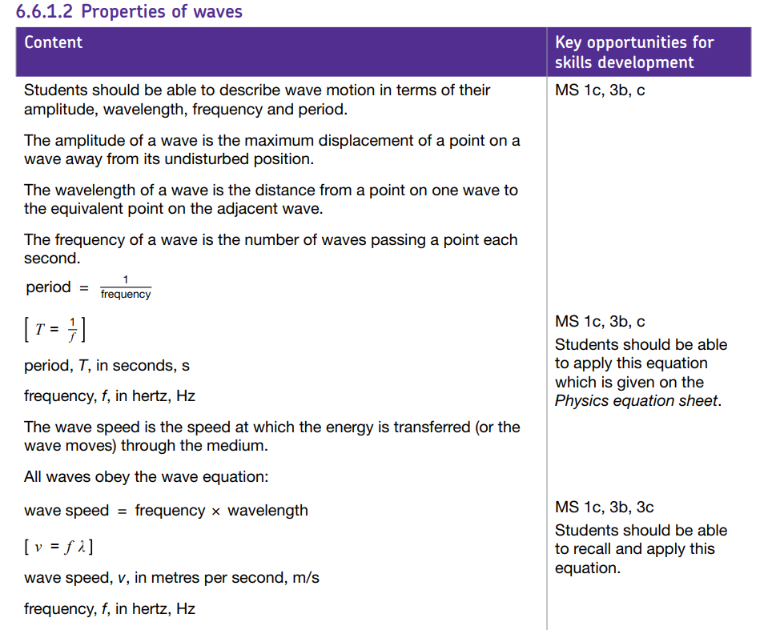
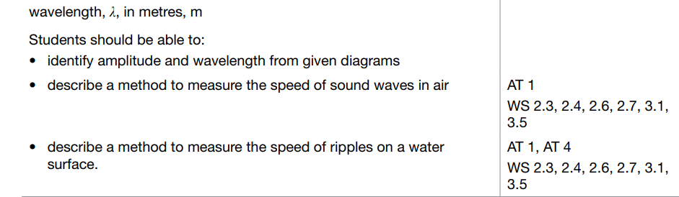
AQA Content

Slide 7
1 2 3 4 5 6 7 8 9 10 11 12 13 14 15 16 17 18 19 20 21 22 23 24 25 26 27 28 29 30 | Types of waves A wave is a disturbance that propagates energy from one place to another without transporting any matter. A general example would be a stone hitting the surface of the water and creating ripples that travel in the shape of concentric circles with its radius increasing until they strike the boundary of the pond. Waves are one of the ways in which energy may be transferred between stores. Waves can be described as oscillations, or vibrations about a rest position. For example: sound waves cause air particles to vibrate back and forth ripples cause water particles to vibrate up and down Longitudinal and transverse waves are two types of waves that differ in the direction of particle oscillation relative to the direction of wave propagation. In longitudinal waves, the vibrations are parallel to the direction of wave travel. In transverse waves, the vibrations are at right angles to the direction of wave travel. Mechanical waves cause oscillations of particles in a solid, liquid or gas and must have a medium to travel through. Electromagnetic waves cause oscillations in electrical and magnetic fields. Longitudinal waves In longitudinal waves, the vibrations are parallel to the direction of wave travel. Examples of longitudinal waves include: sound waves ultrasound waves seismic P-waves One way to remember the movement of particles in longitudinal waves is to use the 'P' sound: longitudinal waves such as seismic P-waves may be thought of as pressure or push waves as the particles move parallel to the wave. Demonstrating longitudinal waves Longitudinal waves show areas of compression and rarefaction: compressions are regions of high pressure due to particles being close together rarefactions are regions of low pressure due to particles being spread further apart Longitudinal waves are often demonstrated by pushing and pulling a stretched slinky spring.

Slide 8
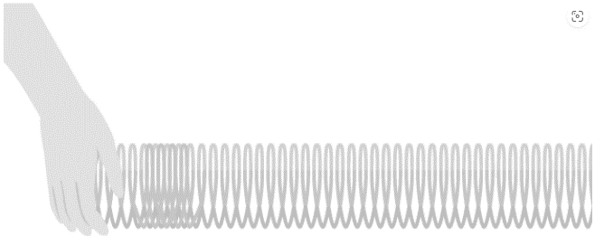
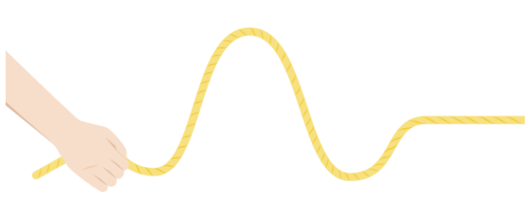
1 2 3 4 5 6 7 8 9 10 11 12 13 14 15 16 17 18 19 20 21 22 23 24 25 26 27 28 29 30 | In the diagram above, the compressions move from left to right and energy is transferred from left to right. However, none of the particles are transported along a longitudinal wave. Instead, they move backwards and forwards between compressions as the wave is transmitted through the medium. In longitudinal waves, the particles oscillate parallel to the direction of wave propagation Transverse waves In transverse waves, the vibrations are at right angles to the direction of wave travel. Examples of transverse waves include: ripples on the surface of water vibrations in a guitar string a Mexican wave in a sports stadium electromagnetic waves - eg light waves, microwaves, radio waves seismic S-waves One way to remember the movement of particles in transverse waves is to use the 'S' sound: transverse waves such as seismic S-waves may be thought of as shake or shear waves as the particles move from side-to-side - crossing the direction of wave travel. Demonstrating transverse waves Transverse waves are often demonstrated by moving a rope rapidly up and down.

Slide 9
1 2 3 4 5 6 7 8 9 10 11 12 13 14 15 16 17 18 19 20 21 22 23 24 25 26 27 28 29 30 | In the diagram above, the rope moves up and down, producing peaks and troughs. Energy is transferred from left to right. However, none of the particles are transported along a transverse wave. The particles move up and down as the wave is transmitted through the medium. In a transverse wave the medium or the channel moves perpendicular to the direction of the wave.

Slide 10
Rehearsal questions - Types of wave
1. What do all waves do?
………………………………………………………………………………………………………………………………………………………………
………………………………………………………………………………………………………………………………………………………….…
2. Name the 2 types of wave? …………………………………………………………………………………………………………………………………………………………
…………………………………………………………………………………………………………………………………………………………………
3. Ripples on water , light waves, a Mexican wave are what type of wave? .………………………………………………………………………………………………………………………………………………………………
…………………………………………………………………………………………………………………………………………………………….....
4. Give 2 examples of longitudinal waves
…………………………………………………………………………………………………………………………………………………………………
…………………………………………………………………………………………………………………………………………………………………
5. Which type of wave needs particles for the energy to be transferred?
…………………………………………………………………………………………………………………………………………………………………
…………………………………………………………………………………………………………………………………………………………………
6. Which type of wave transfers light through the medium of space?
………………………………………………………………………………………………………………………………………………………...........
…………………………………………………………………………………………………………………………………………………………………
7. How is energy transferred from one place to another?
…………………………………………………………………………………………………………………………………………………………………
…………………………………………………………………………………………………………………………………………………………………
8. Give 3 examples of transverse waves
………………………………………………………………………………………………………………………………………...........................
……………………………………………………………………………………………………………………………………………………………….
9. What can be grouped into Transverse & Longitudinal?
.............................................................................................................................................................................................................................................................................................................................................
10. Sound waves are what type of wave?
…………………………………………………………………………………………………………………………………………………………………………………………………………………………………………………………………………………………………………………………………..
Transfer energy from one place to another
Transverse & Longitudinal
Transverse
Sound, ultrasound, Seismic P (primary) waves
Longitudinal
Transverse
By waves
Ripples on water, any electromagnetic wave, Mexican wave, vibrations on a guitar string
Types of wave
Longitudinal

Slide 11
YOU DO Wrong answers – Types of wave
Read the passage below. Underline incorrect words/phrases, and correct them.
All waves transfer matter not energy through a substance. When a particle in the medium travels parallel to direction of wave it is a transverse wave and if it travels perpendicular to direction of wave it is a longitudinal wave. Sound waves and earthquake S waves are examples of longitudinal waves. Water waves and earthquake P waves are examples of transverse waves. Longitudinal waves have two parts: compression and rarefraction whereas transverse waves have two parts: crests and troughs. A longitudinal wave is a wave wherein the movement of the medium is at right angles to the wave while a transverse wave is a wave wherein the movement of the medium is in the same direction to that of the wave. A longitudinal wave acts in two directions while a transverse wave acts in one direction. Longitudinal waves can be produced on the surface of a liquid or a vacuum whilst transverse waves can be produced in a solid, liquid, or gas.
All waves transfer energy not matter through a substance. When a particle in the medium travels parallel to direction of wave it is a longitudinal wave and if it travels perpendicular to direction of wave it is a transverse wave. Sound waves and earthquake P waves are examples of longitudinal waves. Water waves and earthquake S waves are examples of transverse waves. Longitudinal waves have two parts: compression and rarefaction whereas transverse waves have two parts: crests and troughs. A longitudinal wave is a wave wherein the movement of the medium is in the same direction as the wave while a transverse wave is a wave wherein the movement of the medium is at a right angles to the direction of the wave. A longitudinal wave acts in one direction while a transverse wave acts in two directions. Transverse waves can be produced on the surface of a liquid or a vacuum whilst Longitudinal waves can be produced in a solid, liquid, or gas.

Slide 12
Contrasting concepts: Types of wave
I DO: Compare the movement of the two types of wave
.……………………………………………………………………............................................................................................... …………………………………………………………………………………………………………………………………………………………........
.……………………………………………………………………............................................................................................... …………………………………………………………………………………………………………………………………………………………........
WE DO: Compare the function of the two wave types.
.……………………………………………………………………............................................................................................... …………………………………………………………………………………………………………………………………………………………........
.……………………………………………………………………............................................................................................... …………………………………………………………………………………………………………………………………………………………........
YOU DO: Compare the features of the two wave types.
.……………………………………………………………………............................................................................................... …………………………………………………………………………………………………………………………………………………………........
.……………………………………………………………………............................................................................................... …………………………………………………………………………………………………………………………………………………………........
YOU DO: Compare seismic P (primary) and S (secondary) waves.
.……………………………………………………………………............................................................................................... …………………………………………………………………………………………………………………………………………………………........
.……………………………………………………………………............................................................................................... …………………………………………………………………………………………………………………………………………………………........
YOU DO: Compare the transmission of energy and matter by both types of wave
.……………………………………………………………………............................................................................................... …………………………………………………………………………………………………………………………………………………………........
.……………………………………………………………………............................................................................................... …………………………………………………………………………………………………………………………………………………………........
.……………………………………………………………………............................................................................................... …………………………………………………………………………………………………………………………………………………………........
Longitudinal waves - the vibrations are parallel to the direction of wave travel.
Transverse waves -the vibrations are at right angles to the direction of wave travel.
Longitudinal waves – sound waves, ultrasound waves, seismic P-waves
Transverse waves - seismic S –waves ,water waves, Mexican wave, electromagnetic waves
Longitudinal waves – compressions, rarefactions
Transverse waves - crests & troughs
P waves = Longitudinal waves - move in same direction as transfer of energy
S waves = Transverse waves - waves move at 90⁰ to the direction of energy transfer
Both types of wave transfer energy AND matter. Longitudinal REQUIRE a medium/ particles to travel through but Transverse waves do NOT need matter- can travel through a vacuum

Slide 13
Spaced Retrieval – Types of wave
Waves transfer energy between energy stores. What can you remember about energy stores & transfers?
1. What is meant by the term ‘an energy store?
………………………………………………………………………………………………………………………………………………….…..……......…………………………………………………………………………………………………………………………………………….……..………….
2. What is meant by an energy transfer? ………………………………………………………………………………………………………………………………………………….…..……......…………………………………………………………………………………………………………………………………………….……..………….
3. What is meant by a closed system? ………………………………………………………………………………………………………………………………………………….…..……......…………………………………………………………………………………………………………………………………………….……..………….
4.Name the energy store in food, fuel ………………………………………………………………………………………………………………………………………………….…..…….....
5. If an object gains height, which energy store increases? ………………………………………………………………………………………………………………………………………………….…..……..... 6.What is meant by an ‘ energy pathway’?
………………………………………………………………………………………………………………………………………………….…..……......…………………………………………………………………………………………………………………………………………….……..………….
7. Name the four energy pathways ………………………………………………………………………………………………………………………………………………….…..……......…………………………………………………………………………………………………………………………………………….……..………….
8. Describe the energy pathway when energy is transferred by light or sound ………………………………………………………………………………………………………………………………………………….…..…….....
9. Describe the energy pathway when energy is transferred by compressing a spring
………………………………………………………………………………………………………………………………………………….…..…….....
10. Describe the energy stores & pathways when a weightlifter lifts a 150Kg mass
………………………………………………………………………………………………………………………………………………….…..……......…………………………………………………………………………………………………………………………………………….……..………….
Where we can measure the amount of energy available for something to happen
Where energy is moved from one energy store to another
A system where neither energy of matter can enter or escape
chemical
Gravitational Potential Energy
The way energy is transferred between energy stores/ objects
Mechanical / Electrical / Heating / Radiation
Radiation
Mechanical
Chemical → Pathway = Mechanical → Gravitational

Slide 14
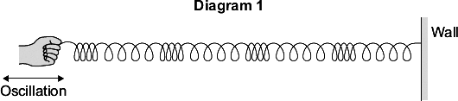
Exam questions
Q1. Diagram 1 shows a longitudinal wave being produced in a stretched spring.
A longitudinal wave has areas of compression and areas of rarefaction.
Mark with the letter C, one area of compression shown in Diagram 1.
Mark with the letter R, one area of compression shown in Diagram 1.
(2)
Q2.Waves may be longitudinal or transverse.
(a) Describe the differences between longitudinal waves and transverse waves. …………………………………………………………………………………………………………………………………………………………………………………………………………………………………………………………………………………………………………….. …………………………………………………………………………………………………………………………………………………………………………………………………………………………………………………………………………………………………………….. ………………………………………………………………………………………………………………………………………………………………………………………………………………………………………………………………………………………………………………
(3)
a) letter C clearly marking a compression
accept C at any point in a compression
if more than one letter C marked
all must be correct 1
b) letter R clearly marking a rarefaction
accept R at any point in a compression
if more than one letter R marked
all must be correct 1
M2.(a) the oscillation / vibration (causing the wave)
a movement causes the wave is insufficient 1
for a transverse wave is perpendicular to the direction of energy transfer
accept direction of wave travel 1
and for a longitudinal wave is parallel to the direction of energy transfer
accept direction of wave travel
if no marks awarded allow 1 mark for correctly linking perpendicular with transverse and parallel with longitudinal
the marks may be scored by the drawing of two correctly labelled diagrams 1

Slide 15
Exam questions
Q3. Explain how the compressions and rarefactions in a sound wave allow sound to be detected by the human ear
…………………………………………………………………………………………………………………………………………………………………………………………………………………………………………………………………………………………………………….. …………………………………………………………………………………………………………………………………………………………………………………………………………………………………………………………………………………………………………….. ……………………………………………………………………………………………………………………………………………………………………………………………………………………………………………………………………………………………………………..
(3)
Q4.
(a) Sound and light are different types of waves. Give two similarities and two differences between sound waves and light waves.
…………………………………………………………………………………………………………………………………………………………………………………………………………………………………………………………………………………………………………….. …………………………………………………………………………………………………………………………………………………………………………………………………………………………………………………………………………………………………………….. …………………………………………………………………………………………………………………………………………………………………………………………………………………………………………………………………………………………………………….. ……………………………………………………………………………………………………………………………………………………………………………………………………………………………………………………………………………………………………………..
(4)
M3.(a) At compressions the air pressure is higher 1
at rarefactions the air pressure is lower
1
these areas of higher and lower pressure make the ear drum oscillate (accept vibrate)
1
(a) any two similarities and any two differences
similarities
• (both can be) reflected • (both can be) refracted
allow both travel through any correctly named solid / gas / liquid
• (both can be) diffracted • (both) transfer energy
ignore both are types of energy / waves / oscillations
do not accept statements like both are transverse as a similarity
differences
• light can travel through a vacuum / sound cannot travel through a vacuum
allow sound requires a medium / particles to travel through
• (different) speed / velocity • one is longitudinal and one is transverse
accept light is faster than sound
allow correct description:
(longitudinal) the oscillations / vibrations are parallel to / same direction as (the direction of energy transfer) and (transverse) the oscillations / vibrations are 90° to / perpendicular to (the direction of energy transfer)
• sound is a mechanical wave / caused by vibrations and light is an electromagnetic wave

Slide 16
Subtopic 1a: Transverse & Longitudinal Waves
I wasn’t there but I still care!
Using the Physics AQA Text book from pages 174 -175 and the glossary on pages 284-287 to help you answer the following;
Name the 2 groups that waves can be categorised as
……………………………………………………………………………………………………………………………………………………………………………………………………………………………………………………………………………………………………………………
Define the term Transverse Wave ……………………………………………………………………………………………………………………………………………………………………………………………………………………………………………………………………………………………………………………
Define the term Longitudinal wave: ……………………………………………………………………………………………………………………………………………………………………………………………………………………………………………………………………………………………………………………
Give 2 examples of longitudinal waves ……………………………………………………………………………………………………………………………………………………………………………………………………………………………………………………………………………………………………………………
Give 2 examples of transverse waves
……………………………………………………………………………………………………………………………………………………………………………………………………………………………………………………………………………………………………………………
Describe 2 differences between longitudinal & transverse waves
……………………………………………………………………………………………………………………………………………………………………………………………………………………………………………………………………………………………………………………

Slide 17
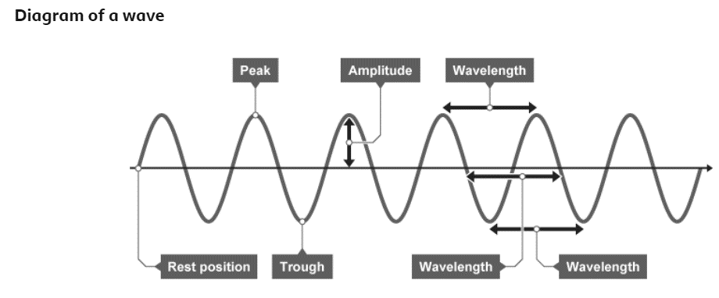
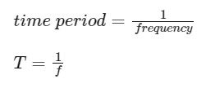
1 2 3 4 5 6 7 8 9 10 11 12 13 14 15 16 17 18 19 20 21 22 23 24 25 26 27 28 29 30 | Properties of waves Parts of a wave Waves are described using the following terms: Rest position – the undisturbed position of particles or fields when they are not vibrating. Displacement – the distance that a certain point in the medium has moved from its rest position. Peak – the highest point above the rest position. Trough – the lowest point below the rest position. Amplitude – the maximum displacement of a point of a wave from its rest position. Wavelength – distance covered by a full cycle of the wave. Usually measured from peak to peak, or trough to trough. Time period – the time taken for a full cycle of the wave. Usually measured from peak to peak, or trough to trough. Frequency – the number of waves passing a point each second. Wave period and period of a wave can be calculated using the equation: Wave period and wave speed The time period of a wave can be calculated using the equation: This is when: time period (T) is measured in seconds (s) frequency (f) is measured in hertz (Hz)

Slide 18
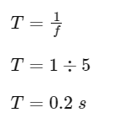

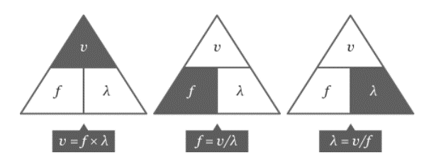
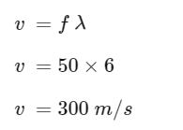
1 2 3 4 5 6 7 8 9 10 11 12 13 14 15 16 17 18 19 20 21 22 23 24 25 26 27 28 29 30 | Example Calculate the time period of a wave with a frequency of 5 Hz. Calculating wave speed Wave velocity, the speed of a wave, can be calculated using the equation: wave speed = frequency × wavelength This is when: wave speed (T) is measured in metres per second (m/s) frequency (f) is measured in Hertz (Hz) wavelength (λ ) is measured in metres (m) Example calculation What is the wave speed if the frequency is 50 Hz and the wavelength is 6 m? The speed of sound in different materials Sound is a mechanical longitudinal wave. The wave is passed on by collisions between particles, so the speed the wave moves depends on the density of the particles.

Slide 19
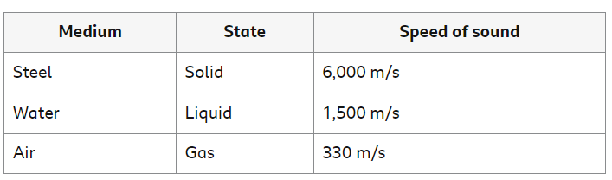

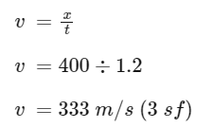
1 2 3 4 5 6 7 8 9 10 11 12 13 14 15 16 17 18 19 20 21 22 23 24 25 26 27 28 29 30 | When sound moves from one medium into another, the change in speed will also cause a change in wavelength, frequency is unaffected. wave speed = frequency × wavelength Constant frequency means that the wavelength will be proportional to the wave velocity. Measuring the speed of sound in air The air is made up of many tiny particles. When sound is created, the air particles vibrate and collide with each other, causing the vibrations to pass between air particles. The vibrating particles pass the sound through to a person’s ear and vibrate the ear drum. Light travels much faster than sound through air. For example, a person fires a starting pistol and raises their hand in the air at the same time. A distant observer standing 400 metres (m) away records the time between seeing the action (the light reaches the timekeeper immediately) and hearing the sound (which takes more time to cover the same distance). The speed of sound can be calculated using the equation: This is when: wave speed (v) is measured in metres per second (m/s) distance (x) is measured in metres (m) time (t) is measured in seconds (s) Example calculation An observer 400 m away records a 1.2 s time difference between seeing the hand signal and hearing the bang of the starting pistol.

Slide 20
1 2 3 4 5 6 7 8 9 10 11 12 13 14 15 16 17 18 19 20 21 22 23 24 25 26 27 28 29 30 | The accepted value for the speed of sound in air is 330 m/s. However, this experimental method is flawed as humans do not use stop clocks identically to one another. One person might stop the timer a fraction of a second later than another person. The values recorded will be dependent on the reaction time of the observer, and will not be entirely accurate – this explains why the answer of 333 m/s is slightly above the accepted value for the speed of sound in air.

Slide 21
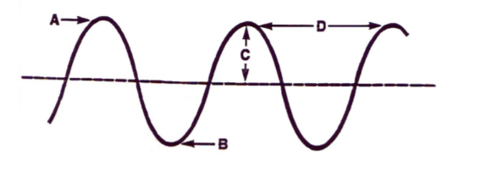
Rehearsal questions - Properties of waves
1. Label the features of the wave in the diagram
A =………………………
B = ………………………
C = ………………………
D = ………………………
2. Define the term wave amplitude? …………………………………………………………………………………………………………………………………………………………
…………………………………………………………………………………………………………………………………………………………………
3. What is meant by the wavelength of a wave? .………………………………………………………………………………………………………………………………………………………………
…………………………………………………………………………………………………………………………………………………………….....
4. What is meant by the frequency of a wave?
…………………………………………………………………………………………………………………………………………………………………
…………………………………………………………………………………………………………………………………………………………………
5. How does the period of a wave differ to its frequency?
…………………………………………………………………………………………………………………………………………………………………
…………………………………………………………………………………………………………………………………………………………………
6. Recall the wave equation
………………………………………………………………………………………………………………………………………………………...........
7. If 10 waves pass in 1 second, what does this tell you about the wave?
…………………………………………………………………………………………………………………………………………………………………
8. The highest point on a transverse wave is the .
…………………………………………………………………………………………………………………………………………………………………
9. The lowest point on a transverse wave is the .
…………………………………………………………………………………………………………………………………………………………………
10. The distance from one crest to the next crest is the .
…………………………………………………………………………………………………………………………………………………………………
11. This is a measure of the time taken for 1 wave top pass a point ………………………………………………………………………………………………………………………………………...........................
A= Crest / Peak
B = Trough
C =Amplitude
D = Wavelength
Maximum displacement from the undisturbed position
Distance from one point of a wave to the equivalent point on the next wave
Number of waves passing a point in 1 second
Frequency = number of waves / second measured in Hertz
Period = time for 1 wave to pass a point measured in seconds
Wave speed = frequency X wavelength
Its frequency is 10 Hertz
Peak / Crest
Trough
Wavelength
period

Slide 22
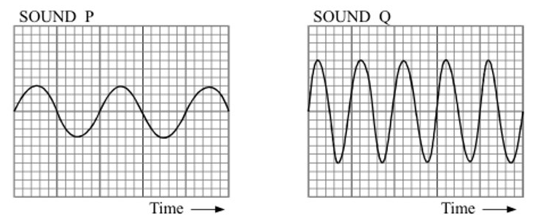
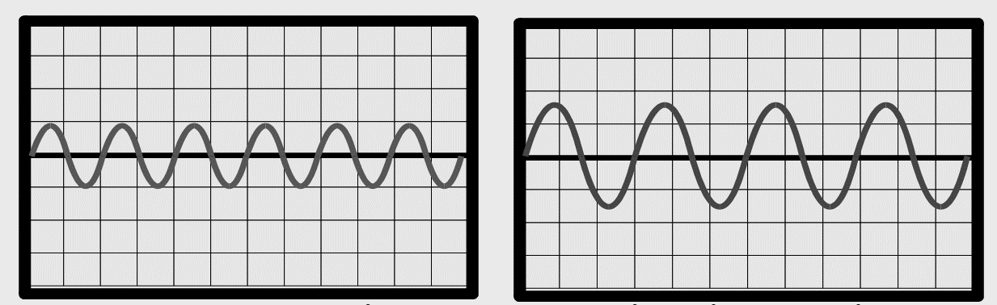
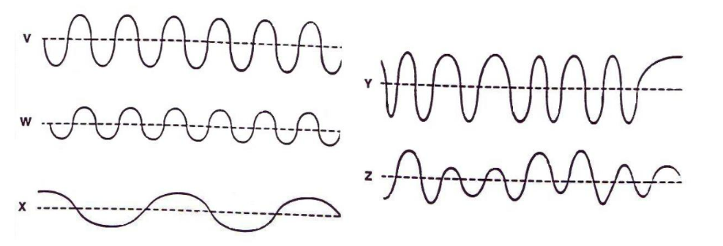
Contrasting concepts
I DO: Compare the features of the 2 waves
.……………………………………………………………………............................................................................................... …………………………………………………………………………………………………………………………………………………………........
.……………………………………………………………………............................................................................................... …………………………………………………………………………………………………………………………………………………………........
WE DO: Compare the features of the 2 waves below.
.……………………………………………………………………............................................................................................... …………………………………………………………………………………………………………………………………………………………........
.……………………………………………………………………............................................................................................... …………………………………………………………………………………………………………………………………………………………........
YOU DO: Compare the features of the waves below.
P is smaller amplitude/longer wavelength / lower frequency.​
Q is higher frequency/shorter wavelength/larger amplitude
LEFT is smaller amplitude/shorter wavelength / higher frequency.​
RIGHT is lower frequency/longer wavelength/larger amplitude

Slide 23
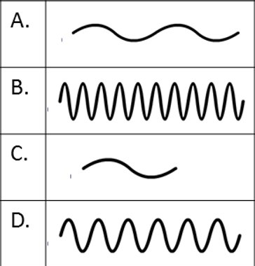
Contrasting concepts
a. Waves V and W have the same ……………… but wave V has twice the ………………………… the of wave W.
b. Waves W and X have the same……………….. but wave X has half the …………………………. of wave W.
c. Wave …………….. shows a steady frequency but a changing amplitude but wave ……………. shows a steady amplitude but a changing frequency.
d. Waves ………………. and ……………………. have a low amplitude and a steady frequency but wave ………. has a high amplitude
e. When the particles of the medium move back and forth along the direction of the wave motion, the wave is …………………………….. but a wave in which the particles of the medium move at right angles to the direction in which the wave travels is called a ………………………………..
f. Compare the differences between the waves A, B, C, D
A =………………………………………………………………………………….
B = …………………………………………………………………………………
C = ………………………………………………………………………………..
D = ………………………………………………………………………………..
a. Frequency amplitude
b. Amplitude frequency
c. Z Y
d. X W Y
e. Longitudinal transverse
A = smaller amplitude/long wavelength / low frequency.​
B = larger amplitude / short wavelength/high frequency
C = small amplitude / long wavelength/low frequency
D = high amplitude / medium wavelength/ medium frequency

Slide 24
Procedural knowledge
I DO: Compare the movement of the two types of wave
.……………………………………………………………………............................................................................................... …………………………………………………………………………………………………………………………………………………………........
.……………………………………………………………………............................................................................................... …………………………………………………………………………………………………………………………………………………………........
WE DO: Compare the function of the two wave types.
.……………………………………………………………………............................................................................................... …………………………………………………………………………………………………………………………………………………………........
.……………………………………………………………………............................................................................................... …………………………………………………………………………………………………………………………………………………………........
YOU DO: Compare the features of the two wave types.
.……………………………………………………………………............................................................................................... …………………………………………………………………………………………………………………………………………………………........
.……………………………………………………………………............................................................................................... …………………………………………………………………………………………………………………………………………………………........
YOU DO: Compare seismic P (primary) and S (secondary) waves.
.……………………………………………………………………............................................................................................... …………………………………………………………………………………………………………………………………………………………........
.……………………………………………………………………............................................................................................... …………………………………………………………………………………………………………………………………………………………........
YOU DO: Compare the transmission of energy and matter by both types of wave
.……………………………………………………………………............................................................................................... …………………………………………………………………………………………………………………………………………………………........
.……………………………………………………………………............................................................................................... …………………………………………………………………………………………………………………………………………………………........
.……………………………………………………………………............................................................................................... …………………………………………………………………………………………………………………………………………………………........
Longitudinal waves – sound waves, ultrasound waves, seismic P-waves
Transverse waves - seismic S –waves ,water waves, Mexican wave, electromagnetic waves
Longitudinal waves – compressions, rarefactions
Transverse waves - crests & troughs
P waves = Longitudinal waves - move in same direction as transfer of energy
S waves = Transverse waves - waves move at 90⁰ to the direction of energy transfer
Both types of wave transfer energy AND matter. Longitudinal REQUIRE a medium/ particles to travel through but Transverse waves do NOT need matter- can travel through a vacuum

Slide 25
Procedural knowledge
Calculating wave speed
I DO:
If the wavelength is 10m and the frequency is 5Hz what is the wave speed?​
Equation ……………………………………………………......................................................................................... Substitute values ……………………………………………………………………………………………………………………........
Calculate wave speed …………………………...............................................................................................
WE DO:
If the wavelength is 250m and the frequency is 3Hz what is the wave speed?​
Equation ……………………………………………………......................................................................................... Substitute values ……………………………………………………………………………………………………………………........
Calculate wave speed …………………………...............................................................................................
YOU DO:
a. If the wavelength 40m and the frequency is 10Hz what is the wave speed?​
Equation ……………………………………………………......................................................................................... Substitute values ……………………………………………………………………………………………………………………........
Calculate wave speed …………………………...............................................................................................
b. If the wavelength is 4.25m and the frequency is 80Hz what is the wave speed?​
Calculate wave speed …………………………...............................................................................................
c. If the wavelength is 25cm and the frequency is 600Hz what is the wave speed?​
Calculate wave speed …………………………...............................................................................................
d. If the wavelength is 1.0Km and the frequency is 3Hz what is the wave speed?​
Calculate wave speed …………………………...............................................................................................
e. If the wavelength is 1.3 Km and the frequency is 0.3KHz what is the wave speed?​
Calculate wave speed …………………………...............................................................................................
f. A radio wave has a wavelength of 1Km and a frequency of 3x10⁵ Hz. Calculate the wave speed. …………………………........................................................................................................................
V = fxλ​
= 5 x 5​
= 25m/s​
V = fxλ​
= 3 x 250​
= 750m/s​
V = fxλ​
= 10 x 40​
= 400m/s​
V = fxλ​ 80 x 4.25 = 340m/s​
V = fxλ​ 600 x 0.25 = 150m/s​
V = fxλ​ 3 x 1000 = 3000m/s​
V = fxλ​ 300 x 1300 = 390,000m/s​
V = fxλ = 1000 x 3x10⁵ = 3x10⁸ m/s

Slide 26
Procedural knowledge
Calculating wave frequency
I DO:
If the wavelength is 40m and the wave speed is 500m/s what is the wave frequency?​
Equation ……………………………………………………......................................................................................... Substitute values ……………………………………………………………………………………………………………………........
Calculate wave speed …………………………...............................................................................................
WE DO:
If the wavelength is 2m and the speed is 3m/s what is the wave frequency?​
Equation ……………………………………………………......................................................................................... Substitute values ……………………………………………………………………………………………………………………........
Calculate wave speed …………………………...............................................................................................
YOU DO:
A wave travelling at 1000 m/s has a wavelength of 2 m. Calculate the frequency of the wave. Equation ……………………………………………………..................................................................................................
Substitute values ……………………………………………………………………………………………………………………..........
Calculate wave speed …………………………...............................................................................................
b. Calculate the frequency of a wave that travels at 1 km/s and has a wavelength of 333m
Calculate wave frequency …………………………...................................................................................................................................
c. . Calculate the frequency of a wave that travels at 0.5km/s and has a wavelength of 30cm
Calculate wave frequency …………………………...................................................................................................................................
d. . A wave has a wavelength of 7500cm and a speed of 3.0x10⁸m/s. What is it’s frequency?
Calculate wave frequency in kHz …………………………...................................................................................................................................
f = v / λ​
= 500 /40​
= 12.5Hz​
f = v / λ​
= 3 / 2​
= 1.5Hz​
f = v / λ​
= 1000 / 2​
= 500Hz​
f = v / λ​ = 1000/333 = 3Hz​
f = v / λ​ = 500/0.3 = 1666.6Hz​
f = v / λ​ = 3.0x10⁸/7.5 = 40,000kHz

Slide 27
Procedural knowledge
Calculating wave length & time period
I DO:
If the frequency is 12.5Hertz and the wave speed is 500m/s what is the wave length?​
λ = v /f​
= 500 /12.5​
= 40m
Equation ……………………………………………………......................................................................................... Substitute values ……………………………………………………………………………………………………………………........
Calculate wave speed …………………………...............................................................................................
WE DO:
If the wavespeed is 4m/s and the frequency is 3Hz what is the wavelength ?​
Equation ……………………………………………………......................................................................................... Substitute values ……………………………………………………………………………………………………………………........
Calculate wave speed …………………………...............................................................................................
YOU DO:
a. If waves travel at 0.5m/s and the and 5 waves pass every second, what is their wavelength ?​
Equation ……………………………………………………......................................................................................... Substitute values ……………………………………………………………………………………………………………………........
Calculate wave speed …………………………...............................................................................................
b. A paddle moving up & down in a swimming pool is used to produce waves in the water. The speed of the waves is 2.4m/s and 2 waves pass every second, how far apart are the waves?
……………………………………………………........................................................................................................
…………………………..……………………………………………………………………………………………………………………........
c. A wave travelling at 3km/s has a frequency of 3kHz
  Calculate the wavelength ………………………………………………………………………………………..
  Calculate the time period of the wave.
  …………………………………………………….........................................................................................
  How many complete wave cycles will occur in:
    1 second? ……………………………...........................................................................
    10 seconds? …………………………….......................................................................
    1 minute? ………………...............................................................................................
λ = v /f​
= 4/54
= 1.33m
λ = v /f​ = 0.5 / 5 = 0.1m
λ = v /f​ = 2.4 / 2 = 1.2m
λ = v /f​ = 3000/ 3000 = 1m
T = 1/f​ 1/ 3000 = 3.3 x 10⁻⁴ seconds
F = 1/T 1/ 3.3 x 10⁻⁴ = 3000 waves
F = 10/T 10/ 3.3 x 10⁻⁴ = 30000 waves
F = 60/T 60/ 3.3 x 10⁻⁴ = 180,000 waves

Slide 28
Spaced Retrieval – Properties of waves
We have used the wave equation which includes wave speed.
1. What is the equation to determine the speed of a moving object?
………………………………………………………………………………………………………………………………………………….…..……......…………………………………………………………………………………………………………………………………………….……..………….
2. What are the units for each component of the equation?
………………………………………………………………………………………………………………………………………………….…..……......…………………………………………………………………………………………………………………………………………….……..………….
3. In a race, a horse travels 1280 metres in 80 seconds. What is the average speed of the horse?
………………………………………………………………………………………………………………………………………………….…..……......…………………………………………………………………………………………………………………………………………….……..………….
4.A cyclist rides at 40km/hour for 2.5 hours. How many kilometres does he ride? ………………………………………………………………………………………………………………………………………………….…..…….....
5. A man needs to walk to work 3Km away. He walks at 1.5m/s. How long will it take him to get to work? ………………………………………………………………………………………………………………………………………………….…..……..... 6.If he rode his bike at 6m/s, how long would it take him?
………………………………………………………………………………………………………………………………………………….…..……......…………………………………………………………………………………………………………………………………………….……..………….
7. A person walks 100 metres North and then 10 metres South. Calculate the distance they travel & their displacement. ………………………………………………………………………………………………………………………………………………….…..……......…………………………………………………………………………………………………………………………………………….……..………….
Speed = distance travelled / time taken
Speed = m/s or km/hr
Distance = m or km
Time = s or hr
S= d/t 1280/80 = 16m/s
d= s x t 40 x 2.5 = 100K
T = d/s 3000 / 1.5 = 2000s = 33minutes
T = d/s 3000 / 6 = 500s = 8minutes 18 seconds
Distance = 100 + 10 = 110metres
Displacement = 100 -10 = 90 metres

Slide 29
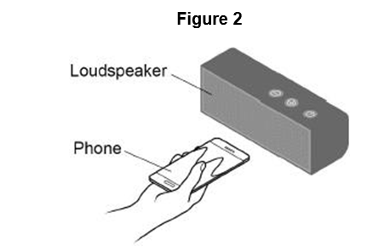
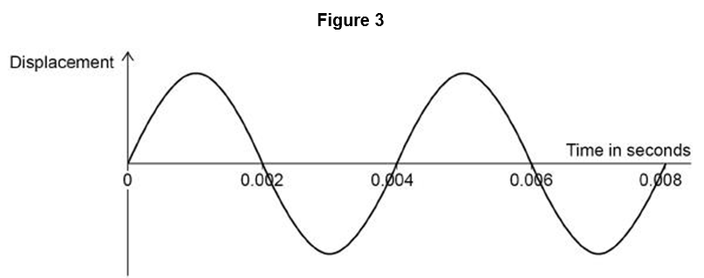

Exam questions
Q1 (a) A wave has a frequency of 1650 Hz and a wavelength of 0.200 m. Calculate the wave speed.
Use the equation: wave speed = frequency × wavelength
………………………………………………………………………………………………………………………………………………….…..……......…………………………………………………………………………………………………………………………………….. (2)
A student uses a mobile phone app that displays sound waves.
Figure 2 shows the student holding the mobile phone close to a loudspeaker
Figure 3 shows the wave pattern seen on the phone screen.
(b) What is the period of the wave shown in Figure 3?
Tick (✓) one box.
a) v = 1650 × 0.200 1
v = 330 (m/s) 1
0.004s

Slide 30
(c) Determine the frequency of the wave shown in Figure 3.
…………………………………………………………………………………………………………………………………………………………………………………………………………………………………………………………………………………………………………….. ……………………………………………………………………………………………………………………………………………………………………………………………………………………………………………………………………………………………………………..
Frequency = ………………… Hz (3)
Q2.
(a) Write down the equation that links frequency, wave speed and wavelength.
Equation………………………………………………………………………………………………………………………………(1)
(b) A baby monitor has a sensor unit that transmits an image of the baby and the noises the baby makes to a monitor unit. The signals for a baby monitor unit are transmitted as electromagnetic waves with a wavelength of 0.125 m.
Wave speed of electromagnetic waves = 3 × 10⁸ m / s
Calculate the frequency of the signal.
…………………………………………………………………………………………………………………………………………………………………………………………………………………………………………………………………………………………………………….. ……………………………………………………………………………………………………………………………………………………………………………………………………………………………………………………………………………………………………………..
Frequency = __________________ Hz (3)
Exam questions
(c )
0.004 = 1/f
allow ecf from question (b) 1
frequency = 1/0.004 1
F = 250 (Hz) 1
M2.(a) wave speed = frequency × wavelength
accept v = f λ
(b) 3 × 10⁸ = f × 0.125 1
f = 3 × 10⁸ / 0.125 1
f = 2.4 × 10⁹ (Hz) 1

Slide 31
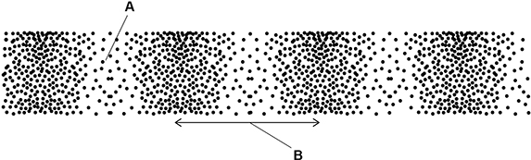
Exam questions
Q3. (a) Figure 1 shows a longitudinal wave.
(a) What do the labels A and B on Figure 1 represent? Choose answers from the box.
A = ………………………………………………………. B = ……………………………………………………… (2)
(b) The wave shown in Figure 1 has a frequency of 4.0 kHz . Calculate the period of the wave.
Give the unit.
…………………………………………………………………………………………………………………………………………………………………………………………………………………………………………………………………………………………………………….. ……………………………………………………………………………………………………………………………………………………………………………………………………………………………………………………………………………………………………………..
Period = __________________ Unit = …………………………………………. (4)
(c) Sound waves are longitudinal.
Figure 2 shows how the speed of sound varies with the temperature of the air.
a) A = rarefaction
B = wavelength
(b) f = 4000 Hz 1
T = 1 / 4000 1
T = 0.00025 1
seconds or s 1

Slide 32
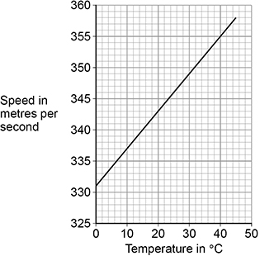
Exam questions
Figure 2
allow a correct rearrangement using an incorrect value of v read from graph
1
1.16 (m)
allow 1.2 (m)
allow a correct calculation using an incorrect value of v read from graph
allow a maximum of 2 marks for use of v = 330 m/s
1
c) wave speed = frequency × wavelength
(c) Write down the equation that links frequency (f), wavelength (λ) and wave speed (v).
…………………………………………………………………………………………………………………………………………………(1)
(d) A sound wave with a frequency of 300 Hz travels through the air.
The air has a temperature of 28.0 °C. Determine the wavelength of the sound wave.
Use Figure 2 above
…………………………………………………………………………………………………………………………………………………………………………………………………………………………………………………………………………………………………………….. ……………………………………………………………………………………………………………………………………………………………………………………………………………………………………………………………………………………………………………..
Wavelength = _______________ m (4)
(d) v = 348
allow a value in the range 347 to 348
subsequent marks may only be awarded if value for v is in the range 343 to 349 1
348 = 300 × λ
λ = 348/ 300
λ = 1.16m

Slide 33
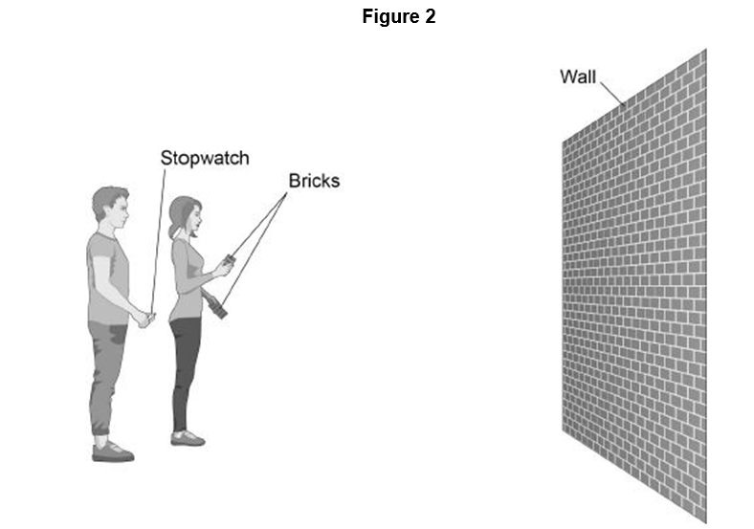
Exam questions
Q4. Figure 2 shows two students measuring the speed of sound in air.
One student bangs two bricks together. The sound wave produced is reflected from the wall and travels back to the students. Describe how they can determine the speed of sound.
…………………………………………………………………………………………………………………………………………………………………………………………………………………………………………………………………………………………………………….. …………………………………………………………………………………………………………………………………………………………………………………………………………………………………………………………………………………………………………….. …………………………………………………………………………………………………………………………………………………………………………………………………………………………………………………………………………………………………………….. …………………………………………………………………………………………………………………………………………………………………………………………………………………………………………………………………………………………………………(4)
M2.(a) wave speed = frequency × wavelength
accept v = f λ
Level 2: The method would lead to the production of a valid outcome. Key steps are identified and logically sequenced. (3−4)
Level 1: The method would not necessarily lead to a valid outcome. Some relevant steps are identified, but links are not made clear. (1−2)
No relevant content (0)
Indicative content
• measure the distance between the student with the bricks and the wall
• trundle wheel or tape measure
• measure the time taken from banging the bricks to the echo
• double the measured distance to give the distance travelled or half the time
• use: speed = distance travelled / time taken
• repeat timings
• remove anomalies
• calculate a mean

Slide 34
Subtopic 2: Required Practical - Waves
Learning Objective
Students should be able to:
• identify amplitude and wavelength from given diagrams
• describe a method to measure the speed of sound waves in air
• describe a method to measure the speed of ripples on a water surface.
Why are we learning about this?
This lessons helps us understand how we can use real examples of everyday waves and pieces of measuring equipment to work out how fast waves travel. Knowing the speed of waves can help to determine the speed at which energy or information will get transferred from one space to another, distance from Earth t distant objects in the Universe or time taken for energy or information to reach certain objects.

Slide 35
AQA Content
Required practical activity 20: make observations to identify the suitability of apparatus to measure the frequency, wavelength and speed of waves in a ripple tank and waves in a solid and take appropriate measurements.
Students should be able to describe wave motion in terms of their amplitude, wavelength, frequency and period.
The amplitude of a wave is the maximum displacement of a point on a wave away from its undisturbed position.
The wavelength of a wave is the distance from a point on one wave to the equivalent point on the adjacent wave.
The frequency of a wave is the number of waves passing a point each second.
period = 1/ f frequency T = 1 /f period, T, in seconds, s frequency, f, in hertz, Hz
The wave speed is the speed at which the energy is transferred (or the wave moves) through the medium.
All waves obey the wave equation:. wave s peed = f requency × wavelength v = f λ wave speed, v, in metres per second, m/s frequency, f, in hertz, Hz wavelength, λ, in metres, m
Students should be able to:
• identify amplitude and wavelength from given diagrams
• describe a method to measure the speed of sound waves in air
• describe a method to measure the speed of ripples on a water surface.

Slide 36
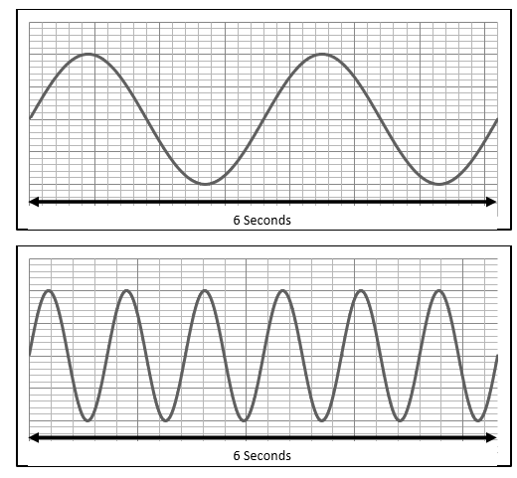
I wasn’t there but I still care!
Using the Physics AQA Text book from pages 176 -177 and the glossary on pages 284-287 to help you answer the following;
Define the term wavelength of a wave ……………………………………………………………………………………………………………………………………………………………………………………………………………………………………………………………………………………………………………………
Define the term frequency of a wave ……………………………………………………………………………………………………………………………………………………………………………………………………………………………………………………………………………………………………………………
Recall the equation that determines wave speed …………………………………………………………………………………………………………………………………………………………
Recall the equation that determines the time period of a wave
…………………………………………………………………………………………………………………………………………………………
Draw on the wavelength and the amplitude of the following waves.
A speedboat sends waves across a lake at a frequency of 2Hz and a wavelength of 3m. Calculate the speed of the waves
……………………………………………………………………………………………………………………………………………………………………………………………………………………………………………………………………………………………………………………
wave speed = frequency × wavelength
V – 2 x 3 = 6m/s

Slide 37
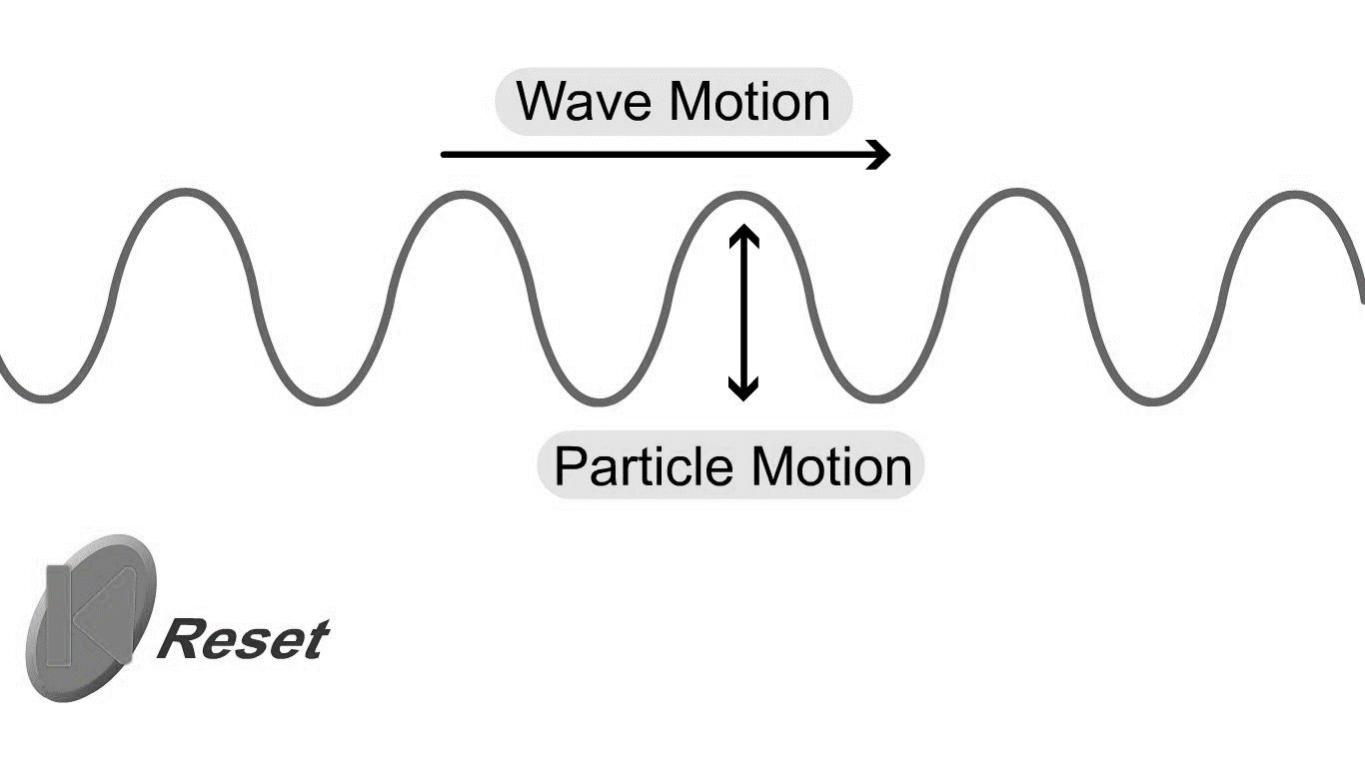
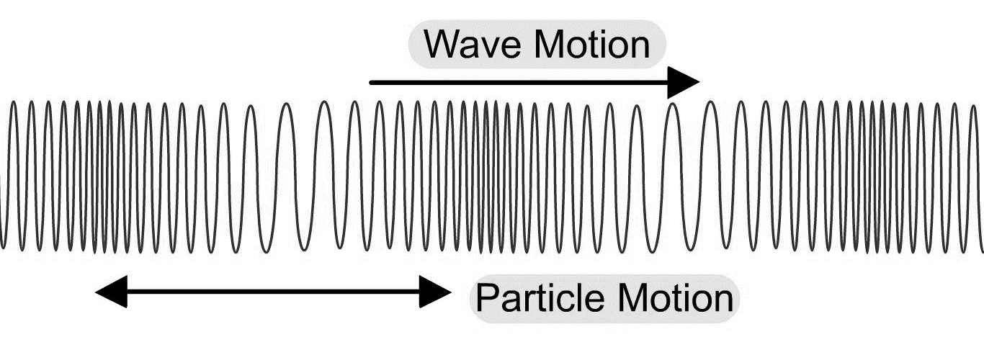
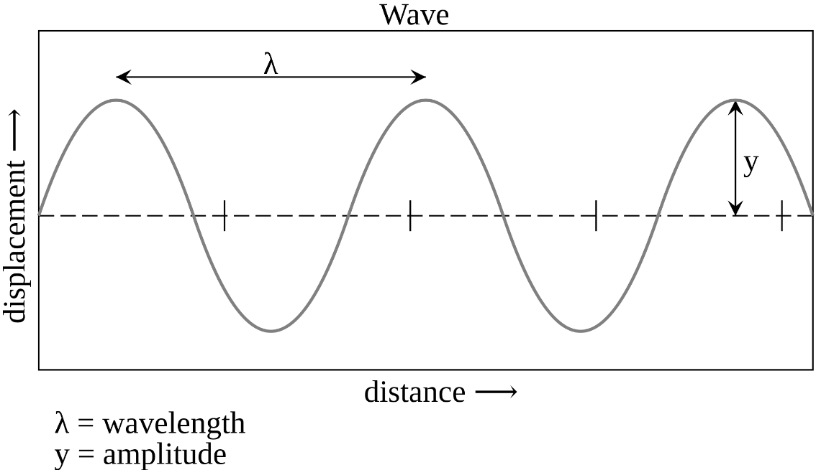
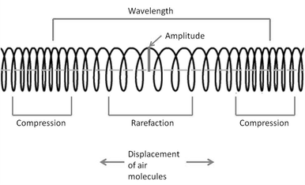
I wasn’t there but I still care!
Task: Read and complete the missing words. Use the diagrams to help you
In a ________________ wave the particles within the wave move perpendicular (at 90º) to the direction the wave is travelling. This is the wave produced in a rope when it is flicked up and down.
Examples of transverse waves are _________________, electromagnetic (light) waves and guitar strings.
________________ waves are compression (squash) waves where the particles are vibrating in the same direction as the wave movement. This is the wave produced when a spring is squashed and released.
Examples of longitudinal waves are: _____________and a type of seismic (P) wave.
Task: Write in the correct measurement and unit for each description
______________–the distance from one point on a wave to the same point on the next wave.
______________– the waves maximum displacement of a point on a wave from its undisturbed position.
______________– the number of waves passing a point per second.
_______________- the time taken to produce one complete wave.
Transverse Wave
Longitudinal Wave
Remember, the particles in a wave move up and down or backwards and forwards only.
It is energy, NOT the particles, that move from one place to another!
Longitudinal, water waves, sound waves, transverse
The displacement of a transverse wave is described as peaks and troughs. In a longitudinal wave these are described as compressions and rarefactions.
Frequency (Hz) Wavelength (m Period (s)
Amplitude (m) ),

Slide 38

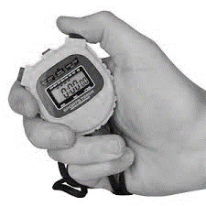
1 2 3 4 5 6 7 8 9 10 11 12 13 14 15 16 17 18 19 20 21 22 23 24 25 26 27 28 29 30 | Measuring the Speed of a wave through different medium Measuring the speed of a wave through the air The air is made up of particles. When sound is created, the air particles vibrate and collide with each other, causing the vibrations to pass between air particles. The vibrating particles pass the sound through to a person's ear and vibrate the ear drum. Light travels much faster than sound through air. For example, a person fires a cannon pistol which releases a flash of light when fired) . A distant observer stood 400 metres (m) away records the time between seeing the action (the light reaches the time keeper immediately) and hearing the sound (which takes more time to cover the same distance). The speed of sound can be calculated using the equation: speed = distance ÷ time This is when: speed (v) is measured in metres per second (m/s) distance (s) is measured in metres (m) time (t) is measured in seconds (s) Example An observer 400 m away records a 1.2 s time difference between seeing the hand signal and hearing the bang of the starting pistol. v=d ÷ t =400÷1.2 v=333 (m/s) (to 3 sig.fig.) The accepted value for the speed of sound in air is 330 m/s. However, this experimental method is flawed as humans do not use stop clocks identically to one another. One person might stop the timer a fraction of a second later than another person. The values recorded will be dependent on the reaction time of the observer, and will not be entirely accurate. This explains why the answer of 333 m/s is slightly above the accepted value for the speed of sound in air.

Slide 39
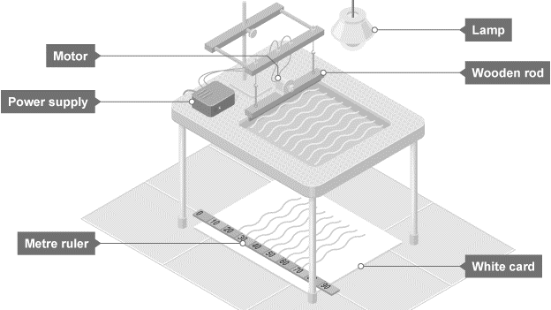
1 2 3 4 5 6 7 8 9 10 11 12 13 14 15 16 17 18 19 20 21 22 23 24 25 26 27 28 29 30 | Measuring the Speed of a wave through different medium Required practical - measuring waves in a ripple tank Measure the frequency, wavelength and speed of waves in a ripple tank A ripple tank can be used to measure and calculate frequency, wavelength and the speed of waves on the surface of the water. A ripple tank is a transparent shallow tray of water with a light shining down through it onto a white card below to clearly see the motion of the ripples created on the water’s surface. Ripples can be made by hand but to generate regular ripples it is better to use a motor. Aim of the experiment To measure the frequency, wavelength and speed of waves in a ripple tank. Method 1. Set up the ripple tank as shown in the diagram with about 5 cm depth of water. 2. Adjust the height of the wooden rod so that it just touches the surface of the water. 3. Switch on the lamp and motor and adjust until low frequency waves can be clearly observed. 4. Measure the length of a number of waves then divide by the number of waves to record wavelength. It may be more practical to take a photograph of the card with the ruler and take measurements from the still picture. 5. Count the number of waves passing a point in ten seconds then divide by ten to record frequency. 6. Calculate the speed of the waves using: wave speed = frequency × wavelength. Example results table:
Length of 10 waves (cm) | Wavelength (cm) | Number of waves in 10s | Frequency (Hz) | Wave Speed (cm/s)

Slide 40
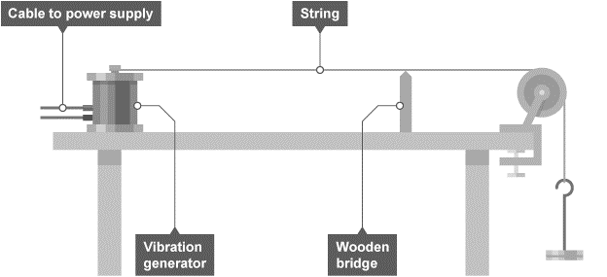
1 2 3 4 5 6 7 8 9 10 11 12 13 14 15 16 17 18 19 20 21 22 23 24 25 26 27 28 29 30 | Measuring the Speed of a wave through different medium Measure the frequency, wavelength and speed of waves in a solid There are many ways that the speed of waves in a solid can be measured. One method involves the use of a vibration generator. Aim of the experiment To measure the frequency, wavelength and speed of waves in a string. Method 1. Attach a string or cord to a vibration generator and use a 200 gram (g) hanging mass and pulley to pull the string taut as shown in the diagram. Place a wooden bridge under the string near the pulley. 2. Switch on the vibration generator and adjust the wooden bridge until stationary waves can be clearly observed. 3. Measure the length of as many half wavelengths as possible, divide by the number of half wavelengths. This is half the wavelength, doubling this gives the wavelength. 4. The frequency is the frequency of the power supply. Calculate the speed of the waves using: wave speed = frequency × wavelength.
Number of half wavelengths | Length of X half wavelengths (m) | Wavelength (m) | Frequency (Hz) | Wave speed (m/s)

Slide 41
Rehearsal Questions
Measuring Speed of a wave in air
In a sound wave what happens to the particles during
a) A compression…………………………………………………………………………………………………………………
b) rarefaction………………………………………………………………………………………………………………………………….
2. How is speed of a wave calculated?
............................................................................................................................................................
3. What type of waves are sound waves? …………………………………………………………………………………….
4. What is the relationship between distance, speed and time?
………………………………………………………………………………………………………………………………………………………….
5. Describe how longitudinal waves travel through air.
………………………………………………………………………………………………………………………………………………………………………………………………………………………………………………………….............................................................
Measuring Speed of a wave through water
What is meant by the term wave frequency?
………………………………………………………………………………………………………………………………............................
2. How are waves created in a ripple tank? …………………………………………………………………………………….
3. Write the equation that links wavelength, frequency and wave speed.
………………………………………………………………………………………………………………………………………………………
4. Using a ripple tank, what piece of equipment would you use to measure the length of a wave?
…………………………………………………………………………………………………………………………………………………………
5. What is the relationship between frequency, wave speed and wavelength?
…………………………………………………………………………………………………………………………………………………………
Using a ripple tank, how would you use the shadow of waves to calculate frequency?
………………………………………………………………………………………………………………………………………………………………………………………………………………………………………………………………………………………..………………………….

Slide 42
Rehearsal Questions: Measuring Speed of a wave through a solid (on a string)
Recall and write the 2 different equations that can be used to calculate wave speed?
…………………………………………………………………………………………………………………………………………………………………………………………………………………………………………………………………………………………………………………………………………………………………………………………………………………………………………………………………………………………………………………………………………………………………………………………………………………………………………
During the waves on a string practical, what solid material is the wave travelling through?
………………………………………………………………………………………………………………………………………………...........
During the waves on a string practical, what is the purpose of the wooden bridge?
………………………………………………………………………………………………………………………………….…………………….
During the waves on a string practical how would you find out the frequency of the wave?
………………………………………………………………………………………………………………………………………………………
5. During the waves on a sting practical, how would you find the length of a full wave of the string?
………………………………………………………………………………………………………………………………………………………
What is the relationship between frequency, wave speed and wavelength?
………………………………………………………………………………………………………………………………………………………….
7.How can you adjust the string so that it is showing a stationary wave on it?
………………………………………………………………………………………………………………………………………………………………………………………………………………………………………………………………………………………………………………
How could the wavelength be determined from the string?
………………………………………………………………………………………………………………………………………………………..
What information could the power supply provide?
……………………………………………………………………………………………………………………………………………………….

Slide 43
Rehearsal Questions ANSWERS
Measuring Speed of a wave in air
In a sound wave what happens to the particles during
A compression… PARTICLES MOVE CLOSER TOGETHER (CREATING HIGH PRESSURE
Rarefaction PARTICLES SPREAD FAR APART FROM EACH OTHER (LOW PRESSURE)
2. How is speed of a wave calculated?
DISTANCE/TIME= WAVE SPEED OR WAVE SPEED =FREQUENCY X WAVELENGTH
3. What type of waves are sound waves? LONGITUDINAL
4. What is the relationship between distance, speed and time?
SPEED = DISTANCE/TIME
5. Describe how longitudinal waves travel through air.
SOUND IS A WAVE CAUSED BY A VIBRATING OBJECT. THE SOUND TRAVELS THROUGH A MEDIUM BY A SERIES OF COMPRESSIONS AND RAREFACTIONS OF THE PARTICLES
Measuring Speed of a wave through water
What is meant by the term wave frequency?
How many waves pass a certain point per second. 1 wave per second is 1 Hz.
How are waves created in a ripple tank? By a motor moving a wooded rod in and out of the water
3. Write the equation that links wavelength, frequency and wave speed.
Wave speed = frequency x wavelength
4. Using a ripple tank, what piece of equipment would you use to measure the length of a wave?
A ruler
5. What is the relationship between frequency, wave speed and wavelength?
Wave speed = frequency x wavelength
Using a ripple tank, how would you use the shadow of waves to calculate frequency?
Count how many waves pass a certain point on the paper in 10 seconds. Then number of waves/10

Slide 44
Rehearsal Questions: Measuring Speed of a wave through a solid (on a string) ANSWERS
Recall and write the 2 different equations that can be used to calculate wave speed?
Wave speed = distance/ time or wave speed = wavelength x frequency
During the waves on a string practical, what solid material is the wave travelling through?
The string is the solid
During the waves on a string practical, what is the purpose of the wooden bridge?
To move up and down the string until a stationary wave can be seen?
During the waves on a string practical how would you find out the frequency of the wave?
Use the power supply. UK mains has a frequency of 50Hz
5. During the waves on a sting practical, how would you find the length of a full wave of the string?
Use a ruler to find out the length of half a wave and then double it
What is the relationship between frequency, wave speed and wavelength?
Wave speed = frequency x wavelength
7.How can you adjust the string so that it is showing a stationary wave on it?
Move the wooden bridge up or down the string until a stationary wave appears on the string
How could the wavelength be determined from the string?
Work out the length of half a wave using a rule and then double it.
What information could the power supply provide? The frequency of the wave
.

Slide 45
I DO: Describe how the speed of a sound wave can be measured through the air. Name the pieces of equipment in your method.
…………………………………………………………………………………………………………………………………………………………………………………………………………………………………………………………………………………………………………………………………………………………………………………………………………………………………………………………………………………………………………………………………………………………………………………………………………………………………………………………………………………………………………………………………………………………………………………………………..
…………………………………………………………………………………………………………………………………………………………………………………………………………………………………………………………………………………………………………………………………………………………………………………………………………………………………………………………………………………………………………………………………………………………………………………………………………………………………………………………………………………………………………………………………………………………………………………………………..
WE DO: Describe how the frequency of a wave can be determined using a ripple tank. Name pieces of equipment you would use.
…………………………………………………………………………………………………………………………………………………………………………………………………………………………………………………………………………………………………………………………………………………………………………………………………………………………………………………………………………………………………………………………………………………………………………………………………………………………………………………………………………………………………………………………………………………………………………………………………. …………………………………………………………………………………………………………………………………………………………………………………………………………………………………………………………………………………………………………………………………………………………………………………………………………………………………………………………………………………………………………………………………………………………………………………………………………………………………………………………………………………………………………………………………………………………………………………………………..
.

Slide 46
YOU DO: Describe how the wavelength of a wave on a string can be calculated . Name any measurements that would be taken and pieces of equipment used to measure. …………………………………………………………………………………………………………………………………………………………………………………………………………………………………………………………………………………………………………………………………………………………………………………………………………………………………………………………………………………………………………………………………………………………………………………………………………………………………………………………………………………………………………………………………………………………………………………………………..
…………………………………………………………………………………………………………………………………………………………………………………………………………………………………………………………………………………………………………………………………………………………………………………………………………………………………………………………………………………………………………………………………………………………………………………………………………………………………………………………………………………………………………………………………………………………………………………………………..
.
These questions are looking at errors made in the practical methods:
A student is using the ripple tank to calculate the wave speed. The student calculated the speed using the frequency and multiplied by the time taken for the wave to pass. Explain why the student has calculated the speed incorrectly.
…………………………………………………………………………………………………………………………………………………………………………………………………………………………………………………………………………………………………………………………………………………………………………………………………………………………………………………………………………………………………………………………………………………………………………………………………………………………………………………………………………………………………………………………………………………………………………………………………..
2. A students has said that the power supply to the string can be used to determine the wavelength of a wave? Explain why they are incorrect? ……………………………………………………………………………………………………………………………………………………………………………………………………………………………………………………………………………………………………………………

Slide 47
3. The student was calculating the frequency of the wave using a ripple tank by counting the number of waves on the piece of paper? The student has calculated this incorrectly. Explain why?
…………………………………………………………………………………………………………………………………………………………………………………………………………………………………………………………………………………………………………………………………………………………………………………………………………………………………………………………………………………………………………………………………………………………………………………………………………………………………………………………………………………………………………………………………………………………………………………………………..
4. A student wanted to measure the length of a wave using the ripple tank and measured the length between the first and the last wave shown on the piece of paper. Explain why the student has done this incorrectly?
…………………………………………………………………………………………………………………………………………………………………………………………………………………………………………………………………………………………………………………………………………………………………………………………………………………………………………………………………………………………………………………………………………………………………………………………………………………………………………………………………………………………………………………………………………………………………………………………………
5. A students wanted to measure the speed of a sound wave through air. They stood 100 m away from the wall and banged two blocks together, immediately started a stop watch and stopped it when they heard the echo back (so the sound wave hit the wall and reflected back to the students ears). It took 2.5 seconds. They calculated the speed by 100/2.5 and got an answer of 40m/s. The answer is incorrect. Explain why they have calculated this wrong?
……………………………………………………………………………………………………………………………………………………………………………………………………………………………………………………………………………………………………………………………………………………………………………………………………………………………………………………………………………………………………………………………………………………………………………………………………………………………………………………………………………………………………………………………………………………………………………………………………

Slide 48
6. A student wanted to measure the speed of a wave using a ripple tank. They used the following method:
For wavelength:
Use the shadows on the paper and measure the length between the first wave and the second wave.
For frequency:
Count the number of waves on the piece of paper for ten seconds.
Then divide the number of waves by 10 to get the frequency
For wave speed:
To calculate the wave speed = frequency / wavelength
There are some steps missing in these methods and some errors. Re write the methods to ensure that the students would accurately calculate the wave speed.
………………………………………………………………………………………………………………………………………………………………………………………………………………………………………………………………………………………………………………………………………………………………………………………………………………………………………………………………………………………………………………………………………………………………………………………………………………………………………………………………………………………………………………………………………………………………………………………
………………………………………………………………………………………………………………………………………………………………………………………………………………………………………………………………………………………………………………
………………………………………………………………………………………………………………………………………………………………………………………………………………………………………………………………………………………………………………………………………………………………………………………………………………………………………………………………………………………………………………………………………………………………………………………………………………………………………………………………………………………………………………………………………………………………………………………
………………………………………………………………………………………………………………………………………………………………………………………………………………………………………………………………………………………………………………

Slide 49
ANSWERS –
I Do: Describe how the speed of a sound wave can be measured through the air. Name the pieces of equipment in your method.
Use a canon or firework (or something that also produces a flash of light) and stand a set distance away from it such as 100m. Fire the cannon and once the flash of light is seen then
Start the stop watch and then stop the stop watch when the sound is heard. Then use the equation distance/time to calculate the speed of the wave
WE do: Describe how the frequency of a wave can be determined using a ripple tank. Name pieces of equipment you would use.
To calculate the frequency of waves count the number of waves passing a certain point on the piece of paper for 10 seconds. Then to calculate the frequency = number of waves passed/10 seconds. This will give you the number of waves per second.
.

Slide 50
You Do: Describe how the wavelength of a wave on a string can be calculated . Name any measurements that would be taken and pieces of equipment used to measure.
Turn the power supply on to cause a vibration in the string. Move the wooden bridge up or down the string until a standing wave is seen on the string. Once this has been seen measure the length of as many half waves that are on the string. Then divide the total length of all half waves/ number of half waves on the string. This will give you the length of a half wave. Then double it to get the length of 1 full wave
.
These questions are looking at errors made in the practical methods:
A student is using the ripple tank to calculate the wave speed. The student calculated the speed using the frequency and multiplied by the time taken for the wave to pass. Explain why the student has calculated the speed incorrectly.
The student is incorrect because they needed to use the frequency x wavelength not /time
A students has said that the power supply to the string can be used to determine the wavelength of a wave? Explain why they are incorrect?
Because the power supply determines the frequency of a wave on a string and the wavelength is calculated by measuring the length of a wave using a ruler.

Slide 51
3. The student was calculating the frequency of the wave using a ripple tank by counting the number of waves on the piece of paper? The student has calculated this incorrectly. Explain why?
Because they needed to count the number of waves passing a certain point in a set time such as ten seconds. Then they needed to divide the number of waves seen by the time taken to measure. This will give you the frequency which is the number of waves per second.
4. A student wanted to measure the length of a wave using the ripple tank and measured the length between the first and the last wave shown on the piece of paper. Explain why the student has done this incorrectly?
They should have measured the length of a number of waves then divide by the number of waves to record wavelength
5. A students wanted to measure the speed of a sound wave through air. They stood 100 m away from the wall and banged two blocks together, immediately started a stopwatch and stopped it when they heard the echo back (so the sound wave hit the wall and reflected back to the students' ears). It took 2.5 seconds. They calculated the speed by 100/2.5 and got an answer of 40m/s. The answer is incorrect. Explain why they have calculated this wrong?
Because they are stood 100m from the wall but the echo sound wave has to get to the wall AND back, so the wave travels 200m. Not 100m. 200/2.5= 80m/s

Slide 52
6. A student wanted to measure the speed of a wave using a ripple tank. They used the following method:
For wavelength:
Use the shadows on the paper and measure the length between the first wave and the second wave.
For frequency:
Count the number of waves on the piece of paper for ten seconds.
Then divide the number of waves by 10 to get the frequency
For wave speed:
To calculate the wave speed = frequency / wavelength
There are some steps missing in these methods and some errors. Re write the methods to ensure that the students would accurately calculate the wave speed.
Missing steps:
For wavelength: Step 2 count the number of waves covered in that distance and then for the length of 1 wave = length / number of waves.
For frequency: Step 1 count te number of waves passing a point on the paper for 10 seconds
For wave speed: should be frequency x wavelength

Slide 53
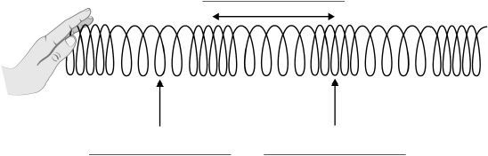
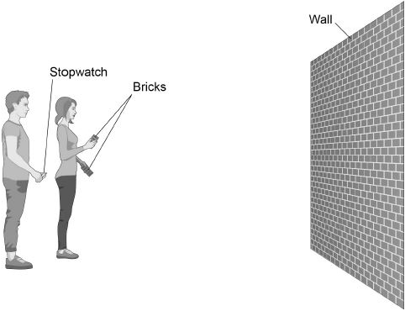
Low demand: Q1. Figure 1 shows a slinky spring used to model a sound wave.
Figure 1
(a) Label the arrows on Figure 1. Choose the answers from the box. (3)
(b) What type of wave is a sound wave? Tick one box.
electromagnetic
longitudinal
transverse (1)
(c) Figure 2 shows two students measuring the speed of sound in air.
Figure 2

Slide 54
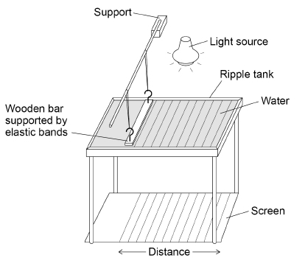
One student bangs two bricks together. The sound wave produced is reflected from the wall and travels back to the students. Describe how they can determine the speed of sound. (4)
……………………………………………………………………………………………………………………………………………………………………………………………………………………………………………………………………………………………………………………………………………………………………………………………………………………………………………………………………………………………………………………………………………………………………………………………………………………………………………………………………………………………………………………………………………………………………………………………………………………………………………………………………………………………………………………………………………………………………………………………………………………………………………………………………………………………………………………………………………
(Total 8 marks)
Medium Q2. Figure 1 below shows the equipment a teacher used to determine the speed of a water wave.
The equipment includes:
• a ripple tank filled with water
• a wooden bar that creates ripples on the surface of the water
• a light source which causes a shadow of the ripples on the screen.

Slide 55
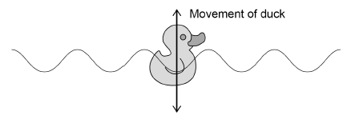
A )Describe how equipment in Figure 1 can be used to measure the wavelength, frequency and speed of a water wave.
………………………………………………………………………………………………………………………………………………………………………………………………………………………………………………………………………………………………………………………………………………………………………………………………………………………………………………………………………………………………………………………………………………………………………………………………………………………………………………………………………………………………………………………………………………………………………………………………………………………………………………………………………………………………………………………………………………………………………………………………………………………………………………………………………………………………………………………….
(6 marks)
The teacher put a plastic duck in the ripple tank as shown in Figure 2. The plastic duck moved up and down as the waves in the water passed.
Figure 2
How does the movement of the plastic duck in Figure 2 demonstrate that water waves are transverse? ………………………………………………………………………………………………………………..(1)
(c) The teacher measured the maximum height and the minimum height of the plastic duck above the screen as the wave passed. The teacher repeated his measurements. The table shows the teacher’s measurements.

Slide 56
Calculate the mean amplitude of the water wave.
…………………………………………………………………………………………………………………………………………………………………………………………………………………………………………………………………………………………………………………………………………………………………………………………………………………………………………………………………………………………………………………………………………………………………………………………………………………………………………………………………………………………………………………………………………………………………………………………………………………
Mean amplitude = ____________________ mm (3)
(Total 10 marks)
High: Q3. A student made water waves in a ripple tank.
(a)Describe how the frequency and wavelength of the water waves in the ripple tank can be measured accurately.
………………………………………………………………………………………………………………………………………………………………………………………………………………………………………………………………………………………………………………………..
…………………………………………………………………………………………………………………………………………………………………………………………………………………………………………………………………………………………………………………………………………………………………………………………………………………………………………………………………………………………………………………………………………………………………………………………………………………………………………………………………………………………………………………………………………………………………………………………………………………
.………………………………………………………………………………………………………………………………………………………..………………………………………………………………………………………………………………………………………………………………………………………………………………………………………………………………………………………………………………………………………………………………………………………………………………………………………………………………………………………………………………………………………………………………………………………………………………………………………………….(4)

Slide 57
The student recorded values for the frequency and the wavelength of waves in the ripple tank.
Table 1 and Table 2 show the results.
(b) Determine the mean wave speed.
……………………………………………………………………………………………………………………………………………………………………………………………………………………………………………………………………………………………………………………………………………………………………………………………………………………………………………………………………………………………………………………………………………………………………………………………………………………………………………………Mean wave speed = ……………………………………. m/s (4)
(c) What is the advantage of taking repeat readings and then calculating a mean?
……………………………………………………………………………………………………………………………………………………………………………………………………………………………………………………………………………………………………….. (1)
(d) The speed of the wave is affected by the depth of the water in the ripple tank. The deeper the water the faster the wave. Explain how the depth of the water affects the wavelength of the wave if the frequency is constant.
……………………………………………………………………………………………………………………………………………………………………………………………………………………………………………………………………………………………………………………………………………………………………………………………………………………………………………………………………………………………………………………………………………………………………………………………………………………………………………………
(2)

Slide 58
EXAM Q ANSWERS
Q1. (a)
(b) longitudinal 1
(c) Level 2: The method would lead to the production of a valid outcome. Key steps are identified and logically sequenced. 3−4
Level 1: The method would not necessarily lead to a valid outcome. Some relevant steps are identified, but links are not made clear. 1−2
No relevant content 0
Indicative content
• measure the distance between the student with the bricks and the wall
• trundle wheel or tape measure
• measure the time taken from banging the bricks to the echo
• double the measured distance to give the distance travelled or half the time
• use:
• repeat timings
• remove anomalies
• calculate a mean [8]
Q2. (a) Level 3: The design/plan would lead to the production of a valid outcome. All key steps are identified and logically sequenced. 5−6
Level 2: The design/plan would not necessarily lead to a valid outcome. Most steps are identified, but the plan is not fully logically sequenced. 3−4
Level 1: The design/plan would not lead to a valid outcome. Some relevant steps are identified, but links are not made clear. 1−2
No relevant content 0
Indicative content
• if two quantities have been determined, v = f λ can be used to find the third.
Frequency
• use a stopclock
• count the number of waves passing a point in a fixed time period
• divide the time by the number of waves to determine the time for one wave, T
• f = 1/T
• read the frequency off the oscillator
Wavelength
• use a camera to freeze the image
• use a metre rule to measure the distance between two wavefronts
• count the number of waves between the wavefronts
• divide distance by the number of waves to determine λ
Velocity
• determine a mean value of frequency
• determine a mean value of wavelength
• measure the time it takes one wavefront to travel the length of the screen
• measure the length of the screen
• speed = distance / time
To access Level 3 there must be a description of how frequency, wavelength and velocity can be determined

Slide 59
(b) (the duck) moves perpendicular to the direction of wave travel. duck moves up and down is insufficient 1
(c) mean maximum height = 511 and mean minimum height = 500 (1)
511 − 500 = 11 allow a calculated difference from incorrect means 1
11 / 2 = 5.5 (mm)
allow their difference divided by 2
any correct method of determining the mean amplitude can score 3 marks
an answer of 5.5 (mm) gains 3 marks [10]
Q3.
(a)Level 2: The design/plan would lead to the production of a valid outcome. All key steps are identified and logically sequenced. 3−4
Level 1: The design/plan would not necessarily lead to a valid outcome. Most steps are identified, but the plan is not fully logically sequenced. 1−2
No relevant content 0
Indicative content
Wavelength
• place a metre rule at the side of the screen perpendicular to the wave fronts
use the metre rule to measure the length of the screen
take a photograph of the shadow on the screen
count the number of complete waves on the screen
determine the wavelength by dividing the length of the by the number of complete waves
or
place a metre rule at the side of the screen perpendicular to the wave fronts
take a photograph of the shadow on the screen
use the metre rule to measure the distance between two wave front
Frequency
count the number of waves that pass a given point
time how long it takes for the waves to pass that point using a stop clock
frequency is number of waves divided by time taken
or
put a stop clock on the screen
use a digital video camera to record the waves passing a point
replay in slow motion and count the number of waves passing a point in 1 second
There must be a description of both frequency and wavelength measurement to access level 2
(b) mean f = 9.5 Hz 1
mean λ = 0.020 m 1
v = 9.5 × 0.020 allow a correct substitution of an incorrect value of mean frequency and/or
Wavelength 1
v = 0.19 (m/s) allow a correct calculation using an incorrect value of mean frequency and/or wavelength 1

Slide 60
or
v = 9.8 × 0.017 and v = 9.4 × 0.022 and v = 9.3 × 0.021 (2)
v = 0.19 (m/s) (1)
allow a maximum of 2 marks if a single pair of values is used
(c) reduces the effect of random errors
allow anomalous readings can be discarded before calculating a mean 1
(d) deeper water means longer wavelength 1
Because v increases and f is constant
allow for a fixed frequency period is constant 1

Slide 61
Subtopic 3: Uses and applications of electromagnetic waves.
Learning Objective
We are learning about the types of electromagnetic radiation and their uses.
Why are we learning about this?
Electromagnetic waves are used extensively by the human race; their use underpins modern civilization. For example, electromagnetic waves are used for communication, cooking, security cameras etc. It is inevitable that we will find more uses for electromagnetic waves so it is essential that we understand their nature, potential and associated hazards.
3

Slide 62
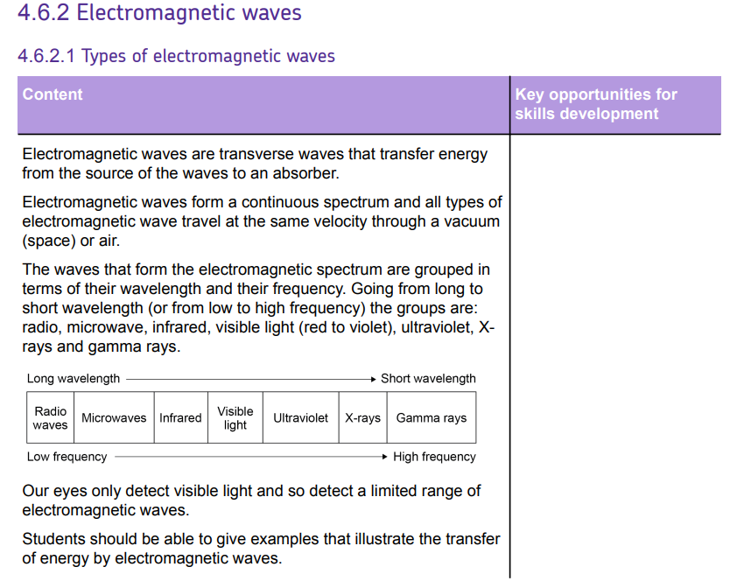
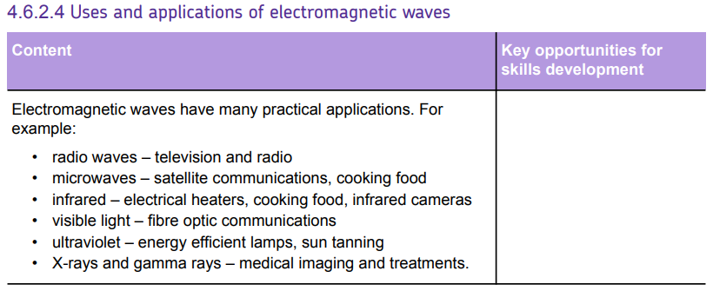

AQA Content

Slide 63
I wasn’t there but I still care!
……………………………………………………………………………………………………………………………………………………………………………………………………………………………………………………………………………………………………………………………………………………………………………………………………………………………………………………………………………………………………………………………………………………………………………………………………………………………………………………………………………………………………………………………………………………………………………………………………………………………………………………………………………………………………………………………………………………………………………………………………………………………………………………………………………………………………………………………………………………………………………………………………………………………………………………………………………………………………………………………………………………………………………………………………………………………………………………………………………………………………………………………………………………………………………………………………………………………………………………………………………………………………………………………………………………………………………………………………………………………………………………………………………………………………………………………………………………………………………………………………………………………………………………………………………………………………………………………………………………………………………………………………………………………………………………………………………………………………………………………………………………………………………………………………………………………………………………………………………………………………………………………………………………………………………………………………………………………………………………………………………………………………………………………………………………………………………………………………………………………………………………………………………………………………………………………………………………………………………………………………………………………………………………………………………………………………………………………………………………………………………………………………………………………………………………………………………………………………………………………………………………………………………………………………………………………………………………………………………………………………………………………………………………………………………………………………………………………………………………………………………………………………………………………………………………………………………………………………………………………………………………………………………………………………………………………………………………………………………………………………………………………………………………………………………………………………………………………………………………………………………………

Slide 64
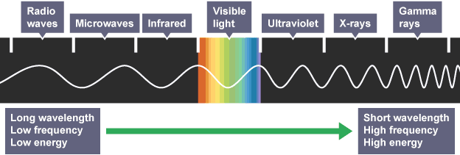
1 2 3 4 5 6 7 8 9 10 11 12 13 14 15 16 17 18 19 20 21 22 23 24 25 26 27 28 29 30 | Electromagnetic waves Electromagnetic waves are transverse waves. Their vibrations or oscillations are changes in electrical and magnetic fields at right angles to the direction of wave travel. All electromagnetic waves: transfer energy as radiation from the source of the waves to an absorber can travel through a vacuum such as in space travel at the same speed through a vacuum or the air Electromagnetic waves travel at 300 million metres per second (m/s) through a vacuum. Electromagnetic spectrum Electromagnetic waves form a continuous spectrum of waves. This includes: waves with a very short wavelength. high frequency and high energy waves with a very long wavelength, low frequency and low energy Electromagnetic waves can be separated into seven distinct groups in the spectrum. Each group contains a range of frequencies. For example, visible light contains all the frequencies that can be detected by the human eye: red light has the lowest frequencies of visible light violet light has the highest frequencies of visible light

Slide 65
1 2 3 4 5 6 7 8 9 10 11 12 13 14 15 16 17 18 19 20 21 22 23 24 25 26 27 28 29 30 | Behaviour and uses of electromagnetic waves The behaviour of an electromagnetic wave in a substance depends on its frequency. The differing behaviours of different groups in the electromagnetic spectrum make them suitable for a range of uses. Radio waves Radio waves are used for communication such as television and radio. Radio waves - Higher Radio waves are transmitted easily through air. They do not cause damage if absorbed by the human body, and they can be reflected to change their direction. These properties make them ideal for communications. Radio waves can be produced by oscillations in electrical circuits. When radio waves are absorbed by a conductor, they create an alternating current. This electrical current has the same frequency as the radio waves. Information is coded into the wave before transmission, which can then be decoded when the wave is received. Television and radio systems use this principle to broadcast information. Microwaves Microwaves are used for cooking food and for satellite communications. Microwaves - Higher High frequency microwaves have frequencies which are easily absorbed by molecules in food. The internal energy of the molecules increases when they absorb microwaves, which causes heating. Microwaves pass easily through the atmosphere, so they can pass between stations on Earth and satellites in orbit. Infrared Infrared light is used by electrical heaters, cookers for cooking food, and by infrared cameras which detect people in the dark. Infrared - Higher Infrared light has frequencies which are absorbed by some chemical bonds. The internal energy of the bonds increases when they absorb infrared light, which causes heating. This makes infrared light useful for electrical heaters and for cooking food. All objects emit infrared light. The human eye cannot see this light but infrared cameras can detect it. This

Slide 66
1 2 3 4 5 6 7 8 9 10 11 12 13 14 15 16 17 18 19 20 21 22 23 24 25 26 27 28 29 30 | 'thermal imaging' is useful for detecting people in the dark. Visible light Visible light is the light we can see. It is used in fibre optic communications, where coded pulses of light travel through glass fibres from a source to a receiver. Ultraviolet, electromagnetic waves in medicine and ionising radiation Ultraviolet We cannot see ultraviolet light but it can have hazardous effects on the human body. Ultraviolet light in sunlight can cause the skin to tan or burn. Fluorescent substances are used in energy-efficient lamps - they absorb ultraviolet light produced inside the lamp, and re-emit the energy as visible light. Electromagnetic waves in medicine Changes in atoms and their nuclei can cause electromagnetic waves to be generated or absorbed. Gamma rays are produced by changes in the nucleus of an atom. They are a form of nuclear radiation. High energy waves such as X-rays and gamma rays are transmitted through body tissues with very little absorption. This makes them ideal for internal imaging. X-rays are absorbed by dense structures like bones, which is why X-ray photos are used to help identify broken bones. Ionising radiation Ultraviolet waves, X-rays and gamma rays are types of ionising radiation. They can add or remove electrons from molecules, producing electrically charged ions. Ionisation can have hazardous effects on the body: ultraviolet waves can cause skin to age prematurely and increase the risk of skin cancer x-rays and gamma rays can cause the mutation of genes, which can lead to cancer

Slide 67
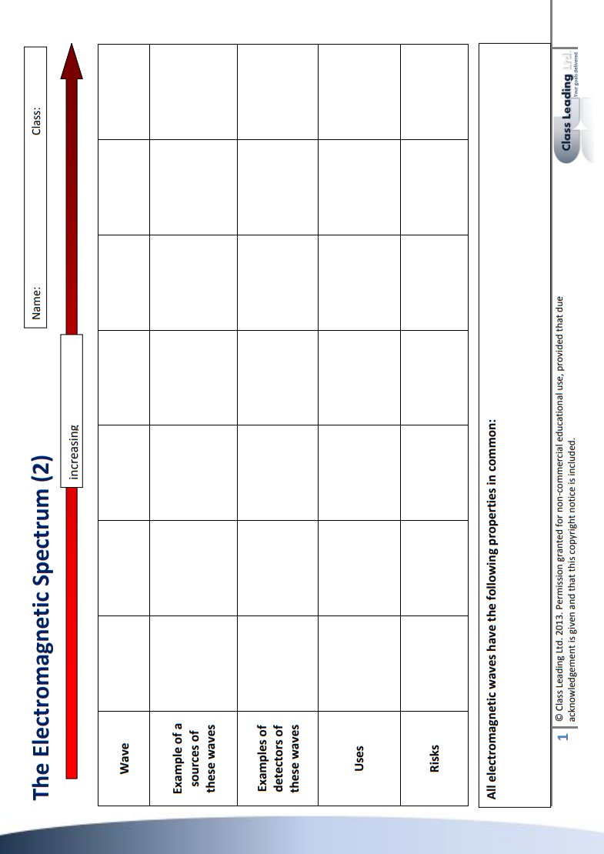

Slide 68
Rehearsal Questions
How many types of electromagnetic wave are there?
…............................................................................................................................................................
b.. Are electromagnetic waves longitudinal or transverse? …............................................................................................................................................................
c. Name two wave properties that all electromagnetic waves have in common.
…...........................................................................................................................................................
d. Which type of electromagnetic radiation do our eyes detect? …............................................................................................................................................................
e. Name two types of electromagnetic wave that are used to communicate over large distances.
…...........................................................................................................................................................
f. Name two types of electromagnetic radiation used for cooking,.
…...........................................................................................................................................................
g. All types of electromagnetic radiation are a specific form of a wave. Are they longitudinal or transverse?
…............................................................................................................................................................
h. List three types of electromagnetic wave used for communication.
…...........................................................................................................................................................
i. What wave properties do all electromagnetic waves have in common.
…...........................................................................................................................................................
j. How many types of electromagnetic wave do we know exist?
…............................................................................................................................................................
k. People cook food on a dally basis. Which two forms of electromagnetic wave can be used for cooking? …............................................................................................................................................................
.

Slide 69
Rehearsal Questions - ANSWERS
How many types of electromagnetic wave are there? SEVEN
…............................................................................................................................................................bb. Are electromagnetic waves longitudinal or transverse? TRANSVERSE
…............................................................................................................................................................cc. Name two wave properties that all electromagnetic waves have in common.
They have a wavelength and a frequency. Also, an amplitude. Oscillations are perpendicular to the direction of travel.
d. Which type of electromagnetic radiation do our eyes detect? Visible light.
…............................................................................................................................................................
e. Name two types of electromagnetic wave that are used to communicate over large distances.
Microwaves and radio waves and visible light..
f. Name two types of electromagnetic radiation used for cooking,.
Microwaves and infra-red. ..........................................................
g. All types of electromagnetic radiation are a specific form of a wave. Are they longitudinal or transverse? Transverse.
…............................................................................................................................................................
h. List three types of electromagnetic wave used for communication.
Microwaves and radio waves and visible light.. .....................
What wave properties do all electromagnetic waves have in common.
They have a wavelength and a frequency. Also, an amplitude. Oscillations are perpendicular to the direction of travel.
j. How many types of electromagnetic wave do we know exist? Seven.
…............................................................................................................................................................
k. People cook food on a dally basis. Which two forms of electromagnetic wave can be used for cooking? Microwaves and infra-red.
…............................................................................................................................................................
.

Slide 70
Wrong answers
There are nine types of electromagnetic wave. All electromagnetic waves have some wave properties in common because they are longitudinal waves. For example, they have a frequency and a wavelength. They are travel at different speeds through a vacuum.
Humans use different electromagnetic waves for different purposes. For example, infra-red and ultraviolet are used for cooking. Microwaves, radiowaves and gamma waves are used for communications.
Wrong answers - ANSWERS
There are nine types of electromagnetic wave. All electromagnetic waves have some wave properties in common because they are transverse waves. For example, they have a frequency and a wavelength. They are travel at the same speeds through a vacuum.
Humans use different electromagnetic waves for different purposes. For example, infra-red and microwaves are used for cooking. Microwaves, radiowaves and visible light are used for communications.
Radiowaves can interact with conductors. When they do this they induce a potential difference and a current. The current will have the same frequency as the radiowave.

Slide 71
Wrong answers – Higher Tier only
There are nine types of electromagnetic wave. All electromagnetic waves have some wave properties in common because they are longitudinal waves. For example, they have a frequency and a wavelength. They are travel at different speeds through a vacuum.
Humans use different electromagnetic waves for different purposes. For example, infra-red and ultraviolet are used for cooking. Microwaves, radiowaves and gamma waves are used for communications.
Radiowaves can be used to communicate with satellites because they can penetrate the atmosphere. However, microwaves reflect off the atmosphere and so do not communicate with satellites. Gamma waves can also be used to communicate over long distances. For example, pulses of gamma waves are used to communicate using fibre optics.
Wrong answers – Higher Tier only
There are seven types of electromagnetic wave. All electromagnetic waves have some wave properties in common because they are transverse waves. For example, they have a frequency and a wavelength. They are travel at the same speeds through a vacuum.
Humans use different electromagnetic waves for different purposes. For example, infra-red and microwaves are used for cooking. Microwaves, radiowaves and visible light are used for communications.
Microwaves can be used to communicate with satellites because they can penetrate the atmosphere. However, radiowaves reflect off the atmosphere and so do not communicate with satellites. Visible light can also be used to communicate over long distances. For example, pulses of visible light are used to communicate using fibre optics.

Slide 72
If it didn’t…
I DO
The different types of electromagnetic radiation have different frequencies and wavelengths. This they didn’t have different wavelengths, how would their properties be affected?
…………………………………………………………………………………………………………………………………………………………………………………………………………………………………………………………………………………………………………………………
WE DO
b. If molecules in our food didn’t absorb microwaves, how would it affect how we cook food?
…………………………………………………………………………………………………………………………………………………………………………………………………………………………………………………………………………………………………………………………
YOU DO
c. If our skin didn’t absorb ultra-violet light, how would our lives be affected?
…………………………………………………………………………………………………………………………………………………………………………………………………………………………………………………………………………………………………………………………
YOU DO
d. How would satellite communication be affected if microwaves could not penetrate the atmosphere?
…………………………………………………………………………………………………………………………………………………………………………………………………………………………………………………………………………………………………………………………
YOU DO
e. If infra-red radiation did not exist, how would our lives be affected?
…………………………………………………………………………………………………………………………………………………………………………………………………………………………………………………………………………………………………………………………
All types of EM wave would have the same properties because properties depend on the wavelength and frequency.
When microwaves are absorbed the food gets hotter. So, if they are not absorbed, the food would not heat up.
UV waves can cause skin cancer; if they aren’t absorbed, nobody would get skin cancer caused by exposure to UV light. UV light also helps our body make vitamin D. So, we would have to take vitamin D supplements.
Microwaves could not be used to communicate with satellites, so we would have to rely on other forms of communication.
Infra-red radiation is also known as thermal energy. If this did not exist, the Earth would be much cooler and it is unlikely that life could exist.

Slide 73
Spaced questions
Electromagnetic waves transfer energy from one place to another. When we talk about objects having energy, we talk about the amount of energy that they have in energy stores. There are eight energy stores: Chemical; gravity; kinetic; thermal; elastic; vibration; nuclear and electromagnetic.
a. Humans have a chemical energy store in their bodies. When they walk along a flat road, which stores receive energy from their chemical energy store?
……………………………………………………………………………………………………………………………………………………….
b. Humans have a chemical energy store in their bodies. When they climb a ladder, which stores receive energy from their chemical energy store?
……………………………………………………………………………………………………………………………………………………….
c. The wind has energy in a kinetic energy store. When the wind turns a wind turbine, which energy store in the wind turbine receives energy? ……………………………………………………………………………………………………………………………………………………….
d. When a sky diver is in a plane at 10,000 feet, they have energy in their gravitational store. When they jump out, which store is energy transferred to? ……………………………………………………………………………………………………………………………………………………….
e. When a sky diver jumps out of a plane, their weight pulls them towards the Earth. Air resistance tries to slow them down. When they first jump out, they accelerate. Are the forces balanced or unbalanced? ……………………………………………………………………………………………………………………………………………………….
f. As the sky diver accelerates, air resistance increases. Eventually weight is balanced by air resistance. Describe their motion when the forces are balanced. ……………………………………………………………………………………………………………………………………………………….
g. Define ‘terminal velocity.. ………………………………………………………………………………………………………………………………………………………………………………………………………………………………………………………………………………………………………………………………………………………………………………………………………………………………………………………………………
Kinetic
Kinetic and gravitational
Kinetic
Kinetic
Unbalanced
Falling towards the Earth at a constant velocity.
The maximum speed of an object, reached when the forces moving the object are balanced by its frictional forces

Slide 74
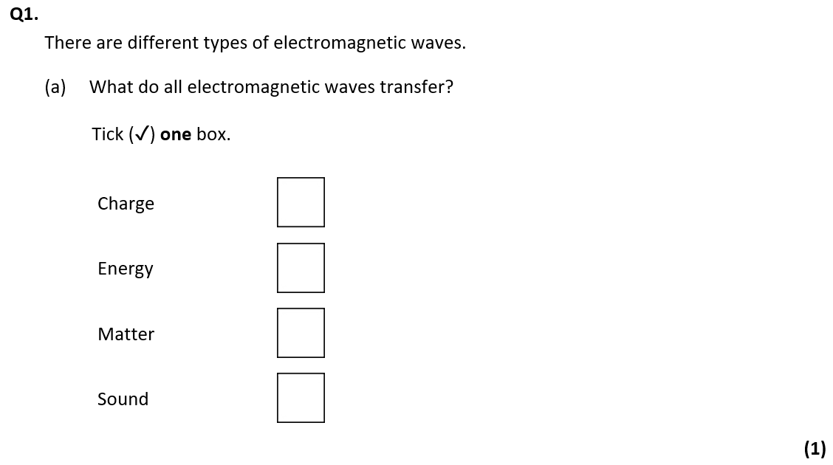
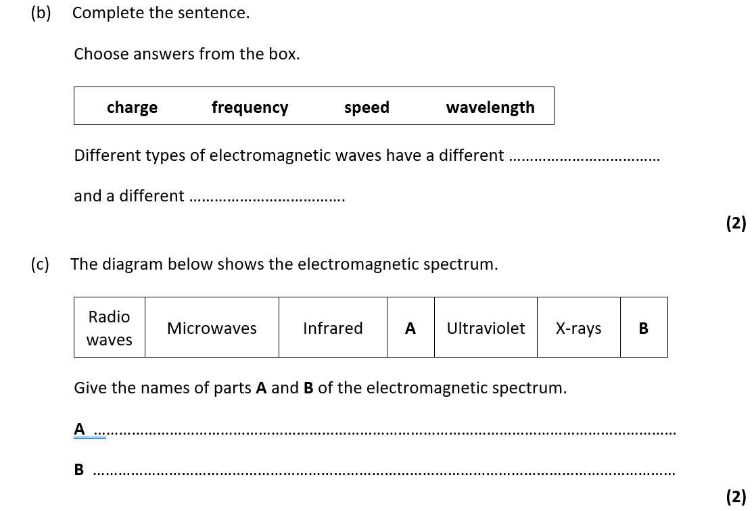
Exam questions
X
frequency
wavelength
Visible light
Gamma

Slide 75
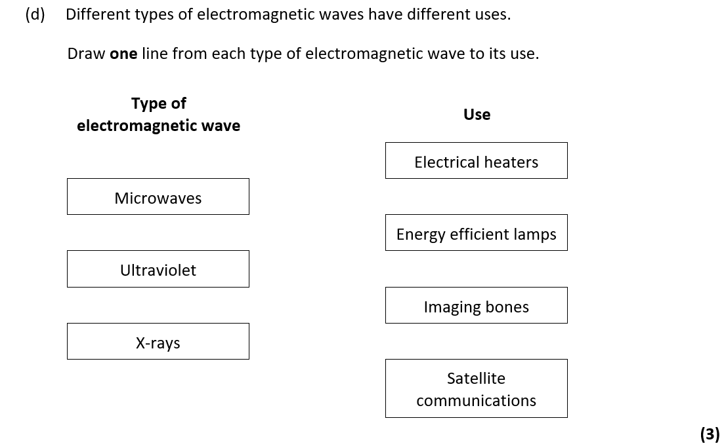

Slide 76
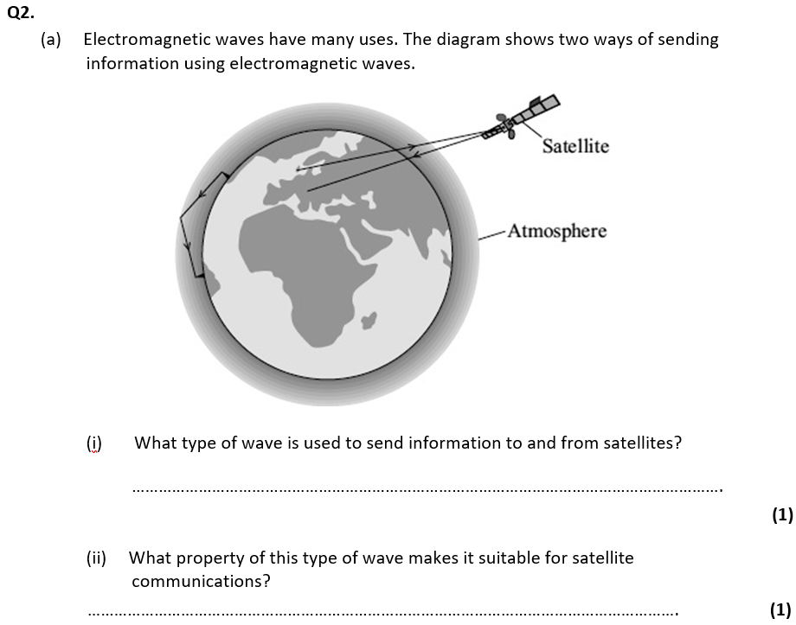
Microwaves
can pass through the ionosphere
accept travels in a straight line
accept atmosphere for ionosphere
do not accept air for ionosphere

Slide 77
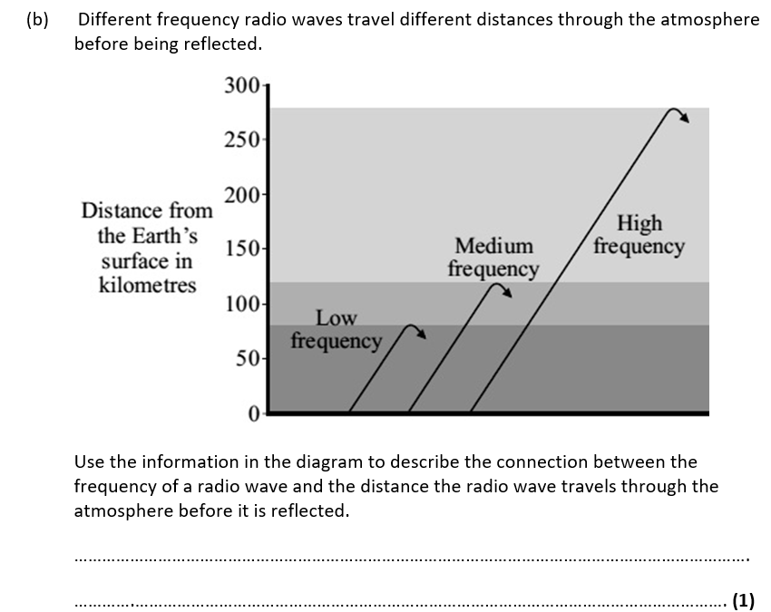

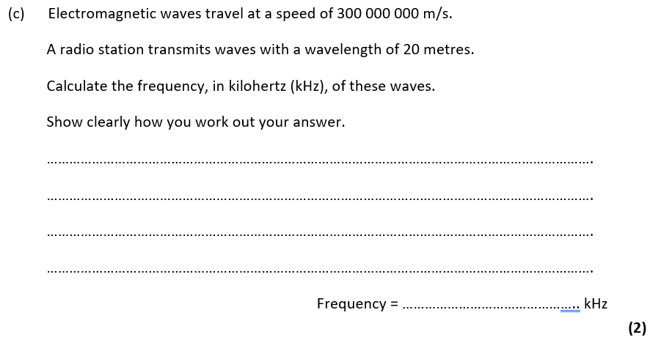
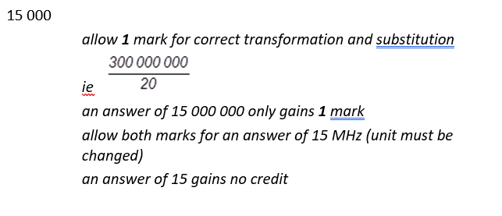

Slide 78
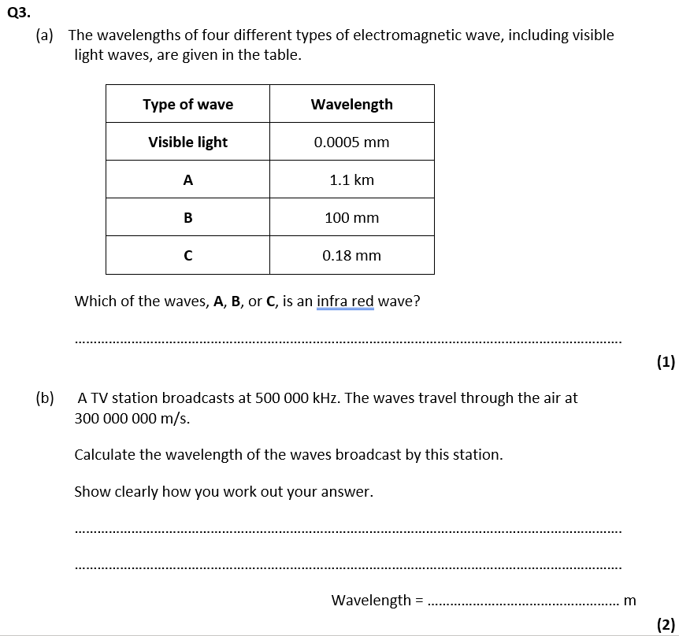

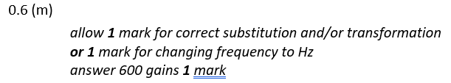

Slide 79
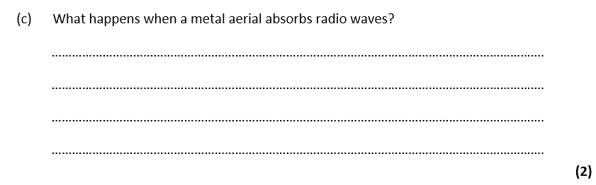




Slide 80
Subtopic 4: Properties of electromagnetic waves
Learning Objective
To understand the different effects a material may have on a wave.
To understand the effects that electromagnetic waves can have on the human body.
Why are we learning about this?
This lessons helps us understand why certain electromagnetic waves are used for specific purposes. It also helps us to understand why different things can occur when a wave meets a material.

Slide 81


AQA Content

Slide 82
I wasn’t there but I still care!
……………………………………………………………………………………………………………………………………………………………………………………………………………………………………………………………………………………………………………………………………………………………………………………………………………………………………………………………………………………………………………………………………………………………………………………………………………………………………………………………………………………………………………………………………………………………………………………………………………………………………………………………………………………………………………………………………………………………………………………………………………………………………………………………………………………………………………………………………………………………………………………………………………………………………………………………………………………………………………………………………………………………………………………………………………………………………………………………………………………………………………………………………………………………………………………………………………………………………………………………………………………………………………………………………………………………………………………………………………………………………………………………………………………………………………………………………………………………………………………………………………………………………………………………………………………………………………………………………………………………………………………………………………………………………………………………………………………………………………………………………………………………………………………………………………………………………………………………………………………………………………………………………………………………………………………………………………………………………………………………………………………………………………………………………………………………………………………………………………………………………………………………………………………………………………………………………………………………………………………………………………………………………………………………………………………………………………………………………………………………………………………………………………………………………………………………………………………………………………………………………………………………………………………………………………………………………………………………………………………………………………………………………………………………………………………………………………………………………………………………………………………………………………………………………………………………………………………………………………………………………………………………………………………………………………………………………………………………………………………………………………………………………………………………………………………………………………………………………………………………………………………

Slide 83
1 2 3 4 5 6 7 8 9 10 11 12 13 14 15 16 17 18 19 20 21 22 23 24 25 26 27 28 29 30 | Transmission and absorption Waves arriving at the interface (boundary) between two materials can be reflected, refracted, transmitted or absorbed. Absorption occurs when most of the energy being transferred by a wave is transferred to the material the wave is hitting. Transmission occurs when most of the energy being transferred by a wave is retained as the wave passes through the material it hits. The type of wave, its properties such as wavelength, and the difference between the two media will determine what happens to most of the wave energy. Common examples of absorption of wave energy: waves hitting the beach usually give most of their energy to the sand sunlight landing on a face is mostly absorbed, warming the skin sound waves hitting thick curtains give up their energy and the sound is muffled Common examples of transmission of wave energy: sea waves passing a shallow area continue with their energy mostly unchanged light passing through a glass window continues with over 95% of its energy ultrasound waves scanning a baby pass from flesh into bone and continue with enough energy for the machine to detect the echo Effect of wavelength on absorption Wavelength has a big effect on how much of a wave's energy is reflected, absorbed or transmitted at an interface. For example, a greenhouse uses these differences to raise the temperature inside. Ultraviolet light has a very short wavelength, and this is mostly transmitted by the glass. The plants, soil and floor in the greenhouse mostly absorb ultraviolet, and their temperature rises. The plants, soil and floor emit infrared light which has a longer wavelength that is mostly reflected by glass. The infrared cannot escape the greenhouse and reflects until it is re-absorbed by objects inside the greenhouse. The amount of energy in the greenhouse rises so its temperature increases.

Slide 84


1 2 3 4 5 6 7 8 9 10 11 12 13 14 15 16 17 18 19 20 21 22 23 24 25 26 27 28 29 30 | Reflection of waves Waves - including sound and light waves - can be reflected at the boundary between two different materials. The reflection of sound causes echoes. The law of reflection states that: angle of incidence = angle of reflection For example, if a light ray hits a surface at 32°, it will be reflected at 32°. Refraction of waves Waves transmitted at the interface (boundary) between two materials may change direction. Refraction is the change in direction of a wave at such a boundary. All wave types can be refracted. It is important to be able to draw ray diagrams to show the refraction of a wave at a boundary.

Slide 85

1 2 3 4 5 6 7 8 9 10 11 12 13 14 15 16 17 18 19 20 21 22 23 24 25 26 27 28 29 30 | Explaining refraction - HT The density of a material is one of the factors that affects the speed that a wave will be transmitted through it. Key fact A useful way of remembering the speed and direction changes of waves during refraction is 'FAST': Faster - Away / Slower - Towards Wave speed, frequency and wavelength in refraction For a given frequency of light, the wavelength is proportional to the wave speed: wave speed = frequency × wavelength So if a wave slows down, its wavelength will decrease. The effect of this can be shown using wave front diagrams, like the one below. The diagram shows that as a wave travels across a depth boundary it slows down and the wavelength decreases. Although the wave slows down, its frequency remains the same, due to the fact that its wavelength is shorter.

Slide 86
Rehearsal questions
What is the law of reflection? ................................................................................................................. .................................................................................................................................................................
When a wave crosses a boundary between two different mediums, it is refracted. What happens to the wave when it is refracted? ................................................................................................................ .................................................................................................................................................................
What happens to the energy of a wave when it is absorbed by a material? ......................................... .................................................................................................................................................................
What happens to the energy of a wave when it is transmitted? ........................................................... .................................................................................................................................................................
When a wave is refracted, what happens to its speed and direction? ................................................... .................................................................................................................................................................
Waves hitting a beach is an example of absorption. What does this tell you about the energy of the wave? ...................................................................................................................................................... .................................................................................................................................................................
How is the angle of incidence related to the angle of reflection? ......................................................... .................................................................................................................................................................
Light is transmitted through transparent materials, such as glass. What does this mean? ................... .................................................................................................................................................................
When a wave arrives at the interface between two different materials, most of its energy is transferred to the material it hits. What is this an example of? .............................................................
If light hits a mirror at an angle of 42º, what angle will it reflect at? How do you know? ..................... .................................................................................................................................................................
When light passes through material with a different density than the air, it changes speed and direction. What is this an example of? ...................................................................................................
If most of the energy transferred by a wave is retained as it crosses a boundary between two different materials, what do we say has happened to it? ......................................................................
Angle of incidence = angle of reflection
The wave will change its speed and direction, depending on the density of the second medium.
Most of the energy is absorbed by the material
Most of the energy is retained by the wave as it passes through
Its speed and direction change
Most of the energy in the wave is transferred to the sand of the beach
They are the same (angle of incidence = angle of reflection)
Most of the energy is retained by the wave as it passes through
Absorption
It will reflect at 42º because angle of incidence = angle of reflection
Refraction
It was transmitted

Slide 87
Contrasting concepts
I DO: Compare the angle of incidence to the angle of reflection, when a wave is reflected.
.....................................................................................................................................................................................................................................................................................................................................................................................................................................................................................................................
WE DO: Compare what happens to the energy of a wave during absorption and transmission.
.....................................................................................................................................................................................................................................................................................................................................................................................................................................................................................................................
YOU DO: Compare what happens to a wave during reflection and refraction.
.....................................................................................................................................................................................................................................................................................................................................................................................................................................................................................................................
YOU DO: Compare the direction change during refraction when a wave speeds up to when a wave slows down.
.....................................................................................................................................................................................................................................................................................................................................................................................................................................................................................................................
YOU DO: Compare the frequency, wavelength, and speed of a wave in air to when it passes through a more dense medium.
.....................................................................................................................................................................................................................................................................................................................................................................................................................................................................................................................
YOU DO: Compare what happens to waves with short wavelengths to those with long wavelengths when they hit the glass walls of a greenhouse.
.....................................................................................................................................................................................................................................................................................................................................................................................................................................................................................................................
When a wave is reflected, the angle of incidence will be the same as the angle of reflection. This is known as the law of reflection.
When a wave is absorbed, most of the energy is transferred form the wave to the material it hits. However, during transmission, most of the energy is retained by the wave as it passes through the material.
When a wave is reflected, it bounces off the surface at the same angle it hit (law of reflection). However, when a wave is refracted, it changes speed and direction as it passes though the material.
If a wave speeds up during refraction, it moves away from the normal (angle of refraction > angle of incidence) However, if a wave slows down, it moves towards the normal (angle of refraction < angle of incidence)
When a wave passes through a more dense material than air, its speed decreases. Its wavelength also decreases. These things allow the frequency of the wave to remain unchanged.
Waves with shorter wavelengths (e.g. UV) are mostly transmitted by the glass, whereas waves with longer wavelengths (e.g. IR) are mostly reflected by the glass. Both of these things allow the energy of the greenhouse to increase, increasing its temperature.

Slide 88
Wrong answers
I DO: “When a wave is refracted, it always slows down”. Explain why this statement is incorrect.
.....................................................................................................................................................................................................................................................................................................................................................................................................................................................................................................................
WE DO: “When a wave is reflected, it reflects at the same angle, meaning it only reflects in one direction”. Explain why this statement is incorrect.
.....................................................................................................................................................................................................................................................................................................................................................................................................................................................................................................................
YOU DO: “When a wave is absorbed, all of the energy is transferred to the material”. Explain why this statement is incorrect.
.....................................................................................................................................................................................................................................................................................................................................................................................................................................................................................................................
YOU DO: “When a wave is transmitted, all of the energy passes through and is retained by the wave”. Explain why this statement is incorrect.
.....................................................................................................................................................................................................................................................................................................................................................................................................................................................................................................................
YOU DO: “When a wave is refracted through a more dense medium, its frequency changes, as the waves are closer together”. Explain why this statement is incorrect.
.....................................................................................................................................................................................................................................................................................................................................................................................................................................................................................................................
YOU DO: “Because a greenhouse is made of glass, all waves can pass through easily”. Explain why this statement is incorrect. .....................................................................................................................................................................................................................................................................................................................................................................................................................................................................................................................
The wave will slow down only if it passes into a more dense medium. If it passes into a less dense medium, the wave will actually speed up.
Although the angle of incidence = angle of reflection, the wave is reflected in all directions, but at the same angle.
When a wave is absorbed, this only means that most of the energy has been transferred to the material. Some of the energy is not transferred, and may be either transmitted, reflected or refracted.
When a wave is transmitted, this only means that most of the energy is retained by the wave. Some of the energy may be absorbed, reflected or refracted.
If the waves are closer together, this means that their wavelength has decreased. However, the waves will also be moving slower, meaning that there will still be the same number of waves per second. This means the frequency actually stays the same.
In a greenhouse, waves with a shorter wavelength are better able to be transmitted (pass through), whereas waves with a longer wavelength are more likely to be reflected by the glass.

Slide 89
1 2 3 4 5 6 7 8 9 10 11 12 13 14 15 16 17 18 19 20 21 22 23 24 25 26 27 28 29 30 | Changes in atoms, and the nuclei of atoms, can result in electromagnetic waves being generated or absorbed over a wide range of frequencies. Gamma rays, for example, originate from changes in the nuclei of atoms. Radio waves Radio waves are used for communication such as broadcasting television and radio, communications and satellite transmissions. Radio waves can be produced by oscillations (back and forth movement) in electrical circuits. When radio waves are absorbed by a conductor, they create an alternating current. This electrical current has the same frequency as the radio waves. Information is coded into the wave before transmission, which can then be decoded when the wave is received. Television and radio systems use this principle to broadcast information. Hazardous radiation Electromagnetic waves increase in energy as the frequency increases (and wavelength decreases). This increases their potential for having hazardous effects on human body tissues. These effects vary depending on the type of electromagnetic wave, as well as the size of the dose. Radiation dose (in sieverts) is a measure of the risk of harm resulting from an exposure of the body to the radiation. ultraviolet waves can damage skin cells and lead to skin cancer and damage the eyes, it can cause skin to age prematurely; X-rays damage cells inside the body. They cause dangerous ionisation and when this happens with molecules in living cells, the genetic material of a cell, the DNA is damaged. This can lead to cancer. This is why doctors and dentists stand behind protective screens when taking lots of X-rays; gamma rays also damage cells inside the body causing dangerous ionisation in living cells which damages DNA. This can lead to cell death and cancer.

Slide 90
Rehearsal questions
Changes within the nuclei of atoms release which type of electromagnetic wave? .............................
How can radio waves be produced? ....................................................................................................... .................................................................................................................................................................
What effects can ultraviolet (UV) radiation have on the body? ............................................................. .................................................................................................................................................................
X-rays and gamma rays both cause dangerous ionisation within cells. What does this mean? ............ .................................................................................................................................................................
Oscillations within an electrical current produce which type of waves? ...............................................
Which type of electromagnetic radiation causes the skin to age prematurely? ....................................
How can gamma rays be produced? ....................................................................................................... .................................................................................................................................................................
DNA within the nuclei of cells can be damaged by radiation. What is this process called? .................................................................................................................................................................
Which types of radiation can cause ionisation within body cells, and what happens as a result of this? ......................................................................................................................................................... .................................................................................................................................................................
Radio waves can be produced by the oscillations in electrical current. How can these radio waves then effect the electrical current of a conductor? .................................................................................. .................................................................................................................................................................
Which type of electromagnetic radiation is likely to lead to skin cancer? .............................................
Gamma rays are produced by changes within which part of an atom? .................................................
Gamma rays
Oscillations within an electrical current.
Damage skin cells, lead to skin cancer, damage the eyes, cause skin to age prematurely
They can damage DNA and cause mutations.
Radio waves
Ultraviolet (UV)
Changes within the nuclei of atoms
Ionisation
X-rays and gamma rays. Damages to the DNA of cells can lead to cell death and cancer
Create an alternating current when absorbed by a conductor.
Ultraviolet (UV)
The nucleus

Slide 91
Wrong answers
I DO: “Changes to the electrons of an atom release gamma rays” Explain why this statement is incorrect. .....................................................................................................................................................................................................................................................................................................................................................................................................................................................................................................................
WE DO: “Waves with longer wavelengths also have more energy”. Explain why this statement is incorrect. .....................................................................................................................................................................................................................................................................................................................................................................................................................................................................................................................
YOU DO: “Radio waves produce a direct current when absorbed by a conductor”. Explain why this statement is incorrect. .....................................................................................................................................................................................................................................................................................................................................................................................................................................................................................................................
YOU DO: “X-rays and gamma rays damage the mitochondria in cells, preventing respiration and causing cell death”. Explain why this statement is incorrect. .....................................................................................................................................................................................................................................................................................................................................................................................................................................................................................................................
YOU DO: “Ultraviolet waves always cause skin cancer”. Explain why this statement is incorrect. .....................................................................................................................................................................................................................................................................................................................................................................................................................................................................................................................
YOU DO: “Ionisation leads to cancer because the DNA is destroyed”. Explain why this statement is incorrect. .....................................................................................................................................................................................................................................................................................................................................................................................................................................................................................................................
Electrons have no effect on releasing gamma rays. Gamma rays are released when changes occur within the nucleus of an atom.
Waves with shorter wavelengths actually have more energy, as they have a much higher frequency (more waves per second), allowing them to transfer more energy within a period of time.
Radio waves produce an alternating current when absorbed by a conductor, as they cause oscillations (back and forth movements) within the circuit.
X-rays and gamma rays actually damage the DNA, found in the nucleus. This can cause cell death because the nucleus controls the activities of the cell, and if the DNA is damaged it may not be able to do this.
Ultraviolet waves can cause damage skin cells, but won’t always cause cancer. It does increase the chances of skin cancer, but the risk depends on the radiation dose.
Ionisation doesn’t destroy the DNA, only damage it. However, this can lead to cancer as this damage may cause the cells to start to divide uncontrollably, as opposed to the normal, controlled division.

Slide 92
Interleaving questions – YOU DO
We are currently learning about how materials affect waves, and how electromagnetic waves can affect the human body. This links in to the following key topics: Energy, cells and organisation, particles, forces.
The following questions will link our current topic with these previous topics:
Refraction occurs when a wave passes into a medium that is more/less dense than air. Define density, and state its units. ..................................................................................................................................................................................................................................................................................................................................
Solids and liquids are more dense mediums than gases. Draw particle diagrams for a solid and a liquid to show this.
We use the equation “wave speed = frequency x wavelength” to calculate the speed of a wave. What equation would we use to calculate the speed of other objects? ..................................................................................................................................................................................................................................................................................................................................
Using the equation in question 4, calculate the speed of a car that travels 5 km in 10 minutes. Give your answer to 1 d.p. ...................................................................................................................................................................................................................................................................................................................................................................................................................................................................................................
In a greenhouse, ultraviolet waves from the Sun are absorbed by the soil, plants, and floor, increasing their temperature. Which energy store is being filled when this happens? .................................................................................................................................................................
The mass of a given volume of a substance. Density is measured in kg/m³.
Solid
Liquid
Speed = distance / time.
5km = 5000 m 10 minutes = 600 s
Speed = distance/time
Speed = 5000 / 600
Speed = 8.3 m/s
The thermal store.

Slide 93
Interleaving questions continued – YOU DO
Electromagnetic radiation can affect cells in the human body. What is a cell? ..................................................................................................................................................................................................................................................................................................................................
The DNA, which can be damaged by radiation, is found in the nucleus (an organelle). Other organelles include the mitochondria and the cell membrane. What are the functions of these organelles?
  Mitochondria: ............................................................................................................................. .....................................................................................................................................................
  Cell membrane: ........................................................................................................................... .....................................................................................................................................................
Damage to the DNA within the nucleus of a cell can lead to cancer. What is cancer? ..................................................................................................................................................................................................................................................................................................................................
A tumour can be one of two types: Malignant and Benign. Compare these two types of tumour. ...................................................................................................................................................................................................................................................................................................................................................................................................................................................................................................
Cancer is an example of a non-communicable disease. Define non-communicable disease. ..................................................................................................................................................................................................................................................................................................................................
Why do we NOT say that risk factors cause diseases? ........................................................................... ..................................................................................................................................................................................................................................................................................................................................
The building block of all living things / the unit of life.
The site of aerobic respiration, releasing energy.
Controls what enters and leaves the cell
The uncontrolled growth and division of cells within the body.
Malignant tumours grow uncontrollably to any size and spread around the body, whereas benign tumours grow to a certain size and then stop, and do not spread.
A disease that can not be transmitted from one person to another by any means.
Risk factors only increase the chances of getting a disease. Not everyone with the risk factor gets the disease, and people who don’t have the risk factor can still get it (e.g. not every smoker gets lung cancer, and some non-smokers get lung cancer).

Slide 94



Exam questions – YOU DO – Tier 1
Q1. A student used a laser to investigate the change of direction of light as it entered a glass block.
  The apparatus is shown in Figure 1.
  The path of a ray of light as it enters the glass block is shown.
Figure 1
(a) The student marked crosses to show the path of the ray of light that left the glass block.
  Use a ruler to help you to draw the path of the ray of light through and out of the glass block.
(2)
(b) Light from lasers can damage your eyes.
  Suggest one safety precaution that the student should have taken during his investigation.
  ......................................................................................................................................................................................................................................................................................................................
(1)

Slide 95



Q2. The diagram shows a ray of light travelling through a glass block.
  (a) Complete the diagram to show what happens to the ray of light when it comes out of the glass.
(2)
  (b) Explain why this happens to the ray of light. ......................................................................................................................................................................................................................................................................................................................
(2)

Slide 96



Exam questions – YOU DO – Tier 2
Q1. Explain fully why pregnant women should not normally have X-rays of the lower body.
  .......................................................................................................................................................................................................................................................................................................................................................................................................................................................................................................................................................................................................................................................................................................................................................................................................
  (Total 4 marks)
Q2.
The diagrams show rays of light. Each ray strikes a surface of a glass block.
  On the diagram draw the path of each ray through the glass block and out into the air again.
  Label another angle on the diagram which is equal to the angle marked X. Label this angle Y.
(4)

Slide 97


(b) The diagrams show two beakers. Both beakers have a drawing pin inside as shown.
The first beaker is empty. The eye cannot see the drawing pin.
The second beaker is full of water and the eye can see the drawing pin.
Explain how the eye is able to see the drawing pin in the second beaker. You may add to the diagram if it helps your answer.
............................................................................................................................................................................................................................................................................................................................................................................................................................................................................................................................................................................................................................................................................................
(3)

Slide 98


Exam questions – YOU DO – Tier 3
Q1. Figure 2 shows X-rays and gamma rays being used for medical imaging.
To use X-rays for medical imaging, a machine produces a very brief burst of X-rays. To use gamma rays for medical imaging, a radioactive isotope is injected into the patient’s blood. The isotope is circulated around the body in the blood. The isotope emits gamma rays.
Compare the potential risks to a patient of using X-rays and gamma rays for medical imaging.
.............................................................................................................................................................................................................................................................................................................................................................................................................................................................................................................................................................................................................................................................................................................................................................................................................................................................................................................................................................................................................................................................................................................................................................................................................................................................................................................................................................................................................................................................................................................................................................................................................................................................................................................................................................................................................................................................................................................
(4)
Figure 2

Slide 99


Exam questions – YOU DO – Tier 3
Q2. X-rays form part of the electromagnetic spectrum. Radiographers use X-rays to produce images of bones inside the body.
  Explain why X-rays can be used to produce images of the bones inside the body.
.....................................................................................................................................................................................................................................................................................................................................................................................................................................................................................................................
(2)
  The table below shows the effect of exposure to different doses of radiation.
  During an X-ray a person receives a dose of 0.5 mSv. The radiographer takes many X-ray images each day.
  Explain why the radiographer stands behind a protective screen when taking an X-ray image.
..........................................................................................................................................................................................................................................................................................................................................................................................................................................................................................................................................................................................................................................................................................................................................................................................................................................................................................................................................................................................................................................
(3)
Dose in mSv | Effect on the human body
100 | slightly increased risk of cancer
1000 | 5% increased risk of cancer
5000 | high risk of death

Slide 100


Exam questions – YOU DO – Tier 3
  Radio waves form part of the electromagnetic spectrum. The diagram below shows one use of radio waves.
  Explain how electrical signals in the transmitter produce a signal in the receiver.
..........................................................................................................................................................................................................................................................................................................................................................................................................................................................................................................................................................................................................................................................................................................................................................................................................................................................................................................................................................................................................................................
(3)
(Total 8 marks)

Slide 101
I wasn’t there but I still care! (For sub-topic 9)
Last lesson we looked at properties of electromagnetic waves, and how they interact with surfaces/materials.
Using the AQA Physics textbook, pages 178-179:
What happen when waves cross a boundary between two different materials? ……..………………… ……………………………………………………………………………………………………………………………………………………
Why does this happen? ……………………………………………………………………………………………………………… ……………………………………………………………………………………………………………………………………………………
Using the AQA Physics textbook, pages 196-197:
What is meant by the term “ionisation”? …………………………………………………………………………………… ……………………………………………………………………………………………………………………………………………………
How are gamma rays produced? ………………………………………………………………………………………………..
Describe the effects of ultraviolet (UV) radiation on your eyes and skin. …………………………………… …………………………………………………………………………………………………………………………………………………………………………………………………………………………………………………………………………………………………………
Describe the effects of x-rays and gamma rays on human tissues. …………………………………………….. ……………………………………………………………………………………………………………………………………………………
They are refracted (unless crossing at normal incidence.
The speed and wavelength of the wave changes at the boundary.
Making uncharged atoms become charged (by removing electrons)
When unstable nuclei release energy
Harmful to eyes (can cause blindness). Can damage skin e.g. sunburn and skin cancer. Cause the skin to age prematurely.
X-rays and gamma rays damage living tissues when they pass through it.

Slide 102
Subtopic 5: Required Practical – Radiation and absorption
Learning Objective
Carry out an investigation to compare the amount of infrared radiation radiated from different surfaces
Why are we learning about this?
Investigations are at the heart of science. Without experiments and investigations many scientific phenomena would not have been discovered or accepted. Current theories would also go unchallenged even if they contain errors.
In this investigation you will investigate the radiation of infrared radiation from different surface types.

Slide 103

AQA Content

Slide 104
I wasn’t there but I still care!
Use pages 190 – 191 & 196 – 197 0f the GCSE Physics textbook.
Name the 7 electromagnetic waves
………………………………………………………………………………………………………………………………………………………………………………………………………………………………………………………………………………………………………………………………………………………………………………………………………………………………………………………………………………
What 3 things can electromagnetic waves do?
………………………………………………………………………………………………………………………………………………………………………………………………………………………………………………………………………………………………………………………………………………………………………………………………………………………………………………………………………………
Name the 3 types of ionising radiation
………………………………………………………………………………………………………………………………………………………………………………………………………………………………………………………………………………………………………………………………………………………………………………………………………………………………………………………………………………
What is the unit for radiation dose?
………………………………………………………………………………………………………………………………………………………………………………………………………………………………………………………………………………………………………………………………………………………………………………………………………………………………………………………………………………

Slide 105

1 2 3 4 5 6 7 8 9 10 11 12 13 14 15 16 17 18 19 20 21 22 23 24 25 26 27 28 29 30 | In this investigation you will compare the amount of infrared radiation that is radiated by different surfaces. You will then evaluate the data that you obtain. The method for the basic experiment is given below. You will use an infrared detector to measure the infrared radiation radiated from each surface. Basic method: 1. Put the Leslie cube onto the heat-proof mat. 2. Fill the cube with very hot water and put the lid on the cube. Your apparatus should look like this: 3. Use the detector to measure the amount of infrared radiated from each surface. Make sure that the detector is the same distance from each surface.

Slide 106


Results table:
Plot an appropriate chart of your data

Slide 107
Analysis:
Questions to consider:
Why is it important that the detector is held the same distance from each side of the cube?
……………………………………………………………………………………………………………………………………………………………………………………………………………………………………………………………………………………………………………………………………………………………………………………………………………………………………………………………………………………………………………………………………………………
Why is it appropriate to use the readings to draw a bar chart and not a line graph?
……………………………………………………………………………………………………………………………………………………………………………………………………………………………………………………………………………………………………………………………………………………………………………………………………………………………………………………………………………………………………………………………………………………
Rank the surfaces from highest to lowest radiation by type of surface
1. …………………………………………...........
2. …………………………………………...........
3. …………………………………………...........
4. …………………………………………...........

Slide 108


The nature of the surface:
Your results should indicate that dark, matt surfaces are good absorbers and emitters of infrared radiation, making them warm up quickly when exposed to heat. On the other hand, light, shiny surfaces are poor absorbers and good reflectors of infrared radiation, so they heat up more slowly.
Exam questions:

Slide 109



Slide 110



Slide 111



Slide 112



Slide 113



Slide 114



Slide 115
DO NOW
Date: ……………………………………….
 | ANSWER
Q1.
Q2.
Q3.
Q4.
Q5.
Date: ……………………………………….
 | ANSWER
Q1.
Q2.
Q3.
Q4.
Q5.

Slide 116
DO NOW
Date: ……………………………………….
 | ANSWER
Q1.
Q2.
Q3.
Q4.
Q5.
Date: ……………………………………….
 | ANSWER
Q1.
Q2.
Q3.
Q4.
Q5.

Slide 117
DO NOW
Date: ……………………………………….
 | ANSWER
Q1.
Q2.
Q3.
Q4.
Q5.
Date: ……………………………………….
 | ANSWER
Q1.
Q2.
Q3.
Q4.
Q5.

Slide 118
DO NOW
Date: ……………………………………….
 | ANSWER
Q1.
Q2.
Q3.
Q4.
Q5.
Date: ……………………………………….
 | ANSWER
Q1.
Q2.
Q3.
Q4.
Q5.

Slide 119
DO NOW
Date: ……………………………………….
 | ANSWER
Q1.
Q2.
Q3.
Q4.
Q5.
Date: ……………………………………….
 | ANSWER
Q1.
Q2.
Q3.
Q4.
Q5.

Slide 120
DO NOW
Date: ……………………………………….
 | ANSWER
Q1.
Q2.
Q3.
Q4.
Q5.
Date: ……………………………………….
 | ANSWER
Q1.
Q2.
Q3.
Q4.
Q5.

Slide 121
DO NOW
Date: ……………………………………….
 | ANSWER
Q1.
Q2.
Q3.
Q4.
Q5.
Date: ……………………………………….
 | ANSWER
Q1.
Q2.
Q3.
Q4.
Q5.

Slide 122
DO NOW
Date: ……………………………………….
 | ANSWER
Q1.
Q2.
Q3.
Q4.
Q5.
Date: ……………………………………….
 | ANSWER
Q1.
Q2.
Q3.
Q4.
Q5.

Slide 123
Knowledge Retrieval Quiz 1
Date: ……………………………………….
Score: …………...
 |  | Answer
Q1. | Insert question in bold
Q2.
Q3.
Q4.
Q5.
Q6.
Q7.
Q8.
Q9.
Q10.

Slide 124
Knowledge Retrieval Quiz 2
Date: ……………………………………….
Score: …………...
 |  | Answer
Q1. | Insert question in bold
Q2.
Q3.
Q4.
Q5.
Q6.
Q7.
Q8.
Q9.
Q10.

Slide 125
Knowledge Retrieval Quiz 3
Date: ……………………………………….
Score: …………...
 |  | Answer
Q1. | Insert question in bold
Q2.
Q3.
Q4.
Q5.
Q6.
Q7.
Q8.
Q9.
Q10.

Slide 126
Extra Space
……………………………………………………………………………………………………………………………………………………………………………………………………………………………………………………………………………………………………………………………………………………………………………………………………………………………………………………………………………………………………………………………………………………………………………………………………………………………………………………………………………………………………………………………………………………………………………………………………………………………………………………………………………………………………………………………………………………………………………………………………………………………………………………………………………………………………………………………………………………………………………………………………………………………………………………………………………………………………………………………………………………………………………………………………………………………………………………………………………………………………………………………………………………………………………………………………………………………………………………………………………………………………………………………………………………………………………………………………………………………………………………………………………………………………………………………..
…………………………………………………………………………………………………………………………………………………………………………………………………………………………………………………………………………………………………………………………………………………………………………………………………………………………………………………………………………………………………………………………………………………………………………………………………………………………………………………………………………………………………………………………………………………………………………………………………………………………………………………………………………………………………………………………………………………………………………………………………………………………………………………………………………………………………………………………………………………………………………………………………………………………………………………………………………………………………………………………………………………………………………………………………………………………………………………………………………………………………………………………………………………………………………………………………………………………………………………………………………………………………………………………………………………………………..
…………………………………………………………………………………………………………………………………………………………………………………………………………………………………………………………………………………………………………………………………………………………………………………………………………………………………………………………………………………………………………………………………………………………………………………………………………………………………………………………………………………………………………………………………………………………………………………………………

Slide 127
Extra Space
……………………………………………………………………………………………………………………………………………………………………………………………………………………………………………………………………………………………………………………………………………………………………………………………………………………………………………………………………………………………………………………………………………………………………………………………………………………………………………………………………………………………………………………………………………………………………………………………………………………………………………………………………………………………………………………………………………………………………………………………………………………………………………………………………………………………………………………………………………………………………………………………………………………………………………………………………………………………………………………………………………………………………………………………………………………………………………………………………………………………………………………………………………………………………………………………………………………………………………………………………………………………………………………………………………………………………………………………………………………………………………………………………………………………………………………………..
…………………………………………………………………………………………………………………………………………………………………………………………………………………………………………………………………………………………………………………………………………………………………………………………………………………………………………………………………………………………………………………………………………………………………………………………………………………………………………………………………………………………………………………………………………………………………………………………………………………………………………………………………………………………………………………………………………………………………………………………………………………………………………………………………………………………………………………………………………………………………………………………………………………………………………………………………………………………………………………………………………………………………………………………………………………………………………………………………………………………………………………………………………………………………………………………………………………………………………………………………………………………………………………………………………………………………..
…………………………………………………………………………………………………………………………………………………………………………………………………………………………………………………………………………………………………………………………………………………………………………………………………………………………………………………………………………………………………………………………………………………………………………………………………………………………………………………………………………………………………………………………………………………………………………………………………

Slide 128
Extra Space
……………………………………………………………………………………………………………………………………………………………………………………………………………………………………………………………………………………………………………………………………………………………………………………………………………………………………………………………………………………………………………………………………………………………………………………………………………………………………………………………………………………………………………………………………………………………………………………………………………………………………………………………………………………………………………………………………………………………………………………………………………………………………………………………………………………………………………………………………………………………………………………………………………………………………………………………………………………………………………………………………………………………………………………………………………………………………………………………………………………………………………………………………………………………………………………………………………………………………………………………………………………………………………………………………………………………………………………………………………………………………………………………………………………………………………………………..
…………………………………………………………………………………………………………………………………………………………………………………………………………………………………………………………………………………………………………………………………………………………………………………………………………………………………………………………………………………………………………………………………………………………………………………………………………………………………………………………………………………………………………………………………………………………………………………………………………………………………………………………………………………………………………………………………………………………………………………………………………………………………………………………………………………………………………………………………………………………………………………………………………………………………………………………………………………………………………………………………………………………………………………………………………………………………………………………………………………………………………………………………………………………………………………………………………………………………………………………………………………………………………………………………………………………………..
…………………………………………………………………………………………………………………………………………………………………………………………………………………………………………………………………………………………………………………………………………………………………………………………………………………………………………………………………………………………………………………………………………………………………………………………………………………………………………………………………………………………………………………………………………………………………………………………………

Slide 129
Extra Space
……………………………………………………………………………………………………………………………………………………………………………………………………………………………………………………………………………………………………………………………………………………………………………………………………………………………………………………………………………………………………………………………………………………………………………………………………………………………………………………………………………………………………………………………………………………………………………………………………………………………………………………………………………………………………………………………………………………………………………………………………………………………………………………………………………………………………………………………………………………………………………………………………………………………………………………………………………………………………………………………………………………………………………………………………………………………………………………………………………………………………………………………………………………………………………………………………………………………………………………………………………………………………………………………………………………………………………………………………………………………………………………………………………………………………………………………..
…………………………………………………………………………………………………………………………………………………………………………………………………………………………………………………………………………………………………………………………………………………………………………………………………………………………………………………………………………………………………………………………………………………………………………………………………………………………………………………………………………………………………………………………………………………………………………………………………………………………………………………………………………………………………………………………………………………………………………………………………………………………………………………………………………………………………………………………………………………………………………………………………………………………………………………………………………………………………………………………………………………………………………………………………………………………………………………………………………………………………………………………………………………………………………………………………………………………………………………………………………………………………………………………………………………………………..
…………………………………………………………………………………………………………………………………………………………………………………………………………………………………………………………………………………………………………………………………………………………………………………………………………………………………………………………………………………………………………………………………………………………………………………………………………………………………………………………………………………………………………………………………………………………………………………………………

Slide 130


KNOWLEDGE ORGANISER
Subject: Science | Topic: Waves | Term: Autumn
KEY WORDS | Key words
1 | Amplitude | The distance from a peak to the zero position of a wave.
2 | Frequency | The number of complete waves that pass a point in a given time.
3 | Time period | Time taken for one complete wave to pass.
4 | Ray diagram | A ray diagram is a representation of the possible paths light can take to get from one place to another.
5 | Normal line | A line drawn perpendicular to a surface.
6 | Incident ray. | A ray of light that falls on any surface.
7 | Reflected ray. | A ray of light that is reflected from a surface.
KEY EXAMPLES
8 | Reflection from mirrors.
9 | Refraction of light and sound by water.
10 | Uses of waves to investigate the structure of the Earth.
11 | Th wide range of uses for electromagnetic waves.
KEY DIAGRAMS
Wave front diagram showing refraction The Law of Reflection

