Slide 1

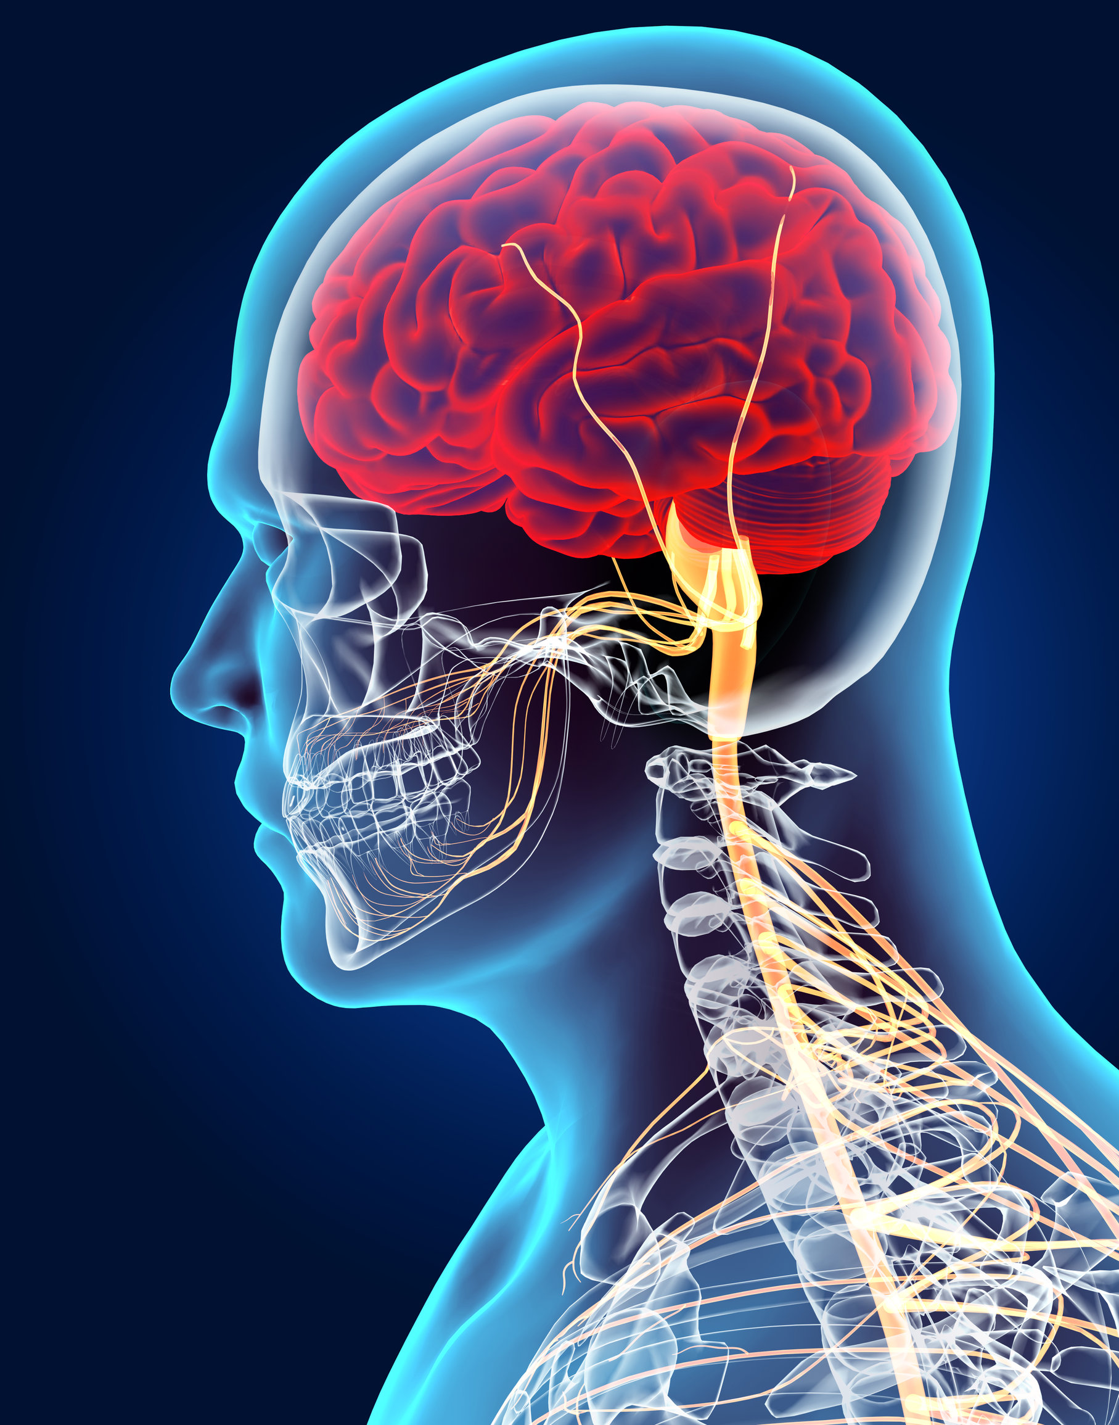
KS4 Homeostasis & Response (Trilogy student booklet A)
Name
Class
Tutor Group
KS4 Science YEAR 11 Homeostasis & Response
KEYSTONE WORDS
Homeostasis | Homeostasis is the regulation of internal conditions to maintain optimal conditions for enzyme action and cell function.
Nervous system | The nervous system enables humans to react to their surroundings and to coordinate their behaviour.
Endocrine system | The endocrine system is composed of glands which secrete chemicals called hormones directly into the bloodstream.
Reproduction | The process by which offspring are produced by parents.
Hormone | Chemical messengers produced by glands.

Slide 2
BIG PICTURE
How will my prior knowledge develop my understanding of this topic?
Y7 | The Cells and Organisation topic introduced the body structures required.
Y8
Y9 | The GCSE Cell Biology topic added depth to prior learning from KS3. This is a threshold topic for this topic.
Learning Journey
Subtopic 1 | 4.5.1 & 4.5.2.1 – Homeostasis and the human nervous system | Subtopic 5 | 4.5.3.4 Hormones in human reproduction
Subtopic 2 | RP – practical & analysis | Subtopic 6 | 4.5.3.5 Contraception 4.5.3.6 HT only Infertility
Subtopic 3 | 4.5.3.1 Human endocrine system | Subtopic 7 | 4.5.4.2 HT only Use of plant hormones
Subtopic 4 | 4.5.3.2 Control of blood glucose concentration
Key knowledge
By the end of this topic you should know… | How the body responds to changes in the environment using the nervous system and the endocrine system.
By the end of this topic should be able to do… | Explain how to determine the effect of distractions on reaction times.
How will this knowledge develop my understanding of future topics?
This topic is one of the final topics in the course. It is not linked to future topics; however, it will deepen understanding of previous topics. For example, Organisation and Cell Biology.

Slide 3
KEY VOCABULARY LIST
Homeostasis | Homeostasis is the regulation of internal conditions to maintain optimal conditions for enzyme action and cell function.
Nervous system | The nervous system enables humans to react to their surroundings and to coordinate their behaviour.
Endocrine system | The endocrine system is composed of glands which secrete chemicals called hormones directly into the bloodstream.
Reproduction | The process by which offspring are produced by parents.
Hormone | Chemical messengers produced by glands.
EXPECTATIONS
Always write in black or blue pen. Always use a ruler for straight lines. If you make a mistake, cross it out with a single line. Always draw diagrams, tables and graphs in pencil with a ruler if necessary Always mark and correct your work in green pen. Respond to any feedback your teacher gives you in green pen. Take pride in your work, make it neat! All tasks should be completed in silence and by yourself unless your teacher tells you otherwise.
PROUD
Punctuation and grammar
Ruler and pencil for diagrams
Outstanding effort every lesson
Underline date and title
Dates and titles every lesson
PROUD FRIDAY
Any piece of work you complete, which meets our PROUD expectations can be taken to the PROUD station during Friday lunchtime. Show your work to a member of SLT and receive a sweet treat!

Slide 4
Subtopic 1: Homeostasis and the human nervous system
Learning Objective
We are learning how the body regulates itself so that enzyme reactions can take place in optimum conditions.
We are learning that there are two main control systems involved in this regulation, which are: the endocrine system and the nervous system
Why are we learning about this?
This lessons helps us understand how the body works and what happens if any of the systems don’t work.

Slide 5
1 2 3 4 5 6 7 8 9 10 11 12 13 14 15 16 17 18 19 20 21 22 23 24 25 26 27 28 29 30 | Homeostasis is the maintenance of a constant internal environment. The conditions inside your body need to be kept relatively constant even when the external conditions change. This is important because your cells need the optimum (best) conditions in order to function properly and to allow enzymes to work in optimum conditions. This allows processes such as respiration and digestion to occur as efficiently as possible. It is really important to maintain this stable environment when both internal and external conditions change. It is also important that these changes happen AUTOMATICALLY ( you don’t have to think about them). There are lots of automatic control systems in our bodies that regulate your internal environment. These include both nervous and hormonal communication systems, for example, body temperature, blood glucose and water levels. You will cover these in later subtopics. All automatic control systems are made up of three main components which all work together. These are: Receptors: Specialised cells that detect a stimulus (change in the environment). Coordination Centre: Process information received from receptors and initiate a response. Examples include the brain, spinal cord and some glands such as the pancreas. Effectors: Muscles or glands that respond to a stimulus. Your automatic control systems keep your internal environment stable using a mechanism called negative feedback. When the level of something (e.g. temperature or water level) gets too high or low your body uses this system to get the level back to normal.
A summary of negative feedback
Detected by receptor
Effectors return system to normal
Normal level
Change from normal
Normal level
Detected by receptor
Effectors return system to normal

Slide 6
Rehearsal questions - Homeostasis
1. Receptors are the first part of a response. What do they do?
………………………………………………………………………………………………………………………………………………………………
………………………………………………………………………………………………………………………………………………………….…
2. After the receptor what is the next stage of the response? …………………………………………………………………………………………………………………………………………………………
…………………………………………………………………………………………………………………………………………………………………
3. What is the final stage in the coordination of a response? .………………………………………………………………………………………………………………………………………………………………
…………………………………………………………………………………………………………………………………………………………….....
4. What is the function of the coordination centre?
…………………………………………………………………………………………………………………………………………………………………
…………………………………………………………………………………………………………………………………………………………………
5. The human body has receptors. What are they?
…………………………………………………………………………………………………………………………………………………………………
…………………………………………………………………………………………………………………………………………………………………
6. What is received by the receptors?
………………………………………………………………………………………………………………………………………………………...........
…………………………………………………………………………………………………………………………………………………………………
7. What is the function of an effector?
…………………………………………………………………………………………………………………………………………………………………
…………………………………………………………………………………………………………………………………………………………………
8. Give two examples of types of effectors?
………………………………………………………………………………………………………………………………………...........................
……………………………………………………………………………………………………………………………………………………………….
9. Which systems have coordination centres?
.............................................................................................................................................................................................................................................................................................................................................
10. What messages do the effectors receive to action a response?
…………………………………………………………………………………………………………………………………………………………………………………………………………………………………………………………………………………………………………………………………..

Slide 7
YOU DO Wrong answers – Homeostasis
Read the passage below. Underline incorrect words/phrases and correct them.
We have to control homeostasis by thinking about the reactions that occur. For example: blood glucose levels, water levels, and our hunger. Homeostasis is about the regulation of the external conditions that our body goes through.
There are two components to homeostatic systems. These are the brain and the spinal cord. Effectors such as muscles and glands receive information and send it to the brain which then sends it to the sense organs to process.
We have 4 sense organs that process this information. The processing of this information is done in the conscious part of the brain.
The two organ systems involved in homeostasis are the digestive and respiratory systems.
One reason why homeostasis is essential is ensuring that hormones have the optimal conditions for working. This allows them to carry out breathing and excretion as efficiently as possible.

Slide 8
If I didn’t – homeostasis
How would my body be affected if I didn’t
I DO: Have sense organs?
………………………………………………………………………………………………………………………………………………………………………………………………………………………………………………………………………………………………………………………………………………………………………………………………………………………………………………………………………………………………………
WE DO: Have coordination centres?
…………………………………………………………………………………………………………………………………………………………………………………………………………………………………………………………………………………………………………………………………..
……………………………………………………………………………………………………………………………………………………………….
YOU DO: Have effectors?
……………………………………………………………………………………………………………………………………………………………………………………………………………………………………………………………………………………………………………………………………………………………………………………………………………………………………………………………………………………………………..
YOU DO: Have automatic and rapid responses ?
………………………………………………………………………………………………………………………………………………………………………………………………………………………………………………………………………………………………………………………………………………………………………………………………………………………………………………………………………………………………………
YOU DO: Have the ability to control my internal environment?
……………………………………………………………………………………………………………………………………………………………………………………………………………………………………………………………………………………………………………………………………………………………………………………………………………………………………………………………………………………………………………………………………………………………………………………………………………………………………………………………………………………………………………………………………………………………………………………………………………………………………………

Slide 9
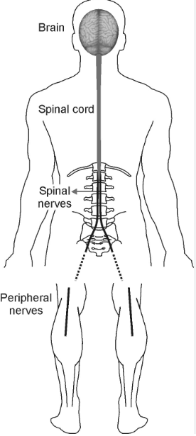
1 2 3 4 5 6 7 8 9 10 11 12 13 14 15 16 17 18 19 20 21 22 23 24 25 26 27 28 29 30 | The Nervous System We need to respond to stimuli to survive and protect ourselves from harm. As we are complex organisms with millions of cells, these cells, and the tissues and organs they form, all need to communicate with each other. Our bodies do this using the nervous and endocrine systems. The nervous system responds RAPIDLY and AUTOMATICALLY. This means humans can coordinate responses. The nervous system is made up of different parts : 1. The CNS or central nervous system (brain, spinal cord and some glands) which process information RAPIDLY to COORDINATE the response. The CNS is a coordination centre. It receives messages from the RECEPTORS, processes the massages and then the response is carried out by the EFFECTORS. Neurones transmit information very quickly to and from your CNS and your CNS processes the messages.
The nerves that run from the spinal cord are called PERIPHERAL nerves

Slide 10
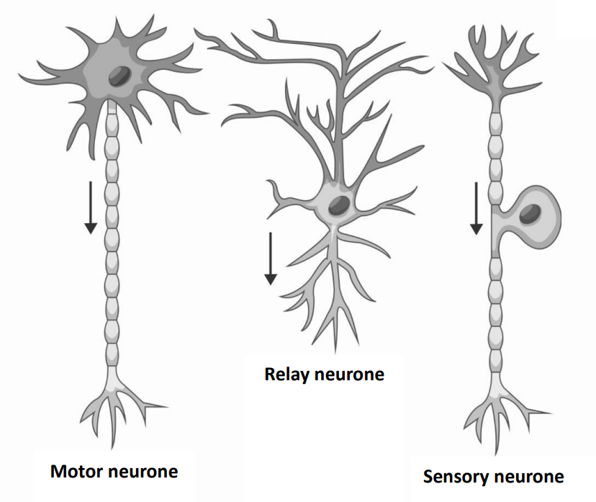
1 2 3 4 5 6 7 8 9 10 11 12 13 14 15 16 17 18 19 20 21 22 23 24 25 26 27 28 29 30 | 2. The sensory neurones take messages/impulses from the receptors to the CNS. They have a single, long axon that is insulated with myelin; this increases the speed of message transmission and prevents the message from being lost. 3. The relay neurone transfers messages from the sensory neurone to the motor neurone. They have a relatively simple structure; they don’t have an insulated axon as they transfer messages over short distances. Their cell body is central. 3. The motor neurones take messages/impulses from the CNS to effectors. They have a long myelinated (insulated) axon. The cell body is always at one end of the axon. 4. The effectors (muscles and glands) receive information from the CNS and act on that information. Receptors and effectors form part of complex organs and organ systems in multicellular organisms
The three types of neurone

Slide 11
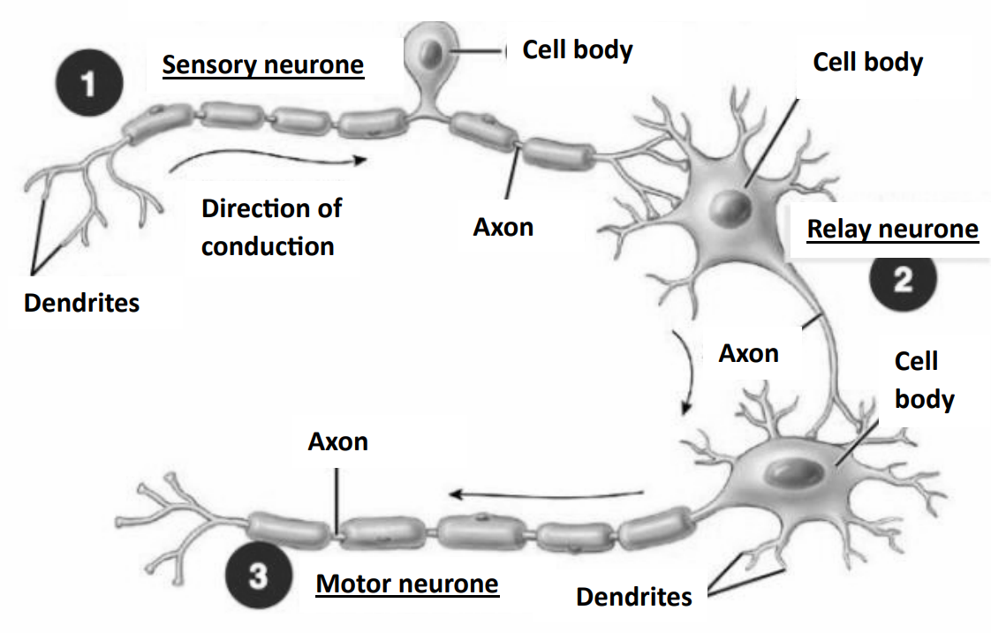
1 2 3 4 5 6 7 8 9 10 11 12 13 14 15 16 17
The three types of neurone

Slide 12
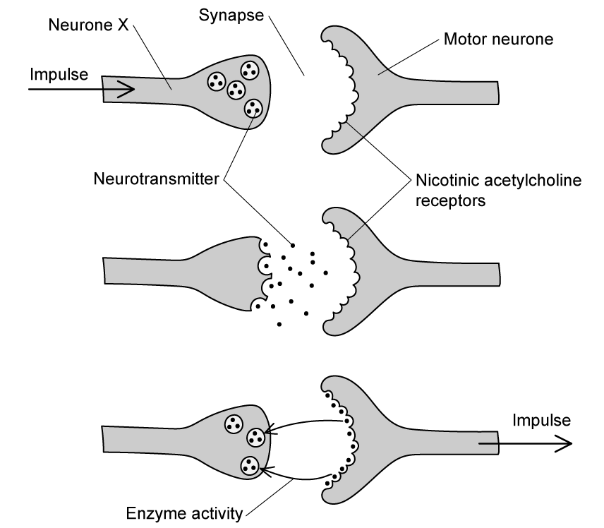
1 2 3 4 5 6 7 8 9 10 11 12 13 14 15 16 17 18 19 20 21 22 23 24 25 26 27 28 29 30 | 5. The Synapse. Neurons do not touch. There is a gap between them called a SYNAPSE. The nerve signal is passed from one neurone to another across the synapse by chemical messengers called NEUROTRANSMITTERS. These transmitters diffuse across the synapse from one neurone to the next and set off a new electrical impulse in the next neurone. As neurones do not touch, the synapse allows for up to 10,000 neurones to be connected with each other. There are over 100 neurotransmitters that we know about. Many drugs, legal, medical, and recreational, plus poisons, work by affecting the transmitters. When the impulse reaches the end of the neurone it triggers the release of the nurotransmitter which then diffuses across the synapse into the receptor site of the next neurone. This then triggers the next impulse in the neurone.
Sensory neurone
Receptors

Slide 13
Rehearsal questions - Nervous system
1. What are the 3 parts of the nervous system ?
.……………………………………………………………………............................................................................................... …………………………………………………………………………………………………………………………………………………………........
2. What are neurones?
…………………………………………………………………………………………………………………………....................................... …………………………………………………………………………………………………………………………………………………………......
3. Name the 3 types of neurone found in the nervous system…
………………………………………………………………………………………………………………………………………………………...........
…………………………………………………………………………………………………………………………………………………………………
4. Which neurone is responsible for sending an impulse to the brain? ……………………………………………………
5. Which neurone is responsible for sending an impulse to the effectors? ……………………………………………..
6. What are the components of the central nervous system.
.……………………………………………………………………............................................................................................... …………………………………………………………………………………………………………………………………………………………........
7. What type of cell carries impulses around the nervous system? …………………………………………………………
8. There are three types of neurone in the nervous system. What are they? .……………………………………………………………………............................................................................................... …………………………………………………………………………………………………………………………………………………………........
9. A type of neurone connects receptors to the coordination centre. Which neurone does this? .……………………………………………………………………...............................................................................................10. A neurone transmits messages to the effector from the coordination centre. Which neurone does this? ………………………………………………………………………………………………………………………………………………………..

Slide 14
Contrasting concepts
I DO: Compare the function of the sensory neurone to the motor neurone.
.……………………………………………………………………............................................................................................... …………………………………………………………………………………………………………………………………………………………........
.……………………………………………………………………............................................................................................... …………………………………………………………………………………………………………………………………………………………........
WE DO: Compare the function of receptors to effectors.
.……………………………………………………………………............................................................................................... …………………………………………………………………………………………………………………………………………………………........
.……………………………………………………………………............................................................................................... …………………………………………………………………………………………………………………………………………………………........
YOU DO: Compare the function of the receptor to the coordination centre.
.……………………………………………………………………............................................................................................... …………………………………………………………………………………………………………………………………………………………........
.……………………………………………………………………............................................................................................... …………………………………………………………………………………………………………………………………………………………........
YOU DO: Compare the structure of a motor neurone to a sensory neurone.
.……………………………………………………………………............................................................................................... …………………………………………………………………………………………………………………………………………………………........
.……………………………………………………………………............................................................................................... …………………………………………………………………………………………………………………………………………………………........
YOU DO: Compare the transmission of an impulse along a neurone to the transmission across a synapse.
.……………………………………………………………………............................................................................................... …………………………………………………………………………………………………………………………………………………………........
.……………………………………………………………………............................................................................................... …………………………………………………………………………………………………………………………………………………………........
.……………………………………………………………………............................................................................................... …………………………………………………………………………………………………………………………………………………………........

Slide 15
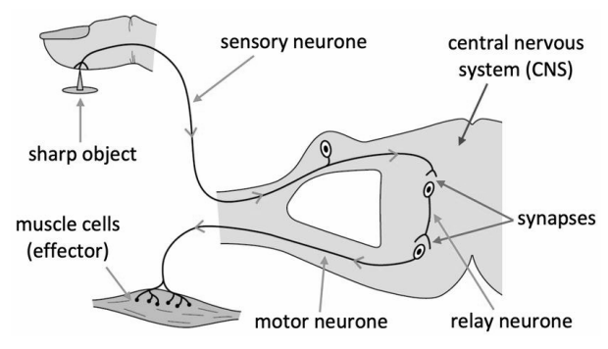
1 2 3 4 5 6 7 8 9 10 11 12 13 14 15 16 17 18 19 20 21 22 23 24 25 | The Reflex Arc A reflex is a ‘rapid automatic response to a stimuli’. Its purpose is to protect us from harm and enable us to react without thinking. It does not involve the conscious part of your brain initially. Because you don’t have to think about the response, it’s quicker than normal responses. The passage of information form the receptor to the effector is called a reflex arc. There are still the 3 main components of a reflex action though: receptor, coordination centre and effector. Information is received from the STIMULUS by the RECEPTOR. This passes via the SENSORY NEURONE to the SPINAL CORD (coordination centre) which then passes it to the MOTOR NEURONE, this transmits to the EFFECTOR to action the response.
The Reflex Arc

Slide 16
Rehearsal questions – Reflex Arc
1. What is a stimulus? .……………………………………………………………………............................................................................................... …………………………………………………………………………………………………………………………………………………………........
2. How is a sensory neurone involved in a reflex? .……………………………………………………………………............................................................................................... …………………………………………………………………………………………………………………………………………………………........
3. Which type of neurone connects the spinal cord to an effector? …………………………………………………………
4. What is the function of the relay neurone? .……………………………………………………………………............................................................................................... …………………………………………………………………………………………………………………………………………………………........
5. When the body detects a stimulus, how does this get transmitted to the spinal cord? …………………………………………………………………………………………………………………………………………………………………
6. What do we call a detected change to our environment? ……………………………………………………………………
7. Which neurone connects the other two types of neurones to each other? …………………………………………
8. How does the response get to the effector? ……………………………………………………………………………………….
9. Our body responds to various types of stimuli. Identify some examples of a stimulus. .……………………………………………………………………............................................................................................... …………………………………………………………………………………………………………………………………………………………........
10. The motor neurone connects which two parts of the reflex arc? .……………………………………………………………………............................................................................................... …………………………………………………………………………………………………………………………………………………………........
11. What is the function of the sensory neurone? .……………………………………………………………………............................................................................................... …………………………………………………………………………………………………………………………………………………………........
Use the components of the pathway to write your rehearsal questions
e.g. What is a stimulus, what does the sensory neurone do, which neurons connects the Spinal cord to the effector?

Slide 17
If I didn’t – Nervous System
What would happen if I didn’t:
I DO
Have receptors?
………………………………………………………………………………………………………………………………………………….…..………………………………………………………………………………………………………………………………………………….……..………………………………………………………………………………………………………………………………..............................
WE DO
2. Have a spinal cord?
………………………………………………………………………………………………………………………………………………….…..………………………………………………………………………………………………………………………………………………….……..………………………………………………………………………………………………………………………………..............................
YOU DO
3. Have sensory neurones?
………………………………………………………………………………………………………………………………………………….…..………………………………………………………………………………………………………………………………………………….……..………………………………………………………………………………………………………………………………..............................
4. Have effectors?
………………………………………………………………………………………………………………………………………………….…..………………………………………………………………………………………………………………………………………………….……..………………………………………………………………………………………………………………………………..............................
5 . Have motor neurones?
………………………………………………………………………………………………………………………………………………….…..………………………………………………………………………………………………………………………………………………….……..………………………………………………………………………………………………………………………………..............................
6. Happen quickly?
………………………………………………………………………………………………………………………………………………….…..………………………………………………………………………………………………………………………………………………….……..………………………………………………………………………………………………………………………………..............................

Slide 18
Spacing – Homeostasis
1. The nervous and endocrine systems are made up from organs. What is an organ?
………………………………………………………………………………………………………………………………………………….…..……......…………………………………………………………………………………………………………………………………………….……..………….
2. Receptors are specialised body cells that detect changes. What are the five key organelles of an animal cell? ………………………………………………………………………………………………………………………………………………….…..……......…………………………………………………………………………………………………………………………………………….……..………….
3. The nervous system contains many specialised cells. What is a specialised cell? ………………………………………………………………………………………………………………………………………………….…..……......…………………………………………………………………………………………………………………………………………….……..………….
4. Describe the process that produces specialised cells. ………………………………………………………………………………………………………………………………………………….…..……......…………………………………………………………………………………………………………………………………………….……..………….
5. Hormones are transported in the blood. Describe the journey of blood around the body, starting in the right atrium of the heart. ………………………………………………………………………………………………………………………………………………….…..……......…………………………………………………………………………………………………………………………………………….……..…………. ………………………………………………………………………………………………………………………………………………….…..……......…………………………………………………………………………………………………………………………………………….……..………….
6. Nervous responses need to happen very quickly. Which equation is used to calculate speed? ………………………………………………………………………………………………………………………………………………….…..……......…………………………………………………………………………………………………………………………………………….……..………….
7. Neurotransmitters are reabsorbed by neurones using active transport. What is active transport? ………………………………………………………………………………………………………………………………………………….…..……......…………………………………………………………………………………………………………………………………………….……..………….
8. The energy required for active transport comes from cellular respiration. Give the word equation for this process: ………………………………………………………………………………………………………………………………………………….…..…….....

Slide 19
9. Synapses between nerve cells can be affected by different drugs, including medicines. What is the function of the drug type: antibiotics? ………………………………………………………………………………………………………………………………………………….…..……......…………………………………………………………………………………………………………………………………………….……..………….
10. Our body is sometimes capable of resisting disease without the use of medicines. Describe the specific and non-specific immune responses.
………………………………………………………………………………………………………………………………………………….…..……......…………………………………………………………………………………………………………………………………………….……..…………. ………………………………………………………………………………………………………………………………………………….…..……......…………………………………………………………………………………………………………………………………………….……..…………. ………………………………………………………………………………………………………………………………………………….…..……......…………………………………………………………………………………………………………………………………………….……..…………. ………………………………………………………………………………………………………………………………………………….…..……......…………………………………………………………………………………………………………………………………………….……..…………. ………………………………………………………………………………………………………………………………………………….…..……......…………………………………………………………………………………………………………………………………………….……..………….
11. An example of a stimulus would be being too close to an extremely high temperature. Which energy store of the body would increase in this situation? ……………………………………………………………………..
12. Which energy pathway does the energy transfer use in this situation? ……………………………………………..
13. As previously stated, energy is released by cellular respiration. Describe the energy transfers that takes place when this energy is used in the body. ………………………………………………………………………………………………………………………………………………….…..……......…………………………………………………………………………………………………………………………………………….……..…………. ………………………………………………………………………………………………………………………………………………….…..……......…………………………………………………………………………………………………………………………………………….……..………….

Slide 20
Exam questions

Slide 21
Exam questions

Slide 22
Exam questions

Slide 23
Exam questions

Slide 24
Subtopic 2: Required practical – practical & analysis
Learning Objective
Carry out an investigation into the effect of a factor on human reaction time.
Why are we learning about this?
Investigations are at the heart of science. Without experiments and investigations many scientific phenomena would not have been discovered or accepted. Current theories would also go unchallenged even if they contain errors.
In this investigation you will investigate the effects of distractions on reaction times.
3

Slide 25
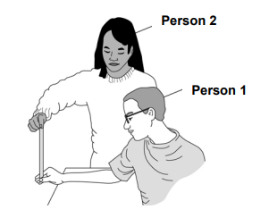
1 2 3 4 5 6 7 8 9 10 11 12 13 14 15 16 17 18 19 20 21 22 23 24 25 26 27 28 29 | In this investigation you will investigate how distractions affect reaction times. You will then evaluate the data that you obtain. The method for the basic experiment is given below. You will complete it without distracting the person being tested. You will then repeat the investigation; the only change you will make is that you will talk to the other student whilst the prepare to catch the ruler. Basic method: 1. Work with a partner to do this test. Choose who will be person 1 and who will be person 2. 2. Each of you should use your dominant hand to do this experiment. If you are right-handed then your dominant hand is your right hand. 3. Person 1 sits down on the chair, with good upright posture and eyes looking across the room. 4. Person 1 puts the forearm of their dominant arm across the table with their hand overhanging the edge. 5. Person 2 holds a ruler vertically with the bottom end (the end with the 0 cm mark) in between person 1’s thumb and first finger. They will tell person 1 to prepare to catch the ruler. 6. Person 1 catches the ruler with their thumb and first finger as quickly as possible when it drops. 7. Record the number on the ruler that is level with the top of person 1’s thumb.

Slide 26
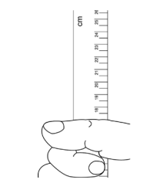
1 2 3 4 5 6 7 8 9 10 11 12 13 14 15 16 | 8. Have a short rest, then repeat the test several times. 9. Record your results on a table. 10. Repeat the test with Person 2 catching the ruler and Person 1 dropping it. 11. Record Person 2’s results on the table. 12. Use a conversion table to convert your ruler measurements into reaction times. 13. Make the change that you are investigating to change human reaction time. 14. Repeat steps 1-9 for each person and record the results in your data table.

Slide 27
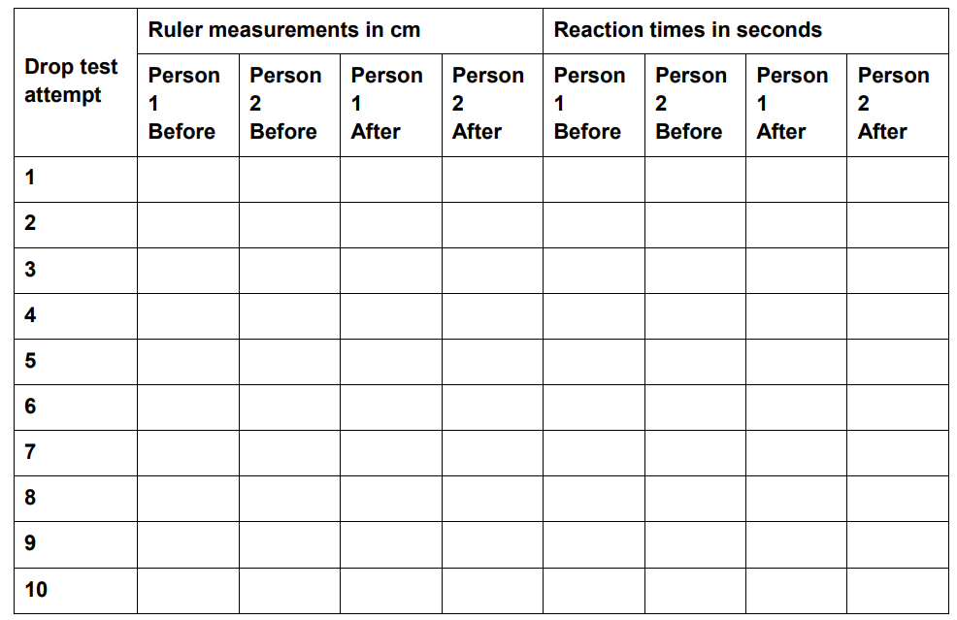
Results tables
The headers specify ‘before’ and ‘after’.
‘Before’ indicates tests without a distraction.
‘After’ indicates tests with a distraction.
Mean results – reaction time sin seconds
Remove anomalous results, then calculate the mean reaction time.
 | Person 1 before | Person 2 before | Person 1 after | Person 2 after
Mean reaction time in seconds

Slide 28
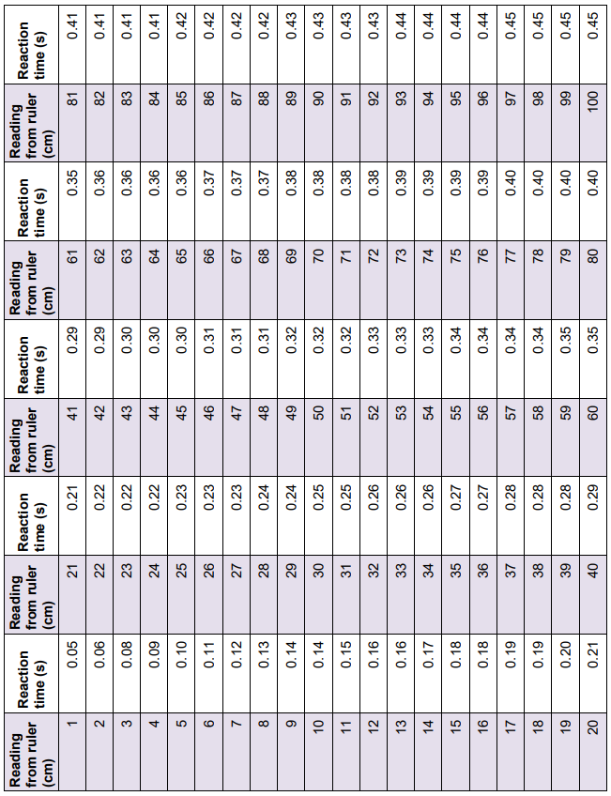
Conversion chart – distance to time

Slide 29
Data evaluation
Look at the results for person 1 without distractions. Are the results repeatable?
……………………………………………………………………………………………………………………………………………………………………………………………………………………………………………………………………………………………………………………
How do you know?
……………………………………………………………………………………………………………………………………………………………………………………………………………………………………………………………………………………………………………………b. Look at the results for person 1 with distractions. Are the results repeatable?
……………………………………………………………………………………………………………………………………………………………………………………………………………………………………………………………………………………………………………………
How do you know?
……………………………………………………………………………………………………………………………………………………………………………………………………………………………………………………………………………………………………………………
c. Compare the results obtained for person 1 and person 2. Are the results reproducible?
……………………………………………………………………………………………………………………………………………………………………………………………………………………………………………………………………………………………………………………
How do you know?
……………………………………………………………………………………………………………………………………………………………………………………………………………………………………………………………………………………………………………………
d. If your results are not repeatable / reproducible, what types of errors have happened that could affect your results?
……………………………………………………………………………………………………………………………………………………………………………………………………………………………………………………………………………………………………………………
……………………………………………………………………………………………………………………………………………………………………………………………………………………………………………………………………………………………………………………
……………………………………………………………………………………………………………………………………………………………………………………………………………………………………………………………………………………………………………………
……………………………………………………………………………………………………………………………………………………………………………………………………………………………………………………………………………………………………………………

Slide 30
Sub-topic 3: 4.5.3.1 Human endocrine system
Learning Objective: We are learning where our endocrine glands are and what hormones they make. Also, how our body is controlled by them and why they take so long to act but last a lifetime
Why are we learning about this?
This lessons helps us understand how we grow and develop sexually, how fertile or not we are but also why certain diseases and conditions occur such as diabetes and menopause affect us.
3

Slide 31
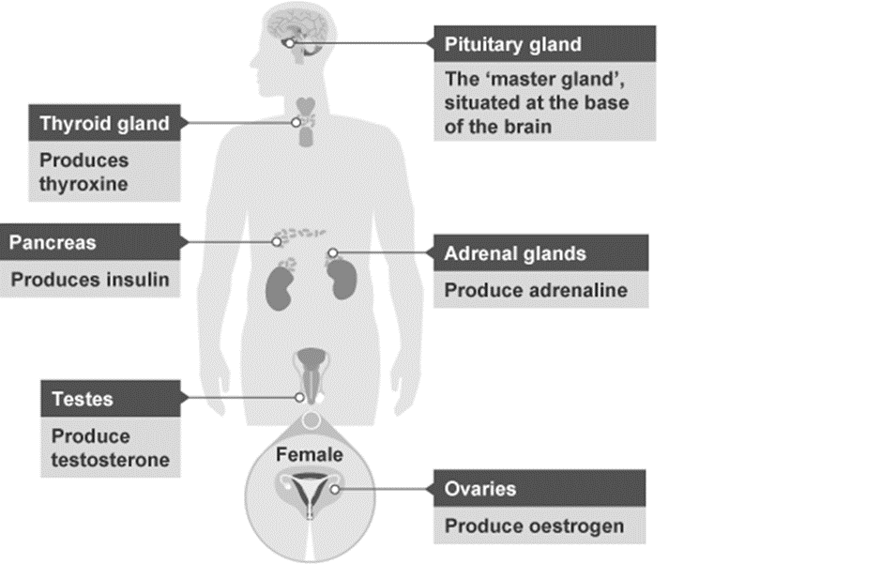
1 2 3 4 5 6 7 8 9 10 11 12 13 14 15 16 17 18 19 20 21 22 23 24 25 26 27 28 29 30the | Structure of thPosition of the Endocrine organs and the hormones they produce The definition of a hormone is ‘a chemical messenger that is produced by cells or tissues from the organs of the endocrine system and that travels through the blood to act on target cells or target organs before being broken down’. An endocrine gland is a ductless gland so its secretions are released directly into the blood. Hormones are the way, apart from nerves, that messages are sent round the body. Hormones are chemical molecules and are made in ENDOCRINE GLANDS and released directly into the blood stream, they travel all way round the body in the blood and act on special organs called TARGET ORGANS. Hormones control things in the body that need constant adjustment. They are slow acting and long lasting unlike nervous responses which are fast and short lasting. The exception to this is ADRENALIN which is fast acting and short lived. This is released when we feel stressed, nervous and frightened.

Slide 32
1 2 3 4 5 6 7 8 9 10 11 12 13 14 15 16 17 18 19 20 21 22 | The endocrine systems has four main functions To maintain homeostasis, E.g. blood sugar, temperature, water balance all need to be kept at a constant level ( see other lessons for more details) To work with the nervous system to reduce stress via the flight and fight response It controls the body's rate of growth It controls sexual development and reproduction Hormones are known as chemical messengers and are large molecules. They work on effectors but unlike nervous messages they don’t take milli seconds to take effect. They can take minutes, hours or years to have an effect. Think for example the age at which puberty starts. That is hormonal control. The hormone adrenalin is the exception to this and its effects take place in seconds. Hormones that affect our development act for years . Hormones control various cells and organs but usually things that are not immediately life threatening. They are however monitor and adjust things that require constant monitoring and that cannot be allowed to change too much. Hormones work by travelling through the blood stream to the target organs or cells where they direct them what to do. Insulin for example is made in the pancreas and travels around the body acting on all cells to take up glucose from the blood. This lowers blood sugar level. Type 1 diabetics cannot do this efficiently and have to take insulin in the form of injections to maintain their blood glucose levels. (see later lesson for more details) The pituitary gland, in the head, is regarded as the MASTER GLAND. This is because in response to conditions in the body it secretes hormones into the blood stream that then act on other organs to secrete additional hormones e.g. the ovaries, testis, thyroid.

Slide 33
1 2 3 4 5 6 7 8 9 10 11 12 13 14 15 16 17 18 19 20 21 22 23 24 25 26 | Table showing function of the hormones Hormones control various cells and organs but usually things that are not immediately life threatening. They are however things that require constant monitoring and cannot be allowed to change too much.
Gland | Hormone | Function
Pituitary | Growth hormone (STH) * Follicle stimulating hormone (FSH) Thyroid stimulating hormone (TSH) | Called the master gland because its hormones act on other glands directing them to release hormones and produce change
Thyroid | Thyroxine | Regulates growth, heartbeat, metabolism
Adrenal | Adrenalin | Fight and flight
Pancreas | Insulin, glucagon | Blood sugar regulation
Testis | Testosterone | Puberty, sperm production
Ovaries | Oestrogen | Menstrual cycle
* STH is Somatotropin hormone

Slide 34
Rehearsal questions
1.Hormones are produced in what type of gland?
…………………………………………………………………………………………………………………………………………….
2. How do hormones travel around the body? …………………………………………………………………………………………………………………………………………….
3. What are target organs?
…………………………………………………………………………………………………………………………………………….
4. Why is the pituitary called the master gland?
…………………………………………………………………………………………………………………………………………….
…………………………………………………………………………………………………………………………………………….
…………………………………………………………………………………………………………………………………………….
5.Which hormone is produced by the ovaries?
…………………………………………………………………………………………………………………………………………….
6. Which hormone is produced by the pancreas?
…………………………………………………………………………………………………………………………………………….
7. Which hormone is produced by the thyroid?
…………………………………………………………………………………………………………………………………………….
8. Which hormone is produced by the testis?
…………………………………………………………………………………………………………………………………………….
9. Which hormones is controlled by the pituitary?
…………………………………………………………………………………………………………………………………………….
10.Which hormone is produced by the adrenalins?
…………………………………………………………………………………………………………………………………………….
11. Nerve impulses travel via nerves how do hormones travel round the body?
…………………………………………………………………………………………………………………………………………….
12. What do hormones act on?
…………………………………………………………………………………………………………………………………………….
13 . What is a target organ?
…………………………………………………………………………………………………………………………………………….

Slide 35
13.The adrenal glands produce adrenaline what does the pancreas produce?
…………………………………………………………………………………………………………………………………………….
14. The testis produce testosterone what do the ovaries produce?
…………………………………………………………………………………………………………………………………………….
15. Thyroxine, oestrogen and somatotropin are controlled by which gland?
…………………………………………………………………………………………………………………………………………….
…………………………………………………………………………………………………………………………………………….
16. How do nervous impulses get transmitted?
…………………………………………………………………………………………………………………………………………….
17. Why is the circulatory system vital for hormone transport?
…………………………………………………………………………………………………………………………………………….
18. The pancreas is a target organ? Name another one in the male body only
…………………………………………………………………………………………………………………………………………….
19. Insulin is produced by the pancreas. What does it control?
…………………………………………………………………………………………………………………………………………….
20. Oestrogen is produced by the ovaries. What is produced by the testis?
……………………………………………………………………………………………………………………………………………
21. The gland is called the master gland is where in the body?
…………………………………………………………………………………………………………………………………………….
22. Testosterone acts on sexual development. What does it affect in the male body?
…………………………………………………………………………………………………………………………………………….
23. Adrenalin is produced by which glands?
…………………………………………………………………………………………………………………………………………….
24. Which gland produces thyroxine?
…………………………………………………………………………………………………………………………………………….

Slide 36
YOU DO Wrong answers – Endocrine system
Read the passage below and underline any incorrect words and replace with the correct ones
The endocrine system is fast acting coordination system involving muscle and glands. Hormones are released via a duct and travel down tubes to get the organs, these organs are called special organs and respond to nervous stimulation.
Hormones are electrical messengers that are made in one gland only and are controlled by the brain. They are fast acting and short lived. Adrenalin takes ages to be secreted and ages to wear off. It helps us deal with being hot and hungry.
There are 4 main endocrine glands and male and female have all the same ones. The adrenal glands are called the master gland as they control every other hormone. All endocrine glands respond to life threatening changes immediately. They are only in the body for a few seconds where as nervous responses are there for years. The control of puberty for example only takes a few seconds. Blood sugar, sexual development, growth and temperature are controlled by nervous coordination not hormonal. If its fast its hormonal if its slow its nervous

Slide 37
If I didn’t – ENDOCRINE SYSTEM
What would happen if I didn’t
I DO
1. Have insulin?
………………………………………………………………………………………………………………………………………………………………………………………………………………………………………………………………………………………………………………………………..
WE DO
2. Have thyroxine?
……………………………………………………………………………………………………………………………………………………………………………………………………………………………………………………………………………………………………………………………..
YOU DO
3. Have oestrogen?
……………………………………………………………………………………………………………………………………………………………………………………………………………………………………………………………………………………………………………………………..
4. Have testosterone?
………………………………………………………………………………………………………………………………………………………………………………………………………………………………………………………………………………………………………………………………
5. Have target organs?
………………………………………………………………………………………………………………………………………………………………………………………………………………………………………………………………………………………………………………………………
6. Have a circulatory system?
………………………………………………………………………………………………………………………………………………………………………………………………………………………………………………………………………………………………………………………………
7. Have adrenalin?
………………………………………………………………………………………………………………………………………………………………………………………………………………………………………………………………………………………………………………………………
8. Have the fight and flight response?
……………………………………………………………………………………………………………………………………………………………………………………………………………………………………………………………………………………………………………………………..

Slide 38
Compare and contrast Hormonal and Nervous actions
I DO :
Hormones are slow acting where as nerves are ………………………………………………………………………………………………………………………………………..
WE DO:
Hormones act for a long time where as nerves act only for a
……………………………………………………………………………………………………………………………............
YOU DO:
Hormones act in a general way where as nerves act in a
……………………………………………………………………………………………………………………………………….
Nerves act very quickly where as hormones act
………………………………………………………………………………………………………………….
Nerves affect all parts of the body where as hormones only act on organs called
……………………………………………………………………………………………………………………………………….
Complete the table below. The first one has been done for you
 | Nervous coordination | Hormonal coordination
Speed of action | Fast | slow
Type of message
General or specific
Duration of response
Site of production of message
Method of transmission

Slide 39
Interleaving – endocrine system
The endocrine system is made up from organs. What is an organ?
……………………………………………………………………………………………………………………………………………………………………………………………………………………………………………………………………………………………………………………
2. Groups of cells from what?
……………………………………………………………………………………………………………………………………………………………………………………………………………………………………………………………………………………………………………………
3. What are the organelles in a cell that make proteins?
……………………………………………………………………………………………………………………………………………………………………………………………………………………………………………………………………………………………………………………
4. Proteins are needed in the body for what 2 functions?
……………………………………………………………………………………………………………………………………………………………………………………………………………………………………………………………………………………………………………………
5. What is the enzyme that breaks down proteins called?
……………………………………………………………………………………………………………………………………………………………………………………………………………………………………………………………………………………………………………………
6. The pH for this enzyme to work is around pH2, so very acidic. Where does this enzyme work?
……………………………………………………………………………………………………………………………………………………………………………………………………………………………………………………………………………………………………………………
7. What word describes the best conditions for an enzyme to work? ……………………………………………………………………………………………………………………………………………………………………………………………………………………………………………………………………………………………………………………
8. What word describes when an enzyme no longer works?
……………………………………………………………………………………………………………………………………………………………………………………………………………………………………………………………………………………………………………………

Slide 40
9. Enzymes are biological catalysts. What happens when you add a catalyst to a reaction?
…………………………………………………………………………………………………………………………………………………………………………………………………………………………………………………………………………………………………………………………….
10. The rate of chemical reactions speeds up when you add a catalyst. How does this occur ?
……………………………………………………………………………………………………………………………………………………………………………………………………………………………………………………………………………………………………………………………
11. Surface area also affects rate of reactions. How does increasing the surface area affect a reaction?
………………………………………………………………………………………………………………………………………………………………12. The lungs have a large surface area. Why is this necessary?
……………………………………………………………………………………………………………………………………………………………………………………………………………………………………………………………………………………………………………………
13. Gaseous exchange occurs in the lungs. Which two gases are involved?
……………………………………………………………………………………………………………………………………………………
14. What do the pulmonary vein and aorta transport ?
…………………………………………………………………………………………………………………………………………………………
15. What does the vena cava and pulmonary artery transport? ………………………………………………………………………………………………………………………………………………………………
16. What is the difference between diffusion and active transport?
……………………………………………………………………………………………………………………………………………………………………………………………………………………………………………………………………………………………………………………………..
17. What is osmosis?
……………………………………………………………………………………………………………………………………………………………………………………………………………………………………………………………………………………………………………………
18. Which part of the plant is best adapted for osmosis?
……………………………………………………………………………………………………………………………………………………………………………………………………………………………………………………………………………………………………………………

Slide 41
Subtopic 4: 4.5.3.2 Control of blood glucose concentration
Learning Objective
We are learning to describe how blood glucose levels are controlled in humans.
Why are we learning about this?
Diabetes is an important disease that affects an increasing proportion of the population. It is also a good example of how hormones are used to control internal conditions.
3

Slide 42
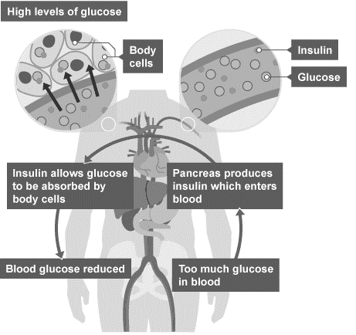
1 2 3 4 5 6 7 8 9 10 11 12 13 14 15 16 17 18 19 20 21 22 23 24 25 26 27 28 29 30 | Regulating blood glucose Glucose is needed by cells for respiration. It is important that the concentration of glucose in the blood is maintained at a constant level and controlled carefully. Insulin is a hormone, produced by the pancreas, that regulates glucose concentrations in the blood. If the blood glucose concentration is too high, the pancreas produces the hormone insulin that causes glucose to move from the blood into the cells. In liver and muscle cells excess glucose is converted to glycogen for storage, and will be used at a later date. Glycogen is a large, branched molecule made by joining together a large number of glucose molecules (Glycogen is a polymer, glucose is its monomer). Maintaining a constant blood glucose concentration is important as high glucose concentrations can damage nerves, blood vessels, and organs, leading to greater problems. Diagram 1 – The effects of insulin when glucose levels are high:

Slide 43
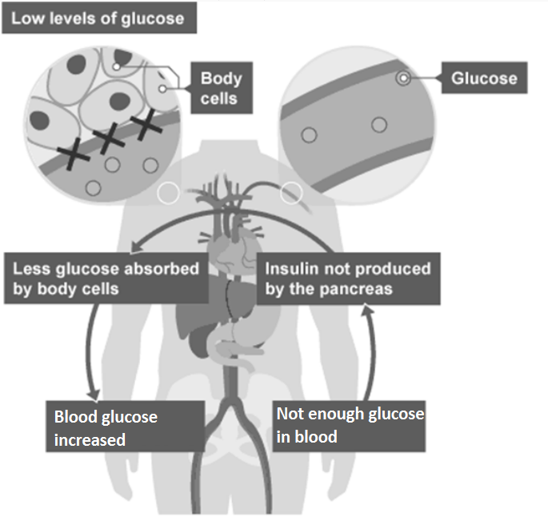
1 2 3 4 5 6 7 8 9 10 11 12 13 14 15 16 17 18 19 20 21 22 23 24 25 26 27 28 29 30 | If the blood glucose concentration is too low, the pancreas stops producing the hormone insulin. This means less glucose will be absorbed by cells in the body, causing the blood glucose concentration to increase. It is just as important to prevent low blood glucose concentrations as it is to prevent high ones too. If blood glucose concentration becomes too low, it can cause a reduction in respiration. Diagram 2 – The effects of insulin when glucose levels are low:

Slide 44
Rehearsal questions
What is the use of glucose in the body? .................................................................................................
Which hormone is produced when glucose levels are too high? ...........................................................
Which organ is responsible for producing this hormone? ......................................................................
What does the liver and muscle cells turn excess glucose into? ............................................................
Homeostasis is the response to changes in the internal environment, and involves nervous and hormonal responses. Which hormone is produced to help reduce glucose levels? .................................................................................................................................................................
Aerobic respiration is an essential process in all living cells, and requires oxygen. What other substance is needed? .............................................................................................................................
Hormones are produced by various organs in response to different changes. Which organ is responsible for making the hormone insulin? ........................................................................................
After cells absorb the excess glucose, what does it get turned in to for storage? .................................................................................................................................................................
Why is it important that glucose gets around the body? .......................................................................
The pancreas is an organ of the human endocrine system. What does it produce? .................................................................................................................................................................
If the blood glucose concentration is too high, what is produced in response? ....................................
The human body sometimes produces a molecule called glycogen. What is glycogen? .................................................................................................................................................................
When blood glucose becomes too low, the body needs to stop producing insulin. Which organ will stop producing this hormone? ................................................................................................................

Slide 45
Wrong answers
I DO: “Having more glucose in your blood is good because it means the body can use it” – Explain why this statement is incorrect.
....................................................................................................................................................................... .......................................................................................................................................................................
.......................................................................................................................................................................
WE DO: “The pancreas is part of the digestive system so it is nothing to do with hormones” – Explain why this statement is incorrect.
....................................................................................................................................................................... .......................................................................................................................................................................
.......................................................................................................................................................................
YOU DO: “The only way to reduce blood sugar is to eat less sugary food” – Explain why this statement is incorrect.
....................................................................................................................................................................... .......................................................................................................................................................................
.......................................................................................................................................................................
YOU DO: “Insulin is produced to increase blood sugar concentration” – Explain why this statement is incorrect.
....................................................................................................................................................................... .......................................................................................................................................................................
.......................................................................................................................................................................
YOU DO: “Our body can only use glucose for respiration, or get rid of it” – Explain why this statement is incorrect.
....................................................................................................................................................................... .......................................................................................................................................................................
.......................................................................................................................................................................
YOU DO: “If blood glucose concentration is too low, we have to eat more” – Explain why this statement is incorrect.
....................................................................................................................................................................... .......................................................................................................................................................................
.......................................................................................................................................................................

Slide 46
If it didn’t
I DO: How might you be affected if you didn’t have glucose?
....................................................................................................................................................................... .......................................................................................................................................................................
.......................................................................................................................................................................
WE DO: How might you be affected if you didn’t have a pancreas?
.......................................................................................................................................................................
.......................................................................................................................................................................
.......................................................................................................................................................................
YOU DO: How might you be affected if your blood glucose becomes too low?
.......................................................................................................................................................................
.......................................................................................................................................................................
.......................................................................................................................................................................
YOU DO: How might you be affected if you didn’t produce the hormone insulin?
.......................................................................................................................................................................
.......................................................................................................................................................................
.......................................................................................................................................................................
YOU DO: How might you be affected if your liver and muscle cells didn’t convert glucose to glycogen?
.......................................................................................................................................................................
.......................................................................................................................................................................
.......................................................................................................................................................................
YOU DO: How might you be affected if your body could not detect changes in blood glucose concentration?
.......................................................................................................................................................................
.......................................................................................................................................................................
.......................................................................................................................................................................
.......................................................................................................................................................................

Slide 47
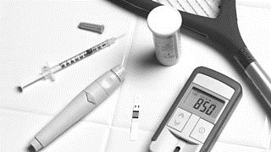
1 2 3 4 5 6 7 8 9 10 11 12 13 14 15 16 17 18 19 20 21 22 23 24 25 26 27 28 29 30 | Diabetes Diabetes is a condition where the blood glucose levels remain too high. It can be treated by injecting insulin. The extra insulin causes the liver to convert glucose into glycogen, which reduces the blood glucose level. There are two types of diabetes - type 1 and type 2. Type 1 diabetes Type 1 diabetes is a disorder in which the pancreas fails to produce enough insulin. This can be detected from an early age. It is characterised by uncontrolled high blood glucose levels and it can be controlled by injecting insulin. People with type 1 diabetes have to monitor their blood sugar levels throughout the day. Their levels of physical activity and their diet affect the amount of insulin needed. They can help to control their blood glucose level by being careful with their diet, and eat foods that will not cause large increases in blood sugar level, and by exercising, which can lower blood glucose levels due to increased respiration in the muscles.

Slide 48
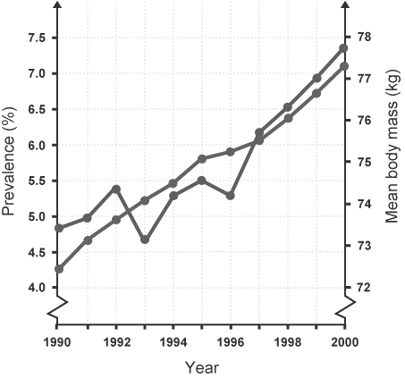
1 2 3 4 5 6 7 8 9 10 11 12 13 14 15 16 17 18 19 20 21 22 23 24 25 26 27 28 29 30 | Type 2 diabetes In type 2 diabetes the person's body cells no longer respond to insulin produced by the pancreas. It is more common in older people. It can be controlled by a carbohydrate controlled diet and an exercise regime. Carbohydrate is digested into glucose, which raises the overall blood glucose level. There is a correlation between rising levels of obesity in the general population and increasing levels of type 2 diabetes. Diagram 3 – A graph to show the relationship between mean body mass and the prevalence of type 2 diabetes, between the years of 1990 and 2000.
Mean body mass
Diabetes

Slide 49
Rehearsal questions
Type 1 diabetes is controlled by what method? .....................................................................................
Type 2 diabetes is controlled by what method? .....................................................................................
What use does the insulin injected by those with diabetes have in the body? ..................................... .................................................................................................................................................................
What causes type 2 diabetes? ................................................................................................................ .................................................................................................................................................................
If a person needs to inject insulin, which type of diabetes are they likely to have? .................................................................................................................................................................
What is a major risk factor associated with type 2 diabetes? ................................................................
What is glucose turned in to when a person injects themselves with insulin? ......................................
A person with type 2 diabetes still produces insulin, so why do they need to control what they eat? .................................................................................................................................................................
Other than a controlled diet, what other form of control can be used for type 2 diabetes? .................................................................................................................................................................
What factors can influence the amount of insulin a type 1 diabetic needs to inject? ........................... .................................................................................................................................................................
Obesity is linked with which type of diabetes? ......................................................................................
Which type of diabetes is more likely to be diagnosed at a young age? ................................................
Their cells no longer respond / have reduced sensitivity to insulin

Slide 50
Contrasting concepts
I DO: Compare the treatment methods for each type of diabetes.
....................................................................................................................................................................... .......................................................................................................................................................................
.......................................................................................................................................................................
WE DO: Compare the pancreas of a healthy person to that of a person with type 1 diabetes.
....................................................................................................................................................................... .......................................................................................................................................................................
.......................................................................................................................................................................
YOU DO: Compare the causes of type 1 and type 2 diabetes.
....................................................................................................................................................................... .......................................................................................................................................................................
.......................................................................................................................................................................
YOU DO: Compare the blood glucose levels for a healthy person with that of a person with type 1 diabetes, 1 hour after eating a meal.
....................................................................................................................................................................... .......................................................................................................................................................................
.......................................................................................................................................................................
YOU DO: Compare the effect of insulin in a healthy person to that of insulin in a person with type 2 diabetes.
....................................................................................................................................................................... .......................................................................................................................................................................
.......................................................................................................................................................................
YOU DO: Compare the trends of mean body mass and prevalence of type 2 diabetes between 1990 and 2000.
....................................................................................................................................................................... .......................................................................................................................................................................
.......................................................................................................................................................................

Slide 51
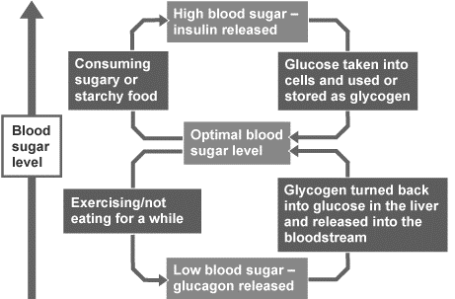
1 2 3 4 5 6 7 8 9 10 11 12 13 14 15 16 17 18 19 20 21 22 23 24 25 26 27 28 29 30Th | The role of glucagon In blood glucose regulation, the hormone insulin plays a key role. When blood sugar rises in the blood, insulin sends a signal to the liver, muscles and other cells to store the excess glucose. Some is stored as body fat and other is stored as glycogen in the liver and muscles. Whereas, if the blood glucose level is too low, the liver receives a message to release some of that stored glucose into the blood. This change is brought about by another hormone produced by the pancreas called glucagon. This is an example of negative feedback. Diagram 4 – A diagram to show how the body’s response changes depending on the blood glucose concentration.

Slide 52
Rehearsal questions
When does the body produce the hormone insulin? ............................................................................. .................................................................................................................................................................
When does the body produce the hormone glucagon? ......................................................................... .................................................................................................................................................................
Which organ produces both insulin and glucagon? ................................................................................
What does glucagon do? ........................................................................................................................ .................................................................................................................................................................
If blood glucose concentration becomes too low, which hormone is produced? ..................................
If blood glucose concentration becomes too high, which hormone is produced? ................................
Insulin is produced in the pancreas. Name another hormone produced in the pancreas. .................................................................................................................................................................
Glucagon is produced to increase blood glucose concentration. How does it do this? ......................... .................................................................................................................................................................
Insulin is a hormone produced in the body to help maintain blood glucose concentration. What effect does it have? .................................................................................................................................
The pancreas is an organ in the endocrine system. What does this mean? .......................................... .................................................................................................................................................................
In the body, glycogen can be broken down into glucose. Which hormone stimulates this process? .................................................................................................................................................................

Slide 53
Wrong answers
I DO: “Glucagon is produced to reduce blood glucose concentration” – Explain why this statement is incorrect.
....................................................................................................................................................................... .......................................................................................................................................................................
.......................................................................................................................................................................
WE DO: “Insulin and glucagon are both hormones, so they do the same thing” – Explain why this statement is incorrect.
....................................................................................................................................................................... .......................................................................................................................................................................
.......................................................................................................................................................................
YOU DO: “Glucose is broken down into glycogen” – Explain why this statement is incorrect. ....................................................................................................................................................................... .......................................................................................................................................................................
.......................................................................................................................................................................
YOU DO: “Glucose is stored in the body as glucagon” – Explain why this statement is incorrect. ....................................................................................................................................................................... .......................................................................................................................................................................
.......................................................................................................................................................................
YOU DO: “The body is always producing insulin and glucagon” – Explain why this statement is incorrect. ....................................................................................................................................................................... .......................................................................................................................................................................
.......................................................................................................................................................................
YOU DO: “Glucagon is produced when blood glucose concentration is too high” – Explain why this statement is incorrect.
....................................................................................................................................................................... .......................................................................................................................................................................
.......................................................................................................................................................................

Slide 54
Interleaving questions – YOU DO
The pancreas is an organ in the endocrine system, but which other organ system? .................................................................................................................................................................
The pancreas produces enzymes to help with digestion. Enzymes work on a “lock and key” model. Explain this model of enzyme activity. You may use a diagram to help you. ................................................................................................................................................................. ..................................................................................................................................................................................................................................................................................................................................
If the conditions inside the body change, enzyme scan become denatured. What does this mean? ..................................................................................................................................................................................................................................................................................................................................
It is essential to maintain blood glucose concentration to allow respiration to occur at an optimal rate. Write the word equation and balanced symbol equation for respiration. ................................................................................................................................................................. .................................................................................................................................................................
Glucose is an example of which type of energy store? ..........................................................................
If blood glucose concentration becomes too high, it can cause damage to nerves, blood vessels and organs.
  What does the “myelin sheath” do for a nerve cell? .................................................................. .....................................................................................................................................................
  What are the three types of blood vessel? ................................................................................. .....................................................................................................................................................
  What is an organ? .......................................................................................................................
Insulin and glucagon are both hormones that travel in the blood. The blood is classed as a tissue.
  What is a tissue? ......................................................................................................................... .....................................................................................................................................................
  What are the four components of the blood? ............................................................................ .....................................................................................................................................................

Slide 55
Interleaving questions – Continued - YOU DO
The blood is a liquid substance. Draw a particle diagram of the particles in a liquid.
Describe, using your diagram, the arrangement and movement of particles in a liquid. ..................................................................................................................................................................................................................................................................................................................................
The formula for the hormone insulin is: C₂₅₇H₃₈₃N₆₅O₇₇S₆. What does this formula tell you about what insulin is made of? ............................................................................................................... ..................................................................................................................................................................................................................................................................................................................................
Glucose has the formula: C₆H₁₂O₆. Calculate the relative molecular mass (M_{r}) for glucose, in g/mol.
  Relative atomic mass: Carbon = 12 ; Hydrogen = 1 ; Oxygen = 16
  .................................................................................................................................................................................................................................................................................................................................................................................................................................................................................

Slide 56
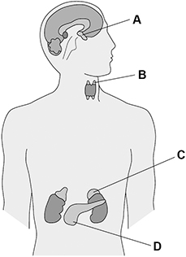

Exam questions – Tier 1 - YOU DO
Q1. The endocrine system is made up of glands which secrete hormones. Figure 1 shows the position of endocrine glands in the human body.
(a) Which letter shows the pancreas? Tick (✓) one box.
(1)
(c) Hormones travel from the gland where they are made to the target organ where they have an effect. How do hormones travel from the gland to the target organ?
..............................................................................................................................................................................................................................................................................................................................................
(1)
When blood glucose concentration becomes too high, hormone X from the pancreas causes a decrease in the glucose concentration.
(d) Name hormone X.
…………………………………………………………………………………………………………………………………………………………..
(1)

Slide 57
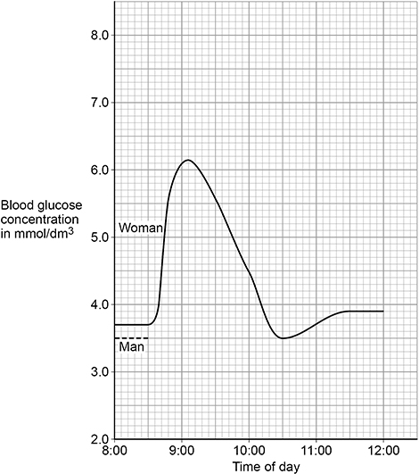
Exam questions – YOU DO
(e) In what two ways does hormone X cause a decrease in blood glucose concentration? Tick (✓) two boxes.
(2)
Figure 2 shows the blood glucose concentration in a woman.
Figure 2
Glucose is broken down
Glucose is converted into glycogen
Glucose is excreted by the kidneys
Glucose moves from the blood into the cells
Glucose moves into the small intestine

Slide 58
Exam questions – YOU DO
(f) Suggest what time of day the woman ate her breakfast of sugar-coated cereal.
Time of day = …………………………………
(1)
The man in Figure 2 has Type 2 diabetes but he has not been treated.
(g) The man ate:
• the same type and amount of breakfast cereal as the woman
• at the same time as the woman.
Suggest what his blood glucose concentration would be at 9:00
Blood glucose concentration = ……………………………… mmol/dm³
(1)
(h) The man:
• is an obese office worker
• does not exercise
• eats sugary snacks at his desk.
Give two lifestyle changes a doctor might recommend to the man to help him control his diabetes.
1 ……………………………………………………………………………………………………………………………………………………………. …………………………………………………………………………………………………………………………………………………………………
2 …………………………………………………………………………………………………………………………………………………………… …………………………………………………………………………………………………………………………………………………………………(2)

Slide 59
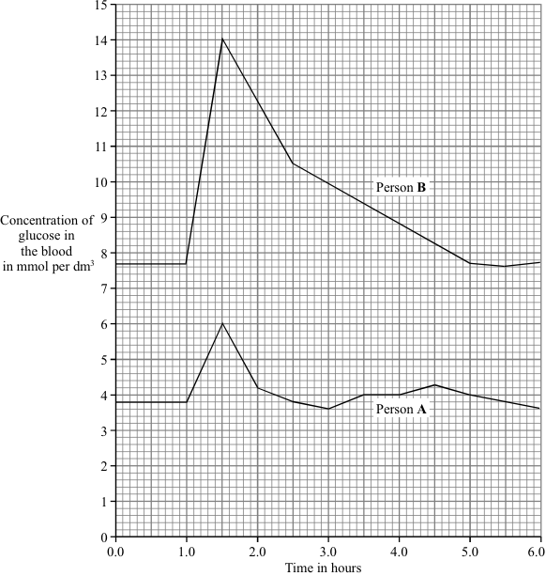
Exam questions – Tier 2 - YOU DO
Q1. The graph shows the concentration of glucose in the blood of two people. Person A is a non-diabetic. Person B has diabetes. Each person ate 75 grams of glucose at 1.0 hours.
(a) (i) What was the maximum concentration of glucose in the blood of Person A?
……………………………………………….. mmol per dm³
(1)
(ii) After eating the glucose, how long did it take for the concentration of glucose in the blood of Person B to return to normal?
…………………………………………………………….. hours
(1)

Slide 60
Exam questions – YOU DO
(b) A diabetic person does not produce enough insulin.
(i) Which organ produces insulin?
…………………………………………………………………………………………………………………………………………………………………
(1)
(ii) Write the letter X on the graph to show one time when the blood of Person A would contain large amounts of insulin.
(1)
(c) A high concentration of glucose in the blood can harm body cells as a result of osmosis.
Explain why.
....................................................................................................................................................................... .......................................................................................................................................................................
.......................................................................................................................................................................
....................................................................................................................................................................... .......................................................................................................................................................................
.......................................................................................................................................................................
....................................................................................................................................................................... .......................................................................................................................................................................
.......................................................................................................................................................................
(4)
(Total 8 marks)

Slide 61
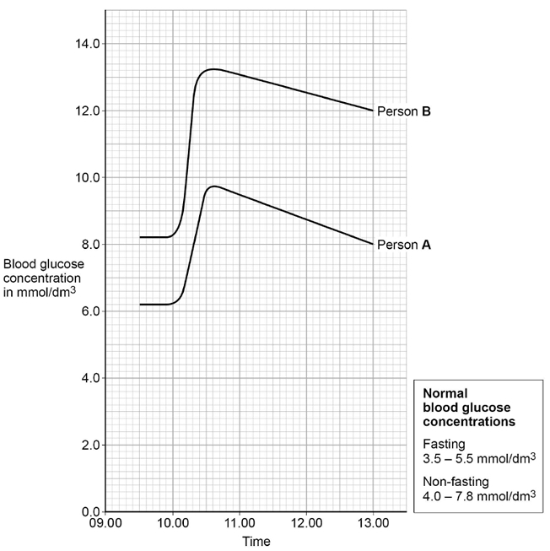
Exam questions – Tier 3 - YOU DO
Q1. This question is about homeostasis.
(b) Name the hormone released if the blood glucose concentration falls too low.
…………………………………………………………………………………………………………………………………………………………………
(1)
Two people were sent to a hospital to find out if they have diabetes.
This is the method used at the hospital.
• Do not eat or drink after midnight. This is called fasting.
• Measure blood glucose concentration at 9.30 am
• Drink a glucose solution at 10.00 am
• Measure blood glucose concentration for the next 3 hours.
The graph shows the results.

Slide 62
Exam questions – YOU DO
Person A and person B have diabetes.
(c) Describe how the graph above shows that person B has diabetes.
Use data from the graph.
....................................................................................................................................................................... .......................................................................................................................................................................
.......................................................................................................................................................................
....................................................................................................................................................................... .......................................................................................................................................................................
.......................................................................................................................................................................
(3)
(d) Person A and person B had a test to measure the concentration of insulin in their blood when they were fasting.
The table shows the results.
Person | Fasting blood insulin concentration in arbitrary units
A | 280
B | 20
Normal range | 50–175

Slide 63
Exam questions – YOU DO
Suggest which type of diabetes person A and person B have.
Give a reason for each answer.
Person A
Type of diabetes ……………………………………………………………………………………………………………………………………..
Reason ……………………………………………………………………………………………………………………………………………………. …………………………………………………………………………………………………………………………………………………………………
Person B
Type of diabetes ……………………………………………………………………………………………………………………………………..
Reason ……………………………………………………………………………………………………………………………………………………. …………………………………………………………………………………………………………………………………………………………………
(2)

Slide 64
DO NOW
Date: ……………………………………….
 | ANSWER
Q1.
Q2.
Q3.
Q4.
Q5.
Date: ……………………………………….
 | ANSWER
Q1.
Q2.
Q3.
Q4.
Q5.
6

Slide 65
DO NOW
Date: ……………………………………….
 | ANSWER
Q1.
Q2.
Q3.
Q4.
Q5.
Date: ……………………………………….
 | ANSWER
Q1.
Q2.
Q3.
Q4.
Q5.
7

Slide 66
Knowledge Retrieval Quiz 1
Date: ……………………………………….
Score: …………...
 |  | Answer
Q1. | Insert question in bold
Q2.
Q3.
Q4.
Q5.
Q6.
Q7.
Q8.
Q9.
Q10.
9

Slide 67
Extra Space
……………………………………………………………………………………………………………………………………………………………………………………………………………………………………………………………………………………………………………………………………………………………………………………………………………………………………………………………………………………………………………………………………………………………………………………………………………………………………………………………………………………………………………………………………………………………………………………………………………………………………………………………………………………………………………………………………………………………………………………………………………………………………………………………………………………………………………………………………………………………………………………………………………………………………………………………………………………………………………………………………………………………………………………………………………………………………………………………………………………………………………………………………………………………………………………………………………………………………………………………………………………………………………………………………………………………………………………………………………………………………………………………………………………………………………………………..
…………………………………………………………………………………………………………………………………………………………………………………………………………………………………………………………………………………………………………………………………………………………………………………………………………………………………………………………………………………………………………………………………………………………………………………………………………………………………………………………………………………………………………………………………………………………………………………………………………………………………………………………………………………………………………………………………………………………………………………………………………………………………………………………………………………………………………………………………………………………………………………………………………………………………………………………………………………………………………………………………………………………………………………………………………………………………………………………………………………………………………………………………………………………………………………………………………………………………………………………………………………………………………………………………………………………………..
…………………………………………………………………………………………………………………………………………………………………………………………………………………………………………………………………………………………………………………………………………………………………………………………………………………………………………………………………………………………………………………………………………………………………………………………………………………………………………………………………………………………………………………………………………………………………………………………………
12

Slide 68
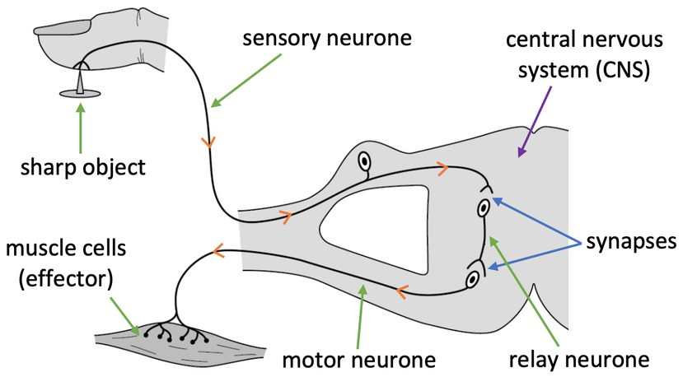
KNOWLEDGE ORGANISER
Subject: Science | Topic: Homeostasis & response | Term: Autumn
KEY WORDS | Key words
1 | Homeostasis | Homeostasis is the regulation of internal conditions to maintain optimal conditions for enzyme action and cell function.
2 | Nervous system | The nervous system enables humans to react to their surroundings and to coordinate their behaviour.
3 | Endocrine system | The endocrine system is composed of glands which secrete chemicals called hormones directly into the bloodstream.
4 | Reproduction | The process by which offspring are produced by parents.
5 | Hormone | Chemical messengers produced by glands.
KEY EXAMPLES
6 | Reflex actions | Automatic and rapid responses to stimuli.
7 | Puberty | Physical changes caused by hormones resulting in sexual maturity.
8 | Menstrual cycle | Recurring series of events in the human female reproductive system.
9 | Phototropism | A plants response to light.
10 | Gravitropism | A plants response to gravity.
KEY DIAGRAMS

