Slide 1

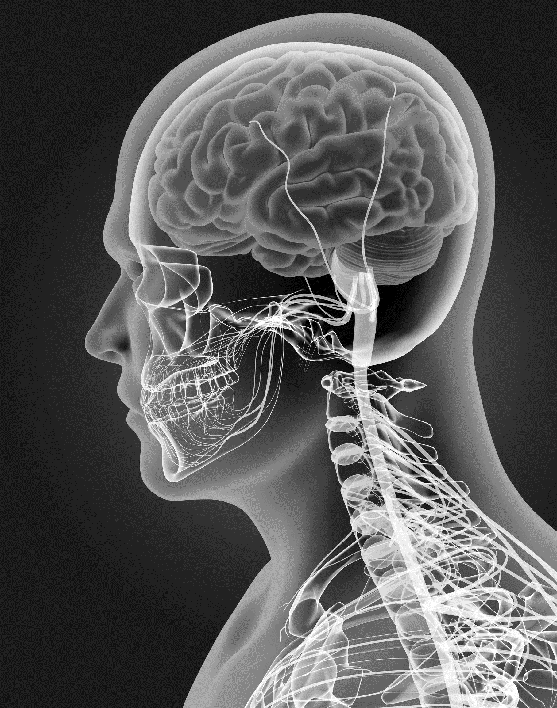
KS4 Homeostasis & Response (TRIPLE student booklet A)
Name
Class
Tutor Group
KS4 Science YEAR 11 Homeostasis & Response
KEYSTONE WORDS
Homeostasis | Homeostasis is the regulation of internal conditions to maintain optimal conditions for enzyme action and cell function.
Nervous system | The nervous system enables humans to react to their surroundings and to coordinate their behaviour.
Endocrine system | The endocrine system is composed of glands which secrete chemicals called hormones directly into the bloodstream.
Reproduction | The process by which offspring are produced by parents.
Hormone | Chemical messengers produced by glands.

Slide 2
BIG PICTURE
How will my prior knowledge develop my understanding of this topic?
Y7 | The Cells and Organisation topic introduced the body structures required.
Y8
Y9 | The GCSE Cell Biology topic added depth to prior learning from KS3. This is a threshold topic for this topic.
Learning Journey
Subtopic 1 | 4.5.1 & 4.5.2.1 – Homeostasis and the human nervous system | Subtopic 5 | 4.5.3.4 Hormones in human reproduction
Subtopic 2 | RP – practical & analysis | Subtopic 6 | 4.5.3.5 Contraception 4.5.3.6 HT only Infertility
Subtopic 3 | 4.5.3.1 Human endocrine system | Subtopic 7 | 4.5.4.2 HT only Use of plant hormones
Subtopic 4 | 4.5.3.2 Control of blood glucose concentration
Key knowledge
By the end of this topic you should know… | How the body responds to changes in the environment using the nervous system and the endocrine system.
By the end of this topic should be able to do… | Explain how to determine the effect of distractions on reaction times.
How will this knowledge develop my understanding of future topics?
This topic is one of the final topics in the course. It is not linked to future topics; however, it will deepen understanding of previous topics. For example, Organisation and Cell Biology.

Slide 3
KEY VOCABULARY LIST
Homeostasis | Homeostasis is the regulation of internal conditions to maintain optimal conditions for enzyme action and cell function.
Nervous system | The nervous system enables humans to react to their surroundings and to coordinate their behaviour.
Endocrine system | The endocrine system is composed of glands which secrete chemicals called hormones directly into the bloodstream.
Reproduction | The process by which offspring are produced by parents.
Hormone | Chemical messengers produced by glands.
EXPECTATIONS
Always write in black or blue pen. Always use a ruler for straight lines. If you make a mistake, cross it out with a single line. Always draw diagrams, tables and graphs in pencil with a ruler if necessary Always mark and correct your work in green pen. Respond to any feedback your teacher gives you in green pen. Take pride in your work, make it neat! All tasks should be completed in silence and by yourself unless your teacher tells you otherwise.
PROUD
Punctuation and grammar
Ruler and pencil for diagrams
Outstanding effort every lesson
Underline date and title
Dates and titles every lesson
PROUD FRIDAY
Any piece of work you complete, which meets our PROUD expectations can be taken to the PROUD station during Friday lunchtime. Show your work to a member of SLT and receive a sweet treat!

Slide 4
Subtopic 1: 4.5.2.2 Biology only: The brain
Learning Objective
We are learning about the parts of the brain, their function and what can happen to a person if the brain becomes injured or damaged through accidents, disease or illness
Why are we learning about this?
We are learning about his because even though scientists and doctors know a lot about the brain there is so more to know and as we are an ageing population, brain conditions such as dementia and Alzheimer's are now the biggest killers so we need to research how to prevent these.

Slide 5
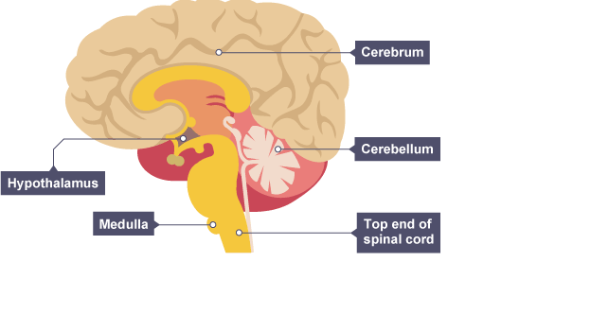
1 2 3 4 5 6 7 8 9 10 11 12 13 14 15 16 17 18 19 20 21 22 23 24 25 26 27 28 29 30 | The brain The brain controls complex behaviour. It is made of billions of interconnected neurones and has different regions that carry out different functions. Along with the spinal cord the brain is part of the Central nervous system or CNS. It is in charge of all our complex behaviours and controls everything you do. It is also involved in simple activities/coordination and reflexes, via the reflex arc after the initial spinal response has occurred for speed. Different regions carry out different functions. The brain has the texture of blancmange and therefore is difficult to investigate without damage as it is so soft. The brain contains the following main areas: cerebral hemispheres or (cerebral cortex) cerebellum and medulla Structure of the brain

Slide 6
1 2 3 4 5 6 7 8 9 10 11 12 13 14 15 16 17 18 19 20 21 22 23 24 25 26 27 28 29 30 | There are four main areas in the brain:
Cerebral hemispheres or cerebral cortex | The cerebrum's outer layer, it is split into two hemispheres and is highly folded. These two hemispheres make up the cerebral cortex. This controls most of our senses, intelligence, personality, conscious thought and high-level functions, such as language and verbal memory.
Cerebellum | Controls balance, co-ordination of movement and muscular activity.
Medulla oblongata | Controls unconscious activities such as heart rate and breathing rate.
Hypothalamus or thermoregulatory centre | Regulates temperature and water balance within the body. Responsible for hunger and thirst, controls release of hormones from the pituitary.

Slide 7
Rehearsal questions – structure and function of the brain and its parts
1. A part of the brain is called the medulla. What is its function?
………………………………………………………………………………………………………………………………………………..
2. A part of the brain is called the cerebrum. What is its function?
………………………………………………………………………………………………………………………………………………..
3. A part of the brain is called the cerebral hemispheres. What is its function.?
………………………………………………………………………………………………………………………………………………..
4. A part of the brain is called the hypothalamus. What is its function?
………………………………………………………………………………………………………………………………………………..
5. A part of the brain coordinates consciousness. What is it called?
………………………………………………………………………………………………………………………………………………..
6. A part of the brain controls temperature. What is it called?
………………………………………………………………………………………………………………………………………………..
7. A part of the brain controls muscle movement. Which is it? ………………………………………………………………………………………………………………………………………………..
8 A part of the brain controls heart beat. Which is it?
………………………………………………………………………………………………………………………………………………..
9 A part of the brain controls intelligence. Which is it? ………………………………………………………………………………………………………………………………………………..
10. Language is controlled by which part of the brain?
………………………………………………………………………………………………………………………………………………..
11. Unconscious activities are controlled by which part of the brain. ? ………………………………………………………………………………………………………………………………………………..
12. A part of the brain controls language. Which is it?
………………………………………………………………………………………………………………………………………………..
13. Breathing is controlled by which part of the brain?
………………………………………………………………………………………………………………………………………………..

Slide 8
Rehearsal questions – structure and function of the brain and its parts
14 What is the function of the cerebellum?
………………………………………………………………………………………………………………………………………………..
15. Part of the brain is called the medulla . What is its function?
……………………………………………………………………………………………………………………………………………..
16. Part of the brain is called the Cerebral hemispheres. What is its function?
………………………………………………………………………………………………………………………………………………..
17. What is the name of the part of the brain that controls temperature ?
………………………………………………………………………………………………………………………………………………..
18. Language is coordinated by which part of the brain?
………………………………………………………………………………………………………………………………………………..
19. Intelligence is coordinated by which part of the brain?
………………………………………………………………………………………………………………………………………………..
20. Heartbeat is controlled by which part of the brain?
………………………………………………………………………………………………………………………………………………..
21. Breathing is controlled by which part of the brain?
………………………………………………………………………………………………………………………………………………..
22. Coordination of the muscles is controlled by which part of the brain? ………………………………………………………………………………………………………………………………………………..
23. If someone damages their cerebral cortex what might be the result?
………………………………………………………………………………………………………………………………………………..
24. If someone damages their medulla what might be the result? ………………………………………………………………………………………………………………………………………………..
25. If someone damages their cerebellum what might be the result?
………………………………………………………………………………………………………………………………………………..
………………………………………………………………………………………………………………………………………………..

Slide 9
YOU DO Wrong answers – structure and function of the brain
The human brain has a simple structure. Most of the structures that the brain contains work together to do simple tasks. Various nerve then carries messages from the brain to the receptors so that it can interpret the impulses and determine what a person should do. The r neurones of the brain are physically connected .
There are two main parts to the brain. These are the medulla and spinal cord, the rest of the brain just carries out one simple activity,. The medulla is responsible for conscious activities. The cerebellum is responsible for heart beat and he cerebral cortex is responsible for heart beat. Intelligence and memory are controlled by the medulla. Beathing and heartbeat are controlled by the cerebellum and intelligence is controlled by the cerebellum.

Slide 10
If I didn’t – the brain and its structure and function
How would I be affected if I didn’t…
I DO
1. Have medulla?
………………………………………………………………………………………………………………………………………………………………………………………………………………………………………………………………………………………………….. ………………………………………………………………………………………………………………………………………………
WE DO
2. Have cerebellum?
……………………………………………………………………………………………………………………………………………………………………………………………………………………………………………………………………………………………………………………………………………………………………………………………………………………………………………………
YOU DO
3. Have cerebral cortex?
………………………………………………………………………………………………………………………………………………………………………………………………………………………………………………………………………………………………………………………………………………………………………………………………………………………………………………………
4.Have a CNSs?
………………………………………………………………………………………………………………………………………………………………………………………………………………………………………………………………………………………………………………………………………………………………………………………………………………………………………………………
5. Have a interconnected neurones?
………………………………………………………………………………………………………………………………………………………………………………………………………………………………………………………………………………………………………………………………………………………………………………………………………………………………………………………

Slide 11
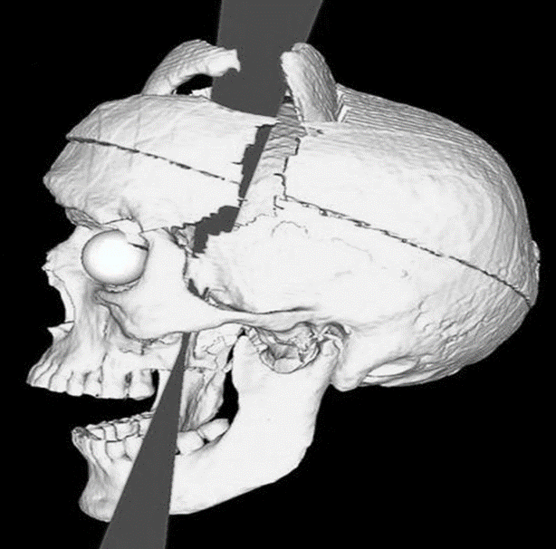
1 2 3 4 5 6 7 8 9 10 11 12 13 14 15 16 17 18 19 20 21 22 23 24 25 26 27 28 29 30 | Investigating the brain - Modern science has allowed scientists to discover how different parts of the brain function. Neuroscientists (people who study the CNS) have been able to map various regions of the brain to particular functions by: Studying patients with brain damage Electrically stimulating different parts of the brain Using various scanning techniques. A well-documented example of brain damage is of Phineas Gage, who in 1848 had a serious accident whilst laying railway tracks and an iron rod went through his skull. The damage to Phineas Gage's skull caused by the iron rod (Phineas survived the accident and could still walk and talk) documented that his personality changed following it. It was noted that he lost his inhibitions socially and emotionally. Doctors realised the changes in Phineas were due to the damage in the particular parts of the brain that the iron rod had passed through. This important case allowed scientists to examine the effect of the injuries on his brain activity.

Slide 12
1 2 3 4 5 6 7 8 9 10 11 12 13 14 15 16 17 18 19 20 21 22 23 24 25 26 | If a small part of the brain has been damaged the effect on the patient can tell you a lot about what the damaged part does e.g. if the area at the back of the brain was damaged through a stroke and the patient went blind, then you know that part had something to do with vision. Electrical stimulation Scientists have stimulated different parts of the brain with a weak electrical current and asked patients to describe what they experienced. The brain can be stimulated by pushing tiny electrode into the tissue and giving it a small zap of electricity. By observing what this does to the brain its possible to get an idea of what that part does. If the motor area is stimulated, the patient makes an involuntary muscle movement. If the visual area is stimulated, they may see a flash of colour. EEGs (Electroencephalograms) can be created and studied, to observe the electrical activity in the brain. There are three modern scanning techniques used to scan the brain: MRI (magnetic resonance imaging) CT (computed tomography) PET (positron emission tomography) MRI scanners use strong magnetic fields and radio waves to show details of brain structure and function. Patients are asked to perform various tasks and, by looking at the scan, scientists can see which parts of the brain are active when the task is carried out. The patient lies on a bed which moves into the machine. Some people can feel claustrophobic inside an MRI scanner. MRI scanning is safe and doesn’t use ionising radiation. It is safer than the PET or CT scans which are not often used now because of that. MRI scan works by giving the precise location of the protons in the body's hydrogen atoms. ECGs, Electroencephalograms are used to monitor abnormal brain activity in the brain an c can be used for mapping out areas of the brain. This is non-invasive.

Slide 13
1 2 3 4 5 6 7 8 9 10 11 12 13 14 15 16 17 18 19 20 21 22 23 24 25 26 27 28 29 30 | CT scanners are similar to MRIs. The patient lies on a bed which passes through a ring of equipment (not into the machine like in MRI). The ring takes a series of x-rays from different angles. These are processed by a computer to allow the doctors to see inside brains and other parts of the body. PET scanners detect gamma rays that radiate from a chemical compound called a tracer. PET scans are used to detect high levels of metabolic reactions inside a person. Before going into the scanner, the patient consumes the tracer. This travels to any area of the body which has unusually high levels of metabolic reactions. This is often a tumour and so PET scans are used to detect cancers Brain damage is any loss of cells in the brain. This is often because of injuries such as car crashes when a person’s head hits an object with a great force. The extent of the injury depends upon many factors including: the force of impact the size or shape of the object hitting the skull the position the object hits the skull the time it takes for treatment Other causes include strokes, consumption of excessive alcohol and brain tumours. Sadly, many brain injuries are fatal. Longer-term symptoms of brain damage include speech or movement problems, reduced coordination, memory loss and personality changes. Often impacts to the skull result in the brain swelling as it produces excessive fluid. Brain surgery may be needed to remove a tumour or excess fluid, such as blood. All surgery carries a level of risk, but due to the complexity and delicacy of the brain, investigating and treating brain disorders can be very difficult. If surgery is undergone more damage or side-effects may be created, which could affect the patients' quality of life. Serious considerations about the risks involved against the benefits need to be undertaken first. Physiotherapists play a very important role helping with the rehabilitation of patients with brain damage. Sadly repair to the brain is often not possible and surgery is often needed, especially if the reason is cancer. Chemo and radio therapy are used after surgery to ensure all cancer cells are killed. This in itself carries risks due to the radiation and chemical used.

Slide 14
Rehearsal questions – investigating the brain
1. A type of scan of the brain is called an MRI. What is this?
………………………………………………………………………………………………………………………………………………..
2. A type of Scan of the brain is called a PET. What is this?
………………………………………………………………………………………………………………………………………………..
3. A type of scan is called a CT scan. What is this?
………………………………………………………………………………………………………………………………………………..
4.MRI scans use magnetic fields, what else do they use?
………………………………………………………………………………………………………………………………………………..
5. Radio waves are used in which scanning technique?
………………………………………………………………………………………………………………………………………………..
6. Which is the safest scanning technique that can be used when investigating the brain?
………………………………………………………………………………………………………………………………………………..
7. What doe CT scans use as the main technique? ………………………………………………………………………………………………………………………………………………..
8 A scanning technique uses gamma rays. Which is it?
………………………………………………………………………………………………………………………………………………..
9 A scanning technique uses a tracer. Which is it? ………………………………………………………………………………………………………………………………………………..
10. Which scanning technique uses non ionising radiation?
………………………………………………………………………………………………………………………………………………..
11. Why are PET scans not as safe as MRI scans ? ………………………………………………………………………………………………………………………………………………..
12. A scanning technique uses Xrays. Which is it?
………………………………………………………………………………………………………………………………………………..
.

Slide 15
Contrasting concepts
I DO
1.MRI scan uses magnetic fields where as PET scans use?
………………………………………………………………………………………………………………………………………………………………………………………………………………………………………………………………………………………………….. ………………………………………………………………………………………………………………………………………………
WE DO
2. CT scans use X-rays whereas MRI scans use?
……………………………………………………………………………………………………………………………………………………………………………………………………………………………………………………………………………………………………………………………………………………………………………………………………………………………………………………
YOU DO
3. CT scan's use X-rays where as PET scans use?
………………………………………………………………………………………………………………………………………………………………………………………………………………………………………………………………………………………………………………………………………………………………………………………………………………………………………………………
4.PET scans use tracers where as MRI scans use?
………………………………………………………………………………………………………………………………………………………………………………………………………………………………………………………………………………………………………………………………………………………………………………………………………………………………………………………
5. MRI scans use non ionising radiation whereas PET scans use?
………………………………………………………………………………………………………………………………………………………………………………………………………………………………………………………………………………………………………………………………………………………………………………………………………………………………………………………

Slide 16
Interleaving questions – The Brain – YOU DO
The brain is an organ. Define ‘organ’.
………………………………………………………………………………………………………………………………………………………
2. Tissues contain groups of cells with similar structure and functions. Name two tissues found in the brain?.
……………………………………………………………………………………………………………………………………………………………………………………………………………………………………………………………………………………………………………..
3. The brain contains three main parts . What are they? ……………………………………………………………………………………………………………………………………………………………………………………………………………………………………………………………………………………………………………..
4. The heart contains 4 main parts . What are they?
…………………………………………………………………………………………………………………………………………………………………………………………………………………………………………………………………………………………………………….. ……………………………………………………………………………………………………………………………………………………………………………………………………………………………………………………………………………………………………………..
5. Heart beat and breathing are automatically controlled . Which part of the brain does this?
……………………………………………………………………………………………………………………………………………………
6. What controls heartbeat in the heart. Where is it?
……………………………………………………………………………………………………………………………………………………………………………………………………………………………………………………………………………………………………………..
7. Breathing occurs in the lungs. Where does respiration occur?
………………………………………………………………………………………………………………………………………………………
8. What is the equation for respiration?
……………………………………………………………………………………………………………………………………………………….
9.What is the equation for photosynthesis?
………………………………………………………………………………………………………………………………………………………
10. Where is energy trapped in the plant cells?
…………………………………………………………………………………………………………………………………………………………

Slide 17
Exam questions: The Brain
Q1.
(b) Describe, in as much detail as you can, how information is transmitted from light receptors in the retina to the brain.
…………………………………………………………………………………………………………………………………………………. ………………………………………………………………………………………………………………………………………………….
………………………………………………………………………………………………………………………………………………….
………………………………………………………………………………………………………………………………………………….
………………………………………………………………………………………………………………………………………………….
………………………………………………………………………………………………………………………………………………….
………………………………………………………………………………………………………………………………………………….
………………………………………………………………………………………………………………………………………………….

Slide 18
Q2.
Describe how the brain is informed of the image detected by the retina.
…………………………………………………………………………………………………………………………………………………. ………………………………………………………………………………………………………………………………………………….
………………………………………………………………………………………………………………………………………………….
………………………………………………………………………………………………………………………………………………….
………………………………………………………………………………………………………………………………………………….
………………………………………………………………………………………………………………………………………………….
………………………………………………………………………………………………………………………………………………….
………………………………………………………………………………………………………………………………………………….

Slide 19
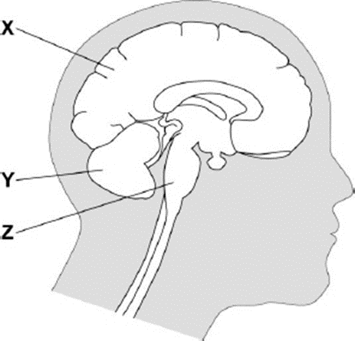
Q3. The diagram shows a vertical section through the head showing the brain.
Use words from the box to name the structures labelled X, Y and Z on the diagram.
 | cerebral cortex | cerebellum | medulla | spinal cord | synapse
(b) One method of mapping brain function is to observe changes in body functions following a stroke.
(i) Give two other methods of mapping brain function.
1. ...........................................................................................................
2. ...........................................................................................................
(2)

Slide 20
Q2.A man hurt his head in an accident.
Doctors found that he could not remember anything that had happened on the day of the accident.
(a) (i) Name the part of the brain concerned with memory.
...................................................................................................... (1)
.(ii) Name one method the doctors could use to find out how much the brain was damaged.
...............................................................................................................
(b) The doctors were worried that the man might also have injured his spine.
They touched different areas of his skin with a sharp point.
They asked him to tell them each time if he could feel the sharp point.
(i) Explain how the information about the sharp point touching the skin reaches the man’s brain.
…………………………………………………………………………………………………………………………………………………..
…………………………………………………………………………………………………………………………………………………..
…………………………………………………………………………………………………………………………………………………..
…………………………………………………………………………………………………………………………………………………..
…………………………………………………………………………………………………………………………………………………..
…………………………………………………………………………………………………………………………………………………..
…………………………………………………………………………………………………………………………………………………..
(6)

Slide 21
(ii) The doctors found that the man could feel the sharp point when the point touched his arms but not when the point touched his legs.
Suggest what this information could tell the doctors about the damage to the man’s spinal cord. Explain your answer. ......................................................................................................................................................
..............................................................................................................,…………………………………….
.......................................................................................................................................................
.......................................................................................................................................................
(2)

Slide 22
Subtopic 2: 4.5.2.3 Biology only: The eye
Learning Objective
We are learning to explain how the structure of the parts of the eye are relate to their function.
We are learning about how defects to the eye are corrected so vision is improved.
Why are we learning about this?
The eye is a sense organ that almost all highly developed animals have. It provides a good example of how evolution has enabled organisms to respond to changes in the environment.

Slide 23
1 2 3 4 5 6 7 8 9 10 11 12 13 14 15 16 17 18 19 20 21 22 23 24 25 26 27 28 29 30 | The Parts of the Eye The eye has a complex structure. If one of the parts doesn’t work effectively, it can drastically affect our vision. The parts of the eye are as follows: Retina: The retina is the innermost layer of the eye's posterior wall. Specialised cells in the retina, called photoreceptors (rods and cones), capture light and initiate the visual process. Optic Nerve: The optic nerve is a bundle of neurones that carries messages generated by the retina to the brain. The brain’s visual centres process and interpret the messages. Pupil: The pupil is the black, central opening in the iris. Iris: The iris is a coloured, muscular structure surrounding the pupil. Its primary function is to regulate the size of the pupil. It achieves this by controlling the contraction and relaxation of its circular and radial muscles, adjusting the pupil's size to optimise the amount of light reaching the retina. Cornea: The cornea is the clear, front part of the eye's outer layer. Its primary function is to refract or bend incoming light and focus it onto the retina. Lens: The lens is a transparent, flexible structure situated behind the pupil and iris. Its primary function is to further focus the incoming light onto the retina. It accomplishes this by changing its shape, a process called accommodation, which allows us to focus on objects at varying distances. Ciliary Muscles and Suspensory Ligaments: These structures work together to control the shape of the lens. The ciliary muscle contracts or relaxes to change the lens's shape, while the suspensory ligament holds the lens in place and adjusts its tension, allowing for precise focusing on objects at different distances. Sclera: The sclera is the tough, white outer layer of the eye. Its primary function is to provide structural support and protection for the internal components of the eye. It also helps maintain the eye's shape and integrity. Each part of the eye plays a crucial role in the complex process of vision, from capturing and focusing light to transmitting visual information to the brain for perception.

Slide 24
Controlling light intensity
Treating eye defects
The Eye
Structure and function
Accommodation

Slide 25
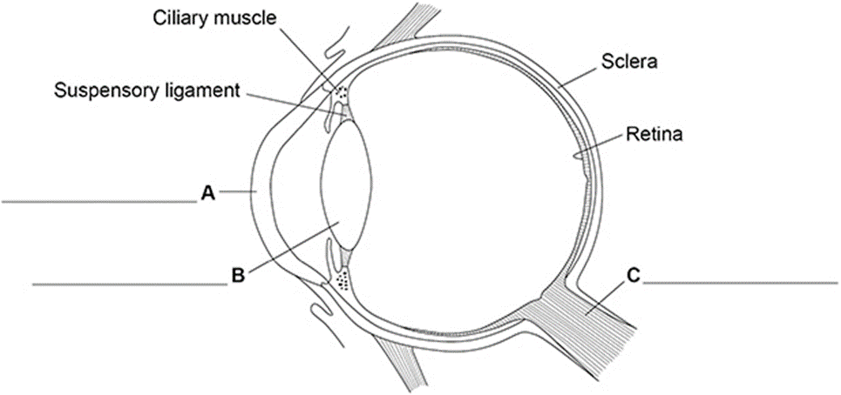
Rehearsal – structure of the eye
F…………………………..
E …………………………..
G…….…………………………..
D…………………………..
A…………………………..
B…………………………..
C…………………………..
Rehearsal – written questions (continued on next page).
What is the function of the receptor cells in the retina?
………………………………………………………………………………………………………………………………………………..
2. What is the function of the optic nerve?
………………………………………………………………………………………………………………………………………………..
3. What is the function of the cornea?
………………………………………………………………………………………………………………………………………………..
4. What is the function of the lens?
………………………………………………………………………………………………………………………………………………..
5. What is the function of the ciliary muscles and suspensory ligaments?
………………………………………………………………………………………………………………………………………………..
6. What is the function of the iris?
………………………………………………………………………………………………………………………………………………..
7. What is the function of the sclera?
………………………………………………………………………………………………………………………………………………..

Slide 26
Rehearsal questions continued – structure of the eye
8. Every eye has an optic nerve. What is its function?
………………………………………………………………………………………………………………………………………………..
9. The size of the pupil can be changed. Which part of the eye does this?
………………………………………………………………………………………………………………………………………………..
10. The shape of the lens can be changed. Which two parts of the eye change its shape?
………………………………………………………………………………………………………………………………………………..
11. What is the function of the sclera?
………………………………………………………………………………………………………………………………………………..
12. The retina contains receptors. What do the receptors detect?
………………………………………………………………………………………………………………………………………………..
13. Two parts of the eye refract light. What are they?
………………………………………………………………………………………………………………………………………………..
14. Light passes through three parts of the eye. What are they? ………………………………………………………………………………………………………………………………………………..
15. The parts of the eye are very fragile. Which part protects them from the environment?
………………………………………………………………………………………………………………………………………………..
16. The eye is very sensitive to light. Which part of the eye controls the amount of light that enters the eye? ………………………………………………………………………………………………………………………………………………..
17. Two parts of the eye are made of muscle fibres. What are they?
………………………………………………………………………………………………………………………………………………..
18. Which parts of the eye must be transparent for the eye to function? ………………………………………………………………………………………………………………………………………………..
19. Receptors detect changes. Which part of the eye contains receptors?
………………………………………………………………………………………………………………………………………………..
20. Boxers occasionally get a detached retina. What is the function of the retina?
………………………………………………………………………………………………………………………………………………..

Slide 27
YOU DO Wrong answers – structure of the eye
The human eye has a complex structure. Most of the structures that the eye contains work together to focus light on the retina. The optic nerve then carries messages from the brain to the retina (the coordinator) so that it can interpret the impulses and determine what a person is looking at.
Retina – the retina contains light receptors. It is found at the front of the eye and is connected to the optic nerve
Optic nerve – once the receptors in the retina receive a stimulus (detect sound), messages are carried to the coordinator, the brain, by the optic nerve.
The above process works best when the intensity of light stimulating the retina isn’t too high or too low. The light also needs to be sharply focused on the retina.
Iris – the pupil controls the size of the iris; the pupil is a hole that light passes through as it goes into the eye. The size of the pupil changes because the iris is composed of muscles that contract and relax. When the pupil gets larger, less light reaches the retina (for example, pupils get larger when it is dark). When it is smaller, less light reaches the retina (the pupils will be smaller in brightly lit rooms for example).
Light is focused using refraction; light is refracted as it travels through the cornea and lens.
Cornea – the cornea is found at the front of the eye. It refracts light by a variable amount.
Lens – the lens is found behind the pupil. Its shape can be changed using the radial muscles which are connected to the lens using suspensory ligaments.
Sclera – The sclera is the white part of the eye. It is very tough and so can protect the components of the eye from damage.

Slide 28
If I didn’t – structure of the eye
How would it affect my vision if I didn’t…
I DO
1. Have a retina?
………………………………………………………………………………………………………………………………………………………………………………………………………………………………………………………………………………………………….. ………………………………………………………………………………………………………………………………………………
WE DO
2. Have a lens?
……………………………………………………………………………………………………………………………………………………………………………………………………………………………………………………………………………………………………………………………………………………………………………………………………………………………………………………
YOU DO
3. Have an optic nerve?
………………………………………………………………………………………………………………………………………………………………………………………………………………………………………………………………………………………………………………………………………………………………………………………………………………………………………………………
4.Have ciliary muscles?
………………………………………………………………………………………………………………………………………………………………………………………………………………………………………………………………………………………………………………………………………………………………………………………………………………………………………………………
5. Have a transparent cornea?
………………………………………………………………………………………………………………………………………………………………………………………………………………………………………………………………………………………………………………………………………………………………………………………………………………………………………………………

Slide 29
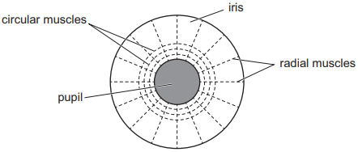
1 2 3 4 5 6 7 8 9 10 11 12 13 14 15 16 17 18 19 20 21 22 23 24 25 26 27 28 29 30 | Controlling the number of light rays entering the eye Controlling the number of light rays entering the eye is vital to maintain visual clarity, protect the delicate retina from damage, adapt to changing light conditions, optimise depth of field, conserve energy, and ensure visual comfort. Proper regulation of light intake enables the eye to function effectively across various environments, enhancing visual acuity and overall visual experience while safeguarding eye health. The iris contains two types of muscle that work together to control the size of the pupil. Radial muscles are located in the outer part of the iris. When they contract they pull the iris outward so making the pupil bigger. Circular muscles are found in the inner part of the iris. When they contract they make the pupil smaller. The two types of muscle are antagonistic; they have opposite roles so when one contracts, the other relaxes. In bright light, the circular muscles contract and the radial muscles relax. This makes the pupil smaller, so less light enters the eye. In dim light, the circular muscles relax and the radial muscles contract. This makes the pupil larger (dilated) so more light rays enter the eye.

Slide 30
Rehearsal – controlling light intensity within the eye
What is the function of the iris?
………………………………………………………………………………………………………………………………………………..
2. What do radial muscles of the iris do?
………………………………………………………………………………………………………………………………………………..
3. What do the circular muscles in the iris do?
………………………………………………………………………………………………………………………………………………..
4. Which muscle contracts when the pupil gets smaller?
………………………………………………………………………………………………………………………………………………..
5. Which muscle relaxes when the pupil gets smaller?
………………………………………………………………………………………………………………………………………………..
6. Which muscle contracts when the pupil gets larger?
………………………………………………………………………………………………………………………………………………..
7. Which muscle relaxes when the pupil gets larger?
………………………………………………………………………………………………………………………………………………..
8. Human eyes have an iris. What is its function?
………………………………………………………………………………………………………………………………………………..
9. Name the two types of muscle in the iris.
………………………………………………………………………………………………………………………………………………..
10. The two types of muscle are antagonistic. If the radial muscles are contracting, are the circular muscles contracting or relaxing?
………………………………………………………………………………………………………………………………………………..
11.If you are in a room with bright lighting, would the circular muscles be contracting or relaxing? ………………………………………………………………………………………………………………………………………………..
12. If you are in a dim room, would the radial muscles be contracting or relaxing?
………………………………………………………………………………………………………………………………………………..

Slide 31
YOU DO Wrong answers – light intensity inside the eye
The iris contains two types of muscles; radial muscles and ciliary muscle. Radial muscles extend from the inside of the iris towards the centre. The circular muscles give the iris its circular shape. When the pupil gets bigger, the radial muscles are relaxing, and the circular muscles are contracting. So, the pupil gets larger.
When the pupil gets smaller, the same happens. The radial muscles relax and the circular muscles contract.
Contrasting concepts – light intensity inside the eye
I DO 1. What are the similarities between radial muscles and circular muscles?
………………………………………………………………………………………………………………………………………………………………………………………………………………………………………………………………………………………………………………………………………………………………………………………………………………………………………………………
WE DO 2. What are the differences between radial muscles and circular muscles?
………………………………………………………………………………………………………………………………………………………………………………………………………………………………………………………………………………………………………………………………………………………………………………………………………………………………………………………
YOU DO 3. What are the similarities between contracting radial muscles and circular muscles?
………………………………………………………………………………………………………………………………………………………………………………………………………………………………………………………………………………………………………………………………………………………………………………………………………………………………………………………
4. What are the differences between effects of contracting radial muscles and circular muscles?
………………………………………………………………………………………………………………………………………………………………………………………………………………………………………………………………………………………………………………………………………………………………………………………………………………………………………………………

Slide 32
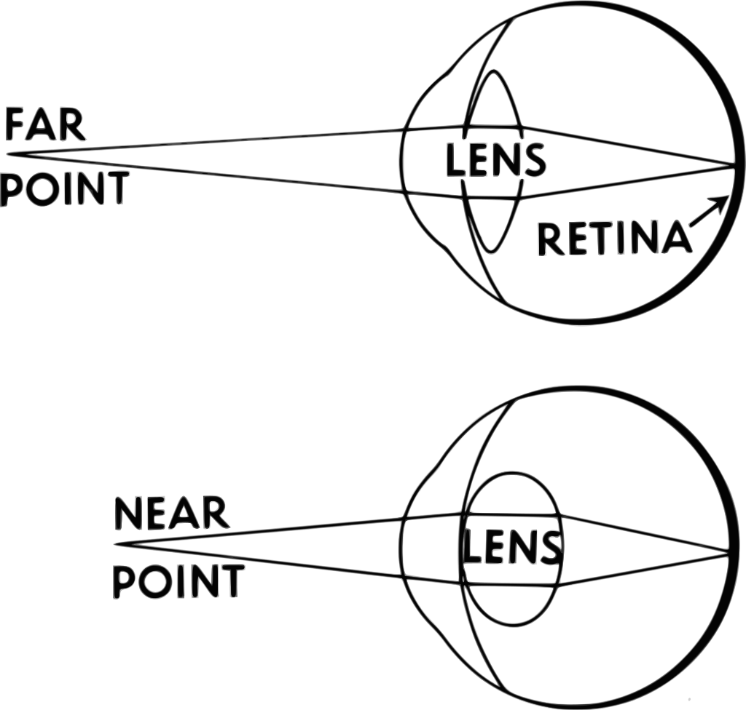
1 2 3 4 5 6 7 8 9 10 11 12 13 14 15 16 17 18 19 20 21 22 23 24 25 26 27 28 29 30 | Accommodation (focusing) The lens, ciliary muscles, and suspensory ligaments work together to enable us to focus on objects through a process called accommodation and the principles of refraction. When an object is far away the light rays need to be refracted less than for near objects. For distant objects the lens needs to be flat; for near objects it needs to be rounder or fatter. Focusing on distant objects: Accommodation involves three structures in the eye. Lens: The lens is a transparent, flexible structure located behind the iris and the pupil. Its primary role is to bend or refract light rays that enter the eye, allowing them to converge onto the retina. Ciliary Muscles: Surrounding the lens are the ciliary muscles. When we need to focus on distant objects, these muscles relax. This causes a reduction in tension on the suspensory ligaments connected to the lens (the lens remains flat). Suspensory Ligaments: These ligaments are thin, thread-like fibres that attach the lens to the ciliary muscles. When the ciliary muscles relax, the suspensory ligaments pull on the lens, making it thinner and flatter. The combined action of the relaxed ciliary muscles and the tension on the suspensory ligaments results in the lens assuming a flat shape. This flat lens refracts incoming light rays less, allowing them to converge on the retina. The opposite happens when we focus on near objects; the ciliary muscles contract and the suspensory ligaments relax. So, the lens becomes rounder and fatter.
Ciliary muscles relax.
Suspensory ligaments under tension.
Ciliary muscles contract.
Suspensory ligaments relax.

Slide 33
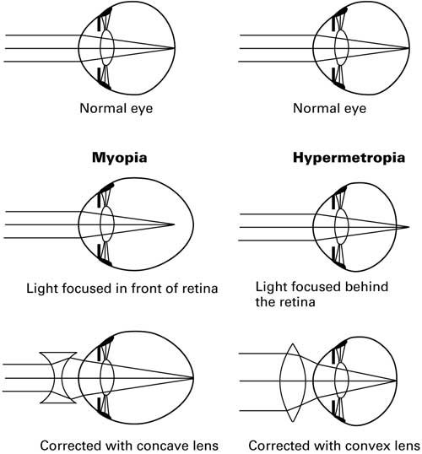
1 2 3 4 5 6 7 8 9 10 11 12 13 14 15 16 17 18 19 20 21 22 23 24 25 26 27 28 29 30 | Correcting poor vision Two common defects of the eyes are myopia (short sightedness) and hyperopia (long sightedness) in which rays of light do not focus on the retina. • Generally these defects are treated with spectacle lenses which refract the light rays so that they do focus on the retina. • New technologies now include hard and soft contact lenses, laser surgery to change the shape of the cornea and a replacement lens in the eye. Spectacles, also known as eyeglasses, are commonly used to correct myopia, or near-sightedness. Myopia occurs when light entering the eye converges in front of the retina instead of directly on it, leading to blurred distance vision. A biconcave (diverging lens) is used in spectacles to focus light rays on the retina. Hyperopia occurs when light entering the eye converges behind the retina, resulting in difficulty focusing on nearby objects. A biconvex (converging lens) is used in spectacles to focus light rays on the retina.

Slide 34
Rehearsal –Accommodation
What is the scientific term for focusing?
………………………………………………………………………………………………………………………………………………..
2. Which part of the changes shape when you focus on an object?
………………………………………………………………………………………………………………………………………………..
3. What is the function of the ciliary muscles and suspensory ligaments?
………………………………………………………………………………………………………………………………………………..
4. What shape would the lens have if the ciliary muscles relax?
………………………………………………………………………………………………………………………………………………..
5. What shape would the lens have if the ciliary muscles contract?
………………………………………………………………………………………………………………………………………………..
6. Would the suspensory ligaments be under tension or relaxed when ciliary muscles relax?
………………………………………………………………………………………………………………………………………………..
7. Would the suspensory ligaments be under tension or relaxed if ciliary muscles contract?
………………………………………………………………………………………………………………………………………………..
8. What shape does the lens need to be to focus on distant objects?
………………………………………………………………………………………………………………………………………………..
9. Do the ciliary muscles contract or relax when you focus on distant objects?
………………………………………………………………………………………………………………………………………………..
10.Are suspensory ligaments relaxed or under tension when you focus on distant objects? ………………………………………………………………………………………………………………………………………………..
11. What shape does the lens need to be to focus on near objects?
………………………………………………………………………………………………………………………………………………..
12. Do the ciliary muscles contract or relax when you focus on near objects?
………………………………………………………………………………………………………………………………………………..
13. Are suspensory ligaments relaxed or under tension when you focus on distant objects? ………………………………………………………………………………………………………………………………………………..

Slide 35
Rehearsal –Accommodation
14. What are the scientific terms for short sightedness and long sightedness?
………………………………………………………………………………………………………………………………………………..
15. Which eye defect is treated with biconcave lenses in spectacles?
………………………………………………………………………………………………………………………………………………..
16. Which eye defect is treated with biconvex lenses in spectacles?
………………………………………………………………………………………………………………………………………………..
17. The eye contains ciliary muscles. What is their function?
………………………………………………………………………………………………………………………………………………..
18. The eye contains suspensory ligaments. What is their function?
………………………………………………………………………………………………………………………………………………..
19. Ciliary muscles change the shape of the lens. What is the shape of the lens when the muscles contract?
………………………………………………………………………………………………………………………………………………..
20. Ciliary muscles can contract and relax. What is the shape of the lens when the muscles relax?
………………………………………………………………………………………………………………………………………………..
21. If you focus on a distant object, will the ciliary muscles be relaxed or contracted?
………………………………………………………………………………………………………………………………………………..
22. If you focus on a near object will the ciliary muscles be contracted or relaxed?
………………………………………………………………………………………………………………………………………………..
23. Name three parts of the eye that are actively involved in focusing.
………………………………………………………………………………………………………………………………………………..
24. What is the scientific term for focusing? ………………………………………………………………………………………………………………………………………………..
25. Spectacles contain lenses. Which eye defect is treated with biconcave lenses? ………………………………………………………………………………………………………………………………………………..
26. Spectacles contain lenses. Which eye defect is treated with biconvex lenses? ………………………………………………………………………………………………………………………………………………..

Slide 36
Contrasting Concepts –Accommodation & light intensity inside the eye
I DO 1. How are ciliary muscles and the lens similar. ………………………………………………………………………………………………………………………………………………………………………………………………………………………………………………………………………………………………………………………………………………………………………………………………………………………………………………………
WE DO 2. How are ciliary muscles and the lens different?
………………………………………………………………………………………………………………………………………………………………………………………………………………………………………………………………………………………………………………………………………………………………………………………………………………………………………………………
YOU DO 3. How are ciliary muscles and the suspensory ligaments different?
………………………………………………………………………………………………………………………………………………………………………………………………………………………………………………………………………………………………………………………………………………………………………………………………………………………………………………………
4. How are myopia and hyperopia different?
………………………………………………………………………………………………………………………………………………………………………………………………………………………………………………………………………………………………………………………………………………………………………………………………………………………………………………………
5. How are the radial muscles and the ciliary muscles similar?
………………………………………………………………………………………………………………………………………………………………………………………………………………………………………………………………………………………………………………………………………………………………………………………………………………………………………………………
6. How are the radial muscles and the ciliary muscles different?
………………………………………………………………………………………………………………………………………………………………………………………………………………………………………………………………………………………………………………………………………………………………………………………………………………………………………………………
7. How are the functions of the ciliary muscles and the circular muscles similar?
………………………………………………………………………………………………………………………………………………………………………………………………………………………………………………………………………………………………………………………………………………………………………………………………………………………………………………………

Slide 37
If I didn’t – accommodation and light intensity inside the eye.
How would I be affected if I didn’t…
I DO
1. Have ciliary muscles?
………………………………………………………………………………………………………………………………………………………………………………………………………………………………………………………………………………………………….. ………………………………………………………………………………………………………………………………………………
WE DO
2. Have suspensory ligaments?
……………………………………………………………………………………………………………………………………………………………………………………………………………………………………………………………………………………………………………………………………………………………………………………………………………………………………………………
YOU DO
3. Have a lens?
………………………………………………………………………………………………………………………………………………………………………………………………………………………………………………………………………………………………………………………………………………………………………………………………………………………………………………………
4.Have circular and radial muscles?
………………………………………………………………………………………………………………………………………………………………………………………………………………………………………………………………………………………………………………………………………………………………………………………………………………………………………………………
5. Have a muscles in the eye?
………………………………………………………………………………………………………………………………………………………………………………………………………………………………………………………………………………………………………………………………………………………………………………………………………………………………………………………

Slide 38
Spacing – The eye
The eye is an organ. Define ‘organ’.
……………………………………………………………………………………………………………………………………………………………………………………………………………………………………………………………………………………………………
2. Tissues contain groups of cells with similar structure and functions. Name two tissues found in the eye.
……………………………………………………………………………………………………………………………………………………………………………………………………………………………………………………………………………………………………
3. The eye contains light receptors. If a bright light is shone in an eye the pupil gets smaller. Which part of the eye is the effector?
……………………………………………………………………………………………………………………………………………………………………………………………………………………………………………………………………………………………………
4. A fly flies towards your face when you are looking at a sunset. You immediately focus on the fly. Name the type of receptor and name the effector.
…………………………………………………………………………………………………………………………………………………………………………………………………………………………………………………………………………………………………..
5. Light is refracted by the cornea and the lens. Define ‘refraction’.
……………………………………………………………………………………………………………………………………………………………………………………………………………………………………………………………………………………………………
6. When light moves into a denser material does it speed up or slow down?
………………………………………………………………………………………………………………………………………………………………………………………………………………………………………………………………………………………………….
7. As light moves from the air into the cornea, does the light ray move towards or away from the normal line?
……………………………………………………………………………………………………………………………………………………………………………………………………………………………………………………………………………………………………

Slide 39
Spacing – The eye
The eye is an organ. Define ‘organ’.
……………………………………………………………………………………………………………………………………………………………………………………………………………………………………………………………………………………………………
2. Tissues contain groups of cells with similar structure and functions. Name two tissues found in the eye.
……………………………………………………………………………………………………………………………………………………………………………………………………………………………………………………………………………………………………
3. The eye contains light receptors. If a bright light is shone in an eye the pupil gets smaller. Which part of the eye is the effector?
……………………………………………………………………………………………………………………………………………………………………………………………………………………………………………………………………………………………………
4. A fly flies towards your face when you are looking at a sunset. You immediately focus on the fly. Name the type of receptor and name the effector.
…………………………………………………………………………………………………………………………………………………………………………………………………………………………………………………………………………………………………..
5. Light is refracted by the cornea and the lens. Define ‘refraction’.
……………………………………………………………………………………………………………………………………………………………………………………………………………………………………………………………………………………………………
6. When light moves into a denser material does it speed up or slow down?
………………………………………………………………………………………………………………………………………………………………………………………………………………………………………………………………………………………………….
7. As light moves from the air into the cornea, does the light ray move towards or away from the normal line?
……………………………………………………………………………………………………………………………………………………………………………………………………………………………………………………………………………………………………

Slide 40
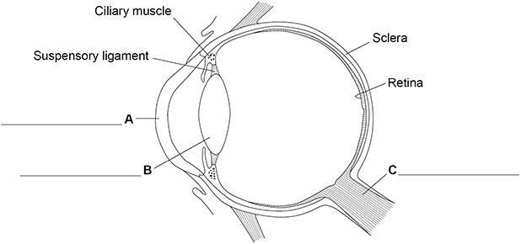
Q1.
The human eye can form images of objects that are at different distances away from the eye.
Figure 1 is a diagram of the eye.
Figure 1
(a) Label structures A, B and C on Figure 1. Choose answers from the box.
cornea | eyelid | iris | lens | optic nerve

Slide 41
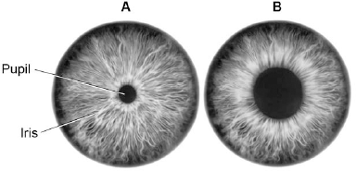
Q2.
Figure 1 shows a reflex in the iris of the human eye in response to changes in light levels.
Figure 1
(a) Describe the changes in the pupil and iris going from A to B in Figure 1.
Explain how these changes occur.
Refer to the changes in light level in your answer. (4 marks)
………………………………………………………………………………………………………………………………………………………………………………………………………………………………………………………………………………………………………………………………………………………………………………………………………………………………………………………………………………………………………………………………………………………………………………………………………………………………………………………………………………………………………………………………………………………………………………………………………………………………………………………………………………………………………………………………………………………………………………………………………………………………………………………………………………………………………………………………………………………………………………………………………………………………………………………………………………………………………………………………………………………………………………………………………………………………………………………………………………………………………………………………………………………………………………………………………………………………………………………………………………………………

Slide 42
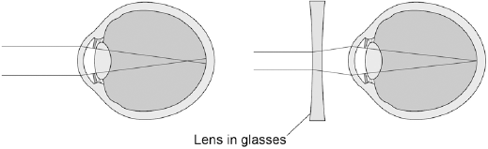
Q2.
(b) Some people wear glasses to improve their vision.
Figure 2 shows light entering the eye in a person with blurred vision.
Figure 3 shows how this condition is corrected with glasses.
Figure 2 Figure 3
Compare Figure 2 and Figure 3.
Explain how the blurred vision is corrected. (2 marks)
………………………………………………………………………………………………………………………………………………………………………………………………………………………………………………………………………………………………………………………………………………………………………………………………………………………………………………………………………………………………………………………………………………………………………………………………………………………………………………………………………………………………………………………………………………………………………………………………………………………………………………………………………………………………………………………………………………………………………………………………………………………………………………………………………………………………………………………………………………………………………………………………………………………………………………………………………………………………………………………………………………………………………………………………………………………………………………………………………………………………………………………………………………………………………………………………………………………………………………………………………………………………

Slide 43
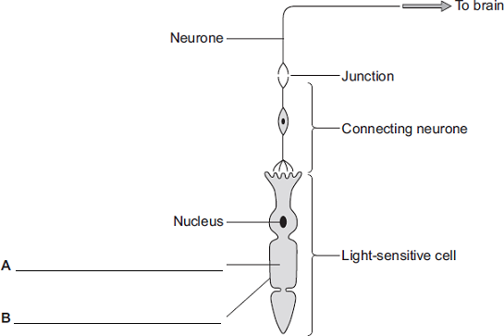
Q3.
Diagram 1 shows cells from the light-sensitive layer in the eye.
Diagram 1
A ………………………………………………………
B ………………………………………………………
(a) On Diagram 1, add labels to name part A and part B of the light-sensitive cell.
(2)
(b) There is a junction between the connecting neurone and the neurone carrying the
impulse to the brain.
(i) What name is given to the junction?
………………………………………………………………………………………………………………………………………..
(1)
(ii) In what form is information passed across the junction?
………………………………………………………………………………………………………………………………………..
………………………………………………………………………………………………………………………………………..
(1)

Slide 44
Subtopic 3: 4.5.2.4 Biology only: Control of body temperature
Learning Objective
To understand how the human body responds to changes in temperature.
Why are we learning about this?
This lessons helps us understand why our body performs certain functions in different conditions e.g. sweating and shivering.

Slide 45
1 2 3 4 5 6 7 8 9 10 11 12 13 14 15 16 17 18 19 20 21 22 23 24 25 26 27 28 29 30 | Automatic responses The conditions inside our body must be carefully controlled to allow it to function effectively. Homeostasis is the maintenance of a constant internal environment in the body. The nervous system and hormones are responsible for controlling this. The body control systems are all automatic, and involve both nervous and chemical responses. It has many important parts, including: Receptors detect a stimulus, which is a change in the environment, such as temperature change Coordination centres in the brain, spinal cord and pancreas. They receive messages from the receptors, process the information and sends messages to effectors to initiate a response.. Effectors, such as muscles or glands create the response. Glands often release a hormone, which would restore the optimum condition again. Body temperature Body temperature is one of the factors that is controlled during homeostasis. The human body maintains the temperature that enzymes work best, which is around 37°C. If body temperature increases over this temperature, enzymes will denature and become less effective at catalysing important reactions, such as respiration. At temperatures below 37ºC, the rate of enzyme activity would decrease. This process is controlled by the thermoregulatory centre, which is contained in the hypothalamus in the brain. The thermoregulatory contains receptors that measure the temperature of the blood. Temperature receptors are also found in the skin. The thermoregulatory centre responds to this messages from receptors by sending nerve impulses to effectors.

Slide 46
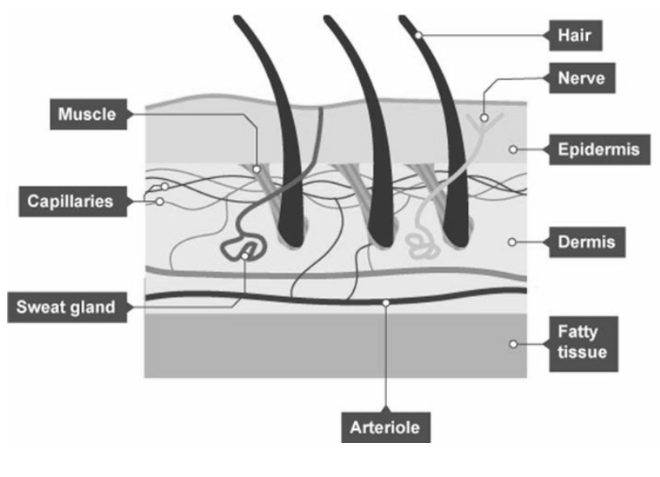
1 2 3 4 5 6 7 8 9 10 11 12 13 14 15 16 17 18 19 20 21 22 23 24 25 26 27 28 29 30 | The skin As previously stated, the skin contains receptors (nerves) sensitive to temperature. It is also made of three layers: the epidermis, the dermis, and a layer of fatty tissue. Structures within these layers are involved in the thermoregulatory process: Too hot When we get too hot: Sweat glands in the dermis release more sweat onto the surface of the epidermis. The sweat evaporates, transferring energy from the thermal store of the skin to the thermal store of the environment. Too cold When we get too cold: Skeletal muscles contract rapidly and we shiver. These contractions need energy from respiration. Energy is transferred from the chemical store of glucose (mainly) to the thermal store of the body. Nerve impulses are sent to the hair erector muscles in the dermis, which contract. This raises the skin hairs and traps a layer of insulating air next to the skin.

Slide 47
Rehearsal questions
What are receptors? …………………………………………………………………………………………………................. …………………………………………………………………………………………………………………………………………………..
When we get too hot or too cold, receptors send messages to the hypothalamus, the coordination centre. What do coordination centres do? ………………………………………………….......... …………………………………………………………………………………………………………………………………………………..
When we get too cold, one of the responses our body has is to shiver. Which structure in our body causes this to happen? …………………………………………………………………………………………………….
When we get too hot, we start to sweat. Which structure in our skin causes this to happen? …………………………………………………………………………………………………………………………………..................
The human body contains receptors sensitive to temperature in the skin and in the thermoregulatory (part of the brain). What do these receptors do? ………………………………………………………………………………………………………………………………………………….. …………………………………………………………………………………………………………………………………………………..
Shivering is one way our body tries to increase its temperature. What causes shivering? …………………………………………………………………………………………………………………………………………………..
A coordination centre receives and processes information from receptors. What is the coordination centre in thermoregulation? ………………………………………………………………………………..
Our skin contains glands that help to cool us down. What is the function of these glands? ………………………………………………………………………………………………………………………………………………....
How do humans detect changes in their environment? ……………………………………………………………. …………………………………………………………………………………………………………………………………………………..
Humans cannot respond to changes in their environment without first processing the information about that change. What does this? ………………………………………………………………………
What response would occur if someone found themselves in a very cold environment? …………………………………………………………………………………………………………………………………………………..
The human body does not work as effectively over 37 ºC. How might the body cool itself down? ……………………………………………………………………………………………………………………………………….

Slide 48
If it didn’t questions
I DO: How might a person’s response to temperature be different if they didn’t have receptors sensitive to temperature?
………………………………………………………………………………………………………………………………………………………………………………………………………………………………………………………………………………………………………………………………………………………………………………………………………………………………………………………………………
WE DO: How might a person’s response to temperature be different if they didn’t have a thermoregulatory (coordination centre)?
………………………………………………………………………………………………………………………………………………………………………………………………………………………………………………………………………………………………………………………………………………………………………………………………………………………………………………………………………
YOU DO: How might a person’s response to temperature be different if they didn’t have sweat glands?
………………………………………………………………………………………………………………………………………………………………………………………………………………………………………………………………………………………………………………………………………………………………………………………………………………………………………………………………………
YOU DO: How might a person’s response to temperature be different if their skeletal muscles couldn’t contract rapidly?
………………………………………………………………………………………………………………………………………………………………………………………………………………………………………………………………………………………………………………………………………………………………………………………………………………………………………………………………………
YOU DO: How might a person’s response to temperature be different if they didn’t have hair erector muscles in their skin?
………………………………………………………………………………………………………………………………………………………………………………………………………………………………………………………………………………………………………………………………………………………………………………………………………………………………………………………………………
YOU DO: How might a person’s body be affected if they couldn’t maintain an internal temperature of 37 ºC?
………………………………………………………………………………………………………………………………………………………………………………………………………………………………………………………………………………………………………………………………………………………………………………………………………………………………………………………………………

Slide 49
Wrong answers
I DO: “Receptors are the same as any other nerve cell”. Explain why this statement is incorrect.
………………………………………………………………………………………………………………………………………………………………………………………………………………………………………………………………………………………………………………………………………………………………………………………………………………………………………………………………………
WE DO: “Receptors just send messages to effectors to tell them what to do”. Explain why this statement is incorrect.
………………………………………………………………………………………………………………………………………………………………………………………………………………………………………………………………………………………………………………………………………………………………………………………………………………………………………………………………………
YOU DO: “Sweating will cool you down because liquids on your skin make you cooler”. Explain why this statement is incorrect.
………………………………………………………………………………………………………………………………………………………………………………………………………………………………………………………………………………………………………………………………………………………………………………………………………………………………………………………………………
YOU DO: “Body hairs have no use. They are just left over from when we were less evolved”. Explain why this statement is incorrect.
………………………………………………………………………………………………………………………………………………………………………………………………………………………………………………………………………………………………………………………………………………………………………………………………………………………………………………………………………
YOU DO: “Enzymes only work at 37 ºC”. Explain why this statement is incorrect.
………………………………………………………………………………………………………………………………………………………………………………………………………………………………………………………………………………………………………………………………………………………………………………………………………………………………………………………………………
YOU DO: “People can live in hot countries or cold countries so our body temperature isn’t important”. Explain why this statement is incorrect.
………………………………………………………………………………………………………………………………………………………………………………………………………………………………………………………………………………………………………………………………………………………………………………………………………………………………………………………………………

Slide 50
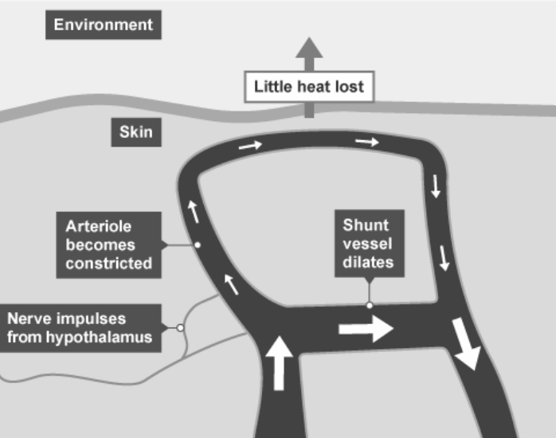
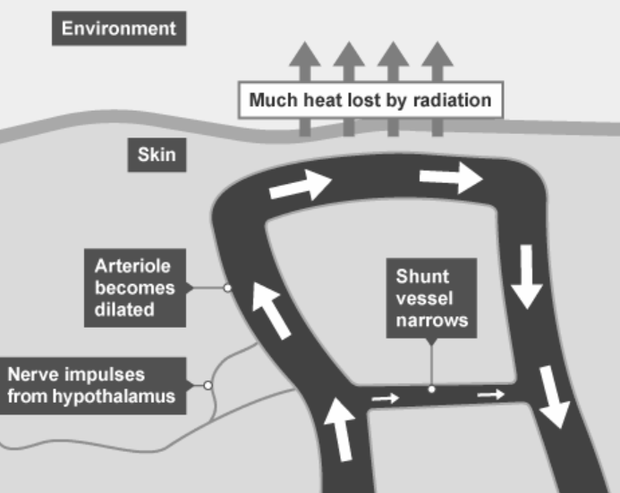
1 2 3 4 5 6 7 8 9 10 11 12 13 14 15 16 17 18 19 20 21 22 23 24 25 26 27 28 29 30 | Vasoconstriction and vasodilation Blood vessels supplying blood to the skin can swell or dilate - vasodilation. This causes more thermal energy to be carried by the blood to the skin, where it can be transferred to the air. Blood vessels can shrink down again - vasoconstriction. This reduces heat loss through the skin once the body’s temperature has returned to normal. Vasoconstriction – A response to being too cold. Vasodilation – A response to being too hot.

Slide 51
Rehearsal questions
Blood vessels can dilate when the body becomes too hot. What is this called? …………………………………………………………………………………………………………………………………………………..
Blood vessels can also shrink if the body becomes too cold. What is this called? …………………………………………………………………………………………………………………………………………………..
The dilation of blood vessels causes more blood to flow to the skin’s surface. What effect does this have? ………………………………………………………………………………………………………………………………….
The constriction of blood vessels reduces blood flow to the skin’s surface. What effect does this have? ………………………………………………………………………………………………………………………………….
Vasoconstriction is one way the body responds to changes in body temperature. What is vasoconstriction? ……………………………………………………………………………………………………………………... …………………………………………………………………………………………………………………………………………………..
Vasodilation is a different response to a change in body temperature. What is vasodilation? ……………………………………………………………………………………………………………........................................
How does the reduction of blood flow to the skin’s surface affect the body’s temperature? ……………………………………………………………………………………………………………........................................
How does an increase in blood flow to the skin’s surface affect the body’s temperature? ……………………………………………………………………………………………………………........................................
What stimulus is required for vasodilation? ………………………………………………………………………………
What stimulus is required for vasoconstriction? ……………………………………………………………………….
How does the constriction of blood vessels affect the blood flow to the skin’s surface? ……………………………………………………………………………………………………………........................................
How does the dilation of blood vessels affect the blood flow to the skin’s surface? ……………………………………………………………………………………………………………........................................

Slide 52
Contrasting concepts
I DO: Compare the stimuli required to cause vasoconstriction and vasodilation.
…………………………………………………………………………………………………………….............................................. …………………………………………………………………………………………………………….............................................. ……………………………………………………………………………………………………………..............................................
WE DO: Compare the effect on vasodilation and vasoconstriction on blood flow to the skins surface.
…………………………………………………………………………………………………………….............................................. …………………………………………………………………………………………………………….............................................. ……………………………………………………………………………………………………………..............................................
YOU DO: Compare the effect of vasodilation and vasoconstriction on heat loss from the skin, and therefore their effect on body temperature.
…………………………………………………………………………………………………………….............................................. …………………………………………………………………………………………………………….............................................. ……………………………………………………………………………………………………………..............................................
YOU DO: Compare the mechanisms of vasodilation and sweating, in terms of cooling the body.
…………………………………………………………………………………………………………….............................................. …………………………………………………………………………………………………………….............................................. …………………………………………………………………………………………………………….............................................. …………………………………………………………………………………………………………….............................................. ……………………………………………………………………………………………………………..............................................
YOU DO: Compare the mechanisms of vasoconstriction and shivering, in terms of warming the body.
…………………………………………………………………………………………………………….............................................. …………………………………………………………………………………………………………….............................................. …………………………………………………………………………………………………………….............................................. …………………………………………………………………………………………………………….............................................. ……………………………………………………………………………………………………………..............................................

Slide 53
Interleaving questions
We are currently learning about how the body controls its temperature. This links in to the following key topics: Energy, cells and organisation, chemical reactions, particles.
The following questions will link our current topic with these previous topics:
Shivering is a technique caused by the skeletal muscle tissues contracting rapidly. What is the definition of a tissue? ……………………………………………………………………………………………………………..............................................…………………………………………………………………………………………………………….........................…......
In order to contract, each muscle cell will require energy. What process will be used to release this energy? ………………………………………………………………………………………………………………………………
Which organelle in each muscle cell will carry out the process from question 2? …………………………………………………………………………………………………………………………………………………..
Write the word equation for the process from question 2. …………………………………………………………………………………………………………………………………………………..
Another way the body tries to warm itself up is by raising body hairs to trap an insulating layer of air close to the skin. Draw a particle diagram of the particles in the air.
Using your diagram from question 5, explain why air is an insulator. …………………………………………………………………………………………………………….................................................................................................................................................................................................
When the body sweats, energy is transferred from the body to the sweat. Which energy store in the sweat will be increasing? …………………………………………………………………………………………………
It takes a lot of energy to evaporate sweat; its specific latent heat of vaporisation is 2.4 x 10⁶ J/kg. What is specific latent heat of vaporisation? …………………………………………………………………………………………………………….................................................................................................................................................................................................

Slide 54
Interleaving questions - continued
Sweat is made mostly of water. Which organ of the body absorbs water? …………………………………………………………………………………………………………………………………………………..
When water is absorbed, it moves by osmosis. What is the definition of osmosis? …………………………………………………………………………………………………………….................................................................................................................................................................................................
Vasodilation increases the amount of energy being lost to the surroundings. Which energy pathway will the energy be using when it is transferred? ……………………………………………………………………………………………………………........................................
Vasodilation increases blood flow to the surface of the skin. What are the four components that make up the blood? …………………………………………………………………………………………………………….................................................................................................................................................................................................

Slide 55
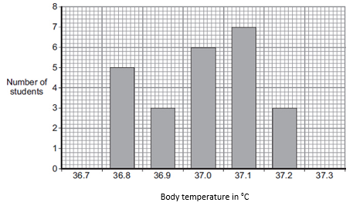
Exam questions – Tier 1
Q1. The body controls internal conditions.
Use words from the box to complete the sentences about water loss from the body.
(i) Water is lost in sweat via the ………………………………………………
(1)
(ii) Water is lost in urine via the ……………………………………………….
(1)
(iii) Water is lost in the breath via the ……………………………………….
(1)
(b) Students investigated body temperature in the class. The bar chart shows the results.
(i) One student used the bar chart to calculate the mean body temperature of the class. The student calculated the mean body temperature as 37.0 °C.
How did the student use the bar chart to calculate the mean?
……………………………………………………………………………………………………………………………………………………
……………………………………………………………………………………………………………………………………………………
……………………………………………………………………………………………………………………………………………………
……………………………………………………………………………………………………………………………………………………
(2)
kidneys | liver | lungs | skin

Slide 56
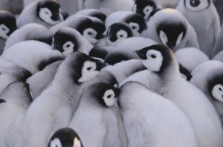
(ii) How many students had a body temperature higher than the mean of 37.0 °C
……………………………………………………………………………………………………………………………………………………
(1)
(iii) Body temperature must be kept within a narrow range.
  Why?
……………………………………………………………………………………………………………………………………………………
……………………………………………………………………………………………………………………………………………………
(1)
(Total 7 marks)
Exam questions – Tier 2
(b) The Antarctic winter is very cold. In the winter some species of penguin huddle together as shown in Photograph 2.
Photograph 2
© Fuse
Suggest how the behaviour shown in Photograph 2 helps the penguins to survive the Antarctic winter.
……………………………………………………………………………………………………………………………………………………
……………………………………………………………………………………………………………………………………………………
……………………………………………………………………………………………………………………………………………………
……………………………………………………………………………………………………………………………………………………
……………………………………………………………………………………………………………………………………………………
……………………………………………………………………………………………………………………………………………………
……………………………………………………………………………………………………………………………………………………
(3)

Slide 57
(c) A student did an investigation to model the behaviour of the penguins shown in Photograph 2. The diagram shows the apparatus the student used.
The student:
• held seven similar test tubes together with elastic bands as shown in the diagram
• stood a similar eighth tube in a test tube rack
• filled each of the eight tubes with hot water to the same level
• measured the temperature of the water in tubes A, B and C every 2 minutes for 20 minutes.
The table shows the student’s results.

Slide 58
(i) Give two variables that were controlled in the investigation.
  1. ……………………………………………………………………………………………………………………………………….
  2. ……………………………………………………………………………………………………………………………………….
(2)
(ii) Describe the patterns the data shows.
……………………………………………………………………………………………………………………………………………………
……………………………………………………………………………………………………………………………………………………
……………………………………………………………………………………………………………………………………………………
……………………………………………………………………………………………………………………………………………………
(2)
(iii) How far does the data from the model support the suggestion you made in part (b)?
……………………………………………………………………………………………………………………………………………………
……………………………………………………………………………………………………………………………………………………
……………………………………………………………………………………………………………………………………………………
……………………………………………………………………………………………………………………………………………………
(2)
(d) Describe how blood vessels help control human body temperature.
……………………………………………………………………………………………………………………………………………………
……………………………………………………………………………………………………………………………………………………
……………………………………………………………………………………………………………………………………………………
……………………………………………………………………………………………………………………………………………………
……………………………………………………………………………………………………………………………………………………
……………………………………………………………………………………………………………………………………………………
……………………………………………………………………………………………………………………………………………………
……………………………………………………………………………………………………………………………………………………
……………………………………………………………………………………………………………………………………………………
(4)

Slide 59
Exam questions – Tier 3
Q3. Humans keep their internal conditions almost constant. Body temperature is kept within a narrow range.
When the core body temperature is too low, this is detected by the thermoregulatory centre in the brain.
Describe how the body responds when a decrease in core body temperature is detected.
……………………………………………………………………………………………………………………………………………………
……………………………………………………………………………………………………………………………………………………
……………………………………………………………………………………………………………………………………………………
……………………………………………………………………………………………………………………………………………………
……………………………………………………………………………………………………………………………………………………
……………………………………………………………………………………………………………………………………………………
……………………………………………………………………………………………………………………………………………………
……………………………………………………………………………………………………………………………………………………
……………………………………………………………………………………………………………………………………………………
……………………………………………………………………………………………………………………………………………………
……………………………………………………………………………………………………………………………………………………
……………………………………………………………………………………………………………………………………………………
……………………………………………………………………………………………………………………………………………………
(Total 6 marks)

Slide 60
DO NOW
Date: ……………………………………….
 | ANSWER
Q1.
Q2.
Q3.
Q4.
Q5.
Date: ……………………………………….
 | ANSWER
Q1.
Q2.
Q3.
Q4.
Q5.

Slide 61
DO NOW
Date: ……………………………………….
 | ANSWER
Q1.
Q2.
Q3.
Q4.
Q5.
Date: ……………………………………….
 | ANSWER
Q1.
Q2.
Q3.
Q4.
Q5.

Slide 62
Knowledge Retrieval Quiz 1
Date: ……………………………………….
Score: …………...
 |  | Answer
Q1. | Insert question in bold
Q2.
Q3.
Q4.
Q5.
Q6.
Q7.
Q8.
Q9.
Q10.

Slide 63
Extra Space
……………………………………………………………………………………………………………………………………………………………………………………………………………………………………………………………………………………………………………………………………………………………………………………………………………………………………………………………………………………………………………………………………………………………………………………………………………………………………………………………………………………………………………………………………………………………………………………………………………………………………………………………………………………………………………………………………………………………………………………………………………………………………………………………………………………………………………………………………………………………………………………………………………………………………………………………………………………………………………………………………………………………………………………………………………………………………………………………………………………………………………………………………………………………………………………………………………………………………………………………………………………………………………………………………………………………………………………………………………………………………………………………………………………………………………………………..
…………………………………………………………………………………………………………………………………………………………………………………………………………………………………………………………………………………………………………………………………………………………………………………………………………………………………………………………………………………………………………………………………………………………………………………………………………………………………………………………………………………………………………………………………………………………………………………………………………………………………………………………………………………………………………………………………………………………………………………………………………………………………………………………………………………………………………………………………………………………………………………………………………………………………………………………………………………………………………………………………………………………………………………………………………………………………………………………………………………………………………………………………………………………………………………………………………………………………………………………………………………………………………………………………………………………………..
…………………………………………………………………………………………………………………………………………………………………………………………………………………………………………………………………………………………………………………………………………………………………………………………………………………………………………………………………………………………………………………………………………………………………………………………………………………………………………………………………………………………………………………………………………………………………………………………………

Slide 64
Extra Space
……………………………………………………………………………………………………………………………………………………………………………………………………………………………………………………………………………………………………………………………………………………………………………………………………………………………………………………………………………………………………………………………………………………………………………………………………………………………………………………………………………………………………………………………………………………………………………………………………………………………………………………………………………………………………………………………………………………………………………………………………………………………………………………………………………………………………………………………………………………………………………………………………………………………………………………………………………………………………………………………………………………………………………………………………………………………………………………………………………………………………………………………………………………………………………………………………………………………………………………………………………………………………………………………………………………………………………………………………………………………………………………………………………………………………………………………..
…………………………………………………………………………………………………………………………………………………………………………………………………………………………………………………………………………………………………………………………………………………………………………………………………………………………………………………………………………………………………………………………………………………………………………………………………………………………………………………………………………………………………………………………………………………………………………………………………………………………………………………………………………………………………………………………………………………………………………………………………………………………………………………………………………………………………………………………………………………………………………………………………………………………………………………………………………………………………………………………………………………………………………………………………………………………………………………………………………………………………………………………………………………………………………………………………………………………………………………………………………………………………………………………………………………………………..
…………………………………………………………………………………………………………………………………………………………………………………………………………………………………………………………………………………………………………………………………………………………………………………………………………………………………………………………………………………………………………………………………………………………………………………………………………………………………………………………………………………………………………………………………………………………………………………………………

Slide 65
Extra Space
……………………………………………………………………………………………………………………………………………………………………………………………………………………………………………………………………………………………………………………………………………………………………………………………………………………………………………………………………………………………………………………………………………………………………………………………………………………………………………………………………………………………………………………………………………………………………………………………………………………………………………………………………………………………………………………………………………………………………………………………………………………………………………………………………………………………………………………………………………………………………………………………………………………………………………………………………………………………………………………………………………………………………………………………………………………………………………………………………………………………………………………………………………………………………………………………………………………………………………………………………………………………………………………………………………………………………………………………………………………………………………………………………………………………………………………………..
…………………………………………………………………………………………………………………………………………………………………………………………………………………………………………………………………………………………………………………………………………………………………………………………………………………………………………………………………………………………………………………………………………………………………………………………………………………………………………………………………………………………………………………………………………………………………………………………………………………………………………………………………………………………………………………………………………………………………………………………………………………………………………………………………………………………………………………………………………………………………………………………………………………………………………………………………………………………………………………………………………………………………………………………………………………………………………………………………………………………………………………………………………………………………………………………………………………………………………………………………………………………………………………………………………………………………..
…………………………………………………………………………………………………………………………………………………………………………………………………………………………………………………………………………………………………………………………………………………………………………………………………………………………………………………………………………………………………………………………………………………………………………………………………………………………………………………………………………………………………………………………………………………………………………………………………

Slide 66
Extra Space
……………………………………………………………………………………………………………………………………………………………………………………………………………………………………………………………………………………………………………………………………………………………………………………………………………………………………………………………………………………………………………………………………………………………………………………………………………………………………………………………………………………………………………………………………………………………………………………………………………………………………………………………………………………………………………………………………………………………………………………………………………………………………………………………………………………………………………………………………………………………………………………………………………………………………………………………………………………………………………………………………………………………………………………………………………………………………………………………………………………………………………………………………………………………………………………………………………………………………………………………………………………………………………………………………………………………………………………………………………………………………………………………………………………………………………………………..
…………………………………………………………………………………………………………………………………………………………………………………………………………………………………………………………………………………………………………………………………………………………………………………………………………………………………………………………………………………………………………………………………………………………………………………………………………………………………………………………………………………………………………………………………………………………………………………………………………………………………………………………………………………………………………………………………………………………………………………………………………………………………………………………………………………………………………………………………………………………………………………………………………………………………………………………………………………………………………………………………………………………………………………………………………………………………………………………………………………………………………………………………………………………………………………………………………………………………………………………………………………………………………………………………………………………………..
…………………………………………………………………………………………………………………………………………………………………………………………………………………………………………………………………………………………………………………………………………………………………………………………………………………………………………………………………………………………………………………………………………………………………………………………………………………………………………………………………………………………………………………………………………………………………………………………………

Slide 67
Extra Space
……………………………………………………………………………………………………………………………………………………………………………………………………………………………………………………………………………………………………………………………………………………………………………………………………………………………………………………………………………………………………………………………………………………………………………………………………………………………………………………………………………………………………………………………………………………………………………………………………………………………………………………………………………………………………………………………………………………………………………………………………………………………………………………………………………………………………………………………………………………………………………………………………………………………………………………………………………………………………………………………………………………………………………………………………………………………………………………………………………………………………………………………………………………………………………………………………………………………………………………………………………………………………………………………………………………………………………………………………………………………………………………………………………………………………………………………..
…………………………………………………………………………………………………………………………………………………………………………………………………………………………………………………………………………………………………………………………………………………………………………………………………………………………………………………………………………………………………………………………………………………………………………………………………………………………………………………………………………………………………………………………………………………………………………………………………………………………………………………………………………………………………………………………………………………………………………………………………………………………………………………………………………………………………………………………………………………………………………………………………………………………………………………………………………………………………………………………………………………………………………………………………………………………………………………………………………………………………………………………………………………………………………………………………………………………………………………………………………………………………………………………………………………………………..
…………………………………………………………………………………………………………………………………………………………………………………………………………………………………………………………………………………………………………………………………………………………………………………………………………………………………………………………………………………………………………………………………………………………………………………………………………………………………………………………………………………………………………………………………………………………………………………………………

Slide 68
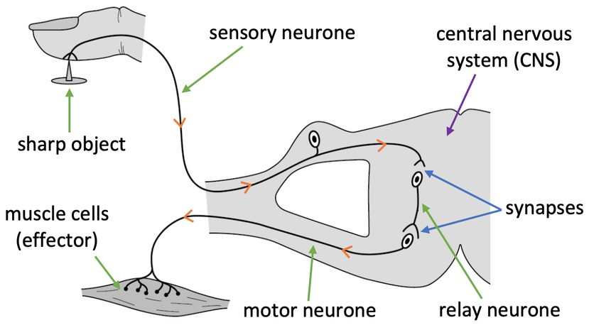
KNOWLEDGE ORGANISER
Subject: Science | Topic: Homeostasis & response | Term: Autumn
KEY WORDS | Key words
1 | Homeostasis | Homeostasis is the regulation of internal conditions to maintain optimal conditions for enzyme action and cell function.
2 | Nervous system | The nervous system enables humans to react to their surroundings and to coordinate their behaviour.
3 | Endocrine system | The endocrine system is composed of glands which secrete chemicals called hormones directly into the bloodstream.
4 | Reproduction | The process by which offspring are produced by parents.
5 | Hormone | Chemical messengers produced by glands.
KEY EXAMPLES
6 | Reflex actions | Automatic and rapid responses to stimuli.
7 | Puberty | Physical changes caused by hormones resulting in sexual maturity.
8 | Menstrual cycle | Recurring series of events in the human female reproductive system.
9 | Phototropism | A plants response to light.
10 | Gravitropism | A plants response to gravity.
KEY DIAGRAMS

