Slide 1
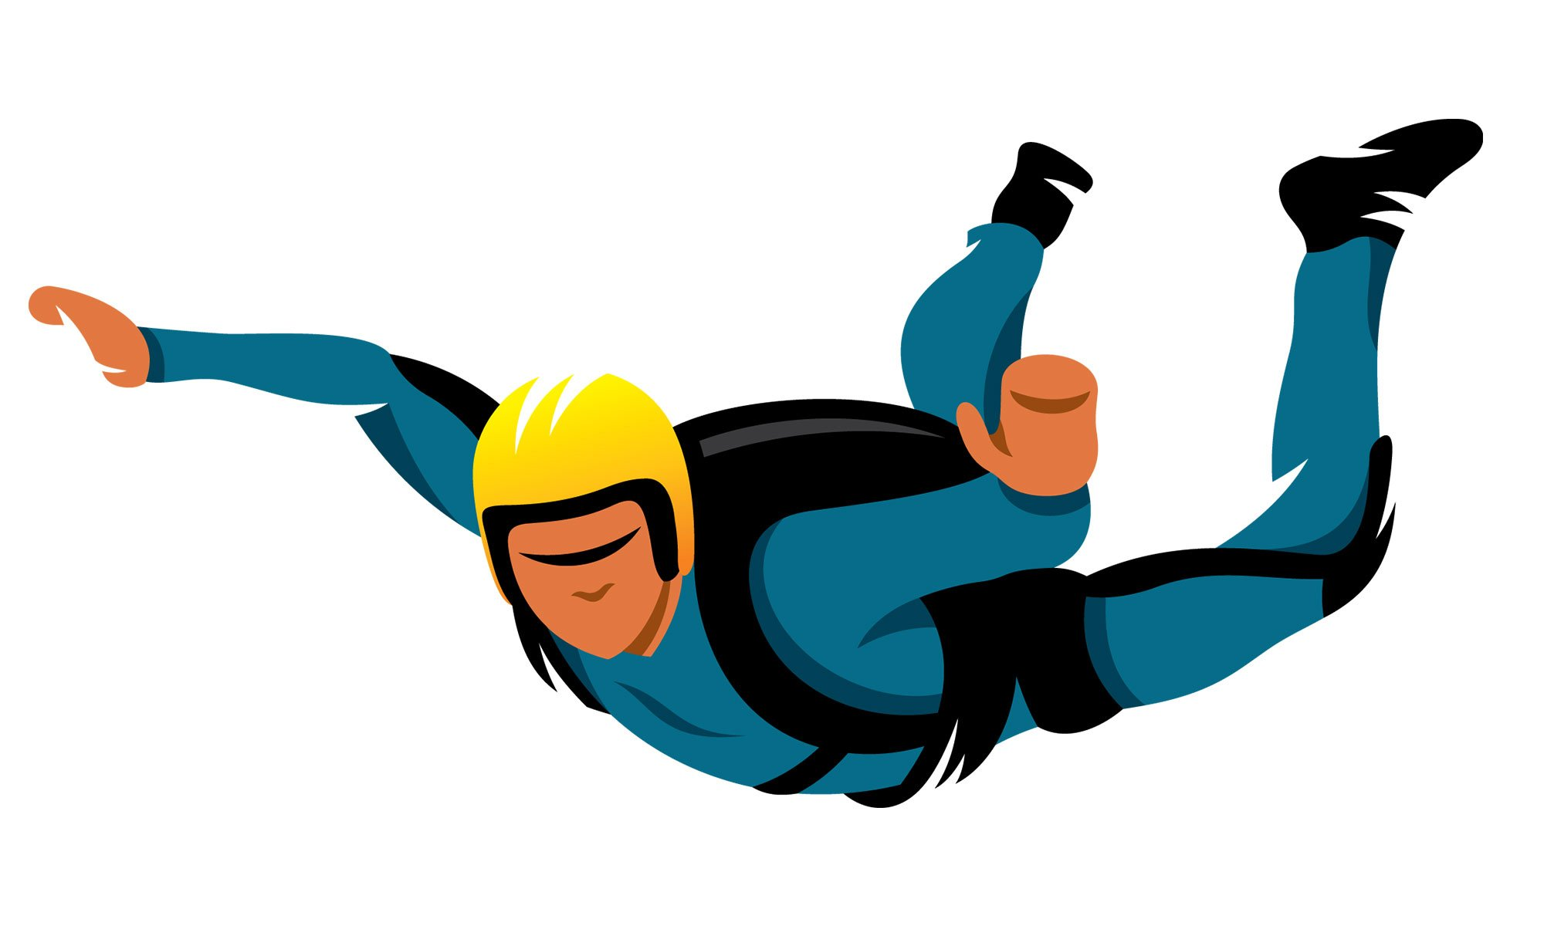
Year 11 Student Booklet B – Forces 2
Name
Class
Tutor Group
KS4 Science YEAR 11 Forces 2
KEYSTONE WORDS
Force | A push or a pull that changes the shape, direction or speed of an object.
Scalar | A quantity that has magnitude only.
Vector | A quantity that has a magnitude and a direction.
Balanced forces | Forces that have equal magnitude but opposite directions.
Momentum | A vector quantity that is the product of an objects mass and velocity.

Slide 2
BIG PICTURE
How will my prior knowledge develop my understanding of this topic?
Y7 | In year 7 you studied Speed and Forces. You learnt how to estimate and calculate speed. You also learnt about types of forces and how they interact and how to represent forces in diagrams.
Learning Journey
Subtopic 1 | Speed & Velocity. | Subtopic 9 | Required practical.
Subtopic 2 | The distance – time relationship. | Subtopic 10 | Required practical.
Subtopic 3 | Acceleration. | Subtopic 11 | Newton’s third law.
Subtopic 4 | The velocity – time relationship. | Subtopic 12 | Stopping distances.
Subtopic 5 | Newton’s first law. | Subtopic 13 | Momentum.
Subtopic 6 | Uniform acceleration & terminal velocity. | Subtopic 14 | Changes in momentum.
Subtopic 7 | Terminal velocity. | Subtopic 15
Subtopic 8 | Newton’s second law (F = ma). | Subtopic 16

Slide 3
Key knowledge
By the end of this topic you should know… | How to calculate speed using numerical and graphical data. How to calculate acceleration from numerical and graphical data. Newton’s Laws of Motion and be able to apply them in novel situations. The definition of stopping distance and how they relate to braking forces and driver reaction times. Describe the motion of an object using momentum and know how to use related concepts in different situations.
By the end of this topic should be able to… | Draw and interpret distance-time and velocity-time graphs. Interpret data related to stopping distances. Apply calculations to different situations involving forces.
How will this knowledge develop my understanding of future topics?
This topic develops skills that are used in many parts of the Science curriculum. For example, risk assessments, identifying variables and evaluating data. The underlying theory taught in this topic is revisited in several topics that include Magnetism and electromagnetism and Space Physics (separate scientists only).

Slide 4
KEY VOCABULARY LIST
Acceleration | The rate of change of velocity.
Braking Distance | The distance a vehicle travels under the braking force.
Conservation of Momentum | The total momentum of a system before an event is always equal to the total momentum after the event.
Inertia | The tendency of an object to remain in its same state of uniform motion or rest.
Momentum | The product of an object’s mass and velocity.
Stopping Distance | The sum of the thinking and braking distances.
Thinking Distance | The distance a vehicle travels during the driver’s reaction time.
EXPECTATIONS
Always write in black or blue pen. Always use a ruler for straight lines. If you make a mistake, cross it out with a single line. Always draw diagrams, tables and graphs in pencil with a ruler if necessary Always mark and correct your work in green pen. Respond to any feedback your teacher gives you in green pen. Take pride in your work, make it neat! All tasks should be completed in silence and by yourself unless your teacher tells you otherwise.
PROUD
Punctuation and grammar
Ruler and pencil for diagrams
Outstanding effort every lesson
Underline date and title
Dates and titles every lesson
PROUD FRIDAY
Any piece of work you complete, which meets our PROUD expectations can be taken to the PROUD station during Friday lunchtime. Show your work to a member of SLT and receive a sweet treat!

Slide 5
Subtopic 8: Newton’s second law (F = ma).
Learning Objective
You are learning to apply the relationship between force, mass and acceleration.
Why are we learning about this?
This lessons helps us understand why some objects, like formula one cars, accelerate very quickly whilst others accelerate slowly. This information is used in a variety of sports (e.g. judo, Olympic weightlifting and golf) and industries (e.g. design of high performance cars).

Slide 6
1 2 3 4 5 6 7 8 9 10 11 12 13 14 15 16 17 18 19 20 21 22 23 24 25 | The second of Isaac Newton’s 3 Laws of motion describes the relationship between force, mass and acceleration. Newton derived that if the mass of an object remains constant then if there is a resultant force acting on it, it will accelerate. If there is no resultant force, the object will not be accelerated (its velocity will remain unchanged). The larger the resultant force is, the faster the object will accelerate, a proportional relationship (as per diagram A). If two objects with different mass have the same resultant force applied to them, then the object with the larger mass will accelerate less quickly. This relationship between mass and acceleration, where resultant force remains constant, is described as being inversely proportional (as per diagram B). The ratio of force over acceleration is known as inertial mass. This describes how difficult it is to change the velocity of an object. Objects with a greater mass have a greater inertia so a greater resultant force is required to make them accelerate Newton’s Second Law of motion can be described with the equation: F = m x a F = force (Newtons, N) m = mass (kilograms, kg) a = acceleration (metres per second squared, m/s²)

Slide 7
Subtopic 8: Newton’s second law (F = ma).
Diagram A
100N
200N
A
100N
1000N
B
Annotate the diagrams to support the explanation on the previous page.
Higher tier scholars should explain how diagram B demonstrates inertial mass.
Diagram B
A
Mass = 1000kg
B
Mass = 5000kg
……………………………………………………………………………………………………………………………………………………………………………………………………………………………………………………………………………………………………………………………………………………………………………………………………………………………………………………………………………………………………………………………………………………………………………………………….

Slide 8
Subtopic 8: Newton’s second law (F = ma).
As previously mentioned the equation F = m x a, or F = ma, summarises Newtons second law
I do:
An object with a mass of 2 kg accelerates 2 m/s² when an unknown force is applied to it. What is the force?
Step 1: Write out the equation: F = m x a
Step 2: insert your values: F = 2 x 2
Step 3: calculate: F = 4N
We do:
An object with a mass of 1.5kg accelerates 10 m/s² when an unknown force is applied to it. What is the force?
Step 1: Write out the equation:
Step 2: insert your values:
Step 3: calculate:
Calculate the force required to accelerate a 5kg mass at 10m/s².
Step 1: Write out the equation:
Step 2: insert your values:
Step 3: calculate:
F = m x a
F = 1.5 x 10
F = 15N
F = m x a
F = 5 x 10
F = 50N

Slide 9
Subtopic 8: Newton’s second law (F = ma).
You do:
Mass = 1.5kg, acceleration = 7.5 m/s²
……………………………………………………………………………………………………………………………………………………………………………………………………………………………………………………………………………………………………………………………………………………………………………………………………………………………………………………………………………………………………………………………………………………………………………………………………………………
Acceleration = 2.5 m/s², mass = 0.5kg
……………………………………………………………………………………………………………………………………………………………………………………………………………………………………………………………………………………………………………………………………………………………………………………………………………………………………………………………………………………………………………………………………………………………………………………………………………………
Mass = 40,000g, acceleration = 63 m/s²
……………………………………………………………………………………………………………………………………………………………………………………………………………………………………………………………………………………………………………………………………………………………………………………………………………………………………………………………………………………………………………………………………………………………………………………………………………………
Acceleration = 12 m/s², mass = 4951g
……………………………………………………………………………………………………………………………………………………………………………………………………………………………………………………………………………………………………………………………………………………………………………………………………………………………………………………………………………………………………………………………………………………………………………………………………………………
Mass = 25g, acceleration = 50 m/s²
……………………………………………………………………………………………………………………………………………………………………………………………………………………………………………………………………………………………………………………………………………………………………………………………………………………………………………………………………………………………………………………………………………………………………………………………………………………

Slide 10
Subtopic 8: Newton’s second law (F = ma).
Rearrange F = m x a to make both mass and acceleration the subject:
m =
a =
F ÷ a
F ÷ m
We do:
Gravity accelerates an object at 9.8m/s² and a gives it a weight (force) of 680N. What is the objects mass?
Step 1: write out the equation:
Step 2: insert your values:
Step 3: rearrange:
Step 4: calculate:
The recently invented plasma engine is designed to accelerate small spacecraft to the stars. The engine provides 8.0N of thrust on a spacecraft of mass 600g. Calculate the acceleration.
Step 1: write out the equation:
Step 2: insert your values:
Step 3: rearrange:
Step 4: calculate:
F = m x a
680 = m x 9.8
m = 680 ÷ 9.8
m = 69.39kg
F = m x a
8.0 = 0.6 x a
a = 8.0 ÷ 0.6
a = 13.33m/s²

Slide 11
Subtopic 8: Newton’s second law (F = ma).
You do:
Work out the mass in each of the following:
acceleration = 5 m/s², force = 12N
……………………………………………………………………………………………………………………………………………………………………………………………………………………………………………………………………………………
…………………………………………………………………………………………………………………………………………
acceleration = 25 m/s², force = 200N
……………………………………………………………………………………………………………………………………………………………………………………………………………………………………………………………………………………
…………………………………………………………………………………………………………………………………………
acceleration = 15 m/s², force = 3N
……………………………………………………………………………………………………………………………………………………………………………………………………………………………………………………………………………………
…………………………………………………………………………………………………………………………………………
Work out the acceleration in each of the following:
force = 20N, mass = 5kg
……………………………………………………………………………………………………………………………………………………………………………………………………………………………………………………………………………………
…………………………………………………………………………………………………………………………………………
force = 7N, mass = 14kg
……………………………………………………………………………………………………………………………………………………………………………………………………………………………………………………………………………………
…………………………………………………………………………………………………………………………………………
force = 2,000N, mass = 1250kg
………………………………………………………………………………………………………………………………………………………………………………………………………………………………………………………………………………………………………………………………………………………………………………………………………………………………

Slide 12
Subtopic 8: Newton’s second law (F = ma).
What is the force if the mass is 3.5 kg and the acceleration is 80 m/s²
………………………………………………………………………………………………………………………………………………………………………………………………………………………………………………………………………………………………………………………………………………………………………………………………………………………………………………………………………
What is the force if the mass is 800 kg and the acceleration is 60 m/s²?
………………………………………………………………………………………………………………………………………………………………………………………………………………………………………………………………………………………………………………………………………………………………………………………………………………………………………………………………………
What is the mass if the force is 90 N and the acceleration is 80m/s²?
………………………………………………………………………………………………………………………………………………………………………………………………………………………………………………………………………………………………………………………………………………………………………………………………………………………………………………………………………
What is the mass if the force is 20 N and the acceleration is 80 m/s²?
………………………………………………………………………………………………………………………………………………………………………………………………………………………………………………………………………………………………………………………………………………………………………………………………………………………………………………………………………
What is the force if the mass is 40 kg and the acceleration is 23 m/s²?
………………………………………………………………………………………………………………………………………………………………………………………………………………………………………………………………………………………………………………………………………………………………………………………………………………………………………………………………………
What is the acceleration if the force is 74 N and the mass is 655 kg?
……………………………………………………………………………………………………………………………………………………………………………………………………………………………………………………………………………………………………………………………………………………………………………………………………………………………………………………………………..

Slide 13
Subtopic 8: Newton’s second law (F = ma).
Q1.
The table contains typical data for an oil tanker.
(i) Write down the equation which links acceleration, force and mass.
………………………………………………………………………………………………………………………………………….....
(1)
(ii) Calculate the deceleration of the oil tanker. Show clearly how you work out your answer.
……………………………………………………………………………………………………………………………………………………………………………………………………………………………………………………………………………………………………………………………………………………………………………………………………………………………………………..
Deceleration = ………………………………………. m/s²
(2)
(Total 3 marks)

Slide 14
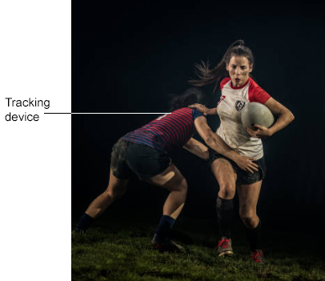
Subtopic 8: Newton’s second law (F = ma).
Q2.
Professional rugby players wear a tracking device that measures their velocity and acceleration.
Figure 1 shows a player wearing a tracking device.
The player is tackling another player who is running with the ball.
Figure 1
(a) Velocity and acceleration are both vector quantities.
What is a vector quantity?
Tick (✓) one box.
(1)
A quantity with both magnitude and direction
A quantity with direction only
A quantity with magnitude only
(b) Which of the following is a vector quantity?
Tick (✓) one box.
(1)
Displacement
Distance
Time
Work done

Slide 15
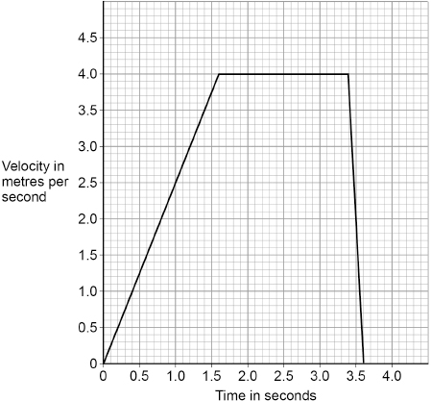
Subtopic 8: Newton’s second law (F = ma).
Figure 2 shows a velocity–time graph for the player running with the ball.
Figure 2
(c) Determine the acceleration of the player between 0 and 1.6 s.
………………………………………………………………………………………………………………………………………………………………………………………………………………………………………………………………………………………………………………………………………………………………………………………………………………………………………………………………………………………………………
Acceleration = …………………………….m/s²
(2)
(d) Describe the motion of the player between 3.4 s and 3.6 s.
…………………………………………………………………………………………………………………………………………………………………………………………………………………………………………………………………………………………………………………………………..
(1)
The force exerted on the player when she is tackled causes her to accelerate.
(e) Write down the equation which links acceleration (a), mass (m) and resultant force (F).
…………………………………………………………………………………………………………………………………………………………(1)

Slide 16
Subtopic 8: Newton’s second law (F = ma).
(f) The player accelerates at 25 m/s² when a resultant force of 1800 N acts on her.
Calculate the mass of the player.
……………………………………………………………………………………………………………………………………………………………………………………………………………………………………………………………………………………………………………………………………………………………………………………………………………………………………………………………………………………………………………………………………………………………………………………………………………………………………………………………………………………………………………………………………………………………
Mass =…………………………… kg
(3)
(g) The tracking device sends data to a computer during the game.
……………………………………………………………………………………………………………………………………………………………………………………………………………………………………………………………………………………………………
(1)
(Total 10 marks)

Slide 17
Subtopic 8: Newton’s second law (F = ma).
Q3.
The diagram shows a boat pulling a water skier.
(a) The arrow represents the force on the water produced by the engine propeller. This force causes the boat to move.
Explain why.
……………………………………………………………………………………………………………………………………………………………………………………………………………………………………………………………………………………………………………………………………………………………………………………………………………………………………………………………………………………….
(2)
(b) The boat accelerates at a constant rate in a straight line. This causes the velocity of the water skier to increase from 4.0 m/s to 16.0 m/s in 8.0 seconds.
(i) Calculate the acceleration of the water skier and give the unit.
………………………………………………………………………………………………………………………………………………………………………………………………………………………………………………………………………………………………………………………………………………………………………………………………………………………………………………………………………………………..
Acceleration = ……………………………………………..
(3)
(ii) The water skier has a mass of 68 kg.
Calculate the resultant force acting on the water skier while accelerating.
………………………………………………………………………………………………………………………………………………………………………………………………………………………………………………………………………………………………………………………………………………………………………………………………………………………………………………………………………………………
Resultant force = …………………………………………………. N
(2)
(Total 6 marks)

Slide 18
Subtopic 9: Required Practical (Acceleration)
Learning Objective
You are learning to determine how mass and force applied affect acceleration.
You are learning to evaluate data and identify sources of error.
Why are we learning about this?
This lessons helps us understand the relationships between variables and how these relates to how we represent them in equations.

Slide 19
1 2 3 4 5 6 7 8 9 10 11 12 13 14 15 16 17 18 19 20 21 22 23 24 25 26 27 28 | Activity 1: Measuring the effect of force on acceleration at constant mass Apparatus • a toy car (or trolley) • a metre ruler • pencil, chalk or masking tape to mark the intervals • a bench pulley • string • a small weight stack • a stopwatch • Blu-tac. Method Use the ruler to measure intervals on the bench and draw straight lines or place tape across the bench at these intervals. Attach the bench pulley to the end of the bench. Tie a length of string to the toy car or trolley. Pass the string over the pulley and attach the weight stack to the other end of the string. Make sure the string is horizontal and is in line with the toy car or trolley. Hold the toy car or trolley at the start point. Attach the full weight stack (1.0 N) to the end of the string. Release the toy car or trolley at the same time as you start the stopwatch, press the stop watch (lap mode) at each measured interval on the bench and for the final time at 100 cm. Record the results in the table. Repeat steps 5−8 for decreasing weights on the stack for example, 0.8 N, 0.6 N, 0.4 N, 0.2 N. Make sure you place the masses that you remove from the weight stack onto the top of the car each time you decrease the weight.

Slide 20
1 2 3 4 5 6 7 8 9 10 11 12 13 14 15 16 17 18 19 20 21 22 23 24 25 26 27 28 | Activity 2: Measuring the effect of mass on acceleration with a constant force Apparatus • a toy car (or trolley) • a metre ruler • pencil, chalk or masking tape to mark the intervals • a bench pulley • string • a small weight stack • a stopwatch • Blu-tac. Method Setup the bench, pulley, weight stack and car as in steps 1-5 of activity 1. Use your results from activity 1 to select a weight for the weight stack that will just accelerate the car along the bench. Put a 200g mass on the car. Hold the car at the start point. Attach your chosen weight stack to the end of the string. Release the car at the same time as you start the stopwatch, press the stopwatch (lap mode) at each measured interval on the bench and for the final time at 100 cm. Record the results in the table outline below. 8. Repeat steps 5−8 for increasing more masses on the car.

Slide 21
Plan: If your teacher isn’t using the method given, they may ask you to write a plan in this space.
Success criteria:
Contains all of the key steps.
Steps are in a logical order.
The method would lead to a valid outcome.
There is sufficient detail so that another person could complete your investigation.
……………………………………………………………………………………………………………………………………………………………………………………………………………………………………………………………………………………………………………………………………………………………………………………………………………………………………………………………………………………………………………………………………………………………………………………………………………………………………………………………………………………………………………………………………………………………………………………………………………………………………………………………………………………………………………………………………………………………………………………………………………………………………………………………………………………………………………………………………………………………………………………………………………………………………………………………………………………………………………………………………………………………………………………………………………………………………………………………………………………………………………………………………………………………………………………………………………………………………………………………………………………………………………………………………………………………………………………………………………………………………………………………………………………………………………………………………………………………………………………………………………………………………………………………………………………………………………………………………………………………………………………………………………………………………………………………………………………………………………………………………………………………………………………………………………………………………………………………………………………………………………………………………………………………………………………………………………………………………………………………………………………………………………………………………………………………………………………………………………………………………………………………………………………………………………………………………………………………………………………………………………………………………………………………………………………………………………………………………………………………………………………………………………………………………………………………………………………………………………………………………………………………………………..…………………………………………………………………………………………………………………………………………………………

Slide 22
………………………………………………………………………………………………………………………………………………………………………………………………………………………………………………………………………………………………………………………………………………………………………………………………………………………………………………………………………………………………………………………………………………………………………………………………………………………………………………………………………………………………………………………………………………………………………………………………………………………………………………………………………………………………………………………………………………………………………………………………………………………………………………………………………………………………………………………………………………………………………………………………………………………………………………………………………………………………………………………………………………………………………………………………………………………………………………………………………………………………………………………………………………………………………………………………………………………………………………………………………………………………………………………………………………………………………………………………………………………………………………………………………………………………………………………………
For each part of the required practical, identify the variables.
Part 1: Measuring the effect of force on acceleration at constant mass
Independent variable: ………………………………………………………………………………………………………………………
Dependent variable: ………………………………………………………………………………………………………………………..
Control variable 1: …………………………………………………………………………………………………………………………..
Control variable 2: …………………………………………………………………………………………………………………………..
Control variable 3: …………………………………………………………………………………………………………………………..
Part 2: Measuring the effect of mass on acceleration with a constant force
Independent variable: ………………………………………………………………………………………………………………………
Dependent variable: ………………………………………………………………………………………………………………………..
Control variable 1: …………………………………………………………………………………………………………………………..
Control variable 2: …………………………………………………………………………………………………………………………..
Control variable 3: …………………………………………………………………………………………………………………………..

Slide 23
Results: Measuring the effect of force on acceleration at constant mass.
Trial 1:
Distance travelled in cm | 1.0 N | 0.8 N | 0.6 N | 0.4 N | 0.2 N
 | Time in s | Time in s | Time in s | Time in s | Time in s
20
40
60
80
100
Trial 2:
Distance travelled in cm | 1.0 N | 0.8 N | 0.6 N | 0.4 N | 0.2 N
 | Time in s | Time in s | Time in s | Time in s | Time in s
20
40
60
80
100

Slide 24
Results continued.
Trial 3:
Distance travelled in cm | 1.0 N | 0.8 N | 0.6 N | 0.4 N | 0.2 N
 | Time in s | Time in s | Time in s | Time in s | Time in s
20
40
60
80
100
Mean results:
Distance travelled in cm | 1.0 N | 0.8 N | 0.6 N | 0.4 N | 0.2 N
 | Time in s | Time in s | Time in s | Time in s | Time in s
20
40
60
80
100

Slide 25
Results tables: If you are using your own plan, draw the results tables here.
……………………………………………………………………………………………………………………………………………………………………………………………………………………………………………………………………………………………………………………………………………………………………………………………………………………………………………………………………………………………………………………………………………………………………………………………………………………………………………………………………………………………………………………………………………………………………………………………………………………………………………………………………………………………………………………………………………………………………………………………………………………………………………………………………………………………………………………………………………………………………………………………………………………………………………………………………………………………………………………………………………………………………………………………………………………………………………………………………………………………………………………………………………………………………………………………………………………………………………………………………………………………………………………………………………………………………………………………………………………………………………………………………………………………………………………………………………………………………………………………………………………………………………………………………………………………………………………………………………………………………………………………………………………………………………………………………………………………………………………………………………………………………………………………………………………………………………………………………………………………………………………………………………………………………………………………………………………………………………………………………………………………………………………………………………………………………………………………………………………………………………………………………………………………………………………………………………………………………………………………………………………………………………………………………………………………………………………………………………………………………………………………………………………………………………………………………………………………………………………………………………………………………………..………………………………………………………………………………………………………………………………………………………………………………………………………………………………………………………………………………………………………………………………………………………………………………………………………………………………………………………………………………………………………………………………………………………………………………………………………………………………………………………………………………………………………………………………………………………………………………………………………………………………………………………………………………………………………………………………………………………………………………………………………………………………………………………………………………………………………………………….

Slide 26
Results tables: If you are using your own plan, draw the results tables here.
……………………………………………………………………………………………………………………………………………………………………………………………………………………………………………………………………………………………………………………………………………………………………………………………………………………………………………………………………………………………………………………………………………………………………………………………………………………………………………………………………………………………………………………………………………………………………………………………………………………………………………………………………………………………………………………………………………………………………………………………………………………………………………………………………………………………………………………………………………………………………………………………………………………………………………………………………………………………………………………………………………………………………………………………………………………………………………………………………………………………………………………………………………………………………………………………………………………………………………………………………………………………………………………………………………………………………………………………………………………………………………………………………………………………………………………………………………………………………………………………………………………………………………………………………………………………………………………………………………………………………………………………………………………………………………………………………………………………………………………………………………………………………………………………………………………………………………………………………………………………………………………………………………………………………………………………………………………………………………………………………………………………………………………………………………………………………………………………………………………………………………………………………………………………………………………………………………………………………………………………………………………………………………………………………………………………………………………………………………………………………………………………………………………………………………………………………………………………………………………………………………………………………………..………………………………………………………………………………………………………………………………………………………………………………………………………………………………………………………………………………………………………………………………………………………………………………………………………………………………………………………………………………………………………………………………………………………………………………………………………………………………………………………………………………………………………………………………………………………………………………………………………………………………………………………………………………………………………………………………………………………………………………………………………………………………………………………………………………………………………………………….

Slide 27
Results: Measuring the effect of mass on acceleration with a constant force.
Trial 1:
Distance travelled in cm
20
40
60
80
100
Trial 2:
Distance travelled in cm
20
40
60
80
100

Slide 28
Results continued.
Trial 3:
Distance travelled in cm
20
40
60
80
100

Slide 29
Comparing your mean results and those of others.
Your own mean results:
Distance travelled in cm
20
40
60
80
100
Another groups mean results:
Distance travelled in cm
20
40
60
80
100

Slide 30
Results tables: If you are using your own plan, draw the results tables here.
……………………………………………………………………………………………………………………………………………………………………………………………………………………………………………………………………………………………………………………………………………………………………………………………………………………………………………………………………………………………………………………………………………………………………………………………………………………………………………………………………………………………………………………………………………………………………………………………………………………………………………………………………………………………………………………………………………………………………………………………………………………………………………………………………………………………………………………………………………………………………………………………………………………………………………………………………………………………………………………………………………………………………………………………………………………………………………………………………………………………………………………………………………………………………………………………………………………………………………………………………………………………………………………………………………………………………………………………………………………………………………………………………………………………………………………………………………………………………………………………………………………………………………………………………………………………………………………………………………………………………………………………………………………………………………………………………………………………………………………………………………………………………………………………………………………………………………………………………………………………………………………………………………………………………………………………………………………………………………………………………………………………………………………………………………………………………………………………………………………………………………………………………………………………………………………………………………………………………………………………………………………………………………………………………………………………………………………………………………………………………………………………………………………………………………………………………………………………………………………………………………………………………………..………………………………………………………………………………………………………………………………………………………………………………………………………………………………………………………………………………………………………………………………………………………………………………………………………………………………………………………………………………………………………………………………………………………………………………………………………………………………………………………………………………………………………………………………………………………………………………………………………………………………………………………………………………………………………………………………………………………………………………………………………………………………………………………………………………………………………………………….

Slide 31
Results tables: If you are using your own plan, draw the results tables here.
……………………………………………………………………………………………………………………………………………………………………………………………………………………………………………………………………………………………………………………………………………………………………………………………………………………………………………………………………………………………………………………………………………………………………………………………………………………………………………………………………………………………………………………………………………………………………………………………………………………………………………………………………………………………………………………………………………………………………………………………………………………………………………………………………………………………………………………………………………………………………………………………………………………………………………………………………………………………………………………………………………………………………………………………………………………………………………………………………………………………………………………………………………………………………………………………………………………………………………………………………………………………………………………………………………………………………………………………………………………………………………………………………………………………………………………………………………………………………………………………………………………………………………………………………………………………………………………………………………………………………………………………………………………………………………………………………………………………………………………………………………………………………………………………………………………………………………………………………………………………………………………………………………………………………………………………………………………………………………………………………………………………………………………………………………………………………………………………………………………………………………………………………………………………………………………………………………………………………………………………………………………………………………………………………………………………………………………………………………………………………………………………………………………………………………………………………………………………………………………………………………………………………………..………………………………………………………………………………………………………………………………………………………………………………………………………………………………………………………………………………………………………………………………………………………………………………………………………………………………………………………………………………………………………………………………………………………………………………………………………………………………………………………………………………………………………………………………………………………………………………………………………………………………………………………………………………………………………………………………………………………………………………………………………………………………………………………………………………………………………………………….

Slide 32
Subtopic 10: Required Practical
Learning Objective
You are learning to determine the relationship between force applied and acceleration.
Why are we learning about this?
This lessons helps us understand the relationships between variables and how these relates to how we represent them in equations.

Slide 33
Subtopic 11: Newton’s third law.
Learning Objective: We are learning to be able to:
Identify force pairs
Understand and apply Newtons third law
Why are we learning about this?
This lesson helps us understand why forces act as they do and what happens when objects interact with each other.
I wasn’t there but I still care!
Using pages 144 and 145 of physics text book to help you
Use the results in the table below to calculate the missing values. You will be using, and rearranging, the equation below:
Force (N) = mass (kg) x acceleration (m/s²)
Assuming the same force is applied to objects of different mass, how would the mass of the object affect its acceleration?
………………………………………………………………………………………………………………………………………………………………………………………………………………………………………………………………………………………………………………………………………………………………………………………………….....………………………………………………………………………
 | Force (N) | Mass (Kg) | Acceleration (m/s²)
A |  | 20 | 0.80
B | 200 |  | 5.0
C | 840 | 70
D |  | 0.40 | 6.0
E | 5000 |  | 0.20

Slide 34
1 2 3 4 5 6 7 8 9 10 11 12 13 14 15 16 17 18 19 20 21 22 23 24 25 26 27 28 29 30 | Newtons Third Law involves Equal and Opposite Forces. It says: “When two objects interact they exert a force on each other that is equal and opposite” If you push a trolley for example, you push on the trolley but the trolley pushes back on you with equal and opposite force. If you push against a wall there is a normal contact force pushing back against you . The two force are of equal size A boxer who punches a bag with a force of 100N will experience the same force of 100N on him form the bag Two people pulling on opposite ends of a rope will move closer to each other as they are pulling each other with equal and opposite forces TOP TIP Even though when two objects interact they exert equal and opposite forces on each other , the effect of the forces on each object will be different as it depends on the MASSES of the objects. The greater the mass the smaller the effect

Slide 35
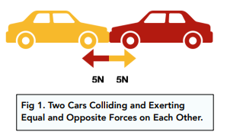
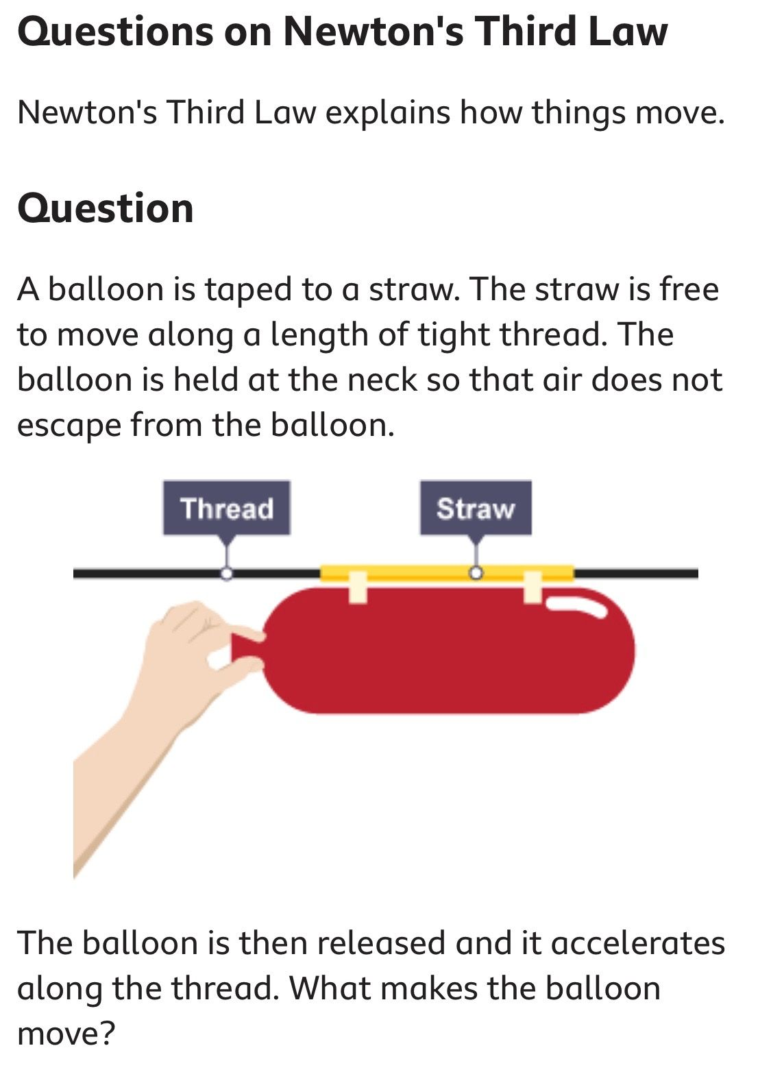
1 2 3 4 5 6 7 8 9 10 11 12 13 14 15 16 17 18 19 20 21 22 23 24 25 26 27 28 29 | It is important to remember that in Newtons 3rd law the forces are: In pairs. Act in opposite directions on different objects. Are of the same size but equal and opposite. The pair of forces are between 2 objects only. Eg the two cars. …………………………………………………………………………………………………………………………………………………………………………………………………………………………………………………………………………………………

Slide 36
1 2 3 4 5 6 7 8 9 10 11 12 13 14 15 16 17 18 19 20 21 22 23 24 25 26 27 28 29 30 | Examples of force pairs Newton's Third Law can be applied to examples of equilibrium situation. Pushing a pram There are contact forces between the person and the pram: the person pushes the pram forwards the pram pushes the person backwards Car tyre on a road There are contact forces between the tyre and the road: the tyre pushes the road backwards the road pushes the tyre forwards A satellite in Earth orbit There are non-contact gravitational forces between Earth and the satellite: the Earth pulls the satellite the satellite pulls the Earth Question You are standing in the middle of a frozen pond. Imagine that the ice on the pond is very slippery and completely frictionless. Because there is no friction, running, walking and crawling are impossible. The ice is also very hard so you cannot dig into it to get a grip. How can you get off the pond? ………………………………………………………………………………………………………………………………………………………………………………………………………………………………………………………………………………………………………………………………………………………………………………………………………………………

Slide 37
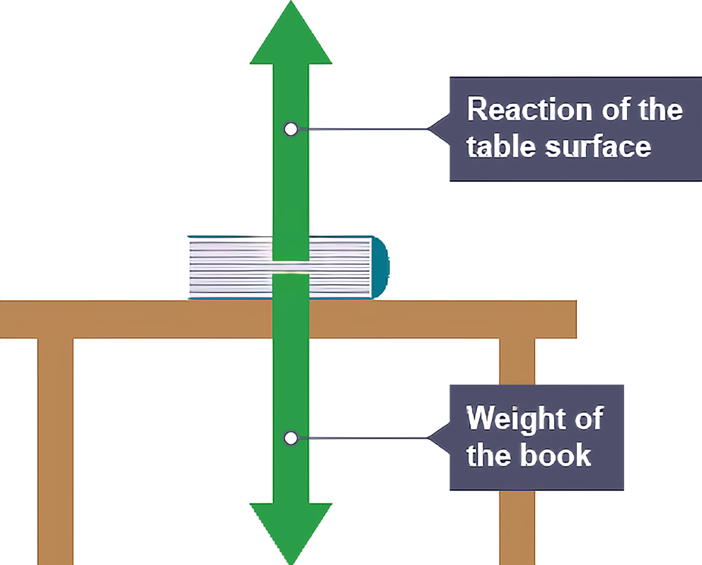
Quick reminder:
Newtons third law is about Force pairs NOT different forces so for example a book resting on a table is in equilibrium that is, its not moving. BUT this isn’t Newtons third law as the two forces acting on it are different types. They are the weight/ gravity of the book downwards and the normal contact force from the table upwards.
A hammer hits a nail with a downward force of 50 N. What is the size and direction of the force of the nail on the hammer
……………………………………………………………………………………………………………………………………………………
A lorry tows a broken down car. It exerts a force of 200N on the tow rope. How much force does the tow rope exert on the lorry.
…………………………………………………………………………………………………………………………………………………….
A student is standing on bathroom scales. They read 500N.
What is size and direction of force of the student on the scales
…………………………………………………………………………………………………………………………………………
What is the size and direction of the force on the student from the scales
………………………………………………………………………………………………………………………………………..
The force of the scales on the floor is 20N. What is the size and direction of the force on the scales from the floor when the student is stood on the scales.
………………………………………………………………………………………………………………………………………..

Slide 38
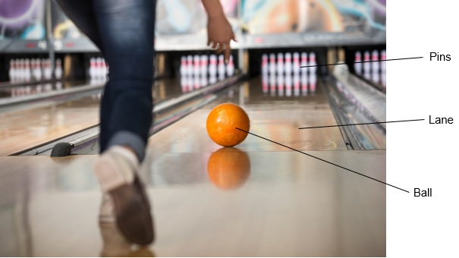
YOU DO
The photograph below shows a girl bowling a ball along a ten-pin bowling lane.
The girl is trying to knock down the ten pins at the end of the bowling lane.
As the ball travels along the lane the velocity of the ball decreases.
Velocity is a vector.
Which statement describes a vector?
Tick (✓) one box.
Vectors have direction only.
Vectors have magnitude and direction.
Vectors have magnitude only.
(1)

Slide 39
(b) Why does the velocity of the ball decrease as the ball travels along the lane?
Tick (✓) one box.
The force of gravity slows the ball down.
There are no forces acting on the ball.
There is a resultant force acting on the ball.
(c) The ball travels along the lane at an average speed of 4.5 m/s
It takes the ball 4.0 seconds to travel the length of the lane.
Calculate the length of the lane.
Use the equation:
distance travelled = speed × time
………………………………………………………………………………………………………………………………………………………………………………………………………………………………………………………………………………………………………………………………………………….…………………………………………………………………………………………………………………………………………………………………………………………………………………………………………………………………………………………………………………………………………………..…………………………………………………………………
Length of the lane ………………………………………………………… m

Slide 40
Subtopic 12: Stopping distances.
Learning Objective: today we are learning about :
How to explain the factors which affect stopping distance
How to explain the dangers caused by rapid deceleration
Why are we learning about this?
This lessons helps us understand why it is important that we have road safety campaigns such as ‘kill your speed not a child’ and why we have speed limits. It also links with why cars have safety features and regular annual MOT checks.
I wasn’t there but I still care!
Using physics text book pages 116 and 117 and the Study tip box and the Key points box, answer the following questions
A lorry tows a broken down car. It exerts a force of 200N on the tow rope. How much force does the tow rope exert on the lorry.
……………………………………………………………………………………………………………………………………………………
A student is standing on bathroom scales. They read 500N.
What is size and direction of force on the scales from the student.
…………………………………………………………………………………………………………………………………………………….
What is the size and direction of the force on the student from the scales
………………………………………………………………………………………………………………......................................

Slide 41
1 2 3 4 5 6 7 8 9 10 11 12 13 14 15 16 17 18 19 20 21 22 23 24 25 26 27 28 29 30 | Driving tests always ask about stopping distances. This is the shortest distance a vehicle can stop safely in. It is made up from two parts: The thinking distance: is the distance travelled by the vehicle while the driver is thinking/reacting. Thinking distance = speed x reaction time. So the faster you are going the longer your thinking distance will be. Thinking distance is proportional to speed. The Braking distance: is the distance travelled by the vehicle while the brakes are on. STOPPING DISTANCE = THINKING DISTANCE + BRAKING DISTANCE. Do NOT mention TIME when answering questions on stopping distance. Thinking distance can be affected by: Tiredness Drugs Alcohol Age of driver Illness/medications Radio playing Children screaming Mobile phone usage High speed You must say how it affects it so, tiredness will INCREASE the thinking distance as will OLD AGE but not being tired or younger will reduce it Stopping distance can be affected by: Poor brakes/vehicle maintenance Icy roads/Wet roads Bald tyres Poor road surfaces. High speed You must say how it affects it so, wet roads will increase stopping distance as less friction, bald tyres as less friction. A driver cannot stop a car immediately so the faster they are going the greater distance will be covered while they think and brake.

Slide 42
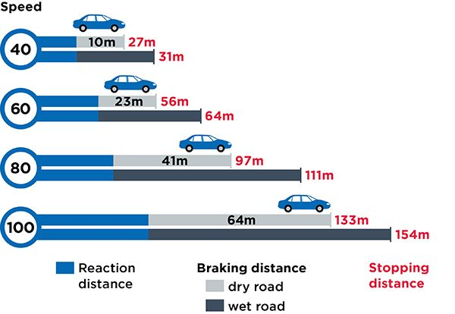
1 2 3 4 5 6 7 8 9 10 11 12 13 14 15 16 17 18 19 20 21 22 23 24 25 26 | Stopping distances Speed is a critical factor in all road crashes and casualties. The faster a vehicle is travelling, the longer it takes to stop, and the greater the risk of a crash. Speed and stopping distances don’t increase at the same rate. Small increases in speed result in bigger increases in stopping distances. When a car slows down (decelerates), kinetic energy is transferred from the vehicle. Work done by the friction force between the brakes and the wheels transfers this energy to the brake pads which heat up. If the slowing down process is managed and slow then no injury results. However, when a vehicle needs to suddenly stop from a very high speed in a short time problems can arise. If the deceleration is very rapid a large braking force is being applied. The result can be over heating of the brake pads or the driver losing control over the direction of the vehicle

Slide 43
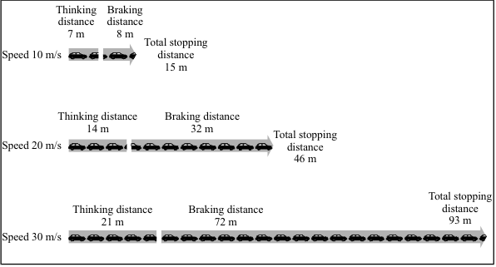
I do
Q1. The diagram below shows the thinking distances, braking distances and total stopping distances at different speeds.
(a) Look at the total stopping distances at each speed.
Complete the sentence by choosing the correct words from those below..
distance force mass time
The total stopping distance depends on the distance the car travels during the
driver’s reaction ……………………………. and under the braking …………………………………
(2)
(b) Give three other factors that could cause the total stopping distance of a car to be greater. Do not give the factors in Figure 1.
1. ………………………………………………………………………………………………………………………….
2. ………………………………………………………………………………………………………………………….
3. …………………………………………………………………………………………………………………………

Slide 44
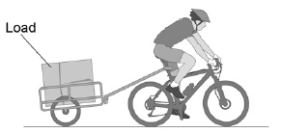
WE DO
Q1.
Figure 1 shows a cyclist with a trailer attached to his bike.
Figure 1
(a) Describe how Newton’s Third Law applies to the forces between the bike and the trailer.
…………………………………………………………………………………………………………………………………………………………………………………………………………………………………………………………………………………………………………………………………………………………………………………………………………………………………………………………………………………………………………………………………………………………………………………………………………… (2)
A student investigated how the stopping distance of the bike was affected by the mass of
the load.
The same person rode the same bike throughout the investigation.
Give two other variables which the student should have controlled.
1.………………………………………………………………………………………………………………………………………………………………………………………………………………………………………………………………………………………………………
2.…………………………………………………………………………………………………………………………………………………………………………………………………………………………………………………………………………………………………(2)

Slide 45
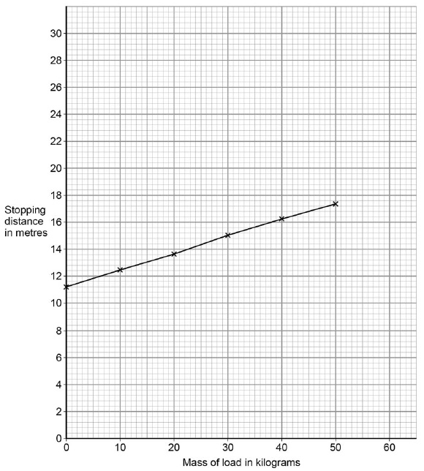
We do
(c) Figure 2 shows the results of the investigation.
Figure 2
Draw a line on Figure 2 to show how the stopping distance would be different if a heavier cyclist rode the bike.(1)
(d) At one time in the investigation the cyclist was distracted.
The distraction increased the stopping distance of the bike but did not affect the braking distance.
Explain why the stopping distance increased.
……………………………………………………………………………………………………………………………………………………………………………………………………………………………………………………………………………………………………………………………………………………………………………………………………………………………………………………………………………………………………………………………………………………………………………………………………………………………………………(3)

Slide 46
YOU DO
Q2.
The stopping distance of a car is the sum of the thinking distance and the braking distance.
(a) The thinking distance is affected by the reaction time of the driver.
Which two of the following can affect the reaction time of the driver?
Tick (✓) two boxes.
Damaged brakes
Taking drugs
Tiredness
Wet roads
Worn tyres
(b) Explain why a person should not drink alcohol and then drive.
…………………………………………………………………………………………………………………………………………………………………………………………………………………………………………………………………………………………………………………………………………………………………………………………………………………………………………………………………………………………………………………………………………………………………………………………………………………………….. …………………………………………………………………………………………………………………………………………………………………………………………………………………………………………………………………………………………………………….. …………………………………………………………………………………………………………………………………………………………………………………………………………………………………………………………………………………………………………(3)

Slide 47
I do
Q3.
(a) The stopping distance of a vehicle is made up of two parts, the thinking distance and the braking distance.
(i) What is meant by thinking distance?
…………………………………………………………………………………………………………………………………………………………………………………………………………………………………………………………………………………………………………….…(1)
(ii) State two factors that affect thinking distance.
1.…………………………………………………………………………………………………………………………………………………………………………………………………………………………………………………………………………………………………………………
2..…………………………………………………………………………………………………………………………………………………………………………………………………………………………………………………………………………………………………………(2)
(b) A car is travelling at a speed of 20 m/s when the driver applies the brakes. The car decelerates at a constant rate and stops.
(i) The mass of the car and driver is 1600 kg.
Calculate the kinetic energy of the car and driver before the brakes are applied.
.………………………………………………………………………………………………………………………..…………………………………………………………………………………………………………………………….…………………………………………………………..
Kinetic energy = ………………………………………..J (2)
(ii) How much work is done by the braking force to stop the car and driver?
Work done = ………………………………………. J (1)
(iii) The braking force used to stop the car and driver was 8000 N.
Calculate the braking distance of the car.
…………………………………………………………………………………………………………………………………………………………………………………………………………………………………………………..……………………………………………………………………………………………………………………………………………………………………………………………………………………….
Braking distance = ………………………………………… m (2)

Slide 48
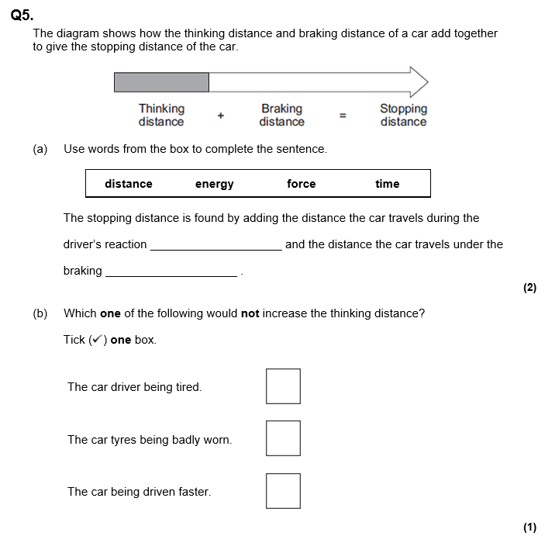
……………………………….
………………………………..

Slide 49
Subtopic 13: Momentum
Learning Objective
You are learning to identify examples of momentum and to calculate changes in momentum using the law of conservation of momentum.
Why are we learning about this?
This lessons helps us understand why objects react in a particular way when they interact. The outcomes of the interaction are predictable if you understand conservation of momentum.

Slide 50
1 2 3 4 5 6 7 8 9 10 11 12 13 14 15 16 17 18 19 20 21 22 23 24 25 26 27 28 29 30 | Momentum Momentum is a very important concept in Physics, and it is a property of all moving objects. The momentum of an object is a measure of how hard it is to stop. It depends on two factors: Mass – the more mass an object has, the harder it is to stop. Velocity – the faster an object is moving, the harder it is to stop. Momentum is directly proportional to both mass and velocity. We can calculate momentum using the following equation: Momentum = mass x velocity p = m x v Where: momentum, p, in kilograms metre per second, kg m/s mass, m, in kilograms, kg velocity, v, in metres per second, m/s Conservation of Momentum There is a key principle that you should know in relation to this topic – the conservation of momentum: In a closed system, the total momentum before an event is equal to the total momentum after the event. Closed and Open Systems This principle is for a closed system. Remember, a closed system is one which does not exchange energy with the surroundings. In real life, if there was a car crash, for example, it would be an open system so lots of energy would be lost as heat and sound energy to the surroundings. However, in Physics, we consider closed systems because it makes it easier to think about the situation. Text adapted from studymind.co.uk.

Slide 51
1 2 3 4 5 6 7 8 9 10 11 12 13 14 15 16 17 18 19 20 21 22 23 24 25 | Everyday examples of momentum. Momentum is a fundamental concept in physics and is observed in various real-world scenarios. Here are some examples of momentum in everyday life: Car Crashes: In a car crash, the momentum of the moving vehicle becomes evident as the force of impact can cause significant damage to the vehicles involved. Sports: In sports like football, rugby, or ice hockey, players demonstrate momentum when they collide with each other, leading to changes in their positions and velocities. Billiards: When playing billiards or pool, the momentum of the cue ball is transferred to other balls upon collision, causing them to move. Recoil of Firearms: When firing a gun, the backward movement of the firearm is a result of the momentum of the bullets being propelled forward. Skateboarding and Cycling: Skateboarders and cyclists showcase momentum as they gain speed downhill and use their momentum to perform tricks and jumps. Space Missions: In space exploration, the momentum of spacecraft and satellites must be precisely controlled to ensure they reach their intended destinations and perform manoeuvres accurately. Bowling: When a bowler releases the bowling ball, the momentum is transferred to the ball, causing it to roll down the lane and knock down pins. Diving: In diving, athletes use their momentum and techniques to perform complex aerial manoeuvres and twists. Planetary Motion: Celestial bodies in the solar system, such as planets and moons, move and interact with each other due to the conservation of momentum. Moving Objects: Any object in motion, such as a moving train, a falling object, or a rolling ball, demonstrates momentum.

Slide 52
Calculate momentum in the following scenarios:
Q1 A car with a mass of 1000 kg is moving at a velocity of 20 m/s. Calculate its momentum.
Equation: p = m x v
Substitute values: p = 1000 x 20
Calculate momentum: 1000 x 20 = 20,000 kg m/s
Q2 (I DO) A tennis ball with a mass of 0.1 kg is served at a velocity of 30 m/s. Calculate its momentum.
Equation: ……………………………………………………………………………………………………………………………..
Substitute values: …………………………………………………………………………………………………………………
Calculate momentum: ………………………………………………………………………………………………………….
Q3 (WE DO) An airplane with a mass of 50,000 kg is flying at a velocity of 200 m/s. Calculate its momentum.
Equation: ……………………………………………………………………………………………………………………………..
Substitute values: …………………………………………………………………………………………………………………
Calculate momentum: ………………………………………………………………………………………………………….
Q4 (YOU DO) A bullet with a mass of 0.02 kg is fired at a velocity of 500 m/s. Calculate its momentum.
Equation: ……………………………………………………………………………………………………………………………..
Substitute values: …………………………………………………………………………………………………………………
Calculate momentum: ………………………………………………………………………………………………………….
Q5 (YOU DO) A baseball player with a mass of 80 kg runs at a velocity of 6 m/s. Calculate his momentum.
………………………………………………………………………………………………………………………………………………………………………………………………………………………………………………………………………………………………………………………………………………………………………………………………………………………………………………………
Q6 (YOU DO) A rocket with a mass of 5000 kg is launched at a velocity of 1000 m/s. Calculate its momentum.
………………………………………………………………………………………………………………………………………………………………………………………………………………………………………………………………………………………………………………………………………………………………………………………………………………………………………………………

Slide 53
Calculate mass in the following scenarios:
Q1 A car with a velocity of 20 m/s has a momentum of 4000 kg·m/s. Calculate its mass.
Equation: p = m x v
Substitute values: 4000 = m x 20
Solve for mass: 4000 ÷ 20 = m = 200kg
Q2 (I DO) A tennis ball is served at a velocity of 30 m/s and has a momentum of 300 kg·m/s. Calculate its mass.
Equation: ……………………………………………………………………………………………………………………………..
Substitute values: …………………………………………………………………………………………………………………
Solve for mass: …………………………………………………………………………………………………………………….
Q3 (WE DO) An airplane traveling at a velocity of 200 m/s has a momentum of 500,000 kg·m/s. Calculate its mass.
Equation: ……………………………………………………………………………………………………………………………..
Substitute values: …………………………………………………………………………………………………………………
Solve for mass : ……………………………………………………………………………………………………………………
Q4 (YOU DO) A bullet has a velocity of 500 m/s and has a momentum of 100 kg·m/s. Calculate its mass.
Equation: ……………………………………………………………………………………………………………………………..
Substitute values: …………………………………………………………………………………………………………………
Solve for mass: …………………………………………………………………………………………………………………….
Q5 (YOU DO) A soccer ball with a velocity of 10 m/s has a momentum of 20 kg·m/s. Calculate its mass.
………………………………………………………………………………………………………………………………………………………………………………………………………………………………………………………………………………………………………………………………………………………………………………………………………………………………………………………
Q6 (YOU DO) A cyclist moving at a velocity of 15 m/s has a momentum of 300 kg·m/s. Calculate their mass.
………………………………………………………………………………………………………………………………………………………………………………………………………………………………………………………………………………………………………………………………………………………………………………………………………………………………………………………

Slide 54
Calculate velocity in the following scenarios:
Q1 A car with a mass of 1000 kg has a momentum of 20,000 kg m/s. Calculate its velocity.
Equation: p = m x v
Substitute values: 20,000 = 1000 x v
Solve for velocity: 20,000 ÷ 1000 = v = 20 m/s
Q2 (I DO) A tennis ball with a mass of 0.1 kg has a momentum of 3 kg m/s. Calculate its velocity
Equation: ……………………………………………………………………………………………………………………………..
Substitute values: …………………………………………………………………………………………………………………
Solve for velocity: …………………………………………………………………………………………………………………
Q3 (WE DO) An airplane with a mass of 50,000 kg has a momentum of 10,000,000 kg m/s. Calculate its velocity.
Equation: ……………………………………………………………………………………………………………………………..
Substitute values: …………………………………………………………………………………………………………………
Solve for velocity: ……………………………………………………………………………………………………………….
Q4 (YOU DO) A bullet with a mass of 0.02 kg has a momentum of 10 kg m/s. Calculate its velocity.
Equation: ……………………………………………………………………………………………………………………………..
Substitute values: …………………………………………………………………………………………………………………
Solve for velocity: ………………………………………………………………………………………………………………..
Q5 (YOU DO) A soccer ball with a mass of 2 kg has a momentum of 10 kg·m/s. Calculate its velocity.
………………………………………………………………………………………………………………………………………………………………………………………………………………………………………………………………………………………………………………………………………………………………………………………………………………………………………………………
Q6 (YOU DO) A cyclist with a mass of 20 kg has a momentum of 100 kg·m/s. Calculate their velocity.
………………………………………………………………………………………………………………………………………………………………………………………………………………………………………………………………………………………………………………………………………………………………………………………………………………………………………………………

Slide 55
Interleaved calculations (YOU DO): You will need to work out if you have to calculate momentum, velocity or mass and then do the appropriate calculation.
Q1 A car with a mass of 1200 kg is moving at a velocity of 25 m/s. Calculate its momentum.
………………………………………………………………………………………………………………………………………………………………………………………………………………………………………………………………………………………………………………………………………………………………………………………………………………………………………………………
Q2 An airplane with a momentum of 15,000,000 kg·m/s is flying at a velocity of 300 m/s. Calculate its mass.
………………………………………………………………………………………………………………………………………………………………………………………………………………………………………………………………………………………………………………………………………………………………………………………………………………………………………………………
Q3 A tennis ball is served with a momentum of 1.5 kg·m/s and a velocity of 30 m/s. Calculate its mass.
………………………………………………………………………………………………………………………………………………………………………………………………………………………………………………………………………………………………………………………………………………………………………………………………………………………………………………………
Q4 A bullet is fired with a mass of 0.02 kg and a momentum of 100 kg·m/s. Calculate its velocity.
………………………………………………………………………………………………………………………………………………………………………………………………………………………………………………………………………………………………………………………………………………………………………………………………………………………………………………………
Q5 A soccer ball with a momentum of 4 kg·m/s is kicked at a velocity of 10 m/s. Calculate its mass.
………………………………………………………………………………………………………………………………………………………………………………………………………………………………………………………………………………………………………………………………………………………………………………………………………………………………………………………

Slide 56
Interleaved calculations continued (YOU DO): You will need to work out if you have to calculate momentum, velocity or mass and then do the appropriate calculation.
Q6 A cyclist with a momentum of 1500 kg·m/s has a mass of 75 kg. Calculate their velocity.
………………………………………………………………………………………………………………………………………………………………………………………………………………………………………………………………………………………………………………………………………………………………………………………………………………………………………………………
Q7 A freight train has a mass of 200,000 kg and a velocity of 5 m/s. Calculate its momentum.
………………………………………………………………………………………………………………………………………………………………………………………………………………………………………………………………………………………………………………………………………………………………………………………………………………………………………………………
Q8 A roller coaster car has a mass of 1500 kg and a momentum of 60,000 kg·m/s. Calculate its velocity.
………………………………………………………………………………………………………………………………………………………………………………………………………………………………………………………………………………………………………………………………………………………………………………………………………………………………………………………
Q9 A golf ball is hit with a mass of 0.04 kg and a velocity of 25 m/s. Calculate its momentum.
………………………………………………………………………………………………………………………………………………………………………………………………………………………………………………………………………………………………………………………………………………………………………………………………………………………………………………………
Q10 A rocket with a mass of 500 kg has a momentum of 50,000 kg·m/s. Calculate its velocity.
………………………………………………………………………………………………………………………………………………………………………………………………………………………………………………………………………………………………………………………………………………………………………………………………………………………………………………………

Slide 57
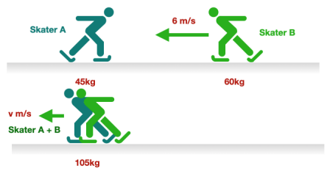
1 2 3 4 5 6 7 8 9 10 11 12 13 14 15 16 17 18 19 20 21 22 23 24 25 26 27 28 29 30 | Examples of Momentum Quantitative Scenarios of Momentum – Worked example We often need to calculate quantities related to momentum before and after collisions. For example, accident investigators use such calculations when investigating a crash. Question: Imagine two skaters on an ice rink. Skater A (mass 45 kg) is stationary, whilst Skater B (mass of 60kg) is moving with a velocity of 6 m/s. Skater B collides into Skater A, causing both skaters to move off together with a lower velocity. Assuming that momentum is conserved, what is the new lower velocity, to 1 d.p.? 1. Draw a diagram. The best way to start a momentum question is to draw a simple diagram. 2. Calculate initial momentum. This is the momentum before the collision occurs. Skater A: Skater A is stationary, so their momentum is 0 kg m/s Skater B: Initial momentum = mass x velocity Initial momentum = 60 x 6 Initial momentum = 360 kg m/s Total momentum = 0 kg m/s + 360 kg m/s = 360 kg m/s

Slide 58
1 2 3 4 5 6 7 8 9 10 11 12 13 14 15 16 17 18 19 20 21 22 23 24 25 26 27 28 29 30 | 3. Calculate the final momentum. We do not know the velocity, so we can substitute this with the symbol ‘v’. We do know that the initial momentum must equal the final momentum (because momentum is conserved). Final momentum = mass x velocity We need to calculate the total mass of both skaters when they move off together. This is 45 + 60 = 105 kg. Final momentum = 105 x v 360 kg m/s = 105 x v 4. Find ‘v’. 360 = 105 x v v = 360 / 105 v = 3.428571 v = 3.4 m/s (1dp) So, after the collisions, the skaters had a velocity of 3.4 m/s.

Slide 59
Conservation of momentum: Calculate velocity after the objects combine.
Q1 (I DO) A 0.5 kg ball is moving at 6 m/s to the right. It collides head-on with a 0.3 kg ball initially at rest. After the collision, the two balls stick together. Calculate the final velocity of the combine balls.
……………………………………………………………………………………………………………………………………………………………………………………………………………………………………………………………………………………………………………………………………………………………………………………………………………………………………………………………………………………………………………………………………………………………………………………………………..... ……………………………………………………………………………………………………………………………………………………………………………………………………………………………………………………………………………………………………………………………………………………………………………………………………………………………………………………………………………………………………………………………………………………………………………………………………...... ……………………………………………………………………………………………………………………………………………………………………………………………………………………………………………………………………………………………………
Q2 (WE DO) A 2 kg block is moving to the right at 10 m/s. It collides with a stationary 3 kg block, and they stick together after the collision. Calculate their final velocity.
……………………………………………………………………………………………………………………………………………………………………………………………………………………………………………………………………………………………………………………………………………………………………………………………………………………………………………………………………………………………………………………………………………………………………………………………………..... ……………………………………………………………………………………………………………………………………………………………………………………………………………………………………………………………………………………………………………………………………………………………………………………………………………………………………………………………………………………………………………………………………………………………………………………………………......
……………………………………………………………………………………………………………………………………………………………………………………………………………………………………………………………………………………………………

Slide 60
Conservation of momentum: Calculate velocity after the objects combine.
Q3 (YOU DO) A 1.2 kg toy car is moving at 8 m/s to the right. It collides with a stationary 0.8 kg toy car in the opposite direction. The two cars stick together after the collision. Calculate the final velocity of the combined cars.
……………………………………………………………………………………………………………………………………………………………………………………………………………………………………………………………………………………………………………………………………………………………………………………………………………………………………………………………………………………………………………………………………………………………………………………………………..... ……………………………………………………………………………………………………………………………………………………………………………………………………………………………………………………………………………………………………………………………………………………………………………………………………………………………………………………………………………………………………………………………………………………………………………………………………...... ……………………………………………………………………………………………………………………………………………………………………………………………………………………………………………………………………………………………………
Q4 (YOU DO) Two ice skaters, one with a mass of 60 kg and the other with a mass of 40 kg, approach each other. The skater with a mass of 60 kg is moving to the left at 4 m/s, while the skater with a mass of 40 kg is moving to the right at 6 m/s. After they collide, they grab each other and move together. Calculate their final velocity.
……………………………………………………………………………………………………………………………………………………………………………………………………………………………………………………………………………………………………………………………………………………………………………………………………………………………………………………………………………………………………………………………………………………………………………………………………..... ……………………………………………………………………………………………………………………………………………………………………………………………………………………………………………………………………………………………………………………………………………………………………………………………………………………………………………………………………………………………………………………………………………………………………………………………………......
……………………………………………………………………………………………………………………………………………………………………………………………………………………………………………………………………………………………………

Slide 61
Conservation of momentum: The objects do not combine (they separate).
Q1 (I DO) A 0.2 kg ball is moving to the right at 4 m/s. It collides with a 0.3 kg ball moving to the left at 2 m/s. After the collision, the 0.2kg ball moves at 3m/s in the opposite direction (-3 m/s). Calculate the velocity of the second ball.
……………………………………………………………………………………………………………………………………………………………………………………………………………………………………………………………………………………………………………………………………………………………………………………………………………………………………………………………………………………………………………………………………………………………………………………………………..... ……………………………………………………………………………………………………………………………………………………………………………………………………………………………………………………………………………………………………………………………………………………………………………………………………………………………………………………………………………………………………………………………………………………………………………………………………...... ……………………………………………………………………………………………………………………………………………………………………………………………………………………………………………………………………………………………………
Q2 (WE DO) A 0.1 kg toy car moves at 5 m/s and collides with a stationary 0.2 kg toy car. After the collision, the first car moves in the opposite direction with a velocity of 2 m/s. Calculate the final velocity of the second car.
……………………………………………………………………………………………………………………………………………………………………………………………………………………………………………………………………………………………………………………………………………………………………………………………………………………………………………………………………………………………………………………………………………………………………………………………………..... ……………………………………………………………………………………………………………………………………………………………………………………………………………………………………………………………………………………………………………………………………………………………………………………………………………………………………………………………………………………………………………………………………………………………………………………………………......
……………………………………………………………………………………………………………………………………………………………………………………………………………………………………………………………………………………………………

Slide 62
Conservation of momentum: The objects do not combine (they separate).
Q3 (YOU DO) A 0.3 kg ball moves at 10 m/s and collides with a stationary 0.2 kg ball. After the collision, the first ball moves with a velocity of 5 m/s to the right. Calculate the final velocity of the second ball.
……………………………………………………………………………………………………………………………………………………………………………………………………………………………………………………………………………………………………………………………………………………………………………………………………………………………………………………………………………………………………………………………………………………………………………………………………..... ……………………………………………………………………………………………………………………………………………………………………………………………………………………………………………………………………………………………………………………………………………………………………………………………………………………………………………………………………………………………………………………………………………………………………………………………………...... ……………………………………………………………………………………………………………………………………………………………………………………………………………………………………………………………………………………………………
Q4 (YOU DO) A 0.4 kg trolley moving at 2 m/s collides with a stationary 0.3 kg trolley. After the collision, the first trolley moves with a velocity of 1 m/s to the left. Calculate the final velocity of the second trolley.
……………………………………………………………………………………………………………………………………………………………………………………………………………………………………………………………………………………………………………………………………………………………………………………………………………………………………………………………………………………………………………………………………………………………………………………………………..... ……………………………………………………………………………………………………………………………………………………………………………………………………………………………………………………………………………………………………………………………………………………………………………………………………………………………………………………………………………………………………………………………………………………………………………………………………......
……………………………………………………………………………………………………………………………………………………………………………………………………………………………………………………………………………………………………

Slide 63
Subtopic 14: Changes in momentum
Learning Objective
You are learning about forces exerted during changes to momentum and how we can protect ourselves from large forces.
Why are we learning about this?
This lessons helps us understand why safety features such as seat belts, crumple zones and rubber mats reduce the likelihood of us being injured.
3

Slide 64
1 2 3 4 5 6 7 8 9 10 11 12 13 14 15 16 17 18 19 20 21 22 23 24 25 26 27 28 29 30 | Change in momentum Change in momentum is a critical concept that relates changes to our velocity to the forces we experience. If a larger force is experienced, it is more likely that we will get hurt. Let's look at some real-world examples to understand why this matters: Air Bags and Seat Belts: Imagine you're in a car, and suddenly you need to stop because of a crash. Your body wants to keep moving forward due to its momentum. But the seat belt and air bags in the car are there to help. They make the change in your momentum happen more slowly. This reduces the force on your body so you are less likely to get hurt. Gym Crash Mats: Think about gymnasts doing flips and jumps. When they land on the mat, their momentum changes quickly. The crash mat is like a cushion. It helps increase the time it takes for the gymnast's momentum to change, which makes the force applied smaller. This helps prevent injuries by reducing the force on their bodies. Cycle Helmets: Imagine you're riding a bike and you fall off. Your head goes from moving to suddenly stopping, which changes its momentum. A cycle helmet decreases the rate of change of momentum. This way, your head doesn't experience a big force, and you're less likely to get seriously hurt. Playground Surfaces: When you're playing on a playground, you might run, jump, or even fall. The ground you're on can influence the force your body feels. Playground surfaces are designed to help. They increase the time it takes for your momentum to change when you land or run. This makes the force on your body lower, because there is a lower rate of change of momentum, which is safer and less likely to cause harm. So, how does change in momentum connect to force? The key relationship is: Force equals the rate of change of momentum. We can derive an equation that shows this: F = m x a (force = mass x acceleration) a = (v – u) / t (acceleration = change in velocity / time) Therefore: F = m x ∆v ∆t

Slide 65
Worked example – calculating force (change in momentum)
A bicycle of mass 15 kg decelerates from a velocity of 10 m/s to rest in 4 seconds.
Calculate the force opposing the motion of the bicycle.
Use the equation: F = m x ∆v
∆t
Step 1: Calculate change in velocity.
0 m/s – 10 m/s = -10 m/s
Step 2: Substitute values into the equation for force.
F = 15kg x -10
4 s
Step 3: Calculate the answer.
Answer = -37.5 N
Worked example – calculating initial velocity.
A car of mass 1200 kg comes to a stop after applying a force of 2500 N for 8 seconds. Calculate its initial velocity.
Use the equation: F = m x ∆v
∆t
Step 1: Substitute values into the equation.
2500 = 1200 x ∆v
8
Step 2: Rearrange for velocity (velocity equals initial velocity as final velocity = 0 m/s).
2500 = 150 x ∆v = -150 x –u (∆v = v – u. v = 0 m/s so ∆v is substituted with –u).
U = 2500 / -150
Step 3: Calculate the answer.
Answer = -16.67 m/s

Slide 66
I DO -Calculating force.
1. A car of mass 1200 kg accelerates from rest to a velocity of 25 m/s in 8 seconds. Calculate the force exerted on the car during this acceleration.
Use the equation: F = m x ∆v
∆t
Step 1: Calculate change in velocity.
………………………………………………………………………………………………………………………………………………….
Step 2: Substitute values into the equation for force.
……………………………………………………………………………………………………………………………………………………………………………………………………………………………………………………………………………………………………
Step 3: Calculate the answer.
Answer = ………………………………………………………………………………………………………………………………………………….
WE DO - Calculating force.
2. A bicycle of mass 15 kg decelerates from a velocity of 10 m/s to rest in 4 seconds. Calculate the force.
Use the equation: F = m x ∆v
∆t
Step 1: Calculate change in velocity.
………………………………………………………………………………………………………………………………………………….
Step 2: Substitute values into the equation for force.
……………………………………………………………………………………………………………………………………………………………………………………………………………………………………………………………………………………………………
Step 3: Calculate the answer.
Answer = ………………………………………………………………………………………………………………………………………………….

Slide 67
YOU DO - Calculating force.
3. A rocket of mass 2000 kg accelerates from rest to a velocity of 150 m/s in 10 seconds. Calculate the force exerted by the rocket engines.
……………………………………………………………………………………………………………………………………………………………………………………………………………………………………………………………………………………………………
……………………………………………………………………………………………………………………………………………………………………………………………………………………………………………………………………………………………………
……………………………………………………………………………………………………………………………………………………………………………………………………………………………………………………………………………………………………
……………………………………………………………………………………………………………………………………………………………………………………………………………………………………………………………………………………………………
……………………………………………………………………………………………………………………………………………………………………………………………………………………………………………………………………………………………………
YOU DO - Calculating force.
4. A skateboarder of mass 70 kg comes to a stop from a velocity of 8 m/s in 2 seconds. Calculate the force.
……………………………………………………………………………………………………………………………………………………………………………………………………………………………………………………………………………………………………
……………………………………………………………………………………………………………………………………………………………………………………………………………………………………………………………………………………………………
……………………………………………………………………………………………………………………………………………………………………………………………………………………………………………………………………………………………………
……………………………………………………………………………………………………………………………………………………………………………………………………………………………………………………………………………………………………
……………………………………………………………………………………………………………………………………………………………………………………………………………………………………………………………………………………………………

Slide 68
I DO - Calculating initial velocity.
1. A cyclist of mass 70 kg slows down and stops in 6 seconds while applying a force of 150 N. Determine the cyclist's initial velocity.
Use the equation: F = m x ∆v
∆t
…………………………………………………………………………………………………………………………………………………………………………………………………………………………………………………………………………………………………………
………………………………………………………………………………………………………………………………………………………………………………………………………………………………………………………………………………………………………..
………………………………………………………………………………………………………………………………………………………………………………………………………………………………………………………………………………………………………..
………………………………………………………………………………………………………………………………………………………………………………………………………………………………………………………………………………………………………..
………………………………………………………………………………………………………………………………………………………………………………………………………………………………………………………………………………………………………..
WE DO - Calculating initial velocity.
2. A block of mass 800 g is pushed to a stop by a constant force of 5 N in 2 seconds. Determine the initial velocity of the block.
Use the equation: F = m x ∆v
∆t
…………………………………………………………………………………………………………………………………………………………………………………………………………………………………………………………………………………………………………
………………………………………………………………………………………………………………………………………………………………………………………………………………………………………………………………………………………………………..
………………………………………………………………………………………………………………………………………………………………………………………………………………………………………………………………………………………………………..
………………………………………………………………………………………………………………………………………………………………………………………………………………………………………………………………………………………………………..
………………………………………………………………………………………………………………………………………………………………………………………………………………………………………………………………………………………………………..

Slide 69
YOU DO - Calculating initial velocity.
3. A sled of mass 150 kg is brought to rest by a force of 300 N in 5 seconds. Calculate the initial velocity of the sled.
Use the equation: F = m x ∆v
∆t
…………………………………………………………………………………………………………………………………………………………………………………………………………………………………………………………………………………………………………
………………………………………………………………………………………………………………………………………………………………………………………………………………………………………………………………………………………………………..
………………………………………………………………………………………………………………………………………………………………………………………………………………………………………………………………………………………………………..
………………………………………………………………………………………………………………………………………………………………………………………………………………………………………………………………………………………………………..
………………………………………………………………………………………………………………………………………………………………………………………………………………………………………………………………………………………………………..
YOU DO - Calculating initial velocity.
4. A spring-loaded toy of mass 0.2 kg is compressed and launched, coming to a stop in 0.5 seconds under the action of a force of 6 N. Calculate its initial velocity.
Use the equation: F = m x ∆v
∆t
…………………………………………………………………………………………………………………………………………………………………………………………………………………………………………………………………………………………………………
………………………………………………………………………………………………………………………………………………………………………………………………………………………………………………………………………………………………………..
………………………………………………………………………………………………………………………………………………………………………………………………………………………………………………………………………………………………………..
………………………………………………………………………………………………………………………………………………………………………………………………………………………………………………………………………………………………………..
………………………………………………………………………………………………………………………………………………………………………………………………………………………………………………………………………………………………………..

Slide 70
Changes to momentum - interleaved calculations:
1. A rocket of mass 2000 kg is launched and slows down to a stop in 12 seconds under the influence of a force of 5000 N. Calculate its initial velocity.
…………………………………………………………………………………………………………………………………………………………………………………………………………………………………………………………………………………………………………
………………………………………………………………………………………………………………………………………………………………………………………………………………………………………………………………………………………………………..
………………………………………………………………………………………………………………………………………………………………………………………………………………………………………………………………………………………………………..
………………………………………………………………………………………………………………………………………………………………………………………………………………………………………………………………………………………………………..
………………………………………………………………………………………………………………………………………………………………………………………………………………………………………………………………………………………………………..
2. A toy car of mass 0.2 kg accelerates from rest to a velocity of 3 m/s in 0.5 seconds. Calculate the force exerted on the toy car.
………………………………………………………………………………………………………………………………………………………………………………………………………………………………………………………………………………………………………..
………………………………………………………………………………………………………………………………………………………………………………………………………………………………………………………………………………………………………..
………………………………………………………………………………………………………………………………………………………………………………………………………………………………………………………………………………………………………..
…………………………………………………………………………………………………………………………………………………………………………………………………………………………………………………………………………………………………………
………………………………………………………………………………………………………………………………………………………………………………………………………………………………………………………………………………………………………..

Slide 71
Interleaved calculations continued:
3. A student of mass 60 kg jumps off a platform with an initial velocity of 0 m/s and accelerates to a final velocity of 5 m/s in 1 second. Calculate the force.
………………………………………………………………………………………………………………………………………………………………………………………………………………………………………………………………………………………………………..
………………………………………………………………………………………………………………………………………………………………………………………………………………………………………………………………………………………………………..
………………………………………………………………………………………………………………………………………………………………………………………………………………………………………………………………………………………………………..
…………………………………………………………………………………………………………………………………………………………………………………………………………………………………………………………………………………………………………
………………………………………………………………………………………………………………………………………………………………………………………………………………………………………………………………………………………………………..
4. A marble of mass 25 g is pushed along a smooth surface and comes to rest in 0.6 seconds under the influence of a force of 4 N. Calculate its initial velocity.
………………………………………………………………………………………………………………………………………………………………………………………………………………………………………………………………………………………………………..
………………………………………………………………………………………………………………………………………………………………………………………………………………………………………………………………………………………………………..
………………………………………………………………………………………………………………………………………………………………………………………………………………………………………………………………………………………………………..
…………………………………………………………………………………………………………………………………………………………………………………………………………………………………………………………………………………………………………
………………………………………………………………………………………………………………………………………………………………………………………………………………………………………………………………………………………………………..

Slide 72
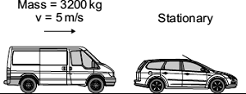
Momentum – interleaved questions.
Q1. a. A van has a mass of 3200 kg. The diagram shows the van just before and just after it collides with the back of a car.
Before collision After collision
Just before the collision, the van was moving at 5 m/s and the car was stationary.
(i) Calculate the momentum of the van just before the collision.
Show clearly how you work out your answer.
………………………………………………………………………………………………………………………………………………………………………………………………………………………………………………………………………………………………………..
Momentum = …………………………………….. kg m/s
(ii) The collision makes the van and car join together.
What is the total momentum of the van and the car just after the collision?
Momentum = _______________ kg m/s
(iii) Complete the following sentence by drawing a ring around the correct line in the box.
more than
The momentum of the car before the collision is the same as the momentum of the
less than
car after the collision.

Slide 73
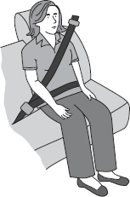
Momentum – interleaved questions.
A seat belt is one of the safety features of a car.
In a collision, wearing a seat belt reduces the risk of injury.
Use words or phrases below to complete the following sentences.
decreases stays the same increases
In a collision, the seat belt stretches. The time it takes for the person held by the seat belt to lose momentum compared to a person not wearing a seat belt,
……………………………………………………………………………………………………………………………………………….. .
The force on the person’s body ………………………………………………………………………………………. and so reduces the risk of injury..

Slide 74
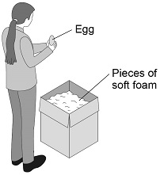
Momentum – interleaved questions.
Q2. (a) An adult of mass 80 kg has more inertia than a child of mass 40 kg
What is inertia?
………………………………………………………………………………………………………………………………………………………………………………………………………………………………………………………………………………………………………..
(b) A teacher demonstrated the idea of a safety surface.
She dropped a raw egg into a box filled with pieces of soft foam.
The egg did not break.
Figure 1 shows the demonstration.
Figure 1
Explain why the egg is less likely to break when dropped onto soft foam rather than onto a concrete floor.
………………………………………………………………………………………………………………………………………………………………………………………………………………………………………………………………………………………………………..
………………………………………………………………………………………………………………………………………………………………………………………………………………………………………………………………………………………………………..
………………………………………………………………………………………………………………………………………………………………………………………………………………………………………………………………………………………………………..
…………………………………………………………………………………………………………………………………………………………………………………………………………………………………………………………………………………………………………
the tendency of an object to continue in its state of rest or motion
allow how difficult it is to change the velocity of an object

Slide 75
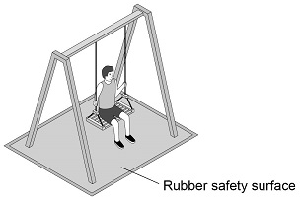
Momentum – interleaved questions.
(c) Figure 2 shows a child on a playground swing. The playground has a rubber safety surface.
Figure 2
A child of mass 32 kg jumped from the swing.
When the child reached the ground she took 180 milliseconds to slow down and stop.
During this time an average force of 800 N was exerted on her by the ground.
Calculate the velocity of the child when she first touched the ground.
………………………………………………………………………………………………………………………………………………………………………………………………………………………………………………………………………………………………………..
………………………………………………………………………………………………………………………………………………………………………………………………………………………………………………………………………………………………………..
………………………………………………………………………………………………………………………………………………………………………………………………………………………………………………………………………………………………………..
……………………………………………………………………………………………………………………………………………………………………………………………………………………………………………………………………………………………………………………………………………………………………………………………………………………………………………………………………………………………………………………………………………………………………………………………………………………
Velocity = …………………………………………………………… m/s

Slide 76
DO NOW
Date: ……………………………………….
 | ANSWER
Q1.
Q2.
Q3.
Q4.
Q5.
Date: ……………………………………….
 | ANSWER
Q1.
Q2.
Q3.
Q4.
Q5.

Slide 77
DO NOW
Date: ……………………………………….
 | ANSWER
Q1.
Q2.
Q3.
Q4.
Q5.
Date: ……………………………………….
 | ANSWER
Q1.
Q2.
Q3.
Q4.
Q5.

Slide 78
DO NOW
Date: ……………………………………….
 | ANSWER
Q1.
Q2.
Q3.
Q4.
Q5.
Date: ……………………………………….
 | ANSWER
Q1.
Q2.
Q3.
Q4.
Q5.

Slide 79
Knowledge Retrieval Quiz 3
Date: ……………………………………….
Score: …………...
 |  | Answer
Q1. | What does the gradient of the line on a distance time graph represent?
Q2. | What does the gradient of the line on a velocity time graph represent?
Q3. | If the resultant force on an object is zero, give the two possible types of motion for this object.
Q4. | Complete this sentence ‘Newton’s second law states that resultant force on an object is __________ to its acceleration’.
Q5. | Complete this sentence ‘Newton’s third law states when two objects exert a force on each other, the force on each object is ______ but in _______ directions’.
Q6. | What distance is the sum of thinking distance and braking distance?
Q7. | State the typical range of human reaction times.
Q8. | If human reaction times increases, how does this affect thinking distance?
Q9. | Tiredness can affect the thinking distance of a vehicle, state three other factors that affect thinking distance.
Q10. | State two factors that affect the braking distance of an object.

Slide 80
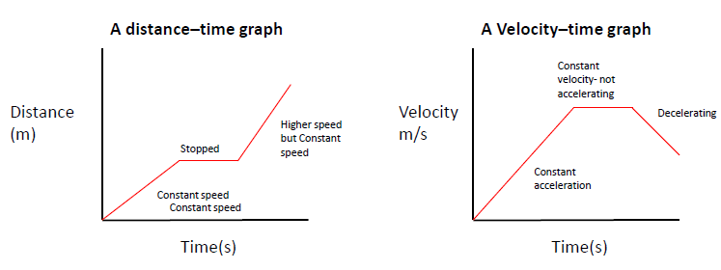
KNOWLEDGE ORGANISER
Subject: Science | Topic: Forces | Term: Autumn
KEY WORDS | Key words
1 | Acceleration | The rate of change of velocity.
2 | Braking Distance | The distance a vehicle travels under the braking force.
3 | Conservation of Momentum | The total momentum of a system before an event is always equal to the total momentum after the event.
4 | Inertia | The tendency of an object to remain in its same state of uniform motion or rest.
5 | Momentum | The product of an object’s mass and velocity.
6 | Stopping Distance | The sum of the thinking and braking distances.
7 | Thinking Distance | The distance a vehicle travels during the driver’s reaction time.
KEY CONCEPTS
1 | Rate of change | Acceleration is a rate of change. All rates of change are calculated by dividing by time.
2 | Gradients | Gradients of graphs show the rate of change of a quantity. They can be used to calculate speed and acceleration from graphs.
3 | Conservation of a quantity | Total momentum is conserved during collisions. When things are conserved in science, they stay the same (e.g. conservation of mass during a chemical reaction).
KEY DIAGRAMS
16

