Slide 1

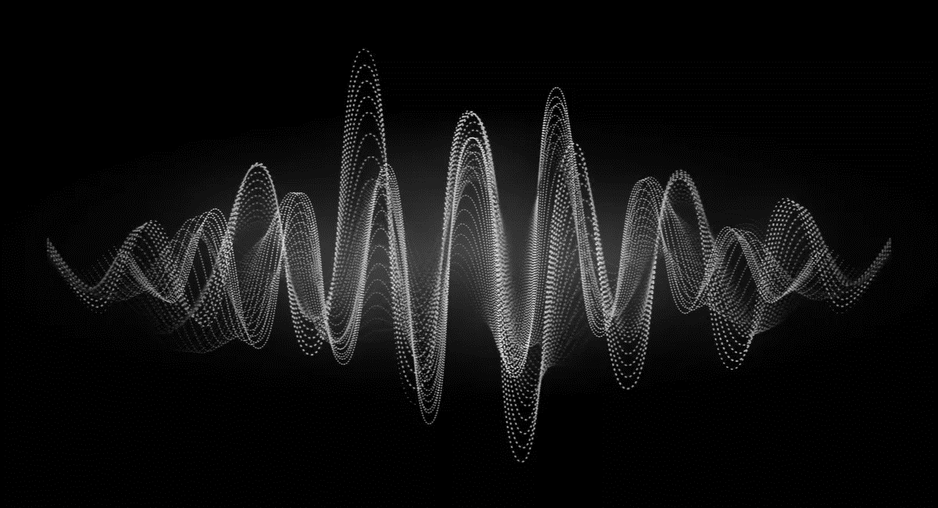
KS4 – Waves (TRILOGY STUDENT BOOKLET A)
Name
Class
Tutor Group
KS4 Science YEAR 11 WAVES
KEYSTONE WORDS
Longitudinal wave | In a longitudinal wave the oscillations are parallel to the direction of energy transfer.
Transverse wave | In a transverse wave the oscillations are perpendicular to the direction of energy transfer.
Refraction | Waves change speed and direction when entering a material with a different density.
Reflection | Reflection of Light occurs when a ray of light approaches a smooth surface and bounces back.

Slide 2
BIG PICTURE
How will my prior knowledge develop my understanding of this topic?
Y7 | You learnt to calculate speed; this will be expanded to include wave speed in this topic. Your knowledge of from the Energy topic will be invaluable waves because waves transfer energy.
Y8 | You studied waves and light. This topic builds on the foundations that you built. You also studied sound waves. How we use sound waves to investigate hidden objects will be studied in this topic.
Learning Journey - Trilogy: Maximum 7 lessons. Triple: Maximum 14 lessons.
Subtopic 1 | 6.6.1.1 Transverse and longitudinal waves 6.6.1.2 Properties of waves | Subtopic 5 | Required practical: Nature of the surface
Subtopic 2 | Required Practical: Waves (ripple tank and wave on a string)
Subtopic 3 | 4.6.2.1 Types of electromagnetic waves 4.6.2.4 Uses and applications of electromagnetic waves
Subtopic 4 | 4.6.2.2 Properties of electromagnetic waves 1 4.6.2.3 Properties of electromagnetic waves 2
Key knowledge
By the end of this topic you should know… | How waves behave in different circumstances and be able to describe how humans use waves to make their lives easier.
By the end of this topic should be able to… | Demonstrate properties of waves such as reflection and refraction.

Slide 3
KEY VOCABULARY LIST
Amplitude | The distance from a peak to the zero position of a wave.
Frequency | The number of complete waves that pass a point in a given time.
Time period | Time taken for one complete wave to pass.
Ray diagram | A ray diagram is a representation of the possible paths light can take to get from one place to another.
Normal line | A line drawn perpendicular to a surface.
Incident ray. | A ray of light that falls on any surface.
Reflected ray. | A ray of light that is reflected from a surface.
EXPECTATIONS
Always write in black or blue pen. Always use a ruler for straight lines. If you make a mistake, cross it out with a single line. Always draw diagrams, tables and graphs in pencil with a ruler if necessary Always mark and correct your work in green pen. Respond to any feedback your teacher gives you in green pen. Take pride in your work, make it neat! All tasks should be completed in silence and by yourself unless your teacher tells you otherwise.
PROUD
Punctuation and grammar
Ruler and pencil for diagrams
Outstanding effort every lesson
Underline date and title
Dates and titles every lesson
PROUD FRIDAY
Any piece of work you complete, which meets our PROUD expectations can be taken to the PROUD station during Friday lunchtime. Show your work to a member of SLT and receive a sweet treat!

Slide 4
Subtopic 1: Transverse & Longitudinal Waves and their properties
Learning Objective
We are learning the different types of wave and how to identify amplitude and wavelength from given diagrams.
We are learning how to label waves to show their features and link this to the differences in their behaviour.
We are learning to use the wave speed equation in calculations
Why are we learning about this?
This lessons helps us understand how waves carry energy and how the features of different waves differ. It also relates the properties of waves to their features. Th relationship between structure / features and properties is an important one in science; understanding the relationship is at the heart of truly understanding science.

Slide 5
1 2 3 4 5 6 7 8 9 10 11 12 13 14 15 16 17 18 19 20 21 22 23 24 25 26 27 28 29 30 | Types of waves A wave is a disturbance that propagates energy from one place to another without transporting any matter. A general example would be a stone hitting the surface of the water and creating ripples that travel in the shape of concentric circles with its radius increasing until they strike the boundary of the pond. Waves are one of the ways in which energy may be transferred between stores. Waves can be described as oscillations, or vibrations about a rest position. For example: sound waves cause air particles to vibrate back and forth ripples cause water particles to vibrate up and down Longitudinal and transverse waves are two types of waves that differ in the direction of particle oscillation relative to the direction of wave propagation. In longitudinal waves, the vibrations are parallel to the direction of wave travel. In transverse waves, the vibrations are at right angles to the direction of wave travel. Mechanical waves cause oscillations of particles in a solid, liquid or gas and must have a medium to travel through. Electromagnetic waves cause oscillations in electrical and magnetic fields. Longitudinal waves In longitudinal waves, the vibrations are parallel to the direction of wave travel. Examples of longitudinal waves include: sound waves ultrasound waves seismic P-waves One way to remember the movement of particles in longitudinal waves is to use the 'P' sound: longitudinal waves such as seismic P-waves may be thought of as pressure or push waves as the particles move parallel to the wave. Demonstrating longitudinal waves Longitudinal waves show areas of compression and rarefaction: compressions are regions of high pressure due to particles being close together rarefactions are regions of low pressure due to particles being spread further apart Longitudinal waves are often demonstrated by pushing and pulling a stretched slinky spring.

Slide 6
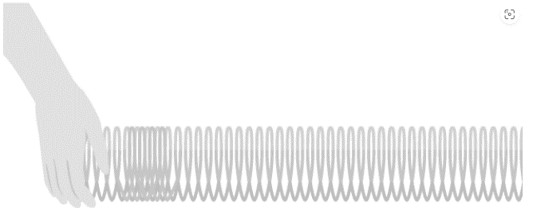

1 2 3 4 5 6 7 8 9 10 11 12 13 14 15 16 17 18 19 20 21 22 23 24 25 26 27 28 29 30 | In the diagram above, the compressions move from left to right and energy is transferred from left to right. However, none of the particles are transported along a longitudinal wave. Instead, they move backwards and forwards between compressions as the wave is transmitted through the medium. In longitudinal waves, the particles oscillate parallel to the direction of wave propagation Transverse waves In transverse waves, the vibrations are at right angles to the direction of wave travel. Examples of transverse waves include: ripples on the surface of water vibrations in a guitar string a Mexican wave in a sports stadium electromagnetic waves - eg light waves, microwaves, radio waves seismic S-waves One way to remember the movement of particles in transverse waves is to use the 'S' sound: transverse waves such as seismic S-waves may be thought of as shake or shear waves as the particles move from side-to-side - crossing the direction of wave travel. Demonstrating transverse waves Transverse waves are often demonstrated by moving a rope rapidly up and down.

Slide 7
1 2 3 4 5 6 7 8 9 10 11 12 13 14 15 16 17 18 19 20 21 22 23 24 25 26 27 28 29 30 | In the diagram above, the rope moves up and down, producing peaks and troughs. Energy is transferred from left to right. However, none of the particles are transported along a transverse wave. The particles move up and down as the wave is transmitted through the medium. In a transverse wave the medium or the channel moves perpendicular to the direction of the wave.

Slide 8
Rehearsal questions - Types of wave
1. What do all waves do?
………………………………………………………………………………………………………………………………………………………………
………………………………………………………………………………………………………………………………………………………….…
2. Name the 2 types of wave? …………………………………………………………………………………………………………………………………………………………
…………………………………………………………………………………………………………………………………………………………………
3. Ripples on water , light waves, a Mexican wave are what type of wave? .………………………………………………………………………………………………………………………………………………………………
…………………………………………………………………………………………………………………………………………………………….....
4. Give 2 examples of longitudinal waves
…………………………………………………………………………………………………………………………………………………………………
…………………………………………………………………………………………………………………………………………………………………
5. Which type of wave needs particles for the energy to be transferred?
…………………………………………………………………………………………………………………………………………………………………
…………………………………………………………………………………………………………………………………………………………………
6. Which type of wave transfers light through the medium of space?
………………………………………………………………………………………………………………………………………………………...........
…………………………………………………………………………………………………………………………………………………………………
7. How is energy transferred from one place to another?
…………………………………………………………………………………………………………………………………………………………………
…………………………………………………………………………………………………………………………………………………………………
8. Give 3 examples of transverse waves
………………………………………………………………………………………………………………………………………...........................
……………………………………………………………………………………………………………………………………………………………….
9. What can be grouped into Transverse & Longitudinal?
.............................................................................................................................................................................................................................................................................................................................................
10. Sound waves are what type of wave?
…………………………………………………………………………………………………………………………………………………………………………………………………………………………………………………………………………………………………………………………………..

Slide 9
YOU DO Wrong answers – Types of wave
Read the passage below. Underline incorrect words/phrases, and correct them.
All waves transfer matter not energy through a substance. When a particle in the medium travels parallel to direction of wave it is a transverse wave and if it travels perpendicular to direction of wave it is a longitudinal wave. Sound waves and earthquake S waves are examples of longitudinal waves. Water waves and earthquake P waves are examples of transverse waves. Longitudinal waves have two parts: compression and rarefraction whereas transverse waves have two parts: crests and troughs. A longitudinal wave is a wave wherein the movement of the medium is at right angles to the wave while a transverse wave is a wave wherein the movement of the medium is in the same direction to that of the wave. A longitudinal wave acts in two directions while a transverse wave acts in one direction. Longitudinal waves can be produced on the surface of a liquid or a vacuum whilst transverse waves can be produced in a solid, liquid, or gas.

Slide 10
Contrasting concepts: Types of wave
I DO: Compare the movement of the two types of wave
.……………………………………………………………………............................................................................................... …………………………………………………………………………………………………………………………………………………………........
.……………………………………………………………………............................................................................................... …………………………………………………………………………………………………………………………………………………………........
WE DO: Compare the function of the two wave types.
.……………………………………………………………………............................................................................................... …………………………………………………………………………………………………………………………………………………………........
.……………………………………………………………………............................................................................................... …………………………………………………………………………………………………………………………………………………………........
YOU DO: Compare the features of the two wave types.
.……………………………………………………………………............................................................................................... …………………………………………………………………………………………………………………………………………………………........
.……………………………………………………………………............................................................................................... …………………………………………………………………………………………………………………………………………………………........
YOU DO: Compare seismic P (primary) and S (secondary) waves.
.……………………………………………………………………............................................................................................... …………………………………………………………………………………………………………………………………………………………........
.……………………………………………………………………............................................................................................... …………………………………………………………………………………………………………………………………………………………........
YOU DO: Compare the transmission of energy and matter by both types of wave
.……………………………………………………………………............................................................................................... …………………………………………………………………………………………………………………………………………………………........
.……………………………………………………………………............................................................................................... …………………………………………………………………………………………………………………………………………………………........
.……………………………………………………………………............................................................................................... …………………………………………………………………………………………………………………………………………………………........

Slide 11
Spaced Retrieval – Types of wave
Waves transfer energy between energy stores. What can you remember about energy stores & transfers?
1. What is meant by the term ‘an energy store?
………………………………………………………………………………………………………………………………………………….…..……......…………………………………………………………………………………………………………………………………………….……..………….
2. What is meant by an energy transfer? ………………………………………………………………………………………………………………………………………………….…..……......…………………………………………………………………………………………………………………………………………….……..………….
3. What is meant by a closed system? ………………………………………………………………………………………………………………………………………………….…..……......…………………………………………………………………………………………………………………………………………….……..………….
4.Name the energy store in food, fuel ………………………………………………………………………………………………………………………………………………….…..…….....
5. If an object gains height, which energy store increases? ………………………………………………………………………………………………………………………………………………….…..……..... 6.What is meant by an ‘ energy pathway’?
………………………………………………………………………………………………………………………………………………….…..……......…………………………………………………………………………………………………………………………………………….……..………….
7. Name the four energy pathways ………………………………………………………………………………………………………………………………………………….…..……......…………………………………………………………………………………………………………………………………………….……..………….
8. Describe the energy pathway when energy is transferred by light or sound ………………………………………………………………………………………………………………………………………………….…..…….....
9. Describe the energy pathway when energy is transferred by compressing a spring
………………………………………………………………………………………………………………………………………………….…..…….....
10. Describe the energy stores & pathways when a weightlifter lifts a 150Kg mass
………………………………………………………………………………………………………………………………………………….…..……......…………………………………………………………………………………………………………………………………………….……..………….

Slide 12
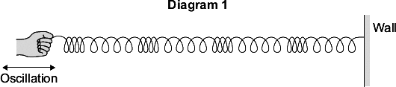
Exam questions
Q1. Diagram 1 shows a longitudinal wave being produced in a stretched spring.
A longitudinal wave has areas of compression and areas of rarefaction.
Mark with the letter C, one area of compression shown in Diagram 1.
Mark with the letter R, one area of compression shown in Diagram 1.
(2)
Q2.Waves may be longitudinal or transverse.
(a) Describe the differences between longitudinal waves and transverse waves. …………………………………………………………………………………………………………………………………………………………………………………………………………………………………………………………………………………………………………….. …………………………………………………………………………………………………………………………………………………………………………………………………………………………………………………………………………………………………………….. ………………………………………………………………………………………………………………………………………………………………………………………………………………………………………………………………………………………………………………
(3)

Slide 13
Exam questions
Q3. Explain how the compressions and rarefactions in a sound wave allow sound to be detected by the human ear
…………………………………………………………………………………………………………………………………………………………………………………………………………………………………………………………………………………………………………….. …………………………………………………………………………………………………………………………………………………………………………………………………………………………………………………………………………………………………………….. ……………………………………………………………………………………………………………………………………………………………………………………………………………………………………………………………………………………………………………..
(3)
Q4.
(a) Sound and light are different types of waves. Give two similarities and two differences between sound waves and light waves.
…………………………………………………………………………………………………………………………………………………………………………………………………………………………………………………………………………………………………………….. …………………………………………………………………………………………………………………………………………………………………………………………………………………………………………………………………………………………………………….. …………………………………………………………………………………………………………………………………………………………………………………………………………………………………………………………………………………………………………….. ……………………………………………………………………………………………………………………………………………………………………………………………………………………………………………………………………………………………………………..
(4)

Slide 14
Subtopic 1a: Transverse & Longitudinal Waves
I wasn’t there but I still care!
Using the Physics AQA Text book from pages 174 -175 and the glossary on pages 284-287 to help you answer the following;
Name the 2 groups that waves can be categorised as
……………………………………………………………………………………………………………………………………………………………………………………………………………………………………………………………………………………………………………………
Define the term Transverse Wave ……………………………………………………………………………………………………………………………………………………………………………………………………………………………………………………………………………………………………………………
Define the term Longitudinal wave: ……………………………………………………………………………………………………………………………………………………………………………………………………………………………………………………………………………………………………………………
Give 2 examples of longitudinal waves ……………………………………………………………………………………………………………………………………………………………………………………………………………………………………………………………………………………………………………………
Give 2 examples of transverse waves
……………………………………………………………………………………………………………………………………………………………………………………………………………………………………………………………………………………………………………………
Describe 2 differences between longitudinal & transverse waves
……………………………………………………………………………………………………………………………………………………………………………………………………………………………………………………………………………………………………………………

Slide 15
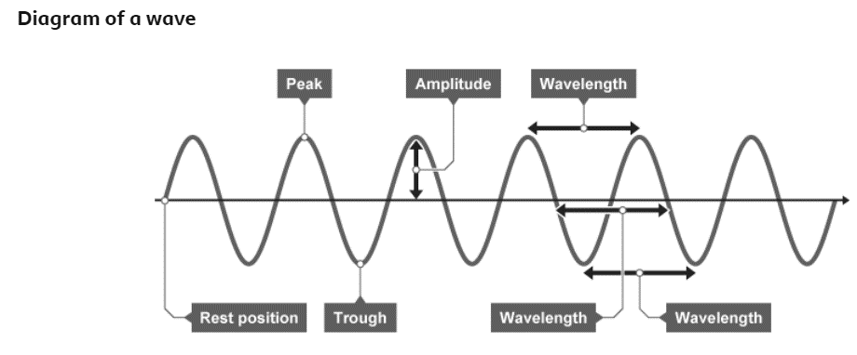
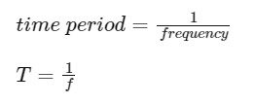
1 2 3 4 5 6 7 8 9 10 11 12 13 14 15 16 17 18 19 20 21 22 23 24 25 26 27 28 29 30 | Properties of waves Parts of a wave Waves are described using the following terms: Rest position – the undisturbed position of particles or fields when they are not vibrating. Displacement – the distance that a certain point in the medium has moved from its rest position. Peak – the highest point above the rest position. Trough – the lowest point below the rest position. Amplitude – the maximum displacement of a point of a wave from its rest position. Wavelength – distance covered by a full cycle of the wave. Usually measured from peak to peak, or trough to trough. Time period – the time taken for a full cycle of the wave. Usually measured from peak to peak, or trough to trough. Frequency – the number of waves passing a point each second. Wave period and period of a wave can be calculated using the equation: Wave period and wave speed The time period of a wave can be calculated using the equation: This is when: time period (T) is measured in seconds (s) frequency (f) is measured in hertz (Hz)

Slide 16
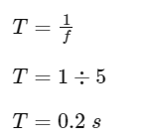

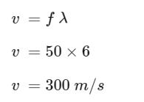
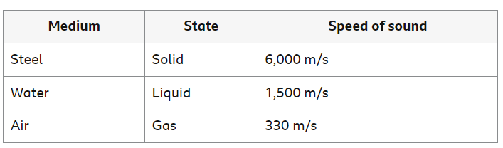
1 2 3 4 5 6 7 8 9 10 11 12 13 14 15 16 17 18 19 20 21 22 23 24 25 26 27 28 29 30 | Example Calculate the time period of a wave with a frequency of 5 Hz. Calculating wave speed Wave velocity, the speed of a wave, can be calculated using the equation: wave speed = frequency × wavelength This is when: wave speed (T) is measured in metres per second (m/s) frequency (f) is measured in Hertz (Hz) wavelength (λ ) is measured in metres (m) Example calculation What is the wave speed if the frequency is 50 Hz and the wavelength is 6 m? The speed of sound in different materials Sound is a mechanical longitudinal wave. The wave is passed on by collisions between particles, so the speed the wave moves depends on the density of the particles.

Slide 17

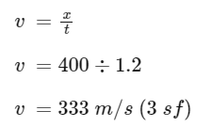
1 2 3 4 5 6 7 8 9 10 11 12 13 14 15 16 17 18 19 20 21 22 23 24 25 26 27 28 29 30 | When sound moves from one medium into another, the change in speed will also cause a change in wavelength, frequency is unaffected. wave speed = frequency × wavelength Constant frequency means that the wavelength will be proportional to the wave velocity. Measuring the speed of sound in air The air is made up of many tiny particles. When sound is created, the air particles vibrate and collide with each other, causing the vibrations to pass between air particles. The vibrating particles pass the sound through to a person’s ear and vibrate the ear drum. Light travels much faster than sound through air. For example, a person fires a starting pistol and raises their hand in the air at the same time. A distant observer standing 400 metres (m) away records the time between seeing the action (the light reaches the timekeeper immediately) and hearing the sound (which takes more time to cover the same distance). The speed of sound can be calculated using the equation: This is when: wave speed (v) is measured in metres per second (m/s) distance (x) is measured in metres (m) time (t) is measured in seconds (s) Example calculation An observer 400 m away records a 1.2 s time difference between seeing the hand signal and hearing the bang of the starting pistol. The accepted value for the speed of sound in air is 330 m/s. However, this experimental method is flawed as humans do not use stop clocks identically to one another. The values recorded will be dependent on the reaction time of the observer, and will not be entirely accurate – this explains why the answer of 333 m/s is slightly above the accepted value for the speed of sound in air.

Slide 18
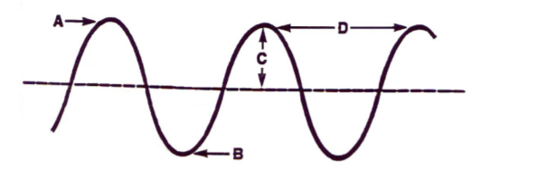
Rehearsal questions - Properties of waves
1. Label the features of the wave in the diagram
A =………………………
B = ………………………
C = ………………………
D = ………………………
2. Define the term wave amplitude? …………………………………………………………………………………………………………………………………………………………
…………………………………………………………………………………………………………………………………………………………………
3. What is meant by the wavelength of a wave? .………………………………………………………………………………………………………………………………………………………………
…………………………………………………………………………………………………………………………………………………………….....
4. What is meant by the frequency of a wave?
…………………………………………………………………………………………………………………………………………………………………
…………………………………………………………………………………………………………………………………………………………………
5. How does the period of a wave differ to its frequency?
…………………………………………………………………………………………………………………………………………………………………
…………………………………………………………………………………………………………………………………………………………………
6. Recall the wave equation
………………………………………………………………………………………………………………………………………………………...........
7. If 10 waves pass in 1 second, what does this tell you about the wave?
…………………………………………………………………………………………………………………………………………………………………
8. The highest point on a transverse wave is the .
…………………………………………………………………………………………………………………………………………………………………
9. The lowest point on a transverse wave is the .
…………………………………………………………………………………………………………………………………………………………………
10. The distance from one crest to the next crest is the .
…………………………………………………………………………………………………………………………………………………………………
11. This is a measure of the time taken for 1 wave top pass a point ………………………………………………………………………………………………………………………………………...........................

Slide 19
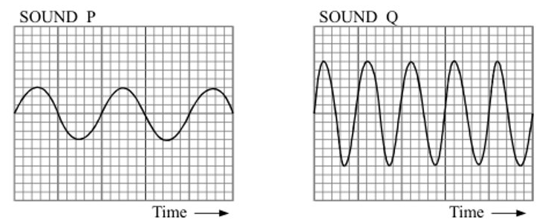
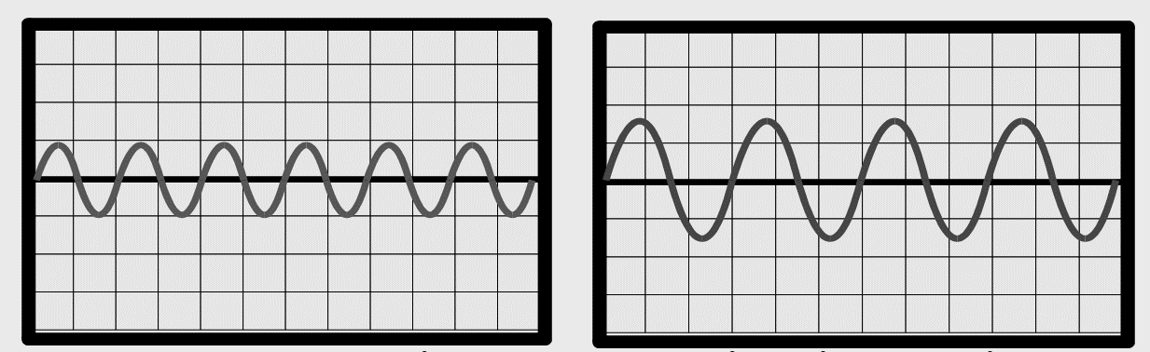
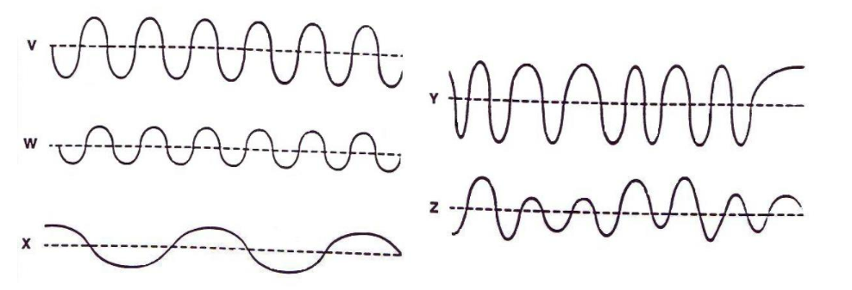
Contrasting concepts
I DO: Compare the features of the 2 waves
.……………………………………………………………………............................................................................................... …………………………………………………………………………………………………………………………………………………………........
.……………………………………………………………………............................................................................................... …………………………………………………………………………………………………………………………………………………………........
WE DO: Compare the features of the 2 waves below.
.……………………………………………………………………............................................................................................... …………………………………………………………………………………………………………………………………………………………........
.……………………………………………………………………............................................................................................... …………………………………………………………………………………………………………………………………………………………........
YOU DO: Compare the features of the waves below.

Slide 20
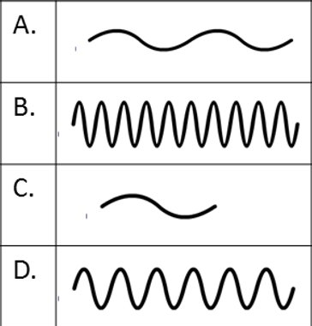
Contrasting concepts
a. Waves V and W have the same ……………… but wave V has twice the ………………………… the of wave W.
b. Waves W and X have the same……………….. but wave X has half the …………………………. of wave W.
c. Wave …………….. shows a steady frequency but a changing amplitude but wave ……………. shows a steady amplitude but a changing frequency.
d. Waves ………………. and ……………………. have a low amplitude and a steady frequency but wave ………. has a high amplitude
e. When the particles of the medium move back and forth along the direction of the wave motion, the wave is …………………………….. but a wave in which the particles of the medium move at right angles to the direction in which the wave travels is called a ………………………………..
f. Compare the differences between the waves A, B, C, D
A =………………………………………………………………………………….
B = …………………………………………………………………………………
C = ………………………………………………………………………………..
D = ………………………………………………………………………………..

Slide 21
Procedural knowledge
I DO: Compare the movement of the two types of wave
.……………………………………………………………………............................................................................................... …………………………………………………………………………………………………………………………………………………………........
.……………………………………………………………………............................................................................................... …………………………………………………………………………………………………………………………………………………………........
WE DO: Compare the function of the two wave types.
.……………………………………………………………………............................................................................................... …………………………………………………………………………………………………………………………………………………………........
.……………………………………………………………………............................................................................................... …………………………………………………………………………………………………………………………………………………………........
YOU DO: Compare the features of the two wave types.
.……………………………………………………………………............................................................................................... …………………………………………………………………………………………………………………………………………………………........
.……………………………………………………………………............................................................................................... …………………………………………………………………………………………………………………………………………………………........
YOU DO: Compare seismic P (primary) and S (secondary) waves.
.……………………………………………………………………............................................................................................... …………………………………………………………………………………………………………………………………………………………........
.……………………………………………………………………............................................................................................... …………………………………………………………………………………………………………………………………………………………........
YOU DO: Compare the transmission of energy and matter by both types of wave
.……………………………………………………………………............................................................................................... …………………………………………………………………………………………………………………………………………………………........
.……………………………………………………………………............................................................................................... …………………………………………………………………………………………………………………………………………………………........
.……………………………………………………………………............................................................................................... …………………………………………………………………………………………………………………………………………………………........

Slide 22
Procedural knowledge
Calculating wave speed
I DO:
If the wavelength is 10m and the frequency is 5Hz what is the wave speed?​
Equation ……………………………………………………......................................................................................... Substitute values ……………………………………………………………………………………………………………………........
Calculate wave speed …………………………...............................................................................................
WE DO:
If the wavelength is 250m and the frequency is 3Hz what is the wave speed?​
Equation ……………………………………………………......................................................................................... Substitute values ……………………………………………………………………………………………………………………........
Calculate wave speed …………………………...............................................................................................
YOU DO:
a. If the wavelength 40m and the frequency is 10Hz what is the wave speed?​
Equation ……………………………………………………......................................................................................... Substitute values ……………………………………………………………………………………………………………………........
Calculate wave speed …………………………...............................................................................................
b. If the wavelength is 4.25m and the frequency is 80Hz what is the wave speed?​
Calculate wave speed …………………………...............................................................................................
c. If the wavelength is 25cm and the frequency is 600Hz what is the wave speed?​
Calculate wave speed …………………………...............................................................................................
d. If the wavelength is 1.0Km and the frequency is 3Hz what is the wave speed?​
Calculate wave speed …………………………...............................................................................................
e. If the wavelength is 1.3 Km and the frequency is 0.3KHz what is the wave speed?​
Calculate wave speed …………………………...............................................................................................
f. A radio wave has a wavelength of 1Km and a frequency of 3x10⁵ Hz. Calculate the wave speed. …………………………........................................................................................................................

Slide 23
Procedural knowledge
Calculating wave frequency
I DO:
If the wavelength is 40m and the wave speed is 500m/s what is the wave frequency?​
Equation ……………………………………………………......................................................................................... Substitute values ……………………………………………………………………………………………………………………........
Calculate wave speed …………………………...............................................................................................
WE DO:
If the wavelength is 2m and the speed is 3m/s what is the wave frequency?​
Equation ……………………………………………………......................................................................................... Substitute values ……………………………………………………………………………………………………………………........
Calculate wave speed …………………………...............................................................................................
YOU DO:
A wave travelling at 1000 m/s has a wavelength of 2 m. Calculate the frequency of the wave. Equation ……………………………………………………..................................................................................................
Substitute values ……………………………………………………………………………………………………………………..........
Calculate wave speed …………………………...............................................................................................
b. Calculate the frequency of a wave that travels at 1 km/s and has a wavelength of 333m
Calculate wave frequency …………………………...................................................................................................................................
c. . Calculate the frequency of a wave that travels at 0.5km/s and has a wavelength of 30cm
Calculate wave frequency …………………………...................................................................................................................................
d. . A wave has a wavelength of 7500cm and a speed of 3.0x10⁸m/s. What is it’s frequency?
Calculate wave frequency in kHz …………………………...................................................................................................................................

Slide 24
Procedural knowledge
Calculating wave length & time period
I DO:
If the frequency is 12.5Hertz and the wave speed is 500m/s what is the wave length?​
Equation ……………………………………………………......................................................................................... Substitute values ……………………………………………………………………………………………………………………........
Calculate wave speed …………………………...............................................................................................
WE DO:
If the wavespeed is 4m/s and the frequency is 3Hz what is the wavelength ?​
Equation ……………………………………………………......................................................................................... Substitute values ……………………………………………………………………………………………………………………........
Calculate wave speed …………………………...............................................................................................
YOU DO:
a. If waves travel at 0.5m/s and the and 5 waves pass every second, what is their wavelength ?​
Equation ……………………………………………………......................................................................................... Substitute values ……………………………………………………………………………………………………………………........
Calculate wave speed …………………………...............................................................................................
b. A paddle moving up & down in a swimming pool is used to produce waves in the water. The speed of the waves is 2.4m/s and 2 waves pass every second, how far apart are the waves?
……………………………………………………........................................................................................................
…………………………..……………………………………………………………………………………………………………………........
c. A wave travelling at 3km/s has a frequency of 3kHz
  Calculate the wavelength ………………………………………………………………………………………..
  Calculate the time period of the wave.
  …………………………………………………….........................................................................................
  How many complete wave cycles will occur in:
    1 second? ……………………………...........................................................................
    10 seconds? …………………………….......................................................................
    1 minute? ………………...............................................................................................

Slide 25
Spaced Retrieval – Properties of waves
We have used the wave equation which includes wave speed.
1. What is the equation to determine the speed of a moving object?
………………………………………………………………………………………………………………………………………………….…..……......…………………………………………………………………………………………………………………………………………….……..………….
2. What are the units for each component of the equation?
………………………………………………………………………………………………………………………………………………….…..……......…………………………………………………………………………………………………………………………………………….……..………….
3. In a race, a horse travels 1280 metres in 80 seconds. What is the average speed of the horse?
………………………………………………………………………………………………………………………………………………….…..……......…………………………………………………………………………………………………………………………………………….……..………….
4.A cyclist rides at 40km/hour for 2.5 hours. How many kilometres does he ride? ………………………………………………………………………………………………………………………………………………….…..…….....
5. A man needs to walk to work 3Km away. He walks at 1.5m/s. How long will it take him to get to work? ………………………………………………………………………………………………………………………………………………….…..……..... 6.If he rode his bike at 6m/s, how long would it take him?
………………………………………………………………………………………………………………………………………………….…..……......…………………………………………………………………………………………………………………………………………….……..………….
7. A person walks 100 metres North and then 10 metres South. Calculate the distance they travel & their displacement. ………………………………………………………………………………………………………………………………………………….…..……......…………………………………………………………………………………………………………………………………………….……..………….

Slide 26
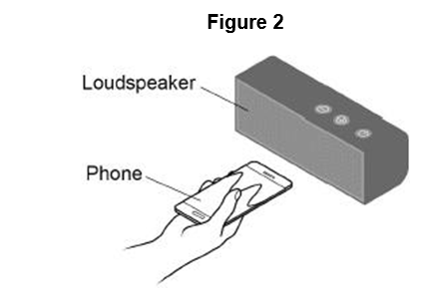
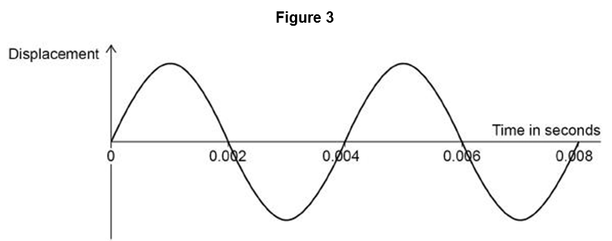

Exam questions
Q1 (a) A wave has a frequency of 1650 Hz and a wavelength of 0.200 m. Calculate the wave speed.
Use the equation: wave speed = frequency × wavelength
………………………………………………………………………………………………………………………………………………….…..……......…………………………………………………………………………………………………………………………………….. (2)
A student uses a mobile phone app that displays sound waves.
Figure 2 shows the student holding the mobile phone close to a loudspeaker
Figure 3 shows the wave pattern seen on the phone screen.
(b) What is the period of the wave shown in Figure 3?
Tick (✓) one box.

Slide 27
(c) Determine the frequency of the wave shown in Figure 3.
…………………………………………………………………………………………………………………………………………………………………………………………………………………………………………………………………………………………………………….. ……………………………………………………………………………………………………………………………………………………………………………………………………………………………………………………………………………………………………………..
Frequency = ………………… Hz (3)
Q2.
(a) Write down the equation that links frequency, wave speed and wavelength.
Equation………………………………………………………………………………………………………………………………(1)
(b) A baby monitor has a sensor unit that transmits an image of the baby and the noises the baby makes to a monitor unit. The signals for a baby monitor unit are transmitted as electromagnetic waves with a wavelength of 0.125 m.
Wave speed of electromagnetic waves = 3 × 10⁸ m / s
Calculate the frequency of the signal.
…………………………………………………………………………………………………………………………………………………………………………………………………………………………………………………………………………………………………………….. ……………………………………………………………………………………………………………………………………………………………………………………………………………………………………………………………………………………………………………..
Frequency = __________________ Hz (3)
Exam questions

Slide 28
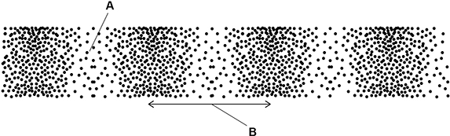
Exam questions
Q3. (a) Figure 1 shows a longitudinal wave.
(a) What do the labels A and B on Figure 1 represent? Choose answers from the box.
A = ………………………………………………………. B = ……………………………………………………… (2)
(b) The wave shown in Figure 1 has a frequency of 4.0 kHz . Calculate the period of the wave.
Give the unit.
…………………………………………………………………………………………………………………………………………………………………………………………………………………………………………………………………………………………………………….. ……………………………………………………………………………………………………………………………………………………………………………………………………………………………………………………………………………………………………………..
Period = __________________ Unit = …………………………………………. (4)
(c) Sound waves are longitudinal.
Figure 2 shows how the speed of sound varies with the temperature of the air.

Slide 29
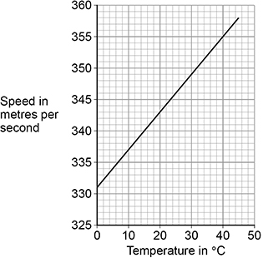
Exam questions
Figure 2
allow a correct rearrangement using an incorrect value of v read from graph
1
1.16 (m)
allow 1.2 (m)
allow a correct calculation using an incorrect value of v read from graph
allow a maximum of 2 marks for use of v = 330 m/s
1
(c) Write down the equation that links frequency (f), wavelength (λ) and wave speed (v).
…………………………………………………………………………………………………………………………………………………(1)
(d) A sound wave with a frequency of 300 Hz travels through the air.
The air has a temperature of 28.0 °C. Determine the wavelength of the sound wave.
Use Figure 2 above
…………………………………………………………………………………………………………………………………………………………………………………………………………………………………………………………………………………………………………….. ……………………………………………………………………………………………………………………………………………………………………………………………………………………………………………………………………………………………………………..
Wavelength = _______________ m (4)

Slide 30
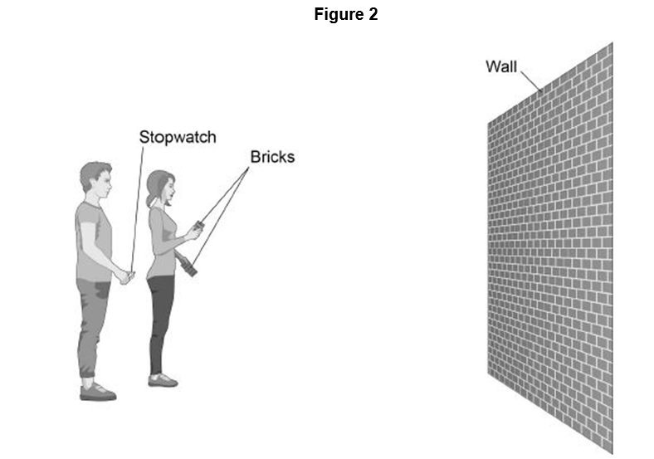
Exam questions
Q4. Figure 2 shows two students measuring the speed of sound in air.
One student bangs two bricks together. The sound wave produced is reflected from the wall and travels back to the students. Describe how they can determine the speed of sound.
…………………………………………………………………………………………………………………………………………………………………………………………………………………………………………………………………………………………………………….. …………………………………………………………………………………………………………………………………………………………………………………………………………………………………………………………………………………………………………….. …………………………………………………………………………………………………………………………………………………………………………………………………………………………………………………………………………………………………………….. …………………………………………………………………………………………………………………………………………………………………………………………………………………………………………………………………………………………………………(4)
M2.(a) wave speed = frequency × wavelength
accept v = f λ

Slide 31
Subtopic 2: Required Practical - Waves
Learning Objective
Students should be able to:
• identify amplitude and wavelength from given diagrams
• describe a method to measure the speed of sound waves in air
• describe a method to measure the speed of ripples on a water surface.
Why are we learning about this?
This lessons helps us understand how we can use real examples of everyday waves and pieces of measuring equipment to work out how fast waves travel. Knowing the speed of waves can help to determine the speed at which energy or information will get transferred from one space to another, distance from Earth t distant objects in the Universe or time taken for energy or information to reach certain objects.

Slide 32
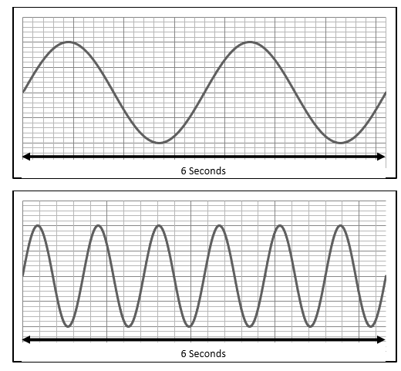
I wasn’t there but I still care!
Using the Physics AQA Text book from pages 176 -177 and the glossary on pages 284-287 to help you answer the following;
Define the term wavelength of a wave ……………………………………………………………………………………………………………………………………………………………………………………………………………………………………………………………………………………………………………………
Define the term frequency of a wave ……………………………………………………………………………………………………………………………………………………………………………………………………………………………………………………………………………………………………………………
Recall the equation that determines wave speed …………………………………………………………………………………………………………………………………………………………
Recall the equation that determines the time period of a wave
…………………………………………………………………………………………………………………………………………………………
Draw on the wavelength and the amplitude of the following waves.
A speedboat sends waves across a lake at a frequency of 2Hz and a wavelength of 3m. Calculate the speed of the waves
……………………………………………………………………………………………………………………………………………………………………………………………………………………………………………………………………………………………………………………

Slide 33
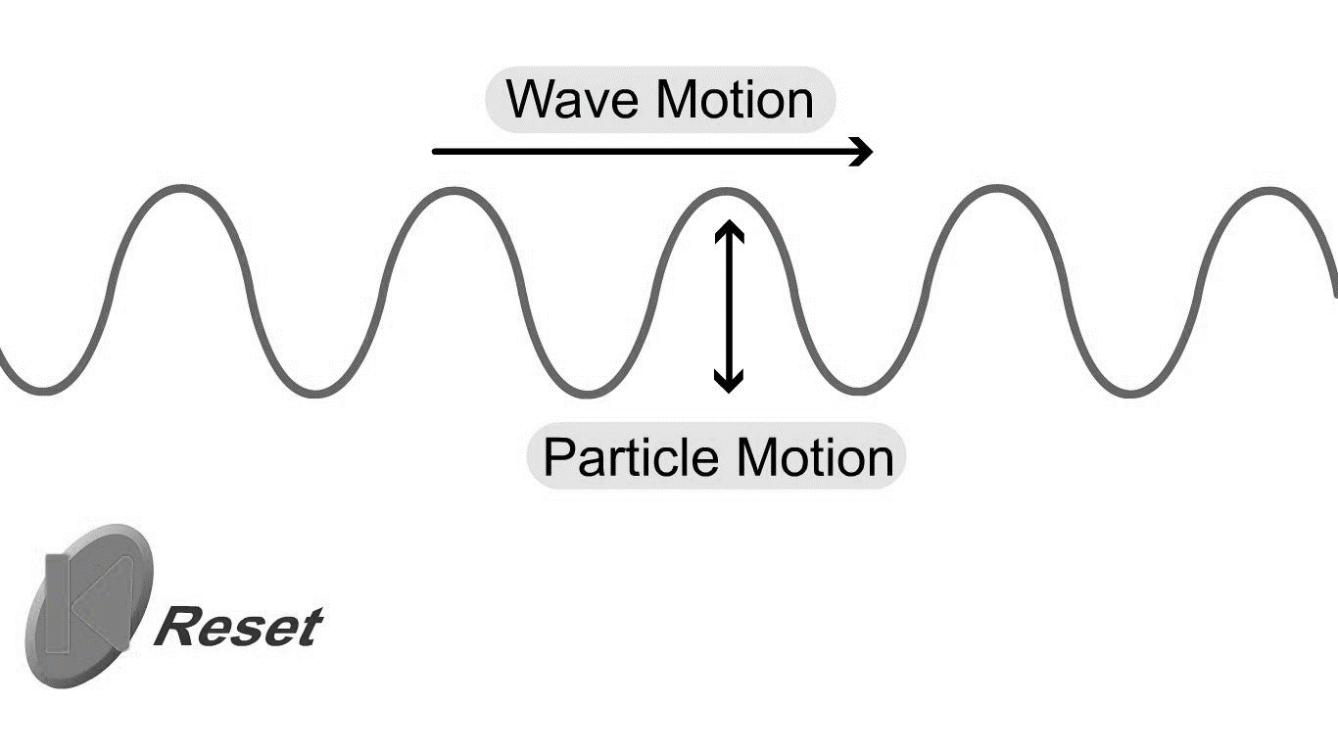
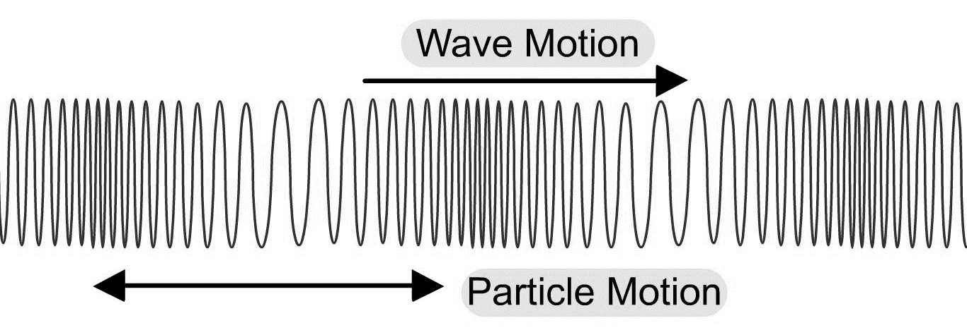
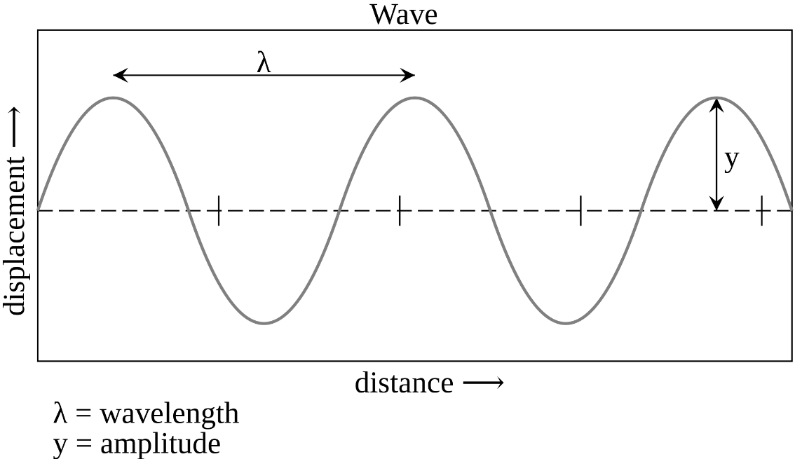
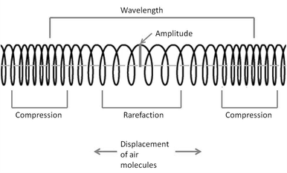
I wasn’t there but I still care!
Task: Read and complete the missing words. Use the diagrams to help you
In a ________________ wave the particles within the wave move perpendicular (at 90º) to the direction the wave is travelling. This is the wave produced in a rope when it is flicked up and down.
Examples of transverse waves are _________________, electromagnetic (light) waves and guitar strings.
________________ waves are compression (squash) waves where the particles are vibrating in the same direction as the wave movement. This is the wave produced when a spring is squashed and released.
Examples of longitudinal waves are: _____________and a type of seismic (P) wave.
Task: Write in the correct measurement and unit for each description
______________–the distance from one point on a wave to the same point on the next wave.
______________– the waves maximum displacement of a point on a wave from its undisturbed position.
______________– the number of waves passing a point per second.
_______________- the time taken to produce one complete wave.
Transverse Wave
Longitudinal Wave
Remember, the particles in a wave move up and down or backwards and forwards only.
It is energy, NOT the particles, that move from one place to another!
Longitudinal, water waves, sound waves, transverse
The displacement of a transverse wave is described as peaks and troughs. In a longitudinal wave these are described as compressions and rarefactions.
Frequency (Hz) Wavelength (m Period (s)
Amplitude (m) ),

Slide 34

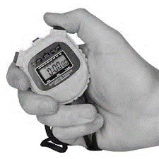
1 2 3 4 5 6 7 8 9 10 11 12 13 14 15 16 17 18 19 20 21 22 23 24 25 26 27 28 29 30 | Measuring the Speed of a wave through different medium Measuring the speed of a wave through the air The air is made up of particles. When sound is created, the air particles vibrate and collide with each other, causing the vibrations to pass between air particles. The vibrating particles pass the sound through to a person's ear and vibrate the ear drum. Light travels much faster than sound through air. For example, a person fires a cannon pistol which releases a flash of light when fired) . A distant observer stood 400 metres (m) away records the time between seeing the action (the light reaches the time keeper immediately) and hearing the sound (which takes more time to cover the same distance). The speed of sound can be calculated using the equation: speed = distance ÷ time This is when: speed (v) is measured in metres per second (m/s) distance (s) is measured in metres (m) time (t) is measured in seconds (s) Example An observer 400 m away records a 1.2 s time difference between seeing the hand signal and hearing the bang of the starting pistol. v=d ÷ t =400÷1.2 v=333 (m/s) (to 3 sig.fig.) The accepted value for the speed of sound in air is 330 m/s. However, this experimental method is flawed as humans do not use stop clocks identically to one another. One person might stop the timer a fraction of a second later than another person. The values recorded will be dependent on the reaction time of the observer, and will not be entirely accurate. This explains why the answer of 333 m/s is slightly above the accepted value for the speed of sound in air.

Slide 35
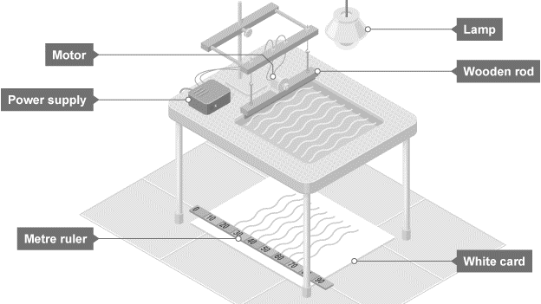
1 2 3 4 5 6 7 8 9 10 11 12 13 14 15 16 17 18 19 20 21 22 23 24 25 26 27 28 29 30 | Measuring the Speed of a wave through different medium Required practical - measuring waves in a ripple tank Measure the frequency, wavelength and speed of waves in a ripple tank A ripple tank can be used to measure and calculate frequency, wavelength and the speed of waves on the surface of the water. A ripple tank is a transparent shallow tray of water with a light shining down through it onto a white card below to clearly see the motion of the ripples created on the water’s surface. Ripples can be made by hand but to generate regular ripples it is better to use a motor. Aim of the experiment To measure the frequency, wavelength and speed of waves in a ripple tank. Method 1. Set up the ripple tank as shown in the diagram with about 5 cm depth of water. 2. Adjust the height of the wooden rod so that it just touches the surface of the water. 3. Switch on the lamp and motor and adjust until low frequency waves can be clearly observed. 4. Measure the length of a number of waves then divide by the number of waves to record wavelength. It may be more practical to take a photograph of the card with the ruler and take measurements from the still picture. 5. Count the number of waves passing a point in ten seconds then divide by ten to record frequency. 6. Calculate the speed of the waves using: wave speed = frequency × wavelength. Example results table:
Length of 10 waves (cm) | Wavelength (cm) | Number of waves in 10s | Frequency (Hz) | Wave Speed (cm/s)

Slide 36
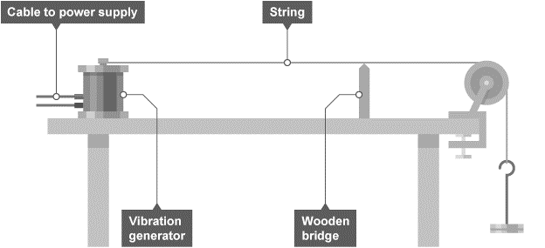
1 2 3 4 5 6 7 8 9 10 11 12 13 14 15 16 17 18 19 20 21 22 23 24 25 26 27 28 29 30 | Measuring the Speed of a wave through different medium Measure the frequency, wavelength and speed of waves in a solid There are many ways that the speed of waves in a solid can be measured. One method involves the use of a vibration generator. Aim of the experiment To measure the frequency, wavelength and speed of waves in a string. Method 1. Attach a string or cord to a vibration generator and use a 200 gram (g) hanging mass and pulley to pull the string taut as shown in the diagram. Place a wooden bridge under the string near the pulley. 2. Switch on the vibration generator and adjust the wooden bridge until stationary waves can be clearly observed. 3. Measure the length of as many half wavelengths as possible, divide by the number of half wavelengths. This is half the wavelength, doubling this gives the wavelength. 4. The frequency is the frequency of the power supply. Calculate the speed of the waves using: wave speed = frequency × wavelength.
Number of half wavelengths | Length of X half wavelengths (m) | Wavelength (m) | Frequency (Hz) | Wave speed (m/s)

Slide 37
Rehearsal Questions
Measuring Speed of a wave in air
In a sound wave what happens to the particles during
a) A compression……………………………………………………………………………………………………………………………
b) rarefaction………………………………………………………………………………………………………………………………….
2. How is speed of a wave calculated?
............................................................................................................................................................
3. What type of waves are sound waves? …………………………………………………………………………………….
4. What is the relationship between distance, speed and time?
………………………………………………………………………………………………………………………………………………………….
5. Describe how longitudinal waves travel through air.
………………………………………………………………………………………………………………………………………………………………………………………………………………………………………………………….............................................................
Measuring Speed of a wave through water
What is meant by the term wave frequency?
………………………………………………………………………………………………………………………………............................
2. How are waves created in a ripple tank? …………………………………………………………………………………….
3. Write the equation that links wavelength, frequency and wave speed.
………………………………………………………………………………………………………………………………………………………..
4. Using a ripple tank, what piece of equipment would you use to measure the length of a wave?
…………………………………………………………………………………………………………………………………………………………
5. What is the relationship between frequency, wave speed and wavelength?
…………………………………………………………………………………………………………………………………………………………
Using a ripple tank, how would you use the shadow of waves to calculate frequency?
………………………………………………………………………………………………………………………………………………………………………………………………………………………………………………………………………………………..………………………….

Slide 38
Rehearsal Questions: Measuring Speed of a wave through a solid (on a string)
Recall and write the 2 different equations that can be used to calculate wave speed?
…………………………………………………………………………………………………………………………………………………………………………………………………………………………………………………………………………………………………………………………………………………………………………………………………………………………………………………………………………………………………………………………………………………………………………………………………………………………………………
During the waves on a string practical, what solid material is the wave travelling through?
………………………………………………………………………………………………………………………………………………...........
During the waves on a string practical, what is the purpose of the wooden bridge?
………………………………………………………………………………………………………………………………….…………………….
During the waves on a string practical how would you find out the frequency of the wave?
………………………………………………………………………………………………………………………………………………………..
5. During the waves on a sting practical, how would you find the length of a full wave of the string?
……………………………………………………………………………………………………………………………………………………….
What is the relationship between frequency, wave speed and wavelength?
……………………………………………………………………………………………………………………………………………………….
7.How can you adjust the string so that it is showing a stationary wave on it?
…………………………………………………………………………………………………………………………………………………………………………………………………………………………………………………………………………………………………………………..
How could the wavelength be determined from the string?
………………………………………………………………………………………………………………………………………………………..
What information could the power supply provide?
……………………………………………………………………………………………………………………………………………………….

Slide 39
I DO: Describe how the speed of a sound wave can be measured through the air. Name the pieces of equipment in your method.
…………………………………………………………………………………………………………………………………………………………………………………………………………………………………………………………………………………………………………………………………………………………………………………………………………………………………………………………………………………………………………………………………………………………………………………………………………………………………………………………………………………………………………………………………………………………………………………………………..
…………………………………………………………………………………………………………………………………………………………………………………………………………………………………………………………………………………………………………………………………………………………………………………………………………………………………………………………………………………………………………………………………………………………………………………………………………………………………………………………………………………………………………………………………………………………………………………………………..
WE DO: Describe how the frequency of a wave can be determined using a ripple tank. Name pieces of equipment you would use.
…………………………………………………………………………………………………………………………………………………………………………………………………………………………………………………………………………………………………………………………………………………………………………………………………………………………………………………………………………………………………………………………………………………………………………………………………………………………………………………………………………………………………………………………………………………………………………………………………. …………………………………………………………………………………………………………………………………………………………………………………………………………………………………………………………………………………………………………………………………………………………………………………………………………………………………………………………………………………………………………………………………………………………………………………………………………………………………………………………………………………………………………………………………………………………………………………………………..
.

Slide 40
YOU DO: Describe how the wavelength of a wave on a string can be calculated . Name any measurements that would be taken and pieces of equipment used to measure. …………………………………………………………………………………………………………………………………………………………………………………………………………………………………………………………………………………………………………………………………………………………………………………………………………………………………………………………………………………………………………………………………………………………………………………………………………………………………………………………………………………………………………………………………………………………………………………………………..
…………………………………………………………………………………………………………………………………………………………………………………………………………………………………………………………………………………………………………………………………………………………………………………………………………………………………………………………………………………………………………………………………………………………………………………………………………………………………………………………………………………………………………………………………………………………………………………………………..
.
These questions are looking at errors made in the practical methods:
A student is using the ripple tank to calculate the wave speed. The student calculated the speed using the frequency and multiplied by the time taken for the wave to pass. Explain why the student has calculated the speed incorrectly.
…………………………………………………………………………………………………………………………………………………………………………………………………………………………………………………………………………………………………………………………………………………………………………………………………………………………………………………………………………………………………………………………………………………………………………………………………………………………………………………………………………………………………………………………………………………………………………………………………..
2. A students has said that the power supply to the string can be used to determine the wavelength of a wave? Explain why they are incorrect? ……………………………………………………………………………………………………………………………………………………………………………………………………………………………………………………………………………………………………………………

Slide 41
3. The student was calculating the frequency of the wave using a ripple tank by counting the number of waves on the piece of paper? The student has calculated this incorrectly. Explain why?
…………………………………………………………………………………………………………………………………………………………………………………………………………………………………………………………………………………………………………………………………………………………………………………………………………………………………………………………………………………………………………………………………………………………………………………………………………………………………………………………………………………………………………………………………………………………………………………………………..
4. A student wanted to measure the length of a wave using the ripple tank and measured the length between the first and the last wave shown on the piece of paper. Explain why the student has done this incorrectly?
…………………………………………………………………………………………………………………………………………………………………………………………………………………………………………………………………………………………………………………………………………………………………………………………………………………………………………………………………………………………………………………………………………………………………………………………………………………………………………………………………………………………………………………………………………………………………………………………………
5. A students wanted to measure the speed of a sound wave through air. They stood 100 m away from the wall and banged two blocks together, immediately started a stop watch and stopped it when they heard the echo back (so the sound wave hit the wall and reflected back to the students ears). It took 2.5 seconds. They calculated the speed by 100/2.5 and got an answer of 40m/s. The answer is incorrect. Explain why they have calculated this wrong?
……………………………………………………………………………………………………………………………………………………………………………………………………………………………………………………………………………………………………………………………………………………………………………………………………………………………………………………………………………………………………………………………………………………………………………………………………………………………………………………………………………………………………………………………………………………………………………………………………

Slide 42
6. A student wanted to measure the speed of a wave using a ripple tank. They used the following method:
For wavelength:
Use the shadows on the paper and measure the length between the first wave and the second wave.
For frequency:
Count the number of waves on the piece of paper for ten seconds.
Then divide the number of waves by 10 to get the frequency
For wave speed:
To calculate the wave speed = frequency / wavelength
There are some steps missing in these methods and some errors. Re write the methods to ensure that the students would accurately calculate the wave speed.
………………………………………………………………………………………………………………………………………………………………………………………………………………………………………………………………………………………………………………………………………………………………………………………………………………………………………………………………………………………………………………………………………………………………………………………………………………………………………………………………………………………………………………………………………………………………………………………
………………………………………………………………………………………………………………………………………………………………………………………………………………………………………………………………………………………………………………
………………………………………………………………………………………………………………………………………………………………………………………………………………………………………………………………………………………………………………………………………………………………………………………………………………………………………………………………………………………………………………………………………………………………………………………………………………………………………………………………………………………………………………………………………………………………………………………
………………………………………………………………………………………………………………………………………………………………………………………………………………………………………………………………………………………………………………

Slide 43
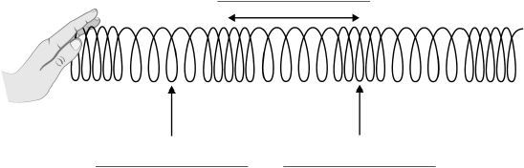
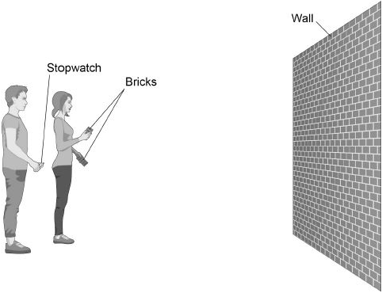
Low demand: Q1. Figure 1 shows a slinky spring used to model a sound wave.
Figure 1
(a) Label the arrows on Figure 1. Choose the answers from the box. (3)
(b) What type of wave is a sound wave? Tick one box.
electromagnetic
longitudinal
transverse (1)
(c) Figure 2 shows two students measuring the speed of sound in air.
Figure 2

Slide 44
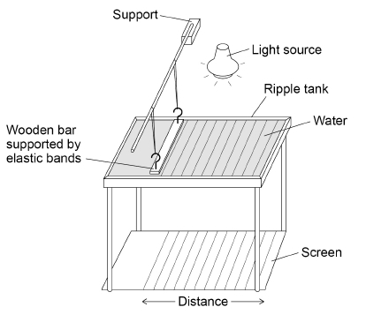
One student bangs two bricks together. The sound wave produced is reflected from the wall and travels back to the students. Describe how they can determine the speed of sound. (4)
……………………………………………………………………………………………………………………………………………………………………………………………………………………………………………………………………………………………………………………………………………………………………………………………………………………………………………………………………………………………………………………………………………………………………………………………………………………………………………………………………………………………………………………………………………………………………………………………………………………………………………………………………………………………………………………………………………………………………………………………………………………………………………………………………………………………………………………………………………
(Total 8 marks)
Medium Q2. Figure 1 below shows the equipment a teacher used to determine the speed of a water wave.
The equipment includes:
• a ripple tank filled with water
• a wooden bar that creates ripples on the surface of the water
• a light source which causes a shadow of the ripples on the screen.

Slide 45
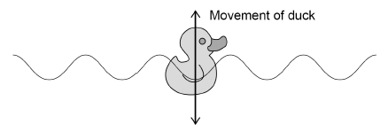
A )Describe how equipment in Figure 1 can be used to measure the wavelength, frequency and speed of a water wave.
………………………………………………………………………………………………………………………………………………………………………………………………………………………………………………………………………………………………………………………………………………………………………………………………………………………………………………………………………………………………………………………………………………………………………………………………………………………………………………………………………………………………………………………………………………………………………………………………………………………………………………………………………………………………………………………………………………………………………………………………………………………………………………………………………………………………………………………….
(6 marks)
The teacher put a plastic duck in the ripple tank as shown in Figure 2. The plastic duck moved up and down as the waves in the water passed.
Figure 2
How does the movement of the plastic duck in Figure 2 demonstrate that water waves are transverse? ………………………………………………………………………………………………………………..(1)
(c) The teacher measured the maximum height and the minimum height of the plastic duck above the screen as the wave passed. The teacher repeated his measurements. The table shows the teacher’s measurements.

Slide 46
Calculate the mean amplitude of the water wave.
…………………………………………………………………………………………………………………………………………………………………………………………………………………………………………………………………………………………………………………………………………………………………………………………………………………………………………………………………………………………………………………………………………………………………………………………………………………………………………………………………………………………………………………………………………………………………………………………………………………
Mean amplitude = ____________________ mm (3)
(Total 10 marks)
High: Q3. A student made water waves in a ripple tank.
(a)Describe how the frequency and wavelength of the water waves in the ripple tank can be measured accurately.
………………………………………………………………………………………………………………………………………………………………………………………………………………………………………………………………………………………………………………………..
…………………………………………………………………………………………………………………………………………………………………………………………………………………………………………………………………………………………………………………………………………………………………………………………………………………………………………………………………………………………………………………………………………………………………………………………………………………………………………………………………………………………………………………………………………………………………………………………………………………
.………………………………………………………………………………………………………………………………………………………..………………………………………………………………………………………………………………………………………………………………………………………………………………………………………………………………………………………………………………………………………………………………………………………………………………………………………………………………………………………………………………………………………………………………………………………………………………………………………………….(4)

Slide 47
The student recorded values for the frequency and the wavelength of waves in the ripple tank.
Table 1 and Table 2 show the results.
(b) Determine the mean wave speed.
……………………………………………………………………………………………………………………………………………………………………………………………………………………………………………………………………………………………………………………………………………………………………………………………………………………………………………………………………………………………………………………………………………………………………………………………………………………………………………………Mean wave speed = ……………………………………. m/s (4)
(c) What is the advantage of taking repeat readings and then calculating a mean?
……………………………………………………………………………………………………………………………………………………………………………………………………………………………………………………………………………………………………….. (1)
(d) The speed of the wave is affected by the depth of the water in the ripple tank. The deeper the water the faster the wave. Explain how the depth of the water affects the wavelength of the wave if the frequency is constant.
……………………………………………………………………………………………………………………………………………………………………………………………………………………………………………………………………………………………………………………………………………………………………………………………………………………………………………………………………………………………………………………………………………………………………………………………………………………………………………………
(2)

Slide 48
Subtopic 3: Uses and applications of electromagnetic waves.
Learning Objective
We are learning about the types of electromagnetic radiation and their uses.
Why are we learning about this?
Electromagnetic waves are used extensively by the human race; their use underpins modern civilization. For example, electromagnetic waves are used for communication, cooking, security cameras etc. It is inevitable that we will find more uses for electromagnetic waves so it is essential that we understand their nature, potential and associated hazards.
3

Slide 49
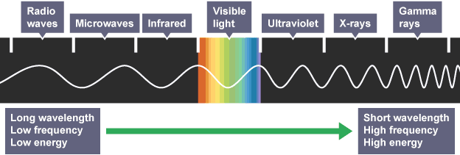
1 2 3 4 5 6 7 8 9 10 11 12 13 14 15 16 17 18 19 20 21 22 23 24 25 26 27 28 29 30 | Electromagnetic waves Electromagnetic waves are transverse waves. Their vibrations or oscillations are changes in electrical and magnetic fields at right angles to the direction of wave travel. All electromagnetic waves: transfer energy as radiation from the source of the waves to an absorber can travel through a vacuum such as in space travel at the same speed through a vacuum or the air Electromagnetic waves travel at 300 million metres per second (m/s) through a vacuum. Electromagnetic spectrum Electromagnetic waves form a continuous spectrum of waves. This includes: waves with a very short wavelength. high frequency and high energy waves with a very long wavelength, low frequency and low energy Electromagnetic waves can be separated into seven distinct groups in the spectrum. Each group contains a range of frequencies. For example, visible light contains all the frequencies that can be detected by the human eye: red light has the lowest frequencies of visible light violet light has the highest frequencies of visible light

Slide 50
1 2 3 4 5 6 7 8 9 10 11 12 13 14 15 16 17 18 19 20 21 22 23 24 25 26 27 28 29 30 | Behaviour and uses of electromagnetic waves The behaviour of an electromagnetic wave in a substance depends on its frequency. The differing behaviours of different groups in the electromagnetic spectrum make them suitable for a range of uses. Radio waves Radio waves are used for communication such as television and radio. Radio waves - Higher Radio waves are transmitted easily through air. They do not cause damage if absorbed by the human body, and they can be reflected to change their direction. These properties make them ideal for communications. Radio waves can be produced by oscillations in electrical circuits. When radio waves are absorbed by a conductor, they create an alternating current. This electrical current has the same frequency as the radio waves. Information is coded into the wave before transmission, which can then be decoded when the wave is received. Television and radio systems use this principle to broadcast information. Microwaves Microwaves are used for cooking food and for satellite communications. Microwaves - Higher High frequency microwaves have frequencies which are easily absorbed by molecules in food. The internal energy of the molecules increases when they absorb microwaves, which causes heating. Microwaves pass easily through the atmosphere, so they can pass between stations on Earth and satellites in orbit. Infrared Infrared light is used by electrical heaters, cookers for cooking food, and by infrared cameras which detect people in the dark. Infrared - Higher Infrared light has frequencies which are absorbed by some chemical bonds. The internal energy of the bonds increases when they absorb infrared light, which causes heating. This makes infrared light useful for electrical heaters and for cooking food. All objects emit infrared light. The human eye cannot see this light but infrared cameras can detect it. This

Slide 51
1 2 3 4 5 6 7 8 9 10 11 12 13 14 15 16 17 18 19 20 21 22 23 24 25 26 27 28 29 30 | 'thermal imaging' is useful for detecting people in the dark. Visible light Visible light is the light we can see. It is used in fibre optic communications, where coded pulses of light travel through glass fibres from a source to a receiver. Ultraviolet, electromagnetic waves in medicine and ionising radiation Ultraviolet We cannot see ultraviolet light but it can have hazardous effects on the human body. Ultraviolet light in sunlight can cause the skin to tan or burn. Fluorescent substances are used in energy-efficient lamps - they absorb ultraviolet light produced inside the lamp, and re-emit the energy as visible light. Electromagnetic waves in medicine Changes in atoms and their nuclei can cause electromagnetic waves to be generated or absorbed. Gamma rays are produced by changes in the nucleus of an atom. They are a form of nuclear radiation. High energy waves such as X-rays and gamma rays are transmitted through body tissues with very little absorption. This makes them ideal for internal imaging. X-rays are absorbed by dense structures like bones, which is why X-ray photos are used to help identify broken bones. Ionising radiation Ultraviolet waves, X-rays and gamma rays are types of ionising radiation. They can add or remove electrons from molecules, producing electrically charged ions. Ionisation can have hazardous effects on the body: ultraviolet waves can cause skin to age prematurely and increase the risk of skin cancer x-rays and gamma rays can cause the mutation of genes, which can lead to cancer

Slide 52
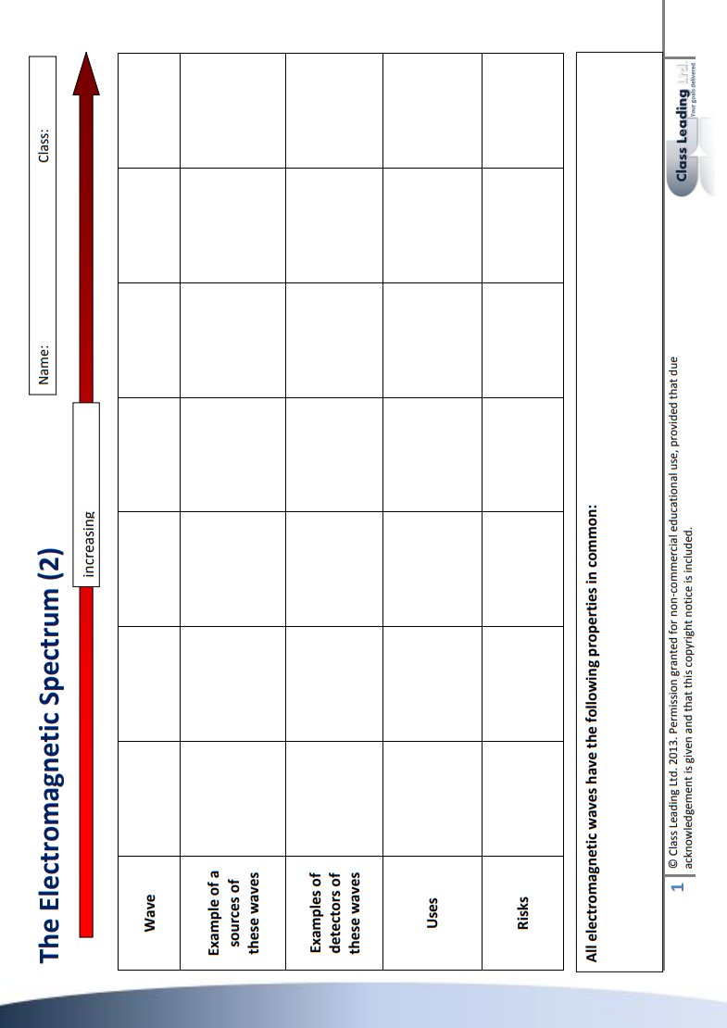

Slide 53
Rehearsal Questions
How many types of electromagnetic wave are there?
…............................................................................................................................................................
b.. Are electromagnetic waves longitudinal or transverse? …............................................................................................................................................................
c. Name two wave properties that all electromagnetic waves have in common.
…...........................................................................................................................................................
d. Which type of electromagnetic radiation do our eyes detect? …............................................................................................................................................................
e. Name two types of electromagnetic wave that are used to communicate over large distances.
…...........................................................................................................................................................
f. Name two types of electromagnetic radiation used for cooking,.
…...........................................................................................................................................................
g. All types of electromagnetic radiation are a specific form of a wave. Are they longitudinal or transverse?
…............................................................................................................................................................
h. List three types of electromagnetic wave used for communication.
…...........................................................................................................................................................
i. What wave properties do all electromagnetic waves have in common.
…...........................................................................................................................................................
j. How many types of electromagnetic wave do we know exist?
…............................................................................................................................................................
k. People cook food on a dally basis. Which two forms of electromagnetic wave can be used for cooking? …............................................................................................................................................................
.

Slide 54
Rehearsal Questions - ANSWERS
How many types of electromagnetic wave are there?
…............................................................................................................................................................
b. Are electromagnetic waves longitudinal or transverse?
…............................................................................................................................................................
c. Name two wave properties that all electromagnetic waves have in common.
…............................................................................................................................................................
d. Which type of electromagnetic radiation do our eyes detect? …............................................................................................................................................................
e. Name two types of electromagnetic wave that are used to communicate over large distances.
f. Name two types of electromagnetic radiation used for cooking,.
…............................................................................................................................................................
g. All types of electromagnetic radiation are a specific form of a wave. Are they longitudinal or transverse?
…............................................................................................................................................................
h. List three types of electromagnetic wave used for communication.
…............................................................................................................................................................
What wave properties do all electromagnetic waves have in common.
…............................................................................................................................................................
j. How many types of electromagnetic wave do we know exist? …............................................................................................................................................................
k. People cook food on a dally basis. Which two forms of electromagnetic wave can be used for cooking? …............................................................................................................................................................
.

Slide 55
Wrong answers
There are nine types of electromagnetic wave. All electromagnetic waves have some wave properties in common because they are longitudinal waves. For example, they have a frequency and a wavelength. They are travel at different speeds through a vacuum.
Humans use different electromagnetic waves for different purposes. For example, infra-red and ultraviolet are used for cooking. Microwaves, radiowaves and gamma waves are used for communications.

Slide 56
Wrong answers – Higher Tier only
There are nine types of electromagnetic wave. All electromagnetic waves have some wave properties in common because they are longitudinal waves. For example, they have a frequency and a wavelength. They are travel at different speeds through a vacuum.
Humans use different electromagnetic waves for different purposes. For example, infra-red and ultraviolet are used for cooking. Microwaves, radiowaves and gamma waves are used for communications.
Radiowaves can be used to communicate with satellites because they can penetrate the atmosphere. However, microwaves reflect off the atmosphere and so do not communicate with satellites. Gamma waves can also be used to communicate over long distances. For example, pulses of gamma waves are used to communicate using fibre optics.

Slide 57
If it didn’t…
I DO
The different types of electromagnetic radiation have different frequencies and wavelengths. This they didn’t have different wavelengths, how would their properties be affected?
…………………………………………………………………………………………………………………………………………………………………………………………………………………………………………………………………………………………………………………………
WE DO
b. If molecules in our food didn’t absorb microwaves, how would it affect how we cook food?
…………………………………………………………………………………………………………………………………………………………………………………………………………………………………………………………………………………………………………………………
YOU DO
c. If our skin didn’t absorb ultra-violet light, how would our lives be affected?
…………………………………………………………………………………………………………………………………………………………………………………………………………………………………………………………………………………………………………………………
YOU DO
d. How would satellite communication be affected if microwaves could not penetrate the atmosphere?
…………………………………………………………………………………………………………………………………………………………………………………………………………………………………………………………………………………………………………………………
YOU DO
e. If infra-red radiation did not exist, how would our lives be affected?
…………………………………………………………………………………………………………………………………………………………………………………………………………………………………………………………………………………………………………………………

Slide 58
Spaced questions
Electromagnetic waves transfer energy from one place to another. When we talk about objects having energy, we talk about the amount of energy that they have in energy stores. There are eight energy stores: Chemical; gravity; kinetic; thermal; elastic; vibration; nuclear and electromagnetic.
a. Humans have a chemical energy store in their bodies. When they walk along a flat road, which stores receive energy from their chemical energy store?
……………………………………………………………………………………………………………………………………………………….
b. Humans have a chemical energy store in their bodies. When they climb a ladder, which stores receive energy from their chemical energy store?
……………………………………………………………………………………………………………………………………………………….
c. The wind has energy in a kinetic energy store. When the wind turns a wind turbine, which energy store in the wind turbine receives energy? ……………………………………………………………………………………………………………………………………………………….
d. When a sky diver is in a plane at 10,000 feet, they have energy in their gravitational store. When they jump out, which store is energy transferred to? ……………………………………………………………………………………………………………………………………………………….
e. When a sky diver jumps out of a plane, their weight pulls them towards the Earth. Air resistance tries to slow them down. When they first jump out, they accelerate. Are the forces balanced or unbalanced? ……………………………………………………………………………………………………………………………………………………….
f. As the sky diver accelerates, air resistance increases. Eventually weight is balanced by air resistance. Describe their motion when the forces are balanced. ……………………………………………………………………………………………………………………………………………………….
g. Define ‘terminal velocity.. ………………………………………………………………………………………………………………………………………………………………………………………………………………………………………………………………………………………………………………………………………………………………………………………………………………………………………………………………………

Slide 59
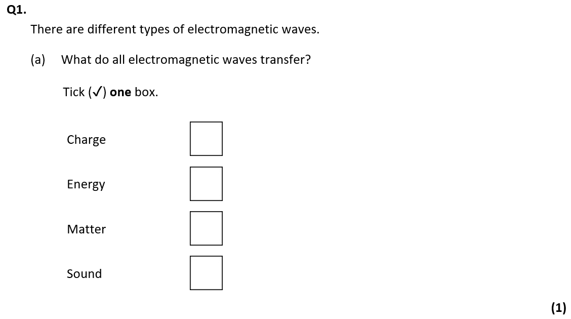
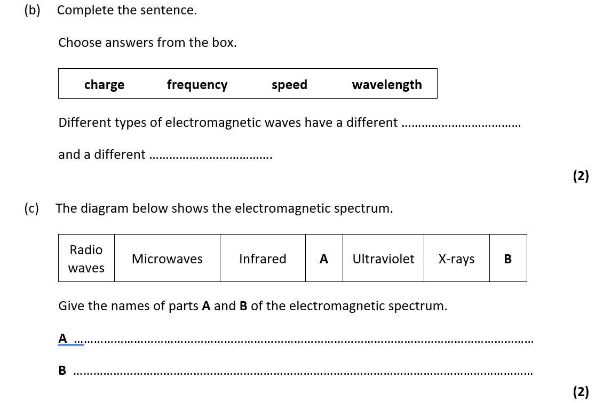
Exam questions

Slide 60
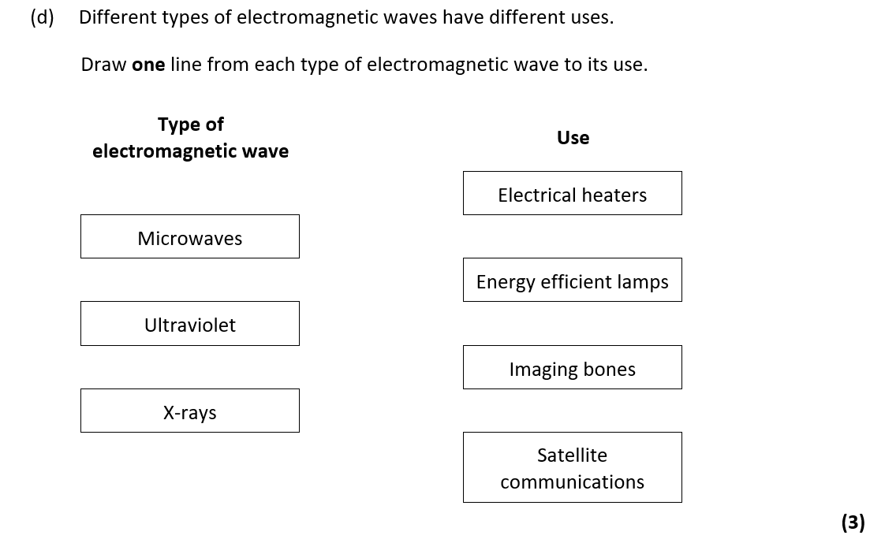

Slide 61
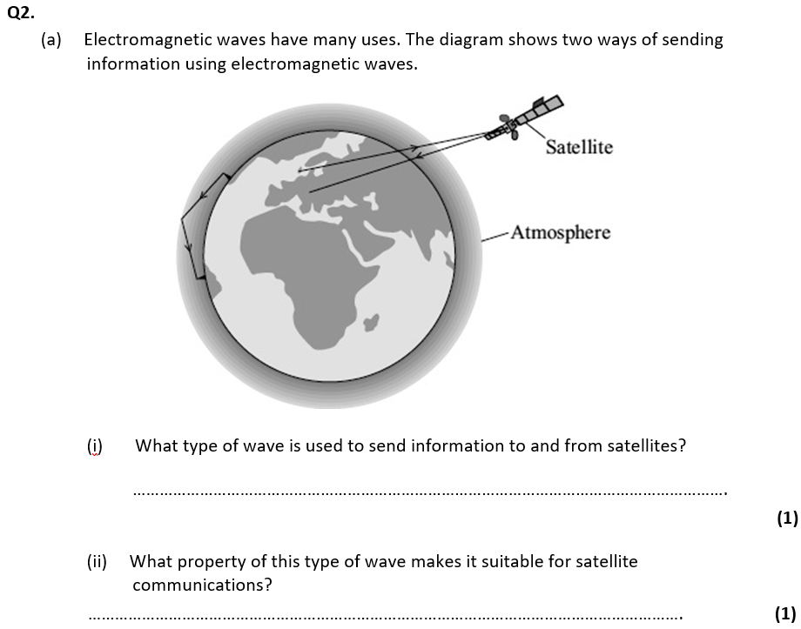

Slide 62
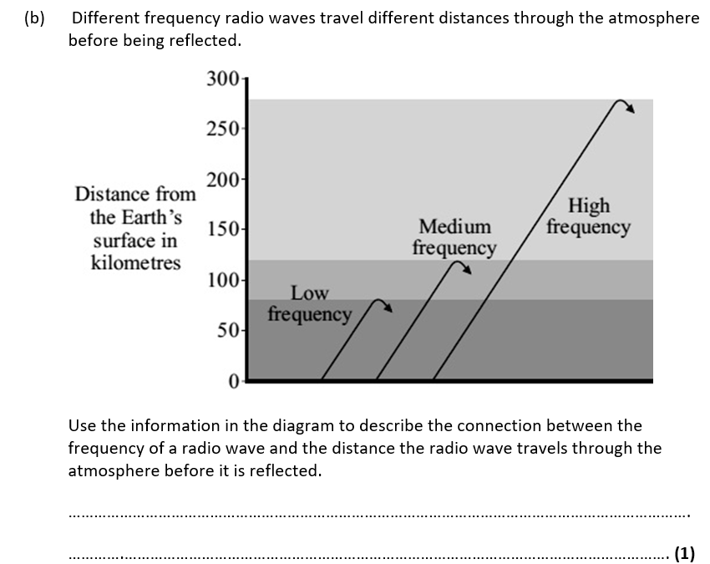

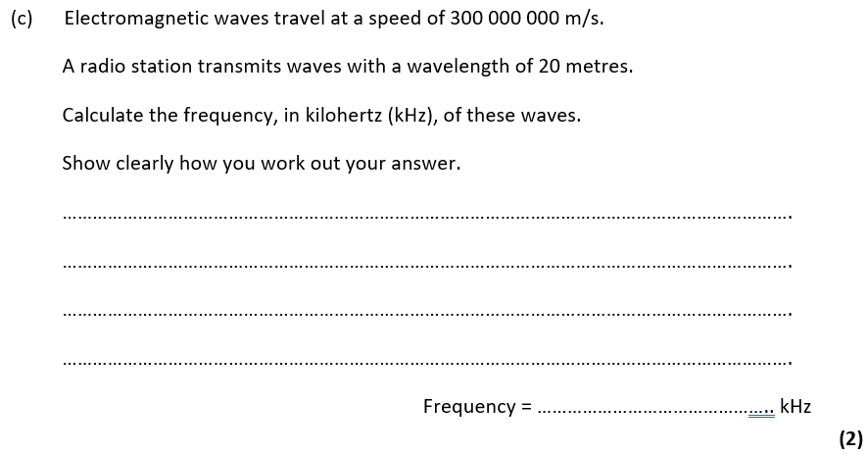
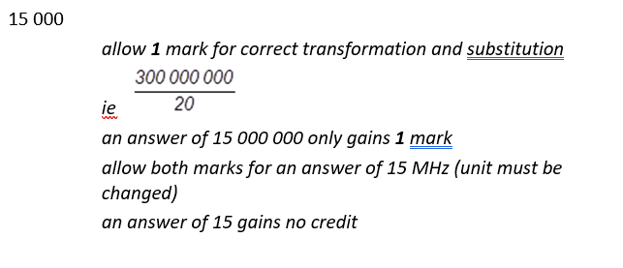

Slide 63
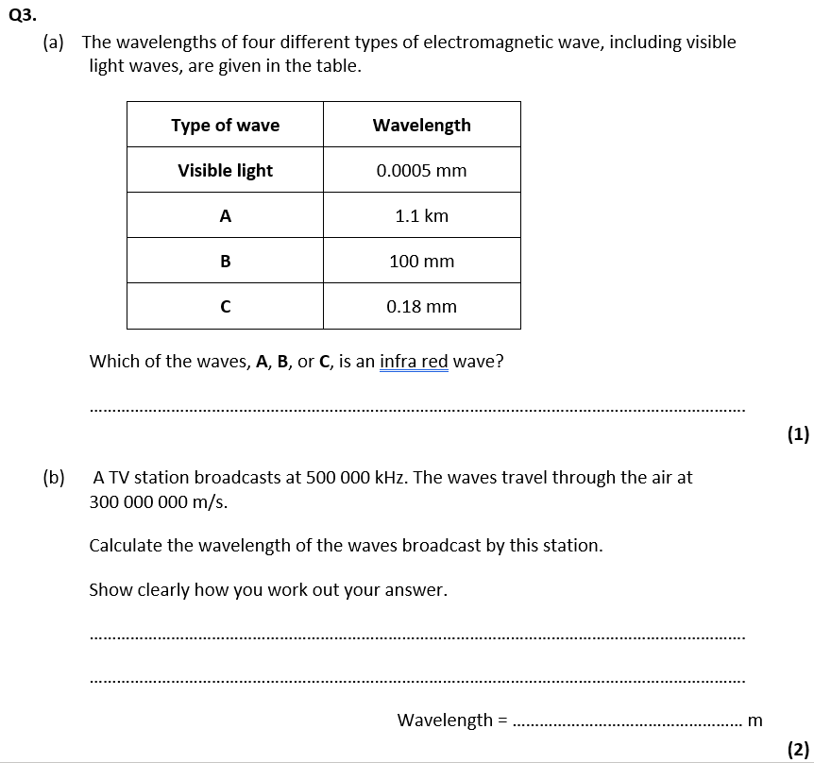

Slide 64
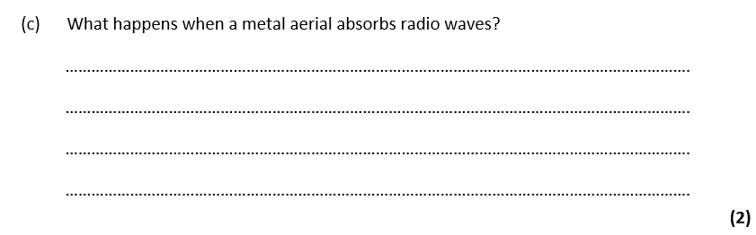
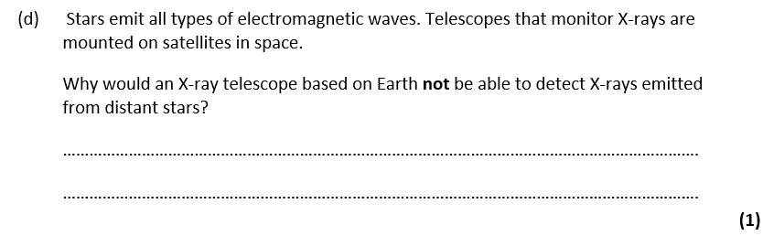

Slide 65
DO NOW
Date: ……………………………………….
 | ANSWER
Q1.
Q2.
Q3.
Q4.
Q5.
Date: ……………………………………….
 | ANSWER
Q1.
Q2.
Q3.
Q4.
Q5.

Slide 66
DO NOW
Date: ……………………………………….
 | ANSWER
Q1.
Q2.
Q3.
Q4.
Q5.
Date: ……………………………………….
 | ANSWER
Q1.
Q2.
Q3.
Q4.
Q5.

Slide 67
Knowledge Retrieval Quiz 1
Date: ……………………………………….
Score: …………...
 |  | Answer
Q1. | Insert question in bold
Q2.
Q3.
Q4.
Q5.
Q6.
Q7.
Q8.
Q9.
Q10.

Slide 68
Extra Space
……………………………………………………………………………………………………………………………………………………………………………………………………………………………………………………………………………………………………………………………………………………………………………………………………………………………………………………………………………………………………………………………………………………………………………………………………………………………………………………………………………………………………………………………………………………………………………………………………………………………………………………………………………………………………………………………………………………………………………………………………………………………………………………………………………………………………………………………………………………………………………………………………………………………………………………………………………………………………………………………………………………………………………………………………………………………………………………………………………………………………………………………………………………………………………………………………………………………………………………………………………………………………………………………………………………………………………………………………………………………………………………………………………………………………………………………..
…………………………………………………………………………………………………………………………………………………………………………………………………………………………………………………………………………………………………………………………………………………………………………………………………………………………………………………………………………………………………………………………………………………………………………………………………………………………………………………………………………………………………………………………………………………………………………………………………………………………………………………………………………………………………………………………………………………………………………………………………………………………………………………………………………………………………………………………………………………………………………………………………………………………………………………………………………………………………………………………………………………………………………………………………………………………………………………………………………………………………………………………………………………………………………………………………………………………………………………………………………………………………………………………………………………………………..
…………………………………………………………………………………………………………………………………………………………………………………………………………………………………………………………………………………………………………………………………………………………………………………………………………………………………………………………………………………………………………………………………………………………………………………………………………………………………………………………………………………………………………………………………………………………………………………………………

Slide 69
Extra Space
……………………………………………………………………………………………………………………………………………………………………………………………………………………………………………………………………………………………………………………………………………………………………………………………………………………………………………………………………………………………………………………………………………………………………………………………………………………………………………………………………………………………………………………………………………………………………………………………………………………………………………………………………………………………………………………………………………………………………………………………………………………………………………………………………………………………………………………………………………………………………………………………………………………………………………………………………………………………………………………………………………………………………………………………………………………………………………………………………………………………………………………………………………………………………………………………………………………………………………………………………………………………………………………………………………………………………………………………………………………………………………………………………………………………………………………………..
…………………………………………………………………………………………………………………………………………………………………………………………………………………………………………………………………………………………………………………………………………………………………………………………………………………………………………………………………………………………………………………………………………………………………………………………………………………………………………………………………………………………………………………………………………………………………………………………………………………………………………………………………………………………………………………………………………………………………………………………………………………………………………………………………………………………………………………………………………………………………………………………………………………………………………………………………………………………………………………………………………………………………………………………………………………………………………………………………………………………………………………………………………………………………………………………………………………………………………………………………………………………………………………………………………………………………..
…………………………………………………………………………………………………………………………………………………………………………………………………………………………………………………………………………………………………………………………………………………………………………………………………………………………………………………………………………………………………………………………………………………………………………………………………………………………………………………………………………………………………………………………………………………………………………………………………

Slide 70
Extra Space
……………………………………………………………………………………………………………………………………………………………………………………………………………………………………………………………………………………………………………………………………………………………………………………………………………………………………………………………………………………………………………………………………………………………………………………………………………………………………………………………………………………………………………………………………………………………………………………………………………………………………………………………………………………………………………………………………………………………………………………………………………………………………………………………………………………………………………………………………………………………………………………………………………………………………………………………………………………………………………………………………………………………………………………………………………………………………………………………………………………………………………………………………………………………………………………………………………………………………………………………………………………………………………………………………………………………………………………………………………………………………………………………………………………………………………………………..
…………………………………………………………………………………………………………………………………………………………………………………………………………………………………………………………………………………………………………………………………………………………………………………………………………………………………………………………………………………………………………………………………………………………………………………………………………………………………………………………………………………………………………………………………………………………………………………………………………………………………………………………………………………………………………………………………………………………………………………………………………………………………………………………………………………………………………………………………………………………………………………………………………………………………………………………………………………………………………………………………………………………………………………………………………………………………………………………………………………………………………………………………………………………………………………………………………………………………………………………………………………………………………………………………………………………………..
…………………………………………………………………………………………………………………………………………………………………………………………………………………………………………………………………………………………………………………………………………………………………………………………………………………………………………………………………………………………………………………………………………………………………………………………………………………………………………………………………………………………………………………………………………………………………………………………………

Slide 71
Extra Space
……………………………………………………………………………………………………………………………………………………………………………………………………………………………………………………………………………………………………………………………………………………………………………………………………………………………………………………………………………………………………………………………………………………………………………………………………………………………………………………………………………………………………………………………………………………………………………………………………………………………………………………………………………………………………………………………………………………………………………………………………………………………………………………………………………………………………………………………………………………………………………………………………………………………………………………………………………………………………………………………………………………………………………………………………………………………………………………………………………………………………………………………………………………………………………………………………………………………………………………………………………………………………………………………………………………………………………………………………………………………………………………………………………………………………………………………..
…………………………………………………………………………………………………………………………………………………………………………………………………………………………………………………………………………………………………………………………………………………………………………………………………………………………………………………………………………………………………………………………………………………………………………………………………………………………………………………………………………………………………………………………………………………………………………………………………………………………………………………………………………………………………………………………………………………………………………………………………………………………………………………………………………………………………………………………………………………………………………………………………………………………………………………………………………………………………………………………………………………………………………………………………………………………………………………………………………………………………………………………………………………………………………………………………………………………………………………………………………………………………………………………………………………………………..
…………………………………………………………………………………………………………………………………………………………………………………………………………………………………………………………………………………………………………………………………………………………………………………………………………………………………………………………………………………………………………………………………………………………………………………………………………………………………………………………………………………………………………………………………………………………………………………………………

Slide 72
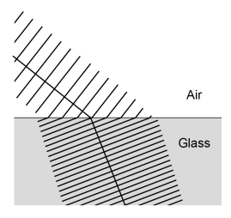
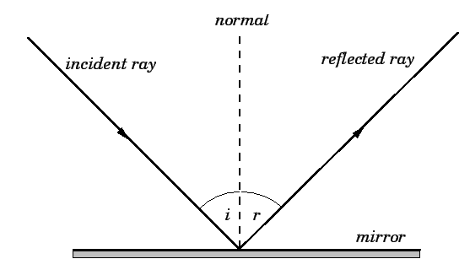
KNOWLEDGE ORGANISER
Subject: Science | Topic: Waves | Term: Autumn
KEY WORDS | Key words
1 | Amplitude | The distance from a peak to the zero position of a wave.
2 | Frequency | The number of complete waves that pass a point in a given time.
3 | Time period | Time taken for one complete wave to pass.
4 | Ray diagram | A ray diagram is a representation of the possible paths light can take to get from one place to another.
5 | Normal line | A line drawn perpendicular to a surface.
6 | Incident ray. | A ray of light that falls on any surface.
7 | Reflected ray. | A ray of light that is reflected from a surface.
KEY EXAMPLES
8 | Reflection from mirrors.
9 | Refraction of light and sound by water.
10 | Uses of waves to investigate the structure of the Earth.
11 | Th wide range of uses for electromagnetic waves.
KEY DIAGRAMS
Wave front diagram showing refraction The Law of Reflection

