Slide 1
Year 10 – Forces 2
Name
Class
Tutor Group
KS4 Science YEAR 11 Forces 2
KEYSTONE WORDS
Force | A push or a pull that changes the shape, direction or speed of an object.
Scalar | A quantity that has magnitude only.
Vector | A quantity that has a magnitude and a direction.
Balanced forces | Forces that have equal magnitude but opposite directions.
Momentum | A vector quantity that is the product of an objects mass and velocity.

Slide 2
BIG PICTURE
How will my prior knowledge develop my understanding of this topic?
Y7 | In year 7 you studied Speed and Forces. You learnt how to estimate and calculate speed. You also learnt about types of forces and how they interact and how to represent forces in diagrams.
Learning Journey
Subtopic 1 | Speed & Velocity. DCN | Subtopic 9 | Required practical. JVG
Subtopic 2 | The distance – time relationship. VOY | Subtopic 10 | Required practical. JVG
Subtopic 3 | Acceleration. DCN | Subtopic 11 | Newton’s third law. LCS
Subtopic 4 | The velocity – time relationship. VOY | Subtopic 12 | Stopping distances. LCS
Subtopic 5 | Newton’s first law. SGY | Subtopic 13 | Momentum. JVG
Subtopic 6 | Uniform acceleration & terminal velocity. SGY | Subtopic 14 | Changes in momentum. JVG
Subtopic 7 | Terminal velocity. WBY | Subtopic 15
Subtopic 8 | Newton’s second law (F = ma). WBY | Subtopic 16
1

Slide 3
Key knowledge
By the end of this topic you should know… | How to calculate speed using numerical and graphical data. How to calculate acceleration from numerical and graphical data. Newton’s Laws of Motion and be able to apply them in novel situations. The definition of stopping distance and how they relate to braking forces and driver reaction times. Describe the motion of an object using momentum and know how to use related concepts in different situations.
By the end of this topic should be able to… | Draw and interpret distance-time and velocity-time graphs. Interpret data related to stopping distances. Apply calculations to different situations involving forces.
How will this knowledge develop my understanding of future topics?
This topic develops skills that are used in many parts of the Science curriculum. For example, risk assessments, identifying variables and evaluating data. The underlying theory taught in this topic is revisited in several topics that include Magnetism and electromagnetism and Space Physics (separate scientists only).

Slide 4
KEY VOCABULARY LIST
Acceleration | The rate of change of velocity.
Braking Distance | The distance a vehicle travels under the braking force.
Conservation of Momentum | The total momentum of a system before an event is always equal to the total momentum after the event.
Inertia | The tendency of an object to remain in its same state of uniform motion or rest.
Momentum | The product of an object’s mass and velocity.
Stopping Distance | The sum of the thinking and braking distances.
Thinking Distance | The distance a vehicle travels during the driver’s reaction time.
EXPECTATIONS
Always write in black or blue pen. Always use a ruler for straight lines. If you make a mistake, cross it out with a single line. Always draw diagrams, tables and graphs in pencil with a ruler if necessary Always mark and correct your work in green pen. Respond to any feedback your teacher gives you in green pen. Take pride in your work, make it neat! All tasks should be completed in silence and by yourself unless your teacher tells you otherwise.
PROUD
Punctuation and grammar
Ruler and pencil for diagrams
Outstanding effort every lesson
Underline date and title
Dates and titles every lesson
PROUD FRIDAY
Any piece of work you complete, which meets our PROUD expectations can be taken to the PROUD station during Friday lunchtime. Show your work to a member of SLT and receive a sweet treat!
3

Slide 5
Subtopic 1: Speed & Velocity.
Learning Objectives.
You are learning…
about the difference between speed and velocity
how to apply and rearrange the speed equation to calculate speed, distance or time.
that, as a vector, velocity can change even if speed remains constant, and that velocity can also be negative.
Why are we learning about this?
This lesson helps us understand why velocity can change even when speed remains constant. It will also help us to solidify our understanding of calculations and the rearranging of equations.

Slide 6
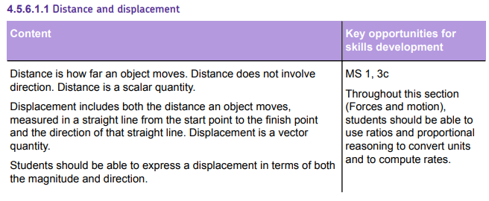
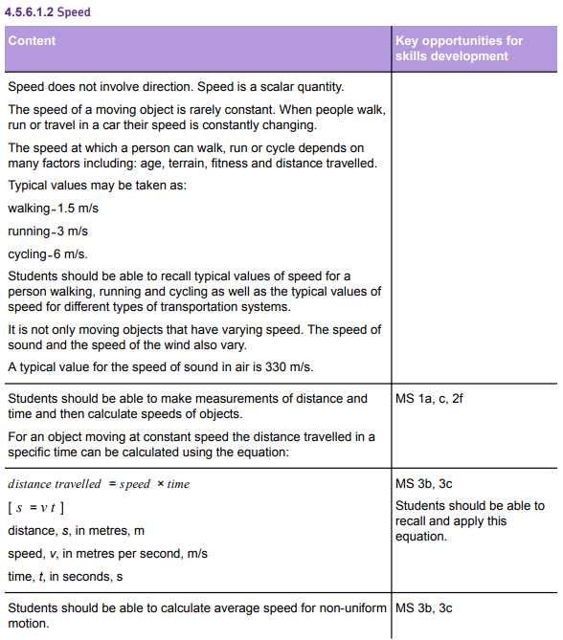
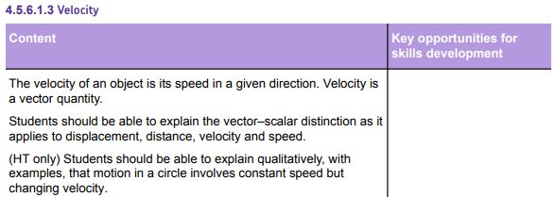
AQA Content
There are a lot of calculations in this sub-topic.
Calculations require:
Worked example.
Sufficient calculations for use of fading (I do, we do, you do).
In this case, opportunities to calculate speed, distance or time. This needs to be blocked and interleaved:
Calculations of speed.
Calculations of distance.
Calculations of time.
Mixed calculations.
Understanding of changing velocity related to changing speed and changing direction needs to be addressed.

Slide 7
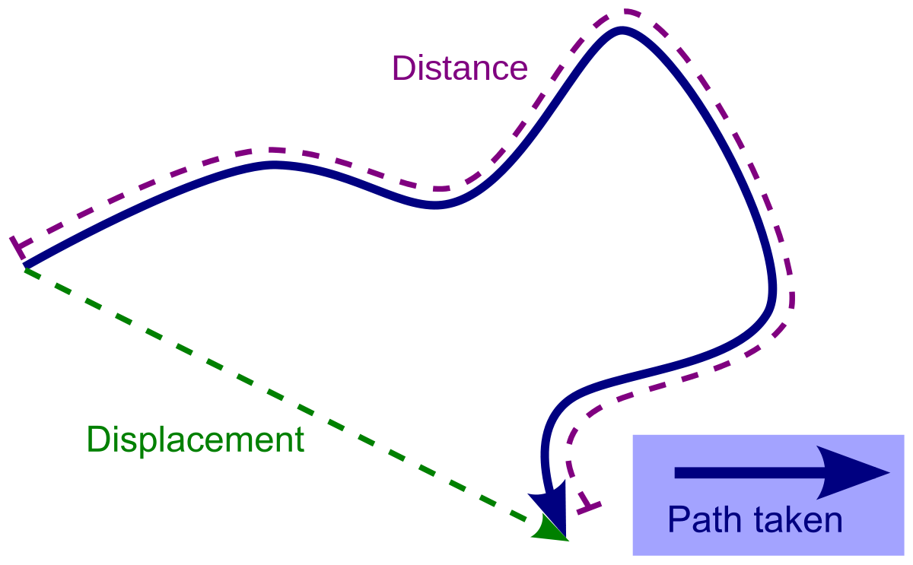
Suggested chunking of concepts
Scalar and vector quantities.
Comparing distance and displacement & speed and velocity.
Calculating speed and velocity.
Key explanations
a. You encountered scalar and vector quantities in the Forces 1 topic last year. You might recall that scalar quantities are those which only have a magnitude. For example:
Time
Mass
Distance
Vector quantities have a magnitude and a direction. The direction is sometimes shown using an arrow; the length of the arrow represents the magnitude of the quantity. For example:
All forces (we use an arrow to show the direction that they act in)
Weight
Displacement
Velocity.
b. Distance and displacement are related. Distance is the number of metres between two points. For example, on your journey to school you probably don’t travel in a straight line for the whole journey; there will be changes of direction. The total number of metres that you travel is the distance.
Displacement is the shortest distance between two points. It is always a straight line.

Slide 8
Key explanations
Speed and velocity are also related.
Speed is a scalar quantity because it doesn’t have a direction. The definition of speed is distance travelled per unit of time. The standard units are metres travelled per second (m/s). However, in everyday life other units, such as miles per hour, are often used.
Velocity is similar to speed except that it also has a direction. This means that there is a change in velocity if the speed of an object changes or if the direction that an object is travelling in changes.
Speed is calculated using the following equation:
Speed = distance / time.

Slide 9
1 2 3 4 5 6 7 8 9 10 11 12 13 14 15 16 17 18 19 20 21 22 23 24 25 26 27 28 29 30 | Quantities related to speed. In the forces 1 topic we learned about the difference between scalar and vector quantities: A scalar quantity has magnitude (size) only. Examples include distance and speed. Other examples include time, temperature, and mass. A vector has BOTH magnitude and a direction. Examples include displacement and velocity. All forces are also examples of vector quantities. Distance is scalar as it only represents how far an object has travelled (e.g. she walked 30m). When a direction is stated, distance becomes a vector quantity known as displacement (e.g. She walked 30m north). Speed and velocity are very similar to distance and displacement. Speed represents how fast an object is moving (e.g. The car was travelling at 30 m/s). When a direction is stated, speed becomes the vector quantity known as velocity (e.g. The car was travelling at 30 m/s east). Due to the difference between speed and velocity, as seen above, it is possible for velocity to change even though the speed is constant (if the object is changing direction). It is also possible for velocity to be negative, if the object is moving backwards. We can calculate the speed of any object if we know how far it has travelled, in metres (m), and how long it took, in seconds (s). The equation is shown below: Speed = distance / time v = s / t Speed, v, in metres per second (m/s) Distance, s, in metres (m) Time, t, in seconds (s) Something worth noting with this equation is that it only tells us the average speed of the object during the journey. The object may not be travelling at the same speed throughout the entire journey, but this equation gives us the average.

Slide 10
I DO
Calculate the speed of a car if it travels 300 m in 50 seconds.
STEP 1: Write the equation: ………………………………………………………………………………………………………………..
STEP 2: Substitute the values: …………………………………………………………………………………………………………….
STEP 3: Calculate the answer, with units: …………………………………………………………………………………………..
WE DO
Calculate the speed of a runner who sprints 100 m in 9.8 seconds. Give your answer to 1 d.p.
STEP 1: Write the equation: ………………………………………………………………………………………………………………..
STEP 2: Substitute the values: …………………………………………………………………………………………………………….
STEP 3: Calculate the answer, with units: …………………………………………………………………………………………..
Calculate the speed of a cyclist who travels 1.5 km in 3 minutes. Give your answer to 1 d.p.
STEP 1: Write the equation: ………………………………………………………………………………………………………………..
STEP 2: Substitute the values: …………………………………………………………………………………………………………….
STEP 3: Calculate the answer, with units: …………………………………………………………………………………………..
YOU DO
For each of the following questions, you are calculating the speed, in metres per second (m/s):
A man drives 2000 m in 120 seconds. Calculate his average speed:
………………………………………………………………………………………………………………………………………………………………………………………………………………………………………………………………………………………………………………………………………………………………………………………………………………………………………………………………………………………
A woman runs a marathon (42,200 m) in 240 minutes. Calculate her average speed:
………………………………………………………………………………………………………………………………………………………………………………………………………………………………………………………………………………………………………………………………………………………………………………………………………………………………………………………………………………………
A train travels 65 km in 1.5 hours. Calculate its average speed:
………………………………………………………………………………………………………………………………………………………………………………………………………………………………………………………………………………………………………………………………………………………………………………………………………………………………………………………………………………………
Speed = distance / time
Speed = 300 / 50
Speed = 6 m/s
Speed = distance / time
Speed = 100 / 9.8
Speed = 10.2 m/s
Speed = distance / time
Speed = 1500 / 180
Speed = 8.3 m/s
Speed = distance / time
Speed = 2000 / 120
Speed = 16.7 m/s
Speed = distance / time
Speed = 42200 / 14400
Speed = 2.93 m/s
Speed = distance / time
Speed = 65000 / 5400
Speed = 12.0 m/s

Slide 11
Sometimes we will need to rearrange the equation, to find either distance travelled, or time taken.
I DO
Calculate the distance travelled by a runner who runs 7 m/s for 45 seconds:
STEP 1: Write the equation: ………………………………………………………………………………………………………………..
STEP 2: Substitute the values: …………………………………………………………………………………………………………….
STEP 3: Use opposite math functions to rearrange: …………………………………………………………………………….
STEP 4: Calculate the answer, with units: ……………………………………………………………………………………………
WE DO
Calculate the time taken for a car to travel 3000 m at 20 m/s
STEP 1: Write the equation: ………………………………………………………………………………………………………………..
STEP 2: Substitute the values: …………………………………………………………………………………………………………….
STEP 3: Use opposite math functions to rearrange: …………………………………………………………………………….
STEP 4: Calculate the answer, with units: ……………………………………………………………………………………………
Calculate the distance travelled by a cyclist who cycles for 4 minutes at 12 m/s
STEP 1: Write the equation: ………………………………………………………………………………………………………………..
STEP 2: Substitute the values: …………………………………………………………………………………………………………….
STEP 3: Use opposite math functions to rearrange: …………………………………………………………………………….
STEP 4: Calculate the answer, with units: ……………………………………………………………………………………………
YOU DO
For the following questions, rearrange to calculate the distance travelled:
A woman runs for 15 minutes at an average speed of 6 m/s. Calculate how far she ran:
………………………………………………………………………………………………………………………………………………………………………………………………………………………………………………………………………………………………………………………………………………………………………………………………………………………………………………………………………………………
A train travels at an average speed of 50 m/s. Calculate how far it travels in 1 hour.
………………………………………………………………………………………………………………………………………………………………………………………………………………………………………………………………………………………………………………………………………………………………………………………………………………………………………………………………………………………
Speed = distance / time
7 = s / 45
S = 7 x 45
Distance = 315 m
Speed = distance / time
20 = 3000 / t
T = 3000 / 20
Time = 150 s
Speed = distance / time
12 = s / 240
S = 12 x 240
Distance = 2880 m
Speed = distance / time
6 = s / 900
S = 6 x 900
Distance = 5400 m
Speed = distance / time
50 = s / 3600
S = 50 x 3600
Distance = 180000 m

Slide 12
A rock rolls down a hill at an average speed of 5.7 m/s. It takes 1.2 minutes to reach the bottom. How long was the hill?
………………………………………………………………………………………………………………………………………………………………………………………………………………………………………………………………………………………………………………………………………………………………………………………………………………………………………………………………………………………
For the following questions, rearrange to calculate the time taken:
A car travels 5 km at an average speed of 26 m/s. Calculate how long it takes. Give your answer to 1 d.p. :
………………………………………………………………………………………………………………………………………………………………………………………………………………………………………………………………………………………………………………………………………………………………………………………………………………………………………………………………………………………
A boat sails at an average speed of 19 m/s. How long will it take to travel from Liverpool to Dublin (220 km). Give your answer to 1 d.p. :
………………………………………………………………………………………………………………………………………………………………………………………………………………………………………………………………………………………………………………………………………………………………………………………………………………………………………………………………………………………
How long would it take for a man to run a marathon (42.2 km) if he ran at an average speed of 7 m/s. Give your answer to 1 d.p. :
………………………………………………………………………………………………………………………………………………………………………………………………………………………………………………………………………………………………………………………………………………………………………………………………………………………………………………………………………………………
Speed = distance / time
5.7 = s / 72
S = 5.7 x 72
Distance = 410.4 m
Speed = distance / time
26 = 5000 / t
T = 5000 / 26
Time = 192.3 s
Speed = distance / time
19 = 220000 / t
T = 220000 / 19
11,578.9 s
Speed = distance / time
7 = 42200 / t
T = 42200 / 7
Time = 6028.6 s

Slide 13
YOU DO
Calculate the answers to the following questions. Rearrange the equation if required. Use the space on the next page to show your working out. Give all your answers to 1 d.p.:
Calculate the average speed of a bike that travels 300 m in 16 seconds.
Calculate the average speed of a man that walks 1200 m in 120 seconds.
Calculate the distance a woman can run if she has an average speed of 6.5 m/s for 5 minutes.
Calculate how long it would take a tram to travel from Meadowhall to Sheffield (6 km) at 4.2 m/s.
Calculate the average speed of a car that travels for 30 minutes and travels 64 km.
Calculate the time it would take to run a marathon (42.2 km) at 9 m/s.
Calculate the length of a race if the winner ran at an average speed of 9.6 m/s for 41.7 s.
Calculate the distance from Barnsley to York if you can rive at an average speed of 24 m/s and arrive in 51 minutes.
How long would it take for a car to travel from Barnsley to York if it was only driving at an average speed of 19 m/s?
How far does a satellite move in 1 day if it moves at an average speed of 8000 m/s?
Answers:
18.8 m/s
10 m/s
1950 m
1428.6 m/s
35.6 m/s
4688.9 m/s
400.3 m
73440 m
3865.3 s
691,200,000 m

Slide 14
Space to show your working out:
………………………………………………………………………………………………………………………………………………………………………………………………………………………………………………………………………………………………………………………………………………………………………………………………………………………………………………………………………………………
………………………………………………………………………………………………………………………………………………………………………………………………………………………………………………………………………………………………………………………………………………………………………………………………………………………………………………………………………………………
………………………………………………………………………………………………………………………………………………………………………………………………………………………………………………………………………………………………………………………………………………………………………………………………………………………………………………………………………………………
………………………………………………………………………………………………………………………………………………………………………………………………………………………………………………………………………………………………………………………………………………………………………………………………………………………………………………………………………………………
………………………………………………………………………………………………………………………………………………………………………………………………………………………………………………………………………………………………………………………………………………………………………………………………………………………………………………………………………………………
………………………………………………………………………………………………………………………………………………………………………………………………………………………………………………………………………………………………………………………………………………………………………………………………………………………………………………………………………………………
………………………………………………………………………………………………………………………………………………………………………………………………………………………………………………………………………………………………………………………………………………………………………………………………………………………………………………………………………………………
………………………………………………………………………………………………………………………………………………………………………………………………………………………………………………………………………………………………………………………………………………………………………………………………………………………………………………………………………………………
………………………………………………………………………………………………………………………………………………………………………………………………………………………………………………………………………………………………………………………………………………………………………………………………………………………………………………………………………………………
………………………………………………………………………………………………………………………………………………………………………………………………………………………………………………………………………………………………………………………………………………………………………………………………………………………………………………………………………………………

Slide 15
Below is an image showing the orbit of the Earth around the Sun, which is a roughly circular orbit.#
The length of Earth’s orbit is approximately 940,000,000 km.
The time it takes for the Earth to orbit the Sun is 1 year (365.25 days).
Calculate the average speed of Earth’s orbit:
………………………………………………………………………………………………………………………………………………………………………………………………………………………………………………………………………………………………………………………………………………………………………………………………………………………………………………………………………………………
………………………………………………………………………………………………………………………………………………………………………………………………………………………………………………………………………………………………………………………………………………………………………………………………………………………………………………………………………………………
Explain, using ideas about scalar and vector quantities, why the Earth’s velocity is constantly changing, even though its speed remains constant.
……………………………………………………………………………………………………………………………………………………………………………………………………………………………………………………………………………………………………………………………………………………………………………………………………………………………………………………………………………………………………………………………………………………………………………………………………………………………………………………
Distance = 940,000,000 x 1000 = 940,000,000,000 m
Time = 365.25 days → 31,557,600 s
Speed = distance / time
Speed = 940,000,000,000 / 31,557,600
Speed = 29,786.8 m/s
Earth’s velocity is constantly changing because velocity is a vector. The Earth moves in a circular motion, meaning its direction is always changing.
Its average speed remains the same because speed is scalar, and therefore does not have a specific direction.

Slide 16
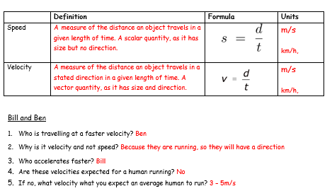
Subtopic 2: The distance – time relationship.
I wasn’t there but I still care!
Bill and Ben Bill and Ben run a 400m race on a track. Bill sets off quickly and leads at the 200m point but Ben completes the 400m race in 55 seconds whilst Bill takes 1 minute.
Who was travelling at a faster velocity?
……………………………………………………………………………………………………………………………………………………….
2. Why is it a velocity not a speed?
………………………………………………………………………………………………………………………………………………………..
3. Who accelerates faster?
………………………………………………………………………………………………………………………………………………………..
4. Are these velocities expected for a human running? …………………………………………………………………………………………………………………………………………………………5. If no, what velocity would you expect an average human to run? ………………………………………………………………………………………………………………………………………………………………………………………………………………………………………………………………………………………………………………………………………………………………………………………………………………………………………………………………………………
 | Definition | Formula | Units
Speed
Velocity

Slide 17
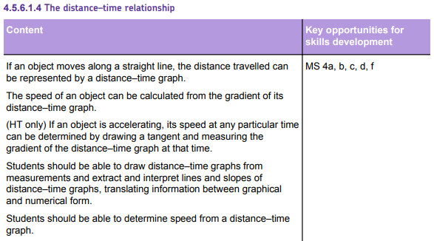
AQA Content
Disciplinary content
The interpretation of the graphs is the highest priority. This must be addressed first. Students have opportunity throughout the course to draw graphs.
FT: Only need to determine speed from linear sections of the graph.
HT: Need to determine speed from curved parts of the graph (drawing tangent and drawing gradient).
For both FT and HT graphs, the following need to be included:
Worked example.
‘I do’ modelling opportunity so teachers can model how to determine speed.
Two opportunities to complete ‘we do’ calculations.
Several examples for students to complete (you do).

Slide 18
Suggested chunking of concepts
Interpreting distance-time graphs (including curved lines).
Calculating speed using distance-time graphs (including tangents and gradients).
Drawing distance-time graphs (note that interpretation of pre-drawn graphs is prioritised over the drawing of graphs).
Key explanations
a. We can represent some journeys on a graph. If the journey occurs in a straight line, we can represent it on a distance-time graph.
Some distance-time graphs only contain straight lines; these can be horizontal or at an angle. Horizontal lines represent stationary objects; this makes sense because the distance isn’t increasing. Diagonal lines show that the object is moving. With diagonal lines, the gradient represents the speed. This makes sense if we think about the equation showing the relationship between speed, distance and time and the equation for a straight line that you use in maths:
Speed = distance / time
OR
Distance = speed x time
y = m x + C
If we plot distance on the y axis and time on the x-axis, the gradient (m) represents speed.
The steeper the gradient, the greater the speed.
Some distance-time graphs will contain curved sections. This tells us that the speed is changing (because the gradient is changing). In these cases, speed is harder to find. You need to draw a tangent and then calculate the gradient of the tangent.
b & c. Use worked examples.

Slide 19
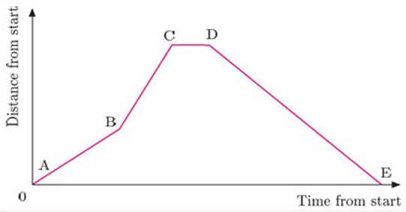
Subtopic 2: The distance – time relationship.
Learning Objective
You are learning to construct and interpret a distance – time relationship graph.
Why are we learning about this?
This lesson helps us understand how to illustrate a journey with changing speed on a distance –time graph and determine the speed at different points.
Task 1:
Rana delivers newspapers. Here is a distance-time graph of her round. Using the graph, answer the questions.
On which section of the journey do you think she was walking the fastest? Make some brief notes to explain your answer.
…………………………………………………………………………………………………………………………………………………………………………………………………………………………………………………………………………………………………………
What is your interpretation of section CD?
…………………………………………………………………………………………………………………………………………………
c) Part of her round is up a hill where her walking speed is slowest. Which section of the graph do you think represents this?
d) Which part of the graph represents Rana’s return to her starting place. Why?

Slide 20
Task 1:
Rana delivers newspapers. Here is a distance-time graph of her round. Using the graph, answer the questions.
a) On which section of the journey do you think she was walking the fastest? Make some brief notes to explain your answer.
……………………………………………………………………………………………………………………………………………………………………………………………………………………………………………………………………………………………………………………
What is your interpretation of section CD?
……………………………………………………………………………………………………………………………………………………………………………………………………………………………………………………………………………………………………………………
c) Part of her round is up a hill where her walking speed is slowest. Which section of the graph do you think represents this?
……………………………………………………………………………………………………………………………………………………………………………………………………………………………………………………………………………………………………………………
Which part of the graph represents Rana’s return to her starting place. Why?
……………………………………………………………………………………………………………………………………………………………………………………………………………………………………………………………………………………………………………………
B-C steepest line – covers most distance in shortest time
Flat line – stationary
A-B shallowest line
D-E returns to zero distance

Slide 21
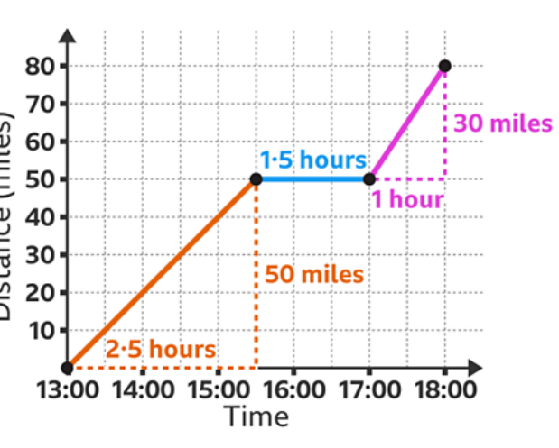
Subtopic 2: The distance – time relationship.
I Do Task 2
Draw a distance – time graph for the journey described below
A vehicle starts its journey at 13:00H.
It travels at a speed of 20 mph for 2.5 hours.
The vehicle stops for 1.5 hours before continuing its journey.
It travels a further 30 miles and arrives at its destination at 18:00H.
On the graph paper below, draw a distance-time graph of this journey.

Slide 22
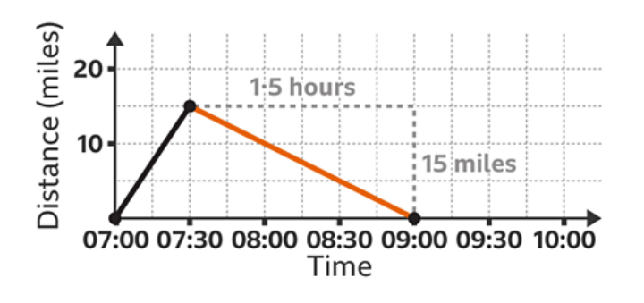
Subtopic 2: The distance – time relationship.
We Do Task 2
Omar and Rosie set off on their holiday.
They leave at 07:00 driving at 30 mph for 30 minutes before realising Omar has forgotten his passport.
They travel back home at 10 mph due to traffic.
Plot a distance-time graph to represent his journey.

Slide 23
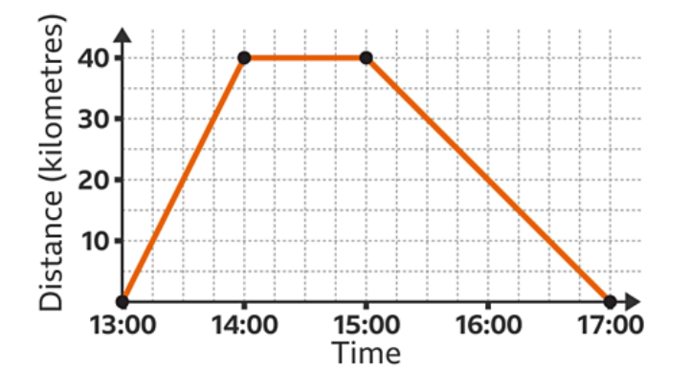
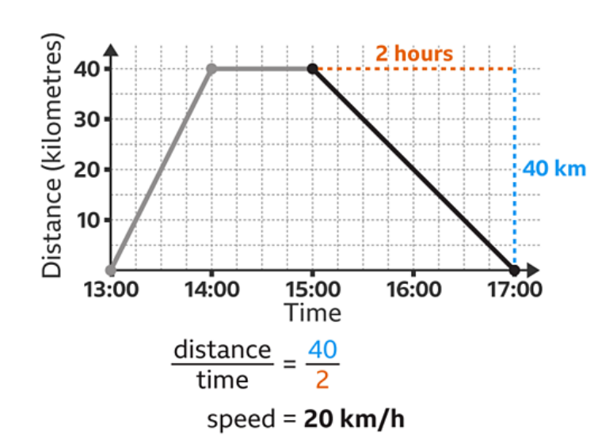
Subtopic 2: The distance – time relationship.
We Do Task 2
Find the speed for the return journey shown on this distance-time graph.
………………………………………………………………………………………………………………………………………………………………………………………………………………………………………………………………………………………………………………………………………………………………………………………………………………………………………………………………………………………………………………………………………………………………………………………………………………………………………………………………………………………………………………………………………………………………………………………………………………………………………………………………………………………………………………………………………………………………

Slide 24
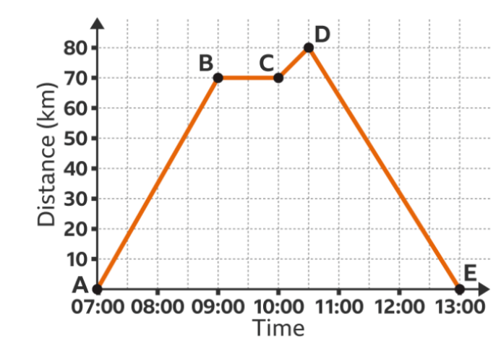
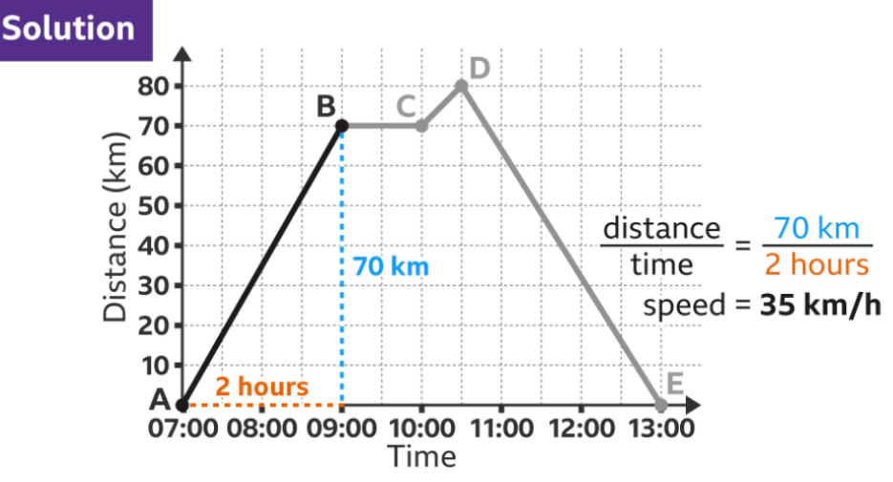
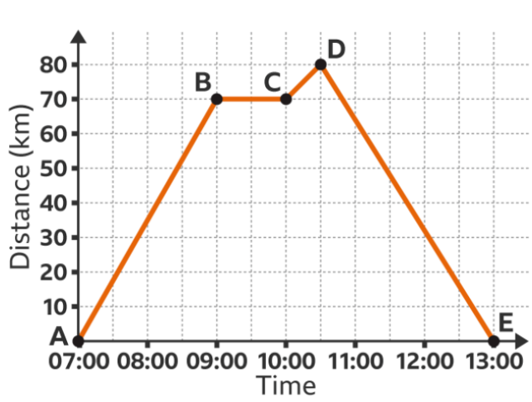
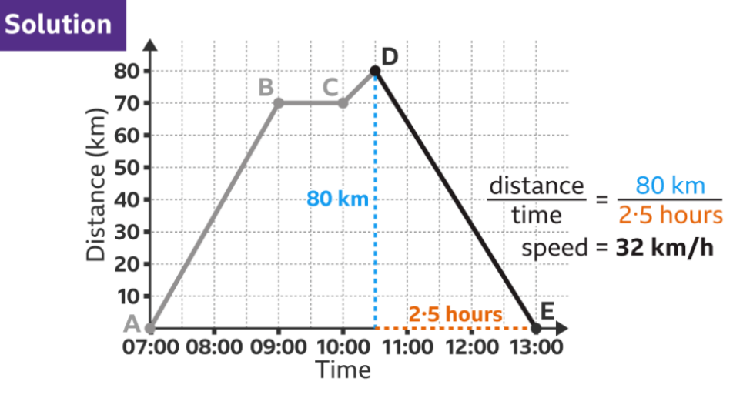
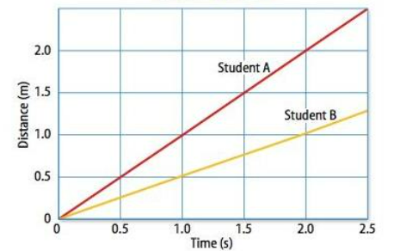
Subtopic 2: The distance – time relationship.
You Do Task 2
What is the speed for the first stage of the journey shown by the line segment AB?
….
What is the speed of the return journey?
This graph shows the distance – time data for two students running a race.
a) Which student is the fastest?
b) Calculate the speed of each student.
………………………………………………………………………….
……………………………………………………………… ………………………………………………………………………….
…………………………………………………………………………
…………………………………………………………………………………………………………………………………………………………………………………………………………………………………………………………………………………………………………………………………………………………
………………………………………………………………………………………………………………………………………………………………………………………………………………………………………………………………………………………………………………………………………………………………………………………………………………………………
Answer
Student A
S=d ÷ t
student A = 2.5 / 2.5 = 1m/s
student B = 1.25 / 2.5 = 0.5m/s

Slide 25
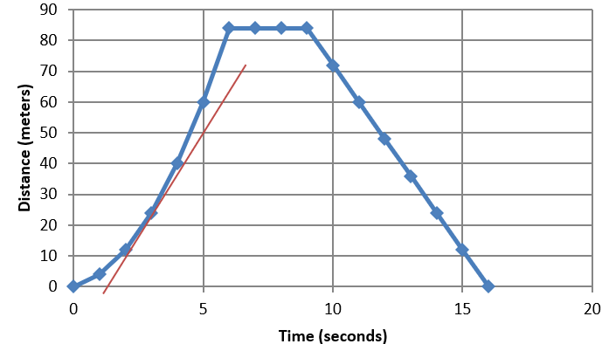
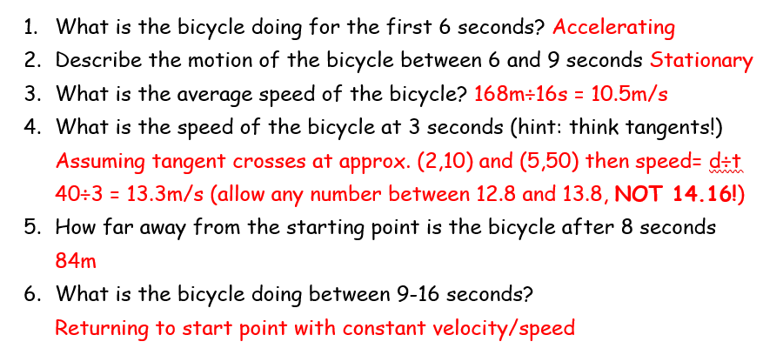
Subtopic 2: The distance – time relationship.
I Do Task 3 (HT)
The following distance –time graph represents a student riding a bicycle:-
What is the bicycle doing for the first 6 seconds?
…………………………………………………………………………………………………………………………………………………………
Describe the motion of the bicycle between 6 and 9 second?
……………………………………………………………………………………………………………………………………………………………………………………………………………………………………………………………………………………………………………………
What is the average speed of the bicycle?
………………………………………………………………………………………………………………………………………………………………………………………………………………………………………………………………………………………………………………..…. 4. What is the speed of the bicycle at 3 seconds (hint: think tangents!)
………………………………………………………………………………………………………………………………………………………………………………………………………………………………………………………………………………………………………………..…
5. How far away from the starting point is the bicycle after 8 seconds
………………………………………………………………………………………………………………………………………………………………………………………………………………………………………………………………………………………………………………..…
6. What is the bicycle doing between 9-16 seconds?
…………………………………………………………………………………………………………………………………………………………………………………………………………………………………………………………………………………………………………………..

Slide 26
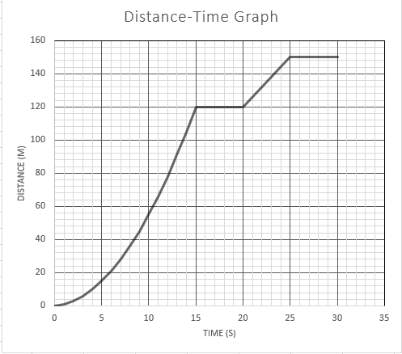
Subtopic 2: The distance – time relationship.
We Do Task 4 (HT)
The following graph represents a car journey:-
Between 0s and 15s is the car travelling at a constant speed? Yes / No
Work out the acceleration at 5s by drawing a tangent and creating a triangle under the line to calculate the gradient
……………………………………………………………………………………………………………………………………………………………………………………………………………………………………………………………………………………………………
3. Work out the acceleration at 12s by drawing a tangent and creating a triangle under the line to calculate the gradient.
………………………………………………………………………………………………………………………………………………………………………………………………………………………………………………………………………………………………………………..….
Answers
No – curved line
40/10 = 4 m/s
120/8 = 15m/s

Slide 27
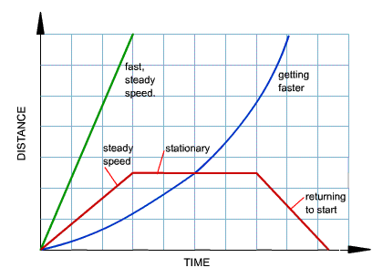
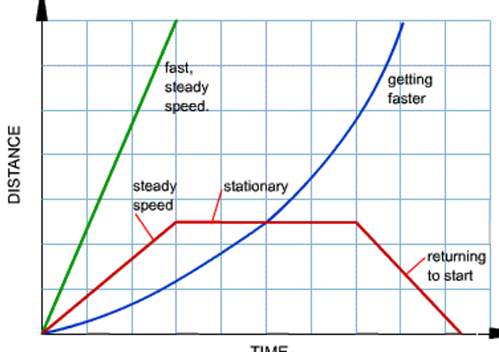
Subtopic 2: The distance – time relationship.
We Do Task 4 (HT)
The following distance –time graph represents different modes of transport:-
Label the boxes to state the motion of each part of the different graphs
Calculate the mean speed of lines a & b
……………………………………………………………………………………………………………………………………………………………………………………………………………………………………………………………………………………………………………………
3. Work out the acceleration at 12s by
………………………………………………………………………………………………………………………………………………………………………………………………………………………………………………………………………………………………………………..….
a
b
140
100
60
20
0 2 4 6 8 10 12 14 16 18 20
Answers
No – curved line
Line a 140 /6 =23.3 m/s
Line b 140 / 16 = 8.75m/s
3. 140/ 12 = 11. 7m/s

Slide 28
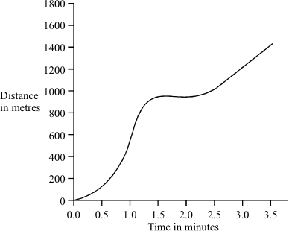
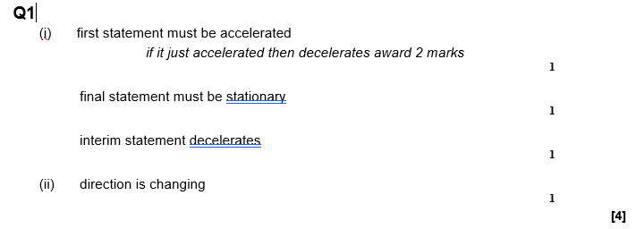
Subtopic 2: The distance – time relationship.
You Do Task 4 (HT)
Q1. The graph shows how the distance travelled by a car changes with time during a short journey.
(i) Describe fully the motion of the car during the first two minutes of the journey.
…………………………………………………………………………………………………………………………………………………………………………………………………………………………………………………………………………………………………………………………………………………………………………………………………………………………………………………………………………………(3)
(ii) During the last minute of the journey the velocity of the car changes although the speed remains constant. How is this possible?
……………………………………………………………………………………………………………………………………………………………………………………………………………………………………………………………………………………………………………………(1)
(Total 4 marks)

Slide 29
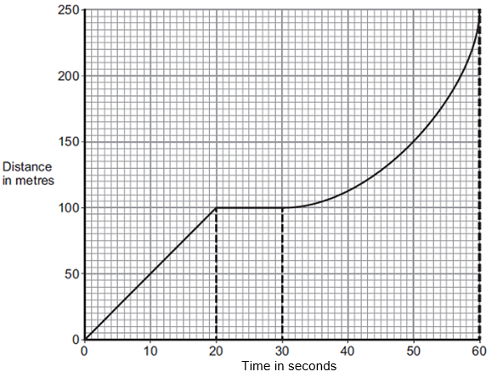
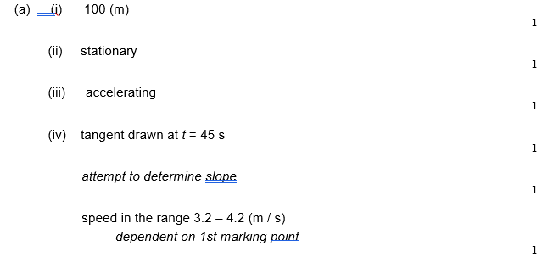
Subtopic 2: The distance – time relationship.
You Do Task 4 (HT)
A bus is taking some children to school.
(a) The bus has to stop a few times. The figure below shows the distance–time graph for part of the journey.
How far has the bus travelled in the first 20 seconds?
Distance travelled = …………………………………………………. m (1)
(ii) Describe the motion of the bus between 20 seconds and 30 seconds.
………………………………………………………………………………………………………………………………………………………………………………………………………………………………………………………………………………………………………………….(1)
(iii) Describe the motion of the bus between 30 seconds and 60 seconds.
Tick one box
(iv) What is the speed of the bus at 45 seconds? Show clearly on the figure above how you obtained your answer.
…………………………………………………………………………………………………………………………………………………………………………………………………………………………………………………………………………………………………………………
Speed = ______________________ m / s (3)

Slide 30
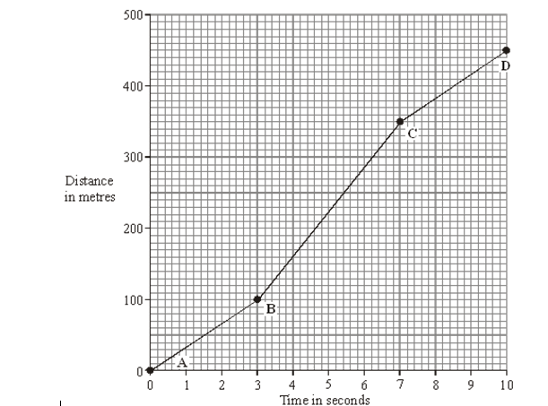
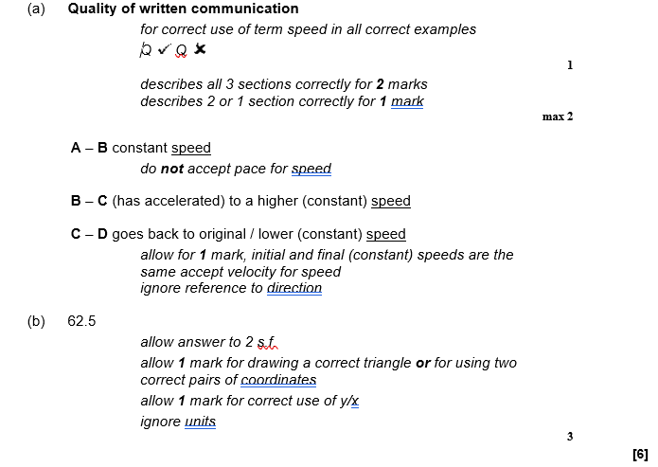
Subtopic 2: The distance – time relationship.
You Do Task 4 (HT)
The distance-time graph represents the motion of a car during a race.
(a) Describe the motion of the car between point A and point D. You should not carry out any calculations. To gain full marks in this question you should write your ideas in good English. Put them into a sensible order and use the correct scientific words.
…………………………………………………………………………………………………………………………………………………………………………………………………………………………………………………………………………………………………………………………………………………………………………………………………………………………………………………(3)
(b) Calculate the gradient of the graph between point B and point C. Show clearly how you get your answer.
……………………………………………………………………………………………………………………………………………………………………………………………………………………………………………………………………………………………………………………………………………………………………………………………………………………………………………………………………………………………………………………………………………………………………………………………………(3)

Slide 31
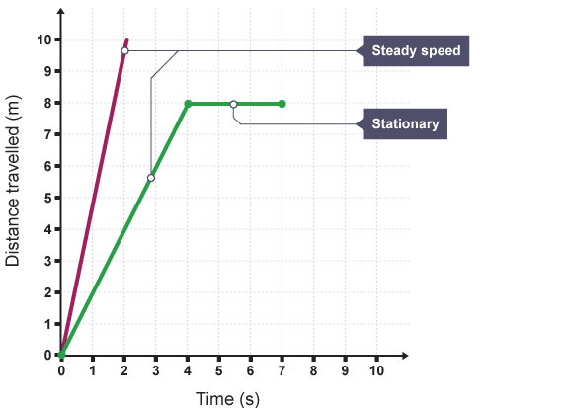
1 2 3 4 5 6 7 8 9 10 11 12 13 14 15 16 17 18 19 20 21 22 23 24 25 26 27 28 29 30 | A distance-time graph is a way of representing a journey. If an object moves along a straight line, the distance travelled can be represented by a distance-time graph. Each straight line segment of the journey represents one part of the whole journey. An oblique line segment represents a steady moving speed part of the journey. A horizontal line segment represents no movement / stationary - this is the part of the journey where the object is stationary. The gradient of the line is equal to the speed of the object. The gradient of a distance-time graph gives the constant speed for that part of the journey. The steeper the line, the faster the speed. Example Calculate the speed of the object represented by the green line in the graph, from 0 to 4 s. change in distance = (8 - 0) = 8 m change in time = (4 - 0) = 4 s �����=������������ �����=8÷4 �����=2 �/� Example Calculation Calculate the speed of the object shown by the lower line in the graph, from 0 to 4 s. change in distance = (8 - 0) = 8 m change in time = (4 - 0) = 4 s
Speed = Distance / Time
Speed = 8 / 4
Speed = 2 m/s

Slide 32
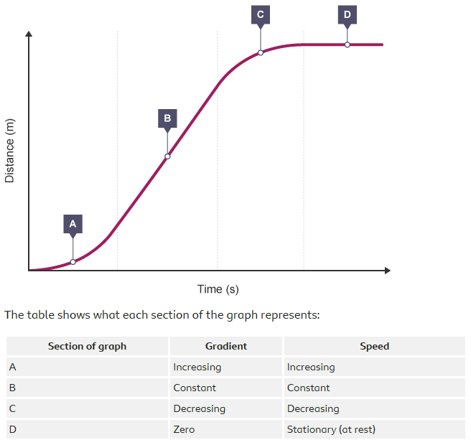
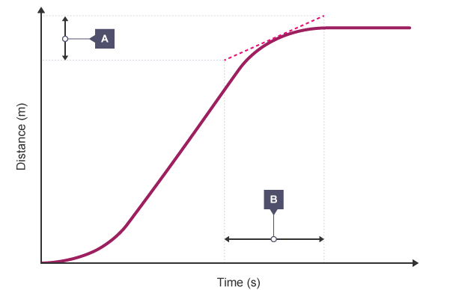
1 2 3 4 5 6 7 8 9 10 11 12 13 14 15 16 17 18 19 20 21 22 23 24 25 26 27 28 29 30 | Distance-time graphs for accelerating objects - Higher If the speed of an object changes, it will be accelerating or decelerating. This can be shown as a curved line on a distance-time graph. If an object is accelerating or decelerating, its speed can be calculated at any time by: Drawing a tangent to the curve at that time. Determining the gradient of the tangent. As the diagram shows, after drawing the tangent, work out the change in distance (A) and the change in time (B).

Slide 33
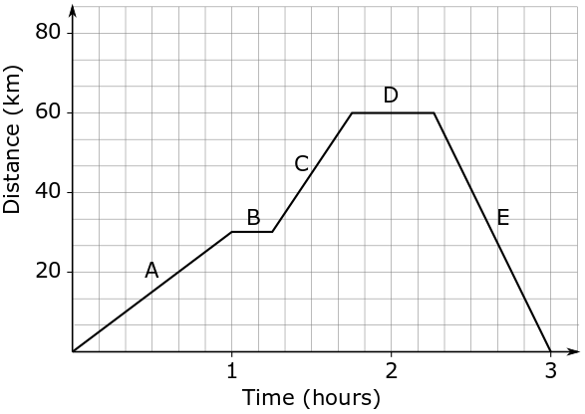
1 2 3 4 5 6 7 8 9 10 11 12 13 14 15 16 17 18 19 20 21 22 23 24 25 26 27 28 29 30 | How to draw a distance-time graph: Decide on the size of the axes. The x-axis represents the time taken. The y-axis represents the distance travelled. Draw each part of the journey in sections. For each stage of the journey, plot the distance travelled against the time taken and draw the line segment. Remember that any stop during the journey will be a horizontal line segment. A return journey means the line segment is drawn going back towards the x-axis.

Slide 34
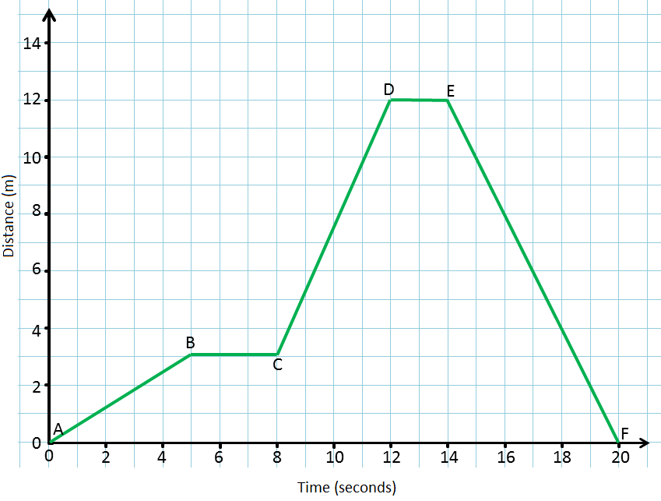
Subtopic 3: Acceleration.
Learning Objective
To understand that acceleration is a vector quantity, which changes if an object changes direction.
To apply and rearrange the acceleration equation.
Why are we learning about this?
This lessons helps us understand why acceleration is different to speed/velocity. It will also help us to understand why velocity can be negative, just as acceleration can be negative.
I wasn’t there but I still care!
The previous lesson looked at distance-time graphs. Use the AQA Physics text book (page 134-135) to answer the following questions:
Use the equation: Speed = distance ÷ time , to calculate the speed of the car in each section of the journey shown in the distance/time graph shown below:
Between A and B:
…………………………………………………………………..
…………………………………………………………………..
…………………………………………………………………..
Between B and C:
…………………………………………………………………..
…………………………………………………………………..
…………………………………………………………………..
Between E and F:
…………………………………………………………………..
…………………………………………………………………..
…………………………………………………………………..

Slide 35
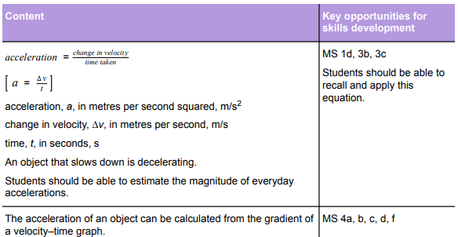
AQA Content
The focus is on the calculations.
As for previous calculations the following is required:
Worked example.
‘I do’ modelling.
Two opportunities for ‘we do’ modelling.
Examples for students to complete independently. This need to be blocked and interleaved:
Block of calculations where acceleration is the subject.
Block of calculations where time is the subject.
Block where change in velocity is the subject.
Mixed calculations.
Acceleration and speed calculations can also be mixed to enable retrieval and interleaving.
Students practiced calculating gradients for distance-time graphs. This skill is now revisited in the context of velocity-time graphs.

Slide 36
Suggested chunking of concepts
Acceleration as the rate of change of velocity.
Calculating acceleration from numerical data.
Interpreting velocity-time graphs.
Calculating acceleration using velocity-time graph.
Key explanations.
When objects move, they rarely maintain the same velocity; they either change direction or they change speed. At GCSE, we usually encounter situations where the speed changes. Acceleration can be defined as the rate of change of velocity per unit time. If the velocity of the object decreases, we often call this deceleration; we can also call this negative acceleration.
We calculate velocity by calculating the change of velocity. We then divide the change in velocity by the time taken. If the change in velocity happens in a very short time period, acceleration is greater than if it happens in a longer period.
You will sometimes need to calculate acceleration from graphical data. The graph required is called a velocity-time graph. As the name implies, time is plotted on the x-axis and velocity is plotted on the y-axis. In this case, horizontal lines represent a constant velocity (acceleration = 0 m/s squared). A diagonal line going up shows a steady increase in velocity (we call this uniform acceleration); the greater the gradient, the greater the acceleration. A diagonal line going down, represents deceleration.
Calculation of acceleration / deceleration from gradients should be modelled.

Slide 37
1 2 3 4 5 6 7 8 9 10 11 12 13 14 15 16 17 18 19 20 21 22 23 24 25 26 27 28 29 30 31 | Acceleration is an often misunderstood idea. Many often use “speed” and “acceleration” interchangeably. However, they are two completely separate ideas. Firstly, speed is a scalar quantity, meaning it has magnitude only. Acceleration is a vector, as it also has a direction. Secondly, speed is only a measure of how far an object travels in a period of time. Acceleration is the rate of change of velocity over time. As acceleration is a vector quantity, it changes as direction changes. This also means that, just like velocity, acceleration can be negative. Acceleration is calculated using the following equation: Acceleration = change in velocity / time a = Δv / t Acceleration, a, in metres per second squared (m/s²) Change in velocity, Δv, in metres per second (m/s) Time, t, in seconds (s) The change in velocity can be calculated using the equation below: Change in velocity = final velocity – initial velocity Δv = v – u Change in velocity, Δv, in metres per second (m/s) Final velocity, v, in metres per second (m/s) Initial velocity, u, in metres per second (m/s) Combining the above equations gives us the following equation: a = (v-u) / t

Slide 38
I DO
A car accelerates from rest to a speed of 20 m/s. This acceleration took 4 seconds. Calculate the acceleration of the car:
STEP 1: Write the equation: ………………………………………………………………………………………………………………..
STEP 2: Substitute the values: …………………………………………………………………………………………………………….
STEP 3: Calculate the answer, with units: …………………………………………………………………………………………..
WE DO
A runner accelerates from 3 m/s to 8 m/s. This takes them 10 seconds. Calculate their acceleration:
STEP 1: Write the equation: ………………………………………………………………………………………………………………..
STEP 2: Substitute the values: …………………………………………………………………………………………………………….
STEP 3: Calculate the answer, with units: …………………………………………………………………………………………..
A cyclist accelerates from 12 m/s to 5 m/s. This takes 10 seconds. Calculate their acceleration:
STEP 1: Write the equation: ………………………………………………………………………………………………………………..
STEP 2: Substitute the values: …………………………………………………………………………………………………………….
STEP 3: Calculate the answer, with units: …………………………………………………………………………………………..
YOU DO
A woman accelerates from rest to 4 m/s in 3 seconds. Calculate her acceleration:
………………………………………………………………………………………………………………………………………………………………………………………………………………………………………………………………………………………………………………………………………………………………………………………………………………………………………………………………………………………
A cyclist accelerates from rest to 16 m/s in 7 seconds. Calculate her acceleration:
………………………………………………………………………………………………………………………………………………………………………………………………………………………………………………………………………………………………………………………………………………………………………………………………………………………………………………………………………………………
A car accelerates from 17 m/s to rest in 3.6 seconds. Calculate her acceleration:
………………………………………………………………………………………………………………………………………………………………………………………………………………………………………………………………………………………………………………………………………………………………………………………………………………………………………………………………………………………
Acceleration = change in velocity / time
Acceleration = (20 – 0) / 4
Acceleration = 5 m/s²
Acceleration = change in velocity / time
Acceleration = (8 – 3) / 10
Acceleration = 0.5 m/s²
Acceleration = change in velocity / time
Acceleration = (5 – 12) / 10
Acceleration = -0.7 m/s²
Acceleration = change in velocity / time
Acceleration = (4 – 0) / 3
Acceleration = 1.3 m/s²
Acceleration = change in velocity / time
Acceleration = (16 – 0) / 7
Acceleration = 2.3 m/s²
Acceleration = change in velocity / time
Acceleration = (0 – 17) / 3.6
Acceleration = -4.7 m/s²

Slide 39
Sometimes we will have to rearrange the equation to find either change in velocity or time:
I DO
Calculate the change in velocity when a car accelerates at 5 m/s² for 8 seconds:
STEP 1: Write the equation: ………………………………………………………………………………………………………………..
STEP 2: Substitute the values: …………………………………………………………………………………………………………….
STEP 3: Use opposite math functions to rearrange: …………………………………………………………………………….
STEP 4: Calculate the answer, with units: ……………………………………………………………………………………………
WE DO
Calculate the time taken for a car to accelerate from 3 m/s to 18 m/s at an acceleration of 1.5 m/s²:
STEP 1: Write the equation: ………………………………………………………………………………………………………………..
STEP 2: Substitute the values: …………………………………………………………………………………………………………….
STEP 3: Use opposite math functions to rearrange: …………………………………………………………………………….
STEP 4: Calculate the answer, with units: ……………………………………………………………………………………………
Calculate the change in velocity when a cyclist accelerates at -2 m/s² for 3.6 s:
STEP 1: Write the equation: ………………………………………………………………………………………………………………..
STEP 2: Substitute the values: …………………………………………………………………………………………………………….
STEP 3: Use opposite math functions to rearrange: …………………………………………………………………………….
STEP 4: Calculate the answer, with units: ……………………………………………………………………………………………
YOU DO
For the following questions, you are calculating change in velocity, in metres per second:
A high-speed train accelerates at 7 m/s² for 15 seconds. Calculate the change in velocity:
………………………………………………………………………………………………………………………………………………………………………………………………………………………………………………………………………………………………………………………………………………………………………………………………………………………………………………………………………………………
A car accelerates at 4.5 m/s² for 4.6 seconds. Calculate the change in velocity:
………………………………………………………………………………………………………………………………………………………………………………………………………………………………………………………………………………………………………………………………………………………………………………………………………………………………………………………………………………………
Acceleration = change in velocity / time
5 = change in velocity / 8
Change in velocity = 5 x 8
Change in velocity = 40 m/s
Acceleration = change in velocity / time
1.5 = (18-3) / time
Time = (18-3) / 1.5
Time = 10 s
Acceleration = change in velocity / time
-2 = change in velocity / 3.6
Change in velocity = -2 x 3.6
Change in velocity = -7.2 m/s
Acceleration = change in velocity / time
7 = Change in velocity / 15
Change in velocity = 7 x 15
Change in velocity = 105 m/s
Acceleration = change in velocity / time
4.5 = Change in velocity / 4.6
Change in velocity = 4.5 x 4.6
Change in velocity = 20.7 m/s

Slide 40
For the following questions, calculate the time taken for the acceleration, in seconds:
A train accelerates from rest to 36 m/s at a rate of 3 m/s². Calculate the time taken:
………………………………………………………………………………………………………………………………………………………………………………………………………………………………………………………………………………………………………………………………………………………………………………………………………………………………………………………………………………………
A man accelerates from 7 m/s to 3.5 m/s at a rate of -0.25 m/s². Calculate the time taken:
………………………………………………………………………………………………………………………………………………………………………………………………………………………………………………………………………………………………………………………………………………………………………………………………………………………………………………………………………………………
The following questions are a bit more complicated:
A car sets off on a journey, from rest. In 1.5 minutes, they are driving their maximum velocity, and travel 1400 m in 50 seconds at this velocity. Calculate their average acceleration in the first 1.5 minutes.
…………………………………………………………………………………………………………………………………………………………………………………………………………………………………………………………………………………………………………………………
…………………………………………………………………………………………………………………………………………………………………………………………………………………………………………………………………………………………………………………………
……………………………………………………………………………………………………………………………………………………………
A woman accelerates at a rate of 2.7 m/s² for 5 seconds. If her initial velocity was 4 m/s, calculate her final velocity:
…………………………………………………………………………………………………………………………………………………………………………………………………………………………………………………………………………………………………………………………
…………………………………………………………………………………………………………………………………………………………………………………………………………………………………………………………………………………………………………………………
……………………………………………………………………………………………………………………………………………………………
Acceleration = change in velocity / time
3 = (36-0) / time
Time = (36-0) / 3
Time = 12 s
Acceleration = change in velocity / time
-0.25 = (3.5-7) / time
Time = (3.5-7) / -0.25
Time = 14 s
Speed = distance / time
Speed = 1400 / 50
Speed = 28 m/s
Acceleration = change in velocity / time
Acceleration = (28-0) / 90
Acceleration = 0.31 m/s²
Acceleration = change in velocity / time
2.7 = Change in velocity / 5
Change in velocity = 2.7 x 5
Change in velocity = 13.5 m/s
Change in velocity = final velocity – initial velocity
13.5 = final velocity – 4
Final velocity = 13.5 + 4
Final velocity = 17.5 m/s

Slide 41
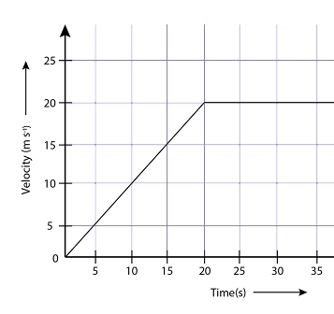
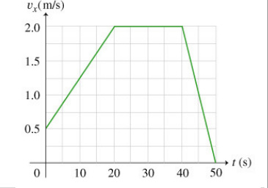
A velocity-time graph shows us in graph form how velocity changes over time. We can use these graphs to calculate acceleration:
I DO
Calculate the acceleration in the first 15 seconds of the journey shown in the graph below:
………………………………………………………………………………………..
………………………………………………………………………………………..
………………………………………………………………………………………..
………………………………………………………………………………………..
WE DO
Calculate the acceleration in the first 20 seconds of the journey shown in the graph below:
………………………………………………………………………………………..
………………………………………………………………………………………..
………………………………………………………………………………………..
………………………………………………………………………………………..
Calculate the acceleration in the final 10 seconds of the journey shown in the graph above:
……………………………………………………………………………………………………………………………………………………………
…………………………………………………………………………………………………………………………………………………………...
……………………………………………………………………………………………………………………………………………………………
……………………………………………………………………………………………………………………………………………………………
Change in velocity = 15 – 0 = 15 m/s
Change in time = 15 – 0 = 15 s
Acceleration = 15 / 15 = 1 m/s²
Change in velocity = 2 – 0.5= 1.5 m/s
Change in time = 20 – 0 = 20 s
Acceleration = 1.5 / 20 = 0.075 m/s²
Change in velocity = 0 - 2= -2 m/s
Change in time = 50 - 40 = 10 s
Acceleration = -2 / 10 = -0.2 m/s²

Slide 42
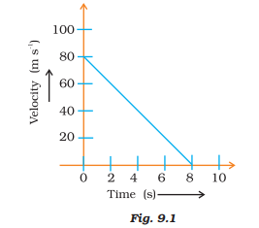
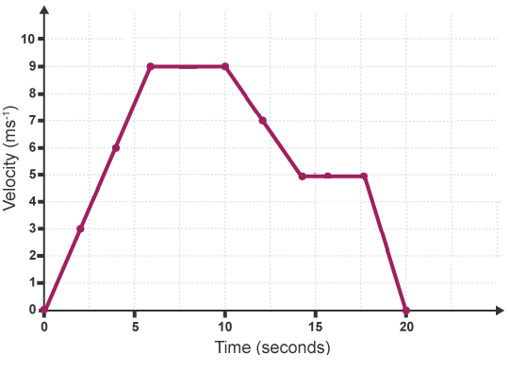
YOU DO
Calculate the acceleration in the first 8 seconds of the graph shown below:
………………………………………………………………………………………..
………………………………………………………………………………………..
………………………………………………………………………………………..
Use the graph below to calculate the acceleration during the following times:
The first five seconds of the journey:
……………………………………………………………………………………………………………………………………………………………………………………………………………………………………………………………………………………………………
…………………………………………………………………………………………………………………………………………………
Between 5 seconds and 10 seconds of the journey:
……………………………………………………………………………………………………………………………………………………………………………………………………………………………………………………………………………………………………
…………………………………………………………………………………………………………………………………………………
The last five seconds of the journey (this will be average acceleration):
……………………………………………………………………………………………………………………………………………………………………………………………………………………………………………………………………………………………………
…………………………………………………………………………………………………………………………………………………
Change in velocity = 80 – 0 = 80 m/s
Change in time = 8 – 0 = 8 s
Acceleration = 80 / 8 = 8 m/s²
Change in velocity = 7.5 – 0 = 7.5 m/s
Change in time = 5 – 0 = 5 s
Acceleration = 7.5 / 5 = 1.5 m/s²
Change in velocity = 9 – 9 = 0 m/s
Change in time = 10 – 5 = 5 s
Acceleration = 0 / 5 = 0 m/s²
Change in velocity = 0 – 5 = -5 m/s
Change in time = 20 - 15 = 5 s
Acceleration = -5 / 5 = -1 m/s²

Slide 43
Subtopic 4: The velocity – time relationship.
Learning Objective
You are learning to draw and interpret velocity-time graphs.
Why are we learning about this?
This lessons helps us understand why…
3

Slide 44
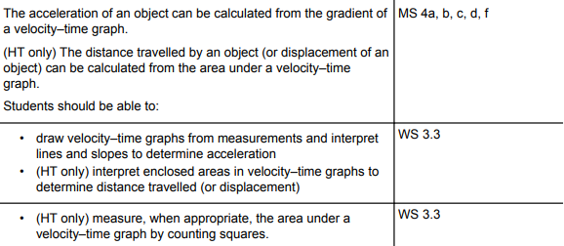
AQA Content
The priority is that students learn to extract information from the graphs…drawing graphs is revisited many times as it is a cumulative skill.
Students need to be able to calculate the area under the graph by:
Dividing the area in rectangles and triangles and obtaining the sum of their areas (linear graphs only).
Counting squares under the graph (non-linear graphs).
Disciplinary content

Slide 45
Subtopic 4: The velocity – time relationship.
I wasn’t there but I still care!
1. If a ball rolls 30m in 15 seconds how fast does it travel?
…………………………………………………………………………………………………………………………………………………………………………………………………………………………………………………………………………………………………………………..
2. A car drives 1km in 30 seconds. How fast was it travelling?
……………………………………………………………………………………………………………………………………………………………………………………………………………………………………………………………………………………………………………………
3. Mary was driving at 25m/s. How long did it take her to drive 500m?
……………………………………………………………………………………………………………………………………………………………………………………………………………………………………………………………………………………………………………………
4. Thomas flew his plane at a speed of 70m/s for 10 minutes. How far did he travel?
……………………………………………………………………………………………………………………………………………………………………………………………………………………………………………………………………………………………………………………
5. A bus accelerates from 5m/s to 25m/s in 10 seconds. What was its acceleration?
…………………………………………………………………………………………………………………………………………………………………………………………………………………………………………………………………………………………………………………..
6. A car had an acceleration of 10m/s² in 20 seconds. What was its change in velocity?
…………………………………………………………………………………………………………………………………………………………………………………………………………………………………………………………………………………………………………………..
7. Usain Bolt can reach a speed of 11m/s. What was his acceleration in his 100m race that takes him 9 seconds?
…………………………………………………………………………………………………………………………………………………………………………………………………………………………………………………………………………………………………………………..
8. How long did it take Stuart to finish the same race if he had an acceleration of 0.3m/s² and a speed of 6m/s?
…………………………………………………………………………………………………………………………………………………………………………………………………………………………………………………………………………………………………………………..
1. 30/15 = 2m/s
2. 1000/30 = 33.33m/s
3. 500/25 = 20s
4. 70 x 100 = 7000m
5. 25-5/10 = 2m/s²
6. 10 x 20 = 200m/s
7. 11-0/9 = 1.22m/s²
8. 6/0.3 = 20sec

Slide 46
Suggested chunking of concepts
Calculating distance travelled using velocity time graphs (including estimating from counting squares).
Drawing velocity-time graphs.
Interleaving of interpreting distance-time and velocity-time graphs.
Key explanations
a. Journeys can be represented graphically using velocity-time graphs. These graphs give us several pieces of information, including, acceleration at different points in time and the distance travelled. The distance travelled is determined from the area under the graph. This can be done using two methods 1. By counting the squares under graph and then multiplying by the distance represented by one square 2. Dividing the area under the graph into rectangles and triangles. The area of each rectangle / triangle is then determined, and all the values summed (see worked examples).
b & c. Drawing of graphs requires modelling using the following success criteria: Each point plotted with an error of less than half of one square; Points are joined dot to dot (one of the rare cases where we do this in science); if scales are drawn, spacings need to be regular, tick marks should be included, axis labels and units should be included.

Slide 47
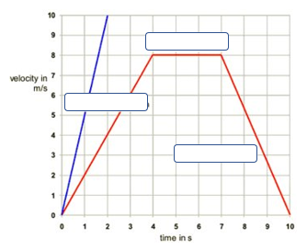
Subtopic 4: The velocity – time relationship.
Learning Objective
to construct and interpret a velocity – time relationship graph
Why are we learning about this?
This lesson helps us understand how to illustrate a journey with changing speed on a velocity –time graph, calculate the acceleration and determine the distance travelled.
Task 1: I do
Label the different parts of the graph
10
Answers
The steeper gradient represents a faster acceleration​
​
The horizontal line represents a constant velocity or speed (no acceleration or deceleration)​
​
The line coming back down represents deceleration​
​
The straight gradients represent a constant acceleration or deceleration ​
9
8
Velocity in m/s
7
6
5
4
3
2
1
0
0 1 2 3 4 5 6 7 8 9 10
Time in seconds
3

Slide 48
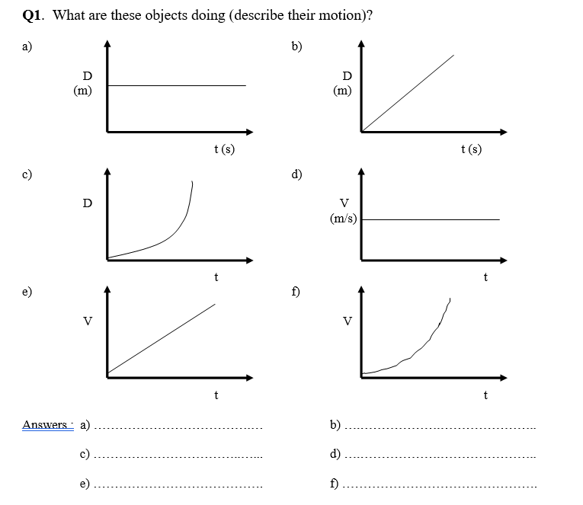
Subtopic 4: The velocity – time relationship.
Task 1: We do
Q1. Describe the motion of these objects.
Answers
…………………………………….
…………………………………….
e) …………………………………….
b) …………………………………….
d) …………………………………….
f) …………………………………….
Stationary b). Constant speed
c). acceleration d). Constant speed
e). Accelerating f). Increasing rate of acceleration
3

Slide 49
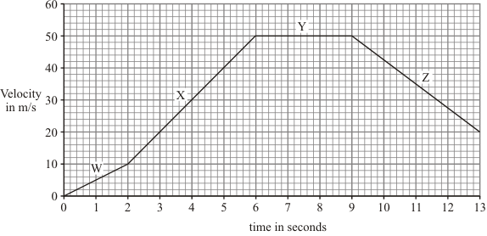
Subtopic 4: The velocity – time relationship.
Q1.
The graph shows changes in the velocity of a racing car.
Task 1: You Do
(a) Describe the motion of the racing car during:
(i) the period labelled W………………………………………………………………………………….…….……….
……………………………………………………………………………………………………………………………………….(1)
(ii) the period labelled Y.………………………………………………………………………………………………….
………………………………………………………………………………………………………………………………………. (1)

Slide 50
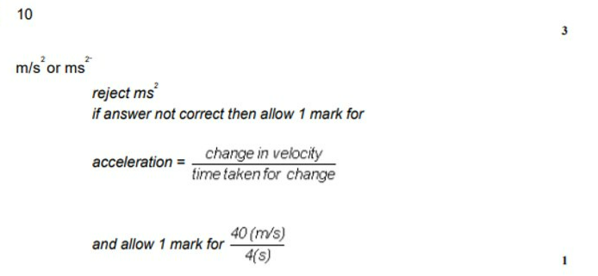
We Do: Task 2
Subtopic 4: The velocity – time relationship.
Calculate the acceleration of the racing car during the period labelled X.
Show clearly how you work out your answer and give the unit.
………………………………………………………………………………………………………………………………………………………………………………………………………………………………………………………………………………………………………………………..…………………………………………………………………………………………………………………………………………………………………………………………………………………………………………………………………………………………………………………………………………………………………………………………..…………………………………………………………………………………………………………………………………………………………………………………………………………………………………………………………………………………………………………………………………………………………………………………………………………………………………………………………………………………………………………………………………………………………………………………………………………………………………………………………………………………………………………………………………………………………………………………………………
Acceleration =…………………………………………

Slide 51
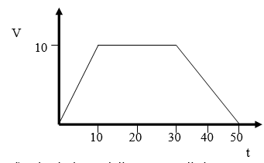
Subtopic 4: The velocity – time relationship.
Task 2: You do
The graph below describes the motion of a car.
What is the car’s acceleration in the first 10 s?
…………………………………………………………………………………………………………………………………………………………………………………………………………………………………………………………………………………………………………………………………………………………………………………………………………………………………………………………………………
Calculate its rate of deceleration.
…………………………………………………………………………………………………………………………………………………………………………………………………………………………………………………………………………………………………………………………………………………………………………………………………………………………………………………………………………
10 – 0 / 10 =1m/s²
0 – 10 / 20 =-0.5m/s²

Slide 52
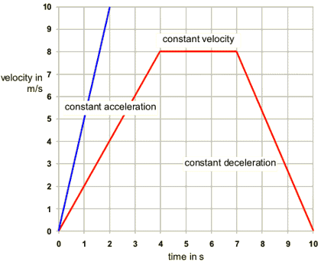
Subtopic 4: The velocity – time relationship.
Task 2: You do
The graph below describes two different journeys.
Use the graph to calculate the greatest acceleration shown.
……………………………………………………………………………………………………………………………………………………………………………………………………………………………………………………………………………………………………………………………………………………………………………………………………………………………………………………………………………..
Use the graph to calculate the acceleration between 7s and 10s.
………………………………………………………………………………………………………………………………………………………………………………………………………………………………………………………………………………………………………………………………………………………………………………………………………………………………………………………………………………
Steepest line
10 – 0 / 2 =5m/s²
0 – 8 / 3 =-2.6m/s²

Slide 53
Subtopic 4: The velocity – time relationship.
Task 3: I do HT
The graph below describes the motion of a car.
How far does it travel in the first 10 s?
…………………………………………………………………………………………………………………………………………………………………………………………………………………………………………………………………………………………………………………………………………………………………………………………………………………………………………………………………………
What is the total distance travelled?
…………………………………………………………………………………………………………………………………………………………………………………………………………………………………………………………………………………………………………………………………………………………………………………………………………………………………………………………………………
(10/2) x 10 =50m
(10/2) x 10 =50m
20 x 10 =200m
(20/2) x 10 =100m
50 + 200 +100 = 350m

Slide 54
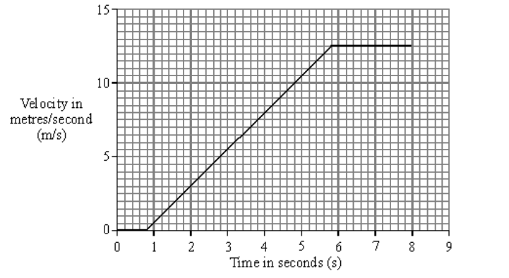
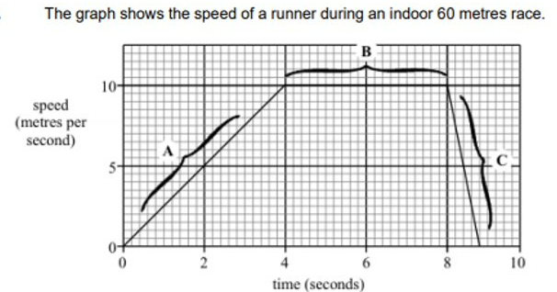
Subtopic 4: The velocity – time relationship.
Task 3: We do HT
A car travelling along a straight road has to stop and wait at red traffic lights. The graph shows how the velocity of the car changes after the traffic lights turn green.
Calculate the distance the car travels while accelerating. Show clearly how you work out your answer. ..................................................................................................................................... ..................................................................................................................................................
Distance = ...............................................metres (3)
How far does the runner travel during the first four seconds? (Show your working.) ..................................................................................................................................... ..................................................................................................................................... .....................................................................................................................................(3)
Base (5.8-0.8) =5 seconds
Height 12.5 m/s
Area = ½ base x height
Distance travelled = 31.25m
The graph shows the speed of a runner during an indoor 60 metres race.
10
Speed (m/s)
5
0
0 2 4 6 8 10
Time (s)
Base =4 seconds
Height 10 m/s
Area = ½ base x height
Distance travelled = 20m

Slide 55
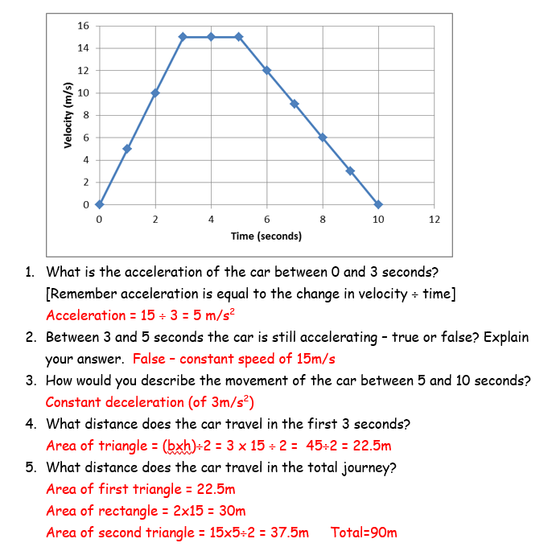
Subtopic 4: The velocity – time relationship.
Task 3: You do HT
The following table represents the movement of a car:-
Draw a Velocity time graph (with time on the x-axis)
1. What is the acceleration of the car between 0 and 3 seconds? ……………………………………………..
.........................................................................................................................................................
2. Between 3 and 5 seconds the car is still accelerating – true or false? Explain your answer.
.........................................................................................................................................................
3. How would you describe the movement of the car between 5 and 10 seconds? ………………….
.........................................................................................................................................................
4. What distance does the car travel in the first 3 seconds? ………………………………………………………
.........................................................................................................................................................
5. What distance does the car travel in the total journey? ………………………………………………………..
.........................................................................................................................................................

Slide 56
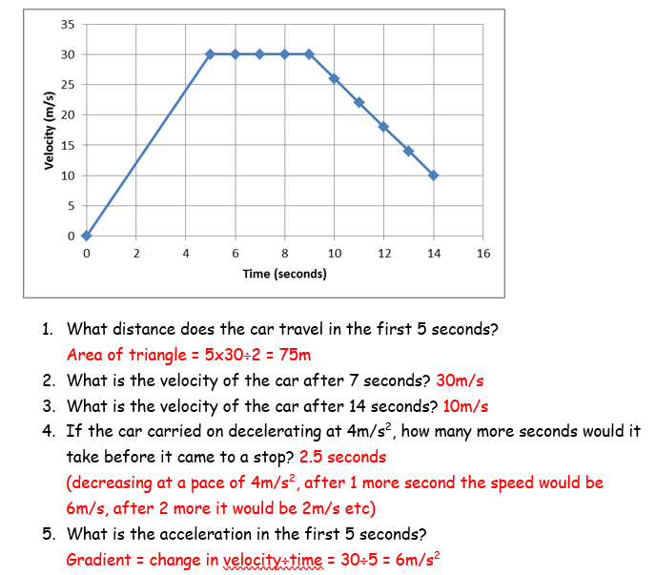
Subtopic 4: The velocity – time relationship.
Task 3: You do HT Challenge
A racing car (at rest) accelerates uniformly from the starting grid on the race track and reaches a top velocity of 30 meters/second/second after 5 seconds. For the next 4 seconds the acceleration is 0 and finally the car decelerates (brakes) at 4meters/second/second for 5 seconds.
Draw a Velocity time graph (with time on the x-axis). If you are stuck, try marking what the velocity would be after each second!
1. What distance does the car travel in the first 5 seconds?………………………………………………………….
...........................................................................................................................................................
2. What is the velocity of the car after 7 seconds? ………………………………………………………………………
3. What is the velocity of the car after 14 seconds?? …………………………………………………………………..
4. If the car carried on decelerating at 4m/s², how many more seconds would it take before it came to a stop? ……………………………………………………………………………………………………………………………………
...........................................................................................................................................................
5. What is the acceleration in the first 5 seconds?? …………………………………………………………………….
...........................................................................................................................................................

Slide 57
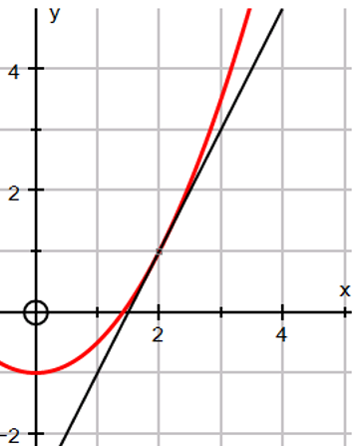
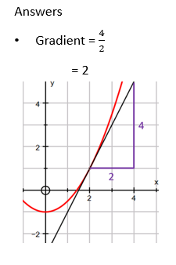
Subtopic 4: The velocity – time relationship.
Task 4 HT
I do
To find the gradient of a curve at a given point, you need to draw a tangent – this is a line that only touches the curve at this point.
Then calculate the gradient from the tangent.
Example: For the curve below, find the gradient when $x=2$.
………………………………………………………………………………………………………………………………………………………………………………………………………………………………………………………………………………………………………………………………………………………………………………………………………………………………………………………………………………………………………………………………………………………………………………………………………………………………………………………………………………………………………………………………………………………………………..

Slide 58
Subtopic 4: The velocity – time relationship.
Task 4 HT
We do
Find the gradient of the curve at$x=−1$
Find the gradient of the curve at 𝑥=1
………………………………………………………………………………………………………………………………………………………………………………………………………………………………………………………………………………………………………………………………………………………………………………………………………………………………………………………………………………………………………………………………………………………………………………………………………………………………………………………………………………………………………………………………………………
………………………………………………………………………………………………………………………………..………………………………………………………………………………………………………………………………..………………………………………………………………………………………………………………………………..

Slide 59
Subtopic 4: The velocity – time relationship.
Task 4 HT
You do
The graph below shows the journey of a javelin when thrown.
Calculate the acceleration of the javelin at time t = 4.
Calculate the distance travelled by the javelin between 2 and 5 seconds.
5 / (5.5-3)
5 / 2.5
2m/s²
b) Counting squares under graph = 49 small squares
49/4 = 12.25 m
(permit answers 12.2- 12.5m)

Slide 60
1 2 3 4 5 6 7 8 9 10 11 12 13 14 15 16 17 18 19 20 21 22 23 24 25 26 27 28 29 30 | Velocity-time graphs Determining acceleration If an object moves along a straight line, its motion can be represented by a velocity-time graph. The gradient of the line is equal to the acceleration of the object. The table shows what each section of the graph represents :Calculating displacement - higher The displacement of an object can be calculated from the area under a velocity-time graph. The area under the graph can be calculated by: using geometry (if the lines are straight) counting the squares beneath the line (particularly if the lines are curved) Eg Calculate the total displacement of the object, whose motion is represented by the velocity-time graph below.

Slide 61
1 2 3 4 5 6 7 8 9 10 11 12 13 14 15 16 17 18 19 20 21 22 23 24 25 26 27 28 29 30 | Here, the displacement can be found by calculating the total area of the shaded sections below the line. Find the area of the triangle: Find the area of the rectangle: Add the areas together to find the total displacement: Estimating the area under a curve - HT The area under a curve can be estimated by dividing it into triangles, rectangles and trapeziums. If we have a speed-time or velocity-time graph, the distance travelled can be estimated by finding the area. Example The velocity of a sledge as it slides down a hill is shown in the graph. Find the distance travelled by the sledge over its 30 second journey. Vertical lines every 4 seconds along the horizontal axis have been added and points joined to make triangles, rectangles or trapeziums that approximate to the curve.
The area of the triangle is 16 m²
base × height
(10 - 4) × 8 = 48 The area of the rectangle is 48 m²
(16 + 48) = 64 Total displacement = 64 m

Slide 62
1 2 3 4 5 6 7 8 9 10 11 12 13 14 15 16 17 18 19 20 21 22 23 24 25 26 27 28 29 30 | The areas of the shapes are: The total area is 10+28+35+31+20+7+0.5=131.5 so the sledge travelled approximately 131.5 m.

Slide 63
Subtopic 5: Newton’s first law.
Learning Objective
You are learning to describe the motion of an object using knowledge of the forces acting on it.
Why are we learning about this?
This lessons helps us understand how objects behave when forces are applied to them. For example, it explains why some objects accelerate under some conditions but move at a constant velocity at other points in time.
3

Slide 64
AQA Content
Students can find this challenging. They will need lots of everyday examples to help they relate to the content.
Disciplinary content

Slide 65
Suggested chunking of concepts
Calculating resultant forces.
The effects of resultant forces on speed and direction.
Applying Newton’s First Law.
Key explanations
a. Isaac Newton was a key historical figure in the Scientific Revolution and the Enlightenment. He made many discoveries and described many phenomena. As part of his work, he described the three Laws of Motion. To understand this law, you need to understand resultant forces; you learnt about these in the Forces 1 topic. When more than one force acts on an object, we can represent their effects using a single overall force called a resultant force.
If two forces act in on an object in the same direction we add them together.
If two forces oppose each other, we subtract one force from the other.
b. Newton’s first law states that every object will remain at rest or have uniform motion in a straight line unless a resultant force greater than 0 N is applied. In other words:
If a resultant force of 0 N acts on an object, it will keep doing what it was already doing (we call this tendency to resist change, inertia).
If a resultant force greater than 0 N acts on an object, it will accelerate in the direction of the resultant force.
Use examples then fade into independent work.

Slide 66
Suggested chunking of concepts
Calculating resultant forces.
The effects of resultant forces on speed and direction.
Applying Newton’s First Law.
Inertia.
Key explanations

Slide 67
Key explanations

Slide 68
Key explanations
I Do
We Do:

Slide 69
Key explanations
You Do:

Slide 70
Key explanations

Slide 71
Answers
I Do:
(a) 4 N to the right 1
(b) (i) bigger than 1
equal to 1
(ii) reduces it 1
increases air resistance / drag / force C
accept parachute has large(r) (surface) area 1
[5
We Do:
You Do:

Slide 72
Suggested chunking of concepts
Calculating distance travelled and displacement using velocity time graphs (including estimating from counting squares).
Drawing velocity-time graphs.
Interleaving of interpreting distance-time and velocity-time graphs.
Answers
You Do:

Slide 73
Answers
You Do:

Slide 74
I Do:
Q1.
(a) The diagram shows two forces acting on an object.
We Do:
(b) BASE jumpers jump from very high buildings and mountains for sport.
The diagram shows the forces acting on a BASE jumper in flight. The BASE jumper is wearing a wingsuit.

Slide 75
I Do:
We Do:
……………………………………………………………………………………………………….
………………………………………………………………………………………………………………………………………………………………………………………………………………

Slide 76
You Do:

Slide 77
You Do:

Slide 78
You Do:
…………………………………………………………………………………………………………………………………………………………………………………………………………………………
Explain why the egg did not break.
………………………………………………………………………………………………………………………………………………………………………………………………………………………………………………………………………………………………………………………………………………………………………………………………………………………………………………………………………………………………………………………………

Slide 79
You Do:
………………………………………………………………………………………………………………………………………………………………………………………………………………………………………………………………………………………………………………………………………………………………………………………………………………………………………………………………………………………………………………………………

Slide 80
Subtopic 6: Uniform acceleration & terminal velocity.
Learning Objective
You are learning to apply the concept of uniform acceleration.
You are learning to explain why objects achieve terminal velocity.
Why are we learning about this?
This lessons helps us understand why objects such as cars have a maximum velocity. This is used in multiple industries including vehicle design, parachute design and to determine the minimum safety features of vehicles, surfaces ibn playgrounds etc.
3

Slide 81
AQA Content
The equation is quite challenging. So, worked examples and modelling opportunities are essential.
There should be:
‘I do’ modelling opportunities
‘We do’ opportunities.
‘You do’ opportunities.
As for previous calculations, students should be expected to change the subject for some calculations.
As for previous graphs, interpreting graphs is the priority.
Disciplinary content

Slide 82
Suggested chunking of concepts
Uniform acceleration.
Calculating uniform acceleration.
Terminal velocity (why we do not observe uniform velocity).
Key explanations
When we learnt about velocity-time graphs, increases in velocity were represented by a straight line. We called this uniform acceleration. In other words, acceleration was constant. Another example of uniform acceleration is the acceleration of objects towards the Earth by Earth’s gravitational field. If the object is close to Earth, acceleration is constant (acceleration due to gravity is 9.8 m/s squared on or near to the Earth); it is uniform acceleration.
Use fading to demonstrate examples of calculations.
If a parachutist was falling towards the Moon, they would continue to uniformly accelerate until they collided with the Moon. This is because the Moon does not have an atmosphere so air resistance, a resistive force, doesn’t oppose the acceleration. The situation is different if the parachutist falls towards the Earth because the Earth has an atmosphere. In this situation, weight movers the parachutist towards the Earth; air resistance resists this. Whilst the parachutist is moving slowly, weight is a greater force than air resistance so there is a resultant force in the direction of the Earth; Newton’s first law states that the parachutist will accelerate towards. As the parachutist moves faster, air resistance increases. This will continue to happen until air resistance balances weight. When this happens, the resultant force is 0 N, so Newton’s first law says that the parachutist will move at a constant velocity. We call this terminal velocity. This phenomena also applies to vehicles that are accelerating, so long as the force from the engine is constant. Indeed, it applis to any object moving through a fluid.

Slide 83
Suggested chunking of concepts
Uniform acceleration.
Calculating uniform acceleration.
Terminal velocity (why we do not observe uniform velocity).
Key explanations
Calculating Uniform Acceleration
Worked Example
A car begins at a speed of 3m/s and accelerates at 2m/s^2 over a distance of 40m. Calculate the final speed of the car.
V^2 = U^2 + 2as
V^2 = 3^2 + 2 (2x40)
V^2 = 9 + 160
V^2 = 169
V = √ 169
V = 13m/s

Slide 84
Answers:
I Do:
(a) terminal 1
(b) 5.4 (kg) correct substitution of 54 = m × 10 gains 1 mark 2
(c) (i) 0< a <10
some upward force accept some drag / air resistance reduced resultant force 1
(ii) 0 upward force = weight (gravity) resultant force zero 1
[9]
We Do:
(a) starting / stopping the stopwatch
human error is insufficient reaction time is insufficient
or
timing over the smaller distances
accept not timing accurately do not accept references to measuring distance incorrectly 1
(b) (i) before 1
(ii) increasing
accept accelerating
it is not constant is insufficient it is less than after four seconds is insufficient
it reaches a constant speed negates
1
(iii) calculate the gradient of the straight/steepest/constant section
accept gradient of any section after 5.5 seconds/30 cm
1
(iv) drag (force) increases (as the ball bearing gets faster)
accept frictional/upward force for drag
1
(until) drag (force) = weight or (until) resultant force is zero
accept upward force = downward force accept till forces are balanced 1
(c) less than 1
ball bearing increases speed at a greater rate
accept it travels the same distance in less time
or
ball bearing has a greater acceleration
accept the ball bearing is going faster
or
terminal velocity has not been reached
1
so resultant force must be greater
or
as weight is the same (the drag must be less)
accept warmer oil has a lower density/viscosity for 1 mark if neither of the two reason marks score
1
[9]

Slide 85
Answers:
You Do:
(a) (i) air resistance/drag/friction (or upthrust) weight/gravitational pull/gravity
for 1 mark each 1
(ii) air resistance/friction acts in opposite direction to motion 1
(iii) Y 1
(iv) the sky-diver accelerates/his speed increases in downward direction/towards the Earth/falls
for 1 mark each 2
(b) force X has increased force Y has stayed the same the speed of the sky-diver will stay the same for 1 mark each 3
(c) (i) CD 1
3
(iv) 10 (but apply e.c.f. from (ii) and (iii)) gets 2 marks
or 500/50 or d/t gets 1 mark 2
[14]
(a) gravity
accept weight
do not accept mass
accept gravitational pull
1
(b) (i) Initially force L greater than force M
accept there is a resultant force downwards
1
(as speed increases) force M increases
accept the resultant force decreases
1
when M = L, (speed is constant)
accept resultant force is 0
accept gravity/weighty for L
accept drag/ upthrust/resistance/friction for M
do not accept air resistance for M but penalise only once
1
(ii) terminal velocity
1
(iii) 0.15
accept an answer between 0.14 – 0.16 an answer of 0.1 gains no credit allow 1 mark for showing correct use of the graph
2
[7]

Slide 86
Answers:
You Do:
(a) 750
allow 1 mark for correct substitution, ie 75 × 10 provided no subsequent step shown 2
newton(s) / N do not accept n 1
(b) Marks awarded for this answer will be determined by the Quality of Written Communication (QWC) as well as the standard of the scientific response. Examiners should also refer to the Marking Guidance and apply a ‘best-fit’ approach to the marking.
0 marks No relevant content.
Level 1 (1-2 marks) There is a brief attempt to explain why the velocity / speed of the parachutist changes. or the effect of opening the parachute on velocity/speed is given.
Level 2 (3-4 marks) The change in velocity / speed is clearly explained in terms of force(s) or a reasoned argument for the open parachute producing a lower speed.
Level 3 (5-6 marks) There is a clear and detailed explanation as to why the parachutist reaches terminal velocity and a reasoned argument for the open parachute producing a lower speed
examples of the physics points made in the response to explain first terminal velocity
• on leaving the plane the only force acting is weight (downwards)
accept gravity for weight throughout
• as parachutist falls air resistance acts (upwards)
accept drag / friction for air resistance
• weight greater than air resistance or resultant force downwards
• (resultant force downwards) so parachutist accelerates
• as velocity / speed increases so does air resistance
• terminal velocity reached when air resistance = weight
accept terminal velocity reached when forces are balanced
to explain second lower terminal velocity
• opening parachute increases surface area
• opening parachute increases air resistance
• air resistance is greater than weight
• resultant force acts upwards / opposite direction to motion
• parachutist decelerates / slows down
• the lower velocity means a reduced air resistance
air resistance and weight become equal but at a lower (terminal) velocity
6

Slide 87
Answers:
You Do:
(c) (i) any one from:
• mass of the (modelling) clay
accept size/shape of clay size/amount/volume/shape of clay
accept plasticine for (modelling)clay
• material parachute made from
accept same (plastic) bag
• number / length of strings
1
(ii) C
reason only scores if C is chosen
1
smallest (area) so falls fastest (so taking least time)
accept quickest/quicker for fastest
if A is chosen with the reason given as ‘the largest area so falls slowest’ this gains 1 mark
1
[12]
(a) there is a resultant force acting
allow weight is greater than air resistance
allow (initially) weight/gravity is the only force acting
1
(b) as the velocity of the hailstone increases air resistance increases
allow speed for velocity
1
uuntil air resistance becomes equal to the weight of the hailstone
1
so the resultant force is (equal to) zero
1
(c) as mass increases the weight of a hailstone increases
1
(d) kinetic energy depends on both mass and velocity
allow E_{k} = ½ mv²
1
as mass increases so does maximum velocity
a statement is required
1
kinetic energy ∝ m and kinetic energy ∝ v² so as mass doubles kinetic energy more than doubles
this mark can be scored by relevant calculations
1

Slide 88
Answers:
You Do:
(e) 1 Nm
1
(f) mass = 0.0185 (kg)
allow 0.018 to 0.019 inclusive
1
allow a correct substitution using an incorrectly / not converted value of m
1
F = 7.708 (N)
allow 7.7 (N)
allow correct calculation using an incorrectly / not converted value of m
if no other marks are awarded
a misreading of the scale giving a value between 15.6 and 15.7 inclusive that is then correctly converted giving an answer between 6.50 and 6.54 scores 2 marks
a misreading of the scale giving a value between 15.6 and 15.7 inclusive that is then not converted giving an answer between 6500 and 6542 scores 1 mark
1
[12]
Thrust SSC Answers
1
(a) (i) Uniform acceleration
(ii) Non-uniform acceleration
After 4 s, acceleration first increases (slightly) then decreases.
(NB NO deceleration, acceleration does NOT become negative)
(b) a = Dv/Dt = 180 m s⁻¹/10 s
(or similar values read from tangent to graph) = 18.0 m s⁻¹
(c) 100 small squares represent 1000 m area under graph is about 62 small squares so displacement is about 1000 m x 62/100 = 620 m (or similar value deduced from area of graph)

Slide 89
Suggested chunking of concepts
Uniform acceleration.
Calculating uniform acceleration.
Terminal velocity (why we do not observe uniform velocity).
Key explanations
Interpreting Velocity-Time Graphs
When plotting the graphical relationship of ( velocity – time ) we may get :
A straight line that may start from the origin , By finding the slope of the straight line , we obtain the acceleration of the object motion , when the slope of line is positive , It is a positive acceleration , The object is moving at a uniform acceleration .
A straight line parallel to the time axis , It is zero acceleration , The slope of line = 0 , The object is moving at zero acceleration .
A straight line that may end at the time axis , The slope of line is negative , It is negative acceleration , The object is moving at a uniform deceleration .
The projectile whose velocity decreases till reaches zero at its maximum height , represents an example for negative acceleration .
When the object moves at a uniform acceleration = 10 m/s² , It means that the object velocity increases by 10 m/s every second .
When an object decelerates uniformly at − 10 m/s² , It means that the object velocity decreases by 10 m/s every second .

Slide 90
Suggested chunking of concepts
Uniform acceleration.
Calculating uniform acceleration.
Terminal velocity (why we do not observe uniform velocity).
Key explanations
Common Misconceptions:
Heavier objects fall faster because they experience less air resistance. Air resistance opposes the motion of a falling object. As an object falls, air resistance act upwards so as to reduce the net force. Heavy objects fall faster than lighter objects because the downward force (gravity) is bigger. A more massive object must accelerate to higher speeds in order to acquire an air resistance force that is large enough to balance the downward force. Thus, a heavier object will experience a greater amount of air resistance than a lighter object; it’s just that it must have a higher terminal velocity value in order to obtain this larger air resistance value.
As an object approaches terminal velocity, both its velocity and acceleration decrease. As a falling object approaches its terminal velocity, the net force is observed to decrease as the air resistance force increases. This decrease in net force is accompanied by a decreasing acceleration. These two statements are true. What often follows in a student's mind is the incorrect perception that the velocity is decreasing. This false belief exemplifies a student’s tendency to confuse concepts of velocity and acceleration. The decrease in acceleration should be correctly understood to mean that the falling object is still picking up speed, just at a lower rate of acceleration. If the object were equipped with a speedometer, the needle would continue to show an increase in speed; however the rate at which the needle moves upward would decrease.

Slide 91
1 2 3 4 5 6 7 8 9 10 11 12 13 14 15 16 17 18 19 20 21 22 23 24 25 26 27 28 29 30 | How Skydiver Jumped Without a Parachute (and Survived) By Ashley P. Taylor ( livescience.com) published August 02, 2016 Skydiver Luke Aikins became the first person to jump from a plane without a parachute or wingsuit this past weekend, carrying out the daring stunt on live television. Aikins jumped from a height of 25,000 feet (7,600 meters) and, after a two-minute fall, flipped onto his back to land in a 100-foot-by-100-foot (30 m by 30 m) net, according to news reports. How did the daredevil pull off such a heart-stopping stunt? To accomplish such a jump with a parachute, a skydiver would typically jump from the plane, free-fall at 120 mph (190 km/h) or faster and then, at higher than 2,500 feet (760 m) above the ground, deploy the parachute, according to Nancy Koreen, spokeswoman for the U.S. Parachute Association. The parachute works to slow the skydiver's descent enough for a safe landing, she told Live Science. Without a parachute, a skydiver would continue to fall at 120 mph, a speed at which it would be fatal if the person hit the ground, she said. However, instead of hitting the ground, Aikins fell into a net in Simi Valley, California, reported CBS News. "That was what he used to survive," Koreen said.

Slide 92
1 2 3 4 5 6 7 8 9 10 11 12 13 14 15 16 17 18 19 20 21 22 23 24 25 26 27 28 29 30 | But did Aikins' movements, such as flipping onto his back or tumbling in the air, slow his fall? Not by much, Koreen said. To slow down, a skydiver can spread his or her limbs to increase surface area, but "that will only slow you down maybe 10 miles an hour [16 km/h] — not substantially. You're still falling above 100 miles an hour [160 km/h]," Koreen said. A skydiver falling at high speed has a lot of kinetic energy, and that energy has to transfer somewhere upon landing, Potvin said. If you hit the ground, the kinetic energy is "dissipated into the ground, then reflected back into your body and breaks your body into a million pieces," he said. How Skydiver Jumped Without a Parachute (and Survived) | Live Science

Slide 93
Subtopic 7: Terminal velocity.
Learning Objective
You are learning to interpret information related to terminal velocity.
Why are we learning about this?
This lessons helps us understand why objects such as cars have a maximum velocity. This is used in multiple industries including vehicle design, parachute design and to determine the minimum safety features of vehicles, surfaces ibn playgrounds etc.
3

Slide 94
AQA Content
Disciplinary content

Slide 95
Suggested chunking of concepts
Terminal velocity.
Interpreting changing motion in terms of forces involved.
Interpreting velocity-time graphs related to terminal velocity (including calculating acceleration / deceleration using tangents and gradients).
Drawing velocity-time graphs involving terminal velocity.
Key explanations
a & b. See explanation for last lesson.
c & d. See worked examples.

Slide 96
1 2 3 4 5 6 7 8 9 10 11 12 13 14 15 16 17 18 19 20 21 22 23 24 25 26 27 28 29 30 31 | Any object free falling through a fluid near to the surface of the Earth will have an acceleration of approximately 9.8m/s², because of the interaction of the gravitational field of the Earth with the objects mass. As the object falls, velocity will increase up to the point where the gravitational pull and the drag force are equal. At this point the velocity of the falling object will be constant and terminal velocity has been reached. Terminal velocity is the point where the resultant force acting on a falling object is zero. The terminal velocity of a falling object can be changed. To do so, the cross section of the horizontal plane of the falling object can be altered. This is known as the projected area. An object with a large projected area relative to its mass will have a low terminal velocity. If the projected area of this object is reduced, its terminal velocity will increase. Some objects are so small that the terminal velocity that they reach is overcome by convection currents in the air. As such, they can stay suspended in the air indefinitely. This applies to substances such dust and mist. This can also be seen in sky divers. The terminal velocity of a skydiver in the belly-to-Earth position is about 55m/s (123mph). If they were to pull their limbs in this would increase to about 90m/s (201mph). Competitive free fallers can reach velocities of 150m/s (335mph), The fastest velocity a human has ever attained in freefall was achieved by Felix Baumgartner who reached a velocity of 380m/s (850mph) on his way down from an altitude of 38,887m. It must be noted however, that he achieved this velocity at a high altitude where the air density is lower, producing a lower drag force. In all instances mentioned, a parachute is usually used to navigate safely to the ground. The effect of a parachute is to increase the resistive force, causing a deceleration effect. This resistive force decreases to eventually equal weight, thus establishing a safer terminal velocity. There is an urban myth surrounding the idea of terminal velocity. Dropping an penny from the top of the Empire State Building in New York is said to be able to cause death on impact, however this is not the case. It must be said that the penny in question is an

Slide 97
1 2 3 4 5 6 7 8 9 10 11 12 13 14 15 16 17 18 19 20 21 22 23 24 25 26 27 28 29 30 | American penny (the cent) has a mass of about 2.5g. With tumbling and air resistance, the terminal velocity reached by the penny is quite low. It would most certainly hurt on impact but would not cause death. There is a grain of truth in this though, and is one of the main reasons why hard hats are necessary on a building site. A nut or bolt (~50g) falling from height could do a lot of damage, and depending on the height, could even be fatal.

Slide 98
Subtopic 7: Terminal velocity.
A falling object will accelerate to its terminal velocity. A falling object will not immediately reach its terminal velocity, however the terminal velocity will be reached as weight and air resistance strike up a balance. Whilst there is a difference between these 2 forces, there will be a resultant force causing acceleration. Over time, as air resistance increases, the size of the resultant forces will decrease, causing the effect of acceleration to be smaller.
Task:
Draw a free body diagram for A – B,
Why might it be difficult to draw a free body diagram for B – C?
………………………………………………………………………………………………………………………………………………………………………………………………………………………………………………………………………………………………………………………………………………………………………………………………………………………………………………………………………………………………………………………………………………………………………………………………………………………………………………………………………………………………………………………………………………………………………………………

Slide 99
Subtopic 7: Terminal velocity.
Constant Terminal Upward Unbalanced Increases Decreases Small Increase Weight Balanced Same Accelerate Decelerate Large
The skydiver jumps out of the plane and the downward force of her …………………. pulls her down, her air resistance at the start is very ………………….. but soon she starts to ………………….. ,
As she accelerates the air resistance force ……………………. and acts in the opposite direction to her ………………………….. .
As she accelerates faster the air resistance force continues to …………………… until eventually it is the …………………… as her weight. She is now moving at a …………………….. speed and her weight is equal to the air resistance. Her speed is called her ……………………. velocity. The two forces are …………………………. .
She opens her parachute. There is now a very ……………………. air resistance force so she starts to ……………………. (slow down).
As she decelerates the air resistance force on her parachute ………………….. until it is the ……………………. size as her weight. She is now again falling at a …………………. speed but she has a new and slower ………………….. velocity.
On the ground her ………………… is now equal to the ………………… force
from the ground, the forces are balanced.
weight
small
accelerate
increases
weight
increase
same
constant
terminal
balanced
large
decelerate
decreases
same
constant
terminal
weight
upwards

Slide 100
Subtopic 7: Terminal velocity
3
4
Velocity
1
2
3
5
A velocity - time graph for a falling parachutist
I do:
Where on the graph are the following events?
Acceleration
…………………………………………………………………………………………………………………………………………..
Deceleration
…………………………………………………………………………………………………………………………………………..
Terminal velocity
……………………………………………………………………………………………………………………………….………….
Parachute open
………………………………………………………………………………………………………………………………………….
Sky diver lands
……………………………………………………………………………………………………………………………………......

Slide 101
Subtopic 7: Terminal velocity.
You do: The table below shows how the velocity of a skydiver changes over time. Plot a velocity-time graph below and draw a smooth curve that passes through each point.
Time (s) | 0 | 5 | 10 | 15 | 20 | 25 | 30 | 35 | 40 | 45 | 50 | 55 | 60
Velocity (m/s) | 0 | 28 | 43 | 48 | 50 | 50 | 50 | 49 | 12 | 10 | 10 | 10 | 0
10
18
18 ÷ 10
= 1.8m/s²
1. Label the following part of the skydivers descent:
Acceleration
Deceleration
Terminal velocity
Parachute open
Sky diver lands
2. Calculate acceleration at 10s.
……………………………………………………………………………………………………………………………………………………………………………………………………………………………………………………………………………………………………………………………………………………………………………………………………………………………………………………..

Slide 102
Subtopic 7: Terminal velocity
I do:
The diagram shows a shuttlecock that is used for playing badminton.
The shuttlecock weighs very little. When you drop it from a height of a few metres, it accelerates at first but soon reaches a steady speed.
Explain, as fully as you can:
(a) why the shuttlecock accelerates at first,
………………………………………………………………………………………………………………………………………………………………………………………………………………………………………………………………………………………………………………………………………………………………………………………………………………………………………………………………………………………………………………………………………………………………………………………………………………………………
(2)
(b) why the shuttlecock reaches a steady speed.
………………………………………………………………………………………………………………………………………………………………………………………………………………………………………………………………………………………………………………………………………………………………………………………………………………………………………………………………………………………………………………………………………………………………………………………………………………………………………………………………………………………………………………………………………………………………………………………………………………………………………………………………………………………………………………………………………………
(3)
(Total 5 marks)

Slide 103
Subtopic 7: Terminal velocity
We do:
A swimmer dives off a boat.
Look at Figure 1.
Figure 1
The swimmer’s speed increases as she swims away from the boat.
The swimmer has a top speed.
Explain why.
………………………………………………………………………………………………………………………………………………………………………………………………………………………………………………………………………………………………………………………………………………………………………………………………………………………………………………………………………………………………………………………………………………………………………………………………………………………………………………………………………………………………………………………………………………………………………………………………………………………………………………………………………………………………………………………………………………………………
………………………………………………………………………………………………………………………………………………………………………………………………………………………………………………………………………………………………………………………………………………………………………………………………………………………………………………………………………………
(5)

Slide 104
Subtopic 7: Terminal velocity
You do:
Q1.
A sky-diver jumps from a plane.
The sky-diver is shown in the diagram below.
(a) Arrows X and Y show two forces acting on the sky-diver as he falls.
(i) Name the forces X and Y.
X ………………………………………………………
Y ………………………………………………………
(2)
(ii) Explain why force X acts in an upward direction.
………………………………………………………………………………………………………………………
………………………………………………………………………………………………………………………
(1)
(iii) At first forces X and Y are unbalanced.
Which of the forces will be bigger? ………………………………..
(1)
(iv) How does this unbalanced force affect the sky-diver?
………………………………………………………………………………………………………………………
………………………………………………………………………………………………………………………
(2)

Slide 105
Subtopic 7: Terminal velocity
You do:
(b) After some time the sky-diver pulls the rip cord and the parachute opens.
The sky-diver and parachute are shown in the diagram below.
After a while forces X and Y are balanced.
Underline the correct answer in each line below.
Force X has
increased / stayed the same / decreased.
Force Y has
increased / stayed the same / decreased.
The speed of the sky-diver will
increase / stay the same / decrease.
(3)

Slide 106
Subtopic 7: Terminal velocity
You do:
(c) The graph below shows how the height of the sky-diver changes with time.
(i) Which part of the graph, AB, BC or CD shows the sky-diver falling at a constant speed?
…………………………………………………. (1)
(ii) What distance does the sky-diver fall at a constant speed?
Distance …………………………….m (1)
(iii) How long does he fall at this speed?
Time ………………………….. s (1)
(iv) Calculate this speed.
………………………………………………………………………………………………………………………………..
Speed ……………………………………….. m/s (2)
(Total 14 marks)

Slide 107
Subtopic 7: Terminal velocity
You do:
Q2.
(a) The diagram shows the forces acting on a parachutist in free fall.
The parachutist has a mass of 75 kg.
Calculate the weight of the parachutist.
Show clearly how you work out your answer and give the unit.
…………………………………………………………………………………………………………………………………………………………………………………………………………………………………………………………………………………………………………………..
Weight = ……………………………………………….
(3)
gravitational field strength = 10 N/kg

Slide 108
Subtopic 7: Terminal velocity
You do:
(b) In this question you will be assessed on using good English, organising information clearly and using specialist terms where appropriate.
The graph shows how the vertical velocity of a parachutist changes from the moment the parachutist jumps from the aircraft until landing on the ground.
Using the idea of forces, explain why the parachutist reaches a terminal velocity and why opening the parachute reduces the terminal velocity.
………………………………………………………………………………………………………………………………………………………..……………………………………………………………………………………………………………………………………………………………..
…………………………………………………………………………………………………………………………………………………………..…………………………………………………………………………………………………………………………………………………………..
..……………………………………………………………………………………………………………………………………………………………………………………………………………………………………………………………………………………………………………………..
…..…………………………………………………………………………………………………………………………………………………………………………………………………………………………………………………………………………………………………………………..
……..……………………………………………………………………………………………………………………………………………………………………………………………………………………………………………………………………………………………………………(6)

Slide 109
Subtopic 8: Newton’s second law (F = ma).
Learning Objective
You are learning to apply the relationship between force, mass and acceleration.
Why are we learning about this?
This lessons helps us understand why some objects, like formula one cars, accelerate very quickly whilst others accelerate slowly. This information is used in a variety of sports (e.g. judo, Olympic weightlifting and golf) and industries (e.g. design of high performance cars).

Slide 110
AQA Content
The focus is on the calculations.
As for previous calculations the following is required:
Worked example.
‘I do’ modelling.
Two opportunities for ‘we do’ modelling.
Examples for students to complete independently. This need to be blocked and interleaved:
Block of calculations where acceleration is the subject.
Block of calculations where mass is the subject.
Block where change in resultant force is the subject.
Mixed calculations.
Disciplinary content

Slide 111
Suggested chunking of concepts
F = m x a and what the equation represents.
Applying F = m x a
HT: Inertial mass.
Key explanations
a. Newton’s second law states an important relationship that exists between force, mass and acceleration. Intuitively, we might say that if one person pushed a broken-down car off the road its acceleration would be less than if two people pushed it. We might even predict that the acceleration would be doubled if two people pushed it. So, force is directly proportional to acceleration. Force is also directly proportional to mass; a car with less mass would accelerate faster than one with less mass. We capture this relationship in the equation:
Force = mass x acceleration.
b. See worked examples and examples used in fading.
c. The mass of an object determines the ratio that exists between force applied and acceleration. We call the ration of force over acceleration inertial mass. This is a measure of how hard it is to change the velocity of an object.

Slide 112
1 2 3 4 5 6 7 8 9 10 11 12 13 14 15 16 17 18 19 20 21 22 23 24 25 26 27 28 29 30 | The second of Isaac Newton’s 3 Laws of motion describes the relationship between force, mass and acceleration. Newton derived that if the mass of an object remains constant then if there is a resultant force acting on it, it will accelerate. If there is no resultant force, the object will not be accelerated (its velocity will remain unchanged). The larger the resultant force is, the faster the object will accelerate, a proportional relationship (as per diagram A). If two objects with different mass have the same resultant force applied to them, then the object with the larger mass will accelerate less quickly. This relationship between mass and acceleration, where resultant force remains constant, is described as being inversely proportional (as per diagram B). The ratio of force over acceleration is known as inertial mass. This describes how difficult it is to change the velocity of an object. Objects with a greater mass have a greater inertia so a greater resultant force is required to make them accelerate Newton’s Second Law of motion can be described with the equation: F = m x a F = force (Newtons, N) m = mass (kilograms, kg) a = acceleration (metres per second squared, m/s²)

Slide 113
Subtopic 8: Newton’s second law (F = ma).
Diagram A
100N
200N
A
100N
1000N
B
Annotate the diagrams to support the explanation on the previous page.
Higher tier scholars should explain how diagram B demonstrates inertial mass.
Diagram B
A
Mass = 1000kg
B
Mass = 5000kg
……………………………………………………………………………………………………………………………………………………………………………………………………………………………………………………………………………………………………………………………………………………………………………………………………………………………………………………………………………………………………………………………………………………………………………………………….

Slide 114
Subtopic 8: Newton’s second law (F = ma).
As previously mentioned the equation F = m x a, or F = ma, summarises Newtons second law
I do:
An object with a mass of 2 kg accelerates 2 m/s² when an unknown force is applied to it. What is the force?
Step 1: Write out the equation: F = m x a
Step 2: insert your values: F = 2 x 2
Step 3: calculate: F = 4N
We do:
An object with a mass of 1.5kg accelerates 10 m/s² when an unknown force is applied to it. What is the force?
Step 1: Write out the equation:
Step 2: insert your values:
Step 3: calculate:
Calculate the force required to accelerate a 5kg mass at 10m/s².
Step 1: Write out the equation:
Step 2: insert your values:
Step 3: calculate:
F = m x a
F = 1.5 x 10
F = 15N
F = m x a
F = 5 x 10
F = 50N

Slide 115
Subtopic 8: Newton’s second law (F = ma).
You do:
Mass = 1.5kg, acceleration = 7.5 m/s²
……………………………………………………………………………………………………………………………………………………………………………………………………………………………………………………………………………………………………………………………………………………………………………………………………………………………………………………………………………………………………………………………………………………………………………………………………………………
Acceleration = 2.5 m/s², mass = 0.5kg
……………………………………………………………………………………………………………………………………………………………………………………………………………………………………………………………………………………………………………………………………………………………………………………………………………………………………………………………………………………………………………………………………………………………………………………………………………………
Mass = 40,000g, acceleration = 63 m/s²
……………………………………………………………………………………………………………………………………………………………………………………………………………………………………………………………………………………………………………………………………………………………………………………………………………………………………………………………………………………………………………………………………………………………………………………………………………………
Acceleration = 12 m/s², mass = 4951g
……………………………………………………………………………………………………………………………………………………………………………………………………………………………………………………………………………………………………………………………………………………………………………………………………………………………………………………………………………………………………………………………………………………………………………………………………………………
Mass = 25g, acceleration = 50 m/s²
……………………………………………………………………………………………………………………………………………………………………………………………………………………………………………………………………………………………………………………………………………………………………………………………………………………………………………………………………………………………………………………………………………………………………………………………………………………
1.5 x 7.5
= 11.25N
0.5 x 2.5
= 1.25N
40 x 63
= 2520N
4.951 x 12
= 59.412N
0.025 x 50
= 1.25N

Slide 116
Subtopic 8: Newton’s second law (F = ma).
Rearrange F = m x a to make both mass and acceleration the subject:
m =
a =
F ÷ a
F ÷ m
We do:
Gravity accelerates an object at 9.8m/s² and a gives it a weight (force) of 680N. What is the objects mass?
Step 1: write out the equation:
Step 2: insert your values:
Step 3: rearrange:
Step 4: calculate:
The recently invented plasma engine is designed to accelerate small spacecraft to the stars. The engine provides 8.0N of thrust on a spacecraft of mass 600g. Calculate the acceleration.
Step 1: write out the equation:
Step 2: insert your values:
Step 3: rearrange:
Step 4: calculate:
F = m x a
680 = m x 9.8
m = 680 ÷ 9.8
m = 69.39kg
F = m x a
8.0 = 0.6 x a
a = 8.0 ÷ 0.6
a = 13.33m/s²

Slide 117
Subtopic 8: Newton’s second law (F = ma).
You do:
Work out the mass in each of the following:
acceleration = 5 m/s², force = 12N
……………………………………………………………………………………………………………………………………………………………………………………………………………………………………………………………………………………
…………………………………………………………………………………………………………………………………………
acceleration = 25 m/s², force = 200N
……………………………………………………………………………………………………………………………………………………………………………………………………………………………………………………………………………………
…………………………………………………………………………………………………………………………………………
acceleration = 15 m/s², force = 3N
……………………………………………………………………………………………………………………………………………………………………………………………………………………………………………………………………………………
…………………………………………………………………………………………………………………………………………
Work out the acceleration in each of the following:
force = 20N, mass = 5kg
……………………………………………………………………………………………………………………………………………………………………………………………………………………………………………………………………………………
…………………………………………………………………………………………………………………………………………
force = 7N, mass = 14kg
……………………………………………………………………………………………………………………………………………………………………………………………………………………………………………………………………………………
…………………………………………………………………………………………………………………………………………
force = 2,000N, mass = 1250kg
………………………………………………………………………………………………………………………………………………………………………………………………………………………………………………………………………………………………………………………………………………………………………………………………………………………………
12 ÷ 5
= 2.4kg
200 ÷ 25
= 8kg
3 ÷ 15
= 0.2kg
20 ÷ 5
= 4m/s²
7 ÷ 14
= 0.5m/s²
2000 ÷ 1250
= 1.6m/s²

Slide 118
Subtopic 8: Newton’s second law (F = ma).
What is the force if the mass is 3.5 kg and the acceleration is 80 m/s²
………………………………………………………………………………………………………………………………………………………………………………………………………………………………………………………………………………………………………………………………………………………………………………………………………………………………………………………………………
What is the force if the mass is 800 kg and the acceleration is 60 m/s²?
………………………………………………………………………………………………………………………………………………………………………………………………………………………………………………………………………………………………………………………………………………………………………………………………………………………………………………………………………
What is the mass if the force is 90 N and the acceleration is 80m/s²?
………………………………………………………………………………………………………………………………………………………………………………………………………………………………………………………………………………………………………………………………………………………………………………………………………………………………………………………………………
What is the mass if the force is 20 N and the acceleration is 80 m/s²?
………………………………………………………………………………………………………………………………………………………………………………………………………………………………………………………………………………………………………………………………………………………………………………………………………………………………………………………………………
What is the force if the mass is 40 kg and the acceleration is 23 m/s²?
………………………………………………………………………………………………………………………………………………………………………………………………………………………………………………………………………………………………………………………………………………………………………………………………………………………………………………………………………
What is the acceleration if the force is 74 N and the mass is 655 kg?
……………………………………………………………………………………………………………………………………………………………………………………………………………………………………………………………………………………………………………………………………………………………………………………………………………………………………………………………………..
3.5 x 80
= 280N
800 x 60
= 48,000N
90 ÷ 80
= 1.125kg
20 ÷ 80
= 0.25kg
40 x 23
= 920N
74 ÷ 655
= 0.113m/s²

Slide 119
Subtopic 8: Newton’s second law (F = ma).
Q1.
The table contains typical data for an oil tanker.
(i) Write down the equation which links acceleration, force and mass.
………………………………………………………………………………………………………………………………………….....
(1)
(ii) Calculate the deceleration of the oil tanker. Show clearly how you work out your answer.
……………………………………………………………………………………………………………………………………………………………………………………………………………………………………………………………………………………………………………………………………………………………………………………………………………………………………………..
Deceleration = ………………………………………. m/s²
(2)
(Total 3 marks)

Slide 120
Subtopic 8: Newton’s second law (F = ma).
Q2.
Professional rugby players wear a tracking device that measures their velocity and acceleration.
Figure 1 shows a player wearing a tracking device.
The player is tackling another player who is running with the ball.
Figure 1
(a) Velocity and acceleration are both vector quantities.
What is a vector quantity?
Tick (✓) one box.
(1)
x
A quantity with both magnitude and direction
A quantity with direction only
A quantity with magnitude only
(b) Which of the following is a vector quantity?
Tick (✓) one box.
(1)
x
Displacement
Distance
Time
Work done

Slide 121
Subtopic 8: Newton’s second law (F = ma).
Figure 2 shows a velocity–time graph for the player running with the ball.
Figure 2
(c) Determine the acceleration of the player between 0 and 1.6 s.
………………………………………………………………………………………………………………………………………………………………………………………………………………………………………………………………………………………………………………………………………………………………………………………………………………………………………………………………………………………………………
Acceleration = …………………………….m/s²
(2)
(d) Describe the motion of the player between 3.4 s and 3.6 s.
…………………………………………………………………………………………………………………………………………………………………………………………………………………………………………………………………………………………………………………………………..
(1)
The force exerted on the player when she is tackled causes her to accelerate.
(e) Write down the equation which links acceleration (a), mass (m) and resultant force (F).
…………………………………………………………………………………………………………………………………………………………(1)

Slide 122
Subtopic 8: Newton’s second law (F = ma).
(f) The player accelerates at 25 m/s² when a resultant force of 1800 N acts on her.
Calculate the mass of the player.
……………………………………………………………………………………………………………………………………………………………………………………………………………………………………………………………………………………………………………………………………………………………………………………………………………………………………………………………………………………………………………………………………………………………………………………………………………………………………………………………………………………………………………………………………………………………
Mass =…………………………… kg
(3)
(g) The tracking device sends data to a computer during the game.
……………………………………………………………………………………………………………………………………………………………………………………………………………………………………………………………………………………………………
(1)
(Total 10 marks)

Slide 123
Subtopic 8: Newton’s second law (F = ma).
Q3.
The diagram shows a boat pulling a water skier.
(a) The arrow represents the force on the water produced by the engine propeller. This force causes the boat to move.
Explain why.
……………………………………………………………………………………………………………………………………………………………………………………………………………………………………………………………………………………………………………………………………………………………………………………………………………………………………………………………………………………….
(2)
(b) The boat accelerates at a constant rate in a straight line. This causes the velocity of the water skier to increase from 4.0 m/s to 16.0 m/s in 8.0 seconds.
(i) Calculate the acceleration of the water skier and give the unit.
………………………………………………………………………………………………………………………………………………………………………………………………………………………………………………………………………………………………………………………………………………………………………………………………………………………………………………………………………………………..
Acceleration = ……………………………………………..
(3)
(ii) The water skier has a mass of 68 kg.
Calculate the resultant force acting on the water skier while accelerating.
………………………………………………………………………………………………………………………………………………………………………………………………………………………………………………………………………………………………………………………………………………………………………………………………………………………………………………………………………………………
Resultant force = …………………………………………………. N
(2)
(Total 6 marks)

Slide 124
Subtopic 9: Required Practical (Acceleration)
Learning Objective
You are learning to determine how mass and force applied affect acceleration.
You are learning to evaluate data and identify sources of error.
Why are we learning about this?
This lessons helps us understand why…
3

Slide 125
AQA Content
Disciplinary content
This is a comparative / fair test inquiry that has two parts (changing force and changing mass).
Students will be asked to identify independent, dependent and control variables. The first part of the investigation can be used to model this.
Students will repeat their experiment and compare their results to other data. They will also calculate the mean of their repeats. This enables the following aspects of data evaluation: repeatability, reproducibility, precision, accuracy and anomalies.
Following data evaluation, sources of random and systematic error will be identified. Random errors cause spread about the true value (increase uncertainty) and are caused by measurement errors and not controlling a control variable. They can be reduced by repetition and calculating a mean or removal of anomalies. Further repetition increases accuracy.
Systematic errors cannot be reduced through repetition. They can be caused by the environment, methods of observation or instrument used.
Newton’s second law will be used to predict patterns in data. Comparison will be made of data and Newton’s second law.
Suggested chunking of concepts
The bulk of the subtopic will be composed of practical work (there are two practicals to complete).
Hypothesis and prediction.
Evaluating data.
Sources of error.
Conclusions.

Slide 126
Key explanations
Hypothesis and prediction.
A hypothesis is a general statement that explains certain facts or observations. In this required practical, Newton’s second law is investigated. This can be summarised in an equation:
Force = mass x acceleration
A hypothesis might state that if the force on an object is increased, acceleration will also increase. In fact, acceleration should be directly proportional to the force applied. This means that acceleration increases in proportion to the force applied; if the force is doubled, the acceleration will double.
If this relationship was plotted on a graph it would be linear and pass through the origin. This makes sense if we compare the equation for a straight line to the equation given above:
Y = m x + C
F = m a
If we plot force on the y axis and acceleration on the x axis, the gradient (m) would be mass. There isn’t a term for the intercept, so the expected line of best fit passes through the origin.
A prediction is similar, but it relates to a specific experiment. In this case, we would predict that the acceleration of the car is directly proportional to the force applied to the car. If we then tested the hypothesis in a totally different experiment, we could have a second prediction that tested the same hypothesis.
Evaluating data.
When we evaluate experimental data, we are trying to determine how ‘good’ or useful it is. It also helps us to start identifying any sources of error in the experiment.
There are five parts to data evaluation:
Repeatablility: A measurement is repeatable if the original experimenter repeats the investigation using same method and equipment and obtains the same results. We assess this by comparing data from where we repeated experiments.
Reproducibility: A measurement is reproducible if the investigation is repeated by another person, or by using different equipment or techniques, and the same results are obtained. We assess this by comparing our data to somebody elses.

Slide 127
Key explanations
Accuracy: A measurement is accurate if it is judged to be close to the true value (this is the value that would be obtained in a perfect measurement).
Precision: Precise measurements are ones where is very little spread about the mean value.
Precision depends only on the extent of random errors – it doesn’t indicate how close results are to the true value.
Anomalies: These are values in a set of results which are judged not to be part of the variation caused by random uncertainty; they are data points that do not fit the overall pattern.
Our overall judgement on the quality of the data takes into account all of the above. We can also begin to think about sources of error once we have evaluated the data.
People often confuse accuracy and precision; the image below often clarifies their understanding:

Slide 128
Key explanations
Sources of error.
When we evaluate data, we can begin to identify errors in our experiment. There are two main types of error:
Random errors: These cause results to vary unpredictably from one measurement to the next. Random errors can occur in any experiment and can’t be corrected. They are usually caused by mistakes made in the use of equipment or in carrying out the method. They can also be caused by failing to control important control measures.
Data that is not very precise is caused by experiments with large random errors.
The effects of random errors can be reduced by repeating experiments and calculating a mean. One reason that we repeat experiments is so that we can calculate a mean and so reduce the effect of random errors. Another is so we can identify anomalies.
Systematic errors: Systematic errors cause readings to vary from the true value by a consistent amount every time a measurement is made. Because of this, systematic errors cause data to be inaccurate.
Systematic errors are caused by a variety of things. These include:
The environment.
Methods of observation.
The instruments used.
Systematic errors cannot be removed by repeating experiments. The only way to address them, is to use a totally different technique or set of equipment and then comparing the data to the original data.
Zero errors are an example of a systematic error.
Conclusions:
A conclusion states what you found out in an experiment. For example, you might determine that acceleration is directly proportional to force applied. You could also state that your data is consistent with Newton’s second law.
We sometimes judge the extent that the data supports the conclusion by referring to the evaluation of the data.

Slide 129
1 2 3 4 5 6 7 8 9 10 11 12 13 14 15 16 17 18 19 20 21 22 23 24 25 26 27 28 | Activity 1: Measuring the effect of force on acceleration at constant mass Apparatus • a toy car (or trolley) • a metre ruler • pencil, chalk or masking tape to mark the intervals • a bench pulley • string • a small weight stack • a stopwatch • Blu-tac. Method Use the ruler to measure intervals on the bench and draw straight lines or place tape across the bench at these intervals. Attach the bench pulley to the end of the bench. Tie a length of string to the toy car or trolley. Pass the string over the pulley and attach the weight stack to the other end of the string. Make sure the string is horizontal and is in line with the toy car or trolley. Hold the toy car or trolley at the start point. Attach the full weight stack (1.0 N) to the end of the string. Release the toy car or trolley at the same time as you start the stopwatch, press the stop watch (lap mode) at each measured interval on the bench and for the final time at 100 cm. Record the results in the table. Repeat steps 5−8 for decreasing weights on the stack for example, 0.8 N, 0.6 N, 0.4 N, 0.2 N. Make sure you place the masses that you remove from the weight stack onto the top of the car each time you decrease the weight.

Slide 130
1 2 3 4 5 6 7 8 9 10 11 12 13 14 15 16 17 18 19 20 21 22 23 24 25 26 27 28 | Activity 2: Measuring the effect of mass on acceleration with a constant force Apparatus • a toy car (or trolley) • a metre ruler • pencil, chalk or masking tape to mark the intervals • a bench pulley • string • a small weight stack • a stopwatch • Blu-tac. Method Setup the bench, pulley, weight stack and car as in steps 1-5 of activity 1. Use your results from activity 1 to select a weight for the weight stack that will just accelerate the car along the bench. Put a 200g mass on the car. Hold the car at the start point. Attach your chosen weight stack to the end of the string. Release the car at the same time as you start the stopwatch, press the stopwatch (lap mode) at each measured interval on the bench and for the final time at 100 cm. Record the results in the table outline below. 8. Repeat steps 5−8 for increasing more masses on the car.

Slide 131
Plan: If your teacher isn’t using the method given, they may ask you to write a plan in this space.
Success criteria:
Contains all of the key steps.
Steps are in a logical order.
The method would lead to a valid outcome.
There is sufficient detail so that another person could complete your investigation.
……………………………………………………………………………………………………………………………………………………………………………………………………………………………………………………………………………………………………………………………………………………………………………………………………………………………………………………………………………………………………………………………………………………………………………………………………………………………………………………………………………………………………………………………………………………………………………………………………………………………………………………………………………………………………………………………………………………………………………………………………………………………………………………………………………………………………………………………………………………………………………………………………………………………………………………………………………………………………………………………………………………………………………………………………………………………………………………………………………………………………………………………………………………………………………………………………………………………………………………………………………………………………………………………………………………………………………………………………………………………………………………………………………………………………………………………………………………………………………………………………………………………………………………………………………………………………………………………………………………………………………………………………………………………………………………………………………………………………………………………………………………………………………………………………………………………………………………………………………………………………………………………………………………………………………………………………………………………………………………………………………………………………………………………………………………………………………………………………………………………………………………………………………………………………………………………………………………………………………………………………………………………………………………………………………………………………………………………………………………………………………………………………………………………………………………………………………………………………………………………………………………………………………..…………………………………………………………………………………………………………………………………………………………

Slide 132
………………………………………………………………………………………………………………………………………………………………………………………………………………………………………………………………………………………………………………………………………………………………………………………………………………………………………………………………………………………………………………………………………………………………………………………………………………………………………………………………………………………………………………………………………………………………………………………………………………………………………………………………………………………………………………………………………………………………………………………………………………………………………………………………………………………………………………………………………………………………………………………………………………………………………………………………………………………………………………………………………………………………………………………………………………………………………………………………………………………………………………………………………………………………………………………………………………………………………………………………………………………………………………………………………………………………………………………………………………………………………………………………………………………………………………………………
For each part of the required practical, identify the variables.
Part 1: Measuring the effect of force on acceleration at constant mass
Independent variable: ………………………………………………………………………………………………………………………
Dependent variable: ………………………………………………………………………………………………………………………..
Control variable 1: …………………………………………………………………………………………………………………………..
Control variable 2: …………………………………………………………………………………………………………………………..
Control variable 3: …………………………………………………………………………………………………………………………..
Part 2: Measuring the effect of mass on acceleration with a constant force
Independent variable: ………………………………………………………………………………………………………………………
Dependent variable: ………………………………………………………………………………………………………………………..
Control variable 1: …………………………………………………………………………………………………………………………..
Control variable 2: …………………………………………………………………………………………………………………………..
Control variable 3: …………………………………………………………………………………………………………………………..

Slide 133
Results: Measuring the effect of force on acceleration at constant mass.
Trial 1:
Distance travelled in cm | 1.0 N | 0.8 N | 0.6 N | 0.4 N | 0.2 N
 | Time in s | Time in s | Time in s | Time in s | Time in s
20
40
60
80
100
Trial 2:
Distance travelled in cm | 1.0 N | 0.8 N | 0.6 N | 0.4 N | 0.2 N
 | Time in s | Time in s | Time in s | Time in s | Time in s
20
40
60
80
100

Slide 134
Results continued.
Trial 3:
Distance travelled in cm | 1.0 N | 0.8 N | 0.6 N | 0.4 N | 0.2 N
 | Time in s | Time in s | Time in s | Time in s | Time in s
20
40
60
80
100
Mean results:
Distance travelled in cm | 1.0 N | 0.8 N | 0.6 N | 0.4 N | 0.2 N
 | Time in s | Time in s | Time in s | Time in s | Time in s
20
40
60
80
100

Slide 135
Results tables: If you are using your own plan, draw the results tables here.
……………………………………………………………………………………………………………………………………………………………………………………………………………………………………………………………………………………………………………………………………………………………………………………………………………………………………………………………………………………………………………………………………………………………………………………………………………………………………………………………………………………………………………………………………………………………………………………………………………………………………………………………………………………………………………………………………………………………………………………………………………………………………………………………………………………………………………………………………………………………………………………………………………………………………………………………………………………………………………………………………………………………………………………………………………………………………………………………………………………………………………………………………………………………………………………………………………………………………………………………………………………………………………………………………………………………………………………………………………………………………………………………………………………………………………………………………………………………………………………………………………………………………………………………………………………………………………………………………………………………………………………………………………………………………………………………………………………………………………………………………………………………………………………………………………………………………………………………………………………………………………………………………………………………………………………………………………………………………………………………………………………………………………………………………………………………………………………………………………………………………………………………………………………………………………………………………………………………………………………………………………………………………………………………………………………………………………………………………………………………………………………………………………………………………………………………………………………………………………………………………………………………………………..………………………………………………………………………………………………………………………………………………………………………………………………………………………………………………………………………………………………………………………………………………………………………………………………………………………………………………………………………………………………………………………………………………………………………………………………………………………………………………………………………………………………………………………………………………………………………………………………………………………………………………………………………………………………………………………………………………………………………………………………………………………………………………………………………………………………………………………….

Slide 136
Results tables: If you are using your own plan, draw the results tables here.
……………………………………………………………………………………………………………………………………………………………………………………………………………………………………………………………………………………………………………………………………………………………………………………………………………………………………………………………………………………………………………………………………………………………………………………………………………………………………………………………………………………………………………………………………………………………………………………………………………………………………………………………………………………………………………………………………………………………………………………………………………………………………………………………………………………………………………………………………………………………………………………………………………………………………………………………………………………………………………………………………………………………………………………………………………………………………………………………………………………………………………………………………………………………………………………………………………………………………………………………………………………………………………………………………………………………………………………………………………………………………………………………………………………………………………………………………………………………………………………………………………………………………………………………………………………………………………………………………………………………………………………………………………………………………………………………………………………………………………………………………………………………………………………………………………………………………………………………………………………………………………………………………………………………………………………………………………………………………………………………………………………………………………………………………………………………………………………………………………………………………………………………………………………………………………………………………………………………………………………………………………………………………………………………………………………………………………………………………………………………………………………………………………………………………………………………………………………………………………………………………………………………………………..………………………………………………………………………………………………………………………………………………………………………………………………………………………………………………………………………………………………………………………………………………………………………………………………………………………………………………………………………………………………………………………………………………………………………………………………………………………………………………………………………………………………………………………………………………………………………………………………………………………………………………………………………………………………………………………………………………………………………………………………………………………………………………………………………………………………………………………….

Slide 137
Results: Measuring the effect of mass on acceleration with a constant force.
Trial 1:
Distance travelled in cm
20
40
60
80
100
Trial 2:
Distance travelled in cm
20
40
60
80
100

Slide 138
Results continued.
Trial 3:
Distance travelled in cm
20
40
60
80
100

Slide 139
Comparing your mean results and those of others.
Your own mean results:
Distance travelled in cm
20
40
60
80
100
Another groups mean results:
Distance travelled in cm
20
40
60
80
100

Slide 140
Results tables: If you are using your own plan, draw the results tables here.
……………………………………………………………………………………………………………………………………………………………………………………………………………………………………………………………………………………………………………………………………………………………………………………………………………………………………………………………………………………………………………………………………………………………………………………………………………………………………………………………………………………………………………………………………………………………………………………………………………………………………………………………………………………………………………………………………………………………………………………………………………………………………………………………………………………………………………………………………………………………………………………………………………………………………………………………………………………………………………………………………………………………………………………………………………………………………………………………………………………………………………………………………………………………………………………………………………………………………………………………………………………………………………………………………………………………………………………………………………………………………………………………………………………………………………………………………………………………………………………………………………………………………………………………………………………………………………………………………………………………………………………………………………………………………………………………………………………………………………………………………………………………………………………………………………………………………………………………………………………………………………………………………………………………………………………………………………………………………………………………………………………………………………………………………………………………………………………………………………………………………………………………………………………………………………………………………………………………………………………………………………………………………………………………………………………………………………………………………………………………………………………………………………………………………………………………………………………………………………………………………………………………………………..………………………………………………………………………………………………………………………………………………………………………………………………………………………………………………………………………………………………………………………………………………………………………………………………………………………………………………………………………………………………………………………………………………………………………………………………………………………………………………………………………………………………………………………………………………………………………………………………………………………………………………………………………………………………………………………………………………………………………………………………………………………………………………………………………………………………………………………….

Slide 141
Results tables: If you are using your own plan, draw the results tables here.
……………………………………………………………………………………………………………………………………………………………………………………………………………………………………………………………………………………………………………………………………………………………………………………………………………………………………………………………………………………………………………………………………………………………………………………………………………………………………………………………………………………………………………………………………………………………………………………………………………………………………………………………………………………………………………………………………………………………………………………………………………………………………………………………………………………………………………………………………………………………………………………………………………………………………………………………………………………………………………………………………………………………………………………………………………………………………………………………………………………………………………………………………………………………………………………………………………………………………………………………………………………………………………………………………………………………………………………………………………………………………………………………………………………………………………………………………………………………………………………………………………………………………………………………………………………………………………………………………………………………………………………………………………………………………………………………………………………………………………………………………………………………………………………………………………………………………………………………………………………………………………………………………………………………………………………………………………………………………………………………………………………………………………………………………………………………………………………………………………………………………………………………………………………………………………………………………………………………………………………………………………………………………………………………………………………………………………………………………………………………………………………………………………………………………………………………………………………………………………………………………………………………………………..………………………………………………………………………………………………………………………………………………………………………………………………………………………………………………………………………………………………………………………………………………………………………………………………………………………………………………………………………………………………………………………………………………………………………………………………………………………………………………………………………………………………………………………………………………………………………………………………………………………………………………………………………………………………………………………………………………………………………………………………………………………………………………………………………………………………………………………….

Slide 142
Subtopic 10: Required Practical
Learning Objective
You are learning to determine the relationship between force applied and acceleration.
Why are we learning about this?
This lessons helps us understand why…

Slide 143
AQA Content
Disciplinary content
This is a comparative / fair test inquiry that has two parts (changing force and changing mass).
Students will be asked to identify independent, dependent and control variables. The first part of the investigation can be used to model this.
Students will repeat their experiment and compare their results to other data. They will also calculate the mean of their repeats. This enables the following aspects of data evaluation: repeatability, reproducibility, precision, accuracy and anomalies.
Following data evaluation, sources of random and systematic error will be identified. Random errors cause spread about the true value (increase uncertainty) and are caused by measurement errors and not controlling a control variable. They can be reduced by repetition and calculating a mean or removal of anomalies. Further repetition increases accuracy.
Systematic errors cannot be reduced through repetition. They can be caused by the environment, methods of observation or instrument used.
Newton’s second law will be used to predict patterns in data. Comparison will be made of data and Newton’s second law.
Suggested chunking of concepts
The bulk of the subtopic will be composed of practical work (there are two practicals to complete).
Hypothesis and prediction.
Evaluating data.
Sources of error.
Conclusions.

Slide 144
Key explanations
Hypothesis and prediction.
A hypothesis is a general statement that explains certain facts or observations. In this required practical, Newton’s second law is investigated. This can be summarised in an equation:
Force = mass x acceleration
A hypothesis might state that if the force on an object is increased, acceleration will also increase. In fact, acceleration should be directly proportional to the force applied. This means that acceleration increases in proportion to the force applied; if the force is doubled, the acceleration will double.
If this relationship was plotted on a graph it would be linear and pass through the origin. This makes sense if we compare the equation for a straight line to the equation given above:
Y = m x + C
F = m a
If we plot force on the y axis and acceleration on the x axis, the gradient (m) would be mass. There isn’t a term for the intercept, so the expected line of best fit passes through the origin.
A prediction is similar, but it relates to a specific experiment. In this case, we would predict that the acceleration of the car is directly proportional to the force applied to the car. If we then tested the hypothesis in a totally different experiment, we could have a second prediction that tested the same hypothesis.
Evaluating data.
When we evaluate experimental data, we are trying to determine how ‘good’ or useful it is. It also helps us to start identifying any sources of error in the experiment.
There are five parts to data evaluation:
Repeatablility: A measurement is repeatable if the original experimenter repeats the investigation using same method and equipment and obtains the same results. We assess this by comparing data from where we repeated experiments.
Reproducibility: A measurement is reproducible if the investigation is repeated by another person, or by using different equipment or techniques, and the same results are obtained. We assess this by comparing our data to somebody else’s.

Slide 145
Key explanations
Accuracy: A measurement is accurate if it is judged to be close to the true value (this is the value that would be obtained in a perfect measurement).
Precision: Precise measurements are ones where is very little spread about the mean value.
Precision depends only on the extent of random errors – it doesn’t indicate how close results are to the true value.
Anomalies: These are values in a set of results which are judged not to be part of the variation caused by random uncertainty; they are data points that do not fit the overall pattern.
Our overall judgement on the quality of the data takes into account all of the above. We can also begin to think about sources of error once we have evaluated the data.
People often confuse accuracy and precision; the image below often clarifies their understanding:

Slide 146
Key explanations
Sources of error.
When we evaluate data, we can begin to identify errors in our experiment. There are two main types of error:
Random errors: These cause results to vary unpredictably from one measurement to the next. Random errors can occur in any experiment and can’t be corrected. They are usually caused by mistakes made in the use of equipment or in carrying out the method. They can also be caused by failing to control important control measures.
Data that is not very precise is caused by experiments with large random errors.
The effects of random errors can be reduced by repeating experiments and calculating a mean. One reason that we repeat experiments is so that we can calculate a mean and so reduce the effect of random errors. Another is so we can identify anomalies.
Systematic errors: Systematic errors cause readings to vary from the true value by a consistent amount every time a measurement is made. Because of this, systematic errors cause data to be inaccurate.
Systematic errors are caused by a variety of things. These include:
The environment.
Methods of observation.
The instruments used.
Systematic errors cannot be removed by repeating experiments. The only way to address them, is to use a totally different technique or set of equipment and then comparing the data to the original data.
Zero errors are an example of a systematic error.
Conclusions:
A conclusion states what you found out in an experiment. For example, you might determine that acceleration is directly proportional to force applied. You could also state that your data is consistent with Newton’s second law.
We sometimes judge the extent that the data supports the conclusion by referring to the evaluation of the data.

Slide 147
Subtopic 11: Newton’s third law.
Learning Objective: We are learning to be able to:
Identify force pairs
Understand and apply Newtons third law
Why are we learning about this?
This lesson helps us understand why forces act as they do and what happens when objects interact with each other.
I wasn’t there but I still care!
Using pages 144 and 145 of physics text book to help you
Use the results in the table below to calculate the missing values. You will be using, and rearranging, the equation below:
Force (N) = mass (kg) x acceleration (m/s²)
Assuming the same force is applied to objects of different mass, how would the mass of the object affect its acceleration?
………………………………………………………………………………………………………………………………………………………………………………………………………………………………………………………………………………………………………………………………………………………………………………………………….....………………………………………………………………………
 | Force (N) | Mass (Kg) | Acceleration (m/s²)
A |  | 20 | 0.80
B | 200 |  | 5.0
C | 840 | 70
D |  | 0.40 | 6.0
E | 5000 |  | 0.20
16
40
12
2.4
25000
The greater the mass, the smaller its acceleration will be if the force is the same.

Slide 148
AQA Content
Disciplinary content
Suggested chunking of concepts
a. Interaction pairs.
b. Identifying interaction pairs where two objects interact.
c. Application to equilibrium situations.

Slide 149
1 2 3 4 5 6 7 8 9 10 11 12 13 14 15 16 17 18 19 20 21 22 23 24 25 26 27 28 29 30 | Newtons Third Law involves Equal and Opposite Forces. It says: “When two objects interact they exert a force on each other that is equal and opposite” If you push a trolley for example, you push on the trolley but the trolley pushes back on you with equal and opposite force. If you push against a wall there is a normal contact force pushing back against you . The two force are of equal size A boxer who punches a bag with a force of 100N will experience the same force of 100N on him form the bag Two people pulling on opposite ends of a rope will move closer to each other as they are pulling each other with equal and opposite forces TOP TIP Even though when two objects interact they exert equal and opposite forces on each other , the effect of the forces on each object will be different as it depends on the MASSES of the objects. The greater the mass the smaller the effect

Slide 150
1 2 3 4 5 6 7 8 9 10 11 12 13 14 15 16 17 18 19 20 21 22 23 24 25 26 27 28 29 | It is important to remember that in Newtons 3rd law the forces are: In pairs. Act in opposite directions on different objects. Are of the same size but equal and opposite. The pair of forces are between 2 objects only. Eg the two cars. …………………………………………………………………………………………………………………………………………………………………………………………………………………………………………………………………………………………
The air pushing backwards

Slide 151
1 2 3 4 5 6 7 8 9 10 11 12 13 14 15 16 17 18 19 20 21 22 23 24 25 26 27 28 29 30 | Examples of force pairs Newton's Third Law can be applied to examples of equilibrium situation. Pushing a pram There are contact forces between the person and the pram: the person pushes the pram forwards the pram pushes the person backwards Car tyre on a road There are contact forces between the tyre and the road: the tyre pushes the road backwards the road pushes the tyre forwards A satellite in Earth orbit There are non-contact gravitational forces between Earth and the satellite: the Earth pulls the satellite the satellite pulls the Earth Question You are standing in the middle of a frozen pond. Imagine that the ice on the pond is very slippery and completely frictionless. Because there is no friction, running, walking and crawling are impossible. The ice is also very hard so you cannot dig into it to get a grip. How can you get off the pond? ………………………………………………………………………………………………………………………………………………………………………………………………………………………………………………………………………………………………………………………………………………………………………………………………………………………
You could do it by blowing! When you blow air from your mouth you apply a force to the air. By Newton's Third Law, the air that is pushed from your mouth pushes back on you. The air pushing on your mouth would cause you to start sliding backwards and you would eventually reach the edge of the pond

Slide 152
Quick reminder:
Newtons third law is about Force pairs NOT different forces so for example a book resting on a table is in equilibrium that is, its not moving. BUT this isn’t Newtons third law as the two forces acting on it are different types. They are the weight/ gravity of the book downwards and the normal contact force from the table upwards.
A hammer hits a nail with a downward force of 50 N. What is the size and direction of the force of the nail on the hammer
……………………………………………………………………………………………………………………………………………………
A lorry tows a broken down car. It exerts a force of 200N on the tow rope. How much force does the tow rope exert on the lorry.
…………………………………………………………………………………………………………………………………………………….
A student is standing on bathroom scales. They read 500N.
What is size and direction of force of the student on the scales
…………………………………………………………………………………………………………………………………………
What is the size and direction of the force on the student from the scales
………………………………………………………………………………………………………………………………………..
The force of the scales on the floor is 20N. What is the size and direction of the force on the scales from the floor when the student is stood on the scales.
………………………………………………………………………………………………………………………………………..
50 N upwards
200N
500 N downwards
500 N upwards
520 N upwards

Slide 153
YOU DO
The photograph below shows a girl bowling a ball along a ten-pin bowling lane.
The girl is trying to knock down the ten pins at the end of the bowling lane.
As the ball travels along the lane the velocity of the ball decreases.
Velocity is a vector.
Which statement describes a vector?
Tick (✓) one box.
Vectors have direction only.
Vectors have magnitude and direction.
Vectors have magnitude only.
(1)

Slide 154
(b) Why does the velocity of the ball decrease as the ball travels along the lane?
Tick (✓) one box.
The force of gravity slows the ball down.
There are no forces acting on the ball.
There is a resultant force acting on the ball.
(c) The ball travels along the lane at an average speed of 4.5 m/s
It takes the ball 4.0 seconds to travel the length of the lane.
Calculate the length of the lane.
Use the equation:
distance travelled = speed × time
………………………………………………………………………………………………………………………………………………………………………………………………………………………………………………………………………………………………………………………………………………….…………………………………………………………………………………………………………………………………………………………………………………………………………………………………………………………………………………………………………………………………………………..…………………………………………………………………
Length of the lane ………………………………………………………… m

Slide 155
Subtopic 12: Stopping distances.
Learning Objective: today we are learning about :
How to explain the factors which affect stopping distance
How to explain the dangers caused by rapid deceleration
Why are we learning about this?
This lessons helps us understand why it is important that we have road safety campaigns such as ‘kill your speed not a child’ and why we have speed limits. It also links with why cars have safety features and regular annual MOT checks.
I wasn’t there but I still care!
Using physics text book pages 116 and 117 and the Study tip box and the Key points box, answer the following questions
A lorry tows a broken down car. It exerts a force of 200N on the tow rope. How much force does the tow rope exert on the lorry.
……………………………………………………………………………………………………………………………………………………
A student is standing on bathroom scales. They read 500N.
What is size and direction of force on the scales from the student.
…………………………………………………………………………………………………………………………………………………….
What is the size and direction of the force on the student from the scales
………………………………………………………………………………………………………………......................................
200 N
500 N down
500 N up

Slide 156
AQA Content

Slide 157
1 2 3 4 5 6 7 8 9 10 11 12 13 14 15 16 17 18 19 20 21 22 23 24 25 26 27 28 29 30 | Driving tests always ask about stopping distances. This is the shortest distance a vehicle can stop safely in. It is made up from two parts: The thinking distance: is the distance travelled by the vehicle while the driver is thinking/reacting. Thinking distance = speed x reaction time. So the faster you are going the longer your thinking distance will be. Thinking distance is proportional to speed. The Braking distance: is the distance travelled by the vehicle while the brakes are on. STOPPING DISTANCE = THINKING DISTANCE + BRAKING DISTANCE. Do NOT mention TIME when answering questions on stopping distance. Thinking distance can be affected by: Tiredness Drugs Alcohol Age of driver Illness/medications Radio playing Children screaming Mobile phone usage High speed You must say how it affects it so, tiredness will INCREASE the thinking distance as will OLD AGE but not being tired or younger will reduce it Stopping distance can be affected by: Poor brakes/vehicle maintenance Icy roads/Wet roads Bald tyres Poor road surfaces. High speed You must say how it affects it so, wet roads will increase stopping distance as less friction, bald tyres as less friction. A driver cannot stop a car immediately so the faster they are going the greater distance will be covered while they think and brake.

Slide 158
1 2 3 4 5 6 7 8 9 10 11 12 13 14 15 16 17 18 19 20 21 22 23 24 25 26 27 28 29 30 | Stopping distances Speed is a critical factor in all road crashes and casualties. The faster a vehicle is travelling, the longer it takes to stop, and the greater the risk of a crash. Speed and stopping distances don’t increase at the same rate. Small increases in speed result in bigger increases in stopping distances. When a car slows down (decelerates), kinetic energy is transferred from the vehicle. Work done by the friction force between the brakes and the wheels transfers this energy to the brake pads which heat up. If the slowing down process is managed and slow then no injury results. However, when a vehicle needs to suddenly stop from a very high speed in a short time problems can arise. If the deceleration is very rapid a large braking force is being applied. The result can be over heating of the brake pads or the driver losing control over the direction of the vehicle

Slide 159
I do
Q1. The diagram below shows the thinking distances, braking distances and total stopping distances at different speeds.
(a) Look at the total stopping distances at each speed.
Complete the sentence by choosing the correct words from those below..
distance force mass time
The total stopping distance depends on the distance the car travels during the
driver’s reaction ……………………………. and under the braking …………………………………
(2)
(b) Give three other factors that could cause the total stopping distance of a car to be greater. Do not give the factors in Figure 1.
1. ………………………………………………………………………………………………………………………….
2. ………………………………………………………………………………………………………………………….
3. …………………………………………………………………………………………………………………………

Slide 160
WE DO
Q1.
Figure 1 shows a cyclist with a trailer attached to his bike.
Figure 1
(a) Describe how Newton’s Third Law applies to the forces between the bike and the trailer.
…………………………………………………………………………………………………………………………………………………………………………………………………………………………………………………………………………………………………………………………………………………………………………………………………………………………………………………………………………………………………………………………………………………………………………………………………………… (2)
A student investigated how the stopping distance of the bike was affected by the mass of
the load.
The same person rode the same bike throughout the investigation.
Give two other variables which the student should have controlled.
1.………………………………………………………………………………………………………………………………………………………………………………………………………………………………………………………………………………………………………
2.…………………………………………………………………………………………………………………………………………………………………………………………………………………………………………………………………………………………………(2)

Slide 161
We do
(c) Figure 2 shows the results of the investigation.
Figure 2
Draw a line on Figure 2 to show how the stopping distance would be different if a heavier cyclist rode the bike.(1)
(d) At one time in the investigation the cyclist was distracted.
The distraction increased the stopping distance of the bike but did not affect the braking distance.
Explain why the stopping distance increased.
……………………………………………………………………………………………………………………………………………………………………………………………………………………………………………………………………………………………………………………………………………………………………………………………………………………………………………………………………………………………………………………………………………………………………………………………………………………………………………(3)

Slide 162
YOU DO
Q2.
The stopping distance of a car is the sum of the thinking distance and the braking distance.
(a) The thinking distance is affected by the reaction time of the driver.
Which two of the following can affect the reaction time of the driver?
Tick (✓) two boxes.
Damaged brakes
Taking drugs
Tiredness
Wet roads
Worn tyres
(b) Explain why a person should not drink alcohol and then drive.
…………………………………………………………………………………………………………………………………………………………………………………………………………………………………………………………………………………………………………………………………………………………………………………………………………………………………………………………………………………………………………………………………………………………………………………………………………………………….. …………………………………………………………………………………………………………………………………………………………………………………………………………………………………………………………………………………………………………….. …………………………………………………………………………………………………………………………………………………………………………………………………………………………………………………………………………………………………………(3)

Slide 163
I do
Q3.
(a) The stopping distance of a vehicle is made up of two parts, the thinking distance and the braking distance.
(i) What is meant by thinking distance?
…………………………………………………………………………………………………………………………………………………………………………………………………………………………………………………………………………………………………………….…(1)
(ii) State two factors that affect thinking distance.
1.…………………………………………………………………………………………………………………………………………………………………………………………………………………………………………………………………………………………………………………
2..…………………………………………………………………………………………………………………………………………………………………………………………………………………………………………………………………………………………………………(2)
(b) A car is travelling at a speed of 20 m/s when the driver applies the brakes. The car decelerates at a constant rate and stops.
(i) The mass of the car and driver is 1600 kg.
Calculate the kinetic energy of the car and driver before the brakes are applied.
.………………………………………………………………………………………………………………………..…………………………………………………………………………………………………………………………….…………………………………………………………..
Kinetic energy = ………………………………………..J (2)
(ii) How much work is done by the braking force to stop the car and driver?
Work done = ………………………………………. J (1)
(iii) The braking force used to stop the car and driver was 8000 N.
Calculate the braking distance of the car.
…………………………………………………………………………………………………………………………………………………………………………………………………………………………………………………..……………………………………………………………………………………………………………………………………………………………………………………………………………………….
Braking distance = ………………………………………… m (2)

Slide 164
……………………………….
………………………………..

Slide 165
Subtopic 13: Momentum
Learning Objective
You are learning to identify examples of momentum and to calculate changes in momentum using the law of conservation of momentum.
Why are we learning about this?
This lessons helps us understand why…
3

Slide 166
AQA Content

Slide 167
Suggested chunking of concepts
a. Defining momentum.
b. Conservation of momentum.
Key explanations
A. Defining momentum: All moving objects have momentum. Momentum is a quantity that is used to describe the state of motion of an object that has a mass above zero. The amount of momentum that an object has is directly proportional to its mass. Momentum is also directly proportional to velocity.
The equation for momentum is therefore:
Momentum = mass x velocity
p = m x v
The units for the quantities are:
Mass kg
Velocity m/s
Momentum kg m/s
B. Conservation of momentum: In science we often talk about quantities being conserved. For example, mass is conserved in a chemical reaction. This means that the total mass of all of the reactants equals the total mass of all the products. When two objects interact, the total amount of momentum is also conserved. The total momentum of the objects before the collision equals the total momentum after the collision. This means that if two objects interact and the first object has a decrease in momentum, the second object must have an increase in momentum. The decrease in momentum of the first object is accompanied by an equal increase in momentum for the second object.

Slide 168
1 2 3 4 5 6 7 8 9 10 11 12 13 14 15 16 17 18 19 20 21 22 23 24 25 26 27 28 29 30 | Momentum Momentum is a very important concept in Physics, and it is a property of all moving objects. The momentum of an object is a measure of how hard it is to stop. It depends on two factors: Mass – the more mass an object has, the harder it is to stop. Velocity – the faster an object is moving, the harder it is to stop. Momentum is directly proportional to both mass and velocity. We can calculate momentum using the following equation: Momentum = mass x velocity p = m x v Where: momentum, p, in kilograms metre per second, kg m/s mass, m, in kilograms, kg velocity, v, in metres per second, m/s Conservation of Momentum There is a key principle that you should know in relation to this topic – the conservation of momentum: In a closed system, the total momentum before an event is equal to the total momentum after the event. Closed and Open Systems This principle is for a closed system. Remember, a closed system is one which does not exchange energy with the surroundings. In real life, if there was a car crash, for example, it would be an open system so lots of energy would be lost as heat and sound energy to the surroundings. However, in Physics, we consider closed systems because it makes it easier to think about the situation. Text adapted from studymind.co.uk.

Slide 169
1 2 3 4 5 6 7 8 9 10 11 12 13 14 15 16 17 18 19 20 21 22 23 24 25 26 27 28 29 30 | Everyday examples of momentum. Momentum is a fundamental concept in physics and is observed in various real-world scenarios. Here are some examples of momentum in everyday life: Car Crashes: In a car crash, the momentum of the moving vehicle becomes evident as the force of impact can cause significant damage to the vehicles involved. Sports: In sports like football, rugby, or ice hockey, players demonstrate momentum when they collide with each other, leading to changes in their positions and velocities. Billiards: When playing billiards or pool, the momentum of the cue ball is transferred to other balls upon collision, causing them to move. Recoil of Firearms: When firing a gun, the backward movement of the firearm is a result of the momentum of the bullets being propelled forward. Skateboarding and Cycling: Skateboarders and cyclists showcase momentum as they gain speed downhill and use their momentum to perform tricks and jumps. Space Missions: In space exploration, the momentum of spacecraft and satellites must be precisely controlled to ensure they reach their intended destinations and perform manoeuvres accurately. Bowling: When a bowler releases the bowling ball, the momentum is transferred to the ball, causing it to roll down the lane and knock down pins. Diving: In diving, athletes use their momentum and techniques to perform complex aerial manoeuvres and twists. Planetary Motion: Celestial bodies in the solar system, such as planets and moons, move and interact with each other due to the conservation of momentum. Moving Objects: Any object in motion, such as a moving train, a falling object, or a rolling ball, demonstrates momentum.

Slide 170
Calculate momentum in the following scenarios:
Q1 A car with a mass of 1000 kg is moving at a velocity of 20 m/s. Calculate its momentum.
Equation: p = m x v
Substitute values: p = 1000 x 20
Calculate momentum: 1000 x 20 = 20,000 kg m/s
Q2 (I DO) A tennis ball with a mass of 0.1 kg is served at a velocity of 30 m/s. Calculate its momentum.
Equation: ……………………………………………………………………………………………………………………………..
Substitute values: …………………………………………………………………………………………………………………
Calculate momentum: ………………………………………………………………………………………………………….
Q3 (WE DO) An airplane with a mass of 50,000 kg is flying at a velocity of 200 m/s. Calculate its momentum.
Equation: ……………………………………………………………………………………………………………………………..
Substitute values: …………………………………………………………………………………………………………………
Calculate momentum: ………………………………………………………………………………………………………….
Q4 (YOU DO) A bullet with a mass of 0.02 kg is fired at a velocity of 500 m/s. Calculate its momentum.
Equation: ……………………………………………………………………………………………………………………………..
Substitute values: …………………………………………………………………………………………………………………
Calculate momentum: ………………………………………………………………………………………………………….
Q5 (YOU DO) A baseball player with a mass of 80 kg runs at a velocity of 6 m/s. Calculate his momentum.
………………………………………………………………………………………………………………………………………………………………………………………………………………………………………………………………………………………………………………………………………………………………………………………………………………………………………………………
Q6 (YOU DO) A rocket with a mass of 5000 kg is launched at a velocity of 1000 m/s. Calculate its momentum.
………………………………………………………………………………………………………………………………………………………………………………………………………………………………………………………………………………………………………………………………………………………………………………………………………………………………………………………
Momentum (p) = 0.1 kg x 30 m/s = 3 kg·m/s
Momentum (p) = 50,000 kg x 200 m/s = 10,000,000 kg·m/s
Momentum (p) = 0.02 kg x 500 m/s = 10 kg·m/s
Momentum (p) = 80 kg x 6 m/s = 480 kg·m/s
Momentum (p) = 5000 kg x 1000 m/s = 5,000,000 kg·m/s

Slide 171
Calculate mass in the following scenarios:
Q1 A car with a velocity of 20 m/s has a momentum of 4000 kg·m/s. Calculate its mass.
Equation: p = m x v
Substitute values: 4000 = m x 20
Solve for mass: 4000 ÷ 20 = m = 200kg
Q2 (I DO) A tennis ball is served at a velocity of 30 m/s and has a momentum of 300 kg·m/s. Calculate its mass.
Equation: ……………………………………………………………………………………………………………………………..
Substitute values: …………………………………………………………………………………………………………………
Solve for mass: …………………………………………………………………………………………………………………….
Q3 (WE DO) An airplane traveling at a velocity of 200 m/s has a momentum of 500,000 kg·m/s. Calculate its mass.
Equation: ……………………………………………………………………………………………………………………………..
Substitute values: …………………………………………………………………………………………………………………
Solve for mass : ……………………………………………………………………………………………………………………
Q4 (YOU DO) A bullet has a velocity of 500 m/s and has a momentum of 100 kg·m/s. Calculate its mass.
Equation: ……………………………………………………………………………………………………………………………..
Substitute values: …………………………………………………………………………………………………………………
Solve for mass: …………………………………………………………………………………………………………………….
Q5 (YOU DO) A soccer ball with a velocity of 10 m/s has a momentum of 20 kg·m/s. Calculate its mass.
………………………………………………………………………………………………………………………………………………………………………………………………………………………………………………………………………………………………………………………………………………………………………………………………………………………………………………………
Q6 (YOU DO) A cyclist moving at a velocity of 15 m/s has a momentum of 300 kg·m/s. Calculate their mass.
………………………………………………………………………………………………………………………………………………………………………………………………………………………………………………………………………………………………………………………………………………………………………………………………………………………………………………………
Substituting the values, we get: 300 kg·m/s = m × 30 m/s Solving for mass (m): m = 300 kg·m/s ÷ 30 m/s = 10 kg
Substituting the values, we get: 500,000 kg·m/s = m × 200 m/s
Solving for mass (m): m = 500,000 kg·m/s ÷ 200 m/s = 2500 kg
Substituting the values, we get: 100 kg·m/s = m × 500 m/s Solving for mass (m): m = 100 kg·m/s ÷ 500 m/s = 0.2 kg
Substituting the values, we get: 20 kg·m/s = m × 10 m/s
Solving for mass (m): m = 20 kg·m/s ÷ 10 m/s = 2 kg
Substituting the values, we get: 300 kg·m/s = m × 15 m/s
Solving for mass (m): m = 300 kg·m/s ÷ 15 m/s = 20 kg

Slide 172
Calculate velocity in the following scenarios:
Q1 A car with a mass of 1000 kg has a momentum of 20,000 kg m/s. Calculate its velocity.
Equation: p = m x v
Substitute values: 20,000 = 1000 x v
Solve for velocity: 20,000 ÷ 1000 = v = 20 m/s
Q2 (I DO) A tennis ball with a mass of 0.1 kg has a momentum of 3 kg m/s. Calculate its velocity
Equation: ……………………………………………………………………………………………………………………………..
Substitute values: …………………………………………………………………………………………………………………
Solve for velocity: …………………………………………………………………………………………………………………
Q3 (WE DO) An airplane with a mass of 50,000 kg has a momentum of 10,000,000 kg m/s. Calculate its velocity.
Equation: ……………………………………………………………………………………………………………………………..
Substitute values: …………………………………………………………………………………………………………………
Solve for velocity: ……………………………………………………………………………………………………………….
Q4 (YOU DO) A bullet with a mass of 0.02 kg has a momentum of 10 kg m/s. Calculate its velocity.
Equation: ……………………………………………………………………………………………………………………………..
Substitute values: …………………………………………………………………………………………………………………
Solve for velocity: ………………………………………………………………………………………………………………..
Q5 (YOU DO) A soccer ball with a mass of 2 kg has a momentum of 10 kg·m/s. Calculate its velocity.
………………………………………………………………………………………………………………………………………………………………………………………………………………………………………………………………………………………………………………………………………………………………………………………………………………………………………………………
Q6 (YOU DO) A cyclist with a mass of 20 kg has a momentum of 100 kg·m/s. Calculate their velocity.
………………………………………………………………………………………………………………………………………………………………………………………………………………………………………………………………………………………………………………………………………………………………………………………………………………………………………………………
Substituting the values, we get: 3 kg·m/s = 0.1 kg × v
Solving for velocity (v): v = 3 kg·m/s ÷ 0.1 kg = 30 m/s
Substituting the values, we get: 10,000,000 kg·m/s = 50,000 kg × v
Solving for velocity (v): v = 10,000,000 kg·m/s ÷ 50,000 kg = 200 m/s
Substituting the values, we get: 10 kg·m/s = 0.02 kg × v
Solving for velocity (v): v = 10 kg·m/s ÷ 0.02 kg = 500 m/s
Substituting the values, we get: 10 kg·m/s = 2 kg × v
Solving for velocity (v): v = 10 kg·m/s ÷ 2 kg = 5 m/s
Substituting the values, we get: 100 kg·m/s = 20 kg × v
Solving for velocity (v): v = 100 kg·m/s ÷ 20 kg = 5 m/s

Slide 173
Interleaved calculations (YOU DO): You will need to work out if you have to calculate momentum, velocity or mass and then do the appropriate calculation.
Q1 A car with a mass of 1200 kg is moving at a velocity of 25 m/s. Calculate its momentum.
………………………………………………………………………………………………………………………………………………………………………………………………………………………………………………………………………………………………………………………………………………………………………………………………………………………………………………………
Q2 An airplane with a momentum of 15,000,000 kg·m/s is flying at a velocity of 300 m/s. Calculate its mass.
………………………………………………………………………………………………………………………………………………………………………………………………………………………………………………………………………………………………………………………………………………………………………………………………………………………………………………………
Q3 A tennis ball is served with a momentum of 1.5 kg·m/s and a velocity of 30 m/s. Calculate its mass.
………………………………………………………………………………………………………………………………………………………………………………………………………………………………………………………………………………………………………………………………………………………………………………………………………………………………………………………
Q4 A bullet is fired with a mass of 0.02 kg and a momentum of 100 kg·m/s. Calculate its velocity.
………………………………………………………………………………………………………………………………………………………………………………………………………………………………………………………………………………………………………………………………………………………………………………………………………………………………………………………
Q5 A soccer ball with a momentum of 4 kg·m/s is kicked at a velocity of 10 m/s. Calculate its mass.
………………………………………………………………………………………………………………………………………………………………………………………………………………………………………………………………………………………………………………………………………………………………………………………………………………………………………………………
We know that Momentum (p) = Mass (m) × Velocity (v)
Substituting the values, we get: Momentum (p) = 1200 kg × 25 m/s = 30,000 kg·m/s
Substituting the values, we get: 15,000,000 kg·m/s = m × 300 m/s
Solving for mass (m): m = 15,000,000 kg·m/s ÷ 300 m/s = 50,000 kg
Substituting the values, we get: 1.5 kg·m/s = m × 30 m/s
Solving for mass (m): m = 1.5 kg·m/s ÷ 30 m/s = 0.05 kg
Substituting the values, we get: 100 kg·m/s = 0.02 kg × v
Solving for velocity (v): v = 100 kg·m/s ÷ 0.02 kg = 5000 m/s
Substituting the values, we get: 4 kg·m/s = m × 10 m/s
Solving for mass (m): m = 4 kg·m/s ÷ 10 m/s = 0.4 kg

Slide 174
Interleaved calculations continued (YOU DO): You will need to work out if you have to calculate momentum, velocity or mass and then do the appropriate calculation.
Q6 A cyclist with a momentum of 1500 kg·m/s has a mass of 75 kg. Calculate their velocity.
………………………………………………………………………………………………………………………………………………………………………………………………………………………………………………………………………………………………………………………………………………………………………………………………………………………………………………………
Q7 A freight train has a mass of 200,000 kg and a velocity of 5 m/s. Calculate its momentum.
………………………………………………………………………………………………………………………………………………………………………………………………………………………………………………………………………………………………………………………………………………………………………………………………………………………………………………………
Q8 A roller coaster car has a mass of 1500 kg and a momentum of 60,000 kg·m/s. Calculate its velocity.
………………………………………………………………………………………………………………………………………………………………………………………………………………………………………………………………………………………………………………………………………………………………………………………………………………………………………………………
Q9 A golf ball is hit with a mass of 0.04 kg and a velocity of 25 m/s. Calculate its momentum.
………………………………………………………………………………………………………………………………………………………………………………………………………………………………………………………………………………………………………………………………………………………………………………………………………………………………………………………
Q10 A rocket with a mass of 500 kg has a momentum of 50,000 kg·m/s. Calculate its velocity.
………………………………………………………………………………………………………………………………………………………………………………………………………………………………………………………………………………………………………………………………………………………………………………………………………………………………………………………
Substituting the values, we get: 1500 kg·m/s = 75 kg × v
Solving for velocity (v): v = 1500 kg·m/s ÷ 75 kg = 20 m/s
We know that Momentum (p) = Mass (m) × Velocity (v)
Substituting the values, we get: Momentum (p) = 200,000 kg × 5 m/s = 1,000,000 kg·m/s
Substituting the values, we get: 60,000 kg·m/s = 1500 kg × v
Solving for velocity (v): v = 60,000 kg·m/s ÷ 1500 kg = 40 m/s
We know that Momentum (p) = Mass (m) × Velocity (v)
Substituting the values, we get: Momentum (p) = 0.04 kg × 25 m/s = 1 kg·m/s
Substituting the values, we get: 50,000 kg·m/s = 500 kg × v
Solving for velocity (v): v = 50,000 kg·m/s ÷ 500 kg = 100 m/s

Slide 175
1 2 3 4 5 6 7 8 9 10 11 12 13 14 15 16 17 18 19 20 21 22 23 24 25 26 27 28 29 30 | Examples of Momentum Quantitative Scenarios of Momentum – Worked example We often need to calculate quantities related to momentum before and after collisions. For example, accident investigators use such calculations when investigating a crash. Question: Imagine two skaters on an ice rink. Skater A (mass 45 kg) is stationary, whilst Skater B (mass of 60kg) is moving with a velocity of 6 m/s. Skater B collides into Skater A, causing both skaters to move off together with a lower velocity. Assuming that momentum is conserved, what is the new lower velocity, to 1 d.p.? 1. Draw a diagram. The best way to start a momentum question is to draw a simple diagram. 2. Calculate initial momentum. This is the momentum before the collision occurs. Skater A: Skater A is stationary, so their momentum is 0 kg m/s Skater B: Initial momentum = mass x velocity Initial momentum = 60 x 6 Initial momentum = 360 kg m/s Total momentum = 0 kg m/s + 360 kg m/s = 360 kg m/s

Slide 176
1 2 3 4 5 6 7 8 9 10 11 12 13 14 15 16 17 18 19 20 21 22 23 24 25 26 27 28 29 30 | 3. Calculate the final momentum. We do not know the velocity, so we can substitute this with the symbol ‘v’. We do know that the initial momentum must equal the final momentum (because momentum is conserved). Final momentum = mass x velocity We need to calculate the total mass of both skaters when they move off together. This is 45 + 60 = 105 kg. Final momentum = 105 x v 360 kg m/s = 105 x v 4. Find ‘v’. 360 = 105 x v v = 360 / 105 v = 3.428571 v = 3.4 m/s (1dp) So, after the collisions, the skaters had a velocity of 3.4 m/s.

Slide 177
Conservation of momentum: Calculate velocity after the objects combine.
Q1 (I DO) A 0.5 kg ball is moving at 6 m/s to the right. It collides head-on with a 0.3 kg ball initially at rest. After the collision, the two balls stick together. Calculate the final velocity of the combine balls.
……………………………………………………………………………………………………………………………………………………………………………………………………………………………………………………………………………………………………………………………………………………………………………………………………………………………………………………………………………………………………………………………………………………………………………………………………..... ……………………………………………………………………………………………………………………………………………………………………………………………………………………………………………………………………………………………………………………………………………………………………………………………………………………………………………………………………………………………………………………………………………………………………………………………………...... ……………………………………………………………………………………………………………………………………………………………………………………………………………………………………………………………………………………………………
Q2 (WE DO) A 2 kg block is moving to the right at 10 m/s. It collides with a stationary 3 kg block, and they stick together after the collision. Calculate their final velocity.
……………………………………………………………………………………………………………………………………………………………………………………………………………………………………………………………………………………………………………………………………………………………………………………………………………………………………………………………………………………………………………………………………………………………………………………………………..... ……………………………………………………………………………………………………………………………………………………………………………………………………………………………………………………………………………………………………………………………………………………………………………………………………………………………………………………………………………………………………………………………………………………………………………………………………......
……………………………………………………………………………………………………………………………………………………………………………………………………………………………………………………………………………………………………
Total initial momentum = m1 * v1 + m2 * v2
where m1 = 0.5 kg (mass of the first ball), v1 = 6 m/s (initial velocity of the first ball),
m2 = 0.3 kg (mass of the second ball), v2 = 0 m/s (initial velocity of the second ball, as it is at rest).
Total initial momentum = (0.5 kg x 6 m/s) + (0.3 kg x 0 m/s) = 3 kg m/s.
After the collision, the two balls stick together, so they form a single object with a combined mass (m1 + m2) and a final velocity (vf).
Total final momentum = (m1 + m2) * vf.
Since momentum is conserved, the total final momentum = total initial momentum:
(m1 + m2) * vf = 3 kg m/s.
Now, we can calculate the final velocity (vf):
vf = 3 kg m/s / (0.5 kg + 0.3 kg) ≈ 3.75 m/s.
Therefore, the final velocity of the combined balls is approximately 3.75 m/s.
Total initial momentum = m1 x v1 + m2 x v2,
where m1 = 2 kg (mass of the first block), v1 = 10 m/s (initial velocity of the first block), m2 = 3 kg (mass of the second block), v2 = 0 m/s (initial velocity of the second block, as it is at rest).
Total initial momentum = (2 kg x 10 m/s) + (3 kg x 0 m/s) = 20 kg m/s.
After the collision, the two blocks stick together, forming a single object with a combined mass (m1 + m2) and a final velocity (vf).
Total final momentum = (m1 + m2) * vf.
Since momentum is conserved, the total final momentum = total initial momentum:
(m1 + m2) * vf = 20 kg m/s.
Now, we can calculate the final velocity (vf):
vf = 20 kg m/s / (2 kg + 3 kg) = 4 m/s.
Therefore, the final velocity of the combined blocks is 4 m/s.

Slide 178
Conservation of momentum: Calculate velocity after the objects combine.
Q3 (YOU DO) A 1.2 kg toy car is moving at 8 m/s to the right. It collides with a stationary 0.8 kg toy car in the opposite direction. The two cars stick together after the collision. Calculate the final velocity of the combined cars.
……………………………………………………………………………………………………………………………………………………………………………………………………………………………………………………………………………………………………………………………………………………………………………………………………………………………………………………………………………………………………………………………………………………………………………………………………..... ……………………………………………………………………………………………………………………………………………………………………………………………………………………………………………………………………………………………………………………………………………………………………………………………………………………………………………………………………………………………………………………………………………………………………………………………………...... ……………………………………………………………………………………………………………………………………………………………………………………………………………………………………………………………………………………………………
Q4 (YOU DO) Two ice skaters, one with a mass of 60 kg and the other with a mass of 40 kg, approach each other. The skater with a mass of 60 kg is moving to the left at 4 m/s, while the skater with a mass of 40 kg is moving to the right at 6 m/s. After they collide, they grab each other and move together. Calculate their final velocity.
……………………………………………………………………………………………………………………………………………………………………………………………………………………………………………………………………………………………………………………………………………………………………………………………………………………………………………………………………………………………………………………………………………………………………………………………………..... ……………………………………………………………………………………………………………………………………………………………………………………………………………………………………………………………………………………………………………………………………………………………………………………………………………………………………………………………………………………………………………………………………………………………………………………………………......
……………………………………………………………………………………………………………………………………………………………………………………………………………………………………………………………………………………………………
Total initial momentum = m1 * v1 + m2 * v2,
where m1 = 1.2 kg (mass of the first car), v1 = 8 m/s (initial velocity of the first car),
m2 = 0.8 kg (mass of the second car), v2 = 0 m/s (initial velocity of the second car, as it is at rest).
Total initial momentum = (1.2 kg x 8 m/s) + (0.8 kg x 0 m/s) = 9.6 kg m/s.
After the collision, the two cars stick together, so they form a single object with a combined mass (m1 + m2) and a final velocity (vf).
Total final momentum = (m1 + m2) * vf.
Since momentum is conserved, the total final momentum is equal to the total initial momentum:
(m1 + m2) x vf = 9.6 kg m/s.
Now, we can calculate the final velocity (vf):
vf = 9.6 kg m/s / (1.2 kg + 0.8 kg) = 4.8 m/s.
Therefore, the final velocity of the combined cars is 4.8 m/s.
Total initial momentum = m1 * v1 + m2 * v2,
where m1 = 60 kg (mass of the first skater),
v1 = -4 m/s (initial velocity of the first skater, negative as it moves left),
m2 = 40 kg (mass of the second skater),
v2 = 6 m/s (initial velocity of the second skater).
Total initial momentum = (60 kg x -4 m/s) + (40 kg x 6 m/s) = -240 kg m/s + 240 kg m/s = 0 kg m/s.
After the collision, the two skaters grab each other and move together, so they form a single object with a combined mass (m1 + m2) and a final velocity (vf).
Total final momentum = (m1 + m2) * vf.
Since momentum is conserved, the total final momentum is equal to the total initial momentum:
(m1 + m2) x vf = 0 kg m/s.
Now, we can calculate the final velocity (vf):
vf = 0 kg m/s / (60 kg + 40 kg) = 0 m/s.
Therefore, the final velocity of the combined skaters is 0 m/s.

Slide 179
Conservation of momentum: The objects do not combine (they separate).
Q1 (I DO) A 0.2 kg ball is moving to the right at 4 m/s. It collides with a 0.3 kg ball moving to the left at 2 m/s. After the collision, the 0.2kg ball moves at 3m/s in the opposite direction (-3 m/s). Calculate the velocity of the second ball.
……………………………………………………………………………………………………………………………………………………………………………………………………………………………………………………………………………………………………………………………………………………………………………………………………………………………………………………………………………………………………………………………………………………………………………………………………..... ……………………………………………………………………………………………………………………………………………………………………………………………………………………………………………………………………………………………………………………………………………………………………………………………………………………………………………………………………………………………………………………………………………………………………………………………………...... ……………………………………………………………………………………………………………………………………………………………………………………………………………………………………………………………………………………………………
Q2 (WE DO) A 0.1 kg toy car moves at 5 m/s and collides with a stationary 0.2 kg toy car. After the collision, the first car moves in the opposite direction with a velocity of 2 m/s. Calculate the final velocity of the second car.
……………………………………………………………………………………………………………………………………………………………………………………………………………………………………………………………………………………………………………………………………………………………………………………………………………………………………………………………………………………………………………………………………………………………………………………………………..... ……………………………………………………………………………………………………………………………………………………………………………………………………………………………………………………………………………………………………………………………………………………………………………………………………………………………………………………………………………………………………………………………………………………………………………………………………......
……………………………………………………………………………………………………………………………………………………………………………………………………………………………………………………………………………………………………
Initial total momentum = (m1xv1)+(m2+v2)
= (0.2 x 4) + (0.3 x -2)
= 0.8 -0.6
=0.2 kg m/s
Final momentum = 0.2 kg m/s (momentum is conserved).
If v1f and v2f are final velocities…
Final momentum = (0.2 x v1f) + (0.3 x v2f) =0.2 kg m/s
0.2 kg m/s = (0.2 x -3) + (0.3 x v2f)
0.2 kg m/s = -0.6 + 0.3v2f
0.2 + 0.6 = 0.3 v2f
0.8 = 0.3 v2f
v2f = 0.8 / 0.3 = 2.66 m/s
Initial total momentum = (m1xv1)+(m2+v2)
= (0.1 x 5) + (0.2 x 0)
= 0.5 + 0
=0.5 kg m/s
Final momentum = 0.5 kg m/s (momentum is conserved).
If v1f and v2f are final velocities…
Final momentum = (0.1 x v1f) + (0.2 x v2f) =0.5 kg m/s
0.5 kg m/s = (0.1 x -2) + (0.2 x v2f)
0.5 kg m/s = -0.2 + 0.2v2f
0.5 + 0.2 = 0.2 v2f
0.7 = 0.2 v2f
v2f = 0.7 / 0.2 = 3.5 m/s

Slide 180
Conservation of momentum: The objects do not combine (they separate).
Q3 (YOU DO) A 0.3 kg ball moves at 10 m/s and collides with a stationary 0.2 kg ball. After the collision, the first ball moves with a velocity of 5 m/s to the right. Calculate the final velocity of the second ball.
……………………………………………………………………………………………………………………………………………………………………………………………………………………………………………………………………………………………………………………………………………………………………………………………………………………………………………………………………………………………………………………………………………………………………………………………………..... ……………………………………………………………………………………………………………………………………………………………………………………………………………………………………………………………………………………………………………………………………………………………………………………………………………………………………………………………………………………………………………………………………………………………………………………………………...... ……………………………………………………………………………………………………………………………………………………………………………………………………………………………………………………………………………………………………
Q4 (YOU DO) A 0.4 kg trolley moving at 2 m/s collides with a stationary 0.3 kg trolley. After the collision, the first trolley moves with a velocity of 1 m/s to the left. Calculate the final velocity of the second trolley.
……………………………………………………………………………………………………………………………………………………………………………………………………………………………………………………………………………………………………………………………………………………………………………………………………………………………………………………………………………………………………………………………………………………………………………………………………..... ……………………………………………………………………………………………………………………………………………………………………………………………………………………………………………………………………………………………………………………………………………………………………………………………………………………………………………………………………………………………………………………………………………………………………………………………………......
……………………………………………………………………………………………………………………………………………………………………………………………………………………………………………………………………………………………………
Initial total momentum = (m1xv1)+(m2+v2)
= (0.3 x 10) + (0.2 x 0)
= 3.0 + 0
= 3.0 kg m/s
Final momentum = 3.0 kg m/s (momentum is conserved).
If v1f and v2f are final velocities…
Final momentum = (0.3 x v1f) + (0.2 x v2f) = 3.0 kg m/s
3.0 kg m/s = (0.3 x 5) + (0.2 x v2f)
3.0 kg m/s = 1.5 + 0.2v2f
3.0 - 1.5 = 0.2 v2f
1.5 = 0.2 v2f
v2f = 1.5 / 0.2 = 7.5 m/s
Initial total momentum = (m1xv1)+(m2+v2)
= (0.4 x 2) + (0.3 x 0)
= 0.8 + 0
=0.8 kg m/s
Final momentum = 0.8 kg m/s (momentum is conserved).
If v1f and v2f are final velocities…
Final momentum = (0.4 x v1f) + (0.3 x v2f) =0.8 kg m/s
0.8 kg m/s = (0.4 x -1) + (0.3 x v2f)
0.8 kg m/s = -0.4 + 0.3v2f
0.8 + 0.4 = 0.3 v2f
1.2 = 0.3 v2f
v2f = 1.2 / 0.3 = 4.0 m/s

Slide 181
Subtopic 14: Changes in momentum
Learning Objective
You are learning about forces exerted during changes to momentum and how we can protect ourselves from large forces.
Why are we learning about this?
This lessons helps us understand why safety features such as seat belts, crumple zones and rubber mats reduce the likelihood of us being injured.
3

Slide 182
AQA Content
Disciplinary content

Slide 183
Suggested chunking of concepts
a. Causes of changes to momentum.
b. The relationship between force and change of momentum.
c. Applying changes to momentum to safety features.
Key explanations
a. The momentum of an object equals its mass multiplied by its velocity. This helps us understand what can cause changes in momentum. For example, if the objects mass decreases, its momentum will decrease. Velocity is a vector quantity defined as an objects speed in a given direction. This means that an objects momentum will change if its speed changes or if it changes direction (because these two things change velocity).
b. One of the more valuable applications of momentum is its application to safety devices. This is because objects experience forces when they change momentum. The magnitude of the force depends on how fast the change in momentum occurs; a high rate of change leads to a large force being experienced; this can be very damaging.
We can calculate the size of the force by:
Calculating an objects change in momentum.
Dividing the change in momentum by the time taken for the change to occur.
c. Many safety features work by increasing the time it takes for a change in momentum to occur. This decreases the force on an object such as a person’s body. Examples of these include:
Air bags.
Seat belts.
Gymnasium crash mats.
Cycle helmets.
Cushioned surfaces in playgrounds.

Slide 184
1 2 3 4 5 6 7 8 9 10 11 12 13 14 15 16 17 18 19 20 21 22 23 24 25 26 27 28 29 30 | Change in momentum Change in momentum is a critical concept that relates changes to our velocity to the forces we experience. If a larger force is experienced, it is more likely that we will get hurt. Let's look at some real-world examples to understand why this matters: Air Bags and Seat Belts: Imagine you're in a car, and suddenly you need to stop because of a crash. Your body wants to keep moving forward due to its momentum. But the seat belt and air bags in the car are there to help. They make the change in your momentum happen more slowly. This reduces the force on your body so you are less likely to get hurt. Gym Crash Mats: Think about gymnasts doing flips and jumps. When they land on the mat, their momentum changes quickly. The crash mat is like a cushion. It helps increase the time it takes for the gymnast's momentum to change, which makes the force applied smaller. This helps prevent injuries by reducing the force on their bodies. Cycle Helmets: Imagine you're riding a bike and you fall off. Your head goes from moving to suddenly stopping, which changes its momentum. A cycle helmet decreases the rate of change of momentum. This way, your head doesn't experience a big force, and you're less likely to get seriously hurt. Playground Surfaces: When you're playing on a playground, you might run, jump, or even fall. The ground you're on can influence the force your body feels. Playground surfaces are designed to help. They increase the time it takes for your momentum to change when you land or run. This makes the force on your body lower, because there is a lower rate of change of momentum, which is safer and less likely to cause harm. So, how does change in momentum connect to force? The key relationship is: Force equals the rate of change of momentum. We can derive an equation that shows this: F = m x a (force = mass x acceleration) a = (v – u) / t (acceleration = change in velocity / time) Therefore: F = m x ∆v ∆t

Slide 185
Worked example – calculating force (change in momentum)
A bicycle of mass 15 kg decelerates from a velocity of 10 m/s to rest in 4 seconds.
Calculate the force opposing the motion of the bicycle.
Use the equation: F = m x ∆v
∆t
Step 1: Calculate change in velocity.
0 m/s – 10 m/s = -10 m/s
Step 2: Substitute values into the equation for force.
F = 15kg x -10
4 s
Step 3: Calculate the answer.
Answer = -37.5 N
Worked example – calculating initial velocity.
A car of mass 1200 kg comes to a stop after applying a force of 2500 N for 8 seconds. Calculate its initial velocity.
Use the equation: F = m x ∆v
∆t
Step 1: Substitute values into the equation.
2500 = 1200 x ∆v
8
Step 2: Rearrange for velocity (velocity equals initial velocity as final velocity = 0 m/s).
2500 = 150 x ∆v = -150 x –u (∆v = v – u. v = 0 m/s so ∆v is substituted with –u).
U = 2500 / -150
Step 3: Calculate the answer.
Answer = -16.67 m/s

Slide 186
I DO -Calculating force.
1. A car of mass 1200 kg accelerates from rest to a velocity of 25 m/s in 8 seconds. Calculate the force exerted on the car during this acceleration.
Use the equation: F = m x ∆v
∆t
Step 1: Calculate change in velocity.
………………………………………………………………………………………………………………………………………………….
Step 2: Substitute values into the equation for force.
……………………………………………………………………………………………………………………………………………………………………………………………………………………………………………………………………………………………………
Step 3: Calculate the answer.
Answer = ………………………………………………………………………………………………………………………………………………….
25 m/s - 0 m/s = 25 m/s
1200 kg × 25 m/s
8 s
3750 N
WE DO - Calculating force.
2. A bicycle of mass 15 kg decelerates from a velocity of 10 m/s to rest in 4 seconds. Calculate the force.
Use the equation: F = m x ∆v
∆t
Step 1: Calculate change in velocity.
………………………………………………………………………………………………………………………………………………….
Step 2: Substitute values into the equation for force.
……………………………………………………………………………………………………………………………………………………………………………………………………………………………………………………………………………………………………
Step 3: Calculate the answer.
Answer = ………………………………………………………………………………………………………………………………………………….
0 m/s - 10 m/s = -10 m/s
15 kg × -10 m/s
4 s
-37.5 N

Slide 187
YOU DO - Calculating force.
3. A rocket of mass 2000 kg accelerates from rest to a velocity of 150 m/s in 10 seconds. Calculate the force exerted by the rocket engines.
……………………………………………………………………………………………………………………………………………………………………………………………………………………………………………………………………………………………………
……………………………………………………………………………………………………………………………………………………………………………………………………………………………………………………………………………………………………
……………………………………………………………………………………………………………………………………………………………………………………………………………………………………………………………………………………………………
……………………………………………………………………………………………………………………………………………………………………………………………………………………………………………………………………………………………………
……………………………………………………………………………………………………………………………………………………………………………………………………………………………………………………………………………………………………
YOU DO - Calculating force.
4. A skateboarder of mass 70 kg comes to a stop from a velocity of 8 m/s in 2 seconds. Calculate the force.
……………………………………………………………………………………………………………………………………………………………………………………………………………………………………………………………………………………………………
……………………………………………………………………………………………………………………………………………………………………………………………………………………………………………………………………………………………………
……………………………………………………………………………………………………………………………………………………………………………………………………………………………………………………………………………………………………
……………………………………………………………………………………………………………………………………………………………………………………………………………………………………………………………………………………………………
……………………………………………………………………………………………………………………………………………………………………………………………………………………………………………………………………………………………………

Slide 188
I DO - Calculating initial velocity.
1. A cyclist of mass 70 kg slows down and stops in 6 seconds while applying a force of 150 N. Determine the cyclist's initial velocity.
Use the equation: F = m x ∆v
∆t
…………………………………………………………………………………………………………………………………………………………………………………………………………………………………………………………………………………………………………
………………………………………………………………………………………………………………………………………………………………………………………………………………………………………………………………………………………………………..
………………………………………………………………………………………………………………………………………………………………………………………………………………………………………………………………………………………………………..
………………………………………………………………………………………………………………………………………………………………………………………………………………………………………………………………………………………………………..
………………………………………………………………………………………………………………………………………………………………………………………………………………………………………………………………………………………………………..
WE DO - Calculating initial velocity.
2. A block of mass 800 g is pushed to a stop by a constant force of 5 N in 2 seconds. Determine the initial velocity of the block.
Use the equation: F = m x ∆v
∆t
…………………………………………………………………………………………………………………………………………………………………………………………………………………………………………………………………………………………………………
………………………………………………………………………………………………………………………………………………………………………………………………………………………………………………………………………………………………………..
………………………………………………………………………………………………………………………………………………………………………………………………………………………………………………………………………………………………………..
………………………………………………………………………………………………………………………………………………………………………………………………………………………………………………………………………………………………………..
………………………………………………………………………………………………………………………………………………………………………………………………………………………………………………………………………………………………………..

Slide 189
YOU DO - Calculating initial velocity.
3. A sled of mass 150 kg is brought to rest by a force of 300 N in 5 seconds. Calculate the initial velocity of the sled.
Use the equation: F = m x ∆v
∆t
…………………………………………………………………………………………………………………………………………………………………………………………………………………………………………………………………………………………………………
………………………………………………………………………………………………………………………………………………………………………………………………………………………………………………………………………………………………………..
………………………………………………………………………………………………………………………………………………………………………………………………………………………………………………………………………………………………………..
………………………………………………………………………………………………………………………………………………………………………………………………………………………………………………………………………………………………………..
………………………………………………………………………………………………………………………………………………………………………………………………………………………………………………………………………………………………………..
YOU DO - Calculating initial velocity.
4. A spring-loaded toy of mass 0.2 kg is compressed and launched, coming to a stop in 0.5 seconds under the action of a force of 6 N. Calculate its initial velocity.
Use the equation: F = m x ∆v
∆t
…………………………………………………………………………………………………………………………………………………………………………………………………………………………………………………………………………………………………………
………………………………………………………………………………………………………………………………………………………………………………………………………………………………………………………………………………………………………..
………………………………………………………………………………………………………………………………………………………………………………………………………………………………………………………………………………………………………..
………………………………………………………………………………………………………………………………………………………………………………………………………………………………………………………………………………………………………..
………………………………………………………………………………………………………………………………………………………………………………………………………………………………………………………………………………………………………..

Slide 190
Changes to momentum - interleaved calculations:
1. A rocket of mass 2000 kg is launched and slows down to a stop in 12 seconds under the influence of a force of 5000 N. Calculate its initial velocity.
…………………………………………………………………………………………………………………………………………………………………………………………………………………………………………………………………………………………………………
………………………………………………………………………………………………………………………………………………………………………………………………………………………………………………………………………………………………………..
………………………………………………………………………………………………………………………………………………………………………………………………………………………………………………………………………………………………………..
………………………………………………………………………………………………………………………………………………………………………………………………………………………………………………………………………………………………………..
………………………………………………………………………………………………………………………………………………………………………………………………………………………………………………………………………………………………………..
2. A toy car of mass 0.2 kg accelerates from rest to a velocity of 3 m/s in 0.5 seconds. Calculate the force exerted on the toy car.
………………………………………………………………………………………………………………………………………………………………………………………………………………………………………………………………………………………………………..
………………………………………………………………………………………………………………………………………………………………………………………………………………………………………………………………………………………………………..
………………………………………………………………………………………………………………………………………………………………………………………………………………………………………………………………………………………………………..
…………………………………………………………………………………………………………………………………………………………………………………………………………………………………………………………………………………………………………
………………………………………………………………………………………………………………………………………………………………………………………………………………………………………………………………………………………………………..

Slide 191
Interleaved calculations continued:
3. A student of mass 60 kg jumps off a platform with an initial velocity of 0 m/s and accelerates to a final velocity of 5 m/s in 1 second. Calculate the force.
………………………………………………………………………………………………………………………………………………………………………………………………………………………………………………………………………………………………………..
………………………………………………………………………………………………………………………………………………………………………………………………………………………………………………………………………………………………………..
………………………………………………………………………………………………………………………………………………………………………………………………………………………………………………………………………………………………………..
…………………………………………………………………………………………………………………………………………………………………………………………………………………………………………………………………………………………………………
………………………………………………………………………………………………………………………………………………………………………………………………………………………………………………………………………………………………………..
4. A marble of mass 25 g is pushed along a smooth surface and comes to rest in 0.6 seconds under the influence of a force of 4 N. Calculate its initial velocity.
………………………………………………………………………………………………………………………………………………………………………………………………………………………………………………………………………………………………………..
………………………………………………………………………………………………………………………………………………………………………………………………………………………………………………………………………………………………………..
………………………………………………………………………………………………………………………………………………………………………………………………………………………………………………………………………………………………………..
…………………………………………………………………………………………………………………………………………………………………………………………………………………………………………………………………………………………………………
………………………………………………………………………………………………………………………………………………………………………………………………………………………………………………………………………………………………………..

Slide 192
Momentum – interleaved questions.
Q1. a. A van has a mass of 3200 kg. The diagram shows the van just before and just after it collides with the back of a car.
Before collision After collision
Just before the collision, the van was moving at 5 m/s and the car was stationary.
(i) Calculate the momentum of the van just before the collision.
Show clearly how you work out your answer.
………………………………………………………………………………………………………………………………………………………………………………………………………………………………………………………………………………………………………..
Momentum = …………………………………….. kg m/s
(ii) The collision makes the van and car join together.
What is the total momentum of the van and the car just after the collision?
Momentum = _______________ kg m/s
(iii) Complete the following sentence by drawing a ring around the correct line in the box.
more than
The momentum of the car before the collision is the same as the momentum of the
less than
car after the collision.
(i) 16 000
allow 1 mark for correct substitution ie 3200 × 5
16 000

Slide 193
Momentum – interleaved questions.
A seat belt is one of the safety features of a car.
In a collision, wearing a seat belt reduces the risk of injury.
Use words or phrases below to complete the following sentences.
decreases stays the same increases
In a collision, the seat belt stretches. The time it takes for the person held by the seat belt to lose momentum compared to a person not wearing a seat belt,
……………………………………………………………………………………………………………………………………………….. .
The force on the person’s body ………………………………………………………………………………………. and so reduces the risk of injury..
increases
decreases

Slide 194
Momentum – interleaved questions.
Q2. (a) An adult of mass 80 kg has more inertia than a child of mass 40 kg
What is inertia?
………………………………………………………………………………………………………………………………………………………………………………………………………………………………………………………………………………………………………..
(b) A teacher demonstrated the idea of a safety surface.
She dropped a raw egg into a box filled with pieces of soft foam.
The egg did not break.
Figure 1 shows the demonstration.
Figure 1
Explain why the egg is less likely to break when dropped onto soft foam rather than onto a concrete floor.
………………………………………………………………………………………………………………………………………………………………………………………………………………………………………………………………………………………………………..
………………………………………………………………………………………………………………………………………………………………………………………………………………………………………………………………………………………………………..
………………………………………………………………………………………………………………………………………………………………………………………………………………………………………………………………………………………………………..
…………………………………………………………………………………………………………………………………………………………………………………………………………………………………………………………………………………………………………
the tendency of an object to continue in its state of rest or motion
allow how difficult it is to change the velocity of an object
(soft foam) increases the time taken to stop
allow increases impact/contact time
or
increases the time taken to decrease momentum
allow increases the time of the collision
do not accept slows down time
decreases the rate of change in momentum
allow reduces acceleration/deceleration
reduces momentum is insufficient
allow increases the time to reduce the momentum to zero for 2 marks
reducing the force (on the egg)
allow impact for force

Slide 195
Momentum – interleaved questions.
(c) Figure 2 shows a child on a playground swing. The playground has a rubber safety surface.
Figure 2
A child of mass 32 kg jumped from the swing.
When the child reached the ground she took 180 milliseconds to slow down and stop.
During this time an average force of 800 N was exerted on her by the ground.
Calculate the velocity of the child when she first touched the ground.
………………………………………………………………………………………………………………………………………………………………………………………………………………………………………………………………………………………………………..
………………………………………………………………………………………………………………………………………………………………………………………………………………………………………………………………………………………………………..
………………………………………………………………………………………………………………………………………………………………………………………………………………………………………………………………………………………………………..
……………………………………………………………………………………………………………………………………………………………………………………………………………………………………………………………………………………………………………………………………………………………………………………………………………………………………………………………………………………………………………………………………………………………………………………………………………………
Velocity = …………………………………………………………… m/s
an answer 4.5 (m/s) scores 4 marks
an answer 4500 scores 3 marks
180 ms = 0.18 s
if incorrectly or not converted, subsequent marks may still be awarded for correct method and calculations
v = 4.5 (m/s)
Alternative methods that are logical and give the correct answer should be given credit.
4.5 m/s

Slide 196
DO NOW
Date: ……………………………………….
 | ANSWER
Q1.
Q2.
Q3.
Q4.
Q5.
Date: ……………………………………….
 | ANSWER
Q1.
Q2.
Q3.
Q4.
Q5.

Slide 197
DO NOW
Date: ……………………………………….
 | ANSWER
Q1.
Q2.
Q3.
Q4.
Q5.
Date: ……………………………………….
 | ANSWER
Q1.
Q2.
Q3.
Q4.
Q5.

Slide 198
DO NOW
Date: ……………………………………….
 | ANSWER
Q1.
Q2.
Q3.
Q4.
Q5.
Date: ……………………………………….
 | ANSWER
Q1.
Q2.
Q3.
Q4.
Q5.

Slide 199
DO NOW
Date: ……………………………………….
 | ANSWER
Q1.
Q2.
Q3.
Q4.
Q5.
Date: ……………………………………….
 | ANSWER
Q1.
Q2.
Q3.
Q4.
Q5.

Slide 200
DO NOW
Date: ……………………………………….
 | ANSWER
Q1.
Q2.
Q3.
Q4.
Q5.
Date: ……………………………………….
 | ANSWER
Q1.
Q2.
Q3.
Q4.
Q5.

Slide 201
DO NOW
Date: ……………………………………….
 | ANSWER
Q1.
Q2.
Q3.
Q4.
Q5.
Date: ……………………………………….
 | ANSWER
Q1.
Q2.
Q3.
Q4.
Q5.

Slide 202
DO NOW
Date: ……………………………………….
 | ANSWER
Q1.
Q2.
Q3.
Q4.
Q5.
Date: ……………………………………….
 | ANSWER
Q1.
Q2.
Q3.
Q4.
Q5.

Slide 203
DO NOW
Date: ……………………………………….
 | ANSWER
Q1.
Q2.
Q3.
Q4.
Q5.
Date: ……………………………………….
 | ANSWER
Q1.
Q2.
Q3.
Q4.
Q5.

Slide 204
Knowledge Retrieval Quiz 1
Date: ……………………………………….
Score: …………...
 |  | Answer
Q1. | Insert question in bold
Q2.
Q3.
Q4.
Q5.
Q6.
Q7.
Q8.
Q9.
Q10.

Slide 205
Knowledge Retrieval Quiz 2
Date: ……………………………………….
Score: …………...
 |  | Answer
Q1. | Insert question in bold
Q2.
Q3.
Q4.
Q5.
Q6.
Q7.
Q8.
Q9.
Q10.

Slide 206
Knowledge Retrieval Quiz 3
Date: ……………………………………….
Score: …………...
 |  | Answer
Q1. | Insert question in bold
Q2.
Q3.
Q4.
Q5.
Q6.
Q7.
Q8.
Q9.
Q10.

Slide 207
Extra Space
……………………………………………………………………………………………………………………………………………………………………………………………………………………………………………………………………………………………………………………………………………………………………………………………………………………………………………………………………………………………………………………………………………………………………………………………………………………………………………………………………………………………………………………………………………………………………………………………………………………………………………………………………………………………………………………………………………………………………………………………………………………………………………………………………………………………………………………………………………………………………………………………………………………………………………………………………………………………………………………………………………………………………………………………………………………………………………………………………………………………………………………………………………………………………………………………………………………………………………………………………………………………………………………………………………………………………………………………………………………………………………………………………………………………………………………………..
…………………………………………………………………………………………………………………………………………………………………………………………………………………………………………………………………………………………………………………………………………………………………………………………………………………………………………………………………………………………………………………………………………………………………………………………………………………………………………………………………………………………………………………………………………………………………………………………………………………………………………………………………………………………………………………………………………………………………………………………………………………………………………………………………………………………………………………………………………………………………………………………………………………………………………………………………………………………………………………………………………………………………………………………………………………………………………………………………………………………………………………………………………………………………………………………………………………………………………………………………………………………………………………………………………………………………..
…………………………………………………………………………………………………………………………………………………………………………………………………………………………………………………………………………………………………………………………………………………………………………………………………………………………………………………………………………………………………………………………………………………………………………………………………………………………………………………………………………………………………………………………………………………………………………………………………

Slide 208
Extra Space
……………………………………………………………………………………………………………………………………………………………………………………………………………………………………………………………………………………………………………………………………………………………………………………………………………………………………………………………………………………………………………………………………………………………………………………………………………………………………………………………………………………………………………………………………………………………………………………………………………………………………………………………………………………………………………………………………………………………………………………………………………………………………………………………………………………………………………………………………………………………………………………………………………………………………………………………………………………………………………………………………………………………………………………………………………………………………………………………………………………………………………………………………………………………………………………………………………………………………………………………………………………………………………………………………………………………………………………………………………………………………………………………………………………………………………………………..
…………………………………………………………………………………………………………………………………………………………………………………………………………………………………………………………………………………………………………………………………………………………………………………………………………………………………………………………………………………………………………………………………………………………………………………………………………………………………………………………………………………………………………………………………………………………………………………………………………………………………………………………………………………………………………………………………………………………………………………………………………………………………………………………………………………………………………………………………………………………………………………………………………………………………………………………………………………………………………………………………………………………………………………………………………………………………………………………………………………………………………………………………………………………………………………………………………………………………………………………………………………………………………………………………………………………………..
…………………………………………………………………………………………………………………………………………………………………………………………………………………………………………………………………………………………………………………………………………………………………………………………………………………………………………………………………………………………………………………………………………………………………………………………………………………………………………………………………………………………………………………………………………………………………………………………………

Slide 209
Extra Space
……………………………………………………………………………………………………………………………………………………………………………………………………………………………………………………………………………………………………………………………………………………………………………………………………………………………………………………………………………………………………………………………………………………………………………………………………………………………………………………………………………………………………………………………………………………………………………………………………………………………………………………………………………………………………………………………………………………………………………………………………………………………………………………………………………………………………………………………………………………………………………………………………………………………………………………………………………………………………………………………………………………………………………………………………………………………………………………………………………………………………………………………………………………………………………………………………………………………………………………………………………………………………………………………………………………………………………………………………………………………………………………………………………………………………………………………..
…………………………………………………………………………………………………………………………………………………………………………………………………………………………………………………………………………………………………………………………………………………………………………………………………………………………………………………………………………………………………………………………………………………………………………………………………………………………………………………………………………………………………………………………………………………………………………………………………………………………………………………………………………………………………………………………………………………………………………………………………………………………………………………………………………………………………………………………………………………………………………………………………………………………………………………………………………………………………………………………………………………………………………………………………………………………………………………………………………………………………………………………………………………………………………………………………………………………………………………………………………………………………………………………………………………………………..
…………………………………………………………………………………………………………………………………………………………………………………………………………………………………………………………………………………………………………………………………………………………………………………………………………………………………………………………………………………………………………………………………………………………………………………………………………………………………………………………………………………………………………………………………………………………………………………………………

Slide 210
Extra Space
……………………………………………………………………………………………………………………………………………………………………………………………………………………………………………………………………………………………………………………………………………………………………………………………………………………………………………………………………………………………………………………………………………………………………………………………………………………………………………………………………………………………………………………………………………………………………………………………………………………………………………………………………………………………………………………………………………………………………………………………………………………………………………………………………………………………………………………………………………………………………………………………………………………………………………………………………………………………………………………………………………………………………………………………………………………………………………………………………………………………………………………………………………………………………………………………………………………………………………………………………………………………………………………………………………………………………………………………………………………………………………………………………………………………………………………………..
…………………………………………………………………………………………………………………………………………………………………………………………………………………………………………………………………………………………………………………………………………………………………………………………………………………………………………………………………………………………………………………………………………………………………………………………………………………………………………………………………………………………………………………………………………………………………………………………………………………………………………………………………………………………………………………………………………………………………………………………………………………………………………………………………………………………………………………………………………………………………………………………………………………………………………………………………………………………………………………………………………………………………………………………………………………………………………………………………………………………………………………………………………………………………………………………………………………………………………………………………………………………………………………………………………………………………..
…………………………………………………………………………………………………………………………………………………………………………………………………………………………………………………………………………………………………………………………………………………………………………………………………………………………………………………………………………………………………………………………………………………………………………………………………………………………………………………………………………………………………………………………………………………………………………………………………

Slide 211
KNOWLEDGE ORGANISER
Subject: Science | Topic: Forces | Term: Autumn
KEY WORDS | Key words
1 | Acceleration | The rate of change of velocity.
2 | Braking Distance | The distance a vehicle travels under the braking force.
3 | Conservation of Momentum | The total momentum of a system before an event is always equal to the total momentum after the event.
4 | Inertia | The tendency of an object to remain in its same state of uniform motion or rest.
5 | Momentum | The product of an object’s mass and velocity.
6 | Stopping Distance | The sum of the thinking and braking distances.
7 | Thinking Distance | The distance a vehicle travels during the driver’s reaction time.
KEY CONCEPTS
1 | Rate of change | Acceleration is a rate of change. All rates of change are calculated by dividing by time.
2 | Gradients | Gradients of graphs show the rate of change of a quantity. They can be used to calculate speed and acceleration from graphs.
3 | Conservation of a quantity | Total momentum is conserved during collisions. When things are conserved in science, they stay the same (e.g. conservation of mass during a chemical reaction).
KEY DIAGRAMS
16

