Slide 1
Year 11 Student Booklet A – Forces 2
Name
Class
Tutor Group
KS4 Science YEAR 11 Forces 2
KEYSTONE WORDS
Force | A push or a pull that changes the shape, direction or speed of an object.
Scalar | A quantity that has magnitude only.
Vector | A quantity that has a magnitude and a direction.
Balanced forces | Forces that have equal magnitude but opposite directions.
Momentum | A vector quantity that is the product of an objects mass and velocity.

Slide 2
BIG PICTURE
How will my prior knowledge develop my understanding of this topic?
Y7 | In year 7 you studied Speed and Forces. You learnt how to estimate and calculate speed. You also learnt about types of forces and how they interact and how to represent forces in diagrams.
Learning Journey
Subtopic 1 | Speed & Velocity. | Subtopic 9 | Required practical.
Subtopic 2 | The distance – time relationship. | Subtopic 10 | Required practical.
Subtopic 3 | Acceleration. | Subtopic 11 | Newton’s third law.
Subtopic 4 | The velocity – time relationship. | Subtopic 12 | Stopping distances.
Subtopic 5 | Newton’s first law. | Subtopic 13 | Momentum.
Subtopic 6 | Uniform acceleration & terminal velocity. | Subtopic 14 | Changes in momentum.
Subtopic 7 | Terminal velocity. | Subtopic 15
Subtopic 8 | Newton’s second law (F = ma). | Subtopic 16

Slide 3
Key knowledge
By the end of this topic you should know… | How to calculate speed using numerical and graphical data. How to calculate acceleration from numerical and graphical data. Newton’s Laws of Motion and be able to apply them in novel situations. The definition of stopping distance and how they relate to braking forces and driver reaction times. Describe the motion of an object using momentum and know how to use related concepts in different situations.
By the end of this topic should be able to… | Draw and interpret distance-time and velocity-time graphs. Interpret data related to stopping distances. Apply calculations to different situations involving forces.
How will this knowledge develop my understanding of future topics?
This topic develops skills that are used in many parts of the Science curriculum. For example, risk assessments, identifying variables and evaluating data. The underlying theory taught in this topic is revisited in several topics that include Magnetism and electromagnetism and Space Physics (separate scientists only).

Slide 4
KEY VOCABULARY LIST
Acceleration | The rate of change of velocity.
Braking Distance | The distance a vehicle travels under the braking force.
Conservation of Momentum | The total momentum of a system before an event is always equal to the total momentum after the event.
Inertia | The tendency of an object to remain in its same state of uniform motion or rest.
Momentum | The product of an object’s mass and velocity.
Stopping Distance | The sum of the thinking and braking distances.
Thinking Distance | The distance a vehicle travels during the driver’s reaction time.
EXPECTATIONS
Always write in black or blue pen. Always use a ruler for straight lines. If you make a mistake, cross it out with a single line. Always draw diagrams, tables and graphs in pencil with a ruler if necessary Always mark and correct your work in green pen. Respond to any feedback your teacher gives you in green pen. Take pride in your work, make it neat! All tasks should be completed in silence and by yourself unless your teacher tells you otherwise.
PROUD
Punctuation and grammar
Ruler and pencil for diagrams
Outstanding effort every lesson
Underline date and title
Dates and titles every lesson
PROUD FRIDAY
Any piece of work you complete, which meets our PROUD expectations can be taken to the PROUD station during Friday lunchtime. Show your work to a member of SLT and receive a sweet treat!

Slide 5
Subtopic 1: Speed & Velocity.
Learning Objectives.
You are learning…
about the difference between speed and velocity
how to apply and rearrange the speed equation to calculate speed, distance or time.
that, as a vector, velocity can change even if speed remains constant, and that velocity can also be negative.
Why are we learning about this?
This lesson helps us understand why velocity can change even when speed remains constant. It will also help us to solidify our understanding of calculations and the rearranging of equations.

Slide 6
1 2 3 4 5 6 7 8 9 10 11 12 13 14 15 16 17 18 19 20 21 22 23 24 25 26 27 28 29 30 | Quantities related to speed. In the forces 1 topic we learned about the difference between scalar and vector quantities: A scalar quantity has magnitude (size) only. Examples include distance and speed. Other examples include time, temperature, and mass. A vector has BOTH magnitude and a direction. Examples include displacement and velocity. All forces are also examples of vector quantities. Distance is scalar as it only represents how far an object has travelled (e.g. she walked 30m). When a direction is stated, distance becomes a vector quantity known as displacement (e.g. She walked 30m north). Speed and velocity are very similar to distance and displacement. Speed represents how fast an object is moving (e.g. The car was travelling at 30 m/s). When a direction is stated, speed becomes the vector quantity known as velocity (e.g. The car was travelling at 30 m/s east). Due to the difference between speed and velocity, as seen above, it is possible for velocity to change even though the speed is constant (if the object is changing direction). It is also possible for velocity to be negative, if the object is moving backwards. We can calculate the speed of any object if we know how far it has travelled, in metres (m), and how long it took, in seconds (s). The equation is shown below: Speed = distance / time v = s / t Speed, v, in metres per second (m/s) Distance, s, in metres (m) Time, t, in seconds (s) Something worth noting with this equation is that it only tells us the average speed of the object during the journey. The object may not be travelling at the same speed throughout the entire journey, but this equation gives us the average.

Slide 7
I DO
Calculate the speed of a car if it travels 300 m in 50 seconds.
STEP 1: Write the equation: ………………………………………………………………………………………………………………..
STEP 2: Substitute the values: …………………………………………………………………………………………………………….
STEP 3: Calculate the answer, with units: …………………………………………………………………………………………..
WE DO
Calculate the speed of a runner who sprints 100 m in 9.8 seconds. Give your answer to 1 d.p.
STEP 1: Write the equation: ………………………………………………………………………………………………………………..
STEP 2: Substitute the values: …………………………………………………………………………………………………………….
STEP 3: Calculate the answer, with units: …………………………………………………………………………………………..
Calculate the speed of a cyclist who travels 1.5 km in 3 minutes. Give your answer to 1 d.p.
STEP 1: Write the equation: ………………………………………………………………………………………………………………..
STEP 2: Substitute the values: …………………………………………………………………………………………………………….
STEP 3: Calculate the answer, with units: …………………………………………………………………………………………..
YOU DO
For each of the following questions, you are calculating the speed, in metres per second (m/s):
A man drives 2000 m in 120 seconds. Calculate his average speed:
………………………………………………………………………………………………………………………………………………………………………………………………………………………………………………………………………………………………………………………………………………………………………………………………………………………………………………………………………………………
A woman runs a marathon (42,200 m) in 240 minutes. Calculate her average speed:
………………………………………………………………………………………………………………………………………………………………………………………………………………………………………………………………………………………………………………………………………………………………………………………………………………………………………………………………………………………
A train travels 65 km in 1.5 hours. Calculate its average speed:
………………………………………………………………………………………………………………………………………………………………………………………………………………………………………………………………………………………………………………………………………………………………………………………………………………………………………………………………………………………

Slide 8
Sometimes we will need to rearrange the equation, to find either distance travelled, or time taken.
I DO
Calculate the distance travelled by a runner who runs 7 m/s for 45 seconds:
STEP 1: Write the equation: ………………………………………………………………………………………………………………..
STEP 2: Substitute the values: …………………………………………………………………………………………………………….
STEP 3: Use opposite math functions to rearrange: …………………………………………………………………………….
STEP 4: Calculate the answer, with units: ……………………………………………………………………………………………
WE DO
Calculate the time taken for a car to travel 3000 m at 20 m/s
STEP 1: Write the equation: ………………………………………………………………………………………………………………..
STEP 2: Substitute the values: …………………………………………………………………………………………………………….
STEP 3: Use opposite math functions to rearrange: …………………………………………………………………………….
STEP 4: Calculate the answer, with units: ……………………………………………………………………………………………
Calculate the distance travelled by a cyclist who cycles for 4 minutes at 12 m/s
STEP 1: Write the equation: ………………………………………………………………………………………………………………..
STEP 2: Substitute the values: …………………………………………………………………………………………………………….
STEP 3: Use opposite math functions to rearrange: …………………………………………………………………………….
STEP 4: Calculate the answer, with units: ……………………………………………………………………………………………
YOU DO
For the following questions, rearrange to calculate the distance travelled:
A woman runs for 15 minutes at an average speed of 6 m/s. Calculate how far she ran:
………………………………………………………………………………………………………………………………………………………………………………………………………………………………………………………………………………………………………………………………………………………………………………………………………………………………………………………………………………………
A train travels at an average speed of 50 m/s. Calculate how far it travels in 1 hour.
………………………………………………………………………………………………………………………………………………………………………………………………………………………………………………………………………………………………………………………………………………………………………………………………………………………………………………………………………………………

Slide 9
A rock rolls down a hill at an average speed of 5.7 m/s. It takes 1.2 minutes to reach the bottom. How long was the hill?
………………………………………………………………………………………………………………………………………………………………………………………………………………………………………………………………………………………………………………………………………………………………………………………………………………………………………………………………………………………
For the following questions, rearrange to calculate the time taken:
A car travels 5 km at an average speed of 26 m/s. Calculate how long it takes. Give your answer to 1 d.p. :
………………………………………………………………………………………………………………………………………………………………………………………………………………………………………………………………………………………………………………………………………………………………………………………………………………………………………………………………………………………
A boat sails at an average speed of 19 m/s. How long will it take to travel from Liverpool to Dublin (220 km). Give your answer to 1 d.p. :
………………………………………………………………………………………………………………………………………………………………………………………………………………………………………………………………………………………………………………………………………………………………………………………………………………………………………………………………………………………
How long would it take for a man to run a marathon (42.2 km) if he ran at an average speed of 7 m/s. Give your answer to 1 d.p. :
………………………………………………………………………………………………………………………………………………………………………………………………………………………………………………………………………………………………………………………………………………………………………………………………………………………………………………………………………………………

Slide 10
YOU DO
Calculate the answers to the following questions. Rearrange the equation if required. Use the space on the next page to show your working out. Give all your answers to 1 d.p.:
Calculate the average speed of a bike that travels 300 m in 16 seconds.
Calculate the average speed of a man that walks 1200 m in 120 seconds.
Calculate the distance a woman can run if she has an average speed of 6.5 m/s for 5 minutes.
Calculate how long it would take a tram to travel from Meadowhall to Sheffield (6 km) at 4.2 m/s.
Calculate the average speed of a car that travels for 30 minutes and travels 64 km.
Calculate the time it would take to run a marathon (42.2 km) at 9 m/s.
Calculate the length of a race if the winner ran at an average speed of 9.6 m/s for 41.7 s.
Calculate the distance from Barnsley to York if you can rive at an average speed of 24 m/s and arrive in 51 minutes.
How long would it take for a car to travel from Barnsley to York if it was only driving at an average speed of 19 m/s?
How far does a satellite move in 1 day if it moves at an average speed of 8000 m/s?

Slide 11
Space to show your working out:
………………………………………………………………………………………………………………………………………………………………………………………………………………………………………………………………………………………………………………………………………………………………………………………………………………………………………………………………………………………
………………………………………………………………………………………………………………………………………………………………………………………………………………………………………………………………………………………………………………………………………………………………………………………………………………………………………………………………………………………
………………………………………………………………………………………………………………………………………………………………………………………………………………………………………………………………………………………………………………………………………………………………………………………………………………………………………………………………………………………
………………………………………………………………………………………………………………………………………………………………………………………………………………………………………………………………………………………………………………………………………………………………………………………………………………………………………………………………………………………
………………………………………………………………………………………………………………………………………………………………………………………………………………………………………………………………………………………………………………………………………………………………………………………………………………………………………………………………………………………
………………………………………………………………………………………………………………………………………………………………………………………………………………………………………………………………………………………………………………………………………………………………………………………………………………………………………………………………………………………
………………………………………………………………………………………………………………………………………………………………………………………………………………………………………………………………………………………………………………………………………………………………………………………………………………………………………………………………………………………
………………………………………………………………………………………………………………………………………………………………………………………………………………………………………………………………………………………………………………………………………………………………………………………………………………………………………………………………………………………
………………………………………………………………………………………………………………………………………………………………………………………………………………………………………………………………………………………………………………………………………………………………………………………………………………………………………………………………………………………

Slide 12
Below is an image showing the orbit of the Earth around the Sun, which is a roughly circular orbit.#
The length of Earth’s orbit is approximately 940,000,000 km.
The time it takes for the Earth to orbit the Sun is 1 year (365.25 days).
Calculate the average speed of Earth’s orbit:
………………………………………………………………………………………………………………………………………………………………………………………………………………………………………………………………………………………………………………………………………………………………………………………………………………………………………………………………………………………
………………………………………………………………………………………………………………………………………………………………………………………………………………………………………………………………………………………………………………………………………………………………………………………………………………………………………………………………………………………
Explain, using ideas about scalar and vector quantities, why the Earth’s velocity is constantly changing, even though its speed remains constant.
……………………………………………………………………………………………………………………………………………………………………………………………………………………………………………………………………………………………………………………………………………………………………………………………………………………………………………………………………………………………………………………………………………………………………………………………………………………………………………………

Slide 13
Subtopic 2: The distance – time relationship.
Learning Objective
You are learning to construct and interpret a distance – time relationship graph.
Why are we learning about this?
This lesson helps us understand how to illustrate a journey with changing speed on a distance –time graph and determine the speed at different points.

Slide 14
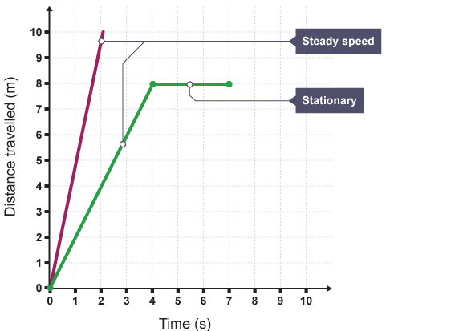
1 2 3 4 5 6 7 8 9 10 11 12 13 14 15 16 17 18 19 20 21 22 23 24 25 26 27 28 29 30 | A distance-time graph is a way of representing a journey. If an object moves along a straight line, the distance travelled can be represented by a distance-time graph. Each straight line segment of the journey represents one part of the whole journey. An oblique line segment represents a steady moving speed part of the journey. A horizontal line segment represents no movement / stationary - this is the part of the journey where the object is stationary. The gradient of the line is equal to the speed of the object. The gradient of a distance-time graph gives the constant speed for that part of the journey. The steeper the line, the faster the speed. Example Calculate the speed of the object represented by the green line in the graph, from 0 to 4 s. change in distance = (8 - 0) = 8 m change in time = (4 - 0) = 4 s �����=������������ �����=8÷4 �����=2 �/� Example Calculation Calculate the speed of the object shown by the lower line in the graph, from 0 to 4 s. change in distance = (8 - 0) = 8 m change in time = (4 - 0) = 4 s
Speed = Distance / Time
Speed = 8 / 4
Speed = 2 m/s

Slide 15
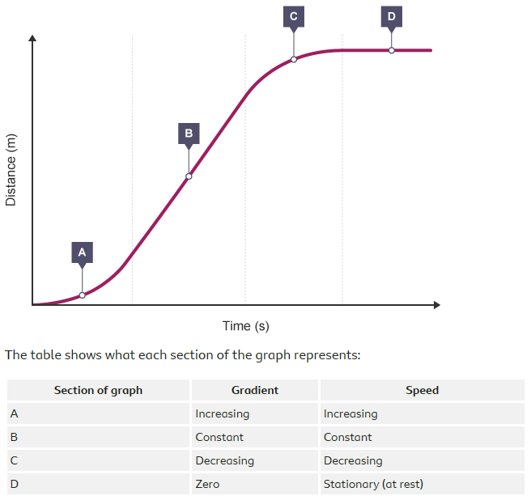
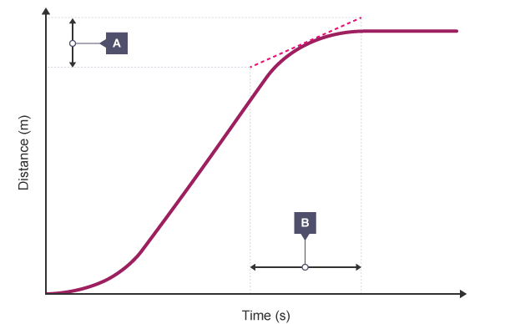
1 2 3 4 5 6 7 8 9 10 11 12 13 14 15 16 17 18 19 20 21 22 23 24 25 26 27 28 29 30 | Distance-time graphs for accelerating objects - Higher If the speed of an object changes, it will be accelerating or decelerating. This can be shown as a curved line on a distance-time graph. If an object is accelerating or decelerating, its speed can be calculated at any time by: Drawing a tangent to the curve at that time. Determining the gradient of the tangent. As the diagram shows, after drawing the tangent, work out the change in distance (A) and the change in time (B).

Slide 16
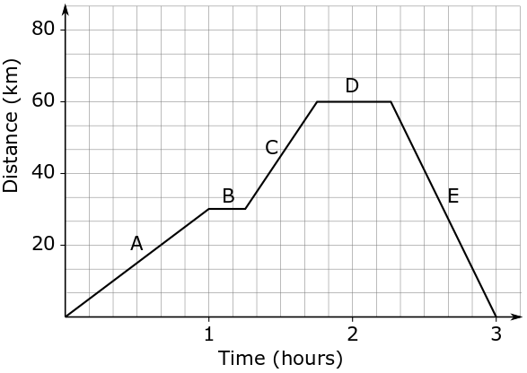
1 2 3 4 5 6 7 8 9 10 11 12 13 14 15 16 17 18 19 20 21 22 23 24 25 26 27 28 29 30 | How to draw a distance-time graph: Decide on the size of the axes. The x-axis represents the time taken. The y-axis represents the distance travelled. Draw each part of the journey in sections. For each stage of the journey, plot the distance travelled against the time taken and draw the line segment. Remember that any stop during the journey will be a horizontal line segment. A return journey means the line segment is drawn going back towards the x-axis.

Slide 17
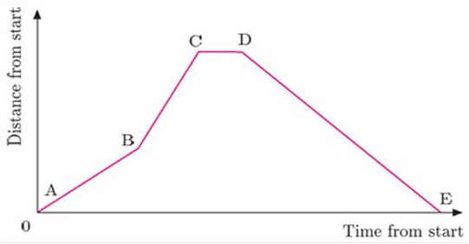
Task 1:
Rana delivers newspapers. Here is a distance-time graph of her round. Using the graph, answer the questions.
a) On which section of the journey do you think she was walking the fastest? Make some brief notes to explain your answer.
……………………………………………………………………………………………………………………………………………………………………………………………………………………………………………………………………………………………………………………
What is your interpretation of section CD?
……………………………………………………………………………………………………………………………………………………………………………………………………………………………………………………………………………………………………………………
c) Part of her round is up a hill where her walking speed is slowest. Which section of the graph do you think represents this?
……………………………………………………………………………………………………………………………………………………………………………………………………………………………………………………………………………………………………………………
Which part of the graph represents Rana’s return to her starting place. Why?
……………………………………………………………………………………………………………………………………………………………………………………………………………………………………………………………………………………………………………………

Slide 18
Subtopic 2: The distance – time relationship.
I Do Task 2
Draw a distance – time graph for the journey described below
A vehicle starts its journey at 13:00H.
It travels at a speed of 20 mph for 2.5 hours.
The vehicle stops for 1.5 hours before continuing its journey.
It travels a further 30 miles and arrives at its destination at 18:00H.
On the graph paper below, draw a distance-time graph of this journey.

Slide 19
Subtopic 2: The distance – time relationship.
We Do Task 2
Omar and Rosie set off on their holiday.
They leave at 07:00 driving at 30 mph for 30 minutes before realising Omar has forgotten his passport.
They travel back home at 10 mph due to traffic.
Plot a distance-time graph to represent his journey.

Slide 20
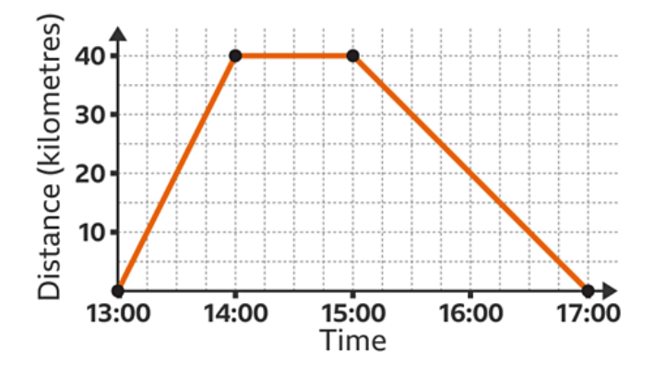
Subtopic 2: The distance – time relationship.
We Do Task 2
Find the speed for the return journey shown on this distance-time graph.
………………………………………………………………………………………………………………………………………………………………………………………………………………………………………………………………………………………………………………………………………………………………………………………………………………………………………………………………………………………………………………………………………………………………………………………………………………………………………………………………………………………………………………………………………………………………………………………………………………………………………………………………………………………………………………………………………………………………

Slide 21
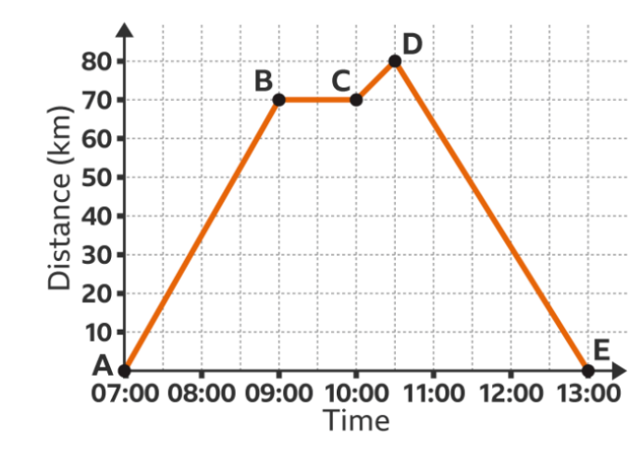
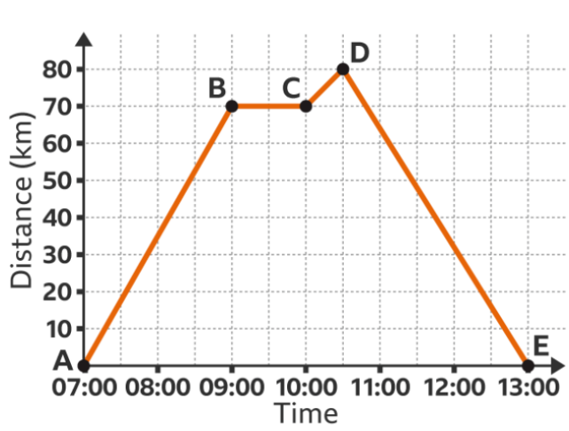
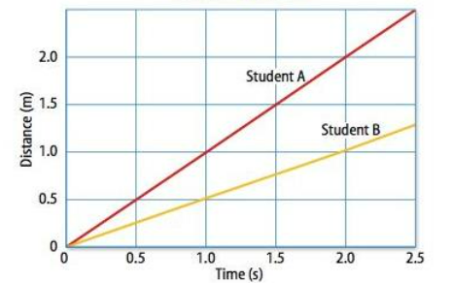
Subtopic 2: The distance – time relationship.
You Do Task 2
What is the speed for the first stage of the journey shown by the line segment AB?
….
What is the speed of the return journey?
This graph shows the distance – time data for two students running a race.
a) Which student is the fastest?
b) Calculate the speed of each student.
………………………………………………………………………….
……………………………………………………………… ………………………………………………………………………….
…………………………………………………………………………
…………………………………………………………………………………………………………………………………………………………………………………………………………………………………………………………………………………………………………………………………………………………
………………………………………………………………………………………………………………………………………………………………………………………………………………………………………………………………………………………………………………………………………………………………………………………………………………………………

Slide 22
Subtopic 2: The distance – time relationship.
I Do Task 3 (HT)
The following distance –time graph represents a student riding a bicycle:-
What is the bicycle doing for the first 6 seconds?
…………………………………………………………………………………………………………………………………………………………
Describe the motion of the bicycle between 6 and 9 second?
……………………………………………………………………………………………………………………………………………………………………………………………………………………………………………………………………………………………………………………
What is the average speed of the bicycle?
………………………………………………………………………………………………………………………………………………………………………………………………………………………………………………………………………………………………………………..…. 4. What is the speed of the bicycle at 3 seconds (hint: think tangents!)
………………………………………………………………………………………………………………………………………………………………………………………………………………………………………………………………………………………………………………..…
5. How far away from the starting point is the bicycle after 8 seconds
………………………………………………………………………………………………………………………………………………………………………………………………………………………………………………………………………………………………………………..…
6. What is the bicycle doing between 9-16 seconds?
…………………………………………………………………………………………………………………………………………………………………………………………………………………………………………………………………………………………………………………..

Slide 23
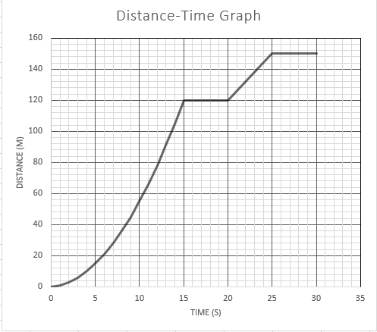
Subtopic 2: The distance – time relationship.
We Do Task 4 (HT)
The following graph represents a car journey:-
Between 0s and 15s is the car travelling at a constant speed? Yes / No
Work out the acceleration at 5s by drawing a tangent and creating a triangle under the line to calculate the gradient
…………………………………………………………………………………………………………………………………………………………………………………………………………………………………………………………………………………………………………………..
3. Work out the acceleration at 12s by drawing a tangent and creating a triangle under the line to calculate the gradient.
………………………………………………………………………………………………………………………………………………………………………………………………………………………………………………………………………………………………………………..….

Slide 24
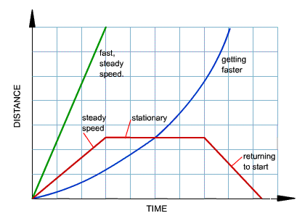
Subtopic 2: The distance – time relationship.
We Do Task 4 (HT)
The following distance –time graph represents different modes of transport:-
Label the boxes to state the motion of each part of the different graphs
Calculate the mean speed of lines a & b
……………………………………………………………………………………………………………………………………………………………………………………………………………………………………………………………………………………………………………………
3. Work out the acceleration at 12s by
………………………………………………………………………………………………………………………………………………………………………………………………………………………………………………………………………………………………………………..….
a
b
140
100
60
20
0 2 4 6 8 10 12 14 16 18 20

Slide 25
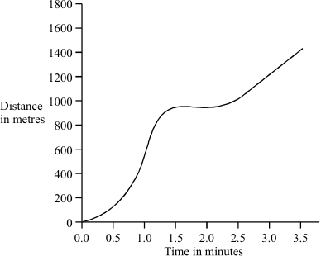
Subtopic 2: The distance – time relationship.
You Do Task 4 (HT)
Q1. The graph shows how the distance travelled by a car changes with time during a short journey.
(i) Describe fully the motion of the car during the first two minutes of the journey.
…………………………………………………………………………………………………………………………………………………………………………………………………………………………………………………………………………………………………………………………………………………………………………………………………………………………………………………………………………………(3)
(ii) During the last minute of the journey the velocity of the car changes although the speed remains constant. How is this possible?
……………………………………………………………………………………………………………………………………………………………………………………………………………………………………………………………………………………………………………………(1)
(Total 4 marks)

Slide 26
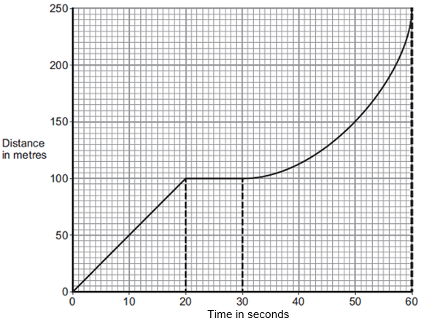
Subtopic 2: The distance – time relationship.
You Do Task 4 (HT)
A bus is taking some children to school.
(a) The bus has to stop a few times. The figure below shows the distance–time graph for part of the journey.
How far has the bus travelled in the first 20 seconds?
Distance travelled = …………………………………………………. m (1)
(ii) Describe the motion of the bus between 20 seconds and 30 seconds.
………………………………………………………………………………………………………………………………………………………………………………………………………………………………………………………………………………………………………………….(1)
(iii) Describe the motion of the bus between 30 seconds and 60 seconds.
Tick one box
(iv) What is the speed of the bus at 45 seconds? Show clearly on the figure above how you obtained your answer.
…………………………………………………………………………………………………………………………………………………………………………………………………………………………………………………………………………………………………………………
Speed = ______________________ m / s (3)

Slide 27
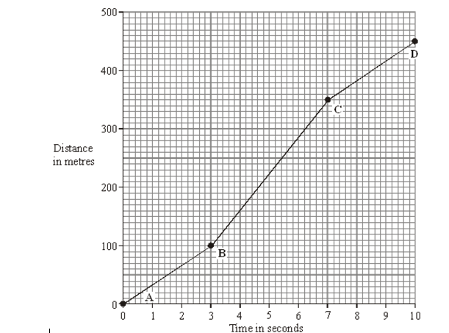
Subtopic 2: The distance – time relationship.
You Do Task 4 (HT)
The distance-time graph represents the motion of a car during a race.
(a) Describe the motion of the car between point A and point D. You should not carry out any calculations. To gain full marks in this question you should write your ideas in good English. Put them into a sensible order and use the correct scientific words.
…………………………………………………………………………………………………………………………………………………………………………………………………………………………………………………………………………………………………………………………………………………………………………………………………………………………………………………(3)
(b) Calculate the gradient of the graph between point B and point C. Show clearly how you get your answer.
……………………………………………………………………………………………………………………………………………………………………………………………………………………………………………………………………………………………………………………………………………………………………………………………………………………………………………………………………………………………………………………………………………………………………………………………………(3)

Slide 28
Subtopic 3: Acceleration.
Learning Objective
To understand that acceleration is a vector quantity, which changes if an object changes direction.
To apply and rearrange the acceleration equation.
Why are we learning about this?
This lessons helps us understand why acceleration is different to speed/velocity. It will also help us to understand why velocity can be negative, just as acceleration can be negative.

Slide 29
1 2 3 4 5 6 7 8 9 10 11 12 13 14 15 16 17 18 19 20 21 22 23 24 25 26 27 | Acceleration is an often misunderstood idea. Many often use “speed” and “acceleration” interchangeably. However, they are two completely separate ideas. Firstly, speed is a scalar quantity, meaning it has magnitude only. Acceleration is a vector, as it also has a direction. Secondly, speed is only a measure of how far an object travels in a period of time. Acceleration is the rate of change of velocity over time. As acceleration is a vector quantity, it changes as direction changes. This also means that, just like velocity, acceleration can be negative. Acceleration is calculated using the following equation: Acceleration = change in velocity / time a = Δv / t Acceleration, a, in metres per second squared (m/s²) Change in velocity, Δv, in metres per second (m/s) Time, t, in seconds (s) The change in velocity can be calculated using the equation below: Change in velocity = final velocity – initial velocity Δv = v – u Change in velocity, Δv, in metres per second (m/s) Final velocity, v, in metres per second (m/s) Initial velocity, u, in metres per second (m/s) Combining the above equations gives us the following equation: a = (v-u) / t

Slide 30
I DO
A car accelerates from rest to a speed of 20 m/s. This acceleration took 4 seconds. Calculate the acceleration of the car:
STEP 1: Write the equation: ………………………………………………………………………………………………………………..
STEP 2: Substitute the values: …………………………………………………………………………………………………………….
STEP 3: Calculate the answer, with units: …………………………………………………………………………………………..
WE DO
A runner accelerates from 3 m/s to 8 m/s. This takes them 10 seconds. Calculate their acceleration:
STEP 1: Write the equation: ………………………………………………………………………………………………………………..
STEP 2: Substitute the values: …………………………………………………………………………………………………………….
STEP 3: Calculate the answer, with units: …………………………………………………………………………………………..
A cyclist accelerates from 12 m/s to 5 m/s. This takes 10 seconds. Calculate their acceleration:
STEP 1: Write the equation: ………………………………………………………………………………………………………………..
STEP 2: Substitute the values: …………………………………………………………………………………………………………….
STEP 3: Calculate the answer, with units: …………………………………………………………………………………………..
YOU DO
A woman accelerates from rest to 4 m/s in 3 seconds. Calculate her acceleration:
………………………………………………………………………………………………………………………………………………………………………………………………………………………………………………………………………………………………………………………………………………………………………………………………………………………………………………………………………………………
A cyclist accelerates from rest to 16 m/s in 7 seconds. Calculate her acceleration:
………………………………………………………………………………………………………………………………………………………………………………………………………………………………………………………………………………………………………………………………………………………………………………………………………………………………………………………………………………………
A car accelerates from 17 m/s to rest in 3.6 seconds. Calculate her acceleration:
………………………………………………………………………………………………………………………………………………………………………………………………………………………………………………………………………………………………………………………………………………………………………………………………………………………………………………………………………………………

Slide 31
Sometimes we will have to rearrange the equation to find either change in velocity or time:
I DO
Calculate the change in velocity when a car accelerates at 5 m/s² for 8 seconds:
STEP 1: Write the equation: ………………………………………………………………………………………………………………..
STEP 2: Substitute the values: …………………………………………………………………………………………………………….
STEP 3: Use opposite math functions to rearrange: …………………………………………………………………………….
STEP 4: Calculate the answer, with units: ……………………………………………………………………………………………
WE DO
Calculate the time taken for a car to accelerate from 3 m/s to 18 m/s at an acceleration of 1.5 m/s²:
STEP 1: Write the equation: ………………………………………………………………………………………………………………..
STEP 2: Substitute the values: …………………………………………………………………………………………………………….
STEP 3: Use opposite math functions to rearrange: …………………………………………………………………………….
STEP 4: Calculate the answer, with units: ……………………………………………………………………………………………
Calculate the change in velocity when a cyclist accelerates at -2 m/s² for 3.6 s:
STEP 1: Write the equation: ………………………………………………………………………………………………………………..
STEP 2: Substitute the values: …………………………………………………………………………………………………………….
STEP 3: Use opposite math functions to rearrange: …………………………………………………………………………….
STEP 4: Calculate the answer, with units: ……………………………………………………………………………………………
YOU DO
For the following questions, you are calculating change in velocity, in metres per second:
A high-speed train accelerates at 7 m/s² for 15 seconds. Calculate the change in velocity:
………………………………………………………………………………………………………………………………………………………………………………………………………………………………………………………………………………………………………………………………………………………………………………………………………………………………………………………………………………………
A car accelerates at 4.5 m/s² for 4.6 seconds. Calculate the change in velocity:
………………………………………………………………………………………………………………………………………………………………………………………………………………………………………………………………………………………………………………………………………………………………………………………………………………………………………………………………………………………

Slide 32
YOU DO For the following questions, calculate the time taken for the acceleration, in seconds:
A train accelerates from rest to 36 m/s at a rate of 3 m/s². Calculate the time taken:
………………………………………………………………………………………………………………………………………………………………………………………………………………………………………………………………………………………………………………………………………………………………………………………………………………………………………………………………………………………
A man accelerates from 7 m/s to 3.5 m/s at a rate of -0.25 m/s². Calculate the time taken:
………………………………………………………………………………………………………………………………………………………………………………………………………………………………………………………………………………………………………………………………………………………………………………………………………………………………………………………………………………………
The following questions are a bit more complicated:
A car sets off on a journey, from rest. In 1.5 minutes, they are driving their maximum velocity, and travel 1400 m in 50 seconds at this velocity. Calculate their average acceleration in the first 1.5 minutes.
…………………………………………………………………………………………………………………………………………………………………………………………………………………………………………………………………………………………………………………………
…………………………………………………………………………………………………………………………………………………………………………………………………………………………………………………………………………………………………………………………
……………………………………………………………………………………………………………………………………………………………
A woman accelerates at a rate of 2.7 m/s² for 5 seconds. If her initial velocity was 4 m/s, calculate her final velocity:
…………………………………………………………………………………………………………………………………………………………………………………………………………………………………………………………………………………………………………………………
…………………………………………………………………………………………………………………………………………………………………………………………………………………………………………………………………………………………………………………………
……………………………………………………………………………………………………………………………………………………………

Slide 33
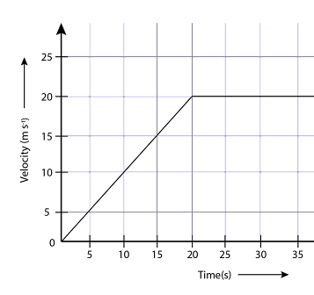
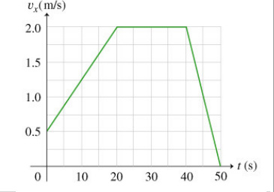
A velocity-time graph shows us in graph form how velocity changes over time. We can use these graphs to calculate acceleration:
I DO
Calculate the acceleration in the first 15 seconds of the journey shown in the graph below:
………………………………………………………………………………………..
………………………………………………………………………………………..
………………………………………………………………………………………..
………………………………………………………………………………………..
WE DO
Calculate the acceleration in the first 20 seconds of the journey shown in the graph below:
………………………………………………………………………………………..
………………………………………………………………………………………..
………………………………………………………………………………………..
………………………………………………………………………………………..
Calculate the acceleration in the final 10 seconds of the journey shown in the graph above:
……………………………………………………………………………………………………………………………………………………………
…………………………………………………………………………………………………………………………………………………………...
……………………………………………………………………………………………………………………………………………………………
……………………………………………………………………………………………………………………………………………………………

Slide 34
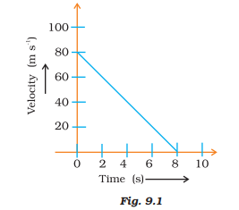
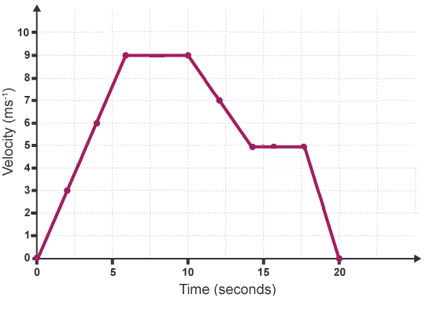
YOU DO
Calculate the acceleration in the first 8 seconds of the graph shown below:
………………………………………………………………………………………..
………………………………………………………………………………………..
………………………………………………………………………………………..
Use the graph below to calculate the acceleration during the following times:
The first five seconds of the journey:
……………………………………………………………………………………………………………………………………………………………………………………………………………………………………………………………………………………………………
…………………………………………………………………………………………………………………………………………………
Between 5 seconds and 10 seconds of the journey:
……………………………………………………………………………………………………………………………………………………………………………………………………………………………………………………………………………………………………
…………………………………………………………………………………………………………………………………………………
The last five seconds of the journey (this will be average acceleration):
……………………………………………………………………………………………………………………………………………………………………………………………………………………………………………………………………………………………………
…………………………………………………………………………………………………………………………………………………

Slide 35
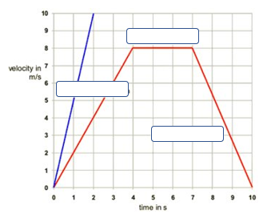
Subtopic 4: The velocity – time relationship.
Learning Objective
to construct and interpret a velocity – time relationship graph
Why are we learning about this?
This lesson helps us understand how to illustrate a journey with changing speed on a velocity –time graph, calculate the acceleration and determine the distance travelled.
Task 1: I do
Label the different parts of the graph.
10
9
8
Velocity in m/s
7
6
5
4
3
2
1
0
0 1 2 3 4 5 6 7 8 9 10
Time in seconds

Slide 36
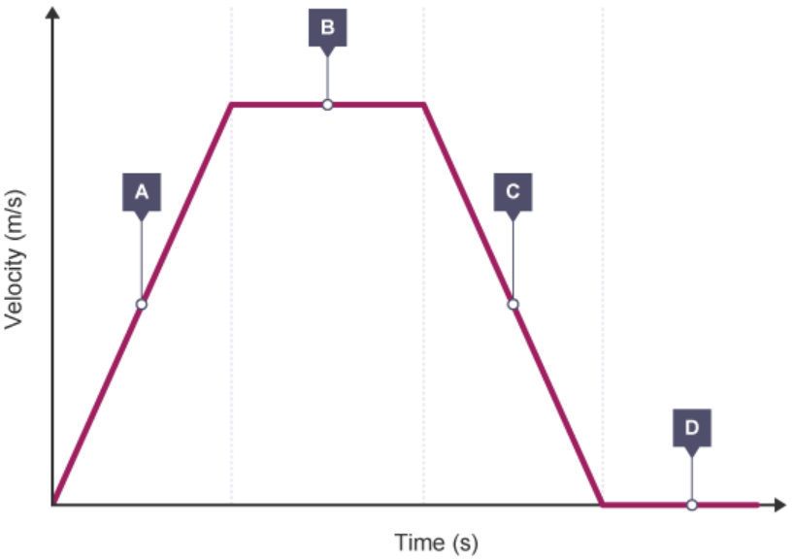
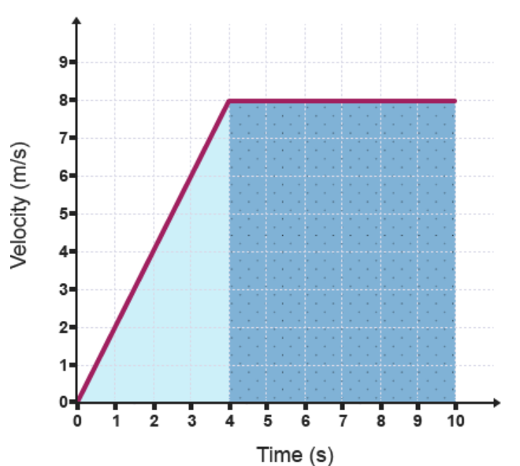
1 2 3 4 5 6 7 8 9 10 11 12 13 14 15 16 17 18 19 20 21 22 23 24 25 26 27 28 29 30 | Velocity-time graphs Determining acceleration If an object moves along a straight line, its motion can be represented by a velocity-time graph. The gradient of the line is equal to the acceleration of the object. The table shows what each section of the graph represents :Calculating displacement - higher The displacement of an object can be calculated from the area under a velocity-time graph. The area under the graph can be calculated by: using geometry (if the lines are straight) counting the squares beneath the line (particularly if the lines are curved) Eg Calculate the total displacement of the object, whose motion is represented by the velocity-time graph below.

Slide 37
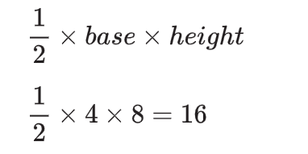
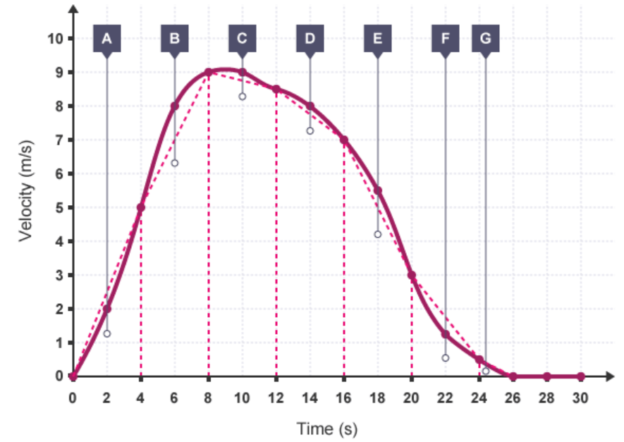
1 2 3 4 5 6 7 8 9 10 11 12 13 14 15 16 17 18 19 20 21 22 23 24 25 26 27 28 29 30 | Here, the displacement can be found by calculating the total area of the shaded sections below the line. Find the area of the triangle: Find the area of the rectangle: Add the areas together to find the total displacement: Estimating the area under a curve - HT The area under a curve can be estimated by dividing it into triangles, rectangles and trapeziums. If we have a speed-time or velocity-time graph, the distance travelled can be estimated by finding the area. Example The velocity of a sledge as it slides down a hill is shown in the graph. Find the distance travelled by the sledge over its 30 second journey. Vertical lines every 4 seconds along the horizontal axis have been added and points joined to make triangles, rectangles or trapeziums that approximate to the curve.
The area of the triangle is 16 m²
base × height
(10 - 4) × 8 = 48 The area of the rectangle is 48 m²
(16 + 48) = 64 Total displacement = 64 m

Slide 38
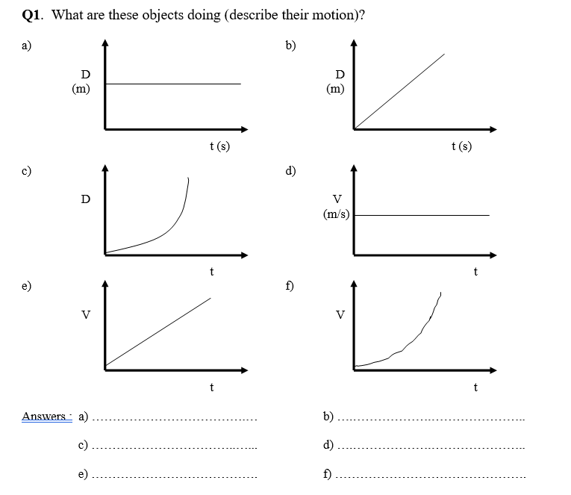
Subtopic 4: The velocity – time relationship.
Task 1: We do
Q1. Describe the motion of these objects.
Answers
…………………………………….
…………………………………….
e) …………………………………….
b) …………………………………….
d) …………………………………….
f) …………………………………….

Slide 39
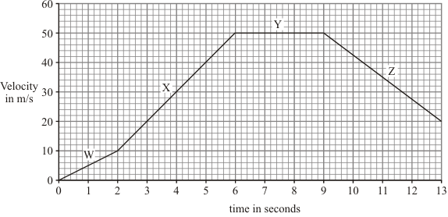
Subtopic 4: The velocity – time relationship.
Q1.
The graph shows changes in the velocity of a racing car.
Task 1: You Do
(a) Describe the motion of the racing car during:
(i) the period labelled W………………………………………………………………………………….…….……….
……………………………………………………………………………………………………………………………………….(1)
(ii) the period labelled Y.………………………………………………………………………………………………….
………………………………………………………………………………………………………………………………………. (1)

Slide 40
We Do: Task 2
Subtopic 4: The velocity – time relationship.
Calculate the acceleration of the racing car during the period labelled X.
Show clearly how you work out your answer and give the unit.
………………………………………………………………………………………………………………………………………………………………………………………………………………………………………………………………………………………………………………………..…………………………………………………………………………………………………………………………………………………………………………………………………………………………………………………………………………………………………………………………………………………………………………………………..…………………………………………………………………………………………………………………………………………………………………………………………………………………………………………………………………………………………………………………………………………………………………………………………………………………………………………………………………………………………………………………………………………………………………………………………………………………………………………………………………………………………………………………………………………………………………………………………………
Acceleration =…………………………………………

Slide 41
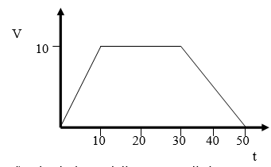
Subtopic 4: The velocity – time relationship.
Task 2: You do
The graph below describes the motion of a car.
What is the car’s acceleration in the first 10 s?
……………………………………………………………………………………………………………………………………………………………………………………………………………………………………………………………………………………………………………………………………………………………………………………………………………………………………………………………………………..
Calculate its rate of deceleration.
……………………………………………………………………………………………………………………………………………………………………………………………………………………………………………………………………………………………………………………………………………………………………………………………………………………………………………………………………………..

Slide 42
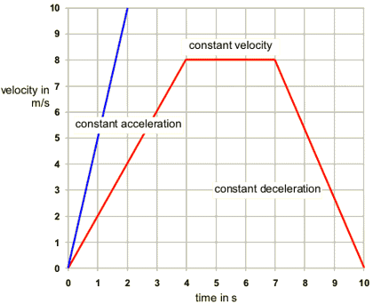
Subtopic 4: The velocity – time relationship.
Task 2: You do
The graph below describes two different journeys.
Use the graph to calculate the greatest acceleration shown.
……………………………………………………………………………………………………………………………………………………………………………………………………………………………………………………………………………………………………………………………………………………………………………………………………………………………………………………………………………..
Use the graph to calculate the acceleration between 7s and 10s.
………………………………………………………………………………………………………………………………………………………………………………………………………………………………………………………………………………………………………………………………………………………………………………………………………………………………………………………………………………

Slide 43
Subtopic 4: The velocity – time relationship.
Task 3: I do HT
The graph below describes the motion of a car.
How far does it travel in the first 10 s?
…………………………………………………………………………………………………………………………………………………………………………………………………………………………………………………………………………………………………………………………………………………………………………………………………………………………………………………………………………
What is the total distance travelled?
…………………………………………………………………………………………………………………………………………………………………………………………………………………………………………………………………………………………………………………………………………………………………………………………………………………………………………………………………………
(10/2) x 10 =50m
(10/2) x 10 =50m
20 x 10 =200m
(20/2) x 10 =100m
50 + 200 +100 = 350m

Slide 44
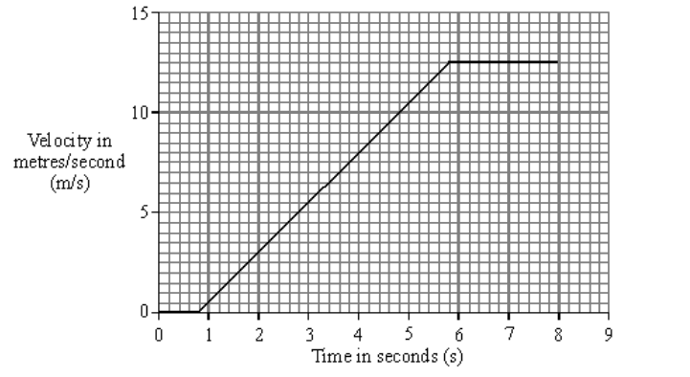
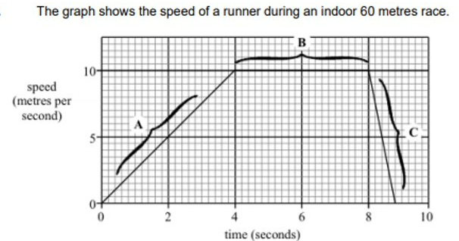
Subtopic 4: The velocity – time relationship.
Task 3: We do HT
A car travelling along a straight road has to stop and wait at red traffic lights. The graph shows how the velocity of the car changes after the traffic lights turn green.
Calculate the distance the car travels while accelerating. Show clearly how you work out your answer. ..................................................................................................................................... ..................................................................................................................................................
Distance = ...............................................metres (3)
How far does the runner travel during the first four seconds? (Show your working.) ..................................................................................................................................... ..................................................................................................................................... .....................................................................................................................................(3)
The graph shows the speed of a runner during an indoor 60 metres race.
10
Speed (m/s)
5
0
0 2 4 6 8 10
Time (s)

Slide 45
Subtopic 4: The velocity – time relationship.
Task 3: You do HT
The following table represents the movement of a car:-
Draw a Velocity time graph (with time on the x-axis)
1. What is the acceleration of the car between 0 and 3 seconds? ……………………………………………..
.........................................................................................................................................................
2. Between 3 and 5 seconds the car is still accelerating – true or false? Explain your answer.
.........................................................................................................................................................
3. How would you describe the movement of the car between 5 and 10 seconds? ………………….
.........................................................................................................................................................
4. What distance does the car travel in the first 3 seconds? ………………………………………………………
.........................................................................................................................................................
5. What distance does the car travel in the total journey? ………………………………………………………..
.........................................................................................................................................................

Slide 46
Subtopic 4: The velocity – time relationship.
Task 3: You do HT Challenge
A racing car (at rest) accelerates uniformly from the starting grid on the race track and reaches a top velocity of 30 meters/second/second after 5 seconds. For the next 4 seconds the acceleration is 0 and finally the car decelerates (brakes) at 4meters/second/second for 5 seconds.
Draw a Velocity time graph (with time on the x-axis). If you are stuck, try marking what the velocity would be after each second!
1. What distance does the car travel in the first 5 seconds?………………………………………………………….
...........................................................................................................................................................
2. What is the velocity of the car after 7 seconds? ………………………………………………………………………
3. What is the velocity of the car after 14 seconds?? …………………………………………………………………..
4. If the car carried on decelerating at 4m/s², how many more seconds would it take before it came to a stop? ……………………………………………………………………………………………………………………………………
...........................................................................................................................................................
5. What is the acceleration in the first 5 seconds?? …………………………………………………………………….
...........................................................................................................................................................

Slide 47
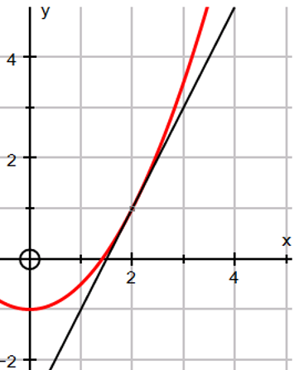
Subtopic 4: The velocity – time relationship.
Task 4 HT
I do
To find the gradient of a curve at a given point, you need to draw a tangent – this is a line that only touches the curve at this point.
Then calculate the gradient from the tangent.
Example: For the curve below, find the gradient when $x=2$.
………………………………………………………………………………………………………………………………………………………………………………………………………………………………………………………………………………………………………………………………………………………………………………………………………………………………………………………………………………………………………………………………………………………………………………………………………………………………………………………………………………………………………………………………………………………………………..

Slide 48
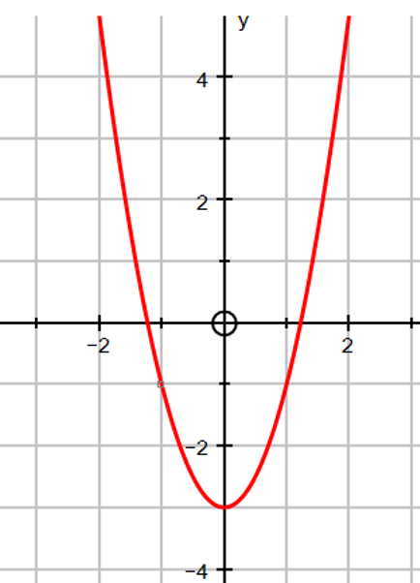
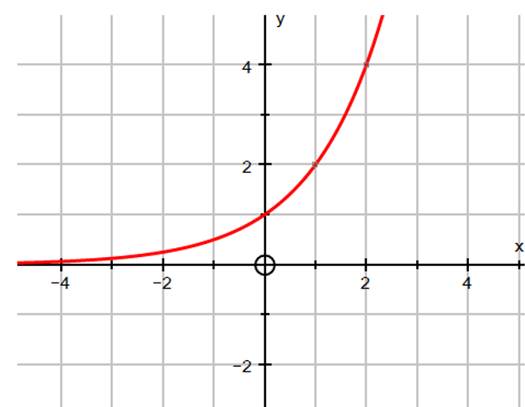
Subtopic 4: The velocity – time relationship.
Task 4 HT
We do
Find the gradient of the curve at$x=−1$
Find the gradient of the curve at 𝑥=1
………………………………………………………………………………………………………………………………………………………………………………………………………………………………………………………………………………………………………………………………………………………………………………………………………………………………………………………………………………………………………………………………………………………………………………………………………………………………………………………………………………………………………………………………………………
………………………………………………………………………………………………………………………………..………………………………………………………………………………………………………………………………..………………………………………………………………………………………………………………………………..

Slide 49
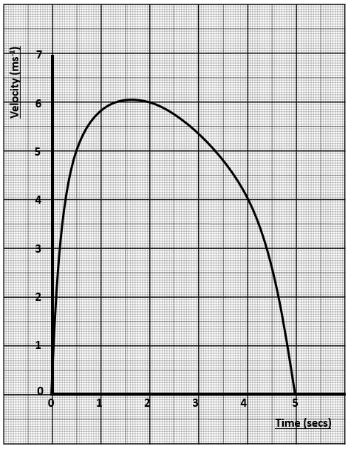
Subtopic 4: The velocity – time relationship.
Task 4 HT
You do
The graph below shows the journey of a javelin when thrown.
Calculate the acceleration of the javelin at time t = 4.
Calculate the distance travelled by the javelin between 2 and 5 seconds.

Slide 50
Subtopic 5: Newton’s first law.
Learning Objective
You are learning to describe the motion of an object using knowledge of the forces acting on it.
Why are we learning about this?
This lessons helps us understand how objects behave when forces are applied to them. For example, it explains why some objects accelerate under some conditions but move at a constant velocity at other points in time.

Slide 51
1 2 3 4 5 6 7 8 9 10 11 12 13 14 15 16 17 18 19 20 21 22 23 24 25 26 27 28 | Newton's first law According to Newton's first law of motion, an object remains in the same state of motion unless a resultant force acts on it. If the resultant force on an object is zero this means: a stationary object stays stationary a moving object continues to move at the same velocity (at the same speed and in the same direction) Examples of objects with uniform velocity Newton's first law can be used to explain the movement of objects travelling with uniform velocity. For example, when a car travels at a constant speed, the driving force from the engine is balanced by resistive forces such as air resistance and frictional forces in the car's moving parts. The resultant force on the car is zero. Other examples include: a runner at their top speed experiences the same air resistance as their thrust an object falling at terminal velocity experiences the same air resistance as its weight. Examples of objects with non-uniform velocity Newton's first law can also be used to explain the movement of objects travelling with non-uniform motion. This includes situations when the speed changes, the direction changes or both change. For example, when a car accelerates, the driving force from the engine is greater than the resistive forces. The resultant force is not zero. Other examples include: at the start of their run, a runner experiences less air resistance than their thrust, so they accelerate an object that begins to fall experiences less air resistance than its weight, so it accelerates

Slide 52
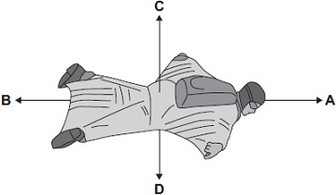
I Do:
Q1.
(a) The diagram shows two forces acting on an object.
We Do:
(b) BASE jumpers jump from very high buildings and mountains for sport.
The diagram shows the forces acting on a BASE jumper in flight. The BASE jumper is wearing a wingsuit.

Slide 53
I Do:
We Do:
……………………………………………………………………………………………………….
………………………………………………………………………………………………………………………………………………………………………………………………………………

Slide 54
You Do:

Slide 55
You Do:

Slide 56
You Do:
…………………………………………………………………………………………………………………………………………………………………………………………………………………………
Explain why the egg did not break.
………………………………………………………………………………………………………………………………………………………………………………………………………………………………………………………………………………………………………………………………………………………………………………………………………………………………………………………………………………………………………………………………

Slide 57
You Do:
………………………………………………………………………………………………………………………………………………………………………………………………………………………………………………………………………………………………………………………………………………………………………………………………………………………………………………………………………………………………………………………………

Slide 58
Subtopic 7: Terminal velocity.
Learning Objective
You are learning to interpret information related to terminal velocity.
Why are we learning about this?
This lessons helps us understand why objects such as cars have a maximum velocity. This is used in multiple industries including vehicle design, parachute design and to determine the minimum safety features of vehicles, surfaces ibn playgrounds etc.

Slide 59
1 2 3 4 5 6 7 8 9 10 11 12 13 14 15 16 17 18 19 20 21 22 23 24 25 26 27 28 | Any object free falling through a fluid near to the surface of the Earth will have an acceleration of approximately 9.8m/s², because of the interaction of the gravitational field of the Earth with the objects mass. As the object falls, velocity will increase up to the point where the gravitational pull and the drag force are equal. At this point the velocity of the falling object will be constant and terminal velocity has been reached. Terminal velocity is the point where the resultant force acting on a falling object is zero. The terminal velocity of a falling object can be changed. To do so, the cross section of the horizontal plane of the falling object can be altered. This is known as the projected area. An object with a large projected area relative to its mass will have a low terminal velocity. If the projected area of this object is reduced, its terminal velocity will increase. Some objects are so small that the terminal velocity that they reach is overcome by convection currents in the air. As such, they can stay suspended in the air indefinitely. This applies to substances such dust and mist. This can also be seen in sky divers. The terminal velocity of a skydiver in the belly-to-Earth position is about 55m/s (123mph). If they were to pull their limbs in this would increase to about 90m/s (201mph). Competitive free fallers can reach velocities of 150m/s (335mph), The fastest velocity a human has ever attained in freefall was achieved by Felix Baumgartner who reached a velocity of 380m/s (850mph) on his way down from an altitude of 38,887m. It must be noted however, that he achieved this velocity at a high altitude where the air density is lower, producing a lower drag force. In all instances mentioned, a parachute is usually used to navigate safely to the ground. The effect of a parachute is to increase the resistive force, causing a deceleration effect. This resistive force decreases to eventually equal weight, thus establishing a safer terminal velocity.

Slide 60
1 2 3 4 5 6 7 8 9 10 11 12 13 14 15 16 17 18 19 20 21 22 23 24 25 26 27 | There is an urban myth surrounding the idea of terminal velocity. Dropping an penny from the top of the Empire State Building in New York is said to be able to cause death on impact, however this is not the case. It must be said that the penny in question is an American penny (the cent) has a mass of about 2.5g. With tumbling and air resistance, the terminal velocity reached by the penny is quite low. It would most certainly hurt on impact but would not cause death. There is a grain of truth in this though, and is one of the main reasons why hard hats are necessary on a building site. A nut or bolt (~50g) falling from height could do a lot of damage, and depending on the height, could even be fatal.

Slide 61
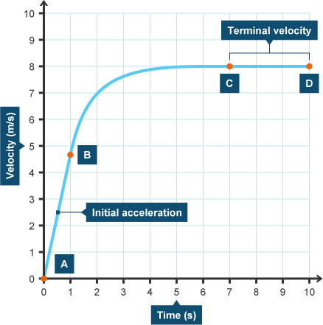
Subtopic 7: Terminal velocity.
A falling object will accelerate to its terminal velocity. A falling object will not immediately reach its terminal velocity, however the terminal velocity will be reached as weight and air resistance strike up a balance. Whilst there is a difference between these 2 forces, there will be a resultant force causing acceleration. Over time, as air resistance increases, the size of the resultant forces will decrease, causing the effect of acceleration to be smaller.
Task:
Draw a free body diagram for A – B,
Why might it be difficult to draw a free body diagram for B – C?
………………………………………………………………………………………………………………………………………………………………………………………………………………………………………………………………………………………………………………………………………………………………………………………………………………………………………………………………………………………………………………………………………………………………………………………………………………………………………………………………………………………………………………………………………………………………………………………

Slide 62
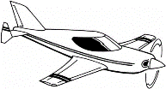
Subtopic 7: Terminal velocity.
Constant Terminal Upward Unbalanced Increases Decreases Small Increase Weight Balanced Same Accelerate Decelerate Large
The skydiver jumps out of the plane and the downward force of her …………………. pulls her down, her air resistance at the start is very ………………….. but soon she starts to ………………….. ,
As she accelerates the air resistance force ……………………. and acts in the opposite direction to her ………………………….. .
As she accelerates faster the air resistance force continues to …………………… until eventually it is the …………………… as her weight. She is now moving at a …………………….. speed and her weight is equal to the air resistance. Her speed is called her ……………………. velocity. The two forces are …………………………. .
She opens her parachute. There is now a very ……………………. air resistance force so she starts to ……………………. (slow down).
As she decelerates the air resistance force on her parachute ………………….. until it is the ……………………. size as her weight. She is now again falling at a …………………. speed but she has a new and slower ………………….. velocity.
On the ground her ………………… is now equal to the ………………… force
from the ground, the forces are balanced.

Slide 63
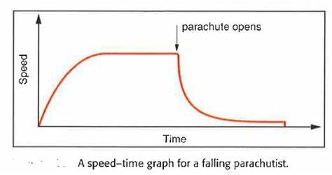
Subtopic 7: Terminal velocity
3
4
Velocity
1
2
3
5
A velocity - time graph for a falling parachutist
I do:
Where on the graph are the following events?
Acceleration
…………………………………………………………………………………………………………………………………………..
Deceleration
…………………………………………………………………………………………………………………………………………..
Terminal velocity
……………………………………………………………………………………………………………………………….………….
Parachute open
………………………………………………………………………………………………………………………………………….
Sky diver lands
……………………………………………………………………………………………………………………………………......

Slide 64
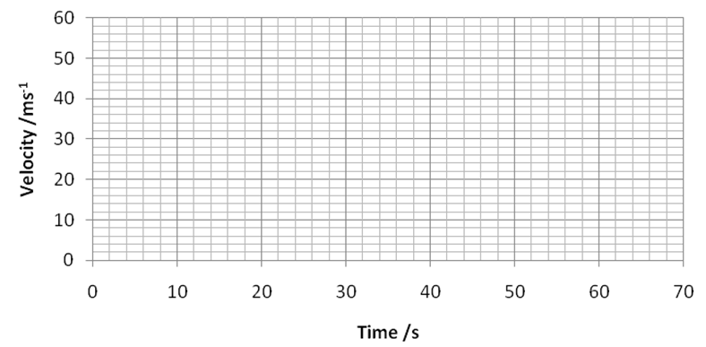
Subtopic 7: Terminal velocity.
You do: The table below shows how the velocity of a skydiver changes over time. Plot a velocity-time graph below and draw a smooth curve that passes through each point.
Time (s) | 0 | 5 | 10 | 15 | 20 | 25 | 30 | 35 | 40 | 45 | 50 | 55 | 60
Velocity (m/s) | 0 | 28 | 43 | 48 | 50 | 50 | 50 | 49 | 12 | 10 | 10 | 10 | 0
1. Label the following part of the skydivers descent:
Acceleration
Deceleration
Terminal velocity
Parachute open
Sky diver lands
2. Calculate acceleration at 10s.
……………………………………………………………………………………………………………………………………………………………………………………………………………………………………………………………………………………………………………………………………………………………………………………………………………………………………………………..

Slide 65
Subtopic 7: Terminal velocity
I do:
The diagram shows a shuttlecock that is used for playing badminton.
The shuttlecock weighs very little. When you drop it from a height of a few metres, it accelerates at first but soon reaches a steady speed.
Explain, as fully as you can:
(a) why the shuttlecock accelerates at first,
………………………………………………………………………………………………………………………………………………………………………………………………………………………………………………………………………………………………………………………………………………………………………………………………………………………………………………………………………………………………………………………………………………………………………………………………………………………………
(2)
(b) why the shuttlecock reaches a steady speed.
………………………………………………………………………………………………………………………………………………………………………………………………………………………………………………………………………………………………………………………………………………………………………………………………………………………………………………………………………………………………………………………………………………………………………………………………………………………………………………………………………………………………………………………………………………………………………………………………………………………………………………………………………………………………………………………………………………
(3)
(Total 5 marks)

Slide 66
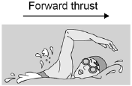
Subtopic 7: Terminal velocity
We do:
A swimmer dives off a boat.
Look at Figure 1.
Figure 1
The swimmer’s speed increases as she swims away from the boat.
The swimmer has a top speed.
Explain why.
………………………………………………………………………………………………………………………………………………………………………………………………………………………………………………………………………………………………………………………………………………………………………………………………………………………………………………………………………………………………………………………………………………………………………………………………………………………………………………………………………………………………………………………………………………………………………………………………………………………………………………………………………………………………………………………………………………………………
…………………………………………………………………………………………………………………………………………………………………………………………………………………………………………………………………………………………………………………………………………………………………………………………………………………………………………………………………………(5)

Slide 67
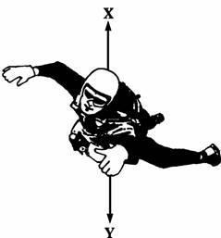
Subtopic 7: Terminal velocity
You do:
Q1.
A sky-diver jumps from a plane.
The sky-diver is shown in the diagram below.
(a) Arrows X and Y show two forces acting on the sky-diver as he falls.
(i) Name the forces X and Y.
X ………………………………………………………
Y ………………………………………………………
(2)
(ii) Explain why force X acts in an upward direction.
………………………………………………………………………………………………………………………
………………………………………………………………………………………………………………………
(1)
(iii) At first forces X and Y are unbalanced.
Which of the forces will be bigger? ………………………………..
(1)
(iv) How does this unbalanced force affect the sky-diver?
………………………………………………………………………………………………………………………
………………………………………………………………………………………………………………………
(2)

Slide 68
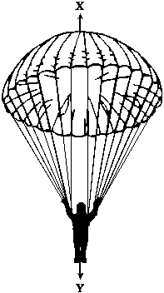
Subtopic 7: Terminal velocity
You do:
(b) After some time the sky-diver pulls the rip cord and the parachute opens.
The sky-diver and parachute are shown in the diagram below.
After a while forces X and Y are balanced.
Underline the correct answer in each line below.
Force X has
increased / stayed the same / decreased.
Force Y has
increased / stayed the same / decreased.
The speed of the sky-diver will
increase / stay the same / decrease.
(3)

Slide 69
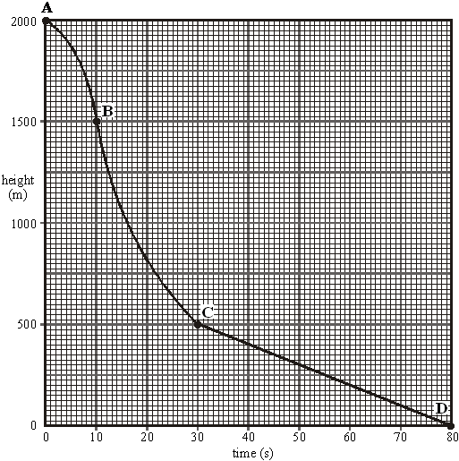
Subtopic 7: Terminal velocity
You do:
(c) The graph below shows how the height of the sky-diver changes with time.
(i) Which part of the graph, AB, BC or CD shows the sky-diver falling at a constant speed?
…………………………………………………. (1)
(ii) What distance does the sky-diver fall at a constant speed?
Distance …………………………….m (1)
(iii) How long does he fall at this speed?
Time ………………………….. s (1)
(iv) Calculate this speed.
………………………………………………………………………………………………………………………………..
Speed ……………………………………….. m/s (2)

Slide 70
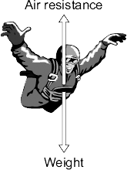
Subtopic 7: Terminal velocity
You do:
Q2.
(a) The diagram shows the forces acting on a parachutist in free fall.
The parachutist has a mass of 75 kg.
Calculate the weight of the parachutist.
Show clearly how you work out your answer and give the unit.
…………………………………………………………………………………………………………………………………………………………………………………………………………………………………………………………………………………………………………………..
Weight = ……………………………………………….
(3)
gravitational field strength = 10 N/kg

Slide 71
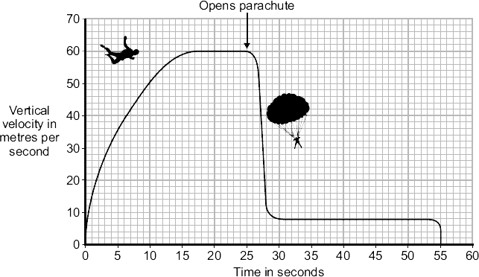
Subtopic 7: Terminal velocity
You do:
(b) The graph shows how the vertical velocity of a parachutist changes from the moment the parachutist jumps from the aircraft until landing on the ground.
Using the idea of forces, explain why the parachutist reaches a terminal velocity and why opening the parachute reduces the terminal velocity.
………………………………………………………………………………………………………………………………………………………..……………………………………………………………………………………………………………………………………………………………..
…………………………………………………………………………………………………………………………………………………………..…………………………………………………………………………………………………………………………………………………………..
..……………………………………………………………………………………………………………………………………………………………………………………………………………………………………………………………………………………………………………………..
…..…………………………………………………………………………………………………………………………………………………………………………………………………………………………………………………………………………………………………………………..
……..……………………………………………………………………………………………………………………………………………………………………………………………………………………………………………………………………………………………………………(6)

Slide 72
DO NOW
Date: ……………………………………….
 | ANSWER
Q1.
Q2.
Q3.
Q4.
Q5.
Date: ……………………………………….
 | ANSWER
Q1.
Q2.
Q3.
Q4.
Q5.

Slide 73
DO NOW
Date: ……………………………………….
 | ANSWER
Q1.
Q2.
Q3.
Q4.
Q5.
Date: ……………………………………….
 | ANSWER
Q1.
Q2.
Q3.
Q4.
Q5.

Slide 74
DO NOW
Date: ……………………………………….
 | ANSWER
Q1.
Q2.
Q3.
Q4.
Q5.
Date: ……………………………………….
 | ANSWER
Q1.
Q2.
Q3.
Q4.
Q5.

Slide 75
Knowledge Retrieval Quiz 3
Date: ……………………………………….
Score: …………...
 |  | Answer
Q1. | Define ‘scalar’.
Q2. | Define ‘vector’.
Q3. | Give an example of a scalar quantity.
Q4. | Give an example of a vector quantity.
Q5. | Define terminal velocity.
Q6. | Which two forces act on a parachutist as they fall towards the Earth?
Q7. | Which force increases in magnitude as the parachutist falls towards the Earth?
Q8. | If the parachutist is falling at their terminal velocity, what is the magnitude of the resultant force acting on them?
Q9. | State Newton’s second law of motion.
Q10. | Which equation represents Newton’s second law of motion?

Slide 76
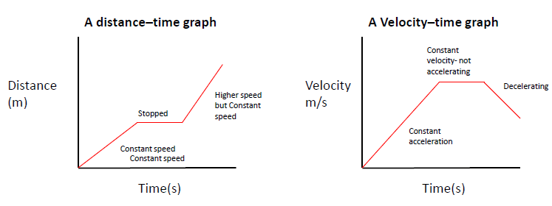
KNOWLEDGE ORGANISER
Subject: Science | Topic: Forces | Term: Autumn
KEY WORDS | Key words
1 | Acceleration | The rate of change of velocity.
2 | Braking Distance | The distance a vehicle travels under the braking force.
3 | Conservation of Momentum | The total momentum of a system before an event is always equal to the total momentum after the event.
4 | Inertia | The tendency of an object to remain in its same state of uniform motion or rest.
5 | Momentum | The product of an object’s mass and velocity.
6 | Stopping Distance | The sum of the thinking and braking distances.
7 | Thinking Distance | The distance a vehicle travels during the driver’s reaction time.
KEY CONCEPTS
1 | Rate of change | Acceleration is a rate of change. All rates of change are calculated by dividing by time.
2 | Gradients | Gradients of graphs show the rate of change of a quantity. They can be used to calculate speed and acceleration from graphs.
3 | Conservation of a quantity | Total momentum is conserved during collisions. When things are conserved in science, they stay the same (e.g. conservation of mass during a chemical reaction).
KEY DIAGRAMS
16

