Slide 1
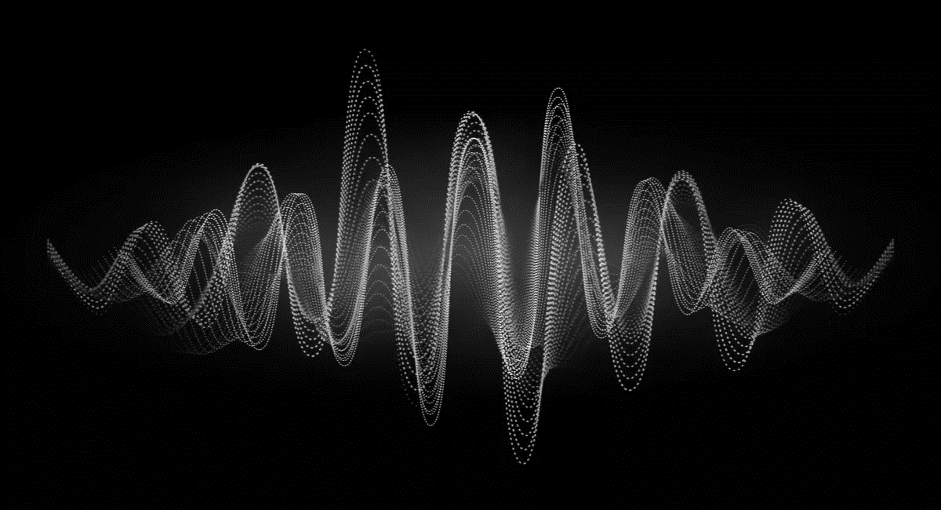
KS4 – Waves (TRIPLE TEACHER BOOKLET)
Name
Class
Tutor Group
KS4 Science YEAR 11 WAVES
KEYSTONE WORDS
Longitudinal wave | In a longitudinal wave the oscillations are parallel to the direction of energy transfer.
Transverse wave | In a transverse wave the oscillations are perpendicular to the direction of energy transfer.
Refraction | Waves change speed and direction when entering a material with a different density.
Reflection | Reflection of Light occurs when a ray of light approaches a smooth surface and bounces back.

Slide 2
BIG PICTURE
How will my prior knowledge develop my understanding of this topic?
Y7 | You learnt to calculate speed; this will be expanded to include wave speed in this topic. Your knowledge of from the Energy topic will be invaluable waves because waves transfer energy.
Y8 | You studied waves and light. This topic builds on the foundations that you built. You also studied sound waves. How we use sound waves to investigate hidden objects will be studied in this topic.
Learning Journey - Trilogy: Maximum 7 lessons. Triple: Maximum 14 lessons.
Subtopic 1 | Physics only: Required practical – reflection and refraction. | Subtopic 5 | Physics only: 4.6.2.6 Visible light.
Subtopic 2 | Physics only: 4.6.2.5 Lenses.
Subtopic 3 | Physics only (HT only): 4.6.1.5 Waves for detection and exploration.
Subtopic 4 | Physics only: 4.6.3.1 Emission and absorption of infrared radiation 4.6.3.2 Perfect black bodies and radiation.
Key knowledge
By the end of this topic you should know… | How waves behave in different circumstances and be able to describe how humans use waves to make their lives easier.
By the end of this topic should be able to… | Demonstrate properties of waves such as reflection and refraction.

Slide 3
KEY VOCABULARY LIST
Amplitude | The distance from a peak to the zero position of a wave.
Frequency | The number of complete waves that pass a point in a given time.
Time period | Time taken for one complete wave to pass.
Ray diagram | A ray diagram is a representation of the possible paths light can take to get from one place to another.
Normal line | A line drawn perpendicular to a surface.
Incident ray. | A ray of light that falls on any surface.
Reflected ray. | A ray of light that is reflected from a surface.
EXPECTATIONS
Always write in black or blue pen. Always use a ruler for straight lines. If you make a mistake, cross it out with a single line. Always draw diagrams, tables and graphs in pencil with a ruler if necessary Always mark and correct your work in green pen. Respond to any feedback your teacher gives you in green pen. Take pride in your work, make it neat! All tasks should be completed in silence and by yourself unless your teacher tells you otherwise.
PROUD
Punctuation and grammar
Ruler and pencil for diagrams
Outstanding effort every lesson
Underline date and title
Dates and titles every lesson
PROUD FRIDAY
Any piece of work you complete, which meets our PROUD expectations can be taken to the PROUD station during Friday lunchtime. Show your work to a member of SLT and receive a sweet treat!

Slide 4
Subtopic 1: Reflection and refraction.
Learning Objective
We are learning to draw ray diagrams that show reflection and refraction of light from different surfaces.
Why are we learning about this?
Being able to detect and respond to light is key to the survival of most eukaryotic species.
For example, animals have specialized organs that contain receptors that detect light. For example, humans have eyes. The eyes increase the probability of survival because they enable animals to, for example, detect predators and to find food.
The human eye has evolved into a complex organ that focuses (as known as accommodation) light onto light receptors. The light rays are focused by the cornea and the lens using refraction. The lens can even change shape; this changes the extent to which the light rays are refracted and so enables us to focus on objects that are different distances away from us.
Reflection and refraction is also used extensively in technology. For example, the Hubble telescope used a giant mirror to focus light using reflection. More traditional telescopes contain lenses that refract light. Similarly, light microscopes contain lenses that can focus on minute objects by refracting light.
Reflection and refraction are therefore essential to our survival whilst also enabling us to explore microscopic and massive objects.

Slide 5
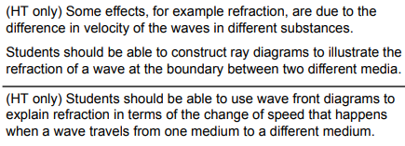
AQA Content
4.6.2.2

Slide 6
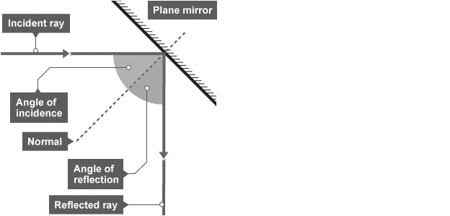
1 2 3 4 5 6 7 8 9 10 11 12 13 14 15 16 17 18 19 20 21 22 23 24 25 26 | Reflection of waves Waves including sound and light - can be reflected at the boundary between two different materials. The reflection of sound causes echoes. The law of reflection states that: angle of incidence = angle of reflection For example, if a light ray hits a surface at 32°, it will be reflected at 32°. The angles of incidence and reflection are measured between the light ray and the normal (an imaginary line at 90° to the surface). The diagrams show a water wave being reflected at a barrier, and a light ray being reflected at a plane mirror. Specular reflection Reflection from a smooth, flat surface is called specular reflection. This is the type of reflection that happens with a flat mirror. The image in a mirror is: upright virtual In a virtual image, the rays appear to diverge from behind the mirror, so the image appears to come from behind the mirror.

Slide 7
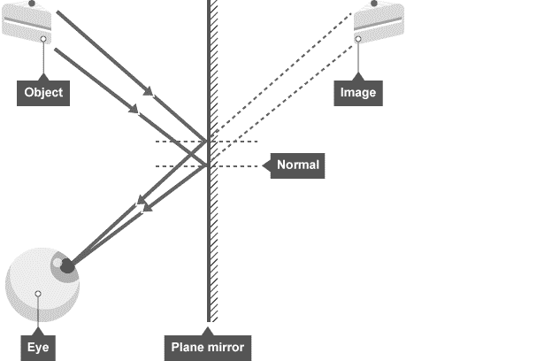
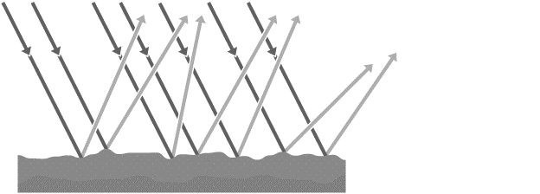
1 2 3 4 5 6 7 8 9 10 11 12 13 14 15 16 17 18 19 20 21 22 23 24 25 26 27 28 | A ray diagram showing how an image forms in a plane mirror. Diffuse reflection If a surface is rough, diffuse reflection happens. Instead of forming an image, the reflected light is scattered in all directions. This may cause a distorted image of the object, as occurs with rippling water, or no image at all. Each individual reflection still obeys the law of reflection, but the different parts of the rough surface are at different angles. Diffuse reflection or scattering from a rough surface.

Slide 8
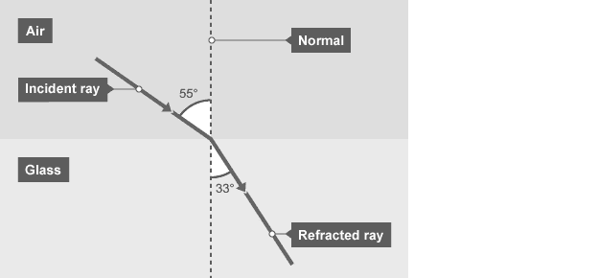
1 2 3 4 5 6 7 8 9 10 11 12 13 14 15 16 17 | Refraction of waves Different materials have different densities. Light waves may change direction at the boundary between two transparent materials. Refraction is the change in direction of a wave at such a boundary. It is important to be able to draw ray diagrams to show the refraction of a wave at a boundary. A ray diagram showing refraction at the boundary between air and glass.

Slide 9
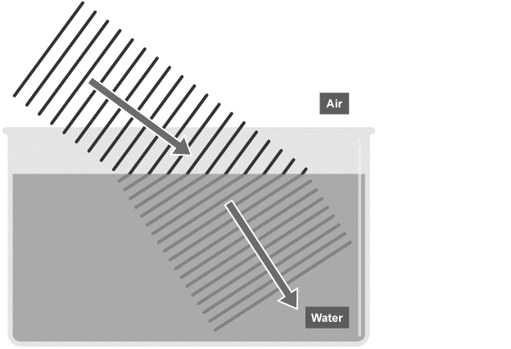
1 2 3 4 5 6 7 8 9 10 11 12 13 14 15 16 17 18 19 20 21 22 23 24 25 26 27 28 29 30 | Explaining refraction – Higher The density of a material affects the speed that a wave will be transmitted through it. In general, the denser the transparent material, the more slowly light travels through it. Glass is denser than air, so a light ray passing from air into glass slows down. If the ray meets the boundary at an angle to the normal, it bends towards the normal. The reverse is also true. A light ray speeds up as it passes from glass into air, and bends away from the normal by the same angle. Wave speed, frequency and wavelength in refraction For a given frequency of light, the wavelength is proportional to the wave speed: wave speed = frequency × wavelength So if a wave slows down, its wavelength will decrease. The effect of this can be shown using wave front diagrams like the one below. The diagram shows that as a wave travels into a denser medium, such as water, it slows down and the wavelength decreases. Although the wave slows down, its frequency remains the same, due to the fact that its wavelength is shorter. In this diagram, the right hand side of the incoming wave slows down before the left hand side does. This causes the wave to change direction.

Slide 10
Rehearsal questions
Light rays can ‘bounce’ off some surfaces. Is this refraction, reflection or diffraction?
………………………………………………………………………………………………………………………………………………………….
2. Which law states that angle of incidence equals the angle of reflection?
………………………………………………………………………………………………………………………………………………………….3. Light rays can change direction when they enter a medium with a different density. Is this refraction, reflection or diffraction?
………………………………………………………………………………………………………………………………………………………….4. Name the line that is at a right angle to the surface. ………………………………………………………………………………………………………………………………………………………….
5. Which type of reflection occurs at a smooth and flat surface?
………………………………………………………………………………………………………………………………………………………….
6. Which type of reflection occurs at a rough surface?
………………………………………………………………………………………………………………………………………………………….
7. If the angle of incidence is 65 degrees, what will be the angle of reflection? ………………………………………………………………………………………………………………………………………………………….
8. Light rays change direction when they enter a more dense material. What is the name of this phenomena? ……………………………………………………………………….…………………………………………………………
9. When studying reflection and refraction, we always draw a line at a right angle to the surface. What do we call this line? ………………………………………………………………………………………………………………
Mirrors have a smooth and flat surface. What type of reflection do they use?
………………………………………………………………………………………………………………………………………………………….
Reflection light rays also happens on rough surfaces. Which type of reflection would occur?
………………………………………………………………………………………………………………………………………………………….
Do light rays move towards or away from the Normal when they enter a more dense material?
………………………………………………………………………………………………………………………………………………………….

Slide 11
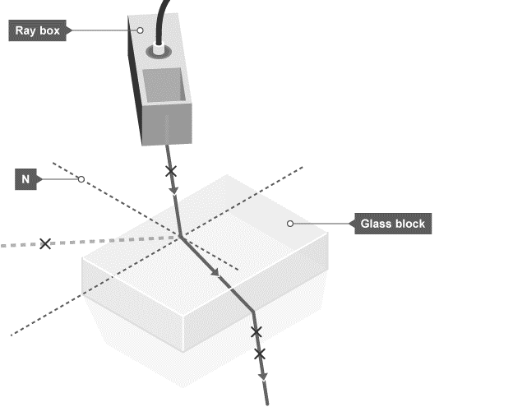
1 2 3 4 5 6 7 8 9 10 11 12 13 14 15 16 17 18 19 20 21 22 23 24 25 26 27 28 | Required Practical – Light Aim of the experiment To investigate the reflection of light by different types of surface, and the refraction of light by different substances. Method Set up a ray box, slit and lens so that a narrow ray of light is produced. Place a 30 centimetre (cm) ruler near the middle of a piece of plain A3 paper. Draw a straight line parallel to its longer sides. Use a protractor to draw a second line at right angles to this line. Label this line with an ‘N’ for ‘normal’. Place the longest side of a rectangular acrylic polymer block against the first line. With the normal near the middle of the block, carefully draw around the block without moving it. Use the ray box to shine a ray of light at the point where the normal meets the block. This is the incident ray.

Slide 12
1 2 3 4 5 6 7 8 9 10 11 12 13 | 5. The angle between the normal and the incident ray is called the angle of incidence. Move the ray box or paper to change the angle of incidence. The aim is to see a clear ray reflected from the surface of the block and another clear ray leaving the opposite face of the block. 6. Using a pencil on the paper, mark the path of the incident ray with a cross the reflected ray with a cross the ray that leaves the block with two crosses - one near the block and the other further away 7. Remove the block. Join the crosses to show the paths of the light rays. 8. Repeat steps 2 to 7 for a rectangular glass block. 9. Measure the angle of incidence, angle of refraction and angle of reflection for each block.

Slide 13
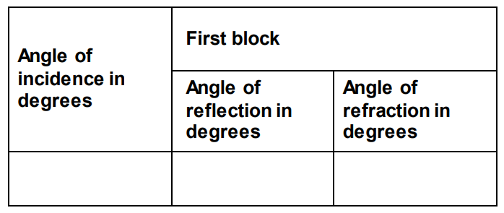
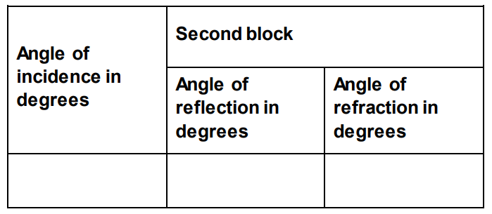
Results.

Slide 14
Conclusion
Physics theory suggests that the angles of incidence and reflection should be the same for a
material, but the angles of refraction for that material should be different.
How well do your results support this theory for the two different materials that you have tested?
…………………………………………………………………………………………………………………………………………………………………………………………………………………………………………………………………………………………………………………………………………………………………………………………………………………………………………………………………………………………………………………………………………………………………………………………………………………………………………………………………………………………………………………………………………………………………………………………………………………………………………………………………………………………………………………………………………………………………………………………………………………………………………………………………………………………………………………………………………………………………………………………………………………………………………………………………………………………………………………………………………………………………………………………………………………………………………………………………………………………………………………………………………………………………………………………………………
Evaluation
Consider the apparatus and method that you used. Are there any improvements that you could
make to improve the accuracy of the angles you measured if you were to repeat this experiment?
……………………………………………………………………………………………………………………………………………………………………………………………………………………………………………………………………………………………………………………………………………………………………………………………………………………………………………………………………………………………………………………………………………………………………………………………………………………………………………………………………………………………………………………………………………………………………………………………………
……………………………………………………………………………………………………………………………………………………………………………………………………………………………………………………………………………………………………………………………………………………………………………………………………………………………………………………………………………………………………………………………………………………………………………………………………………………………………………………………………………………………………………………………………………………………………………………………………

Slide 15
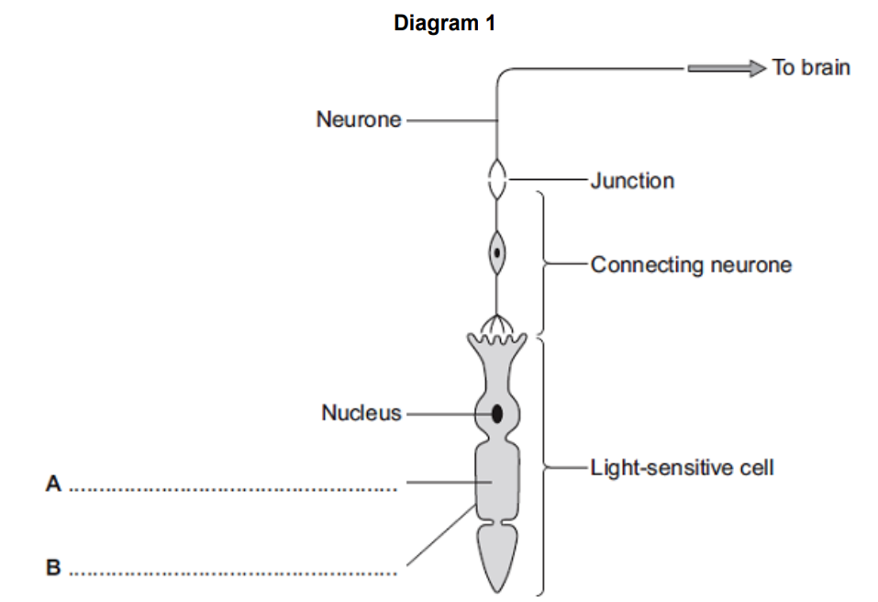
Spaced Retrieval
Most animals can detect changes in light intensity. A large number of them have eyes that enable them to detect changes in the environment and to respond to them. Eyes refract light so the animal can focus on an object. Often the reactions are rapid and automatic; they are reflex actions.
Reflex arcs contain the following parts:
Effector; stimulus; response; coordinator; receptor; sensory neurone; motor neurone; relay neurone; synapse.
Which part is a change in the environment? …………………………………….....................................
Which part includes the brain, spinal cord and pancreas? …………………………………………………….
Which part is made up of cells that detect stimuli?...................................................................
Which part could be a muscle or gland which responds to restore optimum levels?
…………………………………………………………………………………………………………………………………………….
5. Which neurone carries an impulse or message from the receptor to the coordinator?
…………………………………………………………………………………………………………………………………………….
6. Which neurone carries a message from the coordinator to the effector?
…………………………………………………………………………………………………………………………………………….
7. Diagram A shows a light receptor. Receptors are a type of cell.
Label parts A and B.

Slide 16
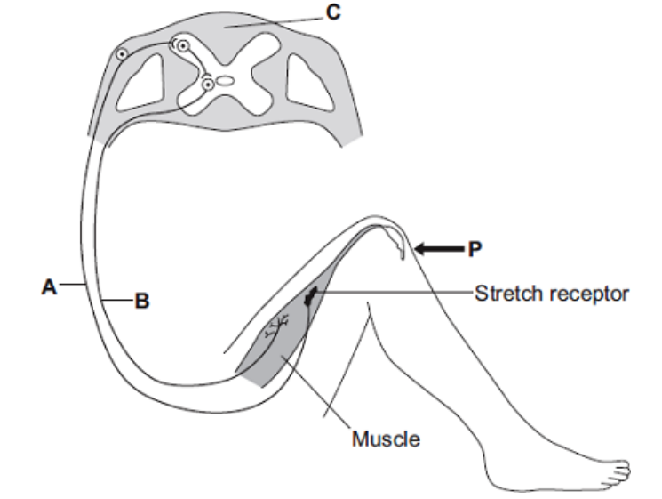
Spaced Retrieval
8. The diagram shows the structures involved in the knee-jerk reflex. When the person is hit at point P, the lower leg is suddenly raised.
Name the structures labelled A, B and C.
A ....................................................................................................................
B ....................................................................................................................
C ....................................................................................................................
Sensory neurone
Spinal cord / coordination centre / coordinator
Motor neurone

Slide 17
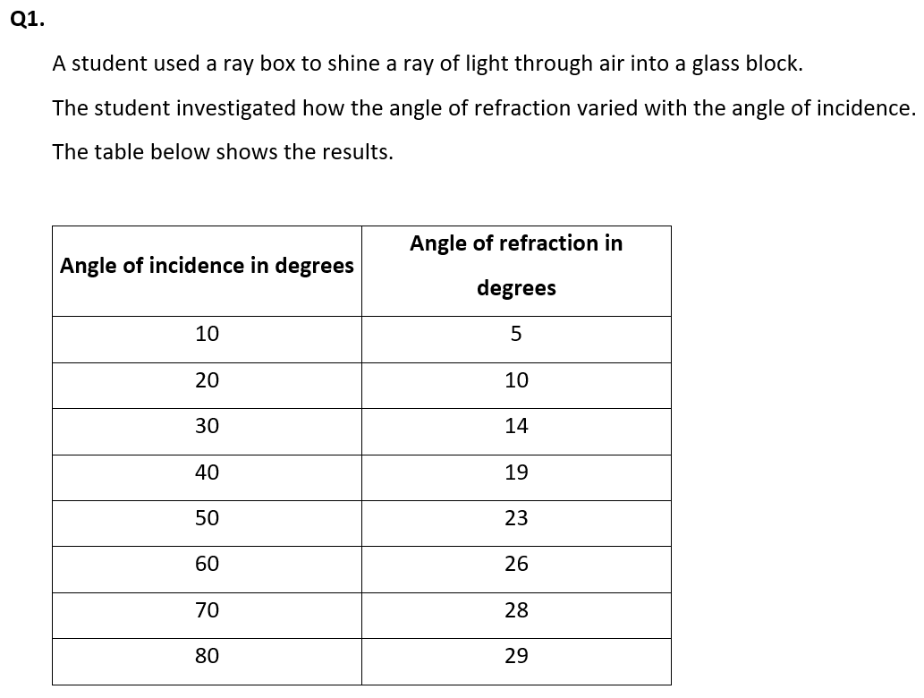
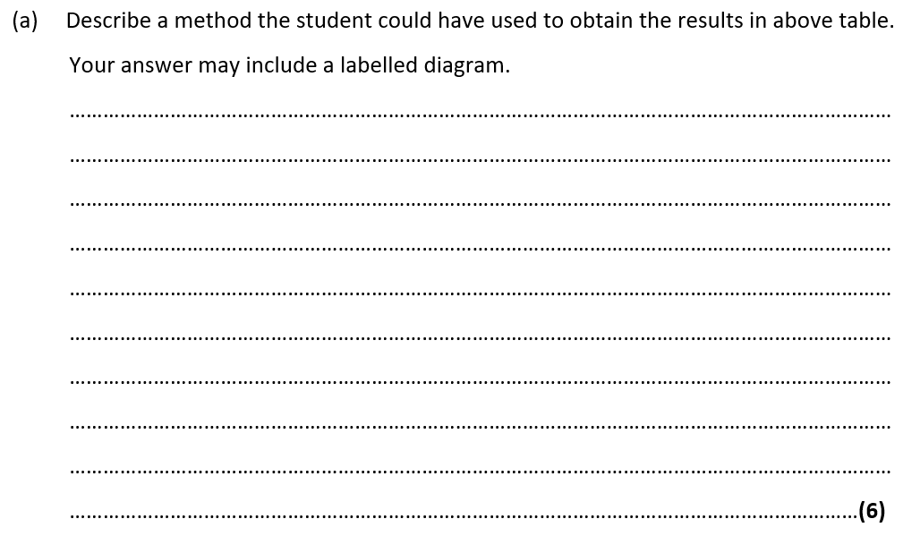
Exam questions

Slide 18
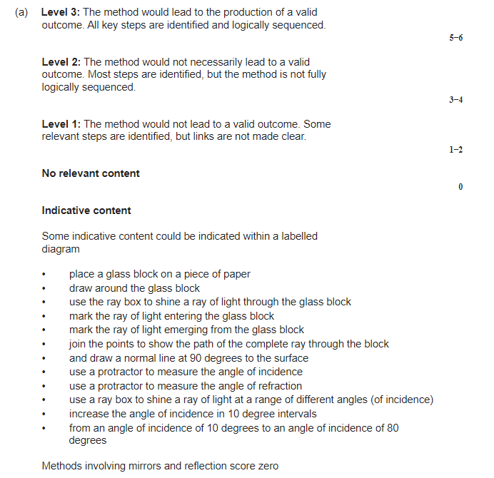

Slide 19
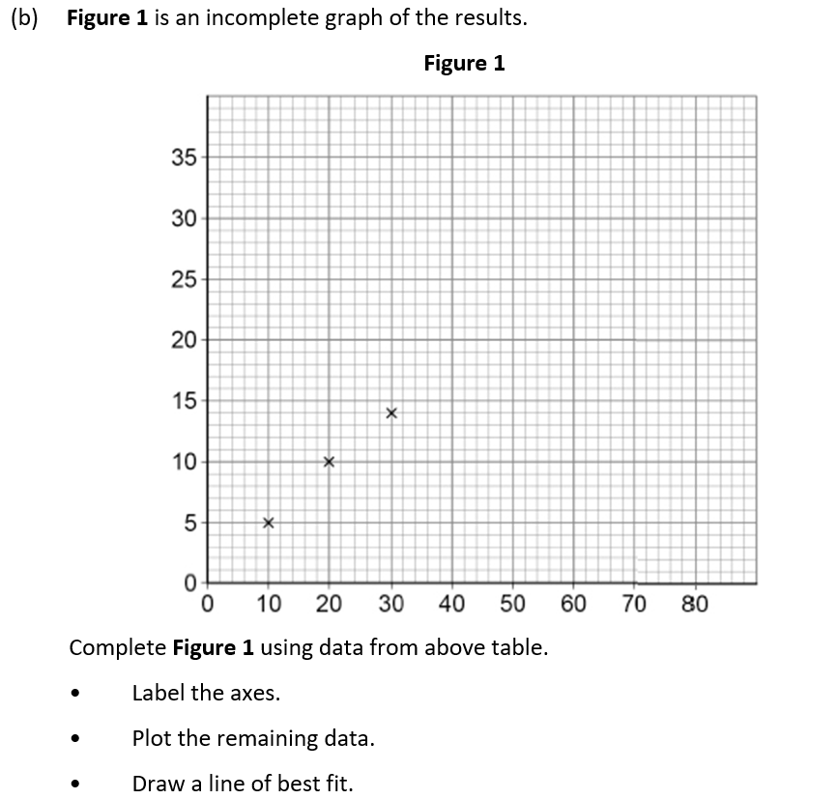

Slide 20
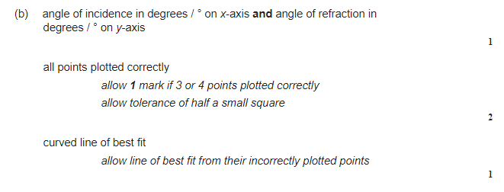

Slide 21
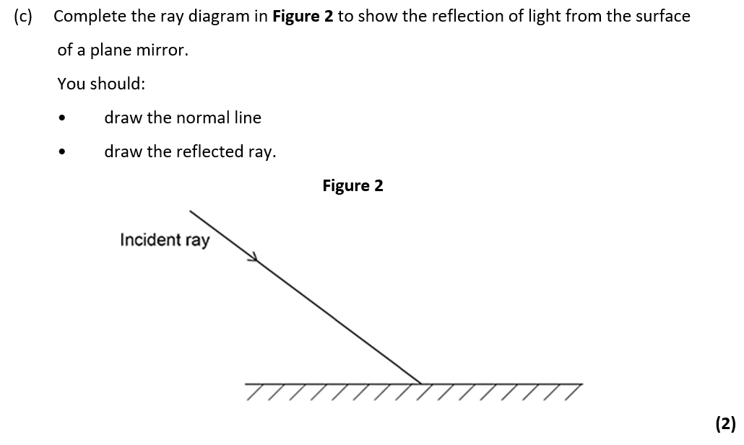
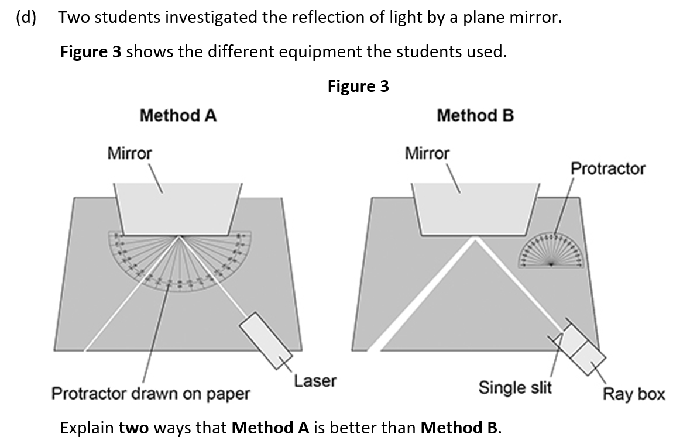

Slide 22
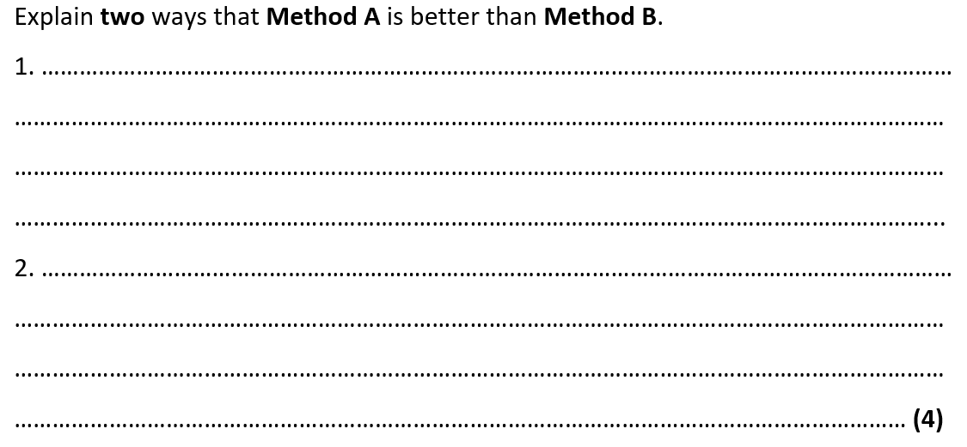
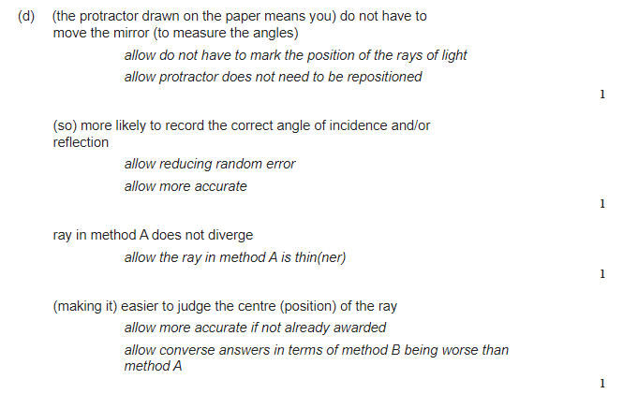

Slide 23
Subtopic 2: Lenses.
Learning Objective
We are learning to draw ray diagrams that show reflection and refraction of light from different surfaces.
Why are we learning about this?
Being able to detect and respond to light is key to the survival of most eukaryotic species.
For example, animals have specialized organs that contain receptors that detect light. For example, humans have eyes. The eyes increase the probability of survival because they enable animals to, for example, detect predators and to find food.
The human eye has evolved into a complex organ that focuses (as known as accommodation) light onto light receptors. The light rays are focused by the cornea and the lens using refraction. The lens can even change shape; this changes the extent to which the light rays are refracted and so enables us to focus on objects that are different distances away from us.
Reflection and refraction is also used extensively in technology. For example, the Hubble telescope used a giant mirror to focus light using reflection. More traditional telescopes contain lenses that refract light. Similarly, light microscopes contain lenses that can focus on minute objects by refracting light.
Reflection and refraction are therefore essential to our survival whilst also enabling us to explore microscopic and massive objects.
3

Slide 24
AQA Content
4.6.2.2

Slide 25
1 2 3 4 5 6 7 8 9 10 11 12 13 14 15 16 17 18 19 20 21 22 23 24 25 26 | Reflection of waves Waves including sound and light - can be reflected at the boundary between two different materials. The reflection of sound causes echoes. The law of reflection states that: angle of incidence = angle of reflection For example, if a light ray hits a surface at 32°, it will be reflected at 32°. The angles of incidence and reflection are measured between the light ray and the normal (an imaginary line at 90° to the surface). The diagrams show a water wave being reflected at a barrier, and a light ray being reflected at a plane mirror. Specular reflection Reflection from a smooth, flat surface is called specular reflection. This is the type of reflection that happens with a flat mirror. The image in a mirror is: upright virtual In a virtual image, the rays appear to diverge from behind the mirror, so the image appears to come from behind the mirror.

Slide 26
1 2 3 4 5 6 7 8 9 10 11 12 13 14 15 16 17 18 19 20 21 22 23 24 25 26 27 28 | A ray diagram showing how an image forms in a plane mirror. Diffuse reflection If a surface is rough, diffuse reflection happens. Instead of forming an image, the reflected light is scattered in all directions. This may cause a distorted image of the object, as occurs with rippling water, or no image at all. Each individual reflection still obeys the law of reflection, but the different parts of the rough surface are at different angles. Diffuse reflection or scattering from a rough surface.

Slide 27
1 2 3 4 5 6 7 8 9 10 11 12 13 14 15 16 17 | Refraction of waves Different materials have different densities. Light waves may change direction at the boundary between two transparent materials. Refraction is the change in direction of a wave at such a boundary. It is important to be able to draw ray diagrams to show the refraction of a wave at a boundary. A ray diagram showing refraction at the boundary between air and glass.

Slide 28
1 2 3 4 5 6 7 8 9 10 11 12 13 14 15 16 17 18 19 20 21 22 23 24 25 26 27 28 29 30 | Explaining refraction – Higher The density of a material affects the speed that a wave will be transmitted through it. In general, the denser the transparent material, the more slowly light travels through it. Glass is denser than air, so a light ray passing from air into glass slows down. If the ray meets the boundary at an angle to the normal, it bends towards the normal. The reverse is also true. A light ray speeds up as it passes from glass into air, and bends away from the normal by the same angle. Wave speed, frequency and wavelength in refraction For a given frequency of light, the wavelength is proportional to the wave speed: wave speed = frequency × wavelength So if a wave slows down, its wavelength will decrease. The effect of this can be shown using wave front diagrams like the one below. The diagram shows that as a wave travels into a denser medium, such as water, it slows down and the wavelength decreases. Although the wave slows down, its frequency remains the same, due to the fact that its wavelength is shorter. In this diagram, the right hand side of the incoming wave slows down before the left hand side does. This causes the wave to change direction.

Slide 29
Rehearsal questions
Light rays can ‘bounce’ off some surfaces. Is this refraction, reflection or diffraction?
………………………………………………………………………………………………………………………………………………………….
2. Which law states that angle of incidence equals the angle of reflection?
………………………………………………………………………………………………………………………………………………………….3. Light rays can change direction when they enter a medium with a different density. Is this refraction, reflection or diffraction?
………………………………………………………………………………………………………………………………………………………….4. Name the line that is at a right angle to the surface. ………………………………………………………………………………………………………………………………………………………….
5. Which type of reflection occurs at a smooth and flat surface?
………………………………………………………………………………………………………………………………………………………….
6. Which type of reflection occurs at a rough surface?
………………………………………………………………………………………………………………………………………………………….
7. If the angle of incidence is 65 degrees, what will be the angle of reflection? ………………………………………………………………………………………………………………………………………………………….
8. Light rays change direction when they enter a more dense material. What is the name of this phenomena? ……………………………………………………………………….…………………………………………………………
9. When studying reflection and refraction, we always draw a line at a right angle to the surface. What do we call this line? ………………………………………………………………………………………………………………
Mirrors have a smooth and flat surface. What type of reflection do they use?
………………………………………………………………………………………………………………………………………………………….
Reflection light rays also happens on rough surfaces. Which type of reflection would occur?
………………………………………………………………………………………………………………………………………………………….
Do light rays move towards or away from the Normal when they enter a more dense material?
………………………………………………………………………………………………………………………………………………………….

Slide 30
1 2 3 4 5 6 7 8 9 10 11 12 13 14 15 16 17 18 19 20 21 22 23 24 25 26 27 28 | Required Practical – Light Aim of the experiment To investigate the reflection of light by different types of surface, and the refraction of light by different substances. Method Set up a ray box, slit and lens so that a narrow ray of light is produced. Place a 30 centimetre (cm) ruler near the middle of a piece of plain A3 paper. Draw a straight line parallel to its longer sides. Use a protractor to draw a second line at right angles to this line. Label this line with an ‘N’ for ‘normal’. Place the longest side of a rectangular acrylic polymer block against the first line. With the normal near the middle of the block, carefully draw around the block without moving it. Use the ray box to shine a ray of light at the point where the normal meets the block. This is the incident ray.

Slide 31
1 2 3 4 5 6 7 8 9 10 11 12 13 | 5. The angle between the normal and the incident ray is called the angle of incidence. Move the ray box or paper to change the angle of incidence. The aim is to see a clear ray reflected from the surface of the block and another clear ray leaving the opposite face of the block. 6. Using a pencil on the paper, mark the path of the incident ray with a cross the reflected ray with a cross the ray that leaves the block with two crosses - one near the block and the other further away 7. Remove the block. Join the crosses to show the paths of the light rays. 8. Repeat steps 2 to 7 for a rectangular glass block. 9. Measure the angle of incidence, angle of refraction and angle of reflection for each block.

Slide 32
Results.

Slide 33
Conclusion
Physics theory suggests that the angles of incidence and reflection should be the same for a
material, but the angles of refraction for that material should be different.
How well do your results support this theory for the two different materials that you have tested?
…………………………………………………………………………………………………………………………………………………………………………………………………………………………………………………………………………………………………………………………………………………………………………………………………………………………………………………………………………………………………………………………………………………………………………………………………………………………………………………………………………………………………………………………………………………………………………………………………………………………………………………………………………………………………………………………………………………………………………………………………………………………………………………………………………………………………………………………………………………………………………………………………………………………………………………………………………………………………………………………………………………………………………………………………………………………………………………………………………………………………………………………………………………………………………………………………………
Evaluation
Consider the apparatus and method that you used. Are there any improvements that you could
make to improve the accuracy of the angles you measured if you were to repeat this experiment?
……………………………………………………………………………………………………………………………………………………………………………………………………………………………………………………………………………………………………………………………………………………………………………………………………………………………………………………………………………………………………………………………………………………………………………………………………………………………………………………………………………………………………………………………………………………………………………………………………
……………………………………………………………………………………………………………………………………………………………………………………………………………………………………………………………………………………………………………………………………………………………………………………………………………………………………………………………………………………………………………………………………………………………………………………………………………………………………………………………………………………………………………………………………………………………………………………………………

Slide 34
Spaced Retrieval
Most animals can detect changes in light intensity. A large number of them have eyes that enable them to detect changes in the environment and to respond to them. Eyes refract light so the animal can focus on an object. Often the reactions are rapid and automatic; they are reflex actions.
Reflex arcs contain the following parts:
Effector; stimulus; response; coordinator; receptor; sensory neurone; motor neurone; relay neurone; synapse.
Which part is a change in the environment? …………………………………….....................................
Which part includes the brain, spinal cord and pancreas? …………………………………………………….
Which part is made up of cells that detect stimuli?...................................................................
Which part could be a muscle or gland which responds to restore optimum levels?
…………………………………………………………………………………………………………………………………………….
5. Which neurone carries an impulse or message from the receptor to the coordinator?
…………………………………………………………………………………………………………………………………………….
6. Which neurone carries a message from the coordinator to the effector?
…………………………………………………………………………………………………………………………………………….
7. Diagram A shows a light receptor. Receptors are a type of cell.
Label parts A and B.

Slide 35
Spaced Retrieval
8. The diagram shows the structures involved in the knee-jerk reflex. When the person is hit at point P, the lower leg is suddenly raised.
Name the structures labelled A, B and C.
A ....................................................................................................................
B ....................................................................................................................
C ....................................................................................................................
Sensory neurone
Spinal cord / coordination centre / coordinator
Motor neurone

Slide 36
Exam questions

Slide 42
Subtopic 3: Waves for Exploration & Detection
Learning Objective
We are learning how waves can be used to detect and explore structures that are hidden from direct observation
We are learning how the above statement applies to sound waves, ultrasound and seismic waves
Why are we learning about this?
This lessons helps us understand how it is we are able to know about the structure of the Earth and how we can monitor the developing foetus.
3

Slide 43
AQA Content

Slide 44
I wasn’t there but I still care!
Use pages 182 – 183 of the GCSE Physics textbook.
How do sound waves interact with solids?
……………………………………………………………………………………………………………………………………………………………………………………………………………………………………………………………………………………………………………………………………………………………………………………………………………………………………………………………………………..
How does the human ear perceive sound?
……………………………………………………………………………………………………………………………………………………………………………………………………………………………………………………………………………………………………………………………………………………………………………………………………………………………………………………………………………..
What is the range of normal human hearing?
………………………………………………………………………………………………………………………………………………………………………………………………………………………………………………………………………………………………………………………………………………………………………………………………………………………………………………………………………………

Slide 45
1 2 3 4 5 6 7 8 9 10 11 12 13 14 15 16 17 18 19 20 21 22 23 24 25 26 27 28 29 30 | Waves, specifically ultrasound, seismic waves, and echo sounding, play a pivotal role in exploration and detection. They provide us with invaluable insights into our bodies, the Earth, and the oceans, demonstrating the power and versatility of wave-based technologies. Ultrasound: Ultrasound technology uses high-frequency sound waves beyond the range of human hearing. In medical applications, an ultrasound machine emits these waves into the body. When they encounter different types of tissues or structures, they bounce back or echo. The machine captures these echoes and uses them to construct an image known as a sonogram. This is particularly useful in prenatal care for monitoring foetal development, but it also aids in diagnosing conditions within the body by visualizing organs, blood vessels, and tissues. Seismic Waves: Seismic waves are primarily used in geology and geophysics for the exploration of the Earth’s interior. These waves can be naturally occurring, as in earthquakes, or artificially induced for scientific study. When seismic waves travel through the Earth, they are refracted and reflected by different layers, creating distinct patterns. By analysing these patterns with seismographs, scientists can infer the structure and composition of the Earth’s interior. This is crucial in understanding geological phenomena like earthquakes and volcanic activity. Furthermore, in the oil and gas industry, seismic surveys are used to locate potential reserves beneath the Earth’s surface. Echo Sounding: Echo sounding is a type of sonar technology used to measure the depth of water bodies. It works by emitting a sound pulse into the water and then measuring the time it takes for the echo to return after bouncing off the sea floor. Given the speed of sound in water, the depth can be calculated from this time delay. Echo sounding is vital in maritime navigation to avoid submerged obstacles and is also used in oceanography for mapping the topography of the ocean floor.

Slide 46
Rehearsal Questions
What is a transverse wave?
……………………………………………………………………………………………………………………………………………………………………………………………………………………………………………………………………………………………………………………
2. What is a longitudinal wave?
................................................................................................................................................................................................................................................................................................................................
3. Can you provide an example of a transverse wave?
……………………………………………………………………………………………………………………………………………………………………………………………………………………………………………………………………………………………………………………
4. Can you provide an example of a longitudinal wave?
……………………………………………………………………………………………………………………………………………………………………………………………………………………………………………………………………………………………………………………
5. What is the difference between a crest and a trough in a transverse wave?
……………………………………………………………………………………………………………………………………………………………………………………………………………………………………………………………………………………………………………………6. What is the difference between compression and rarefaction in a longitudinal wave?
……………………………………………………………………………………………………………………………………………………………………………………………………………………………………………………………………………………………………………………7. What is meant by the amplitude of a wave?
……………………………………………………………………………………………………………………………………………………………………………………………………………………………………………………………………………………………………………………8. What is meant by the wavelength of a wave?
……………………………………………………………………………………………………………………………………………………………………………………………………………………………………………………………………………………………………………………
………………………………………………………………………………………………………………………………………………………..
A transverse wave is a wave in which the displacement of the medium’s particles is perpendicular to the direction of the wave’s propagation.
A longitudinal wave is a wave in which the displacement of the medium’s particles is parallel to the direction of the wave’s propagation.
Light waves and waves on a string are examples of transverse waves.
Sound waves are an example of longitudinal waves.
A crest is the highest point of a transverse wave, while a trough is the lowest point
Compression is the region of a longitudinal wave where the particles are closest together, while rarefaction is the region where the particles are furthest apart.
The amplitude of a wave is the maximum displacement of the medium’s particles from their rest position.
The wavelength of a wave is the distance over which the wave’s shape repeats. It is usually determined as the distance between consecutive crests or troughs (for transverse waves) or compressions or rarefactions (for longitudinal waves)

Slide 47
Detecting sound:
Sound waves are longitudinal waves. This means that they causes particles to vibrate parallel to the direction of the wave travel. Sound wave vibrations can travel through the 3 states of matter, however will travel at different velocities based on the particle arrangement of the particular matter.
The human ear is designed to detect sound waves. When sound waves enter the ear, they cause the ear drum to vibrate. Three small bones transmit these vibrations to the cochlea. This produces electrical signals which pass through the auditory nerve to the brain, where they are interpreted as sound. Humans can detect sound waves that fall into the range of ~20 – 20,000Hz, although this can vary between individuals, and age can play a factor. Different animals have different ranges of frequencies that they can detect which explains why a dog can hear a dog whistle, but a human cannot.
The pitch of a sound is related to the frequency of the wave. High frequency waves have a high pitch, with low frequency waves having the converse. Volume is related to the amplitude of the sound wave. A high amplitude means a loud sound, whereas a low amplitude is quiet.
If the oscilloscope trace for number 1 is described as a quiet, low pitched sound, how would the oscilloscope traces for numbers 2 and 3 be described?
2 = ………………………………………………………………………………………………………………………………………………
3 = ……………………………………………………………………………………………………………………………………………..
Loud, low pitched sound
Loud, high pitched sound

Slide 48
You will be familiar with echoes. An echo is caused by a surface reflecting a sound wave. How far away the surface reflecting the sound wave is will determine the time taken for the echo to be detected. Sound waves typically travel at ~330m/s in air. This means echoes can be used to work how far away the reflective surface is.
For example,
I do:
A sound wave takes 2 seconds to return to its source and the speed of sound is 330m/s, how far has the echo travelled?
……………………………………………………………………………………………………………………………………………………………………………………………………………………………………………………………………………………………………………………………………………………………………………………………………………………………………………………………………………………………………………………………………………………………………………………………………………………………………………………………………………………………………………………………………………………………………………………………………
We do:
An echo is heard 5 seconds after the original sound was made. If the speed of sound is 330m/s, what is the distance between the source of the sound and the reflecting surface?
……………………………………………………………………………………………………………………………………………………………………………………………………………………………………………………………………………………………………………………………………………………………………………………………………………………………………………………………………………………………………………………………………………………………………………………………………………………………………………………………………………………………………………………………………………………………………………………………………
You do:
A sonar pulse returns to a submarine 1.5 seconds after being emitted. The speed of sound in seawater is 1500m/s. How far away is the detected object?
……………………………………………………………………………………………………………………………………………………………………………………………………………………………………………………………………………………………………………………………………………………………………………………………………………………………………………………………………………………………………………………………………………………………………………………………………………………………………………………………………………………………………………………………………………………………………………………………………
Speed = distance ÷ time
330 = distance ÷ 2
Distance = 330 x 2
Distance = 660m
The echo has travelled half of this, 660/2 = 330m
Speed = distance ÷ time
330 = distance ÷ 5
Distance = 330 x 5
Distance = 1650m
The echo has travelled half of this, 1650/2 = 825m
Speed = distance ÷ time
1500 = distance ÷ 1.5
Distance = 1500 x 1.5
Distance = 2250m
The sonar pulse has travelled half of this, 2250/2 = 1125m

Slide 49
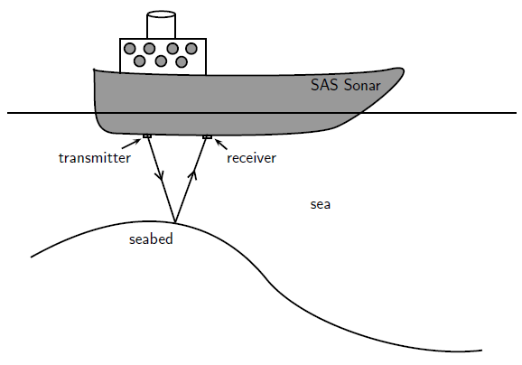
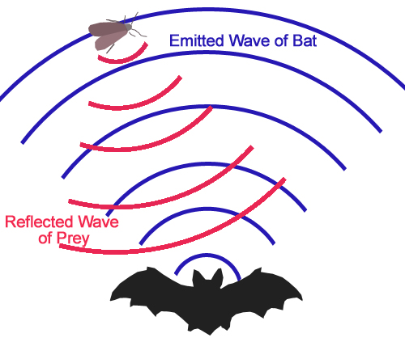
You do:
A bat emits a sound and receives its echo after 0.1 seconds. If the speed of sound is 330m/s, how far way is the object that reflected the sound?
……………………………………………………………………………………………………………………………………………………………………………………………………………………………………………………………………………………………………………………………………………………………………………………………………………………………………………………………………………………………………………………………………………………………………………………………………………………………………………………………………………………………………………………………………………………………………………………………………
This reflection of sound waves is also useful in a process known as echo sounding
In this process, sound waves are sent down into water from a sonar system. This system uses the time for the reflected wave to return, and the speed of sound in water to determine the distance of objects. These objects include the seabed, shipwrecks and shoals of fish.
Speed = distance ÷ time
330 = distance ÷ 0.1
Distance = 330 x 0.1
Distance = 33m
The echo has travelled half of this, 33/2 = 16.5m
Bats (and dolphins) use a similar process called echolocation to find food.

Slide 50
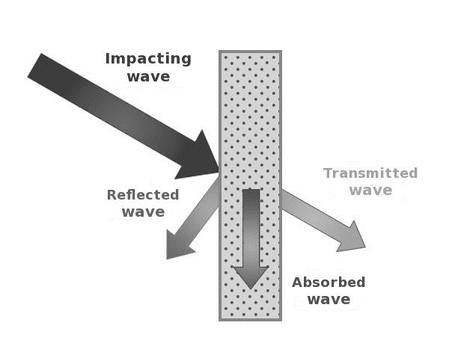
As we have discussed, sound waves can be reflected by surfaces to produce echoes, however, reflection is not the only thing that happens when a sound wave encounters a surface.
This is particularly true for ultrasound waves. Ultrasound is described as a sound wave with a frequency above 20000Hz (20kHz) and are beyond the human audible range. This means that ultrasound waves have a very high pitch and cannot be detected by humans. Having such a high frequency means that ultrasound waves have a number of uses. One such use is cleaning jewellery. The high frequency ultrasound waves causes cleaning fluid to vibrate, causing a process called ‘cavitation’ (the formation and collapse of tiny bubbles in the fluid) which breaks up dirt on the surface of the jewellery. A medical use of ultrasound is the treatment of kidney stones. Again, the high frequency is used to ‘shake’ apart the kidney stones to make them smaller so they can pass out of the kidney.
Three things can occur when a sound wave encounters a surface. These are reflection, absorption ad transmission. This explains why sounds can be heard through walls, and why adding sound proofing to a surface significantly reduces the transmission of sound.

Slide 51
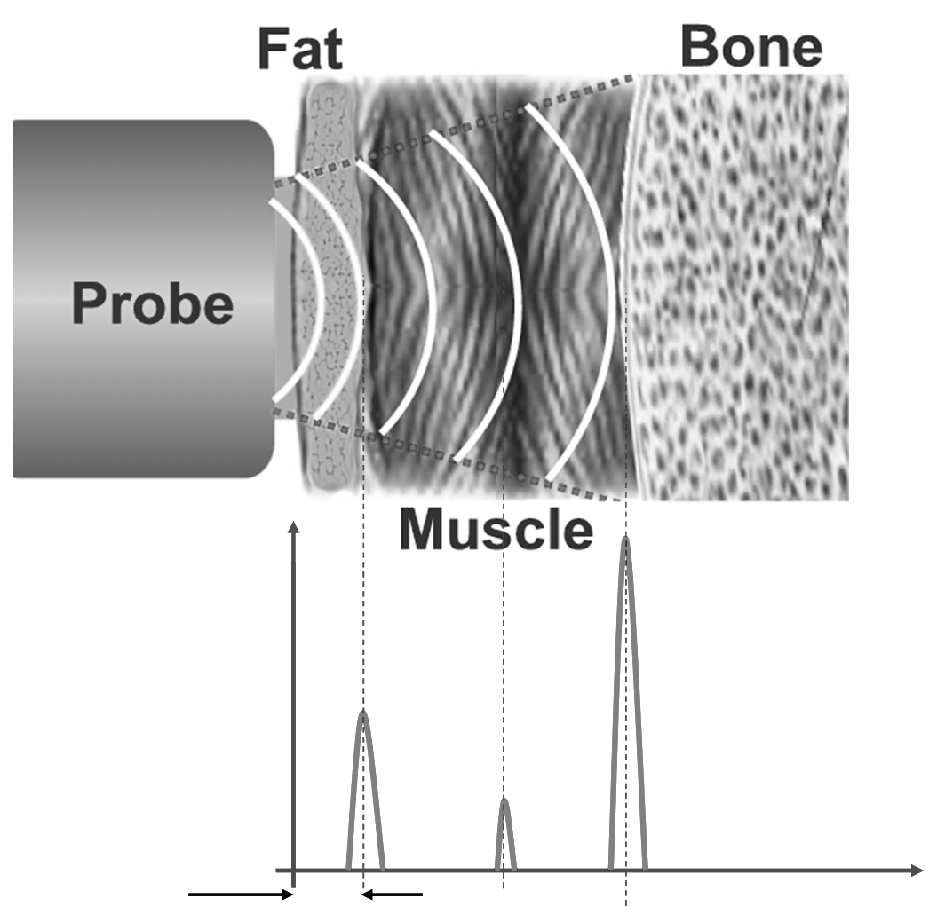
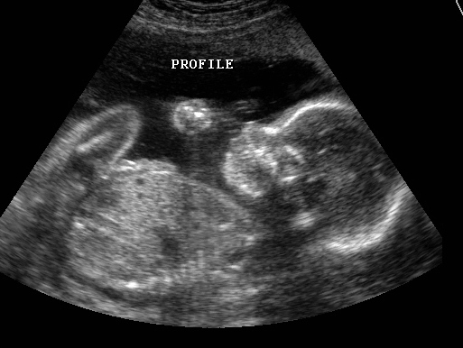
A more common medical use of ultrasound is for body scans and baby scans. The ultrasound waves are sent into the body by a probe attached to a machine. When the ultrasound waves encounter a boundary between different tissue types (fluid and soft tissue, bone and soft tissue) some of the waves get reflected. The rest carry on until they hit another boundary, and again some get reflected.
The reflected waves get detected by the probe and are relayed to the machine. The machine then calculates the distance of the tissue or organ (boundaries) using the speed of sound in tissue (~1540m/s) and the time of each echo’s return. The machine then displays the distances and the intensities of the echoes on a screen, creating a 2 dimensional image.

Slide 52
Rehearsal questions – Ultrasound
What is ultrasound?
………………………………………………………………………………………………………………………………………………………………………………………………………………………………………………………………………………………………………………2. Why can a dog hear the ultrasound produced by a dog whistle but humans cannot?
……………………………………………………………………………………………………………………………………………………………………………………………………………………………………………………………………………………………………………….
3. What are some uses of ultrasound?
………………………………………………………………………………………………………………………………………………………………………………………………………………………………………………………………………………………………………………
4. What happens when ultrasound waves meet the boundary between two different materials?
……………………………………………………………………………………………………………………………………………………………………………………………………………………………………………………………………………………………………………………………………………………………………………………………………………………………………………………………………..
5. How is high frequency sound used in echo sounding?
……………………………………………………………………………………………………………………………………………………………………………………………………………………………………………………………………………………………………………………………………………………………………………………………………………………………………………………………………..
6. Where are the mistakes in this calculation?
A submarine is 1500m away from the bottom of the ocean. The speed of sound in water is 1530m/s. How long will it take for the submarine to detect the ultrasound?
Speed = distance ÷ time
Time = distance ÷ speed
Time = 1500/1530= 0.98s
0.98 ÷2= 0.49s to go there and back
Ultrasound waves have a frequency higher than the upper limit for human hearing - above 20,000 Hertz (Hz).
Different species of animal have different hearing ranges. A dog whistle produces a sound wave at a frequency beyond that which humans can hear.
Uses of ultrasound include breaking kidney stones, cleaning jewellery, and creating images of unborn babies in the womb
When ultrasound waves meet the boundary between two different materials, some of the ultrasound waves are reflected at the boundary. The time taken for the waves to leave a source and return to a detector is measured. The depth of the boundary can be determined using the speed of sound in the material and the time taken.
High frequency sound waves can be used to detect objects in deep water and to measure water depth. The time between a pulse of sound being transmitted and detected and the speed of sound in water can be used to calculate the distance of the reflecting surface or object
x 2 (2 lots of 1500m)
1.96s

Slide 53
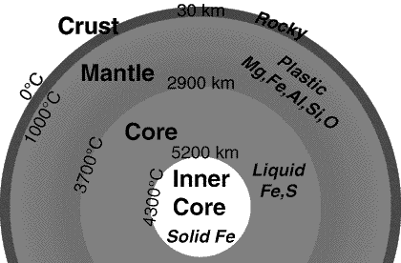
Knowledge of the structure of the Earth
How do we know this about the Earth?
Seismic waves provide us with evidence for the structure of the Earth. Seismic waves are energy waves that travel through the Earth’s layers, and are a result of earthquakes, volcanic eruptions, magma movement, large landslides and manmade explosions that give out low-frequency acoustic energy. They are studied by seismologists to understand the interior structure of the Earth. There are two types: body waves (travel through the Earth’s inner layers) and surface waves (only move along the surface)

Slide 54
Seismic waves:
There are 2 types of seismic wave that can provide us with evidence about the structure of the Earth
P-waves (Primary) which are longitudinal waves
S-waves (Secondary) which are transverse waves
P-waves, or primary waves, are the fastest seismic waves and the first to be detected by seismographs. They can travel through solids, liquids, and gases.
S-waves, or secondary waves, are slower than P-waves and are the second to be detected. They can only travel through solids, not through liquids or gases. This is why S-waves are not detected in the Earth’s outer core, which is liquid.
P-waves can be detected on the opposite side of the Earth. As they move through the different materials of the Earth they get refracted. These refractions cause shadow zones where no P-waves are detected. This provides evidence that the Earth has a solid inner core.
S-waves cannot be detected on the opposite side of the Earth. This suggests that the mantle has solid properties and there is a liquid outer core.

Slide 55
You do – Wrong answers
Read the paragraph below. Underline incorrect phrases and correct them.
P-waves are transverse seismic waves. They can travel through both solids and liquids, and they move at different speeds depending on the medium. They are also slower than S-waves.
On the other hand, S-waves are longitudinal seismic waves. They can only travel through solids and are faster than P-waves.
It’s important to note that only S-waves are detected on the opposite side of the Earth to an earthquake, suggesting the inner core of the Earth is liquid – hence no P-waves can penetrate it. This provides evidence for the structure and size of the Earth’s core.
P-waves are (transverse) longitudinal seismic waves. They can travel through both solids and liquids, and they move at different speeds depending on the medium. They are also (slower) faster than S-waves.
On the other hand, S-waves are (longitudinal) transverse seismic waves. They can only travel through solids and are (faster) slower than P-waves.
It’s important to note that only (S-waves) P-waves are detected on the opposite side of the Earth to an earthquake, suggesting the (inner) outer core of the Earth is (solid) liquid – hence no (P-waves) S-waves can penetrate it. This provides evidence for the structure and size of the Earth’s core.

Slide 56
Exam questions

Slide 57
Exam questions

Slide 58
Exam questions
X

Slide 59
Exam questions

Slide 60
Subtopic 4: Emission & Absorption of infrared radiation
Learning Objective
We are learning that all bodies, no matter what temperature emit and absorb infra red radiation
Why are we learning about this?
This lessons helps us understand how temperature is related to the amount of infra red radiation given out or taken in by an object

Slide 61
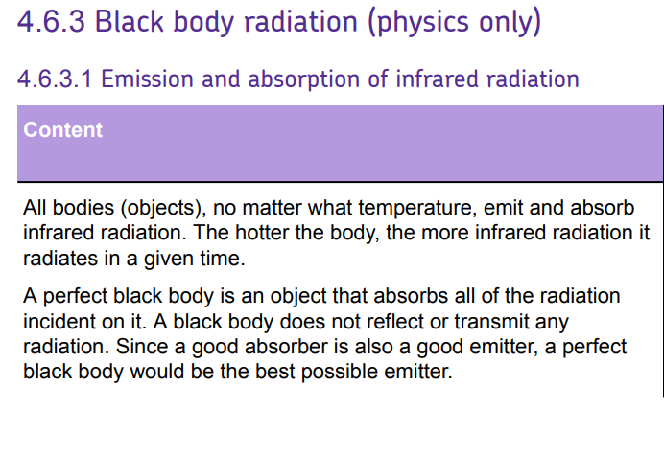
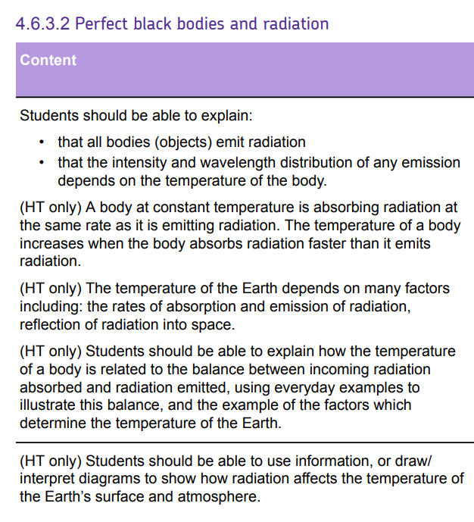
AQA Content

Slide 62
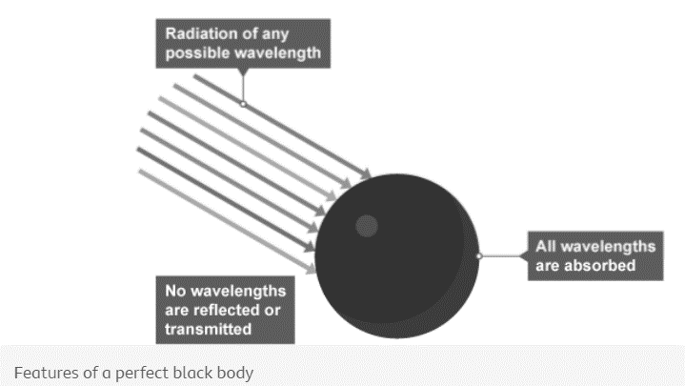
1 2 3 4 5 6 7 8 9 10 11 12 13 14 15 16 17 18 19 20 21 22 23 24 25 26 27 28 29 30 | Emission and absorption of infrared radiation All bodies (objects) emit and absorb infrared radiation. They do this whatever their temperature. The hotter the body: the more infrared radiation it gives out in a given time the greater the proportion of emitted radiation is visible light Black bodies There are no known objects that are perfect at absorbing or emitting all the radiation, of every possible frequency, that may be directed at it. Some objects do, however, come close to this and these are referred to as "black bodies". A perfect black body is a theoretical object. It would have these properties: it would absorb all the radiation that falls on it it would not reflect or transmit any radiation An object that is good at absorbing radiation is also a good emitter, so a perfect black body would be the best possible emitter of radiation. Stars are considered to be black bodies because they are very good emitters of most wavelengths in the electromagnetic spectrum . This suggests that stars also absorb most wavelengths. Whilst there are a few wavelengths that stars do not absorb or emit, this figure is very low, so they can be treated as black bodies. Planets and black holes are also treated as nearly perfect black bodies.

Slide 63
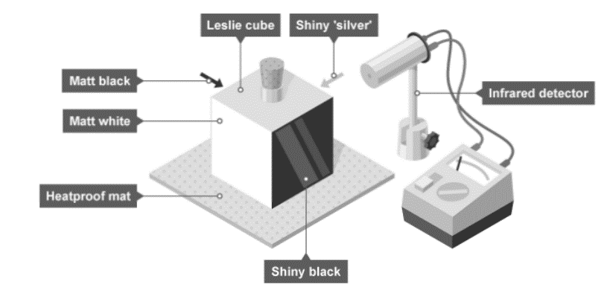
1 2 3 4 5 6 7 8 9 10 11 12 13 14 15 16 17 18 19 20 21 22 23 24 25 26 27 28 29 30 | Poor absorbers and emitters White and shiny silvery surfaces are the worst absorbers, as they reflect all visible light wavelengths. Poor absorbers are also poor emitters, and do not emit radiation as quickly as darker colours. Radiators in homes are usually painted white so that the infrared radiation is emitted gradually. Investigate how the amount of infrared radiation absorbed or radiated by a surface depends on the nature of that surface There are different ways to investigate the amount of infrared radiation absorbed or radiated by a surface. It is important to: use appropriate apparatus to measure and record temperature accurately. make observations regarding the effects of electromagnetic waves on different substances. The method described here uses a Leslie cube. This is a metal cube with four different types of surface. It is filled with hot water to increase its temperature. Aim of the experiment Method Place a Leslie cube on a heat-resistant mat. Fill it, almost to the top, with boiling water and replace the lid. Leave for one minute. This is to enable the surfaces to heat up to the temperature of the

Slide 64
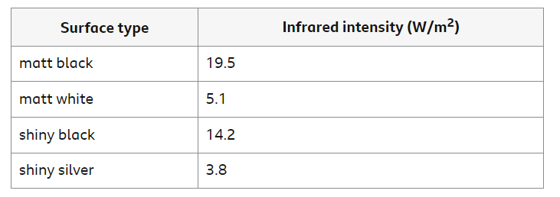
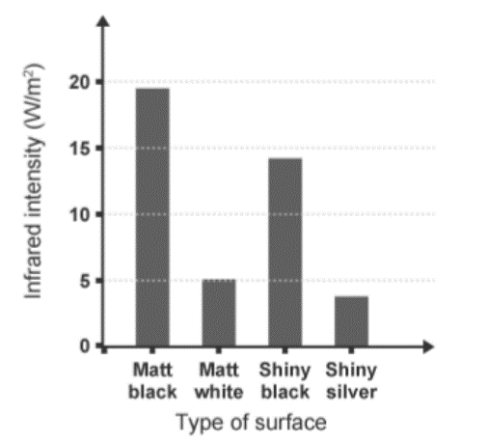
1 2 3 4 5 6 7 8 9 10 11 12 13 14 15 16 17 18 19 20 21 22 23 24 25 26 27 28 29 30 | water. Use the infrared detector to measure the intensity of infrared radiation emitted from each surface, or the temperature of the surface. Make sure that the detector is the same distance from each surface for each reading. Results Record results in a suitable table. The Table below shows some example results: Analysis Plot a bar chart to show the results. Make sure each bar is the same width and labelled clearly to show which surface it represents. Evaluation Explain why the detector must be placed the same distance from each surface before taking a reading.

Slide 65
1 2 3 4 5 6 7 8 9 10 11 12 13 14 15 16 17 18 19 20 21 22 23 24 25 26 27 28 29 30 | Hazards and control measures The Earth's temperature - Higher The temperature of a body is linked to the balance between the amount of radiation absorbed and emitted. Factors affecting the Earth’s temperature The temperature of the Earth depends on many factors including the concentration of greenhouse gases such as water vapour, methane and carbon dioxide. The Earth’s temperature also depends on the rates at which light radiation and infrared radiation are: absorbed by the Earth’s surface and atmosphere emitted by the Earth’s surface and atmosphere When visible light and high frequency infrared radiation are absorbed by the surface of the Earth, the planet’s internal energy increases and the surface gets hotter. Some of this energy is transferred to the atmosphere by conduction and convection. The Earth also radiates lower frequency infrared radiation. Some of this infrared radiation is transmitted through the atmosphere back out into space, and some is absorbed by greenhouse gases in the atmosphere. The greenhouse gases emit infrared radiation in all directions - some out into space and some back towards Earth, which is then re-absorbed.

Slide 66
1 2 3 4 5 6 7 8 9 10 11 12 13 14 15 16 17 18 19 20 21 22 23 24 25 26 27 28 29 30 | The greenhouse effect The ‘greenhouse effect’ caused by naturally occurring greenhouse gases, such as water vapour, stabilises the surface temperature of Earth. This allows the planet to support life. However, human activities such as deforestation and the burning of fossil fuels are releasing additional carbon dioxide. This causes more infrared radiation to be ‘trapped’ and reabsorbed by the Earth’s surface. This enhanced greenhouse effect is causing global temperatures to increase, leading to climate change.

Slide 67
Rehearsal questions - Emission & Absorption of infra red radiation
1. What is meant by infra red radiation?
……………………………………………………………………………………………………………………………………………………………
………………………………………………………………………………………………………………………………………………………….…
2. What is meant by the terms emission & absorption?
………………………………………………………………………………………………………………………………………………………………
………………………………………………………………………………………………………………………………………………………….…
3. Which surfaces are better at emitting infra red radiation?
…………………………………………………………………………………………………………………………………………………………………
4. Which surfaces are better at reflecting infra red radiation?
.……………………………………………………………………………………………………………………………………………………………....
5. Suggest why solar heating panels are dull black colour
…………………………………………………………………………………………………………………………………………………………………
…………………………………………………………………………………………………………………………………………………………………
6. The sun releases what parts of the electromagnetic spectrum?
…………………………………………………………………………………………………………………………………………………………………
…………………………………………………………………………………………………………………………………………………………………
7. What is meant by the term ‘ a perfect black body’?
………………………………………………………………………………………………………………………………………………………...........
…………………………………………………………………………………………………………………………………………………………………
8. When radiation is given out or taken in we can say it is
………………………………………… or ……………………………………
9. Which surfaces are better at absorbing infra red radiation?
……………………………………………………………………………………………………………………………………………………………….
10. Which surfaces give out the least amount of infra red radiation?
.......................................................................................................................................................................
11. What is the name of an object that does not reflect or transmit any radiation?
…………………………………………………………………………………………………………………………………………………………………
Energy part of electromagnetic spectrum – shorter wavelength than microwaves- longer than visible light – detected as thermal energy
Give out take in
Dark ,matt , dull
Shiny, light
Absorb more infra red radiation – to transform to electrical energy store
Infra red, visible light, ultraviolet radiation
Absorbs ALL radiation that hits it & Reflects / transmits NONE
Emitted absorbed
Dark ,matt , dull
Shiny, light
Black body

Slide 68
YOU DO Wrong answers – Perfect black bodies and radiation
Read the passage below. There are 20 scientific detail mistakes. Underline incorrect words/phrases, and correct them.
All objects emit electromagnetic radiation over a range of wavelengths. The cooler object, the more infrared radiation it radiates in a given time whilst a hotter object radiates less. At thermodynamic equilibrium, the rate at which an object absorbs radiation is more than the rate at which it emits it. A perfect absorber emits all electromagnetic radiation incident on it; such an object is called a whitebody. An object that absorbs all of the radiation incident on it and does not reflect or transmit any radiation is called a faulty black body. Since a good absorber is also a good emitter, a perfect black body would be the worst possible emitter too. As a result, an object which perfectly absorbs all radiation will be white. This is because the colour black is what is seen when all colours from the visible light spectrum are reflected. The colour of a body is linked to the balance between the amounts of radiation absorbed and emitted. If the rate of absorption is lower than the rate of emission, then the objects temperature is constant. If absorption & emission rates are equal ,then the temperature will be fall but if absorption is less than the rate of emission, then temperature is increasing.
The temperature of the Earth depends on many factors including the concentration of greenhouse gases such as oxygen, nitrogen and carbon dioxide. The Earth’s temperature also depends on the rates at which light radiation and infrared radiation are absorbed and emitted by the Earth’s core and atmosphere. When visible light and infrared radiation are emitted by the surface of the Earth, the surface gets hotter. The Earth also radiates lower frequency infrared radiation. Some of this infrared radiation is transmitted through the atmosphere back out into space, and some is absorbed by water vapour in the atmosphere. The greenhouse gases take in infrared radiation in all directions – some out into space and some back towards Earth, which is then reabsorbed.
All objects emit electromagnetic radiation over a range of wavelengths. The hotter object, the more infrared radiation it radiates in a given time whilst a cooler object radiates less. At thermodynamic equilibrium, the rate at which an object absorbs radiation is the same as the rate at which it emits it. A perfect absorber absorbs all electromagnetic radiation incident on it; such an object is called a blackbody. An object that absorbs all of the radiation incident on it and does not reflect or transmit any radiation is called a perfect black body. Since a good absorber is also a good emitter, a perfect black body would be the best possible emitter too. As a result, an object which perfectly absorbs all radiation will be black. This is because the colour black is what is seen when all colours from the visible light spectrum are absorbed. The temperature of a body is linked to the balance between the amounts of radiation absorbed and emitted. If the rate of absorption is greater than the rate of emission, then the objects temperature is Increasing. If absorption & emission rates are equal ,then the temperature will be constant but if absorption is less than the rate of emission, then temperature is decreasing.
The temperature of the Earth depends on many factors including the concentration of greenhouse gases such as water vapour, methane and carbon dioxide. The Earth’s temperature also depends on the rates at which light radiation and infrared radiation are absorbed and emitted by the Earth’s surface and atmosphere. When visible light and infrared radiation are absorbed by the surface of the Earth, the surface gets hotter. The Earth also radiates lower frequency infrared radiation. Some of this infrared radiation is transmitted through the atmosphere out into space, and some is absorbed by greenhouse gases in the atmosphere. The greenhouse gases emit infrared radiation in all directions – some out into space and some back towards Earth, which is then reabsorbed.

Slide 69
If It didn’t – Black bodies and infra red radiation
I DO: How would the temperature of an object be affected if it didn’t absorb or emit infrared radiation?
……………………………………………………………………………………………………………………………………………………………………………………………………………………………………………………………………………………………………………………………………
WE DO: How would the temperature of an object be affected if it didn’t have a light colour?
…………………………………………………………………………………………………………………………………………………………………
YOU DO: How would the temperature of an object be affected if it didn’t emit radiation?
………………………………………………………………………………………………………………………………………………………………
YOU DO: How would the temperature of an object be affected if it didn’t absorb radiation?
……………………………………………………………………………………………………………………………………………………………..
YOU DO: How would the temperature of a black body be affected if it wasn’t black?
……………………………………………………………………………………………………………………………………………………………..
YOU DO: How would the infra red radiation detected from Leslie’s Cube be affected if you didn’t maintain a constant gap between detector and cube?
……………………………………………………………………………………………………………………………………………………………..
YOU DO: How would the temperature of the earth be affected if greenhouse gases didn’t exist in the atmosphere?
……………………………………………………………………………………………………………………………………………………………..
Temperature would be constant
Temperature would increase
Temperature would increase
Temperature would decrease
Temperature would change
Readings would show a random error
Temperature would be constant / reduced global warming

Slide 70
Spaced Retrieval – radiation and the Earths atmosphere
The earth’s temperature depends on the absorption of infrared radiation from the sun and the emission of radiation from the Earth’s surface and atmosphere. What can you remember about the greenhouse effect and global warming?
1. What is meant by the term ‘global warming?
………………………………………………………………………………………………………………………………………………….…..……......…………………………………………………………………………………………………………………………………………….……..………….
2. Name 3 greenhouse gases? ………………………………………………………………………………………………………………………………………………….…..……......…………………………………………………………………………………………………………………………………………….……..………….
3. Suggest 3 ways that carbon dioxide levels are increasing in the Earth’s atmosphere? ………………………………………………………………………………………………………………………………………………….…..……......…………………………………………………………………………………………………………………………………………….……..………….
4.Explain why deforestation increases carbon dioxide levels ………………………………………………………………………………………………………………………………………………….…..……….. …………………………………………………………………………………………………………………………………………….……..………….
5. Explain why burning fossil fuels increases carbon dioxide levels ………………………………………………………………………………………………………………………………………………….…..…….....
………………………………………………………………………………………………………………………………………………….…..……….. 6.Explain what is meant by the term ‘greenhouse effect’?
………………………………………………………………………………………………………………………………………………….…..……….. ………………………………………………………………………………………………………………………………………………….…..……......…………………………………………………………………………………………………………………………………………….……..………….
7. Suggest 2 consequences of global warming ………………………………………………………………………………………………………………………………………………….…..……......…………………………………………………………………………………………………………………………………………….……..………….
8.What is meant by the term ‘carbon footprint’?
.…………………………………………………………………………………………………………………………………………….……..………….
………………………………………………………………………………………………………………………………………………….…..…….....
9. Suggest 2 ways to reduce the carbon footprint of a company
………………………………………………………………………………………………………………………………………………….…..…….....
The increase in the global temperatures due to increasing greenhouse gases
Carbon dioxide, methane, water vapour
Burning fossil fuels / deforestation / loss of peat bogs / increasing population/ increased beef consumption / more landfill
Less carbon dioxide absorbed by plants during photosynthesis
Combustion reaction releases CO₂ + H₂O
When high frequency infrared radiation are absorbed by the surface of the Earth, the planet’s internal energy increases and the surface gets hotter. Some is absorbed by greenhouse gases in the atmosphere which is then re-absorbed to the Earth’s surface
Climate change/ melting ice caps/ flooding/ drought/ food shortages / habitat & biodiversity destruction
Measure of carbon dioxide & greenhouse gas emission over the life cycle of a product
Use renewable energy / cut waste/ increase efficiency / use more sustainable processes

Slide 71
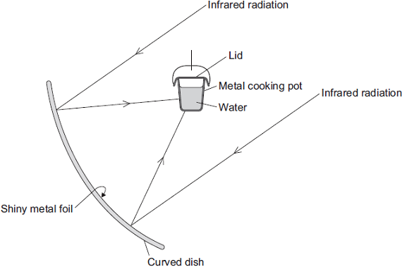
Exam questions
Q1. The diagram shows the design of a solar cooker. The cooker heats water using infrared radiation from the Sun.
(a). Why is the inside of the large curved dish covered with shiny metal foil?
…………………………………………………………………………………………………………………………………………………………………………………………………………………………………………………………………………………………………………(1)
(b) Which would be the best colour to paint the outside of the metal cooking pot?
Draw a ring around the correct answer. black silver white
Give a reason for your answer.
…………………………………………………………………………………………………………………………………………………………………………………………………………………………………………………………………………………………………………(2)
a) to reflect (the infrared)
accept (shiny surfaces) are good reflectors
Black (1)
best absorber (of infrared) answer should be comparative
black absorbs (infrared) is insufficient
accept good absorber (of infrared) 1

Slide 72
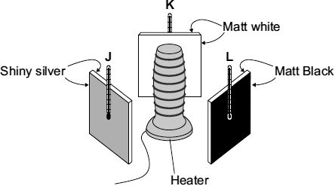
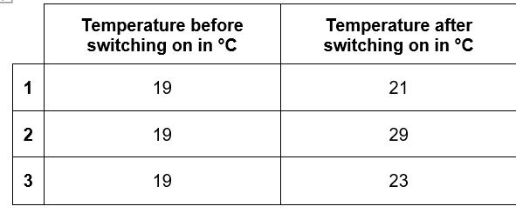
Exam questions
Q2. (b) A student set up the following equipment. The 3 metal plates are the same distance from the heater. The surfaces of each of the 3 metal plates are different colours.
The student switched the heater on for 10 minutes. The thermometers were read before the heater was switched on. The thermometers were read again just after the heaters were switched off. The readings are shown in the table.
Which set of readings, 1, 2 or 3, is most likely to have been taken from the thermometer labelled L? …………………………….. Give a reason for your answer.
…………………………………………………………………………………………………………………………………………………………………………………………………………………………………………………………………………………………………………(2)
(i) 2 (1)
black is the best absorber (of thermal energy / heat)
accept black is the best emitter (of thermal energy / heat)
note that a comparative is needed (eg better or best) (1)

Slide 73
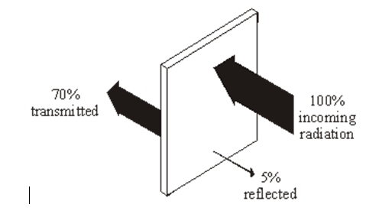
Exam questions
(ii) Which one of the following was not a control variable in this experiment? Put a tick next to your answer. (1)
the distance between the heater and the metal plates
the power of the heater
the temperature before the heater was switched on
the colour of the metal plates
Suggest one advantage of using a temperature sensor, data logger and computer, rather than a thermometer to carry out this experiment. …………………………………………………………………………………………………………………………………………………………………………………………………………………………………………………………………………………………(1)
Q3.(a) Infra red radiation can be reflected, absorbed and transmitted by glass.
(i) What percentage of infra red is absorbed by the glass? ………………………………………………(1)
(ii) the colour of the metal plates
(iii) any one from:
• more precise / accurate / reliable
do not accept better reading
do not accept thermometer is unreliable
• can measure continuously
• take many readings in a small time
• removes (human) reading error
accept easier to read
• can compare / draw graphs automatically
• records data automatically
25 (%) do not accept ¼

Slide 74
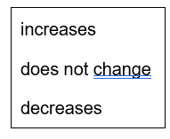
Exam questions
(ii) Complete the following sentence by drawing a ring around the correct word or phrase.
The absorbed infra red the temperature of the glass. (1)
Two of the following statements are true. One of the statements is false. Tick the boxes next to the two true statements. (2)
The following statement is false. Black surfaces are good reflectors of infra red radiation.
Change one word in this statement to make it true. Write down your new statement. …………………………………………………………………………………………………………………………………………………………………………………………………………………………………………………………………………………………………………(1)
(d) All objects emit and absorb infrared radiation. Use the correct answer from the box to complete each sentence.
The best emitters of infrared radiation have …………………………………… surfaces.
The worst emitters of infrared radiation have ………………………………… surfaces. (2)
increases
tick in top and bottom box
both required
SHINY / WHITE surfaces are good reflectors of infra-red radiation
or black surfaces are POOR / BAD reflectors of infra-red radiation
accept insertion of ‘not’ before ‘good’ in statement
or black surfaces are good EMITTERS of infra-red radiation
or black surfaces are good ABSORBERS of infra red radiation
Dark matt
Light shiny

Slide 75
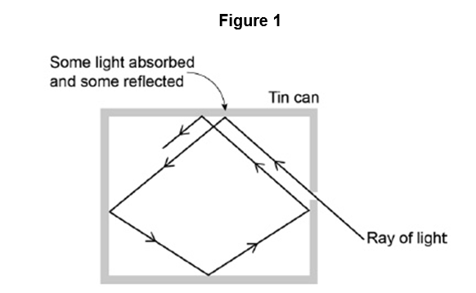
Exam questions
Q5. Figure 1 shows what happens when a ray of light enters a tin can through a small hole.
(a). Explain why the small hole looks black ……………………………………………………………………………………………………………………………………………………………………………………………………………………………………………………………………………………………………………………………………………………………………………………………………………………………………………………………….....(2)
(b) All objects absorb and emit radiation. What is meant when an object is described as a perfect black body? …………………………………………………………………………………………………………………………………………………………………………………………………………………………………………………………………………………………………………(1)
Figure 2 shows how the intensity of different wavelengths of radiation from a hot object varies with temperature.
What can be concluded from Figure 2 about how the distribution of the intensity of radiation from an object changes as the temperature of the object increases?
……………………………………………………………………………………………………………………………………………………………………………………………………………………………………………………………………………………………………………………………………………………………………………………………………………………………………………………………………………………………………………………………………………………………………………………………………………………….....(3)
light (inside the tin can) is reflected many times before incident on the hole 1
at each reflection energy / light is absorbed so (very) little light / energy leaves the hole 1
b) the object absorbs all of the radiation incident on it
or
the object does not reflect or transmit any radiation
or
the object is the best possible emitter of radiation
(c) the intensity of every wavelength increases 1
the shorter the wavelength the more rapid the increase in intensity 1
the peak intensity occurs at shorter wavelength 1

Slide 76
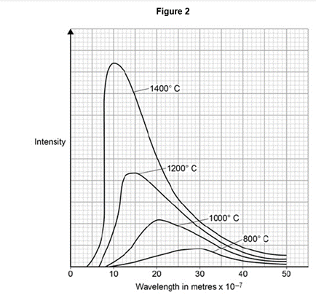
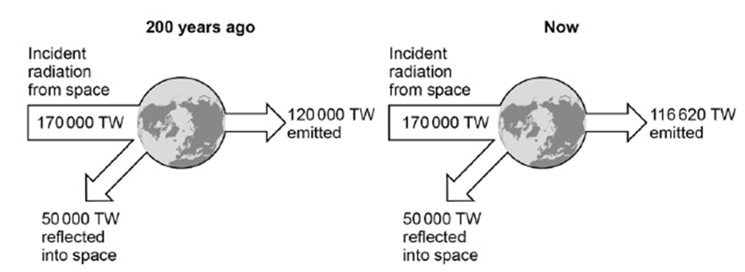
Exam questions
(d) The wavelength at which the Sun emits the maximum intensity of radiation is approximately 5 × 10–7 m. Estimate the surface temperature of the Sun. Use Figure 2.
…………………………………………………………………………………………………………………………………………………………………………………………………………………………………………………………………………………………………………(1) (e) Figure 3 shows how the balance between the incident radiation from space and the radiation emitted by the Earth into space has changed over the last 200 years.
Figure 3
……………………………………………………………………………………………………………………………………………………………………………………………………………………………………………………………………………………………………………………………………………………………………………………………………………………………………………………………………………………………………………………………………………………………………………………………………………………………………………………………………………………………………………………………………………………………………………………………………………………………………………………………………………………………………………………………………….....(3)
d) accept any value above 1600 (°C)
(e) the temperature has increased 1
as 200 years ago the energy / radiation from space = energy / radiation emitted (and reflected) into space 1
but now less radiation is emitted so there is a net absorption
allow energy for radiation 1

Slide 77
Subtopic 5: Visible Light
Learning Objective
We are learning that all colours within the visible spectrum behaves differently due to their wavelength and frequency
Why are we learning about this?
This lessons helps us understand how parts of the visible spectrum are observed as different colours

Slide 78
AQA Content

Slide 79
Subtopic 11 Visible Light
I wasn’t there but I still care!
Using the Physics AQA Text book from pages 26-29 and the glossary on pages 284-287 to help you answer the following;
Define the term infra red radiation ……………………………………………………………………………………………………………………………………………………………………………………………………………………………………………………………………………………………………………………
Define the term black body radiation ……………………………………………………………………………………………………………………………………………………………………………………………………………………………………………………………………………………………………………………
Explain how objects emit and absorb different amounts of infra red radiation depending upon their temperature and colour ………………………………………………………………………………………………………………………………………………………………………………………………………………………………………………………………………………………………………………………………………………………………………………………………………………………………………………………………………………
Describe how wavelength affects the intensity of radiation
……………………………………………………………………………………………………………………………………………………………………………………………………………………………………………………………………………………………………………………
…………………………………………………………………………………………………………………………………………………………
State the factors that affect the temperature of the Earth
……………………………………………………………………………………………………………………………………………………………………………………………………………………………………………………………………………………………………………………
Explain how the temperature of the Earth is dependant upon the greenhouse gases in the atmosphere
……………………………………………………………………………………………………………………………………………………………………………………………………………………………………………………………………………………………………………………
……………………………………………………………………………………………………………………………………………………………………………………………………………………………………………………………………………………………………………………
………………………………………………………………………………………………………………………………………………..………

Slide 80
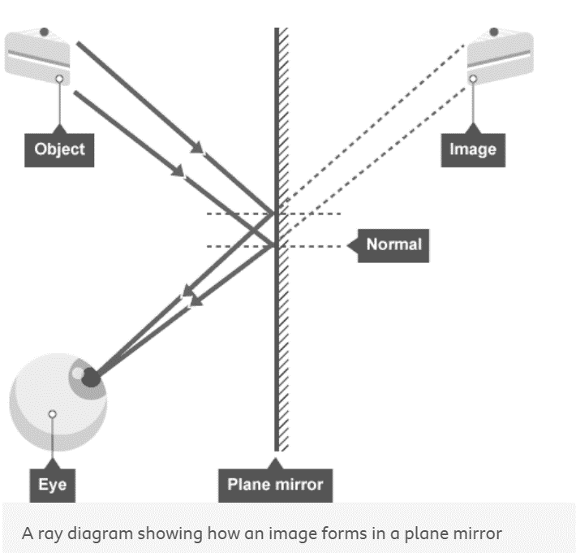
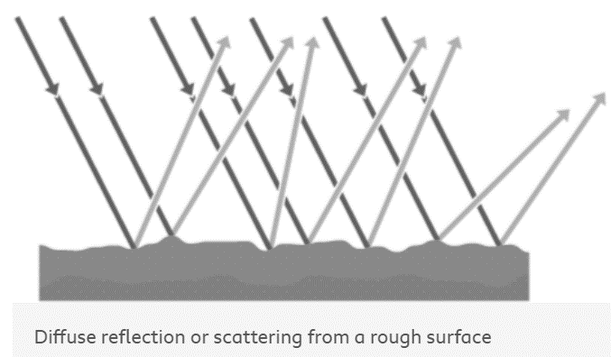
1 2 3 4 5 6 7 8 9 10 11 12 13 14 15 16 17 18 19 20 21 22 23 24 25 26 27 28 29 30 | Specular reflection . This is the type of reflection that happens with a flat mirror. The image in a mirror is: upright virtual In a virtual image , the rays appear to diverge from behind the mirror, so the image appears to come from behind the mirror. Diffuse reflection If a surface is rough, diffuse reflection happens. Instead of forming an image, the reflected light is scattered in all directions. This may cause a distorted image of the object, as occurs with rippling water, or no image at all. Each individual reflection still obeys the law of reflection, but the different parts of the rough surface are at different angles.

Slide 81
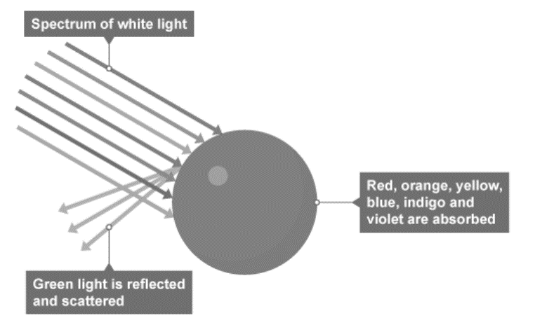
1 2 3 4 5 6 7 8 9 10 11 12 13 14 15 16 17 18 19 20 21 22 23 24 25 26 27 28 29 30 | Colour Within the visible light range of the electromagnetic spectrum there is a spectrum of colour. This is a continuous range of colours. In order of increasing frequency and decreasing wavelength these are given as: red orange yellow green blue indigo violet Each colour within the visible light spectrum has its own narrow band of wavelength and frequency. Absorption of light Waves can be absorbed at the boundary between two different materials. When waves are absorbed by a surface, the energy of the wave is transferred to the particles in the surface. This will usually increase the internal energy of the particles. When white light shines on an opaque object, some wavelengths or colours of light are absorbed. These wavelengths are not detected by our eyes. The other wavelengths are reflected, and these are detected by our eyes. For example, grass appears green in white light, red, orange, yellow, blue, indigo and violet are absorbed by the grass but green light is reflected by the grass and detected by our eyes.

Slide 82
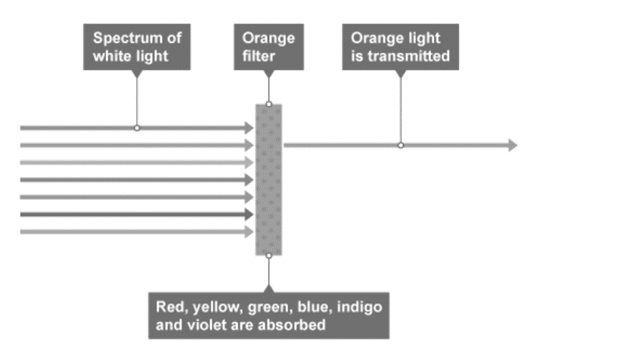
1 2 3 4 5 6 7 8 9 10 11 12 13 14 15 16 17 18 19 20 21 22 23 24 25 26 27 28 29 30 | Transmission of light Waves can also be transmitted at the boundary between two different materials. When waves are transmitted, the wave continues through the material. Air, glass and water are common materials that are very good at transmitting light. They are transparent because light is transmitted with very little absorption. Translucent materials transmit some light but are not completely clear. Lamp shades, shower curtains and window blinds are often translucent objects. Colour filters When white light passes through a coloured filter, all colours are absorbed except for the colour of the filter. For example, an orange filter transmits orange light but absorbs all the other colours. If white light is shone on an orange filter, only the orange wavelengths will be observed by the human eye. Coloured objects in coloured light An object appears to be black if it absorbs all the wavelengths of visible light. For example, an object that appears blue in white light will appear black in red light. This is because the red light contains no blue light for the object to reflect.

Slide 83
Rehearsal questions - visible light
1. Where is visible light positioned on the electromagnetic spectrum?
……………………………………………………………………………………………………………………………………………………………..
………………………………………………………………………………………………………………………………………………………….….
2. Explain what is meant by the term visible light.
………………………………………………………………………………………………………………………………………………………………
………………………………………………………………………………………………………………………………………………………….…..
3. What is meant by the spectrum of visible light?
…………………………………………………………………………………………………………………………………………………………………
………………………………………………………………………………………………………………………………………………………….…….
4. Describe how the wavelengths change across the spectrum of visible light.
.……………………………………………………………………………………………………………………………………………………………... ………………………………………………………………………………………………………………………………………………………….…….
5. Describe what is meant by a translucent object
…………………………………………………………………………………………………………………………………………………………………
…………………………………………………………………………………………………………………………………………………………………
6. Describe what is meant by a transparent object
…………………………………………………………………………………………………………………………………………………………………
…………………………………………………………………………………………………………………………………………………………………
7. Compare the wavelength of visible light to that of ultraviolet and infra red’?
………………………………………………………………………………………………………………………………………………………...........
…………………………………………………………………………………………………………………………………………………………………
8. All the colours of the rainbow make up what?
…………………………………………………………………………………………………………………………………………………………………
9. A material that allow only some light through is called what?
……………………………………………………………………………………………………………………………………………………………….
10. An object allowing all light that enters it pass through is known as ?
.......................................................................................................................................................................
11. Name the primary colours of light?
…………………………………………………………………………………………………………………………………………………………………
Between infra red & ultraviolet
The wavelength of wave in the electromagnetic spectrum that human eyes can detect
The different wavelengths of visible light -ROYGBIV
Wavelength increase from shortest violet to longest red
Object allows ALL light to pass through but scatters or refracts the light within the object
Object allows light to pass through and DOES NOT scatter or refract the light within the object
VL has shorter wavelength than IR but longer than UV
Spectrum of white light
translucent
transparent
Red, Blue , Green

Slide 84
Contrasting concepts - visible light
I DO: Compare the effect of light on transparent and opaque materials
.……………………………………………………………………............................................................................................... …………………………………………………………………………………………………………………………………………………………........
WE DO: Compare the effect of white light on a red ball to that of a green ball
.……………………………………………………………………............................................................................................... …………………………………………………………………………………………………………………………………………………………........…………………………………………………………………………………………………………………………………………………………........
YOU DO: Compare the wavelengths of visible light.
.……………………………………………………………………............................................................................................... …………………………………………………………………………………………………………………………………………………………........
.……………………………………………………………………............................................................................................... YOU DO: In terms of visible light, compare white objects to black
.……………………………………………………………………............................................................................................... …………………………………………………………………………………………………………………………………………………………........
.……………………………………………………………………............................................................................................... …………………………………………………………………………………………………………………………………………………………........
YOU DO: Compare specular and diffuse reflection & the images they produce.
.……………………………………………………………………............................................................................................... …………………………………………………………………………………………………………………………………………………………........
.……………………………………………………………………............................................................................................... …………………………………………………………………………………………………………………………………………………………........
.……………………………………………………………………............................................................................................... …………………………………………………………………………………………………………………………………………………………........
YOU DO: Compare the colour of a blue object in daylight to that seen in red light
.……………………………………………………………………............................................................................................... …………………………………………………………………………………………………………………………………………………………........
.……………………………………………………………………...............................................................................................
Transparent allows ALL light to p[ass through
OPAQUE allows NO light through.
All wavelengths of white light are absorbed by the red ball except the longest wavelength RED which is reflected. All wavelengths are absorbed by the green ball except green which is reflected
Longest wavelength is red . Wavelengths reduce to orange, yellow, green, blue, indigo & violet has the shortest wavelength
White REFLECTS ALL the colours of the visible light spectrum whilst black ABSORBS ALL the colours & REFLECTS NONE
Specular is reflection from a SMOOTH surface & all waves are reflected in a single direction –produce a shiny or clear reflection
Diffuse is reflection from a ROUGH surface & waves are scattered in different directions – produces a matt, unclear or opaque reflection
Object appears blue in daylight as only the blue component of visible light spectrum is reflected. In red light, object appears black because it would absorb all the red light & there is no blue light present in the incident ray to reflect

Slide 85
If It didn’t – visible light
Explain how you would view a red object if it didn’t
I DO: have white light shining on it?
……………………………………………………………………………………………………………………………………………………………………………………………………………………………………………………………………………………………………………………………………
WE DO: have a smooth surface?
…………………………………………………………………………………………………………………………………………………………………
…………………………………………………………………………………………………………………………………………………………………
YOU DO: have the red component of visible light shining on it?
………………………………………………………………………………………………………………………………………………………………
YOU DO: absorb any light?
…………………………………………………………………………………………………………………………………………………………………
………………………………………………………………………………………………………………………………………………………………..
YOU DO: have the component of visible light that has the longest wavelength shining on it?
…………………………………………………………………………………………………………………………………………………………………
………………………………………………………………………………………………………………………………………………………………..
YOU DO: have the blue and green components of the visible spectrum shining on it?
…………………………………………………………………………………………………………………………………………………………….. ……………………………………………………………………………………………………………………………………………………………..
YOU DO: have the red and blue components of white light shining on it?
……………………………………………………………………………………………………………………………………………………………..
……………………………………………………………………………………………………………………………………………………………..
Black – no light to be reflected
RED but Matt/ dull/ opaque – Diffuse reflection & reflected light scattered in different directions
Black – no red light to be reflected
White–as all the wavelengths of light would be reflected – none was absorbed
Black – red is longest wavelength of VL - no red light to be reflected
Red - as this part is still reflected by the red object
BLACK - as there is no red light to be reflected & the green is absorbed by the red object

Slide 86
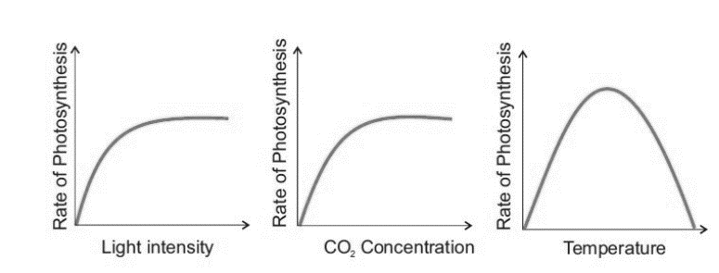
Spaced Retrieval – visible light
Visible Light is also needed by plants for process of photosynthesis .
1. Recall the photosynthesis word equation
………………………………………………………………………………………………………………………………………………….…..……......…………………………………………………………………………………………………………………………………………….……..………….
2. Recall the photosynthesis balanced symbol equation ………………………………………………………………………………………………………………………………………………….…..……......…………………………………………………………………………………………………………………………………………….……..………….
3. Why is light needed for photosynthesis to occur?
………………………………………………………………………………………………………………………………………………….…..……….. …………………………………………………………………………………………………………………………………………….……..………….
4. Name the component that absorbs the light energy for photosynthesis? ………………………………………………………………………………………………………………………………………………….…..……..... 5. Describe where these components are situated ………………………………………………………………………………………………………………………………………………….…..……….. …………………………………………………………………………………………………………………………………………….……..………….
6. Explain how leaves are adapted to photosynthesise efficiently ………………………………………………………………………………………………………………………………………………….…..…….....
………………………………………………………………………………………………………………………………………………….…..……….. ………………………………………………………………………………………………………………………………………………….…..…….....
………………………………………………………………………………………………………………………………………………….…..……….. 7.Name the factors that limit the rate of photosynthesis in plants
………………………………………………………………………………………………………………………………………………….…..……….. ………………………………………………………………………………………………………………………………………………….…..…….....
8. Sketch 3 graphs to show how each limiting factor affects the rate of photosynthesis
Carbon dioxide + water → glucose + water + oxygen
light provides energy for the synthesis of glucose from carbon dioxide and water
Chlorophyll in the chloroplasts
In the green parts of plants – mainly leaves
Big surface area to expose to light
lots of chloroplasts containing chlorophyll to absorb light.
Stomata and guard cells, which regulate the gas exchange of carbon dioxide and oxygen
Thin structure, which allows light to penetrate the leaf
Veins, which transport water, minerals, and sugars throughout the leaf
Light intensity, temperature, carbon dioxide levels

Slide 87
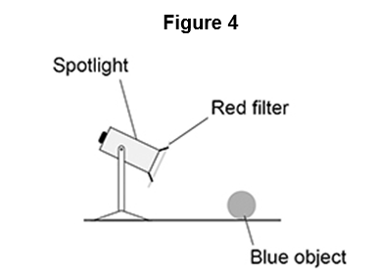
Exam questions
Q1. (a) An object was blue in colour. A student looked at the blue object through a green filter. Complete the sentences.
Choose answers from the box.
Looking at the blue object through a green filter makes the object appear …………………………. This is because the green filter only transmits the light that is …………………………. (2)
(b) Figure 4 shows a spotlight containing a convex lens. A red filter is placed in front of the spotlight. The spotlight is directed at a blue object.
Explain why the blue object appears black. (3) ………………………………………………………………………………………………………………………………………………….…..………………………………………………………………………………………………………………………………………………….…. ………………………………………………………………………………………………………………………………………………….…..………………………………………………………………………………………………………………………………………………….…..
(
Black (1)
green (1)
only red is transmitted by the filter 1
red is absorbed by the (blue) object 1
(so) no light is reflected by the (blue) object 1

Slide 88
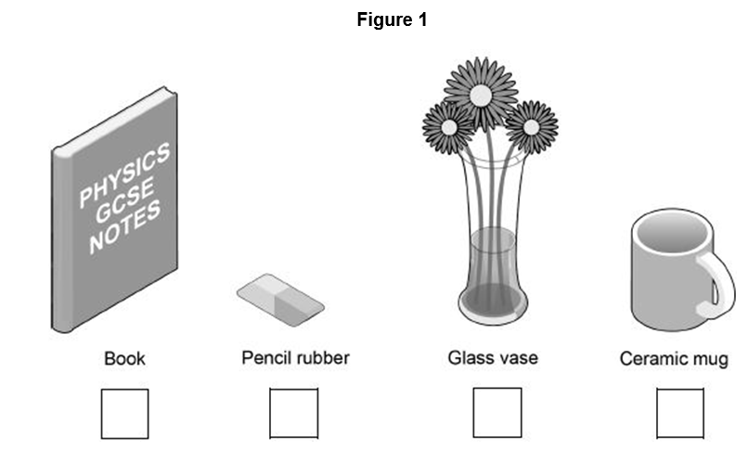
Exam questions
Q2. Some objects are transparent and some objects are opaque.
(a) Which one of the objects in Figure 1 is transparent?
Tick one box. (1)
(b) Complete the sentence. Choose an answer from the box.
An opaque object does not ………………………………….. light. (1)
A student wears a white T-shirt and a red baseball cap to a party.
(c) Why does the T-shirt look white in white light? (1)
………………………………………………………………………………………………………………………………………………….…..………………………………………………………………………………………………………………………………………………….…..
(d) Explain how the colour of the baseball cap appears to change when the room lights at the party change from white to blue. (2)
………………………………………………………………………………………………………………………………………………….…..………………………………………………………………………………………………………………………………………………….….
glass vase (1)
transmit (1)
the T-shirt reflects all wavelengths / colours of light (equally)
allow T-shirt reflects (white / all) light
changes from red to black
it appears black
it is darker is insufficient 1
as the cap absorbs (all) the (blue) light
or
as the cap does not reflect the (blue) light 1

Slide 89
Exam questions
Q3. (a) The appearance of visible light can change when it interacts with different objects.
Complete the sentences choosing the answers from the box. Each answer may be used once, more than once or not at all.
When white light is incident on a green filter, only green light passes through the filter. This is because green light is ………………………… by the filter. All other colours of light are ………………………… by the filter. When red light shines on a blue object the red light is ………………………… . (3)
(b) Explain why violet light is refracted more than red light when it passes through a prism (2)
……………………………………………………………………………………………………………………………………………..…….…..…………………………………………………………………………………………………………………………………………….….…..………………………………………………………………………………………………………………………………………………….
Transmitted 1
Absorbed 1
Absorbed 1
b) Violet has a shorter wavelength than red and so it slows down more when entering the prism and therefore refracts more

Slide 90
Extra Space
……………………………………………………………………………………………………………………………………………………………………………………………………………………………………………………………………………………………………………………………………………………………………………………………………………………………………………………………………………………………………………………………………………………………………………………………………………………………………………………………………………………………………………………………………………………………………………………………………………………………………………………………………………………………………………………………………………………………………………………………………………………………………………………………………………………………………………………………………………………………………………………………………………………………………………………………………………………………………………………………………………………………………………………………………………………………………………………………………………………………………………………………………………………………………………………………………………………………………………………………………………………………………………………………………………………………………………………………………………………………………………………………………………………………………………………………..
…………………………………………………………………………………………………………………………………………………………………………………………………………………………………………………………………………………………………………………………………………………………………………………………………………………………………………………………………………………………………………………………………………………………………………………………………………………………………………………………………………………………………………………………………………………………………………………………………………………………………………………………………………………………………………………………………………………………………………………………………………………………………………………………………………………………………………………………………………………………………………………………………………………………………………………………………………………………………………………………………………………………………………………………………………………………………………………………………………………………………………………………………………………………………………………………………………………………………………………………………………………………………………………………………………………………………..
…………………………………………………………………………………………………………………………………………………………………………………………………………………………………………………………………………………………………………………………………………………………………………………………………………………………………………………………………………………………………………………………………………………………………………………………………………………………………………………………………………………………………………………………………………………………………………………………………

Slide 91
DO NOW
Date: ……………………………………….
 | ANSWER
Q1.
Q2.
Q3.
Q4.
Q5.
Date: ……………………………………….
 | ANSWER
Q1.
Q2.
Q3.
Q4.
Q5.

Slide 92
DO NOW
Date: ……………………………………….
 | ANSWER
Q1.
Q2.
Q3.
Q4.
Q5.
Date: ……………………………………….
 | ANSWER
Q1.
Q2.
Q3.
Q4.
Q5.

Slide 93
DO NOW
Date: ……………………………………….
 | ANSWER
Q1.
Q2.
Q3.
Q4.
Q5.
Date: ……………………………………….
 | ANSWER
Q1.
Q2.
Q3.
Q4.
Q5.

Slide 94
DO NOW
Date: ……………………………………….
 | ANSWER
Q1.
Q2.
Q3.
Q4.
Q5.
Date: ……………………………………….
 | ANSWER
Q1.
Q2.
Q3.
Q4.
Q5.

Slide 95
DO NOW
Date: ……………………………………….
 | ANSWER
Q1.
Q2.
Q3.
Q4.
Q5.
Date: ……………………………………….
 | ANSWER
Q1.
Q2.
Q3.
Q4.
Q5.

Slide 96
DO NOW
Date: ……………………………………….
 | ANSWER
Q1.
Q2.
Q3.
Q4.
Q5.
Date: ……………………………………….
 | ANSWER
Q1.
Q2.
Q3.
Q4.
Q5.

Slide 97
DO NOW
Date: ……………………………………….
 | ANSWER
Q1.
Q2.
Q3.
Q4.
Q5.
Date: ……………………………………….
 | ANSWER
Q1.
Q2.
Q3.
Q4.
Q5.

Slide 98
DO NOW
Date: ……………………………………….
 | ANSWER
Q1.
Q2.
Q3.
Q4.
Q5.
Date: ……………………………………….
 | ANSWER
Q1.
Q2.
Q3.
Q4.
Q5.

Slide 99
Knowledge Retrieval Quiz 1
Date: ……………………………………….
Score: …………...
 |  | Answer
Q1. | Insert question in bold
Q2.
Q3.
Q4.
Q5.
Q6.
Q7.
Q8.
Q9.
Q10.

Slide 100
Knowledge Retrieval Quiz 2
Date: ……………………………………….
Score: …………...
 |  | Answer
Q1. | Insert question in bold
Q2.
Q3.
Q4.
Q5.
Q6.
Q7.
Q8.
Q9.
Q10.

Slide 101
Knowledge Retrieval Quiz 3
Date: ……………………………………….
Score: …………...
 |  | Answer
Q1. | Insert question in bold
Q2.
Q3.
Q4.
Q5.
Q6.
Q7.
Q8.
Q9.
Q10.

Slide 102
Extra Space
……………………………………………………………………………………………………………………………………………………………………………………………………………………………………………………………………………………………………………………………………………………………………………………………………………………………………………………………………………………………………………………………………………………………………………………………………………………………………………………………………………………………………………………………………………………………………………………………………………………………………………………………………………………………………………………………………………………………………………………………………………………………………………………………………………………………………………………………………………………………………………………………………………………………………………………………………………………………………………………………………………………………………………………………………………………………………………………………………………………………………………………………………………………………………………………………………………………………………………………………………………………………………………………………………………………………………………………………………………………………………………………………………………………………………………………………..
…………………………………………………………………………………………………………………………………………………………………………………………………………………………………………………………………………………………………………………………………………………………………………………………………………………………………………………………………………………………………………………………………………………………………………………………………………………………………………………………………………………………………………………………………………………………………………………………………………………………………………………………………………………………………………………………………………………………………………………………………………………………………………………………………………………………………………………………………………………………………………………………………………………………………………………………………………………………………………………………………………………………………………………………………………………………………………………………………………………………………………………………………………………………………………………………………………………………………………………………………………………………………………………………………………………………………..
…………………………………………………………………………………………………………………………………………………………………………………………………………………………………………………………………………………………………………………………………………………………………………………………………………………………………………………………………………………………………………………………………………………………………………………………………………………………………………………………………………………………………………………………………………………………………………………………………

Slide 103
Extra Space
……………………………………………………………………………………………………………………………………………………………………………………………………………………………………………………………………………………………………………………………………………………………………………………………………………………………………………………………………………………………………………………………………………………………………………………………………………………………………………………………………………………………………………………………………………………………………………………………………………………………………………………………………………………………………………………………………………………………………………………………………………………………………………………………………………………………………………………………………………………………………………………………………………………………………………………………………………………………………………………………………………………………………………………………………………………………………………………………………………………………………………………………………………………………………………………………………………………………………………………………………………………………………………………………………………………………………………………………………………………………………………………………………………………………………………………………..
…………………………………………………………………………………………………………………………………………………………………………………………………………………………………………………………………………………………………………………………………………………………………………………………………………………………………………………………………………………………………………………………………………………………………………………………………………………………………………………………………………………………………………………………………………………………………………………………………………………………………………………………………………………………………………………………………………………………………………………………………………………………………………………………………………………………………………………………………………………………………………………………………………………………………………………………………………………………………………………………………………………………………………………………………………………………………………………………………………………………………………………………………………………………………………………………………………………………………………………………………………………………………………………………………………………………………..
…………………………………………………………………………………………………………………………………………………………………………………………………………………………………………………………………………………………………………………………………………………………………………………………………………………………………………………………………………………………………………………………………………………………………………………………………………………………………………………………………………………………………………………………………………………………………………………………………

Slide 104
Extra Space
……………………………………………………………………………………………………………………………………………………………………………………………………………………………………………………………………………………………………………………………………………………………………………………………………………………………………………………………………………………………………………………………………………………………………………………………………………………………………………………………………………………………………………………………………………………………………………………………………………………………………………………………………………………………………………………………………………………………………………………………………………………………………………………………………………………………………………………………………………………………………………………………………………………………………………………………………………………………………………………………………………………………………………………………………………………………………………………………………………………………………………………………………………………………………………………………………………………………………………………………………………………………………………………………………………………………………………………………………………………………………………………………………………………………………………………………..
…………………………………………………………………………………………………………………………………………………………………………………………………………………………………………………………………………………………………………………………………………………………………………………………………………………………………………………………………………………………………………………………………………………………………………………………………………………………………………………………………………………………………………………………………………………………………………………………………………………………………………………………………………………………………………………………………………………………………………………………………………………………………………………………………………………………………………………………………………………………………………………………………………………………………………………………………………………………………………………………………………………………………………………………………………………………………………………………………………………………………………………………………………………………………………………………………………………………………………………………………………………………………………………………………………………………………..
…………………………………………………………………………………………………………………………………………………………………………………………………………………………………………………………………………………………………………………………………………………………………………………………………………………………………………………………………………………………………………………………………………………………………………………………………………………………………………………………………………………………………………………………………………………………………………………………………

Slide 105
Extra Space
……………………………………………………………………………………………………………………………………………………………………………………………………………………………………………………………………………………………………………………………………………………………………………………………………………………………………………………………………………………………………………………………………………………………………………………………………………………………………………………………………………………………………………………………………………………………………………………………………………………………………………………………………………………………………………………………………………………………………………………………………………………………………………………………………………………………………………………………………………………………………………………………………………………………………………………………………………………………………………………………………………………………………………………………………………………………………………………………………………………………………………………………………………………………………………………………………………………………………………………………………………………………………………………………………………………………………………………………………………………………………………………………………………………………………………………………..
…………………………………………………………………………………………………………………………………………………………………………………………………………………………………………………………………………………………………………………………………………………………………………………………………………………………………………………………………………………………………………………………………………………………………………………………………………………………………………………………………………………………………………………………………………………………………………………………………………………………………………………………………………………………………………………………………………………………………………………………………………………………………………………………………………………………………………………………………………………………………………………………………………………………………………………………………………………………………………………………………………………………………………………………………………………………………………………………………………………………………………………………………………………………………………………………………………………………………………………………………………………………………………………………………………………………………..
…………………………………………………………………………………………………………………………………………………………………………………………………………………………………………………………………………………………………………………………………………………………………………………………………………………………………………………………………………………………………………………………………………………………………………………………………………………………………………………………………………………………………………………………………………………………………………………………………

Slide 106
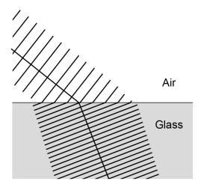
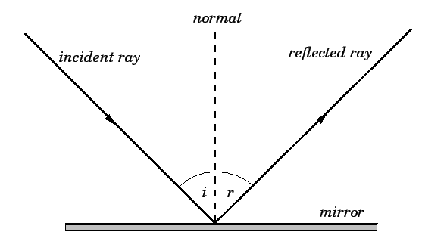
KNOWLEDGE ORGANISER
Subject: Science | Topic: Waves | Term: Autumn
KEY WORDS | Key words
1 | Amplitude | The distance from a peak to the zero position of a wave.
2 | Frequency | The number of complete waves that pass a point in a given time.
3 | Time period | Time taken for one complete wave to pass.
4 | Ray diagram | A ray diagram is a representation of the possible paths light can take to get from one place to another.
5 | Normal line | A line drawn perpendicular to a surface.
6 | Incident ray. | A ray of light that falls on any surface.
7 | Reflected ray. | A ray of light that is reflected from a surface.
KEY EXAMPLES
8 | Reflection from mirrors.
9 | Refraction of light and sound by water.
10 | Uses of waves to investigate the structure of the Earth.
11 | Th wide range of uses for electromagnetic waves.
KEY DIAGRAMS
Wave front diagram showing refraction The Law of Reflection

