Slide 1
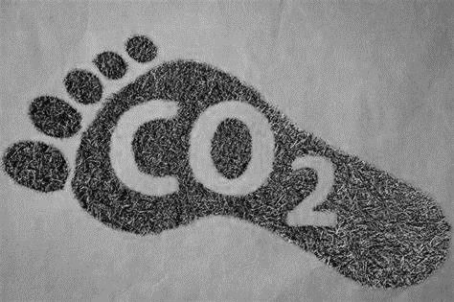
KS4 – Chemistry of the atmosphere
Name
Class
Tutor Group
KS4 Science YEAR 11 CHEMISTRY OF THE ATMOSPHERE
KEYSTONE WORDS
Atmosphere | The layer of gases surrounding the Earth’s surface.
Photosynthesis | A chemical reaction that plants use to produce glucose.
Greenhouse gas | Gases that contribute to global warming.
Carbon footprint | The total amount of carbon dioxide and other greenhouse gases emitted over the full life cycle of a product, service or event.

Slide 2
BIG PICTURE
How will my prior knowledge develop my understanding of this topic?
Y7 | The particle model is essential to understanding the chemistry of the atmosphere.
Y8 | Understanding wave properties and light is a prerequisite to understanding global warming.
Sub-topic | Content
Subtopic 1 | The composition and evolution of the Earth’s atmosphere
Subtopic 2 | Greenhouse Gases & Climate Change
Subtopic 3 | The carbon footprint and its reduction
Subtopic 4 | Atmospheric pollution.
Key knowledge
By the end of this topic you should know… | The composition of the atmosphere, how it has changed over time and how humans contribute to those changes.
By the end of this topic should be able to… | Explain how the atmosphere has changed over time and how humans continue to contribute to this.
1

Slide 3
KEY VOCABULARY LIST
Atmosphere | The layer of gases surrounding the Earth’s surface.
Photosynthesis | A chemical reaction that plants use to produce glucose.
Greenhouse gas | Gases that contribute to global warming.
Carbon footprint | The total amount of carbon dioxide and other greenhouse gases emitted over the full life cycle of a product, service or event.
EXPECTATIONS
Always write in black or blue pen. Always use a ruler for straight lines. If you make a mistake, cross it out with a single line. Always draw diagrams, tables and graphs in pencil with a ruler if necessary Always mark and correct your work in green pen. Respond to any feedback your teacher gives you in green pen. Take pride in your work, make it neat! All tasks should be completed in silence and by yourself unless your teacher tells you otherwise.
PROUD
Punctuation and grammar
Ruler and pencil for diagrams
Outstanding effort every lesson
Underline date and title
Dates and titles every lesson
PROUD FRIDAY
Any piece of work you complete, which meets our PROUD expectations can be taken to the PROUD station during Friday lunchtime. Show your work to a member of SLT and receive a sweet treat!
2

Slide 4
Subtopic 1: The composition and evolution of the Earth’s atmosphere
Learning Objective
We are learning how the Earth’s early atmosphere evolved to produce the proportions of different gases in our atmosphere today
Why are we learning about this?
This sub-topic helps us understand why our atmosphere has changed over the last 5 billon years
3

Slide 5
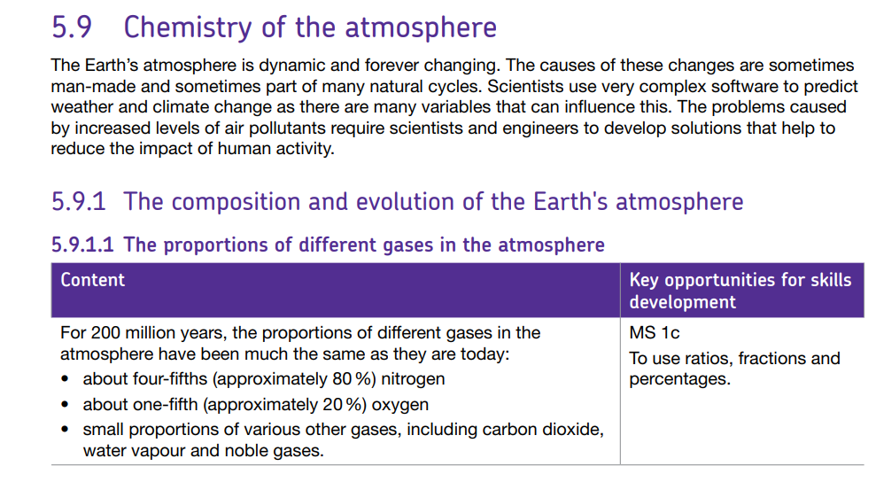
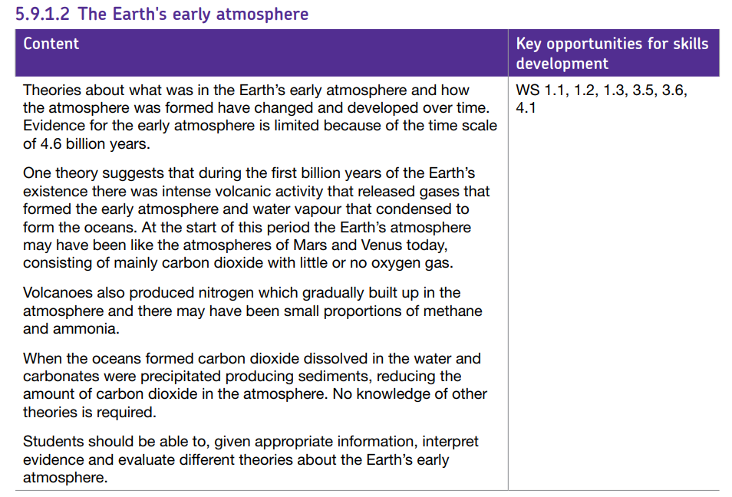
AQA Content
5.9.1 The composition and evolution of the Earth's atmosphere
5.9.1.1 The proportions of different gases in the atmosphere
5.9.1.2 The Earth's early atmosphere
5.9.1.3 How oxygen increased
5.9.1.4 How carbon dioxide decreased

Slide 6
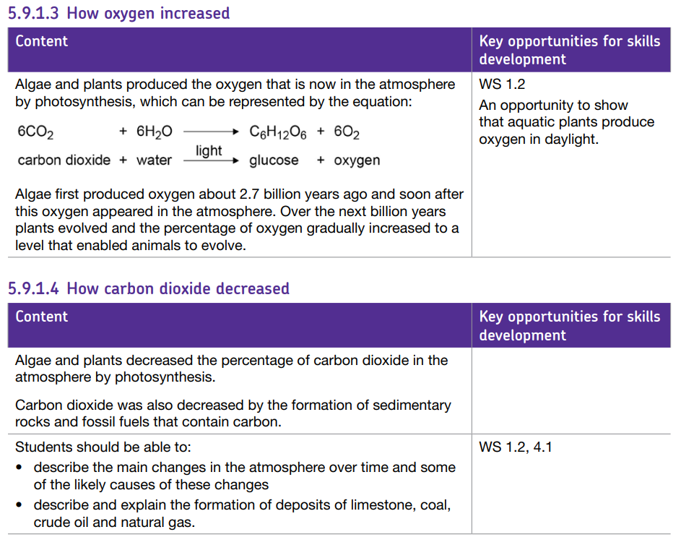
AQA Content
5.9.1 The composition and evolution of the Earth's atmosphere
5.9.1.1 The proportions of different gases in the atmosphere
5.9.1.2 The Earth's early atmosphere
5.9.1.3 How oxygen increased
5.9.1.4 How carbon dioxide decreased

Slide 7
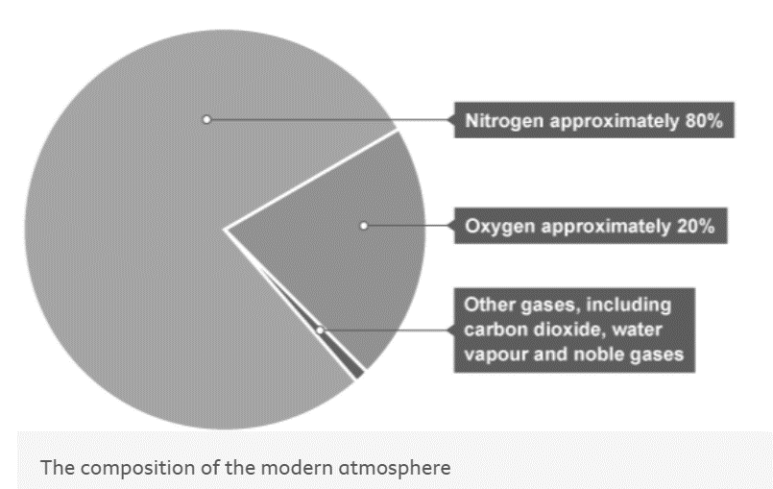
1 2 3 4 5 6 7 8 9 10 11 12 13 14 15 16 17 18 19 20 21 22 23 24 25 26 27 28 29 30 | The Earth’s early atmosphere The Earth formed approximately 4.6 billion years ago. Scientists cannot be certain about what gases made up the Earth’s early atmosphere. Ideas about how the atmosphere was produced and has changed have developed over time as new evidence has been discovered. There is still not enough evidence for scientists to be certain. Where did the atmosphere come from? One theory suggests that the early atmosphere came from intense volcanic activity, which released gases that made the early atmosphere very similar to the atmospheres of Mars and Venus today. These atmospheres have: a large amount of carbon dioxide little or no oxygen small amounts of other gases, such as ammonia and methane Volcanic activity also released water vapour, which condensed as the Earth cooled to form the oceans. Nitrogen was probably also released by volcanoes which gradually built up in the atmosphere because it is unreactive. The modern atmosphere For approximately 200 million years, the proportions of different gases in the atmosphere have been relatively stable. The pie chart below shows the percentages of gases that make up the atmosphere.

Slide 8
1 2 3 4 5 6 7 8 9 10 11 12 13 14 15 16 17 18 19 20 21 22 23 24 25 26 27 28 29 30 | How oxygen increased Plants make their own food by photosynthesis. In this process, carbon dioxide is reacted with water to produce glucose, with oxygen as a by-product: carbon dioxide + water → glucose + oxygen 6CO₂(g) + 6H₂O(l) → C₆H₁₂O₆(aq) + 6O₂(g) Scientists think that algae first evolved approximately 2.7 billion years ago, and soon after this oxygen began to exist in the atmosphere. Photosynthesis by primitive plants and algae released oxygen, which gradually built up in the atmosphere. Eventually, the amount of oxygen present in the atmosphere enabled animals to evolve. How methane decreased Methane reacted with the oxygen that was being produced by photosynthesis CH₄ + 2O₂ → CO₂ + 2H₂O How ammonia decreased Ammonia reacted with the oxygen that was being produced by photosynthesis 4NH₃ + 3O₂ → 2N₂ + 6H₂O How nitrogen increased Nitrogen gas (N₂) is very unreactive, so was able to build up in the atmosphere. How carbon dioxide decreased Formation of sedimentary rocks Carbon dioxide is a very soluble gas. It dissolves readily in water. As the oceans formed, carbon dioxide dissolved to form soluble carbonate compounds so its amount in the atmosphere decreased. Carbonate compounds were then precipitated as sedimentary rocks - eg limestone.

Slide 9
1 2 3 4 5 6 7 8 9 10 11 12 13 14 15 16 17 18 19 20 21 22 23 24 25 26 27 28 29 30 | Uptake by living organisms Carbon dioxide was also absorbed from the oceans into photosynthetic algae and plants. Many of these organisms, and the simple organisms in the food chains that they supported were turned into fossil fuels, eg crude oil, coal and natural gas, which all contain carbon. Coal is a fossil fuel which was formed from trees which were in dense forests in low-lying wetland areas. Flooding caused the wood from these forests to be buried in a way that prevented oxidation taking place. Compression and heating over millions of years turned the wood into coal. Crude oil and natural gas were formed from simple plants and tiny animals which were living in oceans and lakes. These small organisms died and their remains sank to the bottom where they were buried under sediments. The lack of oxygen prevented oxidation from occurring. Over millions of years, heat and pressure turned the remains of the organisms into crude oil and natural gas. Natural gas contains the smallest molecules and is often found on top of crude oil, trapped under sedimentary rock.

Slide 10
It condensed to form the oceans
Rehearsal questions - History of our atmosphere
1. Name the most abundant gas in the Earth’s atmosphere
………………………………………………………………………………………………………………………………………………………………
………………………………………………………………………………………………………………………………………………………….…
2. Which gas was thought to be a major part of the early atmosphere?
…………………………………………………………………………………………………………………………………………………………………
3. Which planets are thought to have an atmosphere most similar to what scientists thought the Earth's early atmosphere was like? .………………………………………………………………………………………………………………………………………………………………
4. In the modern day atmosphere, what is the approximate percentage of nitrogen?
…………………………………………………………………………………………………………………………………………………………………
5. The early atmosphere contained a lot more water vapour than the modern atmosphere does. Where did it go? …………………………………………………………………………………………………………………………………………………………………
…………………………………………………………………………………………………………………………………………………………………
6. What biochemical process absorbs carbon dioxide from the atmosphere and replaces it with oxygen? ………………………………………………………………………………………………………………………………………………………...........
7. Write the word equation for photosynthesis?
…………………………………………………………………………………………………………………………………………………………………
8. Which physical process removed carbon dioxide from the atmosphere?
………………………………………………………………………………………………………………………………………...........................
……………………………………………………………………………………………………………………………………………………………….
9. Why did nitrogen build up in the atmosphere?
............................................................................................................................................................................................................................................................................................................................................
10. State the gases and percentages in today’s atmosphere
…………………………………………………………………………………………………………………………………………………………………………………………………………………………………………………………………………………………………………………………………..
11. State the gases in Earth’s earths atmosphere
…………………………………………………………………………………………………………………………………………………………………………………………………………………………………………………………………………………………………………………………………..
nitrogen
Carbon dioxide
Mars , Venus
80%
It condensed to form the oceans
photosynthesis
carbon dioxide + water → glucose + oxygen
Formation of sedimentary rocks
It is unreactive
80% nitrogen , 20% oxygen + trace elements carbon dioxide, water vapour, etc
Carbon dioxide, water vapour, nitrogen, methane, ammonia

Slide 11
It condensed to form the oceans
Rehearsal questions - History of our atmosphere
13. Venus and Mars are in what way similar to Earth?
………………………………………………………………………………………………………………………………………………………………
………………………………………………………………………………………………………………………………………………………….…
14. How were Earth’s oceans formed?
…………………………………………………………………………………………………………………………………………………………………
15. What produced methane & ammonia in Earth’s early atmosphere? .………………………………………………………………………………………………………………………………………………………………
16. Photosynthesis reduced what gas & increased what gas?
…………………………………………………………………………………………………………………………………………………………………
17. The formation of limestone & fossil fuels reduced what gas from the atmosphere? …………………………………………………………………………………………………………………………………………………………………
18. Which gas remains in our atmosphere in a similar level to that 4.5 billion years ago? ………………………………………………………………………………………………………………………………………………………...........
19. Which gas now present in our atmosphere was not present in the Earth’s early atmosphere?
…………………………………………………………………………………………………………………………………………………………………
20. Write the balanced symbol equation for photosynthesis?
………………………………………………………………………………………………………………………………………...........................
……………………………………………………………………………………………………………………………………………………………….
There atmosphere is thought to be similar to that of early Earth
Water vapour condensing
Volcanic activity
Reduced carbon dioxide, increased oxygen
Carbon dioxide
nitrogen
oxygen
6CO₂(g) + 6H₂O(l) → C₆H₁₂O₆(aq) + 6O₂(g)

Slide 12
Contrasting concepts – Evolution of the atmosphere
I DO 1. What are the differences between Earth’s early atmosphere & that of today?
………………………………………………………………………………………………………………………………………………………………………………………………………………………………………………………………………………………………………………………………………………………………………………………………………………………………………………………
WE DO 2. What are the similarities between Earth’s early atmosphere & that of today?
………………………………………………………………………………………………………………………………………………………………………………………………………………………………………………………………………………………………………………………………………………………………………………………………………………………………………………………
YOU DO 3. Suggest how photosynthesis affected the early atmosphere & compare that to todays atmosphere.
………………………………………………………………………………………………………………………………………………………………………………………………………………………………………………………………………………………………………………………………………………………………………………………………………………………………………………………
4. Compare the formation of coal to that of oil & natural gas
……………………………………………………………………………………………………………………………………………………………………………………………………………………………………………………………………………………………………………………………………………………………………………………………………………………………………………………………………………………………………………………………………………………………………………………………………………………………………………………………………………………………………………………………………………………………
5. Compare the formation of oxygen in the atmosphere to the reduction in carbon dioxide?
………………………………………………………………………………………………………………………………………………………………………………………………………………………………………………………………………………………………………………………………………………………………………………………………………………………………………………………
6. What are the differences between the formation and the burning of fossil fuels ?
………………………………………………………………………………………………………………………………………………………………………………………………………………………………………………………………………………………………………………………………………………………………………………………………………………………………………………………
Early – more carbon dioxide, water vapour, methane, ammonia
Today – more oxygen
Both have nitrogen, some carbon dioxide
Early – no plants, algae so no photosynthesis
Today – plants absorb carbon dioxide, produce oxygen
Coal -formed from trees which were in dense forests in low-lying wetland areas.
Crude oil and natural gas – from simple plants and tiny animals which were living in oceans and lakes. These small organisms died and their remains sank to the bottom where they were buried under sediments.
Formation of oxygen – plants & algae photosynthesised
Reduction of CO2 – absorbed by oceans, locked into sedimentary rock, absorbed by plants
Formation – FF produced by sediments which locked up carbon (dioxide)
Burning – releases carbon dioxide into the atmosphere

Slide 13
If it didn’t – Evolution of the Atmosphere.
How would the Earth’s atmosphere today be affected if …
I DO
1. There originally wasn’t volcanoes?
………………………………………………………………………………………………………………………………………………………………………………………………………………………………………………………………………………………………….. ………………………………………………………………………………………………………………………………………………
WE DO
2. There wasn’t plants?
……………………………………………………………………………………………………………………………………………………………………………………………………………………………………………………………………………………………………………………………………………………………………………………………………………………………………………………
YOU DO
3. The Earth hadn’t cooled?
………………………………………………………………………………………………………………………………………………………………………………………………………………………………………………………………………………………………………………………………………………………………………………………………………………………………………………………
4.There wasn’t oceans?
………………………………………………………………………………………………………………………………………………………………………………………………………………………………………………………………………………………………………………………………………………………………………………………………………………………………………………………
5. There wasn’t carbon dioxide in the early atmosphere ………………………………………………………………………………………………………………………………………………………………………………………………………………………………………………………………………………………………………………………………………………………………………………………………………………………………………………………
less carbon dioxide, less nitrogen, less water vapour, less methane gas
Less photosynthesis so more carbon dioxide, less oxygen
No coal – more carbon dioxide
Water vapour would not have condensed – oceans would not have formed – carbon dioxide would be high
Oceans are a natural store of carbon dioxide – atmospheric CO2 would be high
Less plants –cannot photosynthesise – less oxygen
No sedimentary fossil fuels for the carbon to be locked into

Slide 14
Spacing – carbon cycle
The lesson has examined how our atmosphere has changed. The carbon cycle also changes gases in our atmosphere and has been taught in the Biology Ecology topic.
Carbon enters the atmosphere as carbon dioxide from what 2 processes?.
……………………………………………………………………………………………………………………………………………………………………………………………………………………………………………………………………………………………………
2. What gas is absorbed by producers to make glucose in photosynthesis
…………………………………………………………………………………………………………………………………………………3. Animals feed on plants passing the carbon compounds along the food chain. Most of the carbon they consume is exhaled by what process?
…………………………………………………………………………………………………………………………………………………
4. Whan animals and plants eventually die, what is the general name of the organisms that break down dead organisms?
………………………………………………………………………………………………………………………………………………..
5. Describe the gas & the process by which these organism contribute to the carbon cycle.
……………………………………………………………………………………………………………………………………………………………………………………………………………………………………………………………………………………………………
6. In some conditions without the presence of oxygen, decomposition may not occur. Suggest what may happen to the carbon locked in the dead organism?
………………………………………………………………………………………………………………………………………………………………………………………………………………………………………………………………………………………………….
7. Describe with a chemical equation how carbon dioxide is removed from the atmosphere?
……………………………………………………………………………………………………………………………………………………………………………………………………………………………………………………………………………………………………
8 . Describe with a chemical equation how carbon dioxide is added to the atmosphere by human activity?
……………………………………………………………………………………………………………………………………………………………………………………………………………………………………………………………………………………………………
respiration and combustion
CO2
Aerobic respiration
Detritus feeders / Decomposers
Decomposers break down the dead organisms and return the carbon in their bodies to the atmosphere as carbon dioxide by respiration. .
The plant and animal material may then be available as fossil fuel in the future for combustion.
Plants – photosynthesising carbon dioxide + water → glucose + oxygen
Burning / Combustion Fossil fuels – oxygen + hydroCARBON → carbon dioxide + water (+ energy)

Slide 15
Q1.Greenhouse gases affect the temperature of the Earth.
(a) Which gas is a greenhouse gas?
Circle one word
• Argon
• Methane
• Nitrogen
• Oxygen (1)
(b) An increase in global temperature will cause climate change. What is one possible effect of climate change?
Circle one word
Deforestation
Global dimming
Sea levels rising
Volcanic activity (1)
The amount of carbon dioxide in the Earth’s atmosphere has changed since the Earth was formed. The amount of carbon dioxide continues to change because of human activities.
(c) Cement is produced when a mixture of calcium carbonate and clay is heated in a rotary kiln. The fuel mixture is a hydrocarbon and air.
Hydrocarbons react with oxygen to produce carbon dioxide.
Calcium carbonate decomposes to produce carbon dioxide.
Complete each chemical equation by writing the formula of the other product.
(2)
(ii) Hydrocarbons and calcium carbonate contain locked up carbon dioxide.
What is locked up carbon dioxide?
………………………………………………………………………………………………………………………………………… (1)
methane
Sea levels rising
H2O must be formula 1
CaO must be formula 1
carbon dioxide from the air / (Earth’s early) atmosphere formed (sedimentary) rocks or fossil fuels

Slide 16
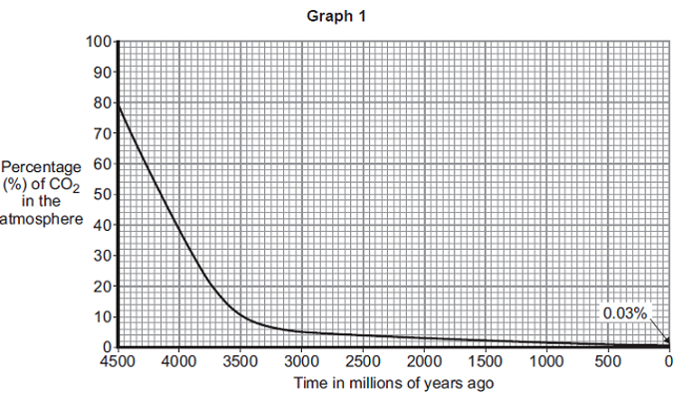
d) Graph 1 shows how the percentage of carbon dioxide in the atmosphere changed in the last 4500 million years.
Use information from Graph 1 to answer these questions.
(i) Describe how the percentage of carbon dioxide has changed in the last 4500 million years.
……………………………………………………………………………………………………………………………………………………………………………………………………………………………………………………………………………………………………………………………………………………………………………………………………………(2)
(ii) Give two reasons why the percentage of carbon dioxide has changed.
……………………………………………………………………………………………………………………………………………………………………………………………………………………………………………………………………………………………………………………………………………………………………………………………………………(2)
decreases rapidly at first 1 then slowly or levels off 1
any two from:
accept photosynthesis
• used by plants
• dissolved in oceans
• ‘locked up’ in fossil fuels or formed fossil fuels
• ‘locked up’ in rocks or formed rocks

Slide 17
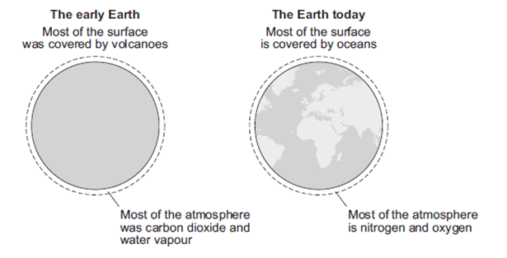
Q2. This question is about life, the Earth and its atmosphere.
(a) There are many theories about how life was formed on Earth.
Suggest one reason why there are many theories.
…………………………………………………………………………………………………………………………………………………………………………………………………………………………………………………………………………………(1)
(b) In this question you will be assessed on using good English, organising information clearly and using specialist terms where appropriate.
This Earth and its atmosphere today are not like the early Earth and its atmosphere
(a) any one from:
• not enough evidence or proof / (life and the Earth were created) billions of years ago / allow a long time ago
ignore different beliefs or no one was there.
Main changes
• oxygen increased because plants / algae developed and used carbon dioxide for photosynthesis / growth producing oxygen; carbon dioxide decreased because of this
• carbon dioxide decreased because oceans formed and dissolved / absorbed carbon dioxide; carbon dioxide became locked up in sedimentary / carbonate rocks and / or fossil fuels
• oceans formed because the Earth / water vapour cooled and water vapour in the atmosphere condensed
• continents formed because the Earth cooled forming a supercontinent / Pangaea which formed the separate continents
• volcanoes reduced because the Earth cooled forming a crust.
Other changes
• nitrogen has formed because ammonia in the Earth’s early atmosphere reacted with oxygen / denitrifying bacteria.
Describe and explain how the surface of the early Earth and its atmosphere have changed to form the surface of the Earth and its atmosphere today
………………………………………………………………………………………………………………………………………………………………………………………………………………………………………………………………………………………………………………………………………………………………………………………………………………………………………………………………………………………………………………………………………………………………………………………………………………………………………………………………………………………………………………………………………………………………………………………………………………………………………………………………………………………………………………………………………………………………(6)

Slide 18
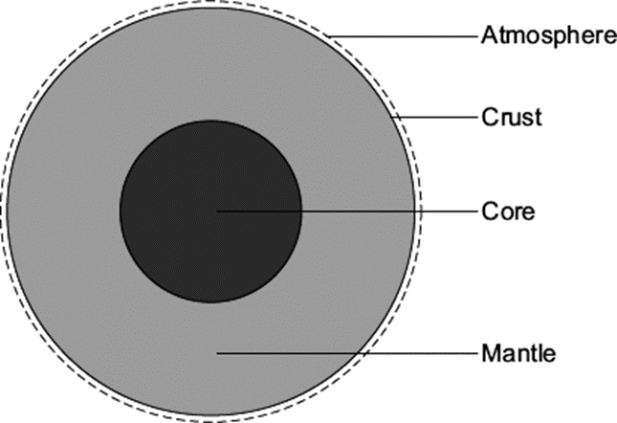
Q3. The Earth has a layered structure and is surrounded by an atmosphere.
Scientists believe that the Earth’s atmosphere was formed by volcanoes releasing gases.
This early atmosphere was about 95 % carbon dioxide.
The composition of the Earth’s atmosphere is always changing.
(i) The Earth’s atmosphere today contains about 0.035 % carbon dioxide.
What happened to most of the carbon dioxide that was in the Earth’s early atmosphere?
……………………………………………………………………………………………………………………………………………………………………………………………………………………………………………………………………………………….. ………………………………………………………………………………………………………………………..………………(2)
(ii) About 60 million years ago a large meteorite hit the Earth.
This meteorite heated limestone in the Earth’s crust causing the release of large amounts of carbon dioxide. Explain how carbon dioxide is released from limestone.
……………………………………………………………………………………………………………………………………………………………………………………………………………………………………………………………………………………….. ………………………………………………………………………………………………………………………..………………(2)
any two from:
• used by plants / allow specific plants and algae
• used for photosynthesis (ignore oxygen released / respiration)
• absorbed / dissolved in oceans
ignore oceans formed
• locked up in fossil fuels / limestone / sedimentary rocks 2
(ii) calcium carbonate / CaCO3 1
decomposed / thermal decomposition
do not allow reaction with oxygen
accept quicklime / calcium oxide produced
CaCO3→ CaO + CO2 gains 2 marks 1

Slide 19
Q4. For 200 million years the proportions of the different gases in the atmosphere have been much the same as today. Over the past 150 years the amount of carbon dioxide in the atmosphere has increased from 0.03% to 0.04%.
(a) Describe how carbon dioxide is released into the atmosphere:
by human and industrial activity;
………………………………………………………………………………………………………………………………………………………………………………………………………………………………………………………………………… ………………………………………………………………………………………………………………………………(2)
from carbonate rocks by geological activity.
………………………………………………………………………………………………………………………………………………………………………………………………………………………………………………………………………… ………………………………………………………………………………………………………………………………(2)
Explain how the seas and oceans can decrease the amount of carbon dioxide in the atmosphere.
…………………………………………………………………………………………………………………………………… ………………………………………………………………………………………………………………………………………………………………………………………………………………………………………………………………………… …………………………………………………………………………………………………………………………………… ………………………………………………………………………………………………………………………………(3)
(i) Give one reason why the amount of carbon dioxide in the atmosphere is increasing gradually.
………………………………………………………………………………………………………………………………(1)
(ii) Give one effect that increasing levels of carbon dioxide in the atmosphere may have on the environment.
………………………………………………………………………………………………………………………………(1)
a) (i) burning / breathing / respiration / fuels / food - for 1 mark each 2
rock is heated / subducted (owtte) / close to magma / melted
rock is decomposed / carbon dioxide released through volcanoes for 1 mark each
(b) carbon dioxide reacts / dissolves in sea-water / dissolves in rain water
insoluble carbonates / calcium carbonate is formed carbon dioxide turned into shells / coral / limestone / chalk / sediments also soluble hydrogencarbonates (calcium / magnesium) are formed photosynthesis by plants
any three for 1 mark each
(c) (i) sea unable to absorb all the extra carbon dioxide being produced
more trees being cut down / deforestation increased burning of fuels / more cars / more industry (not more people) any one for 1 mark
(ii) global warming / greenhouse effect or effects such as melting ice caps /
rising sea levels / climatic change / more deserts (not changes to ozone layer)

Slide 20
Subtopic 2: Greenhouse Gases & Climate Change
Learning Objective
We are learning how human activities contribute towards an increase in greenhouse gases and global climate change
Why are we learning about this?
This sub-topic helps us understand why it is important to consider how human activities affect our atmosphere and may result in global climate changes.
3

Slide 21
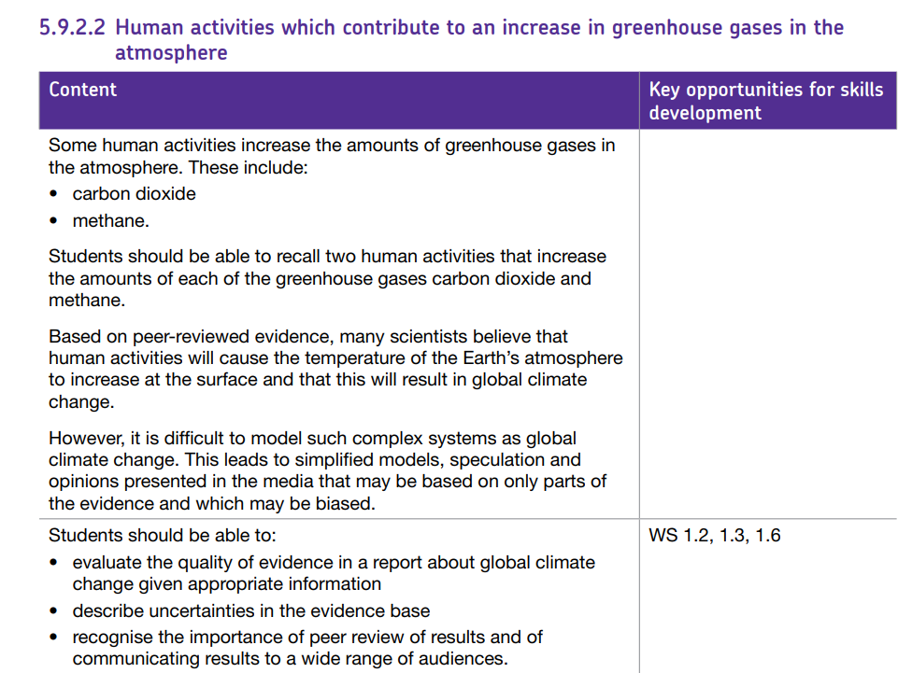
AQA Content
5.9.2 Carbon dioxide and methane as greenhouse gases
5.9.2.1 Greenhouse gases
5.9.2.2 Human activities which contribute to an increase in greenhouse gases in the
atmosphere
5.9.2.3 Global climate change

Slide 22
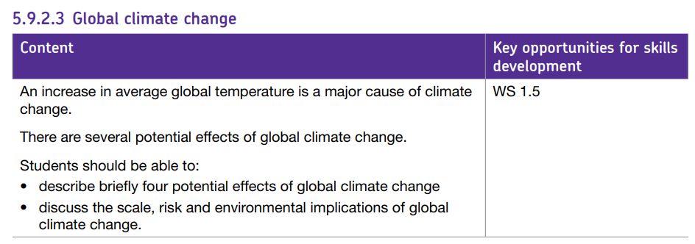
AQA Content
5.9.2 Carbon dioxide and methane as greenhouse gases
5.9.2.1 Greenhouse gases
5.9.2.2 Human activities which contribute to an increase in greenhouse gases in the
atmosphere
5.9.2.3 Global climate change

Slide 23
I wasn’t there but I still care!
Using the Chemistry AQA Text book from pages 194 -197 and the glossary on pages 271 -274 to help you answer the following;
Name 5 gases (and their chemical formula) that scientists think were found in Earths early atmosphere ……………………………………………………………………………………………………………………………………………………………………………………………………………………………………………………………………………………………………………………
State how the Earth’s early atmosphere was formed during the first billion years of existence ………………………………………………………………………………………………………………………………………………………… …………………………………………………………………………………………………………………………………………………………………………………………………………………………………………………………………………………………………………………… …………………………………………………………………………………………………………………………………………………………
What are the gases and percentage proportions in our atmosphere today? ……………………………………………………………………………………………………………………………………………………………………………………………………………………………………………………………………………………………………………………
Explain the origins of nitrogen gas and suggest why its percentage is still high in our atmosphere ……………………………………………………………………………………………………………………………………………………………………………………………………………………………………………………………………………………………………………………
Explain how the levels of carbon dioxide have fallen over the last 5 billion years
…………………………………………………………………………………………………………………………………………………………………………………………………………………………………………………………………………………………………………………… …………………………………………………………………………………………………………………………………………………………
Explain with a chemical equation why oxygen levels have increased in our atmosphere
…………………………………………………………………………………………………………………………………………………………………………………………………………………………………………………………………………………………………………………… ……………………………………………………………………………………………………………………………………………………………………………………………………………………………………………………………………………………………………………………

Slide 24
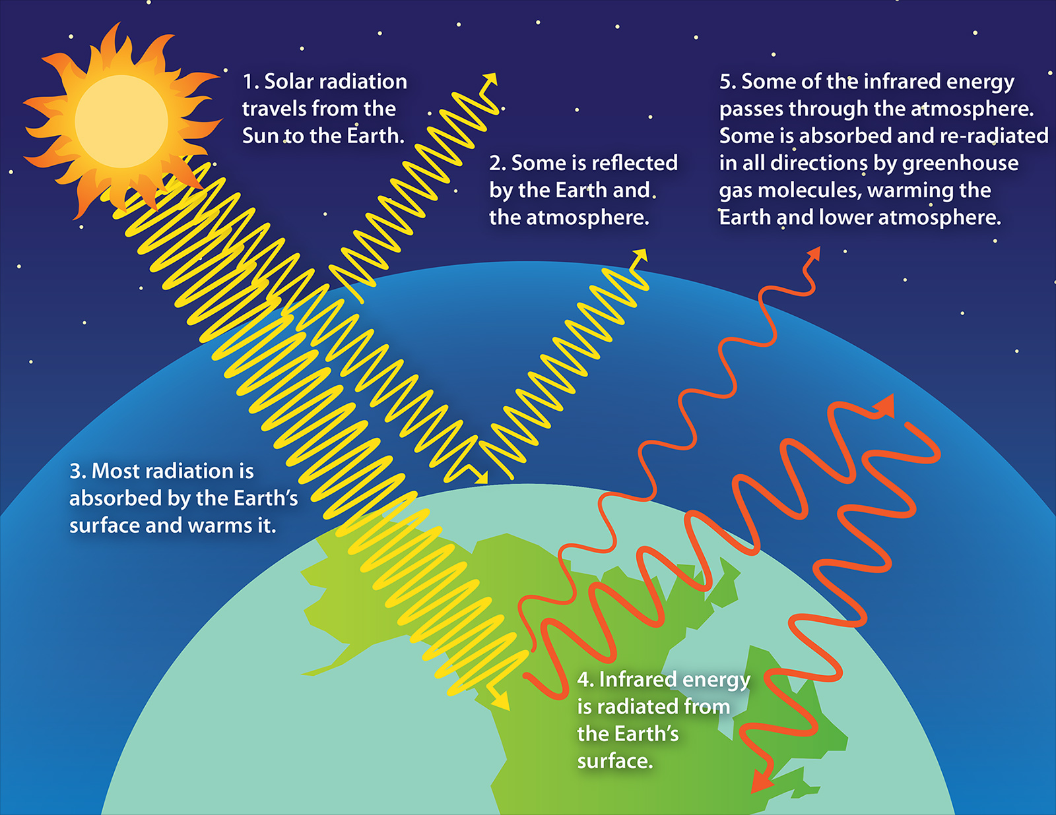
1 2 3 4 5 6 7 8 9 10 11 12 13 14 15 16 17 18 19 20 21 22 23 24 25 26 27 28 29 30 | The greenhouse effect Without greenhouse gases in its atmosphere, the Earth would be about 18°C colder on average than it is now. That would make it too cold to support life as we know it. Greenhouse gases present in the atmosphere include: water vapour carbon dioxide methane These greenhouse gases: Absorb heat radiated from the Earth then release energy in all directions, which keeps the Earth warm. The diagram gives more details about this process, called the greenhouse effect. 1. electromagnetic radiation of both short & long wavelength passes through the Earth's atmosphere 2. the Earth absorbs most of the radiation and warms up

Slide 25
1 2 3 4 5 6 7 8 9 10 11 12 13 14 15 16 17 18 19 20 21 22 23 24 25 26 27 28 29 30 | 3. the Earth radiates energy as infrared radiation 4. the short wavelength infrared radiation is not absorbed by greenhouse gases and goes into space 5. some of the long wavelength infrared radiation is absorbed by greenhouse gases in the atmosphere and the lower atmosphere warms up 6. The long wavelength radiation is re-radiated back to Earth 7. The temperature of the Earth’s surface increases Human activities and the greenhouse effect Human activities are increasing the amount of some greenhouse gases in the atmosphere. For example: farming cattle releases methane farming rice in paddy fields releases methane burning fossil fuels in vehicles and power stations releases carbon dioxide deforestation releases carbon dioxide and reduces the absorption of carbon dioxide through photosynthesis Are humans causing climate change? Not everyone in the world agrees that humans are causing global warming by causing the release of greenhouse gases into the atmosphere. Some people believe that the current and ongoing rise in global temperatures is being caused by natural factors and cycles of climate change. However, the vast majority of scientists do believe that humans are responsible for the increase in greenhouse gases and therefore global warming. This is because the majority of evidence is peer-reviewed and supports the theory that human activities are causing an increase in greenhouse gases and this is causing global warming. However, climate science is complicated and it is difficult to predict and explain what will happen to global temperatures in the future, so scientists cannot be certain about global warming. The media (eg websites, TV news, newspapers) may sometimes present opinions and articles which are simplified, inaccurate, based on only some of the evidence or biased. It is important for new evidence to be shared with as many people as possible, so that other scientists can check the results and interpretation, and repeat experiments for themselves.

Slide 26
1 2 3 4 5 6 7 8 9 10 11 12 13 14 15 16 17 18 19 20 21 22 23 24 25 26 27 28 29 30 | When evaluating the quality of evidence on an issue like global warming, you should consider: who did the research and whether they are trustworthy, skilled and experienced who funded the research, because that might cause some bias what methods were used to collect and analyse the data, because that might cause uncertainties in the evidence base which organisation is reporting or publishing the evidence Global climate change Climate versus weather Climate is different from weather because climate refers to the average temperature and cycles of weather over long periods of time - decades at least. You might talk about the weather being windy last week, or hotter last year than the year before. But unless you compare data for many years you cannot make a judgment about whether the climate is changing. Climate change The Earth’s climate has been constantly changing since the Earth was formed 4.6 billion years ago. This includes several ice ages and periods of much warmer global temperatures. Until 200 years ago, these changes were all caused by natural changes such as volcanic eruptions and changes in the energy that reaches the Earth from the Sun. Global warming Global warming is not the same as climate change. . Global warming is usually used to describe the warming of the climate in the past 200 years, which the vast majority of scientists are almost certain has been caused by human activities.

Slide 27
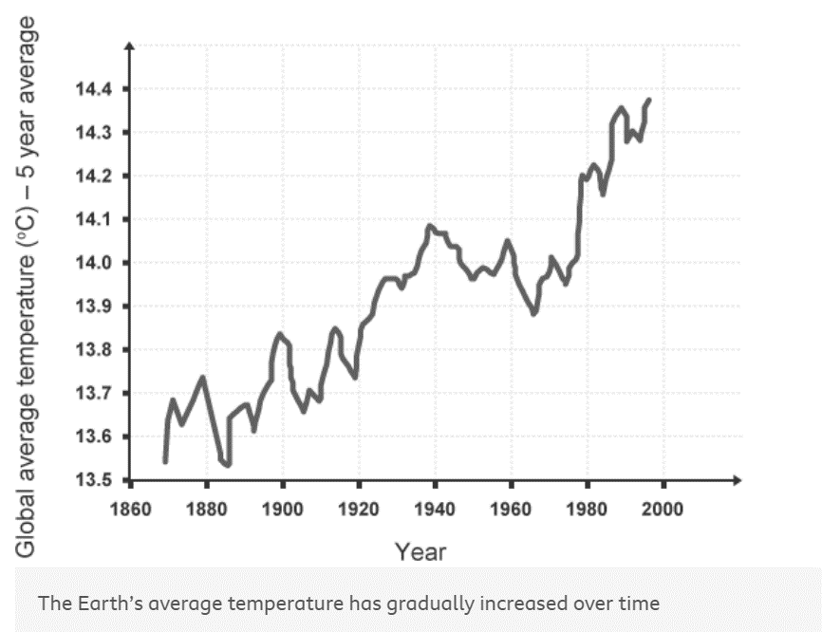
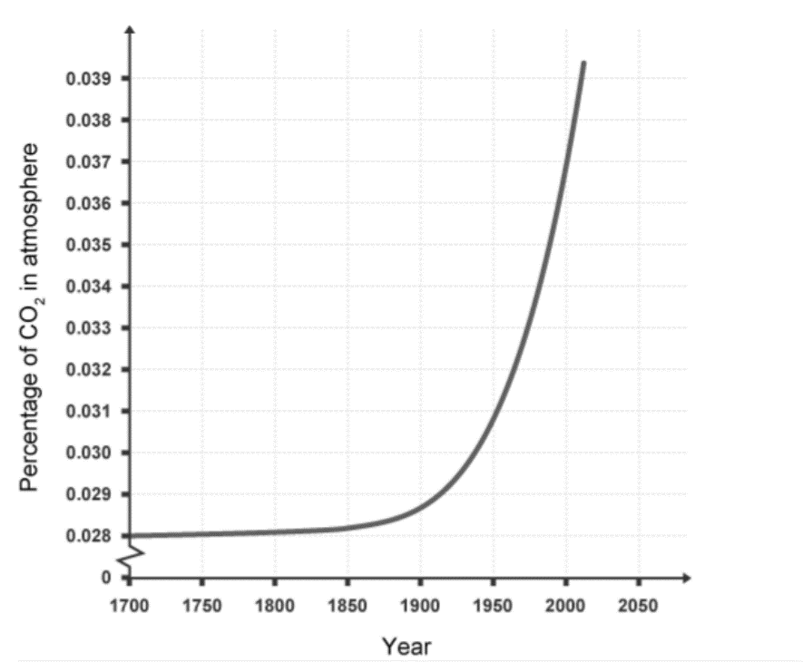
1 2 3 4 5 6 7 8 9 10 11 12 13 14 15 16 17 18 19 20 21 22 23 24 25 26 27 28 29 30 | The correlation between carbon dioxide and global warming One of the commonly used pieces of evidence that humans are causing global warming is that there is a strong correlation between the increase in global carbon dioxide levels caused by human activities and the increase in global temperatures over the same timescale. Compare the following graph to the one above.

Slide 28
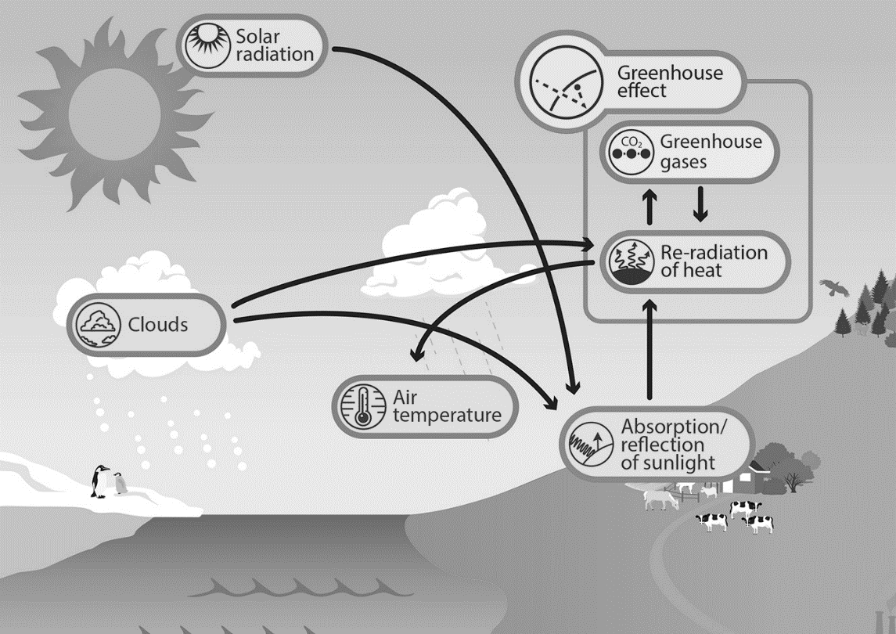
1 2 3 4 5 6 7 8 9 10 11 12 13 14 15 16 17 18 19 20 21 22 23 24 25 26 27 28 29 30 | The effects of global warming The effects of global warming include: Glaciers and polar ice melting sea levels rising patterns of rainfall changing, producing floods or droughts Habitats changing We are already experiencing some of these effects. The consequences of global warming will affect billions of people, all around the world.

Slide 29
Rehearsal questions - Greenhouse Gases & Climate change
1. Name three greenhouse gases
………………………………………………………………………………………………………………………………………………………………
………………………………………………………………………………………………………………………………………………………….…
2. Suggest two reasons why climate change leads to rising sea levels.?
…………………………………………………………………………………………………………………………………………………………………………………………………………………………………………………………………………………………………………………………….…….
3. Which gas is produced during incomplete combustion of a hydrocarbon fuel? .………………………………………………………………………………………………………………………………………………………………
4. What is the name of the atmospheric process which keeps the Earth warm by absorbing radiation from the Sun?
…………………………………………………………………………………………………………………………………………………………………
5. Suggest 2 causes of global warming
…………………………………………………………………………………………………………………………………………………………………
…………………………………………………………………………………………………………………………………………………………………
6. What do the vast majority of scientists believe about global warming?? ………………………………………………………………………………………………………………………………………………………...........
7. Suggest 2 effects of global warming
……………………………………………………………………………………………………………………………………………………………………………………………………………………………………………………………………………………………………………………………………
8. What is the difference between weather and climate?
………………………………………………………………………………………………………………………………………...........................
……………………………………………………………………………………………………………………………………………………………….
9. Why is important that scientist have their work peer reviewed?
............................................................................................................................................................................................................................................................................................................................................
10. Carbon dioxide, methane & water vapour contribute to what?
…………………………………………………………………………………………………………………………………………………………………………………………………………………………………………………………………………………………………………………………………..
11. What is the word equation for combustion of a fossil fuel?
…………………………………………………………………………………………………………………………………………………………………………………………………………………………………………………………………………………………………………………………………..
Carbon dioxide, water vapour, methane
water from melting glaciers and polar ice enters the oceans. As the Earth’s temperature increases, seawater warms up and expands.
Carbon dioxide
Greenhouse effect
Burning fossil fuels, deforestation, increased landfill, more meat production
Result of human activity
Climate change, ice caps melting, flooding, habitat destruction, reduce in biodiversity, drought, problematic agriculture, famine
Climate refers to the average temperature and weather over long periods of time.
so that other scientists can check the results and interpretation, and repeat the experiments for themselves.
Greenhouse effect
Hydrocarbon + oxygen → carbon dioxide + water

Slide 30
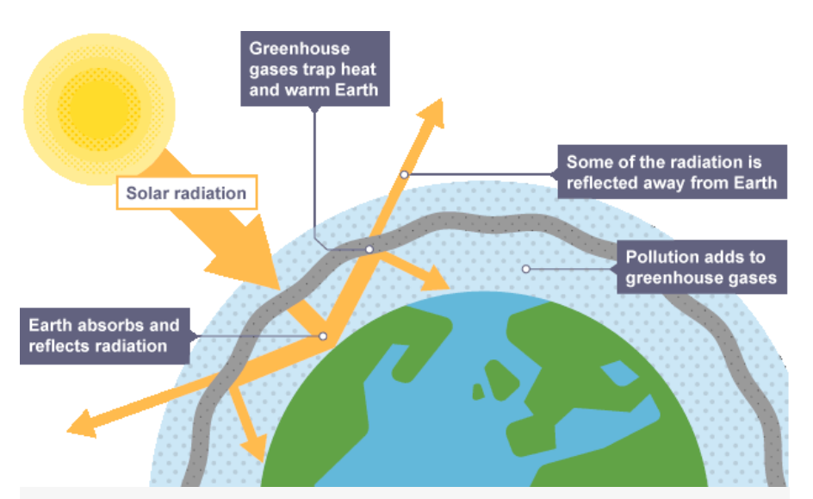
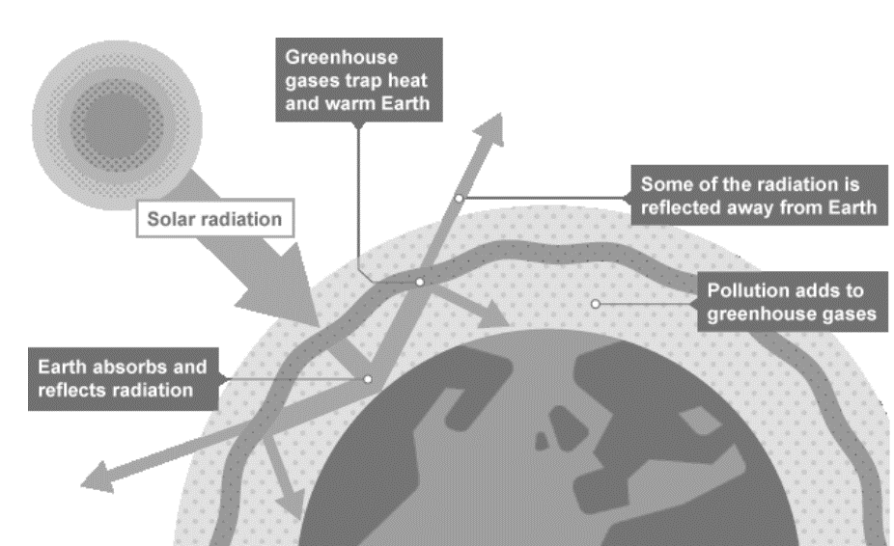
Rehearsal questions - Greenhouse Gases & Climate change
12. Suggest why chopping down trees & rain forests may contribute to global warming
………………………………………………………………………………………………………………………………………………………………
………………………………………………………………………………………………………………………………………………………….…
13. Label the following diagram of the greenhouse effect
14. Explain why scientists are more concerned about the global climate rather than the weather?
………………………………………………………………………………………………………………………………………...........................
……………………………………………………………………………………………………………………………………………………………….
15. What do scientists do to reduce the effect of someone making false claims?
………………………………………………………………………………………………………………………………………...........................
……………………………………………………………………………………………………………………………………………………………….
16. Explain why eating more meat may affect climate change.
………………………………………………………………………………………………………………………………………...........................
……………………………………………………………………………………………………………………………………………………………….
Less photosynthesis (carbon dioxide + water → glucose + oxygen) so less CO2 uptake
Result of human activity
Weather is short term but climate is long term patterns based on evidence
Peer review each others claims
Animals produce lots of methane – greenhouse gas – contributes to global warming – considered to affect global climate

Slide 31
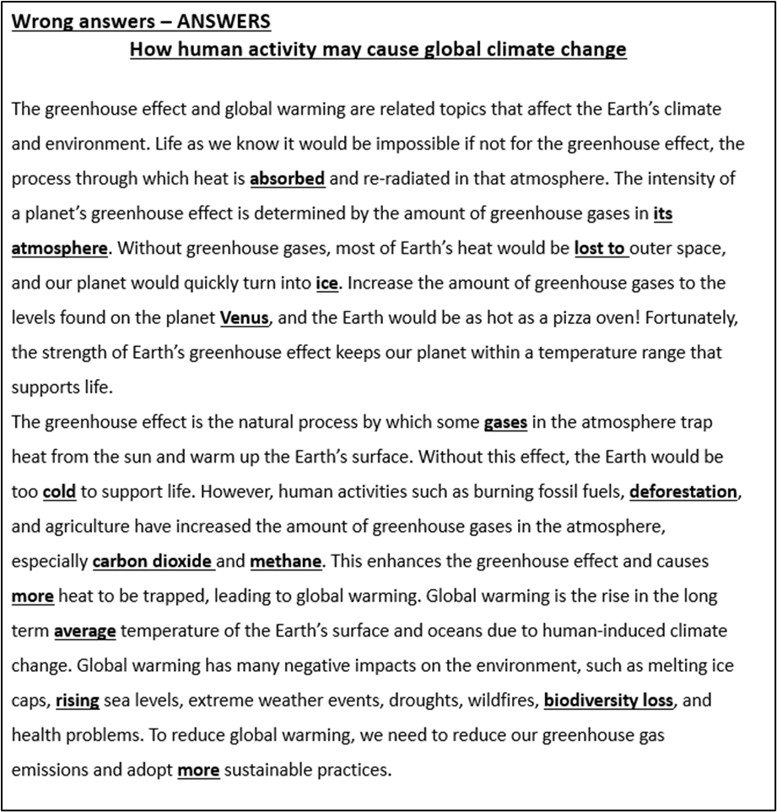
YOU DO Wrong answers –
How human activity may cause global climate change
The following passage contains 15 mistakes. Can you identify & correct them.
The greenhouse effect and global warming are related topics that affect the Earth’s climate and environment. Life as we know it would be impossible if not for the greenhouse effect, the process through which heat is reflected and re-radiated in that atmosphere. The intensity of a planet’s greenhouse effect is determined by the amount of greenhouse gases in outer space. Without greenhouse gases, most of Earth’s heat would be absorbed in outer space, and our planet would quickly turn into a giant ball of fire. Increase the amount of greenhouse gases to the levels found on the planet Mars, and the Earth would be as hot as a pizza oven! Fortunately, the strength of Earth’s greenhouse effect keeps our planet within a temperature range that supports life.
The greenhouse effect is the natural process by which some solid particles in the atmosphere trap heat from the sun and warm up the Earth’s surface. Without this effect, the Earth would be too hot to support life. However, human activities such as burning fossil fuels, planting forests and agriculture have increased the amount of greenhouse gases in the atmosphere, especially carbon monoxide and oxygen. This enhances the greenhouse effect and causes less heat to be trapped, leading to global warming. Global warming is the rise in the daily temperature of the Earth’s surface and oceans due to human-induced climate change. Global warming has many negative impacts on the environment, such as melting ice caps, falling sea levels, extreme weather events, droughts, wildfires, greater biodiversity and health problems. To reduce global warming, we need to reduce our greenhouse gas emissions and adopt less sustainable practices.

Slide 32
Contrasting concepts
I do
Compare greenhouse gases in Earth’s atmosphere to non-greenhouse gases
…………………………………………………………………………………………………………………………………………………………………………………………………………………………………………………………………………………………………………….We do
b. Compare the radiation from the sun & that reflected from the Earth
……………………………………………………………………………………………………………………………………………………………………………………………………………………………………………………………………………………………………………
You do
c What is the difference between global warming and the greenhouse effect?
………………………………………………………………………………………………………………………………………………………………………………………………………………………………………………………………………………………………………………
………………………………………………………………………………………………………………………………………………………
………………………………………………………………………………………………………………………………………………………
d. Compare the way short wavelength & long wavelength radiation affects the greenhouse effect
………………………………………………………………………………………………………………………………………………………
………………………………………………………………………………………………………………………………………………………
………………………………………………………………………………………………………………………………………………………………………………………………………………………………………………………………………………………………………………
e. Compare the human activities that contribute to increasing greenhouse gases to those that do not
………………………………………………………………………………………………………………………………………………………………………………………………………………………………………………………………………………………………………………………………………………………………………………………………………………………………………………………………………
………………………………………………………………………………………………………………………………………………………
GG = CO2, water vapour, methane
Non GG = O2, N2
From sun is short wavelength radiation. Reflected from Earth is long wavelength radiation
Greenhouse effect is the natural process of thermal radiation from Earth not escaping into space but being reflected back to Earths surface.
Global warming is increase in average temperature of the Earth’s surface
Greenhouse gases allow short wavelength radiation from the sun to pass through & warm up the Earth. Long wavelength radiation from Earth is absorbed by the greenhouse gases in the atmosphere & reflected back to the Earth’s surface
Increasing GG = deforestation, burning fossil fuels, agriculture, creating waste/ landfill
Reducing GG = use of renewable energy resources, less fossil fuels, less meat producing/ consumption, recycling,

Slide 33
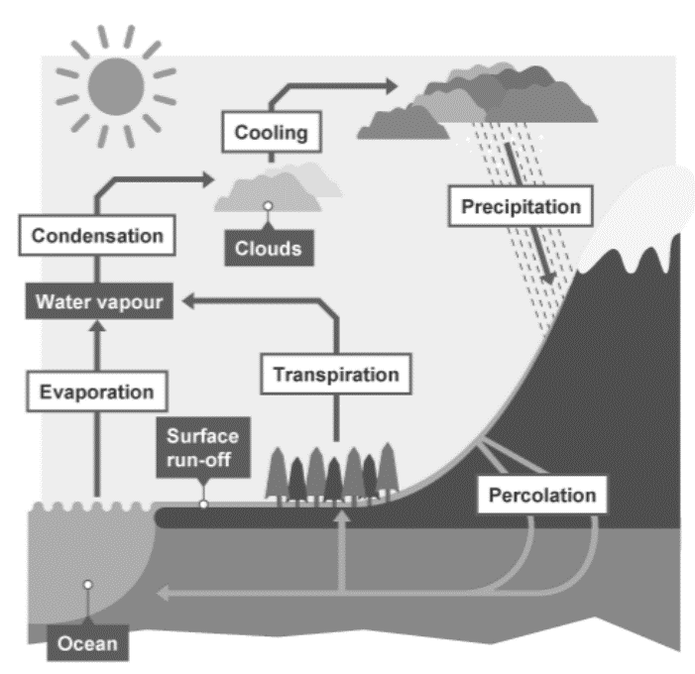
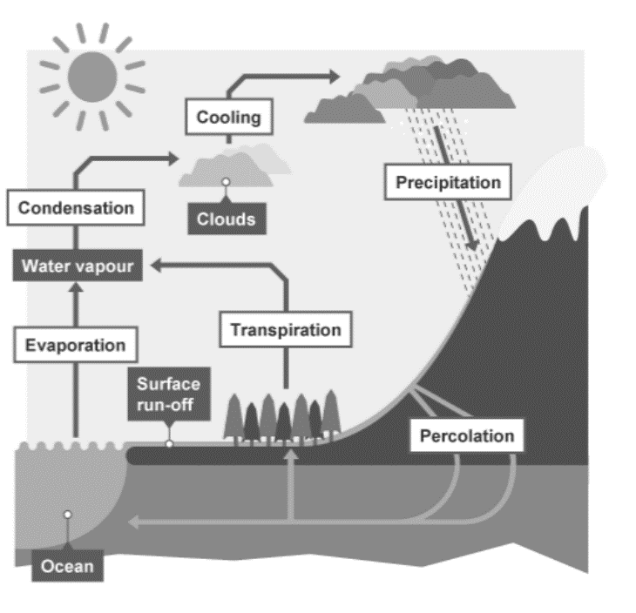
Spacing – the water cycle & biodiversity
This lesson has examined the effects of greenhouse gases on climate change . The water cycle also affects our climate and ecosystems. This has been taught in the Biology Ecology topic.
Define the term ‘the water cycle’.
……………………………………………………………………………………………………………………………………………………………………………………………………………………………………………………………………………………………………
2. Name the 4 main stages of the water cycle
………………………………………………………………………………………………………………………………………………..
3. How does water in the sea become clouds in the sky? …………………………………………………………………………………………………………………………………………………
4. What is meant by the term precipitation?
………………………………………………………………………………………………………………………………………………..
5. Where does rainfall get collected before it returns to the sea?.
…………………………………………………………………………………………………………………………………………………
Label the diagram of the water cycle showing the main process that take place
The recycling of water on our planet by natural processes
Condensation, precipitation, evaporation, transpiration
evaporation
When the raindrops get heavy in clouds, they fall as snow, hail or rain.
Lakes & rivers

Slide 34
Spacing – the water cycle & biodiversity
This lesson has examined the effects of human activity on climate change . The water cycle also affects our climate and ecosystems and has been taught in the Biology Ecology topic.
7. Define the term ‘biodiversity’.
……………………………………………………………………………………………………………………………………………………………………………………………………………………………………………………………………………………………………
8. Define the term ‘ecosystem’
………………………………………………………………………………………………………………………………………………..
9. Suggest 3 biotic factors in an ecosystem …………………………………………………………………………………………………………………………………………………
10. Suggest 3 abiotic factors in an ecosystem?
………………………………………………………………………………………………………………………………………………..
………………………………………………………………………………………………………………………………………………..
11. Suggest 3 ways that biodiversity can be maintained when challenged by human activity.
……………………………………………………………………………………………………………………………………………………………………………………………………………………………………………………………………………………………………
…………………………………………………………………………………………………………………………………………………
Variety of all different species in an ecosystem
The biotic & abiotic things that work together in a habitat
Predators, competition, availability of food, pathogens
Temperature, water, pH, CO2, O2, wind, sun, etc
Breeding programs, legal protection, reduction in deforestation, recycling resources, reduction in CO2 emissions, green belt/ limit construction, amend farming practices (reintroduce hedgerows & field margins)

Slide 35
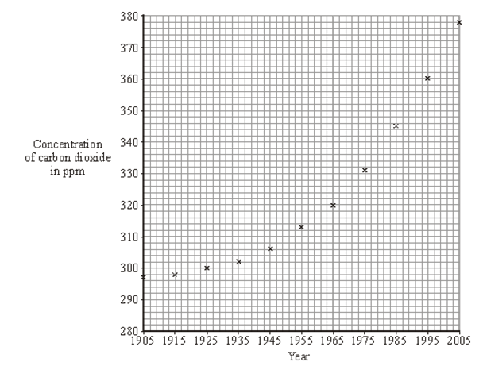
Q1. Some large forest areas are being destroyed. This changes the amount of carbon dioxide in the atmosphere.
(a) (i) State one use for the trees that are cut down.
………………………………………………………………………………………………………………………………………….(1)
(ii) State one use for the cleared land.
………………………………………………………………………………………………………………………………………….(1)
(iii) How has the destruction of forests affected the amount of carbon dioxide in the atmosphere?
…………………………………………………………………………………………………………………………………………(1)
(b) (i) How has the destruction of forests caused an increased Greenhouse effect?
………………………………………………………………………………………………………………………………………………………………………………………………………………………………………………………………………………………………………………………………………………………………………………………………………………………………………………………………………………………………………………………………………………………………………………………………………………………………………………………………………………………………………………………………………….(4)
(ii) State one effect of an increase in the Greenhouse effect.
…………………………………………………………………………………………………………………………………(1)
Q2. Global warming is thought to be happening because of the increased burning of fossil fuels. The concentration of carbon dioxide in the air from 1905 to 2005 has been calculated
building /wood/timber/furniture / paper / packaging / fuel/burning
do not accept ‘logs’ by itself
farming/agriculture/ building/ roads
increased CO2
trees photosynthesise/less photosynthesis takes place (and) 1
trees/photosynthesis uses carbon dioxide releases CO2 1
lets in heat/energy (do not accept sunshine) 1
prevents it escaping (from the atmosphere) or being reflected/retransmitted into space 1
global warming or a named effect of global warming such as polar ice cap melt,
climatic change, increased temperature/sea level rising / warmer weather

Slide 36
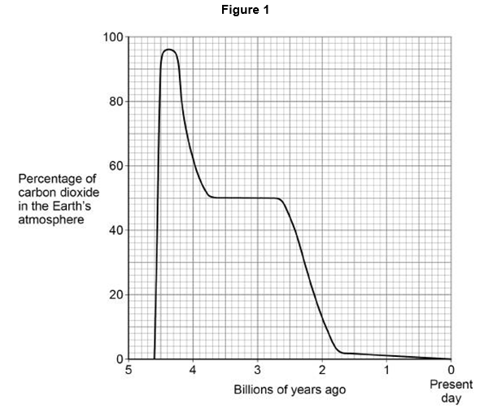
Draw a line of best fit for these points. (1)
(b) (i) What was the concentration of carbon dioxide in 1955?
.…………………………………………………………………………………………………… ppm (1)
(ii) In what year did the concentration of carbon dioxide reach 350 ppm?
……………………………………………………………………………………………………………….(1)
(c) Use the graph to describe, in as much detail as you can, what happened to the concentration of carbon dioxide from 1905 to 2005.
…………………………………………………………………………………………………………………………………………………………………………………………………………………………………………………………………………………………………………………………………………………………………………………………………………………………………………..(2)
Q3. This question is about carbon dioxide in the Earth’s atmosphere.
Figure 1 shows how the percentage of carbon dioxide in the Earth’s atmosphere has changed over 4.6 billion years.
(a) What was the highest percentage of carbon dioxide in the Earth’s atmosphere?
Use Figure 1.
Highest percentage = ……………………….% (1)
curve of best fit drawn through or close to all of the points
313
1989 +/– 1
concentration / amount of carbon dioxide has increased 1
recently the rate of increase is increasing 1
96 (%) allow a value in the range 95–97 (%)

Slide 37
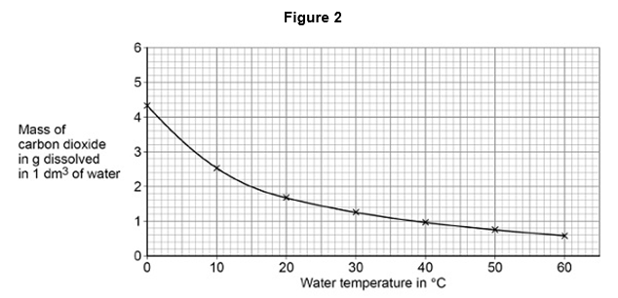
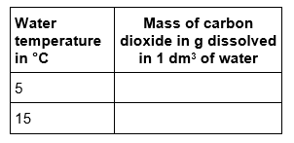
(b) The percentage of carbon dioxide in the atmosphere has decreased since Earth’s early atmosphere.
Which two processes have decreased the percentage of carbon dioxide in the Earth’s atmosphere?
Circle two processes. (4 marks)
Combustion of fuels
Formation of sedimentary rocks
Photosynthesis
Volcanic activity
(c) Carbon dioxide dissolves in water. Figure 2 shows the mass of carbon dioxide dissolved in water at different temperatures.
Using Figure 2, Complete the table below.
formation of sedimentary rocks 1
Photosynthesis 1
3.3 (g)
allow a value in the range 3.2 – 3.4 (g) 1
2 (g)
allow a value in the range 1.9 − 2.1 (g) 1

Slide 38
(d) Calculate the difference in the mass of carbon dioxide dissolved in 1 dm3 of water at 5 °C and at 15 °C
Use the table above.
……………………………………………………………………………………………………Mass = …………………….g (1)
(e) Carbon dioxide is a greenhouse gas. The greenhouse effect happens in four stages.
The four stages are:
Stage A Carbon dioxide stops longer wavelength radiation escaping
Stage B Radiation is absorbed by the Earth
Stage C Longer wavelength radiation is emitted
Stage D Shorter wavelength radiation enters the atmosphere.
What is the correct order of stages A, B, C and D?
Tick (✓) one box.
(f) Changes in the percentage of carbon dioxide in the Earth’s atmosphere cause climate change. Give two effects of climate change.
1.………………………………………………………………………………………………………………………………………………………………………………………………………………………………………………………………………………………
2…………………………………………………………………………………………………………………………………………………………………………………………………………………………………………………………………………………………
(3.3 – 2 =) 1.3 (g)
allow ecf from question (c)
D B C A
any two from:
• rising sea levels
• melting ice (caps) / glaciers
• agricultural problems
• extremes of weather
• (coastal) flooding / erosion
• drought
• forest fires
• animal habitats change / lost
allow extinction of species
allow global warming

Slide 39
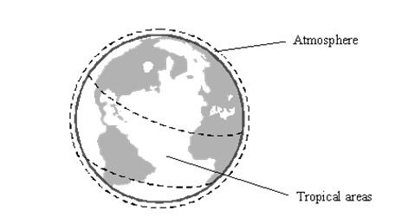
Q4. Recently the concentration of carbon dioxide in the Earth’s atmosphere has increased slightly. This may be linked to an increase in the ‘greenhouse effect’.
(a) The human population has grown rapidly. This has caused an increase in the amount of land used for agriculture, especially in tropical areas. This has helped to increase the carbon dioxide in the atmosphere. Give two reasons for this.
1.……………………………………………………………………………………………………………………………………………………………………………………………………………………………………………………………………………
2……………………………………………………………………………………………………………………………………………………………………………………………………………………………………………………………………….(2) (b) The increased ‘greenhouse effect’ has caused an increase in the Earth’s average temperature. Give two possible environmental effects of this increased average temperature.
1.……………………………………………………………………………………………………………………………………………………………………………………………………………………………………………………………………………
2……………………………………………………………………………………………………………………………………………………………………………………………………………………………………………………………………….(2)
(c) Name another gas, produced by cattle and rice fields, that also helps cause the ‘greenhouse effect’.
………………………………………………………………………………………………………………………………… (1)
any two from
deforestation reduces carbon dioxide removal from the atmosphere
accept less photosynthesis for reduces carbon dioxide removal
accept cutting down trees for deforestation
accept there are less trees to remove carbon dioxide
may cause a rise in sea level / accept may cause polar / ice caps to melt / flooding
do not accept global warming or greenhouse effect 1
may cause changes in the Earth’s climate
accept causes changes in the weather or named, comparative type of weather or drought
accept seasonal changes
methane

Slide 40
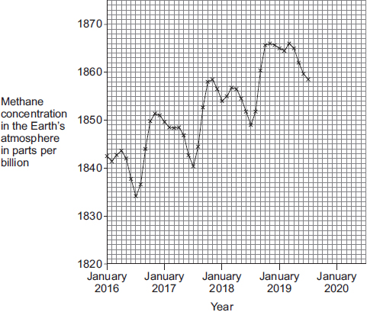
Q5. The graph below shows recent changes in the methane concentration in the Earth’s atmosphere.
(a) Determine the percentage increase in methane concentration in the Earth’s atmosphere from January 2018 to January 2019.
…………………………………………………………………………………………………………………………………………………………………………………………………………………………………………………………………………………………………………………………………………………………………………………………………………………………………………………………………………………………………………………………………………………………………………………..
Percentage increase = ……………………………% (3)
(b) Greenhouse gases maintain temperatures on Earth high enough to support life.
Describe the greenhouse effect in terms of the interaction of short-wavelength and long-wavelength radiation with matter.
…………………………………………………………………………………………………………………………………………………………………………………………………………………………………………………………………………………………………………………………………………………………………………………………………………………………………………………………………………………………………………………………………………………………………………………………………………………………………………………………………………………………………………………………………………………………………………………………………………………………………………………………………………………………………………………………………………………………………………………........................................(4)
(2018) 1854 (ppb) and (2019) 1865 (ppb)
0.593 (%)
short(er) wavelength radiation which enters the atmosphere (from the Sun)
allow UV / ultraviolet / gamma radiation which enters the atmosphere (from the Sun) 1
(short(er) wavelength radiation) is absorbed by matter / materials / Earth and re-emitted 1
as a longer wavelength radiation 1
(the longer wavelength radiation) is absorbed by a greenhouse gas which reduces radiation escaping (to space)
or
(the longer wavelength radiation) is absorbed by a greenhouse gas so temperature increases 1

Slide 41
Subtopic 3: Greenhouse Gases & Climate Change
I wasn’t there but I still care!
Using the Chemistry AQA Text book from pages 198 -201 and the glossary on pages 271 -274 to help you answer the following;
Name 3 greenhouse gases ……………………………………………………………………………………………………………………………………………………………………………………………………………………………………………………………………………………………………………………
Explain how increasing levels of these gases in the atmosphere can result in a rise in the temperature of the Earth’s atmosphere
…………………………………………………………………………………………………………………………………………………………………………………………………………………………………………………………………………………………………………………… …………………………………………………………………………………………………………………………………………………………
……………………………………………………………………………………………………………………………………………………………………………………………………………………………………………………………………………………………………………………
Give 3 reasons why the amount of carbon dioxide in the Earth’s atmosphere has increased so much in the recent past.
………………………………………………………………………………………………………………………………………………………………………………………………………………………………………………………………………………………………………………………………………………………………………………………………………………………………………………………………………………
Give 3 possible consequences of global climate change
…………………………………………………………………………………………………………………………………………………………………………………………………………………………………………………………………………………………………………………… …………………………………………………………………………………………………………………………………………………………
Suggest why it may be difficult to predict the certainty of the effects of increasing levels of greenhouse gases
…………………………………………………………………………………………………………………………………………………………………………………………………………………………………………………………………………………………………………………… ……………………………………………………………………………………………………………………………………………………………………………………………………………………………………………………………………………………………………………………

Slide 42
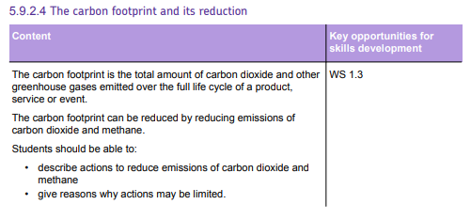
Subtopic 3: The carbon footprint and its reduction
AQA Content

Slide 43
Learning Objective
Why are we learning about this?
This lessons helps us understand why…
3

Slide 44
1 2 3 4 5 6 7 8 9 10 11 12 13 14 15 16 17 18 19 20 21 22 23 24 25 26 27 28 29 30 | What is a carbon footprint? The carbon footprint of a product is the total amount of carbon dioxide (and other greenhouse gases, such as methane) which are emitted over the full life cycle of a product, service or event. For example, the carbon footprint of a car would include the carbon dioxide emitted by: machinery whilst the metal is extracted from the Earth's crust and processed transportation of the raw materials from where they are produced/processed to where the car will be manufactured, using petrol and diesel based vehicles power stations which generate the electricity used to manufacture the car the car itself when it is driven for many years the machinery which is used to dispose of or recycle the car The carbon footprint of a person during one year would consist of the total amount of carbon dioxide released into the atmosphere by all of the activities they take part in, and the manufacture, use and disposal of all the products and resources they use. For example, a typical young person might: use electricity at home, probably generated from fossil fuels, for lighting their room and using electronic devices use a gas-powered boiler at home (which produces carbon dioxide) for heating and hot water travel to school by bus or car (which probably runs on petrol or diesel) eat beef or rice which have been farmed using methods that release methane travel abroad once per year on an aeroplane (which produces carbon dioxide) How to reduce carbon footprint It goes without saying that to reduce your carbon footprint, you must reduce activities that contribute to the release of greenhouse gases. This may include: Walking or cycling more instead of using petrol/diesel-based vehicles Eating less beef and rice Using renewable energy in the home e.g. solar panels

Slide 45
Rehearsal questions
What do we call the total amount of carbon dioxide released during the full life-cycle of a product? …………………………………………………………………………………………………………………………………………………………..
Why must we consider transportation when considering the carbon footprint of a product? ………………………………………………………………………………………………………………………………………………………….. …………………………………………………………………………………………………………………………………………………………..
Why does eating beef and rice increase your individual carbon footprint? ………………………………………. …………………………………………………………………………………………………………………………………………………………..
Why does using electricity at home increase your carbon footprint? ……………………………………………….. …………………………………………………………………………………………………………………………………………………………..
Raw materials must be transported from where they are made to where they are being used to make a product. How does this affect the carbon footprint of the product? …………………………………….. …………………………………………………………………………………………………………………………………………………………..
What do we mean by the term “carbon footprint”? …………………………………………………………………………. …………………………………………………………………………………………………………………………………………………………..
What happens to your carbon footprint if you electricity comes from fossil fuels, and why? ………………………………………………………………………………………………………………………………………………………….. …………………………………………………………………………………………………………………………………………………………..
Some foods have negative effects on your individual carbon footprint. What foods are examples of this? ………………………………………………………………………………………………………………………………………………….
Fossil fuels release carbon dioxide when burned. How does this link to your individual carbon footprint? …………………………………………………………………………………………………………………………………………. …………………………………………………………………………………………………………………………………………………………..
Many companies try to source materials locally to reduce the carbon footprint of their product. How does it do this? …………………………………………………………………………………………………………………………. …………………………………………………………………………………………………………………………………………………………..
What does the “carbon footprint” of a product tell you? …………………………………………………………………. …………………………………………………………………………………………………………………………………………………………..
Methane is a greenhouse gas that contributes to a carbon footprints. Which types of food release large amount of methane when farmed? ………………………………………………………………………………………….
The carbon footprint
Vehicles transporting raw materials use petrol/diesel, which release CO₂ when burned.
Large amount of methane are released when they are farmed.
A lot of electricity is produced by burning fossil fuels, which releases CO₂.
It increases the carbon footprint, as they release CO₂ by burning fuel.
The total amount of CO₂ (and other greenhouse gases) released during a products full life-cycle.
Your carbon footprint increases, as burning fossil fuels releases CO₂.
Beef and rice.
Using electricity in your home often comes from burning fossil fuels, meaning your carbon footprint increases.
Less transportation of materials is needed, which means less CO₂ will be released by vehicles transporting the materials.
The total amount of CO₂ (and other greenhouse gases) released during the product’s full life-cycle.
Beef and rice.

Slide 46
Wrong answers
I DO: “Using electricity doesn’t release carbon dioxide, so it won’t affect your carbon footprint”. Explain why this statement is incorrect.
…………………………………………………………………………………………………………………………………………………………..
…………………………………………………………………………………………………………………………………………………………..
…………………………………………………………………………………………………………………………………………………………..
WE DO: “A carbon footprint only looks at how much carbon dioxide is released”. Explain why this statement is incorrect.
…………………………………………………………………………………………………………………………………………………………..
…………………………………………………………………………………………………………………………………………………………..
…………………………………………………………………………………………………………………………………………………………..
YOU DO: “The carbon footprint is how much carbon dioxide is released when you use a product”. Explain why this statement is incorrect.
…………………………………………………………………………………………………………………………………………………………..
…………………………………………………………………………………………………………………………………………………………..
…………………………………………………………………………………………………………………………………………………………..
YOU DO: “If you are not driving, your carbon footprint is not affected by using vehicles”. Explain why this statement is incorrect.
…………………………………………………………………………………………………………………………………………………………..
…………………………………………………………………………………………………………………………………………………………..
…………………………………………………………………………………………………………………………………………………………..
YOU DO: “Recycling a product won’t affect its carbon footprint, as the materials will be reused”. Explain why this statement is incorrect.
…………………………………………………………………………………………………………………………………………………………..
…………………………………………………………………………………………………………………………………………………………..
…………………………………………………………………………………………………………………………………………………………..
YOU DO: “Using locally sourced materials means there is no transportation involved in the carbon footprint of a product”. Explain why this statement is incorrect.
…………………………………………………………………………………………………………………………………………………………..
…………………………………………………………………………………………………………………………………………………………..
…………………………………………………………………………………………………………………………………………………………..
Using electricity may not release carbon dioxide, but producing the electricity might. If fossil fuels are used, the act of producing the electricity is what will release carbon dioxide, and will contribute to your carbon footprint when you use it.
Although carbon dioxide is the main greenhouse gas, your carbon footprint is a measure of all greenhouse gases, which also includes methane.
A carbon footprint is the full life-cycle, from producing the raw materials, to making the product, to transporting the product, and then using the product, and eventually disposing of it.
Even if you are not the driver, you are using the vehicle to travel, and therefore the carbon dioxide released by that vehicle will contribute to your carbon footprint.
Even though recycling is better than disposing of a product, machinery will need to be used to recycle it, and therefore electricity will be needed, which may come from fossil fuels. This will still contribute towards the carbon footprint of the product.
Even though less transportation will be required, as materials are found near the location of production, there will be some transportation involved, including after the product has been made and is then transported to where it is sold.

Slide 47
Contrasting concepts
I DO: Compare the carbon footprint of a product to that of a person.
…………………………………………………………………………………………………………………………………………………………..
…………………………………………………………………………………………………………………………………………………………..
…………………………………………………………………………………………………………………………………………………………..
WE DO: Compare the impact of a vegetarian diet vs a meat-eating diet on your carbon footprint.
…………………………………………………………………………………………………………………………………………………………..
…………………………………………………………………………………………………………………………………………………………..
…………………………………………………………………………………………………………………………………………………………..
YOU DO: Compare the impact of driving a petrol car to cycling on your carbon footprint.
…………………………………………………………………………………………………………………………………………………………..
…………………………………………………………………………………………………………………………………………………………..
…………………………………………………………………………………………………………………………………………………………..
YOU DO: Compare the impact of fossil fuels to renewable energy resources on your carbon footprint.
…………………………………………………………………………………………………………………………………………………………..
…………………………………………………………………………………………………………………………………………………………..
…………………………………………………………………………………………………………………………………………………………..
YOU DO: Compare the carbon footprint of an individual living in the UK to that of someone living in a poorer country.
…………………………………………………………………………………………………………………………………………………………..
…………………………………………………………………………………………………………………………………………………………..
…………………………………………………………………………………………………………………………………………………………..
YOU DO: Compare the carbon footprint of a child to that of an adult in the UK.
…………………………………………………………………………………………………………………………………………………………..
…………………………………………………………………………………………………………………………………………………………..
…………………………………………………………………………………………………………………………………………………………..
A product’s carbon footprint consists of the greenhouse gases produced during its full life-cycle, from raw materials → disposal. A person’s carbon footprint, however, is a measure of the greenhouse gases released from their activities in one year.
Eating a vegetarian diet means you won’t eat beef, meaning you won’t be playing a part in the methane being released by farming cows. However, you may still eat rice, meaning the methane released there will still contribute to your carbon footprint.
Driving a petrol car burns fossil fuels, and releases carbon dioxide, which will increase your carbon footprint. However, cycling does not require fossil fuels, and so won’t release carbon dioxide.
Burning fossil fuels to generate electricity releases large amounts of carbon dioxide, increasing your carbon footprint. Most renewable energy resources do not release carbon dioxide when used (e.g. solar panels) and so will not increase your carbon footprint.
A person in the UK is mor likely to travel using vehicles, more likely to use devices requiring electricity, and more likely to use more resources than someone in a poorer country, and so would have a larger carbon footprint.
An adult is more likely to travel more by car than a child. An adult is also more likely to use devices for work e.g. a computer. Children and adults are both likely to use devices for recreational purposes. An adult would be expected to have a larger carbon footprint.

Slide 48
Interleaving questions – YOU DO
We are currently learning carbon footprints, and how they can be reduced. This links in to the following key topics: cells, chemical reactions, bonding, organic chemistry, and waves.
The following questions will link our current topic with these previous topics:
Carbon dioxide is one of the greenhouse gases measured using a carbon footprint. Carbon dioxide is released from a process called respiration. Write the word and balanced symbol equations for respiration:
Word: ……………………………………………………………………………....…………………………………………………………
Symbol: ……………………………………………………………………………………………………………………………….………
Respiration happens in all living cells. Which organelle is the site of aerobic respiration? …………………………………………………………………………………………………………………………………………………………..
Carbon dioxide can be removed from the atmosphere by a process called photosynthesis. Write the word and balanced symbol equations for photosynthesis:
Word: ……………………………………………………………………………....…………………………………………………………
Symbol: ……………………………………………………………………………………………………………………………….………
Photosynthesis takes place in the leaves of plants.
Which tissue of the leaf carries out most photosynthesis? …………………………………….……………..
Which organelle is the site of photosynthesis? ………………………………………………………………………
Carbon dioxide is a small molecule.
What type of bonding is present in carbon dioxide? ………………………………………………………………
What does the type of bonding tell you about the electrons in carbon dioxide? ……………………………………………………………………………………………………………………………………………….
Methane is part of the homologous series of compounds known as alkanes. Alkanes are hydrocarbons.
What is a hydrocarbon? ………………………………………………………………………………………………………… ……………………………………………………………………………………………………………………………………………….
What is the general formula of the alkanes? ………………………………………………………………………….
Another homologous series of hydrocarbons are the alkenes. What is the difference between an alkane and an alkene? ……………………………………………………………………………………….. ……………………………………………………………………………………………………………………………………………….
Glucose + Oxygen → Carbon dioxide + Water (+ energy)
C₆H₁₂O₆ + 6O₂ → 6CO₂ + 6H₂O (+ energy)
Mitochondria
(chlorophyll)
Carbon dioxide + Water → Glucose + Oxygen
(light energy)
6CO₂ + 6H₂O → C₆H₁₂O₆ + 6O₂
Palisade mesophyll
Chloroplast
Covalent bonding
Electrons are shared between the outer shells of the atoms.
A compound made of carbon atoms and hydrogen atoms only.
C_{n}H_{2n+2}
Alkanes are fully saturated (all single bonds), but alkenes contain a C=C double bond..

Slide 49
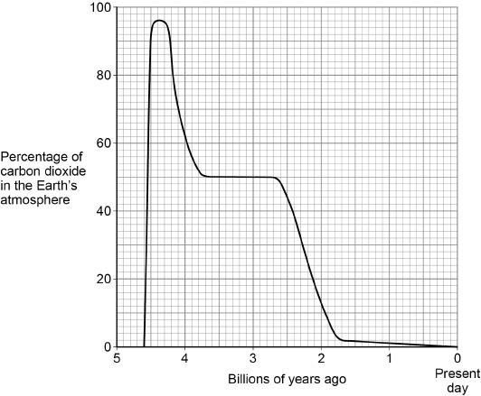
Exam questions – YOU DO
Q1. This question is about carbon dioxide in the Earth’s atmosphere.
Figure 1 shows how the percentage of carbon dioxide in the Earth’s atmosphere has changed over 4.6 billion years.
(a) What was the highest percentage of carbon dioxide in the Earth’s atmosphere?
Use Figure 1.
Highest percentage = ………………………………………%
(1)
96%

Slide 50
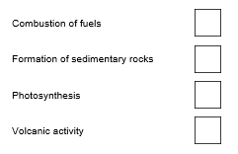
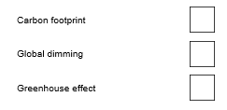
Exam questions – YOU DO
(b) The percentage of carbon dioxide in the atmosphere has decreased since Earth’s early atmosphere.
Which two processes have decreased the percentage of carbon dioxide in the Earth’s atmosphere?
Tick (✓) two boxes.
(2)
(c) The total amount of carbon dioxide emitted over the life cycle of a product can be measured.
What name is given to the total amount of carbon dioxide emitted during the life cycle of a product?
Tick (✓) one box.
(1)
Formation of sedimentary rocks
Photosynthesis
Carbon footprint

Slide 51
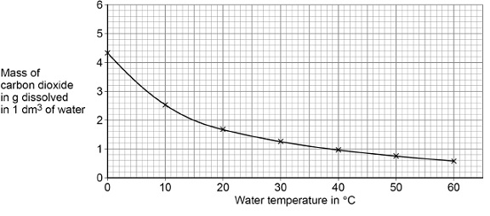
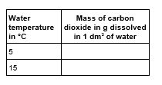
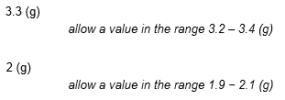
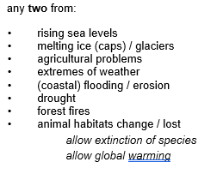
Exam questions – YOU DO
Figure 2 shows the mass of carbon dioxide dissolved in water at different temperatures.
(d) Complete the table below. Use Figure 2.
(2)
(e) Calculate the difference in mass of carbon dioxide dissolved in 1 dm³ of water at 5 °C and at 15 °C. Use the table above. ………………………………………………………………………………………………………………………………………………………………… Mass = ………………………… g
(1)
(f) Changes in the percentage of carbon dioxide in the Earth’s atmosphere cause climate change. Give two effects of climate change.
1. ……………………………………………………………………………………………………………………………………………………………. …………………………………………………………………………………………………………………………………………………………………
2. ……………………………………………………………………………………………………………………………………………………………. …………………………………………………………………………………………………………………………………………………………………
(2)

Slide 52
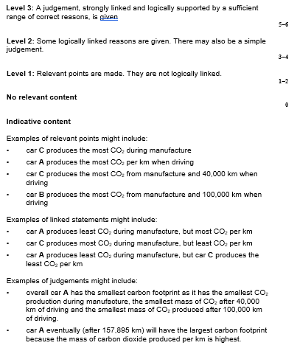
Exam questions – YOU DO
Q2. This question is about atmospheric pollutants from fuels.
(a) The table shows the carbon footprint during the manufacture and use of three cars.
Evaluate the carbon footprint of the cars.
Use information from the table above.
…………………………………………………………………………………………………………………………………………………………………
…………………………………………………………………………………………………………………………………………………………………
…………………………………………………………………………………………………………………………………………………………………
…………………………………………………………………………………………………………………………………………………………………
…………………………………………………………………………………………………………………………………………………………………
…………………………………………………………………………………………………………………………………………………………………
…………………………………………………………………………………………………………………………………………………………………
…………………………………………………………………………………………………………………………………………………………………
…………………………………………………………………………………………………………………………………………………………………
…………………………………………………………………………………………………………………………………………………………………
…………………………………………………………………………………………………………………………………………………………………
…………………………………………………………………………………………………………………………………………………………..……………………………………………………………………………………………………………………………………………………………………..
(6)
(Total 6 marks)
Car | Mass of CO₂ produced during manufacture in kg | Mass of CO₂ produced when driving in kg per km | Total mass of CO₂ produced from manufacture and 40 000 km driving in kg | Total mass of CO₂ produced from manufacture and 100 000 km driving in kg
Car A | 14 000 | 0.123 | 18 920 | 26 300
Car B | 20 000 | 0.085 | 23 400 | 28 500
Car C | 23 000 | 0.044 | 24 760 | 27 400

Slide 53
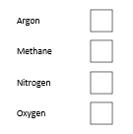
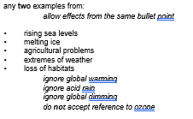
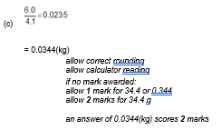
Exam questions – YOU DO
Q3. This question is about the Earth’s atmosphere.
(a) Carbon dioxide is a greenhouse gas. What is another greenhouse gas? Tick one box.
(1)
(b) Greenhouse gases cause global climate change.
Give two effects of global climate change.
1. ……………………………………………………………………………………………………………………………………………………………. …………………………………………………………………………………………………………………………………………………………………
2. ……………………………………………………………………………………………………………………………………………………………. …………………………………………………………………………………………………………………………………………………………………
(2)
(c) 4.1 kg of a plastic, used to make plastic bottles, has a carbon footprint of 6.0 kg of carbon dioxide.
Calculate the carbon footprint of one plastic bottle of mass 23.5 g
…………………………………………………………………………………………………………………………………………………………………
…………………………………………………………………………………………………………………………………………………………………
…………………………………………………………………………………………………………………………………………………………………
…………………………………………………………………………………………………………………………………………………………………
Carbon footprint = ……………………………………………….. kg of carbon dioxide
(2)
Methane

Slide 54
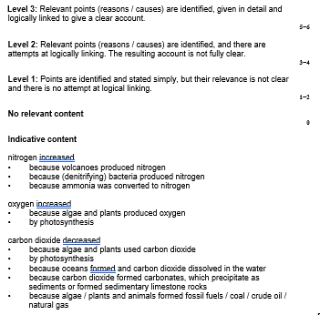
Exam questions – YOU DO
(d) Give one way that carbon dioxide emissions can be reduced when a plastic bottle is manufactured.
…………………………………………………………………………………………………………………………………………………………………
…………………………………………………………………………………………………………………………………………………………………
(1)
(e) Explain how the percentages of nitrogen, oxygen and carbon dioxide in the Earth’s atmosphere today have changed from the Earth’s early atmosphere.
…………………………………………………………………………………………………………………………………………………………………
…………………………………………………………………………………………………………………………………………………………………
…………………………………………………………………………………………………………………………………………………………………
…………………………………………………………………………………………………………………………………………………………………
…………………………………………………………………………………………………………………………………………………………………
…………………………………………………………………………………………………………………………………………………………………
…………………………………………………………………………………………………………………………………………………………………
…………………………………………………………………………………………………………………………………………………………………
…………………………………………………………………………………………………………………………………………………………………
…………………………………………………………………………………………………………………………………………………………………
…………………………………………………………………………………………………………………………………………………………………
…………………………………………………………………………………………………………………………………………………………..……………………………………………………………………………………………………………………………………………………………………..
(6)
(Total 12 marks)

Slide 55
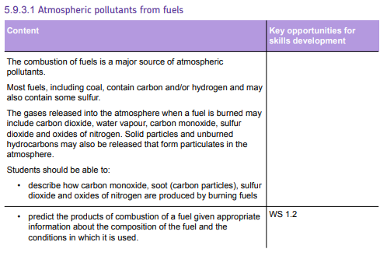
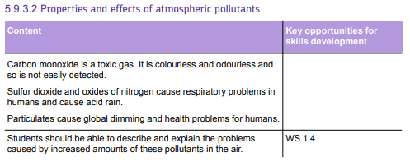
Subtopic 4: 5.9.3.1 Atmospheric pollutants from fuels and 5.9.3.2 Properties and effects of atmospheric pollutants
AQA Content
t

Slide 56
Subtopic 4: Atmospheric pollution
I wasn’t there but I still care!
Last lesson we looked at carbon footprints, and how they can be reduced.
Using the AQA Chemistry textbook, pages 200-201:
What is a carbon footprint? ……………………………………………………………………………..……..………………… ……………………………………………………………………………………………………………………………………………………
How do fossil fuels increase carbon footprints? ………………………………………………………………………… ……………………………………………………………………………………………………………………………………………………
How does farming cattle increase a carbon footprint? ………………………………………………………………. …………………………………………………………………………………………………………………………………………………...
Describe how carbon footprints can be reduced. ………………………………………………………………………. …………………………………………………………………………………………………………………………………………………………………………………………………………………………………………………………………………………………………………
Why is it important that carbon footprints are reduced. ……………………………………………………………. …………………………………………………………………………………………………………………………………………………………………………………………………………………………………………………………………………………………………………
The total amount of CO₂ and other greenhouse gases emitted over the full life cycle of the product, service, or event.
Burning fossil fuels releases carbon dioxide, a greenhouse gas.
Methane is produced by cattle, and methane is a greenhouse gas.
Reduce the use of fossil fuels, reduce the demand for beef.
Greenhouse gases are causing global warming and climate change, leading to potential issues with rising sea levels, threats to ecosystems, and affecting food production.

Slide 57
1 2 3 4 5 6 7 8 9 10 11 12 13 14 15 16 17 18 19 20 21 22 23 24 25 26 27 28 29 30 | Different types of pollutants When fuels are burned, a number of atmospheric pollutants are produced. Here are some of the pollutants from burning fuels, and where they come from: NO_{x} gases as pollutants Nitrogen is not present in fuels, but the high temperatures and pressures inside a car engine can cause the nitrogen and oxygen in the air to react together to make oxides of nitrogen. There are several compounds formed when nitrogen bonds with oxygen, but the two which are made inside engines are NO and NO₂. These two pollutants are grouped together with the general formula NO_{x}. NO_{x} gases can cause acid rain, and they also react in the atmosphere with other pollutants to make photochemical smog. Smog can have major health effects, causing asthma attacks and even death.
Pollutant | Source
Carbon dioxide, CO₂ | Complete combustion of any fuel containing carbon atoms
Carbon monoxide, CO | Incomplete combustion of any fuel containing carbon atoms
Particulate carbon, C (soot) | Incomplete combustion of any fuel containing carbon atoms
Unburned hydrocarbons | Hydrocarbon fuel molecules which have not been oxidised at all
Sulfur dioxide, SO₂ | Combustion of a fossil fuel which contains sulfur impurities
Nitrogen oxides, NO_{x} | Oxidation of atmospheric nitrogen inside the engine of a car, lorry, etc

Slide 58
1 2 3 4 5 6 7 8 9 10 11 12 13 14 15 16 17 18 19 20 21 22 23 24 25 26 27 28 29 30 | Sulfur dioxide as a pollutant Sulfur dioxide is caused when sulfur atoms which are present in some fossil fuels are oxidised: sulfur + oxygen → sulfur dioxide S + O₂ → SO₂ Sulfur dioxide is then further oxidised in the atmosphere to sulfur trioxide, SO₃. This gas dissolves in rainwater to make acid rain, which is a dilute solution of sulfuric acid, H₂SO₄. The two reactions are: sulfur dioxide + oxygen → sulfur trioxide 2SO₂ + O₂ → 2SO₃ And then: sulfur trioxide + water → sulfuric acid SO₃ + H₂O → H₂SO₄ Acid rain harms and kills plants and animals, especially those that live in aquatic environments. It can also damage man-made objects like statues and buildings. Carbon monoxide as a pollutant Carbon monoxide is a toxic gas. It binds to haemoglobin, the red pigment found in red blood cells, and prevents it from transporting oxygen around the body. Particulates as pollutants Particulates are small particles of carbon, also known as soot. They can cause health issues, such as issues with breathing if inhaled. They also cause global dimming.

Slide 59
Rehearsal questions
How are particulates released? ………………………………………………………………………………………………………… …………………………………………………………………………………………………………………………………………………………..
How are nitrogen oxides formed if there is no nitrogen in fuels? …………………………………………………….. …………………………………………………………………………………………………………………………………………………………..
How do sulfur impurities in fuels lead to acid rain? ………………………………………………………………………….. …………………………………………………………………………………………………………………………………………………………..
Why is acid rain harmful? …………………………………………………………………………………………………………………. …………………………………………………………………………………………………………………………………………………………..
What conditions are required for the formation of nitrogen oxides? ………………………………………………… ……………………………………………………………………………………………………………………………………………………….....
What are particulates? ……………………………………………………………………………………………………………………… …………………………………………………………………………………………………………………………………………………………..
What reactions take place to cause the formation of a dilute sulfuric acid in rain? …………………………… …………………………………………………………………………………………………………………………………………………………..
What dangers does acid rain present? ……………………………………………………………………………………………… …………………………………………………………………………………………………………………………………………………………..
Carbon monoxide is produced by the incomplete combustion of fuels containing carbon. Which other type of pollutant is released by this method? ………………………………………………………………………….
Nitrogen oxides can lead to acid rain. Which other pollutant also leads to acid rain? …………………………………………………………………………………………………………………………………………………………..
Acid rain is a danger to the environment. What are the effects of acid rain? ……………………………………. …………………………………………………………………………………………………………………………………………………………..
High temperatures and pressure in an engine causes which pollutant to be released? …………………………………………………………………………………………………………………………………………………………..
Incomplete combustion of any fuels containing carbon
High temp. and pressure causes nitrogen in the air to react with oxygen.
Sulfur dioxide oxidises to sulfur trioxide, which then dissolves in rain water to make a dilute sulfuric acid
It can harm plants and animals, particularly those in aquatic ecosystems. Can also damage buildings and statues.
High temp. and pressure
Small particles of carbon, also called soot.
Sulfur is oxidised to sulfur dioxide, which is then oxidised to sulfur trioxide.
It can harm plants and animals, particularly those in aquatic ecosystems. Can also damage buildings and statues.
Particulates
Sulfur dioxide
It can harm plants and animals, particularly those in aquatic ecosystems. Can also damage buildings and statues.
Nitrogen oxides

Slide 60
Wrong answers
I DO: “Carbon dioxide is always produced when a fuel combusts”. Explain why this statement is incorrect.
…………………………………………………………………………………………………………………………………………………………..
…………………………………………………………………………………………………………………………………………………………..
…………………………………………………………………………………………………………………………………………………………..
WE DO: “Nitrogen in fuels burns to form nitrogen oxides”. Explain why this statement is incorrect.
…………………………………………………………………………………………………………………………………………………………..
…………………………………………………………………………………………………………………………………………………………..
…………………………………………………………………………………………………………………………………………………………..
YOU DO: “Carbon dioxide is the only type of pollution”. Explain why this statement is incorrect.
…………………………………………………………………………………………………………………………………………………………..
…………………………………………………………………………………………………………………………………………………………..
…………………………………………………………………………………………………………………………………………………………..
YOU DO: “Sulfur dioxide forms sulfuric acid when it reacts with water”. Explain why this statement is incorrect.
…………………………………………………………………………………………………………………………………………………………..
…………………………………………………………………………………………………………………………………………………………..
…………………………………………………………………………………………………………………………………………………………..
YOU DO: “Hydrocarbons fully react when they are burned”. Explain why this statement is incorrect.
…………………………………………………………………………………………………………………………………………………………..
…………………………………………………………………………………………………………………………………………………………..
…………………………………………………………………………………………………………………………………………………………..
YOU DO: “Nitrogen and oxygen are in the air we breathe, and they don’t cause problems, so nitrogen oxides won’t either”. Explain why this statement is incorrect.
…………………………………………………………………………………………………………………………………………………………..
…………………………………………………………………………………………………………………………………………………………..
…………………………………………………………………………………………………………………………………………………………..
Carbon dioxide is only produced by complete combustion. If combustion is incomplete, carbon monoxide, or just carbon (soot/particulates) are formed.
There is no nitrogen in fuels. Instead, nitrogen oxides are formed due to high temperatures and pressures in an engine causing nitrogen and oxygen in the air to react with each other.
Pollution is caused by pollutants, of which there are several types. Carbon dioxide is one, but so is carbon monoxide, particulates (carbon), unburned hydrocarbons, nitrogen oxides, and sulfur dioxide.
Sulfur dioxide must first be further oxidised to form sulfur trioxide. After this happens, it can then dissolve in rain water to form a very weak sulfuric acid.
Sometimes hydrocarbons may be released without having been oxidised at all. These unburned hydrocarbons are a separate type of pollutant.
The properties of a compound are not the same as the properties of its constituent elements. Nitrogen oxides can react with other pollutants to produce smog, which can cause respiratory issues. This could lead to asthma attacks and, in serious situations, death.

Slide 61
If it didn’t
I DO: What would happen if there was less oxygen available in a car engine? …………………………………………………………………………………………………………………………………………………………..
…………………………………………………………………………………………………………………………………………………………..
…………………………………………………………………………………………………………………………………………………………..
WE DO: What would happen if nitrogen could not get into a car engine? …………………………………………………………………………………………………………………………………………………………..
…………………………………………………………………………………………………………………………………………………………..
…………………………………………………………………………………………………………………………………………………………..
YOU DO: What would happen if fuel didn’t contain sulfur impurities? …………………………………………………………………………………………………………………………………………………………..
…………………………………………………………………………………………………………………………………………………………..
…………………………………………………………………………………………………………………………………………………………..
YOU DO: What would happen if more carbon monoxide was produced?
…………………………………………………………………………………………………………………………………………………………..
…………………………………………………………………………………………………………………………………………………………..
…………………………………………………………………………………………………………………………………………………………..
YOU DO: What would happen if there was more sulfur oxides and nitrogen oxides in the air? …………………………………………………………………………………………………………………………………………………………..
…………………………………………………………………………………………………………………………………………………………..
…………………………………………………………………………………………………………………………………………………………..
YOU DO: What would happen to the environment if more pollutants were being released? …………………………………………………………………………………………………………………………………………………………..
…………………………………………………………………………………………………………………………………………………………..
…………………………………………………………………………………………………………………………………………………………..
…………………………………………………………………………………………………………………………………………………………..
…………………………………………………………………………………………………………………………………………………………..
There would be less complete combustion and more incomplete combustion, producing more carbon monoxide and particulates.
The nitrogen could not be made to react with oxygen, under conditions of high temperatures and pressures, to for nitrogen oxides.
The sulfur could not be oxidised to sulfur dioxide, a pollutant. This would also prevent further oxidation to sulfur trioxide, and therefore reduce the amount of sulfur trioxide dissolving in rain water to produce acid rain.
If more carbon monoxide was produced, it would seriously affect human health. Carbon monoxide would bind to haemoglobin in red blood cells, and reduce the amount of oxygen a person could transport around their body.
The sulfur oxides would dissolve in rain water to produce acid rain, affecting plants and animals, as well as buildings and statues. Nitrogen oxides would also produce acid rain, as well as photochemical smog, which causes respiratory issues when inhaled.
Carbon dioxide would further increase the effects of climate change. Pollutants such as carbon monoxide and particulates would have negative effects on human health. Sulfur dioxide and nitrogen oxides would cause more acid rain, which would then affect plants and animals, especially those in aquatic ecosystems. The acid rain would also damage buildings and statues.

Slide 62
Interleaving questions – YOU DO
We are currently learning about how materials affect waves, and how electromagnetic waves can affect the human body. This links in to the following key topics: cells and organisation, chemical reactions, energy, and waves.
The following questions will link our current topic with these previous topics:
Carbon monoxide is a pollutant that binds to haemoglobin in red blood cells. Haemoglobin is one adaptation red blood cells have to make them efficient. What other adaptations do they have? ………………………………………………………………………………………………………………………………………………………..……………………………………………………………………………………………………………………………………………………………..
Other than red blood cells, there are three other components to blood. What are these other components? …………………………………………………………………………………………………………………………………….
Blood travels around the body in blood vessels. What are the three types of blood vessel? …………………………………………………………………………………………………………………………………………………………..
Oxidation of sulfur and nitrogen to produce pollutants is seen as the addition of oxygen. However, oxidation can also be considered in terms of electrons. What is oxidation, in terms of electrons? …………………………………………………………………………………………………………………………………………………………..
What is the opposite type of reaction to oxidation? ………………………………………………………………………….
Nitrogen oxides can only form in an engine due to high temperatures and pressure. What causes pressure in gases? …………………………………………………………………………………………………………………………….. …………………………………………………………………………………………………………………………………………………………..
When the temperature of the engine increases, which energy store is being filled? …………………………………………………………………………………………………………………………………………………………..
Burning fuels releases the energy stored within them. Which energy store is the energy in before the fuel is burned? …………………………………………………………………………………………………………………………….
Some pollutants, such as carbon dioxide, contribute to the greenhouse effect, where heat is trapped by the atmosphere and raises the average temperature of the Earth. Heat travels in infrared waves, which are electromagnetic waves. What are the six other electromagnetic waves? ………………………………………………………………………………………………………………………………………………………..……………………………………………………………………………………………………………………………………………………………..
No nucleus – more space for oxygen
Biconcave shape – large SA:V ratio
White blood cells, platelets, plasma
Arteries, veins, and capillaries
Oxidation is the loss of electrons.
Reduction
Collisions between the particles in the air, as well as collisions between the particles and the container.
The thermal store
The chemical store
Gamma rays, x-rays, ultraviolet, visible light, microwaves, radio waves

Slide 63
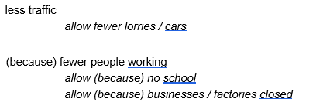
Exam questions – YOU DO
Q1. Cars cause atmospheric pollution. Some car emissions contain nitrogen dioxide. The table below shows the concentration of nitrogen dioxide in the air in three different areas for 1 week.
(a) Which column of data has the greatest range? Tick (✓) one box.
(1)
(b) Explain why the concentration of nitrogen dioxide in the air is lower on Sunday.
…………………………………………………………………………………………………………………………………………………………..
…………………………………………………………………………………………………………………………………………………………..
…………………………………………………………………………………………………………………………………………………………..
…………………………………………………………………………………………………………………………………………………………..
(2)
 | Concentration of nitrogen dioxide in the air in arbitrary units
Day | City centre | Countryside | Motorway
Monday | 35 | 8 | 22
Tuesday | 37 | 8 | 23
Wednesday | 37 | 8 | 23
Thursday | 34 | 8 | 23
Friday | 37 | 8 | 23
Saturday | 29 | 7 | 20
Sunday | 22 | 6 | 17
City centre

Slide 64
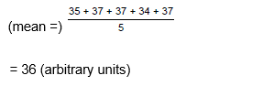
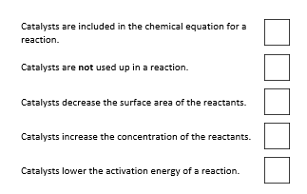
Exam questions – YOU DO
(c) Calculate the mean value for the concentration of nitrogen dioxide in the air in the city centre for the days from Monday to Friday.
Use the table above.
…………………………………………………………………………………………………………………………………………………………..
…………………………………………………………………………………………………………………………………………………………..
…………………………………………………………………………………………………………………………………………………………..
…………………………………………………………………………………………………………………………………………………………..
Mean value for concentration of nitrogen dioxide = ………………………… arbitrary units
(2)
Nitrogen dioxide is removed from car emissions by catalytic converters.
(d) Which two of the following are correct statements about catalysts? Tick (✓) two boxes.
(2)
Catalysts are not used up in a reaction
Catalysts lower the activation energy of a reaction

Slide 65
Exam questions – YOU DO
(e) The catalyst in catalytic converters contains platinum. Platinum is an unreactive metal obtained from the Earth’s crust. Complete the sentence.
Choose the answer from the box.
Platinum is a …………………………………………………… .
(1)
(f) Emissions from cars that burn fossil fuels contain carbon dioxide. What is used to test for carbon dioxide? Tick (✓) one box.
(1)
(g) Describe how oxides of nitrogen are produced in a car engine.
…………………………………………………………………………………………………………………………………………………………..
…………………………………………………………………………………………………………………………………………………………..
…………………………………………………………………………………………………………………………………………………………..
…………………………………………………………………………………………………………………………………………………………..
(2)
(Total 11 marks)
finite resource | formulation | renewable resource
Finite resource
Limewater

Slide 66
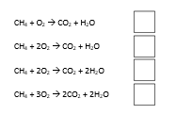
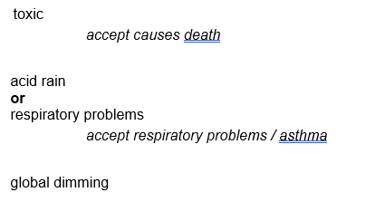
Exam questions – YOU DO
Q1.
(a) Methane is burned in a plentiful supply of oxygen. Which is the correct balanced chemical equation? Tick one box.
(1)
(b) Burning fuels causes atmospheric pollution. Write one effect for each pollutant in Table 1.
(3)
Table 1
Pollutant | Effect
Carbon monoxide
Sulfur dioxide
Particulates

Slide 67
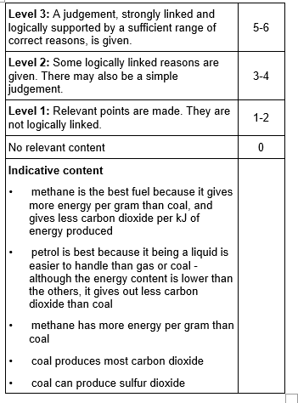
Exam questions – YOU DO
(c) Methane, petrol and coal are fuels. Table 2 shows information about these fuels.
Evaluate the use of the fuels.
Use in the information in Table 2 and your knowledge.
…………………………………………………………………………………………………………………………………………………………..
…………………………………………………………………………………………………………………………………………………………..
…………………………………………………………………………………………………………………………………………………………..
…………………………………………………………………………………………………………………………………………………………..
…………………………………………………………………………………………………………………………………………………………..
…………………………………………………………………………………………………………………………………………………………..
…………………………………………………………………………………………………………………………………………………………..
…………………………………………………………………………………………………………………………………………………………..
…………………………………………………………………………………………………………………………………………………………..
…………………………………………………………………………………………………………………………………………………………..
…………………………………………………………………………………………………………………………………………………………..
…………………………………………………………………………………………………………………………………………………………..
(6)
(Total 10 marks)
Table 2
Fuel | State | Energy content in kJ per g | Mass in mg of CO₂ produced for one kJ of energy released
Methane | Gas | 52 | 53
Petrol | Liquid | 43 | 71
Coal | Solid | 24 | 93

Slide 68
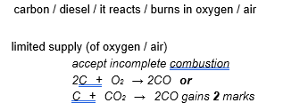
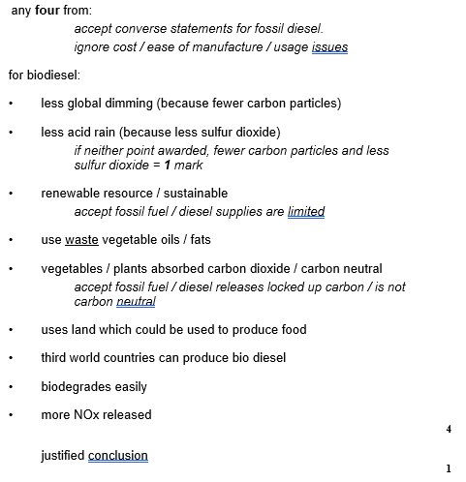
Exam questions – YOU DO
Q3. This information about diesel was printed in a magazine.
Almost all of the crops that we eat can be converted into fuel for cars. Vegetable oils can be used as biodiesel. Diesel from crude oil is called fossil diesel. When either biodiesel or fossil diesel burn they both produce similar amounts of carbon dioxide. Both types of diesel produce carbon monoxide. However, biodiesel produces fewer carbon particles and less sulfur dioxide.
(a) Carbon monoxide can be produced when diesel burns in a car engine. Explain how.
…………………………………………………………………………………………………………………………………………………………..
…………………………………………………………………………………………………………………………………………………………..
…………………………………………………………………………………………………………………………………………………………..
(2)
(b) Use the information at the start of this question and your knowledge and understanding to evaluate the use of biodiesel compared with fossil diesel as a fuel for cars.
Remember to give a conclusion to your evaluation.
…………………………………………………………………………………………………………………………………………………………..
…………………………………………………………………………………………………………………………………………………………..
…………………………………………………………………………………………………………………………………………………………..
…………………………………………………………………………………………………………………………………………………………..
…………………………………………………………………………………………………………………………………………………………..
…………………………………………………………………………………………………………………………………………………………..
…………………………………………………………………………………………………………………………………………………………..
…………………………………………………………………………………………………………………………………………………………..
…………………………………………………………………………………………………………………………………………………………..
…………………………………………………………………………………………………………………………………………………………..
(5)
(Total 7 marks)

Slide 69
DO NOW
Date: ……………………………………….
 | ANSWER
Q1.
Q2.
Q3.
Q4.
Q5.
Date: ……………………………………….
 | ANSWER
Q1.
Q2.
Q3.
Q4.
Q5.
6

Slide 70
DO NOW
Date: ……………………………………….
 | ANSWER
Q1.
Q2.
Q3.
Q4.
Q5.
Date: ……………………………………….
 | ANSWER
Q1.
Q2.
Q3.
Q4.
Q5.
7

Slide 71
DO NOW
Date: ……………………………………….
 | ANSWER
Q1.
Q2.
Q3.
Q4.
Q5.
Date: ……………………………………….
 | ANSWER
Q1.
Q2.
Q3.
Q4.
Q5.
8

Slide 72
Knowledge Retrieval Quiz 1
Date: ……………………………………….
Score: …………...
 |  | Answer
Q1. | Insert question in bold
Q2.
Q3.
Q4.
Q5.
Q6.
Q7.
Q8.
Q9.
Q10.
9

Slide 73
Knowledge Retrieval Quiz 2
Date: ……………………………………….
Score: …………...
 |  | Answer
Q1. | Insert question in bold
Q2.
Q3.
Q4.
Q5.
Q6.
Q7.
Q8.
Q9.
Q10.
10

Slide 74
Extra Space
……………………………………………………………………………………………………………………………………………………………………………………………………………………………………………………………………………………………………………………………………………………………………………………………………………………………………………………………………………………………………………………………………………………………………………………………………………………………………………………………………………………………………………………………………………………………………………………………………………………………………………………………………………………………………………………………………………………………………………………………………………………………………………………………………………………………………………………………………………………………………………………………………………………………………………………………………………………………………………………………………………………………………………………………………………………………………………………………………………………………………………………………………………………………………………………………………………………………………………………………………………………………………………………………………………………………………………………………………………………………………………………………………………………………………………………………..
…………………………………………………………………………………………………………………………………………………………………………………………………………………………………………………………………………………………………………………………………………………………………………………………………………………………………………………………………………………………………………………………………………………………………………………………………………………………………………………………………………………………………………………………………………………………………………………………………………………………………………………………………………………………………………………………………………………………………………………………………………………………………………………………………………………………………………………………………………………………………………………………………………………………………………………………………………………………………………………………………………………………………………………………………………………………………………………………………………………………………………………………………………………………………………………………………………………………………………………………………………………………………………………………………………………………………..
…………………………………………………………………………………………………………………………………………………………………………………………………………………………………………………………………………………………………………………………………………………………………………………………………………………………………………………………………………………………………………………………………………………………………………………………………………………………………………………………………………………………………………………………………………………………………………………………………
12

Slide 75
Extra Space
……………………………………………………………………………………………………………………………………………………………………………………………………………………………………………………………………………………………………………………………………………………………………………………………………………………………………………………………………………………………………………………………………………………………………………………………………………………………………………………………………………………………………………………………………………………………………………………………………………………………………………………………………………………………………………………………………………………………………………………………………………………………………………………………………………………………………………………………………………………………………………………………………………………………………………………………………………………………………………………………………………………………………………………………………………………………………………………………………………………………………………………………………………………………………………………………………………………………………………………………………………………………………………………………………………………………………………………………………………………………………………………………………………………………………………………………..
…………………………………………………………………………………………………………………………………………………………………………………………………………………………………………………………………………………………………………………………………………………………………………………………………………………………………………………………………………………………………………………………………………………………………………………………………………………………………………………………………………………………………………………………………………………………………………………………………………………………………………………………………………………………………………………………………………………………………………………………………………………………………………………………………………………………………………………………………………………………………………………………………………………………………………………………………………………………………………………………………………………………………………………………………………………………………………………………………………………………………………………………………………………………………………………………………………………………………………………………………………………………………………………………………………………………………..
…………………………………………………………………………………………………………………………………………………………………………………………………………………………………………………………………………………………………………………………………………………………………………………………………………………………………………………………………………………………………………………………………………………………………………………………………………………………………………………………………………………………………………………………………………………………………………………………………
13

Slide 76
Extra Space
……………………………………………………………………………………………………………………………………………………………………………………………………………………………………………………………………………………………………………………………………………………………………………………………………………………………………………………………………………………………………………………………………………………………………………………………………………………………………………………………………………………………………………………………………………………………………………………………………………………………………………………………………………………………………………………………………………………………………………………………………………………………………………………………………………………………………………………………………………………………………………………………………………………………………………………………………………………………………………………………………………………………………………………………………………………………………………………………………………………………………………………………………………………………………………………………………………………………………………………………………………………………………………………………………………………………………………………………………………………………………………………………………………………………………………………………..
…………………………………………………………………………………………………………………………………………………………………………………………………………………………………………………………………………………………………………………………………………………………………………………………………………………………………………………………………………………………………………………………………………………………………………………………………………………………………………………………………………………………………………………………………………………………………………………………………………………………………………………………………………………………………………………………………………………………………………………………………………………………………………………………………………………………………………………………………………………………………………………………………………………………………………………………………………………………………………………………………………………………………………………………………………………………………………………………………………………………………………………………………………………………………………………………………………………………………………………………………………………………………………………………………………………………………..
…………………………………………………………………………………………………………………………………………………………………………………………………………………………………………………………………………………………………………………………………………………………………………………………………………………………………………………………………………………………………………………………………………………………………………………………………………………………………………………………………………………………………………………………………………………………………………………………………
14

Slide 77
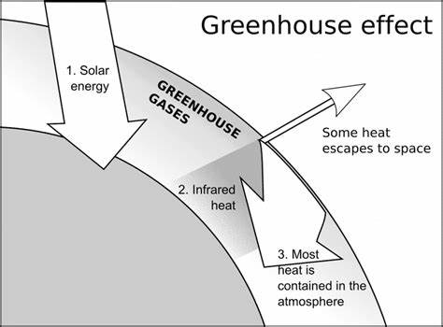
KNOWLEDGE ORGANISER
Subject: Science | Topic: Atmosphere | Term: Spring
KEY WORDS | Key words
1 | Atmosphere | The layer of gases surrounding the Earth’s surface.
2 | Photosynthesis | A chemical reaction that plants use to produce glucose.
3 | Greenhouse gas | Gases that contribute to global warming.
4 | Carbon footprint | The total amount of carbon dioxide and other greenhouse gases emitted over the full life cycle of a product, service or event.
KEY EXAMPLES
5 | Sulphur dioxide | A gas that causes acid rain.
6 | Oxides of nitrogen | A group of gases that cause acid rain.
7 | Carbon monoxide | A gas produced by incomplete combustion of fuels.
8 | Carbon particles | Particulates formed from unburned hydrocarbons and solid particles.
KEY DIAGRAMS
16

