Slide 1
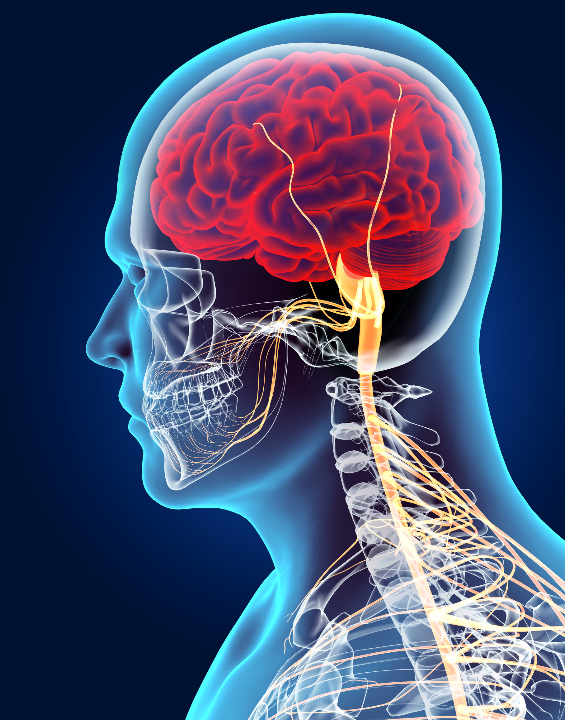
KS4 Homeostasis & Response (Trilogy student booklet B)
Name
Class
Tutor Group
KS4 Science YEAR 11 Homeostasis & Response
KEYSTONE WORDS
Homeostasis | Homeostasis is the regulation of internal conditions to maintain optimal conditions for enzyme action and cell function.
Nervous system | The nervous system enables humans to react to their surroundings and to coordinate their behaviour.
Endocrine system | The endocrine system is composed of glands which secrete chemicals called hormones directly into the bloodstream.
Reproduction | The process by which offspring are produced by parents.
Hormone | Chemical messengers produced by glands.

Slide 2
BIG PICTURE
How will my prior knowledge develop my understanding of this topic?
Y7 | The Cells and Organisation topic introduced the body structures required.
Y8
Y9 | The GCSE Cell Biology topic added depth to prior learning from KS3. This is a threshold topic for this topic.
Learning Journey
Subtopic 1 | 4.5.1 & 4.5.2.1 – Homeostasis and the human nervous system | Subtopic 5 | 4.5.3.4 Hormones in human reproduction
Subtopic 2 | RP – practical & analysis | Subtopic 6 | 4.5.3.5 Contraception 4.5.3.6 HT only Infertility
Subtopic 3 | 4.5.3.1 Human endocrine system | Subtopic 7 | 4.5.4.2 HT only Use of plant hormones
Subtopic 4 | 4.5.3.2 Control of blood glucose concentration
Key knowledge
By the end of this topic you should know… | How the body responds to changes in the environment using the nervous system and the endocrine system.
By the end of this topic should be able to do… | Explain how to determine the effect of distractions on reaction times.
How will this knowledge develop my understanding of future topics?
This topic is one of the final topics in the course. It is not linked to future topics; however, it will deepen understanding of previous topics. For example, Organisation and Cell Biology.

Slide 3
KEY VOCABULARY LIST
Homeostasis | Homeostasis is the regulation of internal conditions to maintain optimal conditions for enzyme action and cell function.
Nervous system | The nervous system enables humans to react to their surroundings and to coordinate their behaviour.
Endocrine system | The endocrine system is composed of glands which secrete chemicals called hormones directly into the bloodstream.
Reproduction | The process by which offspring are produced by parents.
Hormone | Chemical messengers produced by glands.
EXPECTATIONS
Always write in black or blue pen. Always use a ruler for straight lines. If you make a mistake, cross it out with a single line. Always draw diagrams, tables and graphs in pencil with a ruler if necessary Always mark and correct your work in green pen. Respond to any feedback your teacher gives you in green pen. Take pride in your work, make it neat! All tasks should be completed in silence and by yourself unless your teacher tells you otherwise.
PROUD
Punctuation and grammar
Ruler and pencil for diagrams
Outstanding effort every lesson
Underline date and title
Dates and titles every lesson
PROUD FRIDAY
Any piece of work you complete, which meets our PROUD expectations can be taken to the PROUD station during Friday lunchtime. Show your work to a member of SLT and receive a sweet treat!

Slide 4
Subtopic 5: 4.5.3.4 Hormones in human reproduction
Learning Objective
We are learning to describe the effect of different reproductive hormones on the secondary sexual characteristics
Why are we learning about this?
The human reproductive system is a complex system that uses a range of hormones that interact in different ways. By manipulating these hormones we can control a person's ability to get pregnant.
3

Slide 5
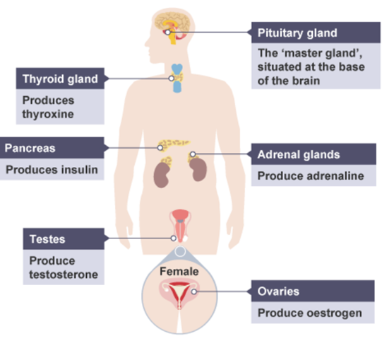
1 2 3 4 5 6 7 8 9 10 11 12 13 14 15 16 17 18 19 20 21 22 23 24 25 26 27 28 29 30 | The role of reproductive hormones in the menstrual cycle A hormone is a chemical substance, produced by a gland and carried by the blood, which alters the activity of specific target organs (and is then destroyed by the liver). Different hormones affect different organs or cells. Puberty Puberty is the stage in life when a child's body develops into an adult's body. The changes take place gradually, usually between the ages of 10 and 16. During puberty, reproductive hormones cause secondary sex characteristics to develop: testosterone - produced by the testes – is the main male reproductive hormone and it stimulates sperm production oestrogen - produced by the ovaries – is the main female reproductive hormone. At puberty, eggs begin to mature in the ovaries and one is released approximately every 28 days. This is ovulation. The menstrual cycle is a recurring process which takes around 28 days. During the process, the lining of the uterus is prepared for pregnancy. If implantation of the fertilised egg into the uterus lining does not happen, the lining is then shed. This is known as menstruation. Several hormones are involved in the menstrual cycle of a woman. – for example, they are involved in controlling the release of an egg each month from an ovary and changing the

Slide 6
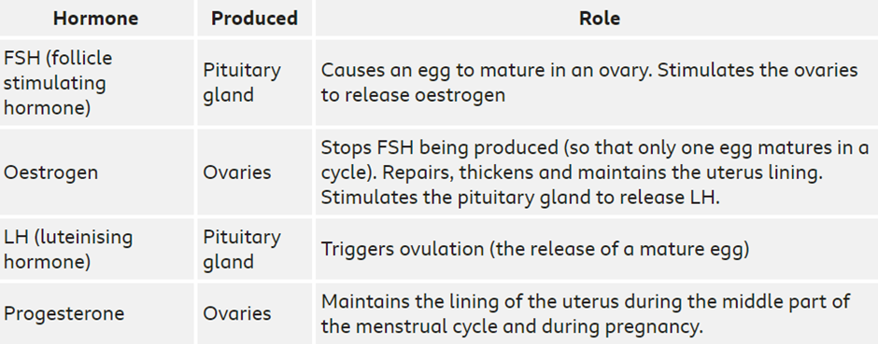
1 2 3 4 5 6 7 8 9 10 11 12 13 14 15 16 17 18 19 20 21 22 23 24 25 26 27 28 29 30 | thickness of the uterus lining. Follicle stimulating hormone (FSH) causes maturation of an egg in the ovary. Luteinising hormone (LH) stimulates the release of the egg. Oestrogen and progesterone are involved in maintaining the uterus lining If a woman becomes pregnant, the placenta produces progesterone. This maintains the lining of the uterus during pregnancy and means that menstruation does not happen. Oestrogen and progesterone in the control of the menstrual cycle Several hormones are involved in the menstrual cycle of a woman: • follicle stimulating hormone (FSH) causes the maturation of an egg in the ovary • luteinising hormone (LH) stimulates the release of the egg • oestrogen is involved in repairing and thickening the uterus lining, progesterone maintains it The menstrual cycles last for approximately 28 days, and graphs can be used to follow changes to the hormones during this process. You should be able to extract and interpret data from graphs showing hormone levels during the menstrual cycle. Stage 1 – Day 1 menstruation starts. #the uterus lining breaks down for 3-4 days. Stage 2 - The uterus lining builds up again as oestrogen is released, into a spongy layer full of blood vessels, ready to receive a fertilised egg. Stage 3 – Oestrogen stimulates the release of LH which causes ovulation to occur. Stage 4 – Progesterone remains to maintain the uterus wall lining for about 14 days until day 28 when the progesterone levels fall and the uterus lining breaks down and the whole cycle starts again.

Slide 7
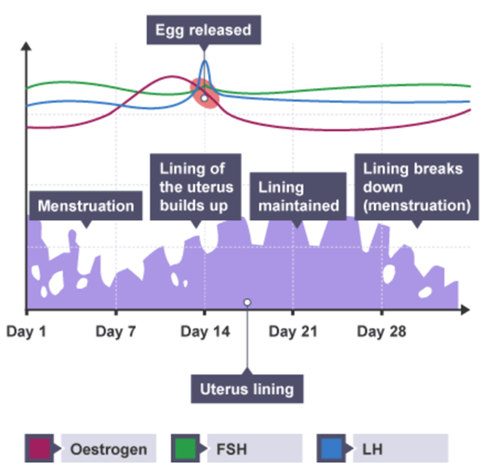
1 2 3 4 5 6 7 8 9 10 11 12 13 14 15 16 17 18 19 20 21 22 23 24 25 26 27 28 29 30

Slide 8
Technique 1
What is the function of the reproductive hormones?
……………………………………………………………………………………………………………………………………
b What is the difference between primary and secondary sexual characteristics?
……………………………………………………………………………………………………………………………………
c Which organ produces oestrogen?
…………………………………………………………………………………………………………………………………
d Where is testosterone produced?
……………………………………………………………………………………………………………………………………
e What is ovulation and how often does it occur?
……………………………………………………………………………………………………………………………………
f What is the function of oestrogen?
……………………………………………………………………………………………………………………………………
g Which hormone stimulates sperm production?
……………………………………………………………………………………………………………………………………
h Name the hormones involved in the menstrual cycle.
……………………………………………………………………………………………………………………………………
i Describe 3 changes that occur in males & females during puberty.
……………………………………………………………………………………………………………………………………
J Which hormone causes maturation of an egg in the ovary?
……………………………………………………………………………………………………………………………………
k Which hormone stimulates the release of the egg from the ovary?
……………………………………………………………………………………………………………………………………

Slide 9
If it didn’t
I do
If oestrogen was not produced by the ovaries, what would be affected?
…………………………………………………………………………………………………………………………………………………………………………………………………………………………………………………………………………………………………………….We do
b. If FSH was not produced by the pituitary gland, what would this cause?
……………………………………………………………………………………………………………………………………………………………………………………………………………………………………………………………………………………………………………
You do
c. If the testes did not produce testosterone, what would be the effect?
………………………………………………………………………………………………………………………………………………………………………………………………………………………………………………………………………………………………………………
d. If the uterus lining did not thicken during the menstrual cycle, how would this affect the ability to become pregnant?
………………………………………………………………………………………………………………………………………………………………………………………………………………………………………………………………………………………………………………
e. If LH did not reach a peak during the middle of the menstrual cycle, how would this affect ovulation?
………………………………………………………………………………………………………………………………………………………………………………………………………………………………………………………………………………………………………………
f. If the female egg does not become fertilised, what happens to the uterus lining?
………………………………………………………………………………………………………………………………………………………………………………………………………………………………………………………………………………………………………………
g. Describe three effects if the female secondary characteristics did not develop
………………………………………………………………………………………………………………………………………………………………………………………………………………………………………………………………………………………………………………

Slide 10
Contrasting concepts
I do
Compare the male & female primary sexual organs?
……………………………………………………………………………………………………………………………………………………………………………………………………………………………………………………………………………………………………………..
We do
Compare the male & female secondary sexual characteristics?
……………………………………………………………………………………………………………………………………………………………………………………………………………………………………………………………………………………………………………..
You do
Compare the ovaries & testes
……………………………………………………………………………………………………………………………………………………………………………………………………………………………………………………………………………………………………………..
Compare Oestrogen & Testosterone
……………………………………………………………………………………………………………………………………………………………………………………………………………………………………………………………………………………………………………..
What is the difference between the start, middle & end of the female menstrual cycle?
……………………………………………………………………………………………………………………………………………………………………………………………………………………………………………………………………………………………………………..
Compare the hormones FSH and LH
……………………………………………………………………………………………………………………………………………………………………………………………………………………………………………………………………………………………………………..
g. Compare the difference between production of eggs in mature women & sperm in mature men
……………………………………………………………………………………………………………………………………………………………………………………………………………………………………………………………………………………………………………..

Slide 11
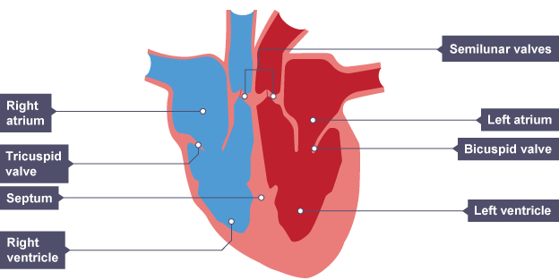
Interleaving
The blood within the circulatory system carries the reproductive hormones around the body. You have learnt about the blood & the circulatory system when studying Organisation.
Describe the function of the circulatory system. ………………………………………………………………………………………………………………………………………………………………………………………………………………………………………………………………………………………………………..
State the 2 main organs that form part of the circulatory system. ………………………………………………………………………………………………………………………………………………………………………………………………………………………………………………………………………………………………………..
Label the 4 chambers of the heart
d. Name the two blood vessels that carry blood INTO the heart. ……………………………………………………………………………………………………………………………………………………………………………………………………………………………………………………………………………………………………………………….
e. Name the two blood vessels that carry blood out of the heart. ……………………………………………………………………………………………………………………………………………………………………………………………………………………………………………………………………………………………………………………….

Slide 12
Interleaving
f. Name the 3 different types of blood vessels in the body
……………………………………………………………………………………………………………………………………………………………………………………………………………………………………………………………………………………………………………………….
g. Describe the different function of each type of blood vessel & how their structure differs. ……………………………………………………………………………………………………………………………………………………………………………………………………………………………………………………………………………………………………………………….
h. The blood has four main constituents. Name them ………………………………………………………………………………………………………………………………………………………………………………………………………………………………………………………………………………………………………………………..
i. Describe the function of each of the four blood constituents. ………………………………………………………………………………………………………………………………………………………………………………………………………………………………………………………………………………………………………………………..
j. Which part of blood carries the reproductive hormones?
………………………………………………………………………………………………………………………………………………………………………………………………………………………………………………………………………………………………………………………..
k. Which blood cell does NOT contain a nucleus? Explain your answer. ………………………………………………………………………………………………………………………………………………………………………………………………………………………………………………………………………………………………………………………..
l. Describe the difference between oxygenated & deoxygenated blood. ………………………………………………………………………………………………………………………………………………………………………………………………………………………………………………………………………………………………………………………..
m. The human circulatory system is made up of 2 separate circuits. What is this called?
………………………………………………………………………………………………………………………………………………………………………………………………………………………………………………………………………………………………………………………..
n. What is the function of each circuit? ………………………………………………………………………………………………………………………………………………………………………………………………………………………………………………………………………………………………………………………..

Slide 13
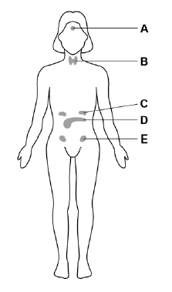
Q1.
The menstrual cycle in a woman is controlled by hormones.
The diagram shows some of the glands in a woman’s body that produce hormones.
The hormones that control the menstrual cycle are produced by the pituitary gland and by the ovaries.
(a) Which gland is the pituitary gland? …………………………………………..
(b) Which gland is the ovary? …………………………………
(c) Complete the sentence.
In the menstrual cycle, one egg is released approximately every ……………… days. (1)
(d) Which hormone is used in the oral contraceptive pill? …………………….. (1)
(e) Describe how the oral contraceptive pill stops a woman becoming pregnant.
……………………………………………………………………………………………………………………………………………………………………………………………………………………………………………………………………………………………………………..………………………………………………………………………………………………………………………………………………………………………………………………………………………………………………………………………………………………………(2)

Slide 14
(f) Complete the sentences. Choose the answers from the box.
Development of the female secondary sex characteristics is controlled by……………………………….. Sperm production is stimulated by…………………………………………………. (2)
(Total 8 marks)
Q2.
Hormones are sometimes used to regulate human reproduction.
(a) (i) What is a hormone?
……………………………………………………………………………………………………………………………………………………………………………………………………………………………………………………………………………………………………… (1)
(ii) How are hormones transported around the body?
……………………………………………………………………………………………………………………………………………………………………………………………………………………………………………………………………………………………………… (1)
The monthly cycle of women is controlled by hormones.
(b) Name the two glands that secrete these hormones.
1. …………………………………………………………………………………….
2. …………………………………………………………………………………… (2)
(Total 4 marks)
Q3.
(a) Describe two ways in which fertility in women can be controlled by giving hormones.
1.………………………………………………………………………………………………………………………………………………………………………………………………………………………………………………………………………………………………………
2.………………………………………………………………………………………………………………………………………………………………………………………………………………………………………………………………………………………… (2)

Slide 15
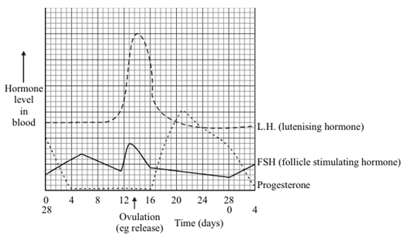
Q4.
The graph shows changes in the levels of three hormones in a menstrual cycle.
(a) What does the graph suggest the stimuli might be which cause the egg to be released?
……………………………………………………………………………………………………………………………………………………………………………………………………………………………………………………………………………………………………………..
………………………………………………………………………………………………………………………………………………………………………………………………………………………………………………………………………………………………………… (3)
(Total 3 marks)

Slide 16
Lesson 6: 4.5.3.5 Contraception
4.5.3.6 HT only Infertility
Learning Objective
We are learning the advantages and disadvantages of different methods of contraception and how hormones can be used to treat infertility
Why are we learning about this?
This lessons helps us understand how we use hormones to control the size of families and populations. For example, through contraception and fertility treatment.

Slide 17
1 2 3 4 5 6 7 8 9 10 11 12 13 14 15 16 17 18 19 20 21 22 23 24 | Contraception Human fertility is controlled by hormones, so fertility can be controlled using hormonal and non- hormonal methods of contraception. Hormonal contraception The oral contraceptive, which is known as the pill, contains oestrogen or progesterone. These hormones prevent the production of FSH, so eggs cannot mature. Benefits and risks of hormonal contraception Oral contraceptives are more than 99% effective if taken correctly and can reduce the risk of certain cancers. However, there are possible side effects, such as changes in weight, mood and blood pressure due to high levels of oestrogen. Modern pills contain much less oestrogen. Contraceptive injections, implants or skin patches contain slow release progesterone to prevent the maturation and release of eggs. Non-hormonal contraception Fertility can be controlled without hormones. These methods include: physical barrier methods such as condoms and diaphragms, which prevent the sperm reaching an egg intrauterine devices (IUD) also known as a coil, prevent the implantation of an embryo or release of a hormone spermicidal agents which kill or disable sperm abstaining from intercourse when an egg may be in the oviduct surgical methods of male and female sterilisation, eg a vasectomy, where the sperm ducts are cut and tied

Slide 18
1 2 3 4 5 6 7 8 9 10 11 12 13 14 15 16 17 18 19 20 21 22 23 24 25 26 27 28 29 30 | Benefits and risks of non-hormonal contraception Condoms are easy and quick to use, but sometimes they can tear or rip. Diaphragms need to be put in just before sex and left in several hours afterwards. IUDs need to be fitted by a health professional. IUDs can remain in position for up to 10 years. However, there is a small risk of causing an ectopic pregnancy, which leads to complications for both the mother and the foetus. Spermicidal agents can be added to other physical barriers such as condoms, but some people can have allergic reactions to these. Abstaining can be used successfully, but if the timings are not accurate, the chance of pregnancy is high. Surgical methods cannot be reversed, and is considered permanent. Infertility treatments – Higher Tier Some women have difficulty becoming pregnant because they don't produce enough FSH to allow their eggs to mature. Fertility drugs contain FSH and LH, which stimulate eggs to mature in the ovary. Fertility treatments increase a woman's chance of becoming pregnant, although the treatment may not always work. On the other hand, because the treatment boosts the production of mature eggs, it increases the chance of twins or triplets. Multiple pregnancies carry a risk of complications, and may lead to premature or underweight babies. If a couple are having difficulty conceiving a child because there are issues with the quality of the man's sperm, or a woman has blocked oviducts, then In vitro fertilisation (IVF) treatment can be used. IVF involves giving a mother FSH and LH to stimulate the maturation of several eggs. The eggs are collected from the mother and fertilised by sperm from the father in a dish in the laboratory. The fertilised eggs develop into embryos. At the stage when they are tiny balls of cells, one or two embryos are inserted into the mother's uterus (womb). The development of microscopy techniques has allowed IVF treatments to be developed further.

Slide 19
1 2 3 4 5 6 7 8 9 10 11 12 13 14 15 16 17 18 19 20 21 22 23 24 25 26 27 28 29 30 | Evaluating infertility treatments The NHS has to choose which couples they can fund for IVF. If they cannot be treated on the NHS, some people choose to pay privately for treatment. This is very expensive, and costs several thousand pounds. The chances of a successful pregnancy vary depending on the age of the woman involved. As a woman's age increases, the chance of conception decreases. In particular, the chances of a woman over the age of 43 becoming pregnant decreases to a 5% success rate. Data from the NHS choices website shows that: In 2010, the percentage of IVF treatments that resulted in a live birth was: 32.2% for women under 35 27.7% for women aged 35-37 20.8% for women aged 38-39 13.6% for women aged 40-42 5% for women aged 43-44 1.9% for women aged over 44 Advantages of IVF It allows people to have babies of their own, who otherwise can't due to a variety of reasons. It has a safe track record and has been used since 1978. The embryos can be screened for genetic diseases, which is important for families that already have an affected child. Only unaffected embryos are used. Unused eggs can be used for research or donated to other couples. Disadvantages of IVF There are side effects from the drugs used, such as hot flushes and severe headaches. There is a possibility of multiple births, which is dangerous for mother and babies. Ovarian hyper-stimulation syndrome (OHS), when too many eggs develop in the ovaries. It is very emotionally and physically stressful. The success rates are not high. Ethical concerns . Some people worry about the ethical implications of IVF from different religious and moral perspectives. They are concerned that couples may want 'designer

Slide 20
1 2 3 4 | babies' with 'desirable' qualities, so may only want certain fertilised eggs. For example, they may want a girl if they have lots of boys in the family. Also, the embryos that are not used may be destroyed. Some people might view these as new lives, so may consider destroying them to be unethical.

Slide 21
Rehearsal questions
What is the name of the main female reproductive hormone?
……………………………………………………………………………………………………………………………………
b What is meant by the term contraception?
……………………………………………………………………………………………………………………………………
c How can the methods of contraception be categorised?
…………………………………………………………………………………………………………………………………
d Name the two female hormones involved in contraception?
……………………………………………………………………………………………………………………………………
e What is meant by IVF and when is it used?
……………………………………………………………………………………………………………………………………
f State 1 advantage and 1 disadvantage of undertaking IVF treatment.
……………………………………………………………………………………………………………………………………
……………………………………………………………………………………………………………………………………
g Suggest 2 hormonal & 2 non-hormonal methods of contraception.
……………………………………………………………………………………………………………………………………
……………………………………………………………………………………………………………………………………
h What is the name of the method that prevents pregnancy?
……………………………………………………………………………………………………………………………………
i Explain how oestrogen can be used in contraception.
……………………………………………………………………………………………………………………………………
……………………………………………………………………………………………………………………………………
j Explain how progesterone can be used in contraception?
……………………………………………………………………………………………………………………………………
……………………………………………………………………………………………………………………………………

Slide 22
Rehearsal questions
k. Group the following methods of contraception– spermicides, sterilisation, the pill, condoms, IUD, implants
……………………………………………………………………………………………………………………………………
l What is the name of the method that can be used to increase fertility? (HT)
……………………………………………………………………………………………………………………………………
m Suggest why some couples may not undertake IVF treatment. (HT)
…………………………………………………………………………………………………………………………………

Slide 23
Contrasting concepts
I do
Compare the different methods of contraception
…………………………………………………………………………………………………………………………………………………………………………………………………………………………………………………………………………………………………………….
We do
b. Give 2 differences between oral contraceptives & barrier methods of contraception
……………………………………………………………………………………………………………………………………………………………………………………………………………………………………………………………………………………………………………Y
You do
c What are the differences between the way the female reproductive hormones are used in contraception
………………………………………………………………………………………………………………………………………………………………………………………………………………………………………………………………………………………………………………
………………………………………………………………………………………………………………………………………………………………………………………………………………………………………………………………………………………………………………
d. Compare the way condoms & IUDs prevent pregnancy
………………………………………………………………………………………………………………………………………………………………………………………………………………………………………………………………………………………………………………
………………………………………………………………………………………………………………………………………………………………………………………………………………………………………………………………………………………………………………
e. Compare the methods of hormonal contraception to that of fertility treatment. Include the way hormones are used differently in your comparison
………………………………………………………………………………………………………………………………………………………………………………………………………………………………………………………………………………………………………………………………………………………………………………………………………………………………………………………………………
………………………………………………………………………………………………………………………………………………………
f

Slide 24
Contrasting concepts
You do
f. What are the advantages & disadvantages of IVF treatment? (HT)
………………………………………………………………………………………………………………………………………………………………………………………………………………………………………………………………………………………………………………………………………………………………………………………………………………………………………………………………………
……………………………………………………………………………………………………………………………………………………..g. Compare the scientific & ethical issues associated with IVF (HT)
………………………………………………………………………………………………………………………………………………………………………………………………………………………………………………………………………………………………………………
………………………………………………………………………………………………………………………………………………………………………………………………………………………………………………………………………………………………………………

Slide 25
Wrong answers
I do
The following are methods of hormonal contraception. Some of these are incorrect?
Condoms
Intrauterine devices
Implants
Contraceptive pill
Sterilisation
Abstinence
……………………………………………………………………………………………………………………………………………………………………………………………………………………………………………………………………………………………………………………………………………………………………………………………………………………………………………………………………………………………………………………………………………………………………………………………………………………………..
We do
A man & woman were both sterilised in a previous relationship. They have now met each other and want children. Why are they wrong to go to the doctor to have their procedures reversed?
……………………………………………………………………………………………………………………………………………………………………………………………………………………………………………………………………………………………………………………………………………………………………………………………………………………………………………………………………………………………………………………………………………………………………………………………………………………………..
You do
A couple want children but the woman is not releasing mature eggs. Explain why the woman is wrong to go to the doctor for some medication.
……………………………………………………………………………………………………………………………………………………………………………………………………………………………………………………………………………………………………………………………………………………………………………………………………………………………………………………………………………………………………………………………………………………………………………………………………………………………..

Slide 26
Wrong answers
You do
Contraception is the use of methods or devices to help pregnancy or sexually transmitted infections (STIs). There are different types of contraception, such as genetic, surgical and physical methods.
Hormonal contraception uses synthetic hormones to interfere with the natural hormonal cycle and prevent ovulation or implantation of sperm. Examples of hormonal contraception are the pill, the condom, the implant, and the patch.
Non-hormonal contraception uses physical barriers or chemicals to prevent the sperm from reaching or fertilising the egg. Examples of non-hormonal contraception are the pill, diaphragms, intrauterine devices (IUDs), spermicides, and natural family planning.
Surgical contraception involves permanent procedures that block or cut the tubes that carry the sperm or the egg. Examples of surgical contraception are vasectomy for women and tubal ligation for men.
Each method of contraception has its benefits and risks, such as effectiveness, side effects, convenience, protection from STIs, and reversibility.
Contraception also raises ethical issues from different religious and moral perspectives. Some people may oppose contraception because they believe it goes against the natural law, the sanctity of life, or the divine plan. Others may support contraception because they believe it promotes human dignity, freedom, and responsibility.
d. Correct the 5 incorrect statements in the above text
…………………………………………………………………………………………………………………………………………………………………………………………………………………………………………………………………………………………………………..
……………………………………………………………………………………………………………………………………………………………………………………………………………………………………………………………………………………………………………..
……………………………………………………………………………………………………………………………………………………………………………………………………………………………………………………………………………………………………………..

Slide 27
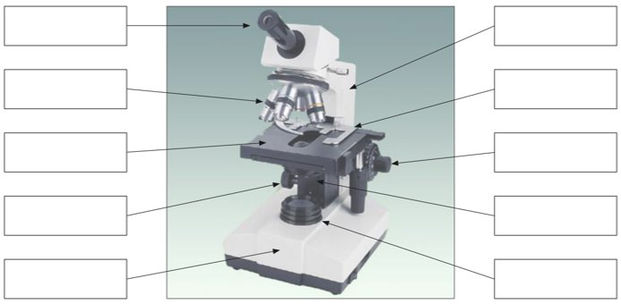
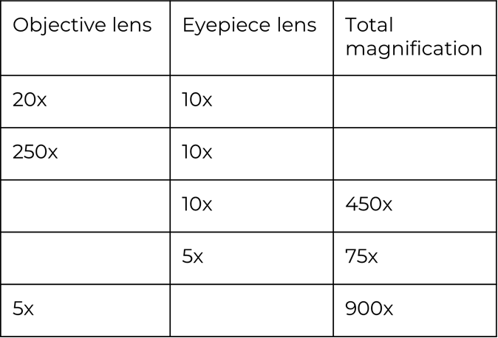
Interleaving
You have previously studied microscopy on the B1 Cell Biology topic. Microscopy techniques have enabled fertility treatments to develop.
Label the parts of the light microscope.
Calculating magnification.
Write the equation to calculate magnification
…………………………………………………………………………………………………………………………………………………………………
Complete the table below

Slide 28
Interleaving
c. Write the equation that links magnification to the real & image sizes
……………………………………………………………………………………………………………………………………………………………
d. Using the equation above complete the table
e. Compare the use of a light & an electron scanning microscope. ……………………………………………………………………………………………………………………………………………………………………………………………………………………………………………………………………………………………………………………….
……………………………………………………………………………………………………………………………………………………………………………………………………………………………………………………………………………………………………………………….. ………………………………………………………………………………………………………………………………………………………………………………………………………………………………………………………………………………………………………………………..

Slide 29
Q1. Hormones regulate the functions of many organs.
Complete the following sentences.
(a) Hormones control the monthly release of an egg from the woman’s ................................... .
(1)
(b) Hormones also control the thickness of the lining of her .................................. . (1)
(c) Hormones given to women to stimulate the release of eggs are called ..................................... drugs. (1)
(Total 3 marks)
Q2. A woman’s fertility can be controlled by using hormones.
(a) Some contraceptive pills contain oestrogen. Name the gland which produces oestrogen.
..................................................................................................................................... (1)
1

Slide 30
Q2. Women are being encouraged to use longer-term methods of contraception to reduce their chances of having an unwanted pregnancy. The table summarises four long-term methods of contraception.
(b) Which of the methods in the table is the most reliable?
................................................................................................................................... (1)
(c) What is the advantage of using long-term contraception methods instead of taking a contraceptive pill every day?
..................................................................................................................................... (1)
(d) The IUD is the least reliable of the contraceptive methods shown in the table. Use information from the table to suggest a reason for this.
.....................................................................................................................................
..................................................................................................................................... (1)
Method | What it is | How it works | How long does it last? | Chances of getting pregnant | Side effects
Hormone implant | Rod containing slow-release hormone inserted under the skin | Stops ovaries releasing eggs | 3 years | Less than 1 in 1000 | Acne in some women
Hormone injection | Injection that slowly releases hormone | Stops ovaries releasing eggs | 12 weeks | Less than 4 in 1000 | Weight gain in some women
IUD | Small plastic and copper coil placed in womb | Stops fertilized eggs developing in womb | 5–10 years | Less than 20 in 1000 | Heavier or more painful periods in some women
IUS | Plastic device containing slow-release hormone placed in womb | Stops fertilized eggs developing in womb | 5 years | Less than 10 in 1000 | Irregular periods in some women

Slide 31
Q2. (e) Some people have ethical objections to the use of an IUD or an IUS.
Suggest one reason why people might object to their use.
.......................................................................................................................................................
.......................................................................................................................................................(1)
(f) Explain how the hormone in the implants prevents the ovary releasing eggs.
........................................................................................................................................................
.......................................................................................................................................................
.......................................................................................................................... …………………………(2)
(Total 8 marks)

Slide 32
Q3. (HT) Read the information about the trialling of the first contraceptive pill.
The Pill was developed by a team of scientists led by Gregory Pincus. The team needed to carry out large scale trials on humans. In the summer of 1955, Pincus visited the island of Puerto Rico. Puerto Rico is one of the most densely populated areas in the world. Officials supported birth control as a form of population control. The women in Puerto Rico were mainly poor and uneducated. The scientists selected a pill with a high dose of hormones. The Pill was found to be 100 % effective when taken properly. But 17 % of the women in the study complained of side effects. The women in the trial had been told only that they were taking a drug that prevented pregnancy. They had not been told that the Pill was experimental or that there was a chance of dangerous side effects.
Evaluate the issues involved with methods used by Pincus in trialling the contraceptive pill.
.........................................................................................................................................................
.........................................................................................................................................................
..........................................................................................................................................................
...........................................................................................................................................................
...................................................................................................................................(Total 6 marks)
The Pill was developed by a team of scientists led by Gregory Pincus. The team needed to carry out large scale trials on humans. In the summer of 1955, Pincus visited the island of Puerto Rico. Puerto Rico is one of the most densely populated areas in the world. Officials supported birth control as a form of population control. The women in Puerto Rico were mainly poor and uneducated. The scientists selected a pill with a high dose of hormones. The Pill was found to be 100 % effective when taken properly. But 17 % of the women in the study complained of side effects. The women in the trial had been told only that they were taking a drug that prevented pregnancy. They had not been told that the Pill was experimental or that there was a chance of dangerous side effects.

Slide 33
Q4. (HT) In-vitro fertilisation (IVF) is used to help infertile women to have babies. The table gives statistics from one clinic that gives IVF treatment.
Use data from the table to help you to answer these questions.
(a) How many of the women aged 38 – 39 had babies?
..................................................................................................................................... (1)
(b) What proportion of the treated women aged 35 – 37 had twins?
..................................................................................................................................... (1)
(c) For which age group was IVF treatment most successful?
..................................................................................................................................... (1)
(d) Give two disadvantages of IVF treatment.
1 ..................................................................................................................................
2 ..................................................................................................................................
..................................................................................................................................... (2)
(Total 5 marks)
 | Age of women given IVF treatment
 | Under 35 years | 35 – 37 years | 38 – 39 years | 40 – 42 years
Number of women treated | 425 | 208 | 106 | 53
Number of single births | 90 | 44 | 17 | 1
Number of sets of twins | 24 | 8 | 4 | 1
Number of sets of triplets | 1 | 0 | 0 | 0

Slide 34
DO NOW
Date: ……………………………………….
 | ANSWER
Q1.
Q2.
Q3.
Q4.
Q5.
Date: ……………………………………….
 | ANSWER
Q1.
Q2.
Q3.
Q4.
Q5.
6

Slide 35
DO NOW
Date: ……………………………………….
 | ANSWER
Q1.
Q2.
Q3.
Q4.
Q5.
Date: ……………………………………….
 | ANSWER
Q1.
Q2.
Q3.
Q4.
Q5.
7

Slide 36
DO NOW
Date: ……………………………………….
 | ANSWER
Q1.
Q2.
Q3.
Q4.
Q5.
Date: ……………………………………….
 | ANSWER
Q1.
Q2.
Q3.
Q4.
Q5.
8

Slide 37
DO NOW
Date: ……………………………………….
 | ANSWER
Q1.
Q2.
Q3.
Q4.
Q5.
Date: ……………………………………….
 | ANSWER
Q1.
Q2.
Q3.
Q4.
Q5.
8

Slide 38
Knowledge Retrieval Quiz 1
Date: ……………………………………….
Score: …………...
 |  | Answer
Q1. | Insert question in bold
Q2.
Q3.
Q4.
Q5.
Q6.
Q7.
Q8.
Q9.
Q10.
9

Slide 39
Knowledge Retrieval Quiz 2
Date: ……………………………………….
Score: …………...
 |  | Answer
Q1. | Insert question in bold
Q2.
Q3.
Q4.
Q5.
Q6.
Q7.
Q8.
Q9.
Q10.
10

Slide 40
Extra Space
……………………………………………………………………………………………………………………………………………………………………………………………………………………………………………………………………………………………………………………………………………………………………………………………………………………………………………………………………………………………………………………………………………………………………………………………………………………………………………………………………………………………………………………………………………………………………………………………………………………………………………………………………………………………………………………………………………………………………………………………………………………………………………………………………………………………………………………………………………………………………………………………………………………………………………………………………………………………………………………………………………………………………………………………………………………………………………………………………………………………………………………………………………………………………………………………………………………………………………………………………………………………………………………………………………………………………………………………………………………………………………………………………………………………………………………………..
…………………………………………………………………………………………………………………………………………………………………………………………………………………………………………………………………………………………………………………………………………………………………………………………………………………………………………………………………………………………………………………………………………………………………………………………………………………………………………………………………………………………………………………………………………………………………………………………………………………………………………………………………………………………………………………………………………………………………………………………………………………………………………………………………………………………………………………………………………………………………………………………………………………………………………………………………………………………………………………………………………………………………………………………………………………………………………………………………………………………………………………………………………………………………………………………………………………………………………………………………………………………………………………………………………………………………..
…………………………………………………………………………………………………………………………………………………………………………………………………………………………………………………………………………………………………………………………………………………………………………………………………………………………………………………………………………………………………………………………………………………………………………………………………………………………………………………………………………………………………………………………………………………………………………………………………
12

Slide 41
Extra Space
……………………………………………………………………………………………………………………………………………………………………………………………………………………………………………………………………………………………………………………………………………………………………………………………………………………………………………………………………………………………………………………………………………………………………………………………………………………………………………………………………………………………………………………………………………………………………………………………………………………………………………………………………………………………………………………………………………………………………………………………………………………………………………………………………………………………………………………………………………………………………………………………………………………………………………………………………………………………………………………………………………………………………………………………………………………………………………………………………………………………………………………………………………………………………………………………………………………………………………………………………………………………………………………………………………………………………………………………………………………………………………………………………………………………………………………………..
…………………………………………………………………………………………………………………………………………………………………………………………………………………………………………………………………………………………………………………………………………………………………………………………………………………………………………………………………………………………………………………………………………………………………………………………………………………………………………………………………………………………………………………………………………………………………………………………………………………………………………………………………………………………………………………………………………………………………………………………………………………………………………………………………………………………………………………………………………………………………………………………………………………………………………………………………………………………………………………………………………………………………………………………………………………………………………………………………………………………………………………………………………………………………………………………………………………………………………………………………………………………………………………………………………………………………..
…………………………………………………………………………………………………………………………………………………………………………………………………………………………………………………………………………………………………………………………………………………………………………………………………………………………………………………………………………………………………………………………………………………………………………………………………………………………………………………………………………………………………………………………………………………………………………………………………
13

Slide 42
Extra Space
……………………………………………………………………………………………………………………………………………………………………………………………………………………………………………………………………………………………………………………………………………………………………………………………………………………………………………………………………………………………………………………………………………………………………………………………………………………………………………………………………………………………………………………………………………………………………………………………………………………………………………………………………………………………………………………………………………………………………………………………………………………………………………………………………………………………………………………………………………………………………………………………………………………………………………………………………………………………………………………………………………………………………………………………………………………………………………………………………………………………………………………………………………………………………………………………………………………………………………………………………………………………………………………………………………………………………………………………………………………………………………………………………………………………………………………………..
…………………………………………………………………………………………………………………………………………………………………………………………………………………………………………………………………………………………………………………………………………………………………………………………………………………………………………………………………………………………………………………………………………………………………………………………………………………………………………………………………………………………………………………………………………………………………………………………………………………………………………………………………………………………………………………………………………………………………………………………………………………………………………………………………………………………………………………………………………………………………………………………………………………………………………………………………………………………………………………………………………………………………………………………………………………………………………………………………………………………………………………………………………………………………………………………………………………………………………………………………………………………………………………………………………………………………..
…………………………………………………………………………………………………………………………………………………………………………………………………………………………………………………………………………………………………………………………………………………………………………………………………………………………………………………………………………………………………………………………………………………………………………………………………………………………………………………………………………………………………………………………………………………………………………………………………
14

Slide 43
Extra Space
……………………………………………………………………………………………………………………………………………………………………………………………………………………………………………………………………………………………………………………………………………………………………………………………………………………………………………………………………………………………………………………………………………………………………………………………………………………………………………………………………………………………………………………………………………………………………………………………………………………………………………………………………………………………………………………………………………………………………………………………………………………………………………………………………………………………………………………………………………………………………………………………………………………………………………………………………………………………………………………………………………………………………………………………………………………………………………………………………………………………………………………………………………………………………………………………………………………………………………………………………………………………………………………………………………………………………………………………………………………………………………………………………………………………………………………………..
…………………………………………………………………………………………………………………………………………………………………………………………………………………………………………………………………………………………………………………………………………………………………………………………………………………………………………………………………………………………………………………………………………………………………………………………………………………………………………………………………………………………………………………………………………………………………………………………………………………………………………………………………………………………………………………………………………………………………………………………………………………………………………………………………………………………………………………………………………………………………………………………………………………………………………………………………………………………………………………………………………………………………………………………………………………………………………………………………………………………………………………………………………………………………………………………………………………………………………………………………………………………………………………………………………………………………..
…………………………………………………………………………………………………………………………………………………………………………………………………………………………………………………………………………………………………………………………………………………………………………………………………………………………………………………………………………………………………………………………………………………………………………………………………………………………………………………………………………………………………………………………………………………………………………………………………
14

Slide 44
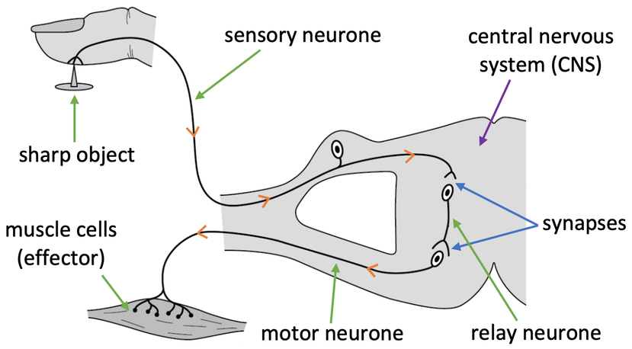
KNOWLEDGE ORGANISER
Subject: Science | Topic: Homeostasis & response | Term: Autumn
KEY WORDS | Key words
1 | Homeostasis | Homeostasis is the regulation of internal conditions to maintain optimal conditions for enzyme action and cell function.
2 | Nervous system | The nervous system enables humans to react to their surroundings and to coordinate their behaviour.
3 | Endocrine system | The endocrine system is composed of glands which secrete chemicals called hormones directly into the bloodstream.
4 | Reproduction | The process by which offspring are produced by parents.
5 | Hormone | Chemical messengers produced by glands.
KEY EXAMPLES
6 | Reflex actions | Automatic and rapid responses to stimuli.
7 | Puberty | Physical changes caused by hormones resulting in sexual maturity.
8 | Menstrual cycle | Recurring series of events in the human female reproductive system.
9 | Phototropism | A plants response to light.
10 | Gravitropism | A plants response to gravity.
KEY DIAGRAMS

