Slide 1
KS4 – Inheritance
Name
Class
Tutor Group
KS4 Science YEAR 11 INHERITANCE
KEYSTONE WORDS
Variation | Differences in the characteristics of individuals in a population.
Reproduction | The process by which new organisms are created, and through which genes are passed on to the future generations of these organisms.
Natural selection | A process where organisms that are better adapted to an environment will survive and reproduce.
Evolution | The change of inherited characteristics within a population over time through natural selection, which may result in the formation of a new species.

Slide 2
BIG PICTURE
How will my prior knowledge develop my understanding of this topic?
Y7 | Cells, organisation and variation are studied in year 7. This knowledge is at the heart of understanding inheritance.
Y9 | Inheritance is studied in year 9; this content is the foundation knowledge required to understand Inheritance at GCSE.
Learning Journey
Subtopic 1 | 4.6.1.1 Sexual and asexual reproduction 4.6.1.2 Meiosis | Subtopic 5 | 4.6.3.5 Fossils 4.6.3.4 Evidence for evolution 4.6.3.7 Resistant bacteria
Subtopic 2 | 4.6.1.4 DNA and the genome 4.6.2.1 Variation | Subtopic 6 | 4.6.2.3 Selective breeding
Subtopic 3 | 4.6.1.6 Genetic inheritance 4.6.1.8 Sex determination 4.6.1.7 Inherited disorders | Subtopic 7 | 4.6.2.4 Genetic engineering
Subtopic 4 | 4.6.2.2 Evolution 4.6.3.6 Extinction | Subtopic 8 | 4.6.4 Classification of living organisms
Key knowledge
By the end of this topic you should know… | How characteristics are controlled at the molecular level and how variation in characteristics help ensure survival of a species, and the evolution of new species. You should also know how humans manipulate characteristics to meet their own needs.
By the end of this topic should be able to do… | Apply the process of evolution by natural selection to new situations. You should also be able to apply selective breeding and genetic engineering to novel situations.
How will this knowledge develop my understanding of future topics?
This topic is a capstone topic in that it draws on knowledge from many topics. However, future topics do not build on it.

Slide 3
KEY VOCABULARY LIST
Variation | Differences in the characteristics of individuals in a population.
Reproduction | The process by which new organisms are created, and through which genes are passed on to the future generations of these organisms.
Natural selection | A process where organisms that are better adapted to an environment will survive and reproduce.
Evolution | The change of inherited characteristics within a population over time through natural selection, which may result in the formation of a new species.
EXPECTATIONS
Always write in black or blue pen. Always use a ruler for straight lines. If you make a mistake, cross it out with a single line. Always draw diagrams, tables and graphs in pencil with a ruler if necessary Always mark and correct your work in green pen. Respond to any feedback your teacher gives you in green pen. Take pride in your work, make it neat! All tasks should be completed in silence and by yourself unless your teacher tells you otherwise.
PROUD
Punctuation and grammar
Ruler and pencil for diagrams
Outstanding effort every lesson
Underline date and title
Dates and titles every lesson
PROUD FRIDAY
Any piece of work you complete, which meets our PROUD expectations can be taken to the PROUD station during Friday lunchtime. Show your work to a member of SLT and receive a sweet treat!

Slide 4
Subtopic 5: Evidence for evolution.
Learning Objective
To be able to explain why Darwin’s theory o evolution is the most widely accepted in the scientific community.
Why are we learning about this?
This topics links to the use of antibiotics and the issues caused by the overuse of antibiotics for treating bacterial infections.
There are lots of different theories about evolution that has been put forward and some people don’t believe the theory of evolution at all, however the scientific community has found evidence to support this theory. This is a fundamental aspect of scientific research, gathering evidence to support or refute what scientists are proposing as explanations to scientific phenomena.

Slide 5
I wasn’t there but I still care!
Define natural selection.
………………………………………………………………………………………………………………………………………………………………………………………………………………………………………………………………………………………………………………………………………………………………………………………………………………………………………………………………………………
2. Define variation.
………………………………………………………………………………………………………………………………………………………………………………………………………………………………………………………………………………………………………………………………………………………………………………………………………………………………………………………………………………
3. List the steps involved in natural selection.
………………………………………………………………………………………………………………………………………………………………………………………………………………………………………………………………………………………………………………………………………………………………………………………………………………………………………………………………………………
………………………………………………………………………………………………………………………………………………………………………………………………………………………………………………………………………………………………………………………………………………………………………………………………………………………………………………………………………………
………………………………………………………………………………………………………………………………………………………………………………………………………………………………………………………………………………………………………………………………………………………………………………………………………………………………………………………………………………

Slide 6
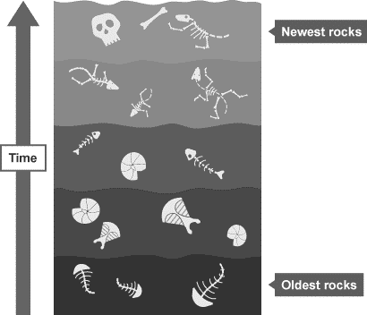
1 2 3 4 5 6 7 8 9 10 11 12 13 14 15 16 17 18 19 20 21 22 23 24 25 26 27 28 29 30 | Evidence to Support Darwin’s Theory of Evolution There are several different theories of evolution put forward by different scientists yet Darwin’ is the most widely accepted in the scientific community. This is due to the evidence that supports this theory. Evidence of evolution - Fossils A fossil is the preserved remains of a dead organism from millions of years ago. Fossils are found in rocks and can be formed from: hard body parts, such as bones and shells, which do not decay easily or are replaced by minerals as they decay parts of organisms that have not decayed because one or more of the conditions needed for decay are absent. For example, dead animals and plants can be preserved in amber, peat bogs, tar pits, or in ice preserved traces of organisms, such as footprints, burrows and rootlet traces - these become covered by layers of sediment, which eventually become rock The fossil record Fossil remains have been found in rocks of all ages. Fossils of the simplest organisms are found in the oldest rocks, and fossils of more complex organisms in the newest rocks. This supports Darwin's theory of evolution, which states that simple life forms gradually evolved into more complex ones. There are gaps in the fossil record because many early forms of life were soft-bodied, which means that they have left few traces behind. What traces there were may have been destroyed by geological activity. This is why scientists cannot be certain about how life began.

Slide 7
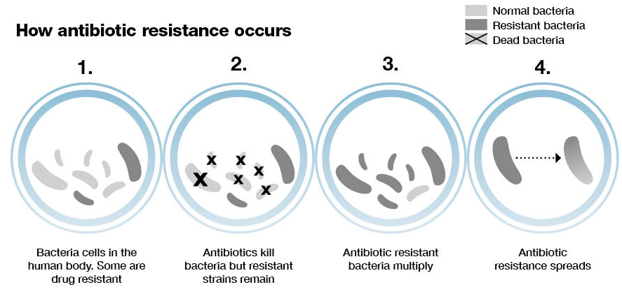
1 2 3 4 5 6 7 8 9 10 11 12 13 14 15 16 17 18 19 20 21 22 23 24 25 26 27 28 29 30 | Evidence for evolution - resistant bacteria Antibiotic resistance Bacteria can evolve quickly because they reproduce at a fast rate. Mutations of bacteria produce new strains. Some bacteria might become resistant to certain antibiotics, such as penicillin, and cannot be destroyed by the antibiotic. The evolution of the bacteria is an example of natural selection. Development of resistance The main steps in the development of resistance are: random mutations occur in the genes of individual bacterial cells some mutations protect the bacterial cell from the effects of the antibiotic bacteria without the mutation die or cannot reproduce when the antibiotic is present resistant bacteria can reproduce with less competition from normal bacterial strains MRSA The number of resistant strains has increased, partly due to the misuse of antibiotics. This has resulted in more infections that are difficult to control. MRSA is methicillin-resistant staphylococcus aureus, and it is very dangerous because it is resistant to most antibiotics. To reduce the rate of development of antibiotic resistant strains: doctors should not prescribe antibiotics inappropriately, such as for the treatment of non-serious infections patients should always complete the full course of antibiotics to ensure all bacteria are killed and none do not survive to mutate and form resistant strains the agricultural use of antibiotics should be restricted

Slide 8
Rehearsal Questions
What is a fossil?
……………………………………………………………………………………………………………………………………………………….
2. What parts of organisms form fossils?
………………………………………………………………………………………………………………………………………………………
3. Why are fossil records incomplete? ………………………………………………………………………………………………………………………………………………………
4. Which scientist’s theory of evolution do fossil records provide evidence for?
……………………………………………………………………………………………………………………………………………………..
5. Why do antibiotic resistant bacteria provide evidence for the theory of evolution?
……………………………………………………………………………………………………………………………………………………..
6. What name is given to preserved remains of a dead organism from millions of years ago?
……………………………………………………………………………………………………………………………………………………..
7. Parts of fossil records are missing. Explain why it is hard to find a compete fossil record?
……………………………………………………………………………………………………………………………………………………..
8. Why do we hardly ever find the skin of dead animals?
……………………………………………………………………………………………………………………………………………………..
10. What are antibiotic resistant bacteria?
……………………………………………………………………………………………………………………………………………………..
11. What steps can doctors take to prevent antibiotic resistant bacteria?
…………………………………………………………………………………………………………………………………..……………………

Slide 9
Rehearsal Questions
12. What two main types of evidence are widely accepted to support the theory of evolution?
…………………………………………………………………………………………………………………………………..…………………….
13. Suggest two reasons why we have incomplete fossil records?
…………………………………………………………………………………………………………………………………..…………………….
How do bacterial strains form to become resistant to antibiotics?
…………………………………………………………………………………………………………………………………………………………………………………………………………………………………………………………………………………………………………………..

Slide 10
Interleaving
1. I DO: Name 2 diseases caused by bacteria? …………………..………………………………………………………….
2. We DO: Explain why HIV cannot be treated with antibiotics?
………………………………………………………………………………………………………………………………………………………….
………………………………………………………………………………………………………………………………………………………….
You do: 3. Explain why doctor would not prescribe antibiotics for a minor bacterial infection such as salmonella?
………………………………………………………………………………………………………………………………………………………….
………………………………………………………………………………………………………………………………………………………….
4. What is the process of evolution?
………………………………………………………………………………………………………………………………………………………….
………………………………………………………………………………………………………………………………………………………….
5. Skin tissue is not often found on fossils. What is the definition of a tissue?
………………………………………………………………………………………………………………………………………………………….
………………………………………………………………………………………………………………………………………………………….
6. What advice would be given to patients prescribed antibiotics for treatment of gonorrhoea? ………………………………………………………………………………………………………………………………………………………….
………………………………………………………………………………………………………………………………………………………….
7.. What type of contraceptive could be used to prevent the transmission of gonorrhoea during sexual intercourse? ………………………………………………………………………………………………………………………………………………………….
………………………………………………………………………………………………………………………………………………………….
8. . What type of reproduction do bacteria use to reproduce?
………………………………………………………………………………………………………………………………………………………….
9. Bacteria grow by using mitosis. State the three stages of the cell cycle for a cell undergoing mitosis?.................................................................................................................................................. …………………………………………………………………………………………………………………………………………………………………………………………………………………………………………………………………………………………………………………..

Slide 11
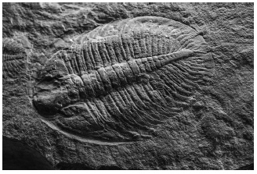
1. Figure 1 shows a photograph of a fossil of a trilobite.
Figure 1
a) When were trilobites alive? Tick one box.
Between 20 and 50 years ago.
Between 20 and 50 thousand years ago.
Between 200 and 500 thousand years ago.
Between 200 and 500 million years ago.
(b) Suggest how the fossil in Figure 1 was formed. Tick one box.
The organism left a footprint behind.
The organism was buried by rocks.
The organism was frozen in ice.
The organism was replaced by minerals.
(c) Trilobites are extinct. What does extinct mean? Tick one box.
The species evolved into another species.
The species does not have any soft tissue parts.
There are no organisms of that species alive today.
There are not enough of the species alive to reproduce.
(d) Hyoliths are another type of fossil. Hyoliths were discovered in the 1800s and thought to be a type of snail. In 2017 scientists used modern techniques to place hyoliths into a different group.
Suggest a modern technique that the scientists may have used. Tick one box.
DNA analysis
Genetic modification
Light microscopy
Selective breeding
.

Slide 12
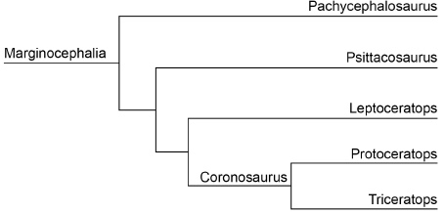
The fossil record is used to draw evolutionary trees. Figure 2 shows an evolutionary tree for a group of dinosaurs
(f) Suggest which two of these dinosaurs are most closely related.
………………………………………………… and ………………………………………………… (1)
(g) Name a common ancestor of Triceratops and Leptoceratops.
…………………………………………………………………………………………………………………………………………………. (1)
(h) How does the fossil record provide evidence for Darwin’s theory of evolution? Tick one box.
Dinosaurs became extinct 65 million years ago.
Fossils have been found in most countries of the world.
Older fossils have a simpler structure.
Trilobites belong to the arthropod group of animals.

Slide 13
Q2. Pseudomonas bacteria cause infections in hospital patients.
A new strain of Pseudomonas bacteria has evolved. This new strain can only be killed by one antibiotic called fluroquinolone. Scientists want to prevent the new strain of Pseudomonas from spreading in the human population.
Explain the advice doctors should be given to prevent the spread of the new strain. (6)
……………………………………………………………………………………………………………………………………………………………………………………………………………………………………………………………………………………………………………………………………………………………………………………………………………………………………………………………………………………………………………………………………………………………………………………………………………………………………………………………………………………………………………………………………………………………………………………………………………………………………………………………………………………………………………………………………………………………………………………………………………………………………………………………………………………………………………………………………………………………………………………………………………………………………………………………………………………………………………………………………………………………………………………………………………………………………………………………………………………………………………………………………………………………………………………………………………………………………………………………………………………………………………………………………………………………………………………………………………………………………………………………………………………………………………………………………………………………………………………………………………………………………………………………………………………………..

Slide 14
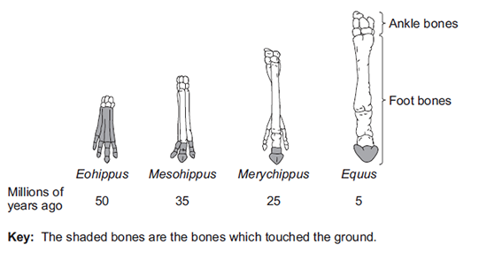
Q3. The diagram below shows changes in the foot bones of four ancestors of modern horses over the past 50 million years.
(a) Describe two changes to the bones in the feet of horses that have taken place over the past 50 million years.
…………………………………………………………………………………………………………………………………………………………………………………………………………………………………………………………………………………………………………………………………………………………………………………………………………………………………………………………………………………………………………………………………………………………………………………………………………………………………..(2)
(b) Eohippus lived in swampy areas with soft mud. Since this time the ground in the habitat has become drier and harder. All of the horse ancestors were preyed upon by other animals.
Explain one advantage to Eohippus of the arrangement of bones in its feet (2)
…………………………………………………………………………………………………………………………………………………………………………………………………………………………………………………………………………………………………………………………………………………………………………………………………………………………………………………………………………………………………………………………………………………………………………………………………………………………………..
(ii) The changes in the arrangement of the foot bones of horses support Darwin’s theory of evolution by natural selection. Explain how the arrangement of the foot bones of Eohippus could have evolved into the arrangement of the foot bones of Equus.
…………………………………………………………………………………………………………………………………………………………………………………………………………………………………………………………………………………………………………………………………………………………………………………………………………………………………………………………………………………………………………………………………………………………………………………………………………………………………..
……………………………………………………………………………………………………………………………………………………………………………………………………………………………………………………………………………………………………………………………………………………………………………………………………………………………………………………………………………………………………………………………………………………………………………………………………………………………………
……………………………………………………………………………………………………………………………………………………………………………………………………………………………………………………………………………………………………………………………………………………………………………………………………………………………………………………………………………………………………………………………………………………………………………………………………………………………………(4)

Slide 15
Subtopic 6: Selective Breeding.
Learning Objective
We are learning to explain how humans control the characteristics of species through selective breeding.
Why are we learning about this?
This lessons helps us understand why humans try to manipulate the characteristics of different species. For example, they might breed dogs that are gentler. It also helps us to undrstand the consequences of humans interfering with nature. This is because natural selection has resulted in some undesirable effects in some species.

Slide 16
I wasn’t there but I still care!
The theory of evolution by natural selection is now widely accepted. Evidence for Darwin's theory is now available as it has been shown that characteristics are passed on to offspring in genes. Fossils now provide proof for evolution showing how organisms changed gradually over millions of years.
Our understanding of evolution has also been helped by the study of antibiotic resistance in bacteria. Bacteria multiply quickly in a short space of time. Advantageous mutations are rapidly spreading throughout the population of bacteria. We can see evolution through natural selection occur and are able to do research.
Fossils are the ‘remains’ of ancient organisms from millions of years ago, which are found in rocks. Scientists can learn how much or how little organisms have changed over time. This is called the fossil record. However, the fossil record is incomplete for many reasons:
1. Early life forms were often soft bodied and so few traces remain.
2. Most organisms do not become fossilised as conditions are rare.
3. We are still discovering fossils which give us more information.
4. Traces are often destroyed by geological activity like earthquakes, volcanic eruptions, formation of mountain ranges and erosion.
The fossil record of the horse gives
us a good idea of how the modern
horse has evolved from a much
smaller, dog like animal.
Task:
Who’s theory of evolution is the most widely accepted and why?
…………………………………………………………………………………………………………..………………………………………...
What are fossils and where are they found?
................................................................................................................................................................
3. Why is there incomplete fossil records?
………………………………………………………………………………………………………………………………………………………….

Slide 17
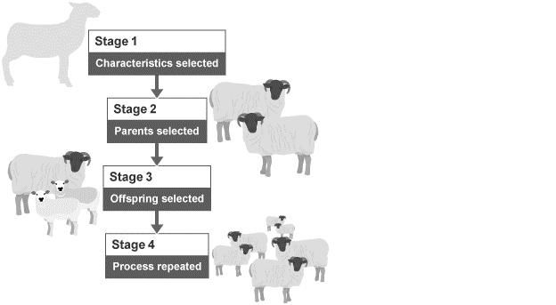
1 2 3 4 5 6 7 8 9 10 11 12 13 14 15 16 17 18 19 20 21 22 23 24 25 26 27 28 29 30 | Selective Breeding Selective breeding or artificial selection is when humans breed plants and animals for particular genetic characteristics. Humans have bred food crops from wild plants and domesticated animals for thousands of years. Main steps involved Selective breeding takes place over many generations. These are the main steps for both plants and animals involve: Decide which characteristics are important enough to select. Choose parents that show these characteristics from a mixed population. They are bred together. Choose the best offspring with the desired characteristics to produce the next generation. Repeat the process continuously over many generations, until all offspring show the desired characteristics.

Slide 18
1 2 3 4 5 6 7 8 9 10 11 12 13 14 15 16 17 18 19 20 21 22 23 24 25 26 27 28 29 30 | Farmers selectively breed different types of cows with highly desirable characteristics in order to produce the best meat and dairy. Characteristics can be chosen for usefulness or appearance: Desired characteristics in plants: disease resistance in food crops wheat plants that produce lots of grain large or unusual flowers Desired characteristics in animals: animals that produce lots of milk or meat chickens that lay large eggs domestic dogs that have a gentle nature The new varieties may be economically important. For example, they may provide more or better quality food, or allow farmers to feed more people. Benefits and risks of selective breeding Because of selective breeding, future generations of selectively bred plants and animals will all share very similar genes which will reduce variation. Genes and their different Alleles within a population are known as its gene pool. Inbreeding can lead to a reduced gene pool, making it more difficult to produce new varieties in the future. This also makes organisms prone to certain diseases or inherited defects. Benefits of selective breeding include: new varieties may be economically important, by producing more or better quality food animals can be selected that cannot cause harm, for example cattle without horns Risks of selective breeding include: reduced genetic variation can lead to attack by specific insects or disease, which could be extremely destructive rare disease genes can be unknowingly selected as part of a positive trait, leading to problems with specific organisms, eg a high percentage of Dalmatian dogs are deaf can create physical problems in specific organisms, eg large dogs can have faulty hips due to not being formed correctly

Slide 19
Rehearsal Questions
Who selects the parent organisms used in selective breeding?
………………………………………………………………………………………………………………………………………………………….b. Parents are selected because they have a desired characteristic. Define ‘desired characteristic’.
………………………………………………………………………………………………………………………………………………………….
c. How many generations of organisms are used in selective breeding?
………………………………………………………………………………………………………………………………………………………….
d. In natural selection, the environment selects organisms. Who selects the parents for selective breeding?
………………………………………………………………………………………………………………………………………………………….
Evolution occurs over many generations. How many generations are required in selective breeding?
………………………………………………………………………………………………………………………………….........................
Give an example of a desired characteristic that might be selected for in selective breeding.
………………………………………………………………………………………………………………………………….........................
g. Do humans select for characteristics in natural selection or selective breeding?
………………………………………………………………………………………………………………………………….........................
How are parents selected for in selective breeding?
………………………………………………………………………………………………………………………………………………………….

Slide 20
I DO –Selective Breeding
A cat breeder wants to use selective breeding so that all new kittens have blue tail tips.
Describe the process of selective breeding the cat breeder could use.
………………………………………………………………………………………………………………………………………………………………………………………………………………………………………………………………………………………………………………………………………………………………………………………………………………………………………………………………………………………………………………………………………………………………………………………………………………………………………………………………………………………………………………………………………………………………………………………………………………………………………………………………………………………………………………………………………………………………
YOU DO
Chickens can be bred either for meat or for laying eggs.
Describe how selective breeding has been used to produce chickens bred for meat.
………………………………………………………………………………………………………………………………………………………………………………………………………………………………………………………………………………………………………………………………………………………………………………………………………………………………………………………………………………………………………………………………………………………………………………………………………………………………………………………………………………………………………………………………………………………………………………………………………………………………………………………………………………………………………………………………………………………………

Slide 21
YOU DO
Read the following.
The IR8 variety of rice was produced by selective breeding.
Describe the steps the scientists would have taken to produce IR8
………………………………………………………………………………………………………………………………………………………………………………………………………………………………………………………………………………………………………………………………………………………………………………………………………………………………………………………………………………………………………………………………………………………………………………………………………………………………………………………………………………………………………………………………………………………………………………………………………………………………………………………………………………………………………………………………………………………………
In the 1950s farmers in India could not grow enough rice to feed the rapidly increasing population. At the International Rice Research Institute (IRRI) scientists began a selective breeding programme with 10 000 different varieties of rice plants. In 1966 the IRRI produced a new variety called IR8 which gave a yield of up to ten times the traditional varieties. IR8 has short stems and large rice grains. IR8 was grown by farmers all over India so people had enough to eat.

Slide 22
Spaced question
Selective breeding is often compared to natural selection.
When we compare two things, we consider their similarities and their differences.
Compare selective breeding and natural selection.
Similarities: ……………………………………………………………………………………………………………………………………………………………………………………………………………………………………………………………………………………………………………………………………………………………………………………………………………………………………………………………………………………………………………………………………………………………………………………………………………………………… ………………………………………………………………………………………………………………………………………………………………………………………………………………………………………………………………………………………………………………………………………………………………………………………………………………………………………………………………………………………………………………………………………………………………………………………………………………………………
Differences:
……………………………………………………………………………………………………………………………………………………………………………………………………………………………………………………………………………………………………………………………………………………………………………………………………………………………………………………………………………………………………………………………………………………………………………………………………………………………… ………………………………………………………………………………………………………………………………………………………………………………………………………………………………………………………………………………………………………………………………………………………………………………………………………………………………………………………………………………………………………………………………………………………………………………………………………………………………

Slide 23
Subtopic 7: Genetic Engineering
Learning Objective
We are learning to describe the process of genetic engineering and explain how humans use it to their own benefit.
Why are we learning about this?
This lessons helps us understand how humans manipulate their environment at the molecular level in order to improve their lives. This is at the heart of science and technology. However, irresponsible use of science can create problems that aren’t obvious at the time.

Slide 24
I wasn’t there but I still care!
Explain what we use selective breeding for.
………………………………………………………………………………………………………………………………………………………………………………………………………………………………………………………………………………………………………………………………………………………………………………………………………………………………………………………………………………
2. List the steps in the process of selective breeding. ………………………………………………………………………………………………………………………………………………………………………………………………………………………………………………………………………………………………………………………………………………………………………………………………………………………………………………………………………………
………………………………………………………………………………………………………………………………………………………………………………………………………………………………………………………………………………………………………………………………………………………………………………………………………………………………………………………………………………

Slide 25
1 2 3 4 5 6 7 8 9 10 11 12 13 14 15 16 17 18 19 20 21 22 23 24 25 26 27 28 29 30 31 | What is genetic engineering? Genetic engineering, also known as genetic modification, is the process of modifying the genome of an organism by introducing a gene from another organism. This then gives the organism a desired trait. It involves “cutting out” the desired gene from an organism which already has it, and transferring it to the cells of another organism. Examples of this include: Plant crops being genetically engineered: Disease resistance Production of bigger, better fruits Resistance to insect attacks or herbicides Bacterial cells being genetically engineered to produce useful substances in large quantities, such as human insulin to treat diabetes. Benefits and risks of genetic engineering There are many benefits to using genetic engineering. It is used in agriculture to do things such as, improve the yields of important economic crops, and provide insect or pest resistance. It is also used in the medical field to create insulin, which can be used for treating diabetes. But, as with most new technology, it also carries potential risks. Benefits of genetic engineering Genetic modification is a faster and more efficient way of getting the same results as selective breeding. Improve crop yields or crop quality, which is important in developing countries. This may help reduce hunger around the world. Introduce herbicide resistance, which results in less herbicides being used, as weeds are quickly and selectively killed. Insect and pest resistance can be developed and inserted into the plants. The plant produces toxins, which would discourage insects from eating the crop. Sterile insects could be created such as a mosquito. They would breed, which would lead to infertile offspring. This may help with spread of diseases, such as malaria, dengue fever and the Zika virus.

Slide 26
1 2 3 4 5 6 7 8 9 10 11 | Risks of genetic engineering Transfer of the selected gene into other species. What benefits one plant may harm another. Some people believe it is not ethical to interfere with nature in this way. Also, GM crop seeds are often more expensive and so people in developing countries cannot afford them. GM crops could be harmful, for example toxins from the crops have been detected in some people’s blood. GM crops could cause allergic reactions in people. Pollen produced by the plants could be toxic and harm insects that transfer it between plants.

Slide 27
Rehearsal questions
What is genetic engineering? ……………………………………………………………………………………………………………. …………………………………………………………………………………………………………………………………………………………..
What are three reasons a plant may be genetically modified? …………………………………………………………. …………………………………………………………………………………………………………………………………………………………..
What substance can bacteria be genetically modified to produce? …………………………………………………..
Why is herbicide resistance beneficial for plants? …………………………………………………………………………….. …………………………………………………………………………………………………………………………………………………………..
Humans genetically modify organisms to benefit the population. What is this process? ………………….. …………………………………………………………………………………………………………………………………………………………..
Bacteria can be modified to produce human insulin. What condition is this used to treat? …………………………………………………………………………………………………………………………………………………………..
Why might it be beneficial to modify plants? ……………………………………………………………………………………. …………………………………………………………………………………………………………………………………………………………..
Herbicides are chemicals used to kill weeds. Why would it be useful to modify plants to be resistance to these chemicals?................................................................................................................ …………………………………………………………………………………………………………………………………………………………..
Type 1 diabetes is a condition where the pancreas doesn’t produce the hormone insulin. How can genetic modification be used to help treat this? ………………………………………………………………………………. …………………………………………………………………………………………………………………………………………………………..
What does it mean to “genetically modify” an organism? ………………………………………………………………… …………………………………………………………………………………………………………………………………………………………..
There are several ways to genetically modify a plant. What are the benefits of this? ……………………….. …………………………………………………………………………………………………………………………………………………………..
One of the ways plants are modified is for herbicide resistance. Why is this useful? ………………………… …………………………………………………………………………………………………………………………………………………………..

Slide 28
Wrong answers
I DO: “Genetic modification takes longer than selective breeding”. Explain why this is incorrect.
……………………………………………………………………………………………………………………………………………………………………………………………………………………………………………………………………………………………………………………………………………………………………………………………………………………………………………………………………………………………………..
WE DO: “Insulin produced by bacteria won’t work as well as human insulin” . Explain why this is incorrect.
……………………………………………………………………………………………………………………………………………………………………………………………………………………………………………………………………………………………………………………………………………………………………………………………………………………………………………………………………………………………………..
YOU DO: “Modified genes can’t be passed on by an organism” . Explain why this is incorrect.
……………………………………………………………………………………………………………………………………………………………………………………………………………………………………………………………………………………………………………………………………………………………………………………………………………………………………………………………………………………………………..
YOU DO: “There are no risks associated with genetically modified crops” . Explain why this is incorrect.
……………………………………………………………………………………………………………………………………………………………………………………………………………………………………………………………………………………………………………………………………………………………………………………………………………………………………………………………………………………………………..
YOU DO: “Modifying an organism doesn’t have any risks to other organisms” . Explain why this is incorrect.
……………………………………………………………………………………………………………………………………………………………………………………………………………………………………………………………………………………………………………………………………………………………………………………………………………………………………………………………………………………………………..
YOU DO: “Genetically modifying an organism involves changes some of the bases in a gene” . Explain why this is incorrect.
……………………………………………………………………………………………………………………………………………………………………………………………………………………………………………………………………………………………………………………………………………………………………………………………………………………………………………………………………………………………………..

Slide 29
If it didn’t
I DO: How might plants be affected if they weren’t genetically modified to resist insects?
……………………………………………………………………………………………………………………………………………………………………………………………………………………………………………………………………………………………………………………………………………………………………………………………………………………………………………………………………………………………………..
WE DO: How might plants be affected if they weren't genetically modified to resist herbicides?
……………………………………………………………………………………………………………………………………………………………………………………………………………………………………………………………………………………………………………………………………………………………………………………………………………………………………………………………………………………………………..
YOU DO: How might humans be affected if we didn’t genetically modify plants?
……………………………………………………………………………………………………………………………………………………………………………………………………………………………………………………………………………………………………………………………………………………………………………………………………………………………………………………………………………………………………..
YOU DO: How might humans be affected if we didn’t genetically modify bacteria?
……………………………………………………………………………………………………………………………………………………………………………………………………………………………………………………………………………………………………………………………………………………………………………………………………………………………………………………………………………………………………..
YOU DO: How might humans be affected if more food becomes genetically modified?
……………………………………………………………………………………………………………………………………………………………………………………………………………………………………………………………………………………………………………………………………………………………………………………………………………………………………………………………………………………………………..
YOU DO: How might humans be affected if genetic modification wasn't used to sterilise insects? ……………………………………………………………………………………………………………………………………………………………………………………………………………………………………………………………………………………………………………………………………………………………………………………………………………………………………………………………………………………………………..

Slide 30
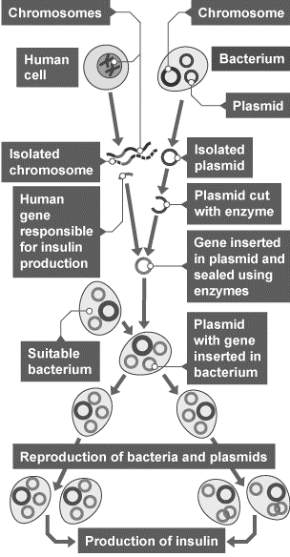
1 2 3 4 5 6 7 8 9 10 11 12 13 14 15 16 17 18 19 20 21 22 23 24 25 26 27 28 29 30 | The process of genetic engineering The main steps of genetic engineering: Enzymes are used to isolate the required gene, this gene is inserted into a vector, which is usually a bacterial plasmid (a ring of genetic material), or a virus. The vector inserts the gene into required cells. The genes are transferred to animal, plant or microorganism cells, during early development. This allows them to develop with the desired characteristics. This diagram shows how the genetic engineering of bacteria to produce insulin works:

Slide 31
Rehearsal questions
What is used to isolate the desired gene? …………………………………………………………………………………………
What is a vector, in terms of genetic modification? ………………………………………………………………………….. …………………………………………………………………………………………………………………………………………………………..
Why are the genes inserted during early development? …………………………………………………………………… …………………………………………………………………………………………………………………………………………………………..
What is a plasmid? …………………………………………………………………………………………………………………………….
When we have the desired gene, it needs to be inserted into the plant/animal cell. What is used to do this? ……………………………………………………………………………………………………………………………………………..
Why would you not insert the desired gene after the organism had developed? ……………………………… …………………………………………………………………………………………………………………………………………………………..
What would an enzyme be used for during genetic modification? ……………………………………………………. …………………………………………………………………………………………………………………………………………………………..
Bacterial cells sometimes contain rings of genetic material. What are they called? ………………………….
When is the best time to insert the desired gene into the target organism? …………………………………….. …………………………………………………………………………………………………………………………………………………………..
Once the desired gene has been identified in a cell, how is it removed? …………………………………………..
What are the two types of vector in genetic modification? ……………………………………………………………….
Plasmids are only found in prokaryotic cells (such as bacteria). What is a plasmid? …………………………. …………………………………………………………………………………………………………………………………………………………..

Slide 32
Wrong answers:
I DO: “Chromosomes are inserted to genetically modify an organism”. Explain why this is incorrect.
……………………………………………………………………………………………………………………………………………………………………………………………………………………………………………………………………………………………………………………………………………………………………………………………………………………………………………………………………………………………………..
WE DO: “Modifying an organism involves modifying the DNA in every cell” . Explain why this is incorrect.
……………………………………………………………………………………………………………………………………………………………………………………………………………………………………………………………………………………………………………………………………………………………………………………………………………………………………………………………………………………………………..
YOU DO: “Bacteria are genetically modified by inserting extra genes into their nucleus” . Explain why this is incorrect.
……………………………………………………………………………………………………………………………………………………………………………………………………………………………………………………………………………………………………………………………………………………………………………………………………………………………………………………………………………………………………..
YOU DO: “Each individual bacteria cell needs to be modified to produce insulin” . Explain why this is incorrect.
……………………………………………………………………………………………………………………………………………………………………………………………………………………………………………………………………………………………………………………………………………………………………………………………………………………………………………………………………………………………………..
YOU DO: “A desired gene can be inserted directly into the target cell” . Explain why this is incorrect.
……………………………………………………………………………………………………………………………………………………………………………………………………………………………………………………………………………………………………………………………………………………………………………………………………………………………………………………………………………………………………..

Slide 33
Interleaving questions – YOU DO
We are currently learning about how organisms can be genetically engineered. This links in to the following key topics: cells and organisation, infection and response, and bonding.
The following questions will link our current topic with these previous topics:
In genetic engineering, genes are transferred from the genetic material of one cell to another. Where is genetic material stored in a eukaryotic cell? ………………………………………………………………………
Genes code for the synthesis of specific proteins. Proteins are large molecules essential for growth and repair in organisms. Describe the role of enzymes in the digestion of proteins. ………………………… …………………………………………………………………………………………………………………………………………………………...………………………………………………………………………………………………………………………………………………………….
Bacteria can be modified to produce the hormone insulin, to treat type 1 diabetes. Diabetes in a non-communicable disease. What is a non-communicable disease? ………………………………………………… ………………………………………………………………………………………………………………………………………………………..……………………………………………………………………………………………………………………………………………………………..
It is not fully understood what causes type 1 diabetes. However, there is another type of diabetes: type 2. What causes type 2 diabetes? ………………………………………………………………………………………………. ………………………………………………………………………………………………………………………………………………………..……………………………………………………………………………………………………………………………………………………………..
Insulin, the hormone used to control blood glucose concentration, is a protein. Proteins are polymers. What is a polymer? ………………………………………………………………………………………………………….. …………………………………………………………………………………………………………………………………………………………..
Polymers are classified as giant structures, just like the allotropes of carbon. What are the three main allotropes of carbon? ………………………………………………………………………………………………………….......
The formula for human insulin is: C₂₅₇H₃₈₃N₆₅O₇₇S₆.
Name the elements found in insulin. …………………………………………………………………………………….. ……………………………………………………………………………………………………………………………………………….
Are these elements metals or non-metals? ……………………………………………………………………………
What type of bonding must be present in insulin? …………………………………………………………………
Other than the bonding identified in question 7c, there are two other types of bonding. What are they? …………………………………………………………………………………………………………………………………………………

Slide 34
Interleaving questions continued – YOU DO
Bacteria can be modified to produce the hormone insulin. Bacterial cells are very small, only visibly when magnified using a microscope. What equation links magnification, actual size of an object, and real size of an object? …………………………………………………………………………………………………………………
Use the equation identified in question 10 to answer the following questions:
What is the magnification of a cell when the image is 50 mm wide, but the actual cell is 0.25 mm wide? …………………………………………………………………………………………………………………………….. ………………………………………………………………………………………………………………………………………………. ……………………………………………………………………………………………………………………………………………….
What is the actual size of a cell that appears 72 mm long at a magnification of 250 X. ………………………………………………………………………………………………………………………………………………………..…………………………………………………………………………………………………………………………………….……………………………………………………………………………………………………………………………………………….

Slide 35
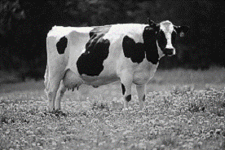
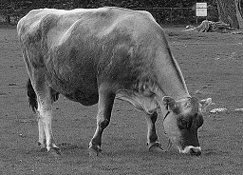
Exam questions – Tier 1 – YOU DO
Q1. The photographs show two breeds of cow.
Friesian cow Jersey cow
(1)
(b) Cows and their calves have many similar characteristics.
(1)
(1)
 |  | asexual reproduction.
(a) | Cows produce their young (calves) by | cloning.
 |  | sexual reproduction.
 |  | clones.
(i) | The information for characteristics is carried by | embryos.
 |  | genes
 | body cells.
(ii) The information for characteristics is passed to the next generation in cells called | gametes.
 | neurones.

Slide 36
Exam questions – Tier 1 continued – YOU DO
(c) Friesian and Jersey cows can both be used for meat or to produce milk.
The information shows features of Friesian and Jersey cows.
Use only the information above to answer these questions.
In your answers you must make comparisons between the two breeds of cow.
(i) Give two advantages of a farmer keeping Friesian cows and not Jersey cows.
1. ……………………………………………………………………………………………………………………………………………………………. ………………………………………………………………………………………………………………………………………………………………..2. ……………………………………………………………………………………………………………………………………………………………. ………………………………………………………………………………………………………………………………………………………………..
(2)
(ii) Give two advantages of a farmer keeping Jersey cows and not Friesian cows.
1. ……………………………………………………………………………………………………………………………………………………………. ………………………………………………………………………………………………………………………………………………………………..2. ……………………………………………………………………………………………………………………………………………………………. ………………………………………………………………………………………………………………………………………………………………..
(2)
Friesian cows | Jersey cows
Body mass up to 600 kg | Body mass up to 400 kg
Milk contains 3.4% protein | Milk contains 3.8% protein
Can be milked for 325 days after giving birth | Can be milked for 250 days after giving birth
Produce no milk for 55 days before having a calf | Produce no milk for 45 days before having a calf
Produce > 30 litres of milk per day | Produce < 30 litres of milk per day

Slide 37
Exam questions – Tier 1 continued – YOU DO
(d) Cow’s milk is different from human milk. Cow’s milk should not be given to young human babies.
Scientists in China have genetically engineered cows to produce human milk. Milk from these cows can be fed to young human babies.
(i) What is genetic engineering ? Tick one box.
(1)
(ii) Some people are worried about using milk from genetically engineered cows, to feed human babies.
Give one reason why.
……………………………………………………………………………………………………………………………………………………………………………………………………………………………………………………………………………………………………………………………………
(1)
(Total 9 marks)
Genes from one organism are transferred to a different organism
Cells are separated from an embryo and are transferred to host mothers
The nucleus from a body cell is transferred to an egg cell

Slide 38
Exam questions – Tier 2 – YOU DO
Q2. The Arctic flounder is a fish that can survive in extremely cold waters.
In the 1990s scientists transferred genes from the Arctic flounder into tomatoes to create a frost-resistant tomato. The tomatoes were never grown commercially, partly because of public concern.
(a) What is the name of the technique in which genes are transferred from one organism into the cells of another organism?
…………………………………………………………………………………………………………………………………………………………………
(1)
(b) Describe the advantages and disadvantages of using this technique to produce crop plants such as frost-resistant tomatoes.
……………………………………………………………………………………………………………………………………………………………………………………………………………………………………………………………………………………………………………………………………………………………………………………………………………………………………………………………………………………………………..
……………………………………………………………………………………………………………………………………………………………………………………………………………………………………………………………………………………………………………………………………………………………………………………………………………………………………………………………………………………………………..
(3)
(Total 4 marks)

Slide 39
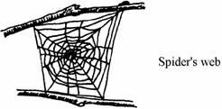
Exam questions – Tier 2 continued – YOU DO
Q3. Spiders produce a protein thread which is extremely strong compared to man-made fibres of the same diameter.
Scientists can now use bacteria to produce the same protein. How can they do this?
……………………………………………………………………………………………………………………………………………………………………………………………………………………………………………………………………………………………………………………………………………………………………………………………………………………………………………………………………………………………………..
……………………………………………………………………………………………………………………………………………………………………………………………………………………………………………………………………………………………………………………………………(Total 3 marks)

Slide 40
Exam questions – Tier 3 – YOU DO
Q4.
(a) Vectors are used in the process of genetic engineering.
Which two statements are correct?
Tick two boxes.
(b) Scientists have genetically engineered a variety of wheat to be resistant to herbicides.
The herbicide resistant variety of wheat will give a higher yield than the non-herbicide resistant variety.
Explain why.
……………………………………………………………………………………………………………………………………………………………………………………………………………………………………………………………………………………………………………………………………………………………………………………………………………………………………………………………………………………………………………………………………………………………………………………………………………………………………………………………………………………………………………………………………………………………………………………………………………………………………………………………………………………………………………………………………………………………………………………………………………..
(3)
Vectors are enzymes used to ‘cut open’ the DNA molecule.
Vectors are used to insert genes into cells.
Vectors are used to isolate the required gene.
Vectors are used to stimulate cell division.
Vectors are usually plasmids or viruses.

Slide 41
Exam questions – Tier 3 – YOU DO
(c) Give two examples of genetic engineering in use today.
Do not refer to herbicide resistance in your answer.
1. ……………………………………………………………………………………………………………………………………………………………. ………………………………………………………………………………………………………………………………………………………………..2. ……………………………………………………………………………………………………………………………………………………………. ………………………………………………………………………………………………………………………………………………………………..
(2)
(d) Scientists working on the ‘Human Genome Project’ have now mapped the entire genetic code of humans.
Explain one way this could be important for people in the future.
……………………………………………………………………………………………………………………………………………………………………………………………………………………………………………………………………………………………………………………………………………………………………………………………………………………………………………………………………………………………………………………………………………………………………………………………………………………………………………………………………………………………………………………………………………………………………………………………………………………………………………
(2)
(Total 9 marks)

Slide 42
Subtopic 8: Classification of living organisms
Learning Objective
to be able to describe the impacts of developments in biology on classification systems
Why are we learning about this?
This lessons helps us understand how organisms can be related at a very distant level, as well as helping us to explain how living organisms can have similarities as well as differences.

Slide 43
I wasn’t there but I still care! Last lesson we looked genetic engineering.
Using the AQA Biology textbook, pages 224-225:
What is genetic engineering? …………………………………………………………………………..……..………………… …………………………………………………………………………………………………………………………………………………………………………………………………………………………………………………………………………………………………………
How is genetic engineering carried out? ......................................................................................... …………………………………………………………………………………………………………………………………………………… ……………………………………………………………………………………………………………………………………………………
What is a vector? ……………………………………………………………………………………………………………………….. ……………………………………………………………………………………………………………………………………………………
Why do we genetically engineer crops? …………………………………………………………..………………………… ……………………………………………………………………………………………………………………………………………………

Slide 44
1 2 3 4 5 6 7 8 9 10 11 12 13 14 15 16 17 18 19 20 21 22 23 24 25 26 27 28 29 30 | There are over 7 million different species of discovered animal on the planet. Of this number it is estimated that 97% are invertebrates. The remaining 3% are vertebrates. The total number of described plant species is approximately 250,000. There are also more than 99,000 species of fungi, about 9300 species of bacteria and more than 200,000 species of protist on the planet. These numbers account f0r the ones that have been discovered. New members of each of the kingdoms are being discovered all the time, although we are also losing species to extinction as well. All living things, including animals, plants, fungi, bacteria and protists, can be organised based on their characteristics. This organisation gives rise to their species name. You should be familiar with the idea that the human species is known as ‘homo sapiens’. Previous hominin species include homo habilis, homo erectus and homo neanderthalensis. Where do these names come from, and why are they written in italics? In the 1800’s a Swedish botanist called Carl Linnaeus developed a method of all classifying all living organisms based on their structure and characteristics and reflects the similarities of obvious traits among organisms. The Linnaean system of classification is hierarchical and allows for the subdivision of living organisms into smaller and more specialised groups. The system starts with the broadest category, the kingdom. There are 5 kingdoms: Animals (all multicellular animals) Plants (all green plants) Fungi (moulds, mushrooms, yeast) Protists (Amoeba, Chlorella and Plasmodium) Prokaryotes (bacteria, blue-green algae) Following on from organisation into kingdoms, species can then be assigned into phylum, class, order, family, genus, and species. This assignation can then be used to provide the organism with its species name, although this statement does not give the full story. If we think back to the humans, we are known as homo sapiens. You should notice from this that this name is made up of 2 words. This is known as a ‘binomial’ name, with ‘binomial’ meaning 2 (the prefix ‘bi’) names (the suffix ‘nomial’). This naming system

Slide 45
1 2 3 4 5 6 7 8 9 10 11 12 13 14 15 16 17 18 19 20 21 22 23 24 25 26 27 28 29 30 | comes from Latin, which is why it is written in italics. They are italicised to indicate that they have come from a foreign language. But how do we arrive at the binomial name for an organism? Look at the classification of humans below: The binomial name homo sapien has come from the genus and species classification (and is Latin for ‘wise man’). This is true for all organisms.
Kingdom | Animalia
Phylum | Chordata
Class | Mammalia
Order | Primates
Family | Hominidae
Genus | Homo
Species | Sapien

Slide 46
Rehearsal Questions
How many different species of discovered animals are there on the planet?
……………………………………………………………………………………………………………………………………………………………………………………………………………………………………………………………………………………………………………………
What percentage of animal species are invertebrates?
……………………………………………………………………………………………………………………………………………………………………………………………………………………………………………………………………………………………………………………
How many species of plants, fungi, bacteria, and protists are there?
…………………………………………………………………………………………………………………………………………………………………………………………………………………………………………………………………………………………………………………… 4. Who developed the method of classifying all living organisms based on their structure and characteristics?
…………………………………………………………………………………………………………………………………………………………………………………………………………………………………………………………………………………………………………………… 5. What are the five kingdoms in the Linnaean system of classification? ……………………………………………………………………………………………………………………………………………………………………………………………………………………………………………………………………………………………………………………
What is the hierarchy of the Linnaean system of classification?
…………………………………………………………………………………………………………………………………………………………7. What does the term ‘binomial’ mean?
………………………………………………………………………………………………………………………………………………………. 8. What is the binomial name for humans?
…………………………………………………………………………………………………………………………………………………………
What are some examples of previous hominin species?
…………………………………………………………………………………………………………………………………………………………………………………………………………………………………………………………………………………………………………………… 10. Are new species being discovered?
……………………………………………………………………………………………………………………………………………………………………………………………………………………………………………………………………………………………………………………

Slide 47
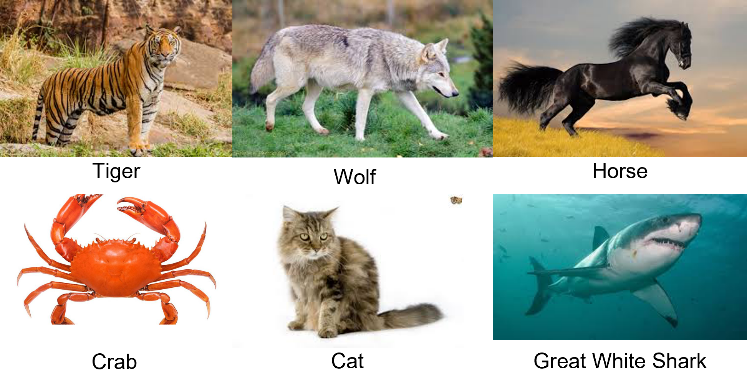
You do
I do
We do

Slide 48
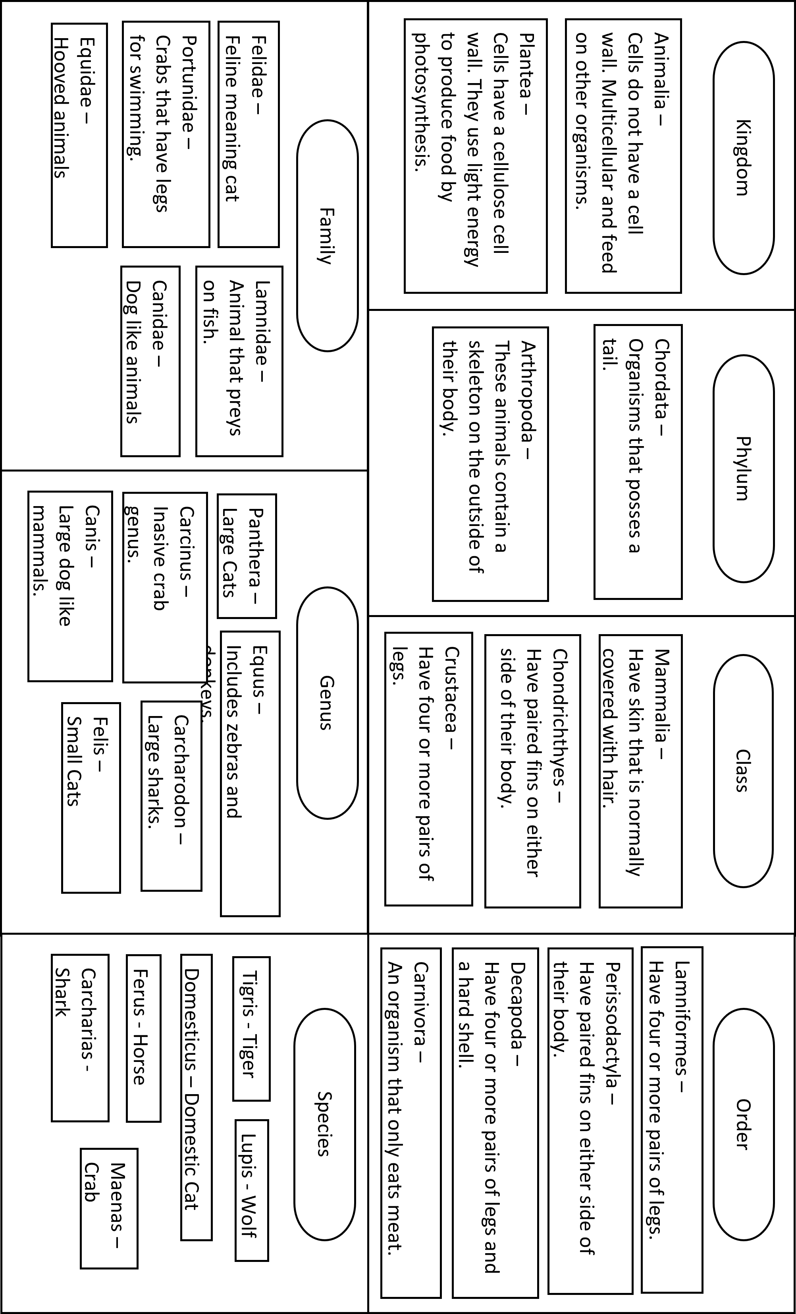

Slide 49
1 2 3 4 5 6 7 8 9 10 11 12 13 14 15 16 17 18 19 20 | As time progressed and the scientific advancements were made, new evidence came to light about the internal structures of cells. You will already be familiar with the designation of cells as being either prokaryotic or eukaryotic. In 1977, an American microbiologist made a discovery regrading the prokaryotic kingdom. For years scientist had thought that all bacteria were the same on a fundamental biological level. Carl Woese discovered that this was not the case, and that the prokaryotic kingdom was actually 2 separate kingdoms. He discovered primitive bacteria which he named Archaea. This separated the prokaryotic kingdom into 2 new kingdoms: Eubacteria, containing True bacteria and cyanobacteria Archaebacteria, containing extremophiles As a result of this, Woese introduced a 3-Domain system, with kingdoms sitting below domains. The new classification system now looked like this: Domain (Bacteria, Archaea, Eukarya) Kingdom (Eubacteria, Archaebacteria, Protist, Fungi, Plant, Animal) Phylum Class Order Family Genus Species

Slide 50
Rehearsal Questions
Who discovered that the prokaryotic kingdom was actually two separate kingdoms?
……………………………………………………………………………………………………………………………………………………………………………………………………………………………………………………………………………………………………………………
What are the two kingdoms that the prokaryotic kingdom was divided into?
……………………………………………………………………………………………………………………………………………………………………………..……………………………………………………………………………………………………………………………………
What is the name of the bacteria that Carl Woese discovered?
…………………………………………………………………………………………………………………………………………………………………………………………………………………………………………………………………………………………………………………… 4. What is the new classification system introduced by Woese?
…………………………………………………………………………………………………………………………………………………………………………………………………………………………………………………………………………………………………………………… 5. What are the three domains in Woese’s classification system?
……………………………………………………………………………………………………………………………………………………………………………………………………………………………………………………………………………………………………………………

Slide 51
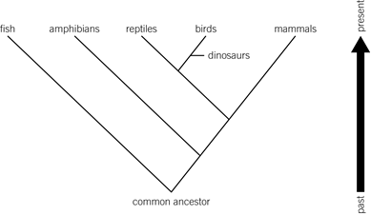
1 2 3 4 5 6 7 8 9 10 11 12 13 14 15 16 17 18 19 20 21 22 23 24 25 26 27 28 29 30 | Evolutionary trees, also known as phylogenetic trees, are like big family trees for every species on Earth. They show us how different species are related to each other. Imagine you’re looking at your own family tree. You’d see your parents, grandparents, and so on. Now imagine that, but for all life on Earth! These trees are based on the idea that all life shares a common ancestor. As time goes on, species evolve and change, leading to the diverse life we see today. Each branch on the tree represents these changes, or evolutionary events, such as the development of a new trait or the formation of a new species. Scientists use these trees to study how species have evolved and how they are related. For example, they can help us understand how birds evolved from dinosaurs, or how humans are related to other primates. They can also show us which species are most closely related, which can be really important for things like conservation or understanding diseases.

Slide 52
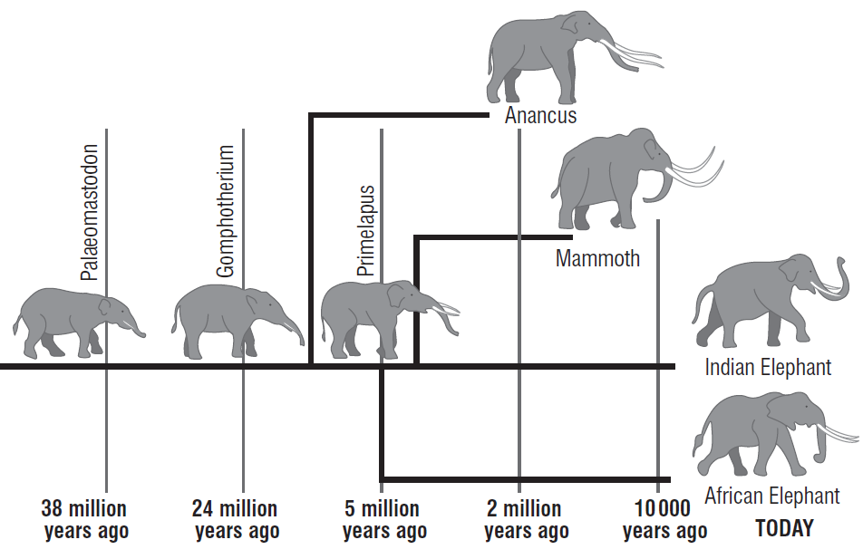
I do: How many millions of years ago did Paleomasodon first appear?
………………………………………………………………………………………………………………………………………………………………………………………………………………………………………………………………………………………………………..
We do: name the common ancestor of Indian and African elephants.
…………………………………………………………………………………………………………………………………………………………………………………………………………………………………………………………………………………………………………
You do: state which elephant alive today is the closest relative of the mammoth. Give a reason for your answer.
…………………………………………………………………………………………………………………………………………………………………………………………………………………………………………………………………………………………………………

Slide 53
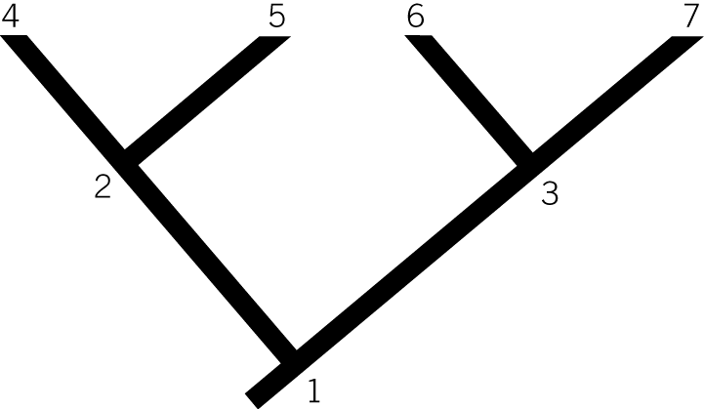
You do:
Place the names of the family on the correct place on the tree.
Rosie has a brother. His name is Tim.
Patrick is Rosie and Tim's father.
Patrick's father is called Robert. Robert also has a daughter called Sheila.
Sheila has two children, Cerys and Becky.
1. Who shares the most similar DNA with both Rosie and Tim?
……………………………………………………………………………………………………………………………………………………………………………………………………………………………………………………………………………………………………
2. Who is the common ancestor of all the people mentioned?
……………………………………………………………………………………………………………………………………………………………………………………………………………………………………………………………………………………………………
3. Which person is Becky most closely related to: Rosie, Tim, or Cerys?
……………………………………………………………………………………………………………………………………………………………………………………………………………………………………………………………………………………………………

Slide 54
Exam questions

Slide 55
Exam questions

Slide 56
Exam questions

Slide 57
Exam questions

Slide 58
Exam questions

Slide 59
Exam questions

Slide 60
Question
1
2
3
4
5
6
C
E
D
B
A
Using the evolutionary tree, identify:
The most recent common ancestor of 5 and 6.
……………………………………………………………………………………………………………………………………………………………………………………………………………………………………………………………………………………………………….. b) The most recent common ancestor of 3 and 6. ………………………………………………………………………………………………………………………………………………………………………………………………………………………………………………………………………………………………………..
c) The most recent common ancestor of all the species. ………………………………………………………………………………………………………………………………………………………………………………………………………………………………………………………………………………………………………..
d) The species most closely related to species 4. ………………………………………………………………………………………………………………………………………………………………………………………………………………………………………………………………………………………………………..
e) The most distantly related species. ………………………………………………………………………………………………………………………………………………………………………………………………………………………………………………………………………………………………………..
f) The number of common ancestors that species 3 and 5 have.
………………………………………………………………………………………………………………………………………………………………………………………………………………………………………………………………………………………………………..

Slide 61
DO NOW
Date: ……………………………………….
 | ANSWER
Q1.
Q2.
Q3.
Q4.
Q5.
Date: ……………………………………….
 | ANSWER
Q1.
Q2.
Q3.
Q4.
Q5.

Slide 62
DO NOW
Date: ……………………………………….
 | ANSWER
Q1.
Q2.
Q3.
Q4.
Q5.
Date: ……………………………………….
 | ANSWER
Q1.
Q2.
Q3.
Q4.
Q5.

Slide 63
DO NOW
Date: ……………………………………….
 | ANSWER
Q1.
Q2.
Q3.
Q4.
Q5.
Date: ……………………………………….
 | ANSWER
Q1.
Q2.
Q3.
Q4.
Q5.

Slide 64
DO NOW
Date: ……………………………………….
 | ANSWER
Q1.
Q2.
Q3.
Q4.
Q5.
Date: ……………………………………….
 | ANSWER
Q1.
Q2.
Q3.
Q4.
Q5.

Slide 65
Knowledge Retrieval Quiz 2
Date: ……………………………………….
Score: …………...
 |  | Answer
Q1. | Insert question in bold
Q2.
Q3.
Q4.
Q5.
Q6.
Q7.
Q8.
Q9.
Q10.

Slide 66
Knowledge Retrieval Quiz 3
Date: ……………………………………….
Score: …………...
 |  | Answer
Q1. | Insert question in bold
Q2.
Q3.
Q4.
Q5.
Q6.
Q7.
Q8.
Q9.
Q10.

Slide 67
Extra Space
……………………………………………………………………………………………………………………………………………………………………………………………………………………………………………………………………………………………………………………………………………………………………………………………………………………………………………………………………………………………………………………………………………………………………………………………………………………………………………………………………………………………………………………………………………………………………………………………………………………………………………………………………………………………………………………………………………………………………………………………………………………………………………………………………………………………………………………………………………………………………………………………………………………………………………………………………………………………………………………………………………………………………………………………………………………………………………………………………………………………………………………………………………………………………………………………………………………………………………………………………………………………………………………………………………………………………………………………………………………………………………………………………………………………………………………………..
…………………………………………………………………………………………………………………………………………………………………………………………………………………………………………………………………………………………………………………………………………………………………………………………………………………………………………………………………………………………………………………………………………………………………………………………………………………………………………………………………………………………………………………………………………………………………………………………………………………………………………………………………………………………………………………………………………………………………………………………………………………………………………………………………………………………………………………………………………………………………………………………………………………………………………………………………………………………………………………………………………………………………………………………………………………………………………………………………………………………………………………………………………………………………………………………………………………………………………………………………………………………………………………………………………………………………..
…………………………………………………………………………………………………………………………………………………………………………………………………………………………………………………………………………………………………………………………………………………………………………………………………………………………………………………………………………………………………………………………………………………………………………………………………………………………………………………………………………………………………………………………………………………………………………………………………

Slide 68
Extra Space
……………………………………………………………………………………………………………………………………………………………………………………………………………………………………………………………………………………………………………………………………………………………………………………………………………………………………………………………………………………………………………………………………………………………………………………………………………………………………………………………………………………………………………………………………………………………………………………………………………………………………………………………………………………………………………………………………………………………………………………………………………………………………………………………………………………………………………………………………………………………………………………………………………………………………………………………………………………………………………………………………………………………………………………………………………………………………………………………………………………………………………………………………………………………………………………………………………………………………………………………………………………………………………………………………………………………………………………………………………………………………………………………………………………………………………………………..
…………………………………………………………………………………………………………………………………………………………………………………………………………………………………………………………………………………………………………………………………………………………………………………………………………………………………………………………………………………………………………………………………………………………………………………………………………………………………………………………………………………………………………………………………………………………………………………………………………………………………………………………………………………………………………………………………………………………………………………………………………………………………………………………………………………………………………………………………………………………………………………………………………………………………………………………………………………………………………………………………………………………………………………………………………………………………………………………………………………………………………………………………………………………………………………………………………………………………………………………………………………………………………………………………………………………………..
…………………………………………………………………………………………………………………………………………………………………………………………………………………………………………………………………………………………………………………………………………………………………………………………………………………………………………………………………………………………………………………………………………………………………………………………………………………………………………………………………………………………………………………………………………………………………………………………………

Slide 69
Extra Space
……………………………………………………………………………………………………………………………………………………………………………………………………………………………………………………………………………………………………………………………………………………………………………………………………………………………………………………………………………………………………………………………………………………………………………………………………………………………………………………………………………………………………………………………………………………………………………………………………………………………………………………………………………………………………………………………………………………………………………………………………………………………………………………………………………………………………………………………………………………………………………………………………………………………………………………………………………………………………………………………………………………………………………………………………………………………………………………………………………………………………………………………………………………………………………………………………………………………………………………………………………………………………………………………………………………………………………………………………………………………………………………………………………………………………………………………..
…………………………………………………………………………………………………………………………………………………………………………………………………………………………………………………………………………………………………………………………………………………………………………………………………………………………………………………………………………………………………………………………………………………………………………………………………………………………………………………………………………………………………………………………………………………………………………………………………………………………………………………………………………………………………………………………………………………………………………………………………………………………………………………………………………………………………………………………………………………………………………………………………………………………………………………………………………………………………………………………………………………………………………………………………………………………………………………………………………………………………………………………………………………………………………………………………………………………………………………………………………………………………………………………………………………………………..
…………………………………………………………………………………………………………………………………………………………………………………………………………………………………………………………………………………………………………………………………………………………………………………………………………………………………………………………………………………………………………………………………………………………………………………………………………………………………………………………………………………………………………………………………………………………………………………………………

Slide 70
Extra Space
……………………………………………………………………………………………………………………………………………………………………………………………………………………………………………………………………………………………………………………………………………………………………………………………………………………………………………………………………………………………………………………………………………………………………………………………………………………………………………………………………………………………………………………………………………………………………………………………………………………………………………………………………………………………………………………………………………………………………………………………………………………………………………………………………………………………………………………………………………………………………………………………………………………………………………………………………………………………………………………………………………………………………………………………………………………………………………………………………………………………………………………………………………………………………………………………………………………………………………………………………………………………………………………………………………………………………………………………………………………………………………………………………………………………………………………………..
…………………………………………………………………………………………………………………………………………………………………………………………………………………………………………………………………………………………………………………………………………………………………………………………………………………………………………………………………………………………………………………………………………………………………………………………………………………………………………………………………………………………………………………………………………………………………………………………………………………………………………………………………………………………………………………………………………………………………………………………………………………………………………………………………………………………………………………………………………………………………………………………………………………………………………………………………………………………………………………………………………………………………………………………………………………………………………………………………………………………………………………………………………………………………………………………………………………………………………………………………………………………………………………………………………………………………..
…………………………………………………………………………………………………………………………………………………………………………………………………………………………………………………………………………………………………………………………………………………………………………………………………………………………………………………………………………………………………………………………………………………………………………………………………………………………………………………………………………………………………………………………………………………………………………………………………

Slide 71
Extra Space
……………………………………………………………………………………………………………………………………………………………………………………………………………………………………………………………………………………………………………………………………………………………………………………………………………………………………………………………………………………………………………………………………………………………………………………………………………………………………………………………………………………………………………………………………………………………………………………………………………………………………………………………………………………………………………………………………………………………………………………………………………………………………………………………………………………………………………………………………………………………………………………………………………………………………………………………………………………………………………………………………………………………………………………………………………………………………………………………………………………………………………………………………………………………………………………………………………………………………………………………………………………………………………………………………………………………………………………………………………………………………………………………………………………………………………………………..
…………………………………………………………………………………………………………………………………………………………………………………………………………………………………………………………………………………………………………………………………………………………………………………………………………………………………………………………………………………………………………………………………………………………………………………………………………………………………………………………………………………………………………………………………………………………………………………………………………………………………………………………………………………………………………………………………………………………………………………………………………………………………………………………………………………………………………………………………………………………………………………………………………………………………………………………………………………………………………………………………………………………………………………………………………………………………………………………………………………………………………………………………………………………………………………………………………………………………………………………………………………………………………………………………………………………………..
…………………………………………………………………………………………………………………………………………………………………………………………………………………………………………………………………………………………………………………………………………………………………………………………………………………………………………………………………………………………………………………………………………………………………………………………………………………………………………………………………………………………………………………………………………………………………………………………………

Slide 72
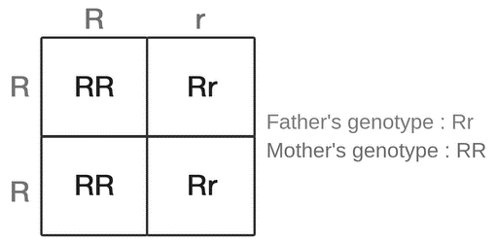
KNOWLEDGE ORGANISER
Subject: Spanish | Topic: Family | Term: Summer
KEY WORDS | Key words
1 | Variation | Differences in the characteristics of individuals in a population.
2 | Reproduction | The process by which new organisms are created, and through which genes are passed on to the future generations of these organisms.
3 | Natural selection | A process where organisms that are better adapted to an environment will survive and reproduce.
4 | Evolution | The change of inherited characteristics within a population over time through natural selection, which may result in the formation of a new species.
KEY EXAMPLES
12 | Peppered moths | Example of natural selection.
13 | Antibiotic resistant bacteria. | Example of evolution.
14 | Cystic fibrosis | Example of inherited disorder.
KEY DIAGRAMS
Genetic Diagram

